Slide 1
Group DIVECOMP
Water Sports Database

Slide 2
DIVECOMP Group Members
Ercan Alp Serteli -150120015
Türker Ünlü -150120118
Cemal Türkoğlu -150140719
İbrahim Dolapçı -150140722
Samet Yılmaz -040100051
itucsdb1525

Slide 3
Goal of the Project
Creating a common database for water sports.
Allow users to get information about different water sports from a single web page.

Slide 4
List of Water Sports
Underwater Photography
Diving
Water Polo
Power Boat Racing
Spear Fishing

Slide 5
Individual Work of Group Members
All members in the project group are responsible for creating a section in the web page for a different water sport.
150120015 - Underwater Photography
150120118 - Diving
150140722 - Water Polo
150140719 - Power Boat Racing
040100051 - Spear Fishing

Slide 6
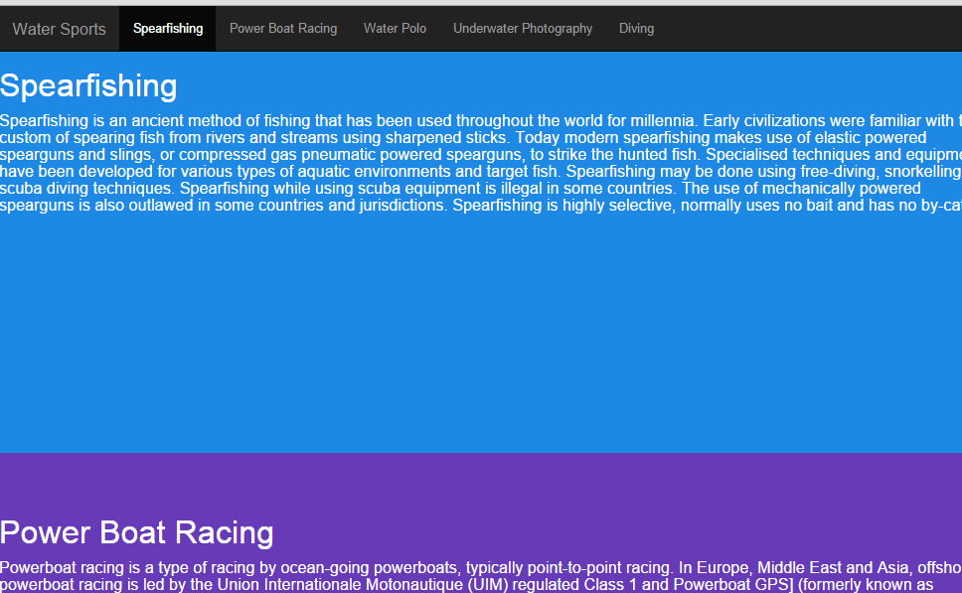
Main Page of the Website

Slide 7
Users can visit the different pages of website by using the nagivation bar at the top of web page.

Slide 8
Sport Category 1 - Diving
Diving category is consists of data about diving sport. There are 3 data tables for this category
DIVER: Information about dive sporters
COMPETITION: International Diving competitions
RECORD: Stores number that represents amount of meters a diver competed in a specific competition.
All tables support CRUD

Slide 9
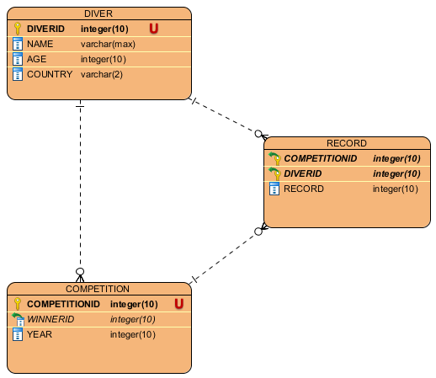
Relation Diagram Between Tables

Slide 10
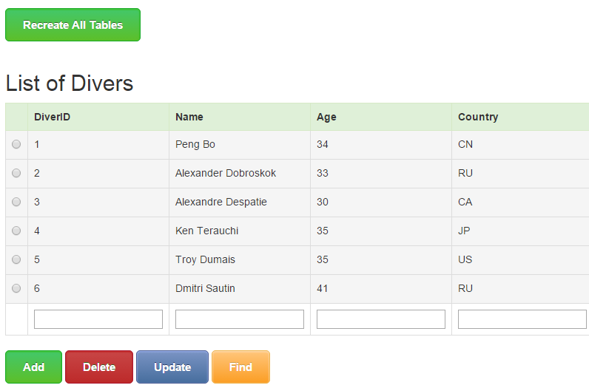
Table 1 DIVER - Picture

Slide 11
Table 1 DIVER - SQL
DIVER (
DIVERID INTEGER PRIMARY KEY NOT NULL,
NAME text,
AGE INTEGER,
COUNTRY text)
Information about diving sporters

Slide 12
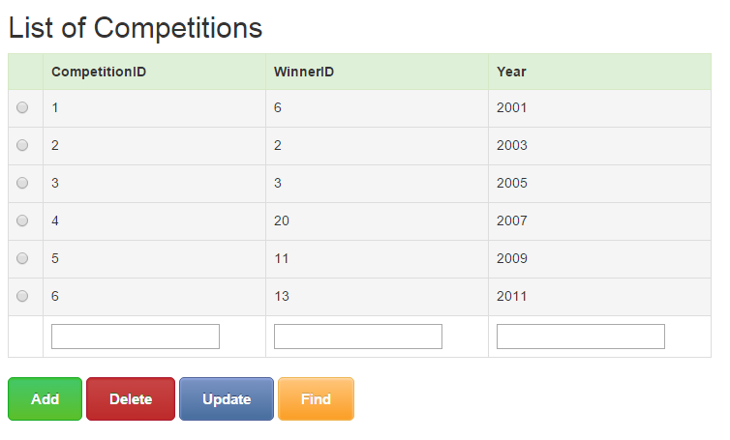
Table 2 COMPETITION - Picture

Slide 13
Table 2 COMPETITION - SQL
COMPETITION (
COMPETITIONID INTEGER PRIMARY KEY NOT NULL,
WinnerID INTEGER REFERENCES DIVER(DIVERID),
YEAR INTEGER)
Information about diving competitions
WinnerID must exist in DIVER table

Slide 14
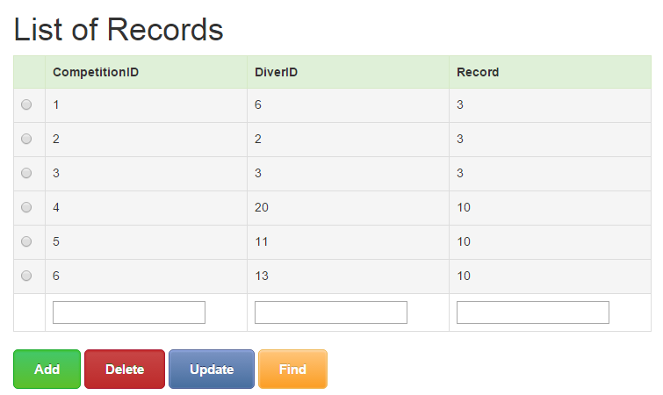
Table 3 RECORD - Picture

Slide 15
Table 3 RECORD - SQL
RECORD (
COMPETITIONID INTEGER REFERENCES COMPETITION(COMPETITIONID),
DIVERID INTEGER REFERENCES DIVER(DIVERID),
RECORD INTEGER DEFAULT NULL,
PRIMARY KEY(COMPETITIONID, DIVERID))
Information about record of a player in a specific competition
COMPETITIONID and DIVERID must exist in previous tables

Slide 16
Sport Category 2 – Underwater Photography
Underwater Photography part consists of two tables.
Competitor table holds data about the individual competitors
Team table holds data regarding the teams

Slide 17
Competitor Table (SQL)
CREATE TABLE competitor (
id serial PRIMARY KEY,
name text NOT NULL,
surname text NOT NULL,
role role NOT NULL,
team_id integer REFERENCES team (id))

Slide 18
Competitor Table
Role type:
CREATE TYPE role AS ENUM ('Photographer', 'Assistant', 'Captain')
Represents the role of a competitor in the team

Slide 19
Team Table (SQL)
CREATE TABLE team (
id serial PRIMARY KEY,
country text NOT NULL)
Assumes one team for each country

Slide 20
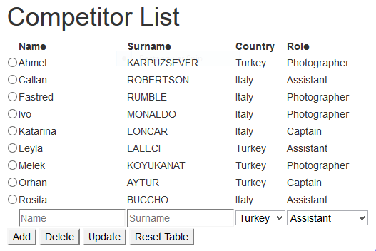
Competitor List (Website)
Shows the competitor table contents
Gets the country information using the team_id by joining the tables
Names and Surnames can be anything
Role is selected from the values in the Role type
Only countries of existing teams can be selected.
To add a competitor for a new team, the team must be added first from the team list.

Slide 21
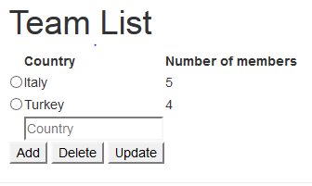
Team List (Website)
Shows the country of each team
Counts the number of members that belong to each team
Deleting a team that has members is not permitted

Slide 22
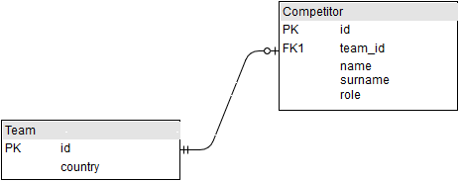
Entity Relationship Diagram
One to many relationship
Competitors are optional for a team

Slide 23
User Table (SQL)
CREATE TABLE users(
id serial PRIMARY KEY,
username text UNIQUE NOT NULL,
password text NOT NULL,
type text NOT NULL)
Holds data about the users

Slide 24
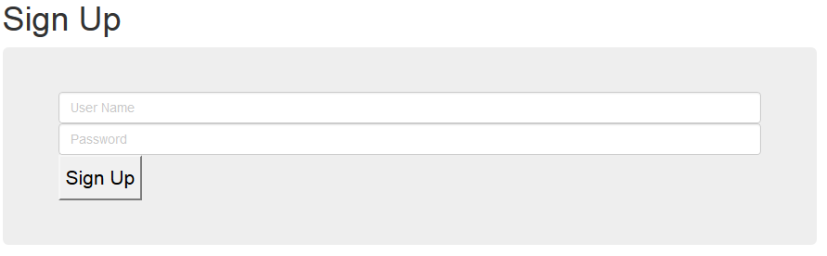
Signing Up
Anyone can sign up to become a user by providing a user name and a password
The user type is defaulted to ‘User’. It can only be changed by an admin
Upon signing up, the user is redirected to the login page

Slide 25
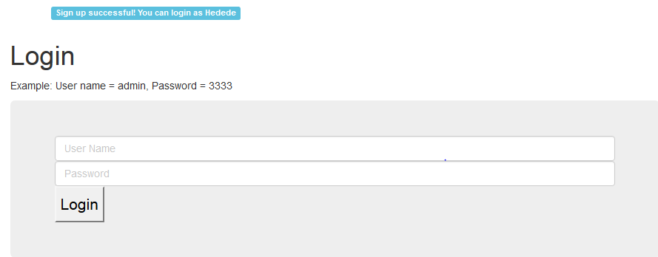
Logging In
There is an example account for trying out admin operations

Slide 26
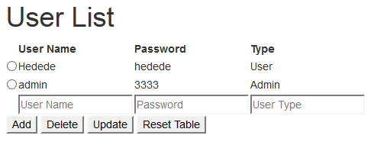
Users List
The user table can only be reached by logging in as an admin account
The entries can be manipulated like any other table

Slide 27
Sport Category 3 – Water Polo
Water Polo section is consist of 2 tables:
water_polo_team: Includes information about team a water polo sport team
Water_polo_player: Includes information about water polo sport player

Slide 28
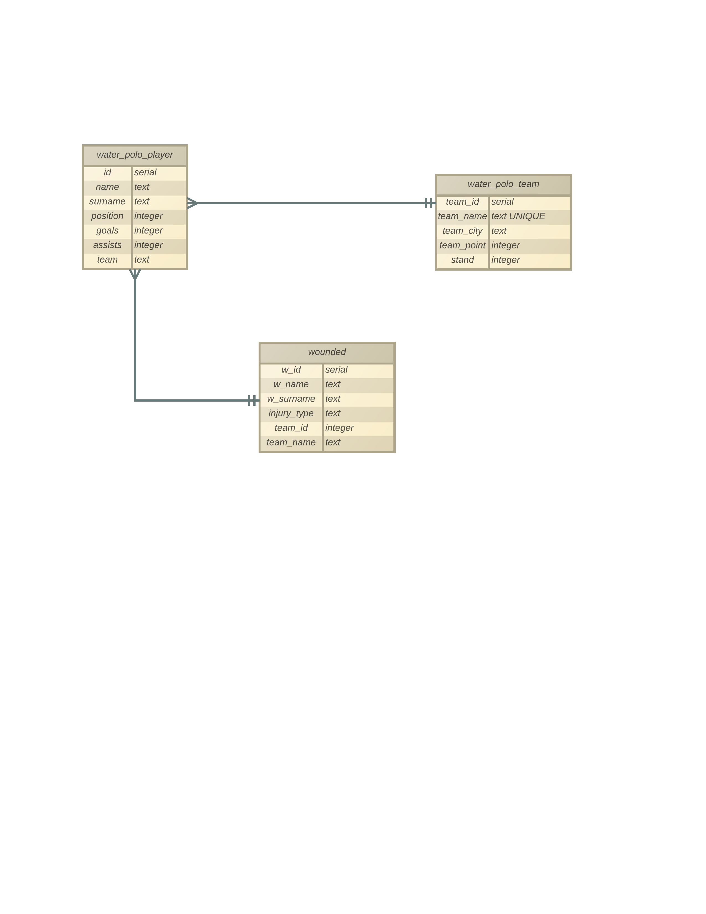

Slide 29
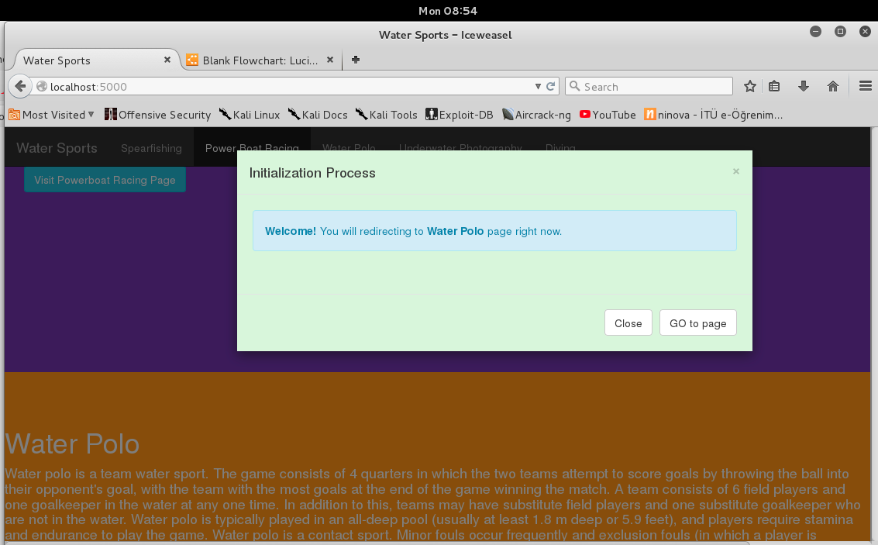
When we press “Visit Water Polo Page” at Home Page, we will be redirected to Water Polo Page.
If you want to go Water Polo Page, you have to press “GO to page” button in Initalization Process.
If you press “Close” or “ESC” , pop-up model will close and you will be redirected to Home Page.

Slide 30
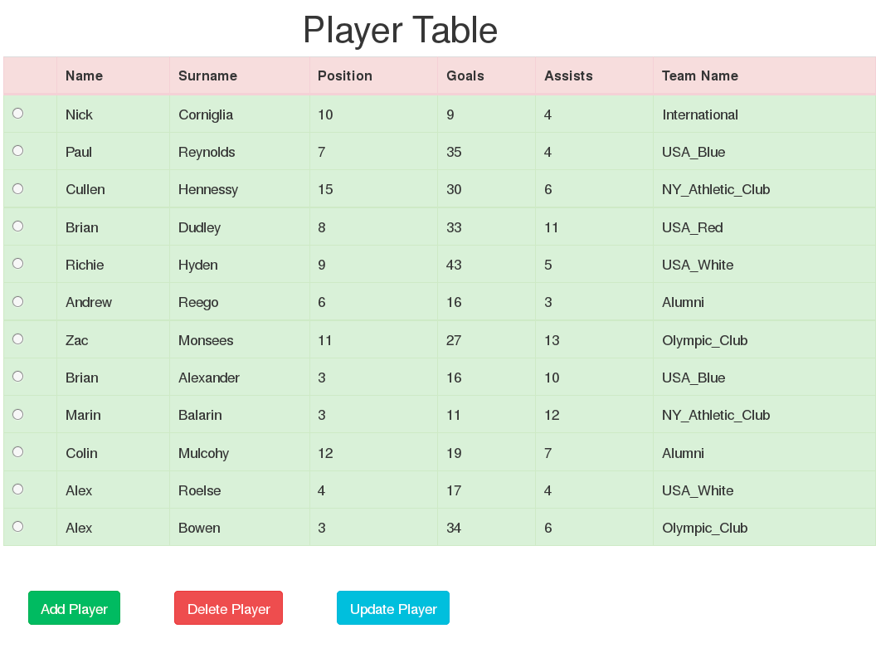
In Player Table, we have some information about water polo players. Player_id is Primary KEY, and team name is foreign key which is referenced from team table.
Our Add, Delete and Update button; we can add, retrieve, remove and update player in water_polo_players table.

Slide 31
SQL – Player Table
water_polo_player (
id serial PRIMARY key,
name text NOT NULL,
surname text NOT NULL,
position integer NOT NULL,
goals integer NOT NULL,
assists integer NOT NULL,
team text NOT NULL)
query = """INSERT INTO water_polo_team(team_name,team_city,team_point,stand)
VALUES
('Alumni','Houstin', '9','6'),
('USA_White', 'Seetle', '22','4'),
('International', 'Austin', '9','7'),
('Olympic_Club', 'San Francisco', '33','1'),
('USA_Red', 'Portland', '21','5'),
('USA_Blue', 'Boston', '25','2'),
('NY_Athletic_Club', 'Philadelphia', '24','3')

Slide 32
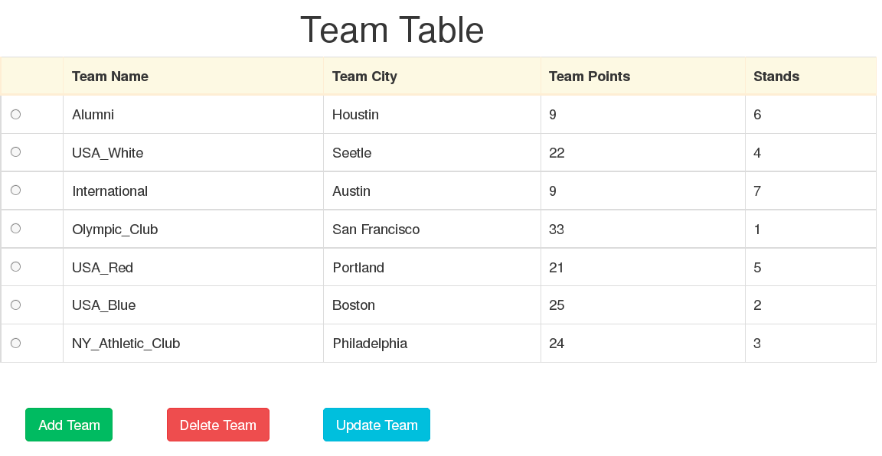
In Team Table, we have some information about water polo team. Team_id is Primary KEY, and there isn't any foreign. Stands column refer team's degree in serie.
With our Add, Delete and Update button; we can add, retrieve, remove and update team in water_polo_team table.

Slide 33
SQL – Team Table
water_polo_team (
team_id serial PRIMARY KEY,
team_name text UNIQUE NOT NULL,
team_city text NOT NULL,
team_point integer NOT NULL,
stand integer NOT NULL)
query = """INSERT INTO water_polo_player(name,
surname, position,goals,assists,team)
VALUES
('Nick','Corniglia', '10','9','4','International'),
('Paul', 'Reynolds', '7','35','4','USA_Blue'),
('Cullen', 'Hennessy', '15','30','6','NY_Athletic_Club'),
('Brian', 'Dudley', '8','33','11','USA_Red'),
('Richie', 'Hyden', '9','43','5','USA_White'),
('Andrew', 'Reego', '6','16','3','Alumni'),
('Zac', 'Monsees', '11','27','13','Olympic_Club'),
('Brian', 'Alexander','3','16','10','USA_Blue'),
('Marin', 'Balarin','3','11','12','NY_Athletic_Club'),
('Colin','Mulcohy', '12','19','7','Alumni'),
('Alex', 'Roelse', '4','17','4','USA_White'),
('Alex', 'Bowen', '3','34','6','Olympic_Club')
"""
cursor.execute(query)

Slide 34
In Team Table, we have some information about water polo team. Team_id is Primary KEY, and there isn't any foreign. Stands column refer team's degree in serie.
With our Add, Delete and Update button; we can add, retrieve, remove and update team in water_polo_team table.

Slide 35
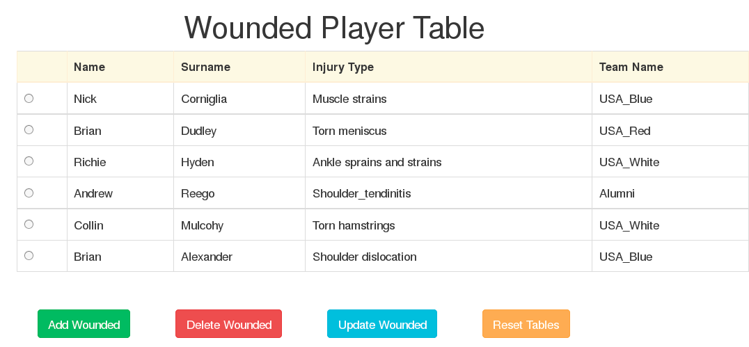
In Wounded Table, we have some information about players who injured. Wounded_id,wounded_name,wounded_surname and team_id,team_name is Foreign KEY, and Wounded_id,Injury_type are Primary KEY.
With our Add, Delete and Update button; we can add, retrieve, remove and update wounded players in wounded table.

Slide 36
Statistics About Water Polo Teams
In water polo sport section, users can also see some useful statistics about the water polo sport which is calculated by using information in water polo database.

Slide 37
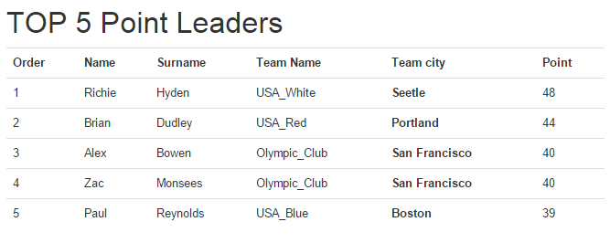
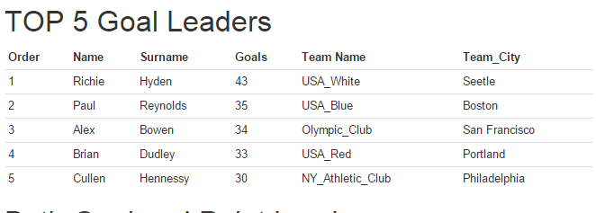

Slide 38
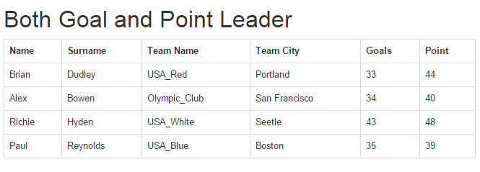
Combined results from previous two tables

Slide 39
Sport Category 4 – Power Boat Racing
Power Boat Racing category is consists of data about power boat racing sport. There are 5 data tables for this category
DRIVERS: Information about sporters
TEAMS: Information about Power boat teams
BOATS: Information about boats that used by drivers
LEAGUE15 : Statistics about leauge in 2015
OLDRACES: Statistics about all international races record
All tables support CRUD

Slide 40
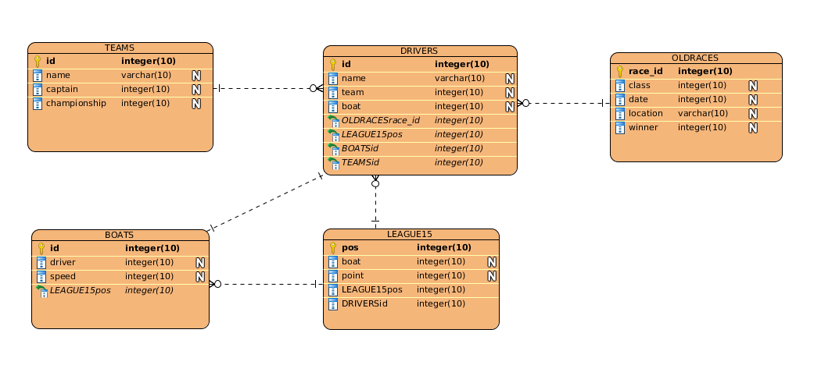
Relation Diagram

Slide 41
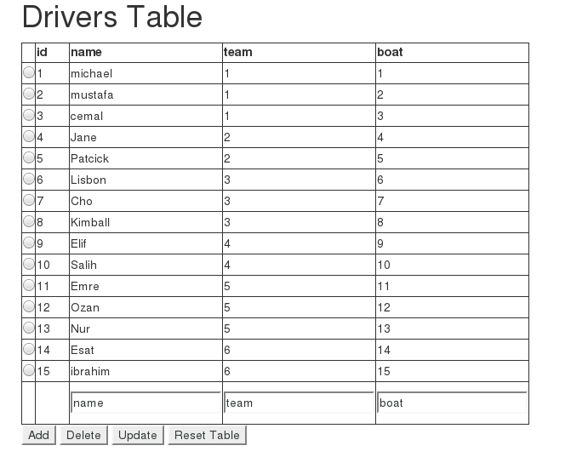
Table1-Drivers

Slide 42
CREATE TABLE IF NOT EXISTS drivers(
id serial primary key,
name text,
team integer default 0,
boat integer default 0)

Slide 43
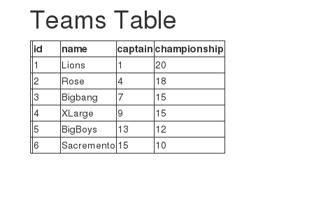
Table2-Teams

Slide 44
CREATE TABLE IF NOT EXISTS teams(
id serial primary key,
name text,
captain integer,
championship integer default 0)

Slide 45
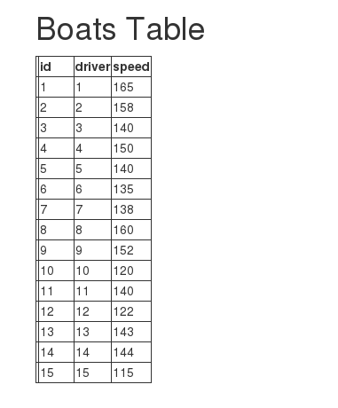
Table3-Boats

Slide 46
CREATE TABLE IF NOT EXISTS boats(
id serial primary key,
driver integer default 0,
speed integer default 0)

Slide 47
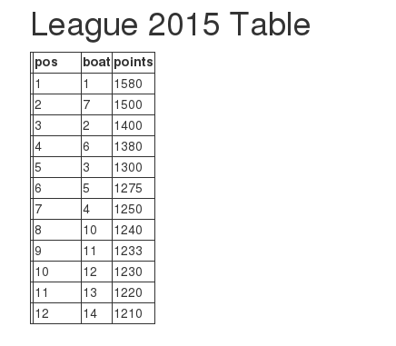
Table4-League15

Slide 48
CREATE TABLE IF NOT EXISTS league15( pos serial primary key,
boat integer default 0,
point integer default 0)

Slide 49
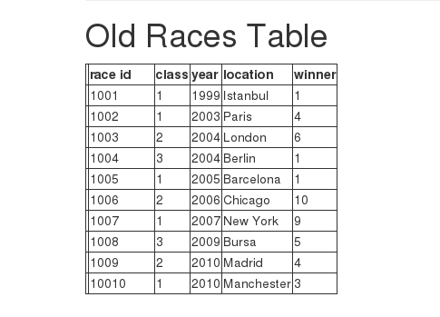
Table5-Oldraces

Slide 50
CREATE TABLE IF NOT EXISTS oldraces(race_id serial primary key,
class integer,
date integer,
location text,
winner integer default 0)

Slide 51
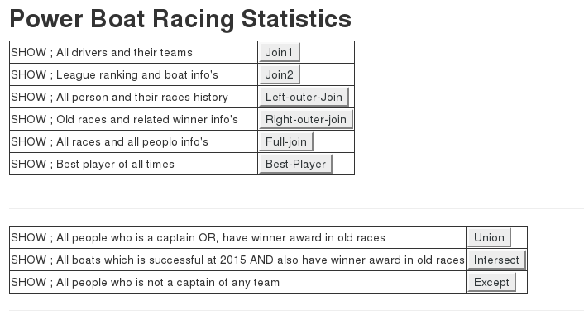
Power Boat Racing Statistics

Slide 52
Sport Category 5 – Spear Fishing

