Slide 1
Welcome to our presentation
Demonstration
On
Rolex-Hub

Slide 2
Project proposal by:
Team Members:
1.Md Maruf Hasan (221-15-5730)
2.Md Najmus Sakib (221-15-4921)
3.Tanjid Hasan Turky (221-15-5916)
4.Md Mehedi Hasan (221-15-5920

Slide 3
Project vision and mission:
Enhance the Digital Brand Experience
Offer Personalized and Engaging Interactions
Streamline the Purchase Process
Foster a Loyal Customer Base

Slide 4
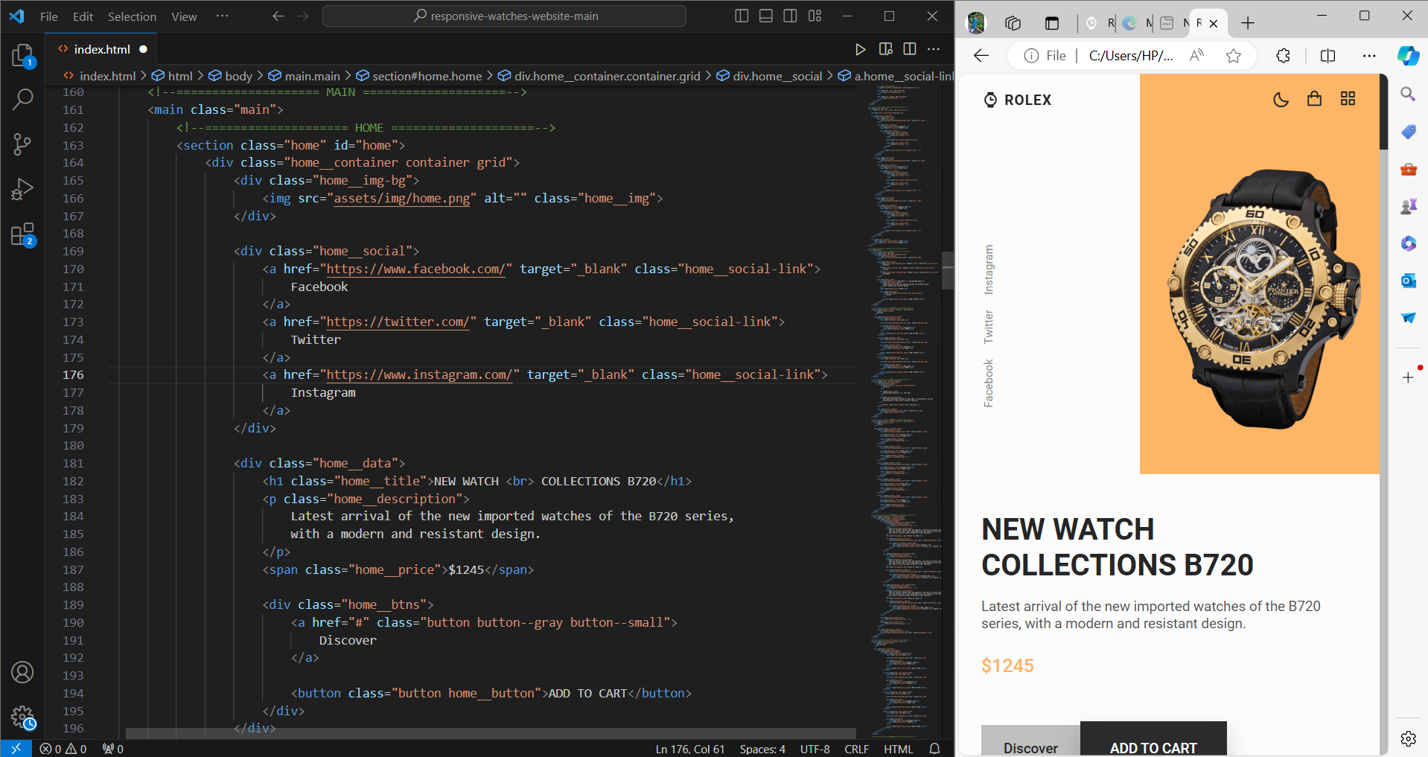
Home Section:

Slide 5
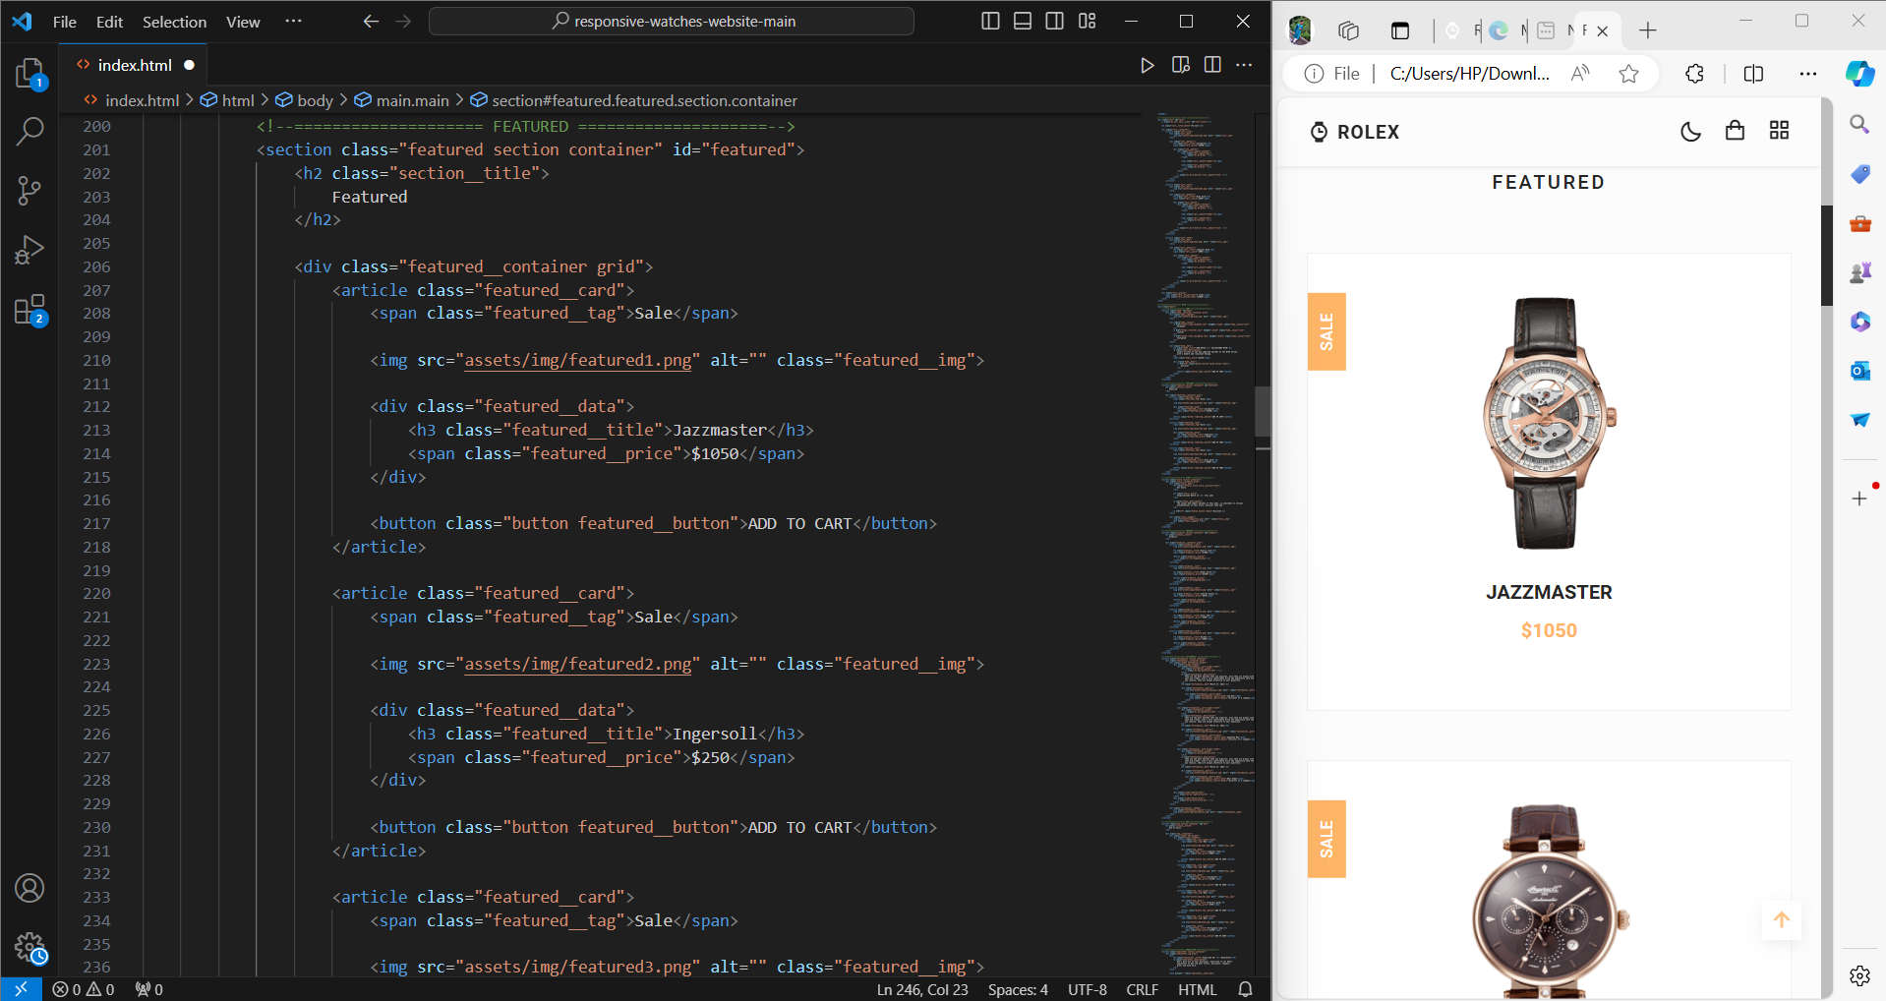
Featured Section:

Slide 6
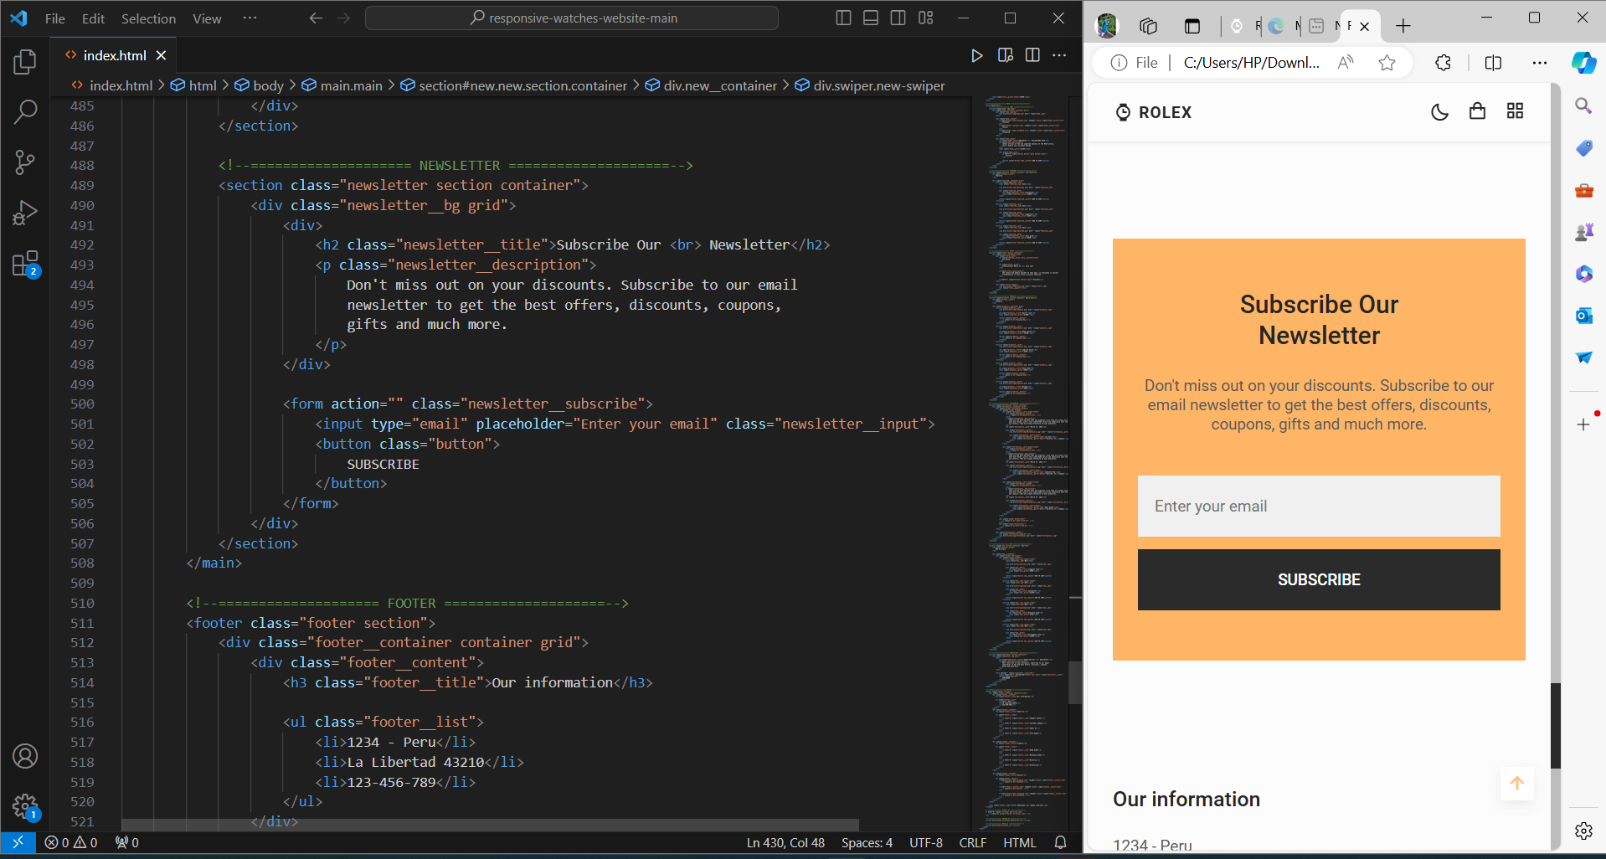
Newsletter Section:

Slide 7
Future Possibilities:
Augmented Reality (AR) Integration
Personalized Recommendations and Customization
Advanced E-commerce Capabilities
Exclusive Content and Community Engagement

Slide 8


