Slide 1
BITTORENT FUNCTIONING

Slide 2
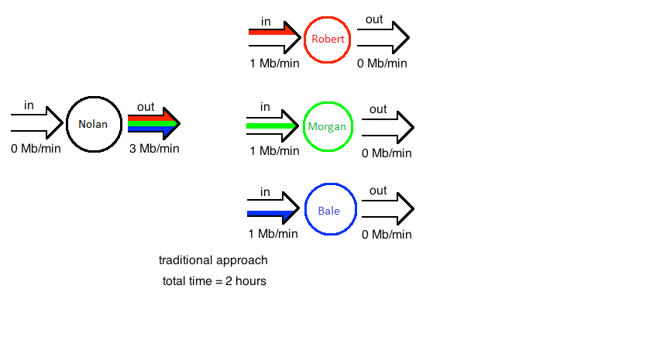

Slide 3
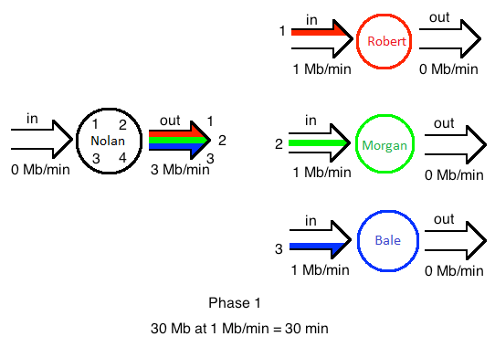

Slide 4
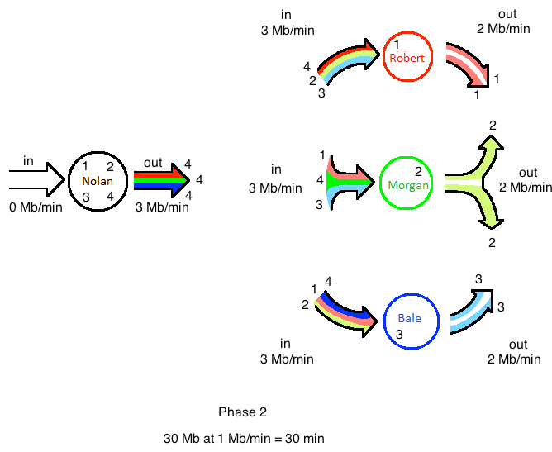

Slide 5


Slide 6
Things you can look upon!!
How a file is divided into so many small parts?
How a file is merged back?
What is the Algorithm for selecting peers?
On what basis are the decisons while sharing files being made?
How does this method of file sharing ensure Quality of Content & Data?

