Slide 1
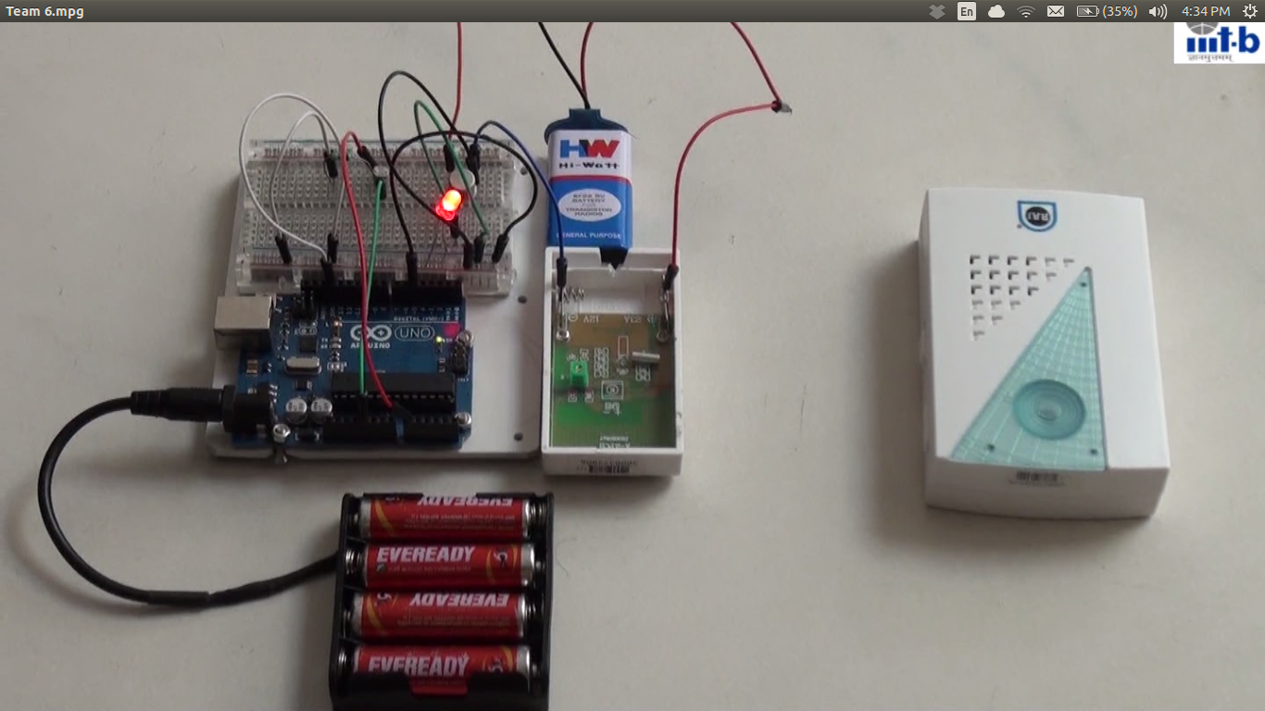
Physical Mail notifier
T Kaushik, I Vivek, B Krishna Chaitanya, R Karthik, K Manosree International Institute Of Information Technology Bangalore
Introduction
If the mailbox is across the street from the house and because mailmen don’t walk door-to-door , we never know when a mail is delivered. Sometimes we’d be waiting for something desperately and we’d really like to know when it arrive. So we made a notifier using arduino which notifies us when a mail is delivered.
Results
Few Lines of our code
Void loop()
{
int value = analogRead(0);
serial.println(value);
if(value > 200)
{ Circuit
digitalWrite(5, HIGH);
delay(1000);
}
Conclusions and future work
Group projects always help us in learning a lot. It was fun working on arduino and also gained a lot of knowledge about the components that we used. We learnt about coding an arduino. Before doing this project we thought coding an arduino was difficult, but now we feel it is nothing different from C programming. With the spirit and the knowledge that we gained through this project, we hope to take up some more projects on electronics in coming years.
Materials and methods
We used the following components for our project
Arduino
Breadboard
Photoresistor(light sensor)
Power Cable
9v battery
Transistor, LEDS
Resistor and jumper wires
Acknowledgments
We thank Nandeep sir for helping us with the project and our professor Madhav Rao Sir for allowing us to work on our proposed project.
References
www.arduino.cc
www.oomlout.com/a/products/ardx
Notes:
Copyright Colin Purrington (http://colinpurrington.com/tips/academic/posterdesign).

