Slide 1
Red Hat Linux & SUSE Linux
An Introduction
Presented to: Mr. Eamon Walsh & HDip. in Science (Software Development) Class of 2015.
By: Turlough Rafferty, 14 April 2015

Slide 2


Overview
Red Hat Software
Symbol of freedom
Enterprise Linux Distribution
Red Hat Enterprise Linux (RHEL)
Current Version is RHEL 7
Founded in USA 1993
Market Cap $12.2B
SUSE
Acronym for Software und System- Entwicklung
Enterprise Linux Distribution
SUSE Linux Enterprise Server (SLES)
Current Version is SLED 11
Founded in Germany 1992
Market Cap $1.52B (Micro Focus)
05/03/2015
Red Hat Linux & SUSE Linux
An Introduction

Slide 3
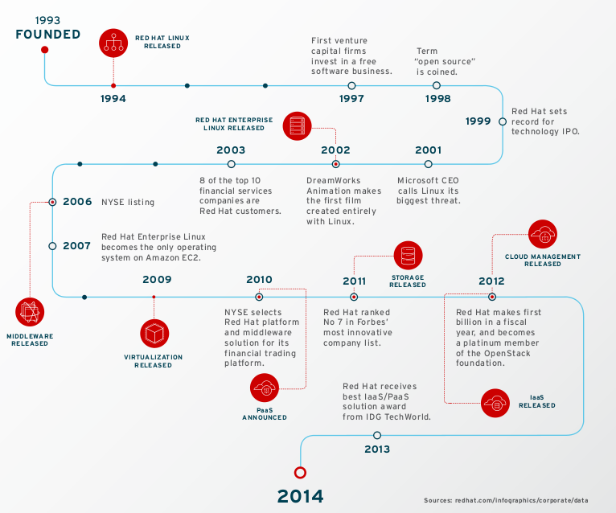
05/03/2015
Red Hat Linux & SUSE Linux
An Introduction

Slide 4
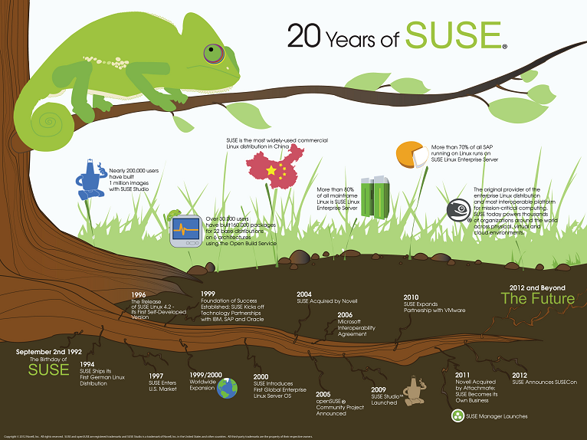
05/03/2015
Red Hat Linux & SUSE Linux
An Introduction

Slide 5


Minimal Hardware Requirements*⁺
Dual-core Intel 64 or AMD64 CPU
4GB RAM (available, not including OS)
25GB writable disk space
1 network interface card (NIC) with bandwidth of at least 1Gbps
* Management Server. Hypervisors approx 50% less.
AMD64 or Intel64 processor
512 MB RAM
2 GB available disk space
16 GB for snapshot/rollback of the OS
+ Requirements vary for specific use.
05/03/2015
Red Hat Linux & SUSE Linux
An Introduction
Notes:
Red Hat Release history: http://en.wikipedia.org/wiki/Red_Hat_Enterprise_Linux
SUSE Releas History: https://www.suse.com/products/server/technical-information/

Slide 6
Unique Features
Update method :Yum / PackageKit
Stability & flexibility – server variants
Partner Network
Certification
Linux Container Support
Id Management & Security
Band value / marketing prowess
Update method: Zypper/YaST2
Up-time: System rollback, RAS, Live patching, cluster extension, security standards.
Operation Efficiency: SCS Center, Ipv6, Linux Containers, VMware tools integrated.
Innovation: Process oriented, certificated applications & HW,
64-bit processor support
05/03/2015
Red Hat Linux & SUSE Linux
An Introduction
Notes:
The Yellowdog Updater, Modified (yum) is an open-source command-line package-management utility for Linux operating systems using the RPM Package Manager.[2] Though yum has a command-line interface, several other tools provide graphical user interfaces to yum functionality.

Slide 7
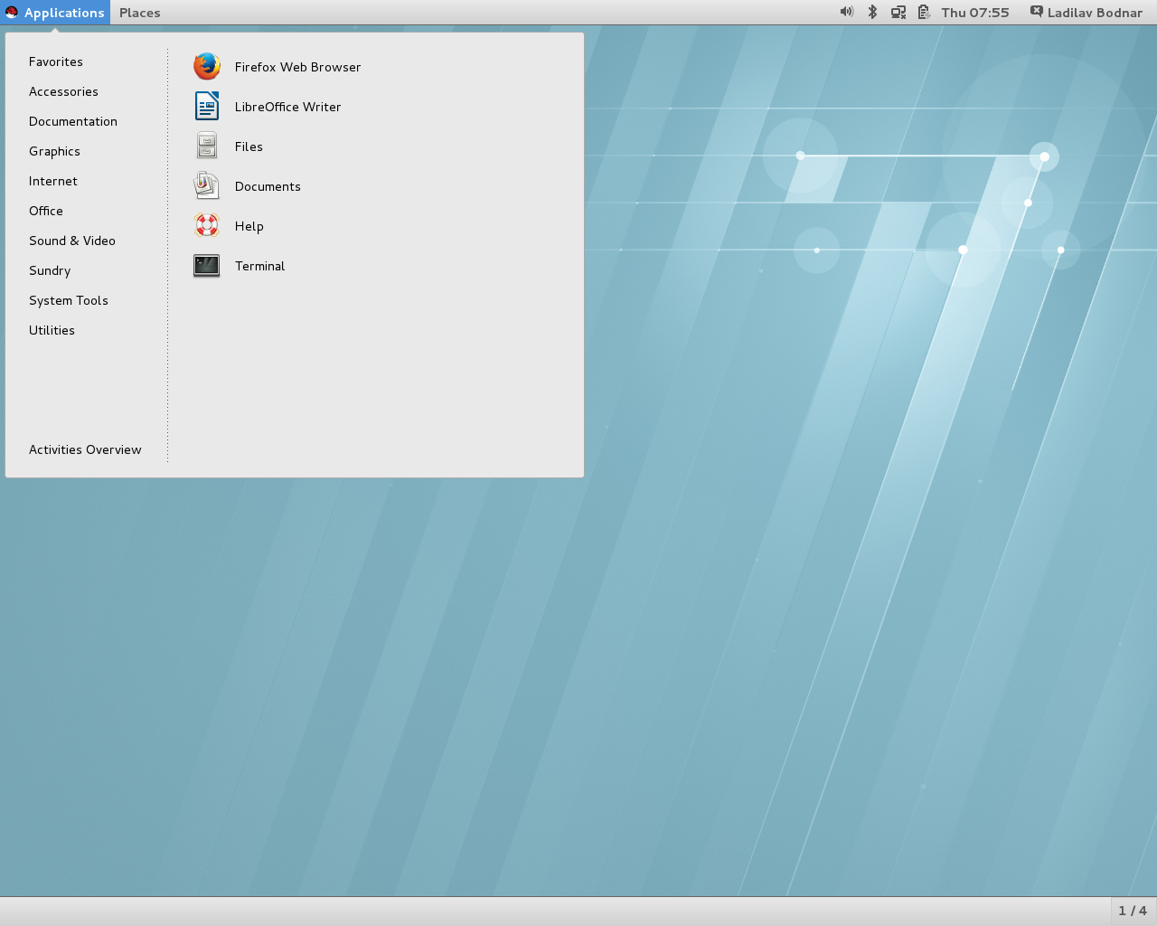
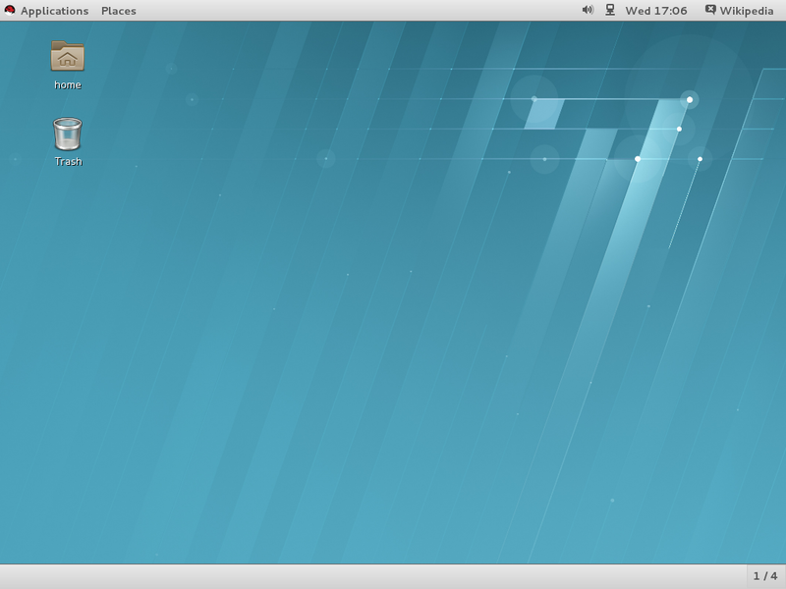
05/03/2015
Red Hat Linux & SUSE Linux
An Introduction

Slide 8
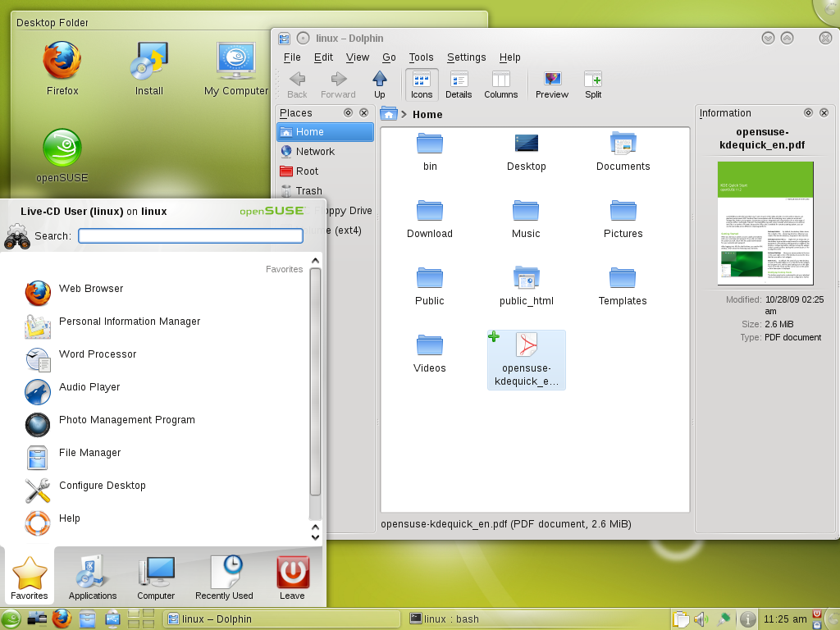
05/03/2015
Red Hat Linux & SUSE Linux
An Introduction

Slide 9
Not so Opensource
Attraction for customers: Reduced lock in.
Red Hat block support for customers from using alt. versions of OpenStack. By allowing varied solutions, customers would lessen interoperability and performance.
Display of market dominance. Walled garden concept.
Customers pay for certification, patches and vendor support.
Microsoft was forced to launch an SVVP program for certifying third party virtualization technologies against Windows Server (45% of server market).
05/03/2015
Red Hat Linux & SUSE Linux
An Introduction
Notes:
The kernel that they distribute (in most cases, Linux) includes “blobs”: pieces of object code distributed without source, usually firmware to run some device.
https://www.gnu.org/distros/common-distros.html#RedHat
GNU is Not Unix is a recursive acronym.
http://www.linuxquestions.org/questions/general-10/what-does-gnu-stand-for-465322/

Slide 10
Why pay for what an OS that is essentially free?
Corporate Linux users care about support throughout the stack, not just an attractive feature set.
Linux users in an enterprise data center willingly pay for the best maintenance and support.
Maintenance lifetime is the length of time that the Linux distribution provider patches and updates the product. Support comes in three different forms: support for applications, support for hardware and support for troubleshooting.
OpenSUSE distribution - 18-month lifecycle, meaning that a security issue that occurs 24 months after the initial release date will go un-patched.
05/03/2015
Red Hat Linux & SUSE Linux
An Introduction

Slide 11
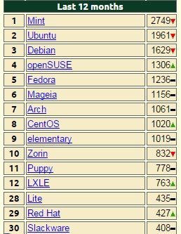
Market Share
RHEL 65+% market share
SUSE Linux Enterprise Server (SLES) 25% market share.
Remainder Ubuntu Long Term Support (LTS) from Canonical, and Oracle Unbreakable Kernel.
Popularity Index – DistroWatch
05/03/2015
Red Hat Linux & SUSE Linux
An Introduction

Slide 12
References
http://searchdatacenter.techtarget.com/feature/Compare-popular-Linux-distributions-for-servers
http://en.wikipedia.org/wiki/Red_Hat_Enterprise_Linux
http://www.redhat.com
http://www.suse.com
http://www.forbes.com/sites/benkepes/2014/05/19/red-hat-plays-dirty-to-lock-its-customers-in-so-much-for-caring-sharing-open-source/
http://www.linuxquestions.org/
http://distrowatch.com/dwres.php?resource=popularity
05/03/2015
Red Hat Linux & SUSE Linux
An Introduction
Notes:
The kernel that they distribute (in most cases, Linux) includes “blobs”: pieces of object code distributed without source, usually firmware to run some device.
https://www.gnu.org/distros/common-distros.html#RedHat
GNU is Not Unix is a recursive acronym.
http://www.linuxquestions.org/questions/general-10/what-does-gnu-stand-for-465322/

