Slide 1
Annotated Plots for Exosims Sandbox documentation
Michael Turmon
2023-11-21

Slide 2
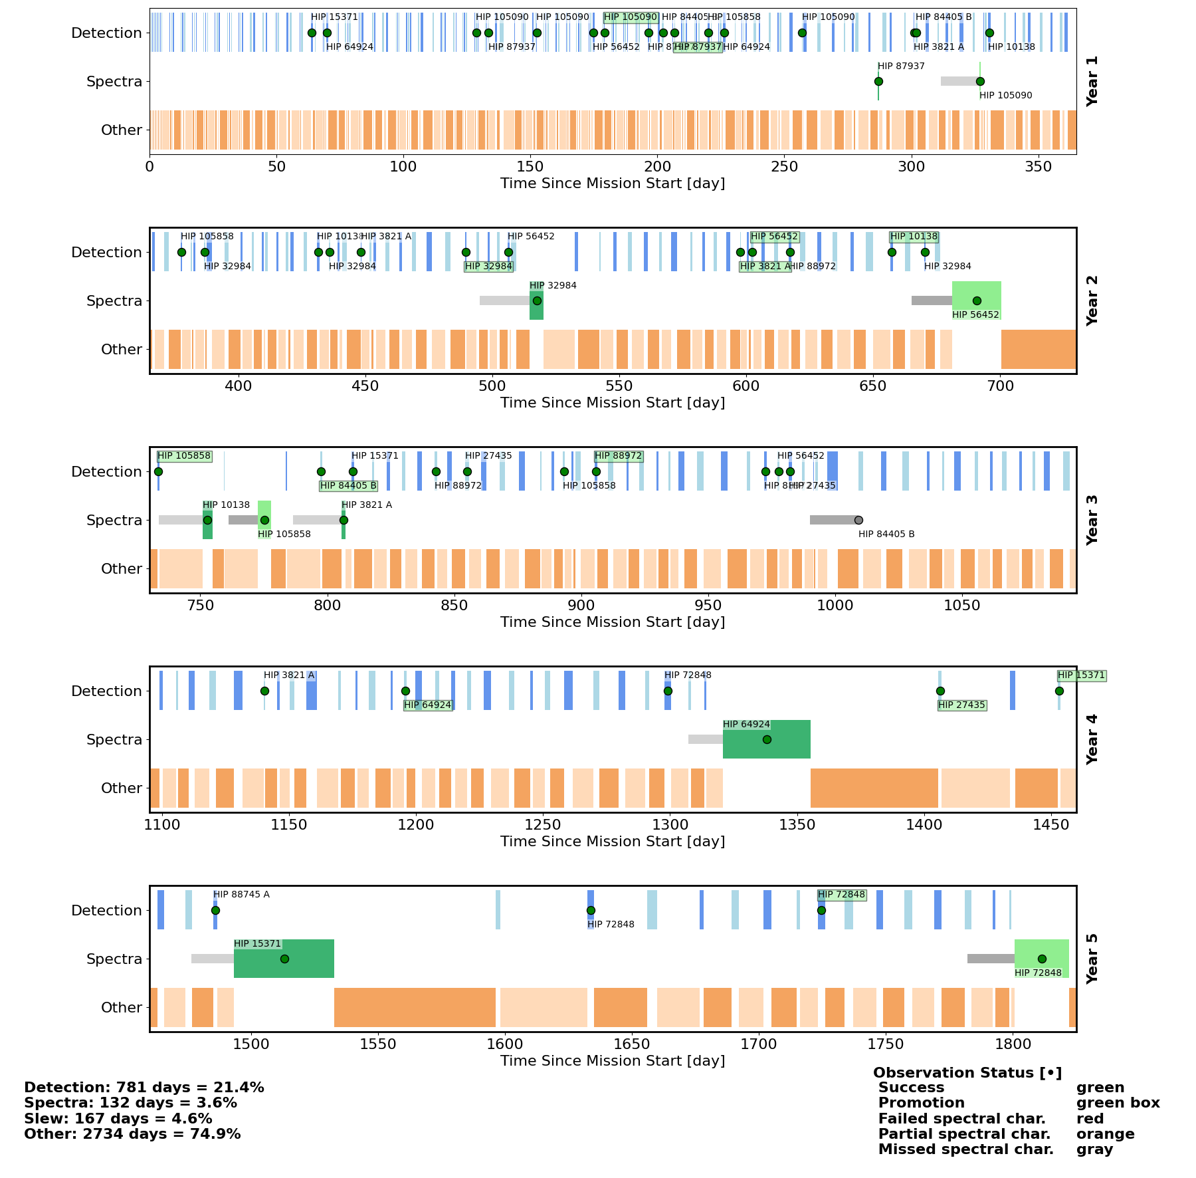
Observation Timeline
Detection Strip
Detections in alternating-shade blue bars Successful detections have green dot and star name (HIP nnnn)
Third detection shown with star name in green box
Spectral Characterization Strip
Shown in alternating-shade green bars
All characterizations show star name Successful characterizations: green dot Partial characterizations: orange dot
Failed characterizations: red dot
Missed characterizations: gray dot
Starshade Slews Starshade missions show the slew time as a gray bar preceding the characterization.
Other Observations Strip Scheduler inserts observations for non- exoplanet targets in an implementation- defined way.

Slide 3
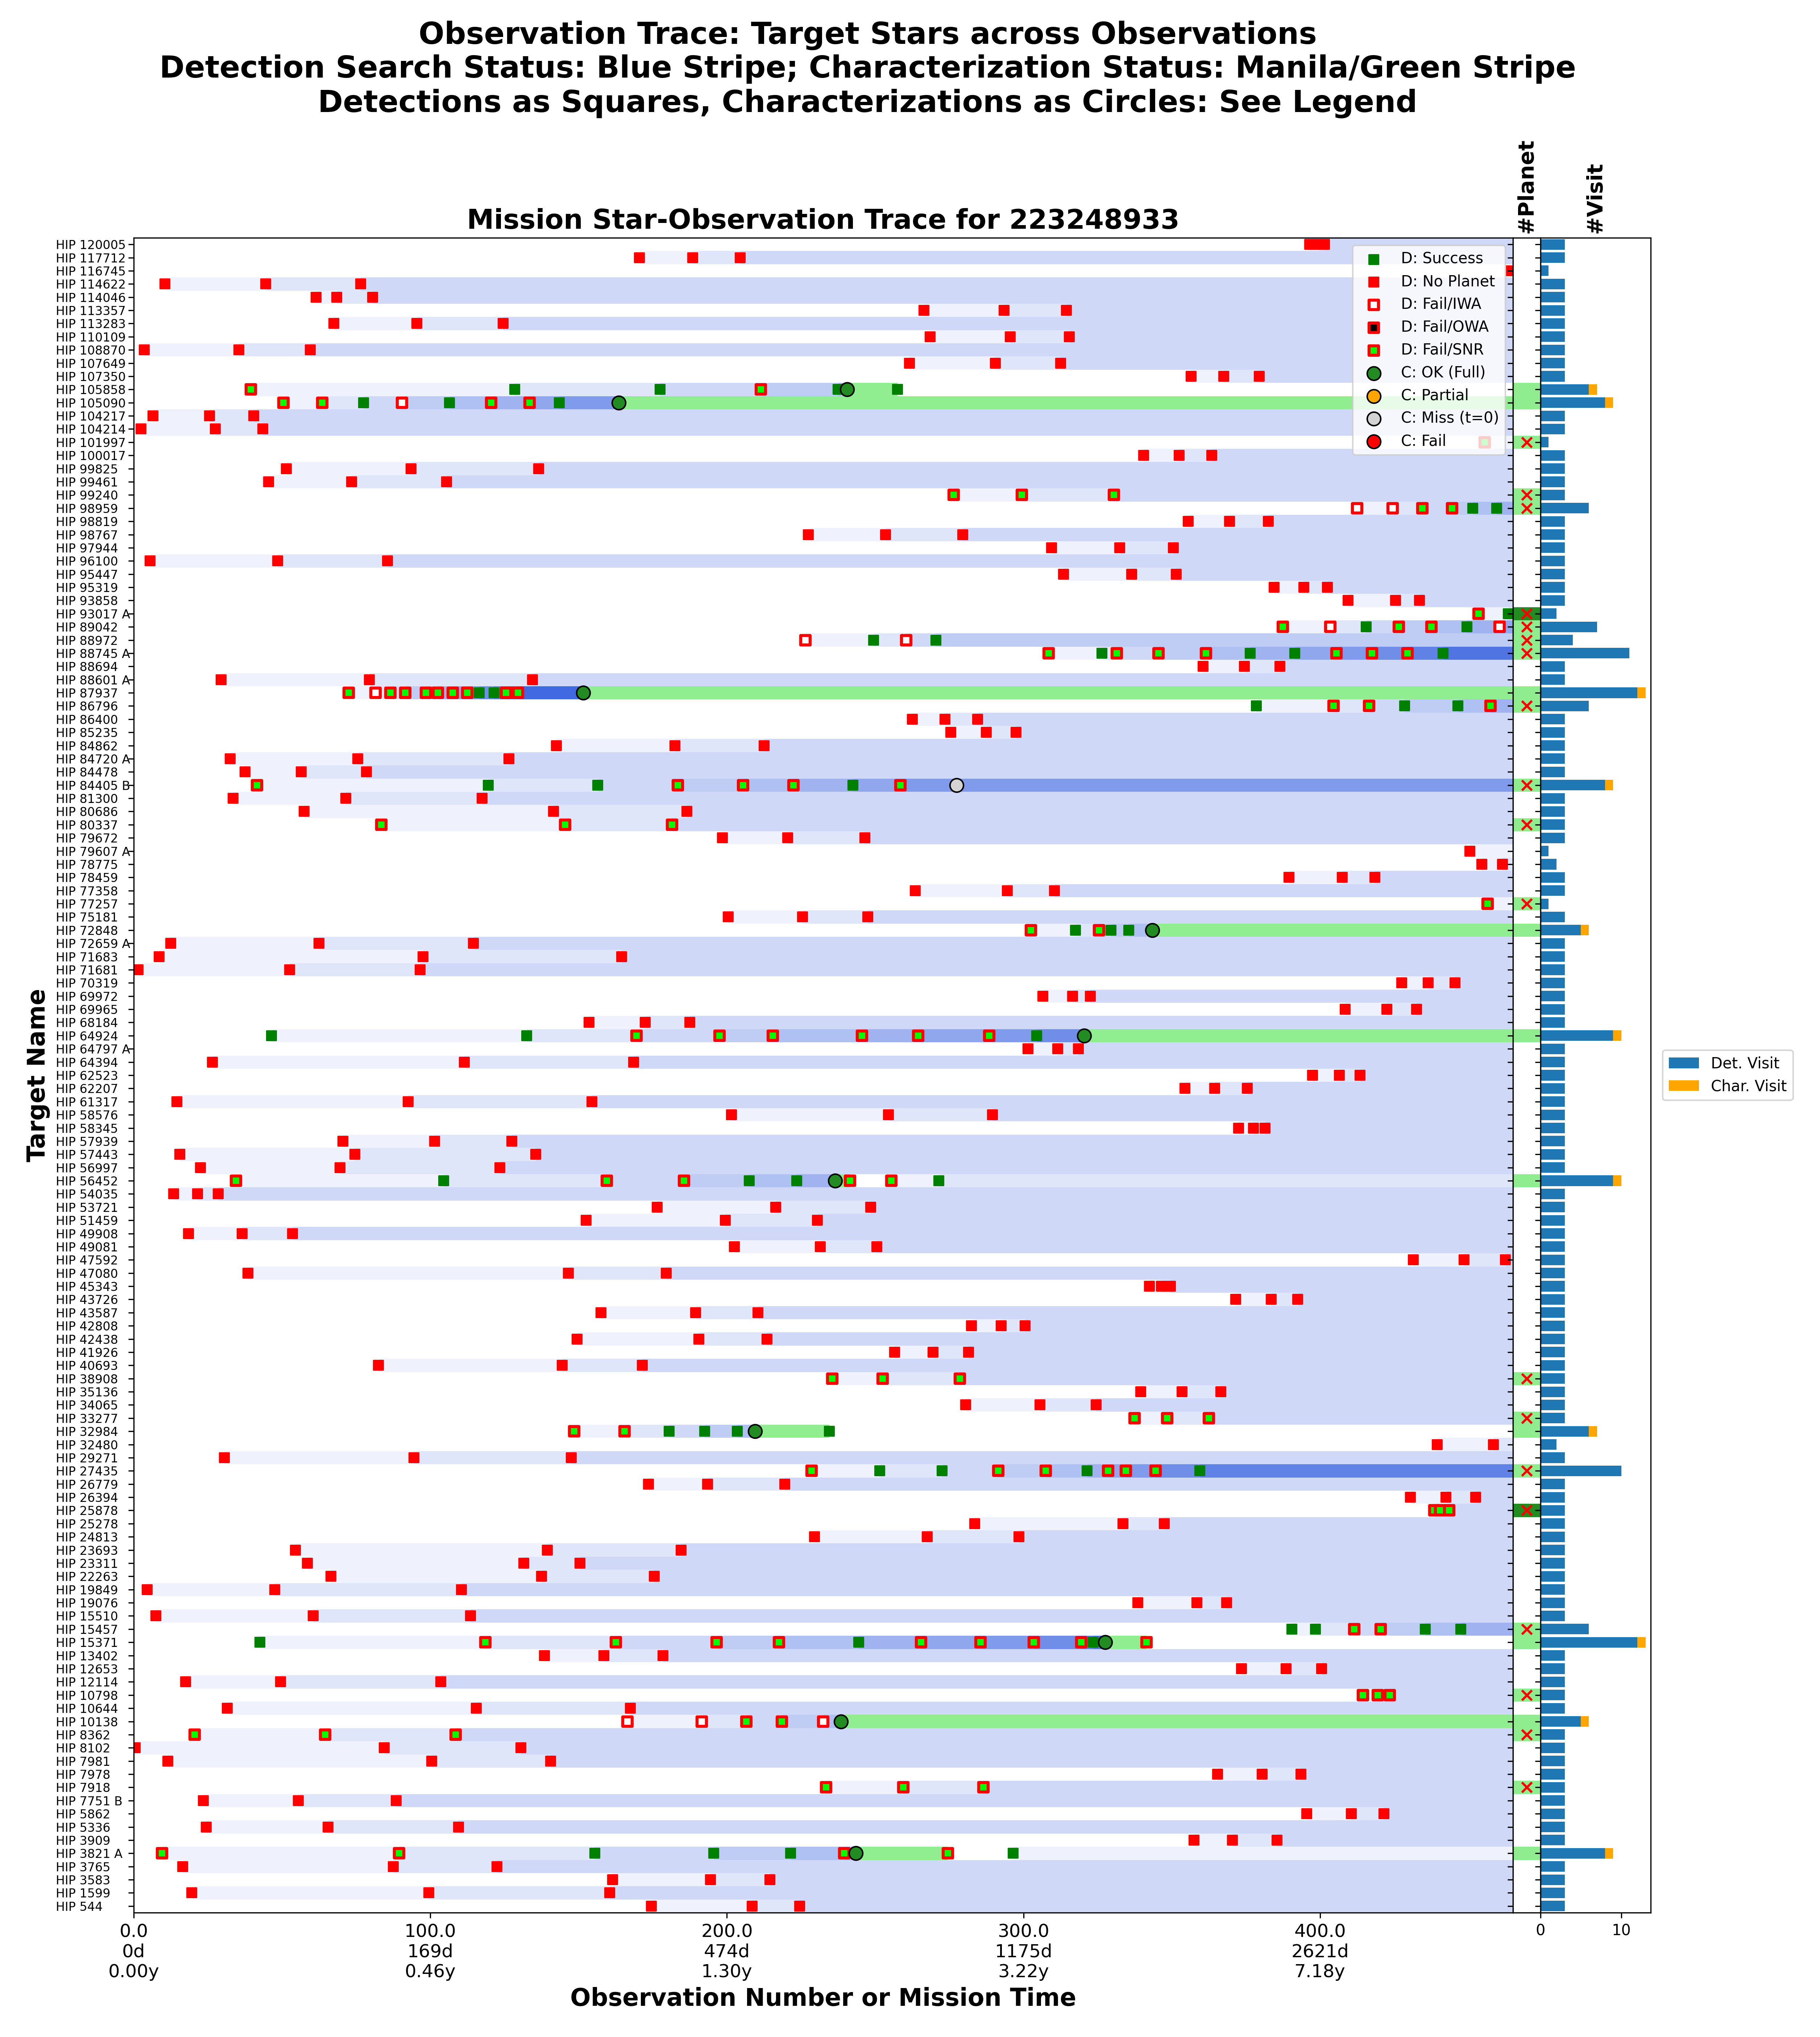
Star-Observation Trace
Detection Observations
Detections in squares Successful detections: green
No planet present: red
Planet & IWA/OWA/SNR fail: see legend
Detection count coded in blue horizontal trace
Spectral Characterization Observations
Shown as a circle, often after several
detection squares Successful: green dot Partial: orange dot
Missed: gray dot Failed: red dot
Last status coded in horizontal trace color
Observation Count Histogram Far right, histogram of count of detections and spectral characterizations (success or fail).
Between: light green box if one planet was present, dark green if ≥ 2 planets, white area if none. Superimposed red X if a planet was not characterized.
Y Axis Only observed stars are shown.
X Axis Axis is uniform with observation number
As a calibration, the mission year of the
observations (not uniform) is also shown

Slide 4
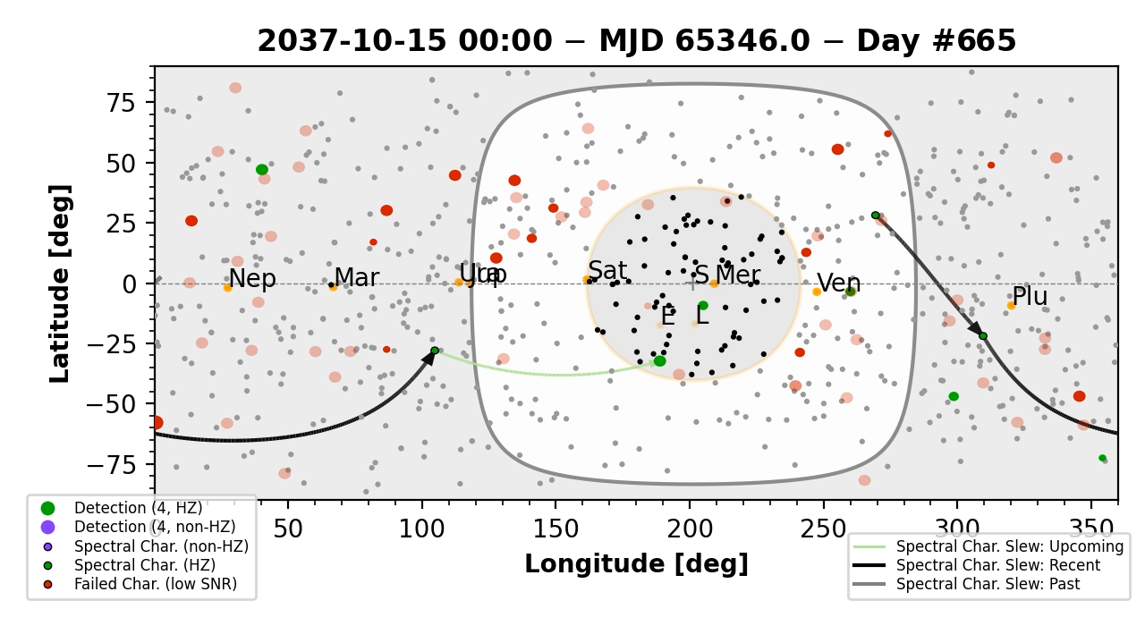
Path Movie
Stars in Target List
Target Stars are shown in ecliptic coordinates Plotted in gray or black depending on whether they satisfy current keepout – keepout is shaded gray
Detections shown as open circles (green or red, increasing in size for multiple detections) Characterizations shown as circles with a black edge (border appears when integration begins)
Solar System Bodies
Shown as if viewed from Observatory Sun (S) is along the ecliptic and has a large gray-shaded keepout region. Earth (E) and Moon (L) move dynamically for L2 orbit Inner and outer planets move more slowly
Characterization Sequence Characterizations are shown by a sequence of black arrows, fading to gray for long-ago targets.
A future target (perhaps unscheduled at the displayed time) is pointed to with a green arrow.

