Slide 1

Cryptocurrency Time Series Analysis
Connor Turnage

Slide 2
The Data
Ripple
A real-time gross settlement system, currency exchange and remittance network, popular especially in Asian markets
Created a native coin called XRP, which held the second largest market capitalization in late 2018 behind Bitcoin
My dataset was comprised of daily close prices from August 4, 2013 to February 20, 2018.

Slide 3
Approach
SARIMA Model: Seasonal Autoregressive Integrated Moving Average
Autoregression – predicted values are based on regression analysis of the series’ own previous values
Moving Average – predicted values depend linearly on the current and various past values of an imperfectly predictable (stochastic) series
Produces a linear equation by doing regression analysis on the series’ previous values as well as taking into account the average of some constant period
Parameters:
P: number of autoregression lags we use in the model
D: weather or not we need differencing we need to make the series stationary
Q: number of moving average lags we use in the model

Slide 4
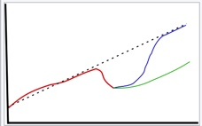
Unit Roots
Important concept in time series analysis
Way of figuring out weather a process is trend stationary or not, and therefore what model to use
Trend stationary processes return to their means and variances after a shock, whereas non-trend stationary processes do not
Inflation Rate may be a good example of a trend stationary process (Fed), whereas GDP is almost always not trend stationary
Unit Roots describe a stochastic series that is not trend stationary, or one that does not return to its original growth rate after a shock

Slide 5
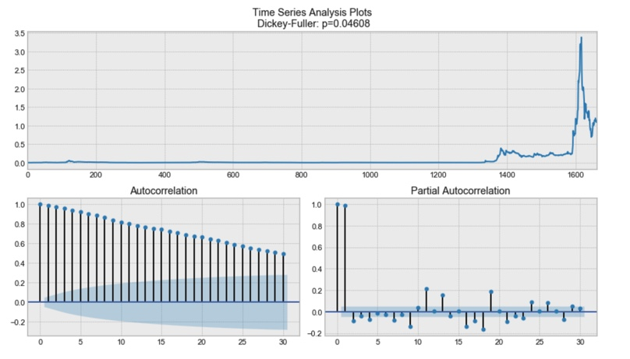
Dickey-Fuller Test
Tests the null hypothesis that a stochastic series has a unit root
The results of a Dickey-Fuller test on this data found it to be below the 0.05 p-value threshold
We can already see that we are dealing with significant autocorrelation in this series, meaning we might have to apply a difference operator

Slide 6
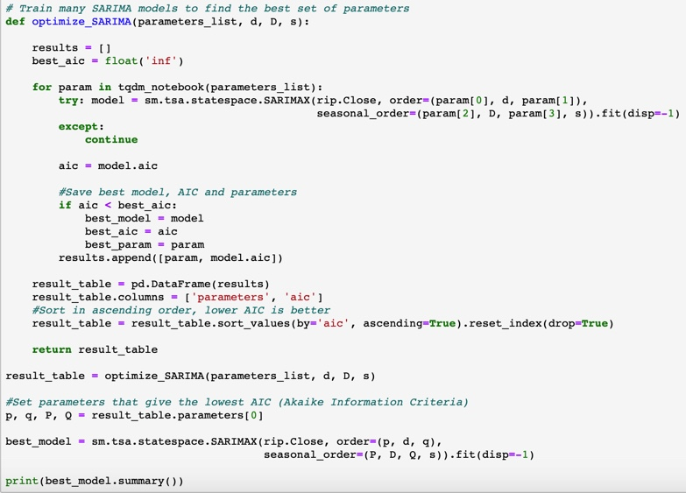
Optimizing the Model
Made a function for finding the optimal model based on the Akaike Information Criterion, a popular way to evaluate a set of models
Run this model over all the possible combinations of parameters, including d=1 since series is highly autocorrelated
Store parameter values and resulting AIC in a new table
Sort table in ascending order based on AIC, use the first-row parameters to print out model summary

Slide 7
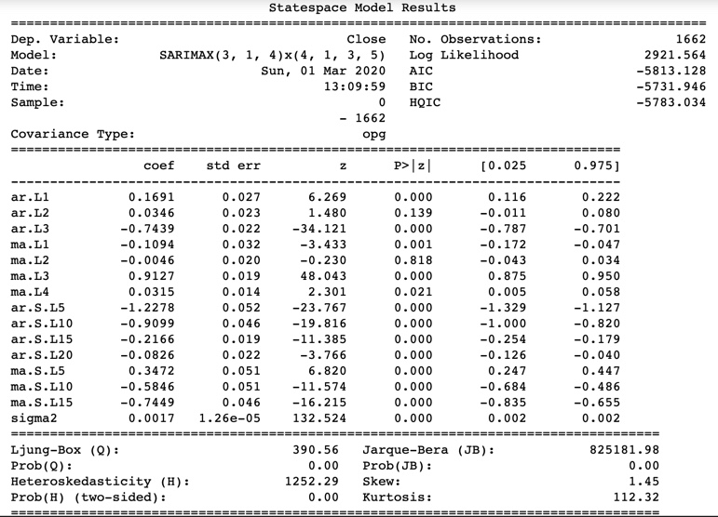
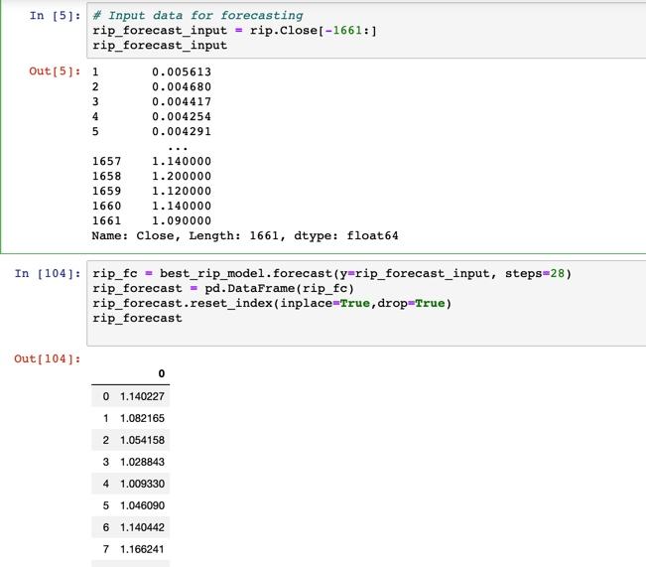
Forecasting With the Model
After finding the optimal combination of parameters, we can print out the results of our model
All these variables and coefficients go into making a linear equation for our model
Once we have determined what model to use, we can feed it a series of values and make a prediction

Slide 8
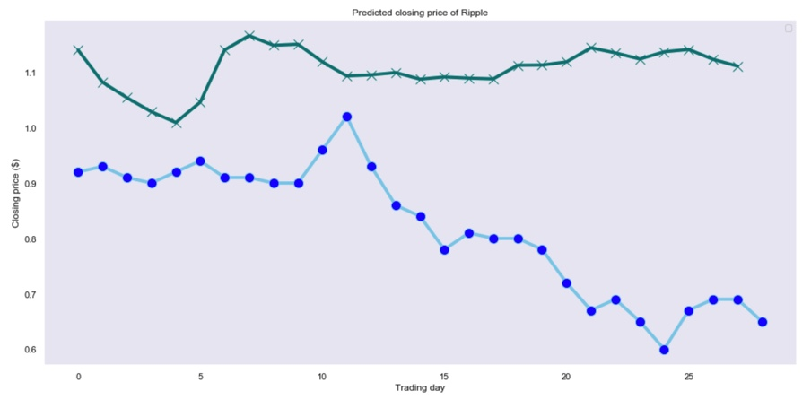
Plotting the Predicted Values

Slide 9
Limitations
Crypto Boom/Bust
Almost immediately after the data ends, Ripple experienced a 32% drop, and hasn’t done much since to recover, today trading at $0.23
This, coupled with the fact that the currency had only experienced major price gains and volatility in the last 60 days of the data, makes it really tough to find a perfect model
Data Structure
These methods are best applied on longer time series, and on data that has more depth
Economic data, such as GDP, is best studied and predicted using methods similar to this. We have the knowledge base of factors that influence GDP in order to be able to study WHY a series has a unit root or is trend stationary and attribute it to very specific exogenous variables
Crypto is so new and unpredictable (like the stock market), so these variables are tough to identify

