Slide 1
Vitis-AI-3.0 Set UP

Slide 2
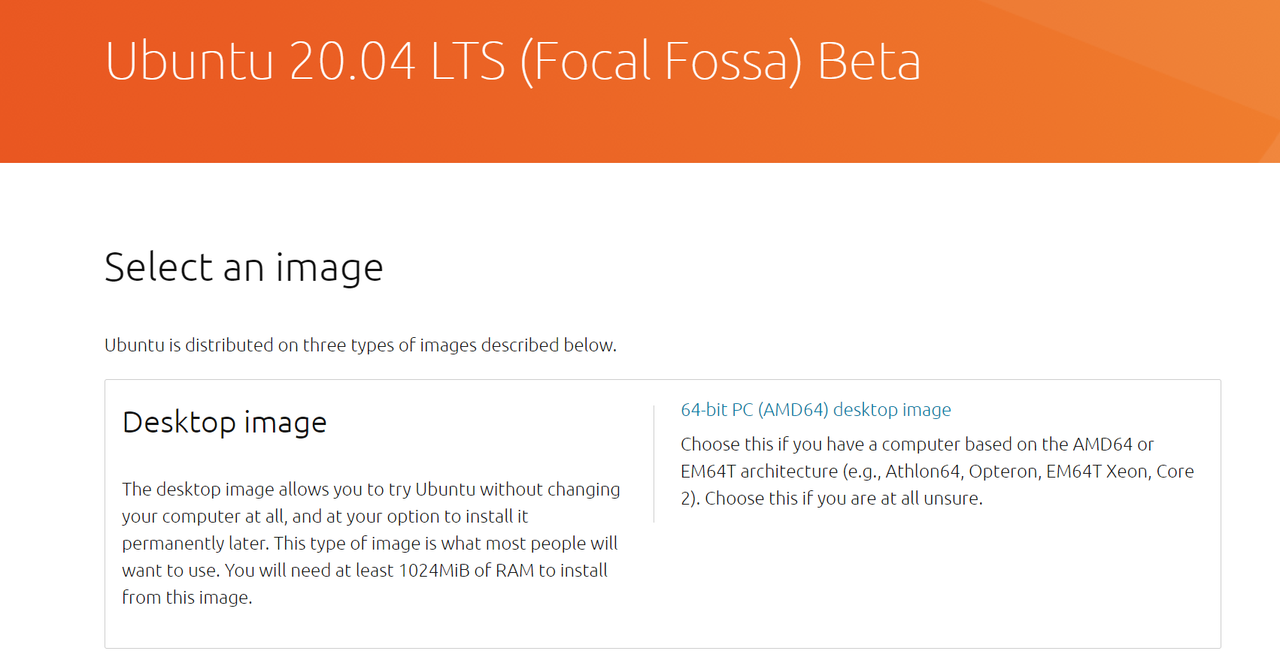
Selling your data to the VM
-Download ubuntu 20.04 image

Slide 3
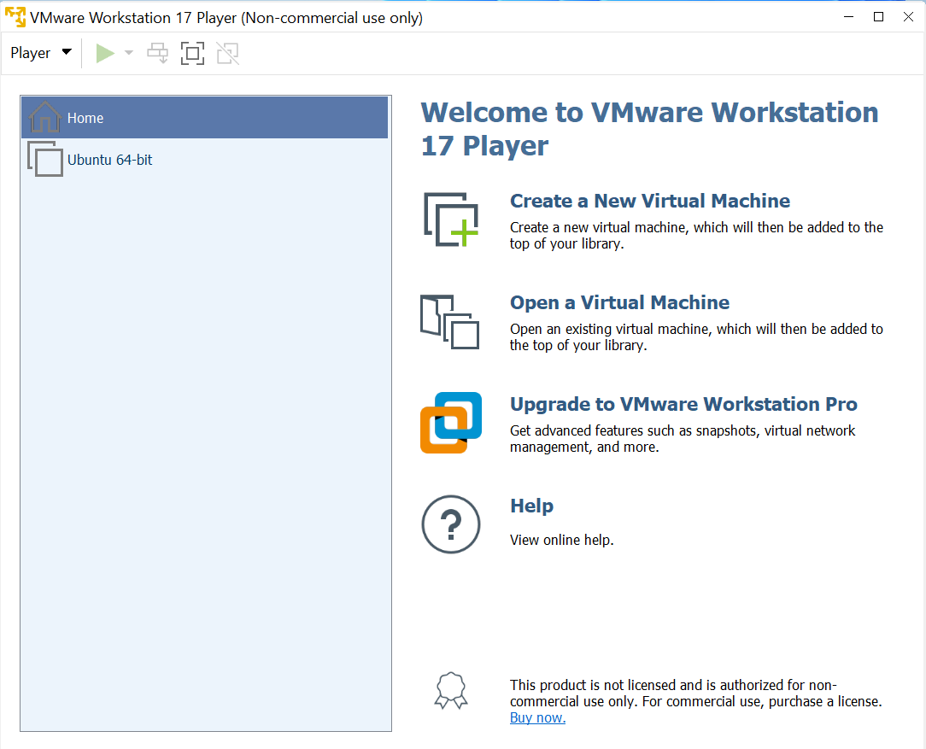

Selling your data to the VM
-Download and install Vmware workstation 17
-should come to a page like the right
-click create a new Virtual machine

Slide 4
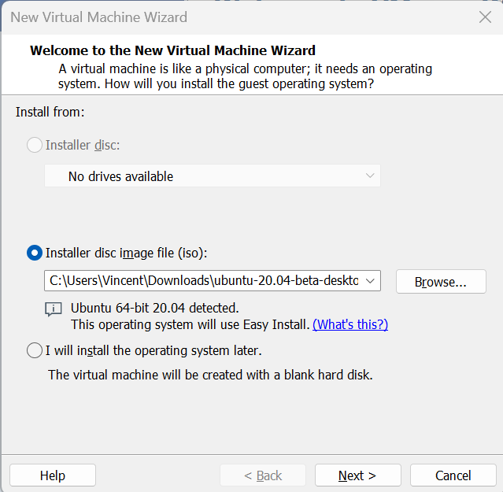
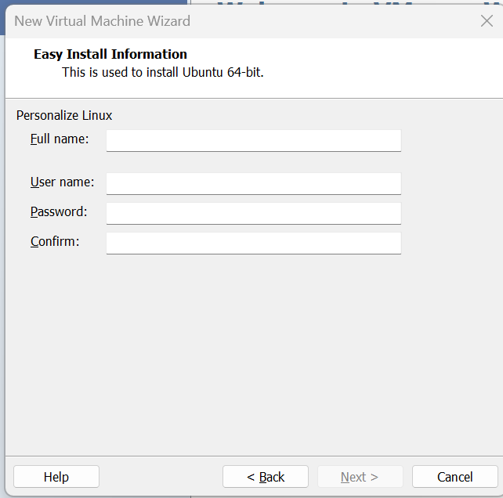
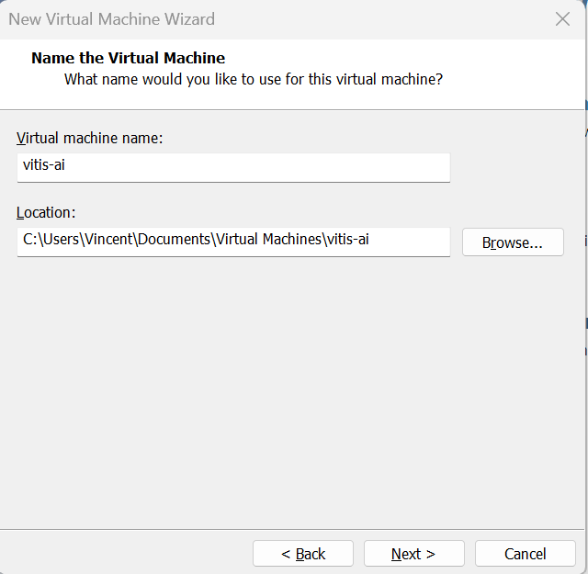
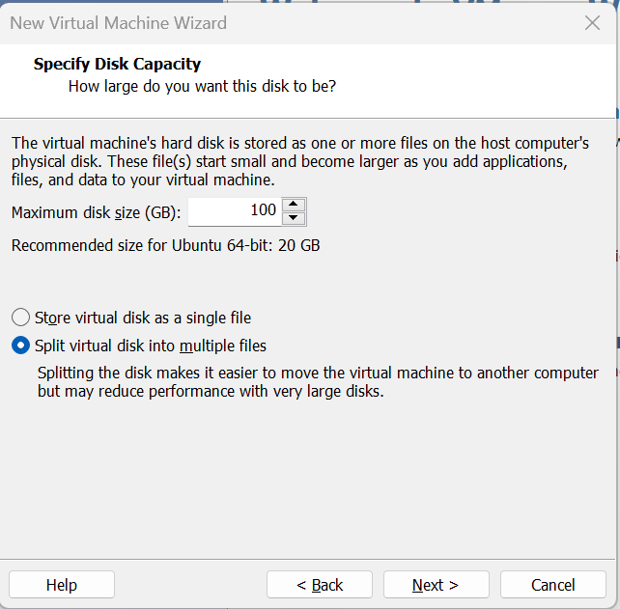
Selling your data to the VM
-select the ubuntu 20.04 image you downloaded
- set up your username and password
-set max disk size >= 100GB (required by vitis-ai)

Slide 5
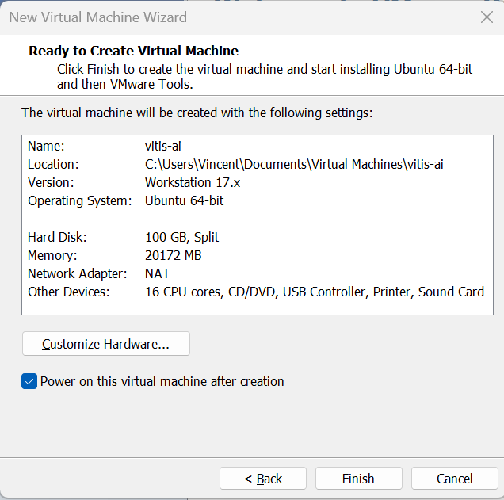
Selling your data to the VM
-select the ubuntu 20.04 image you downloaded
- set up your username and password
-set max disk size >= 100GB (required by vitis-ai)
-choose the amount of memory and cpu cores in customize hardware here 20GB ram 16 cpu cores

Slide 6


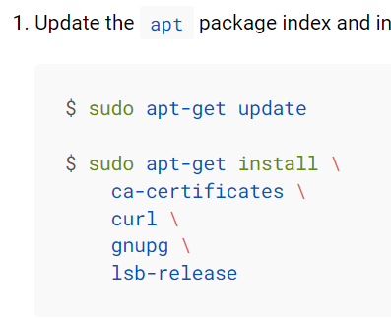
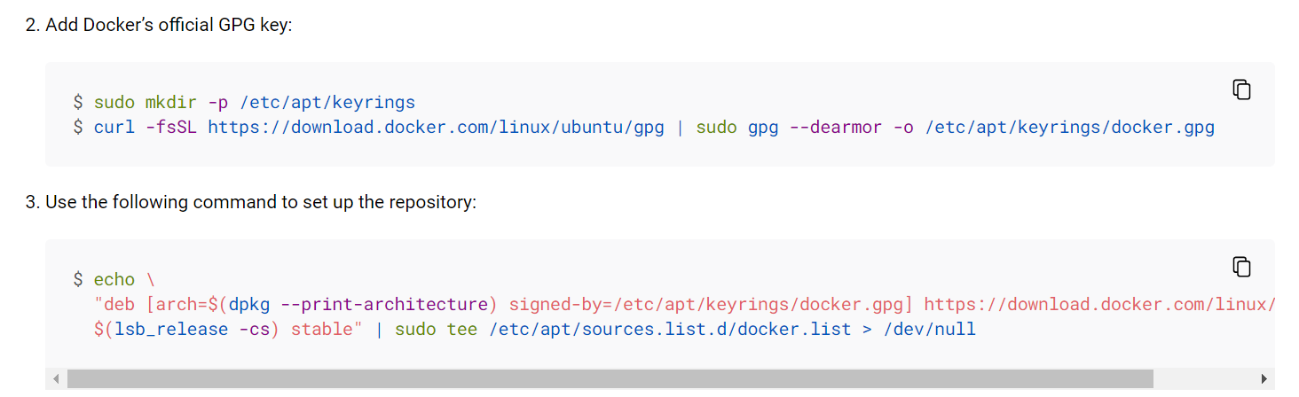
1. Docker set up
Set up vitis-ai
Need docker
Update apt package
Add docker official gpg key
Set up repository

Slide 7
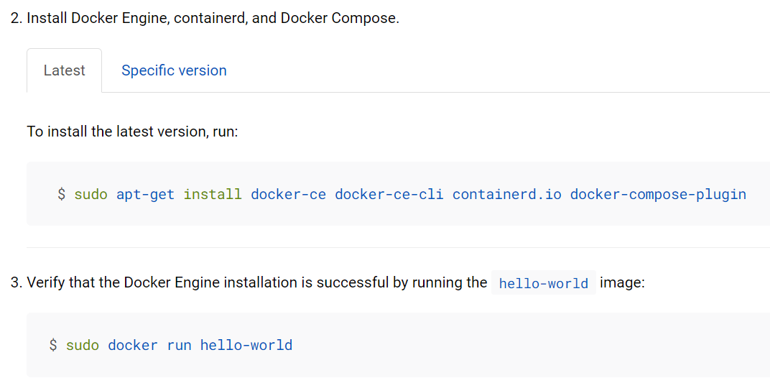
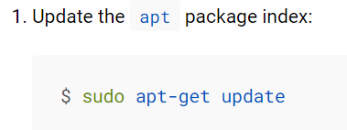
1. Docker set up
Update apt
Install docker engine
Verify docker installed

Slide 8
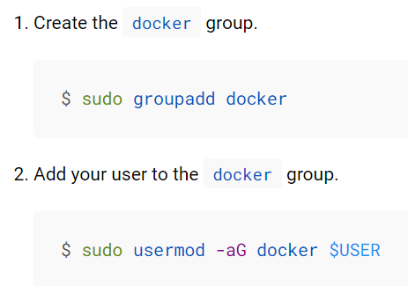
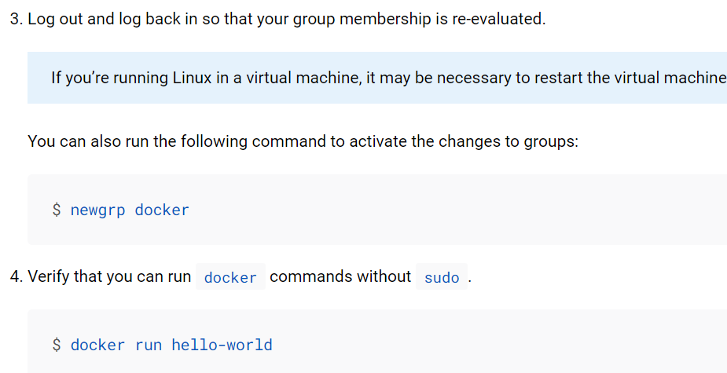
2. Docker post set up
Create docker group
Add user to group
Use command to activate changes
Run docker without sudo

Slide 9
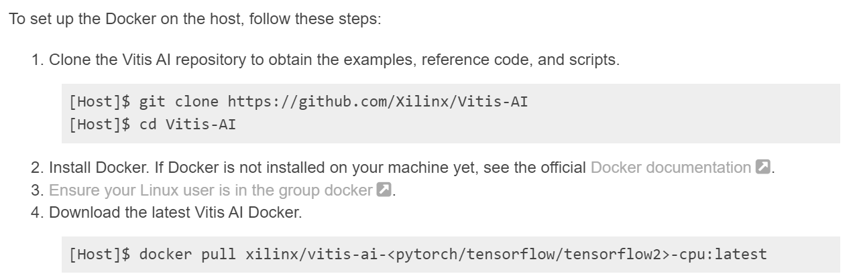
Clone the vitis-ai repository
Download latest vitis-ai docker
Run docker after downloading
Vitis-AI-Setup

Slide 10
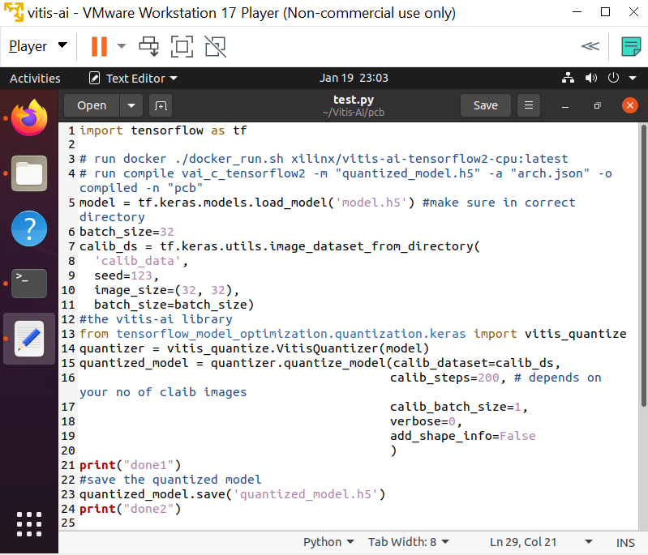
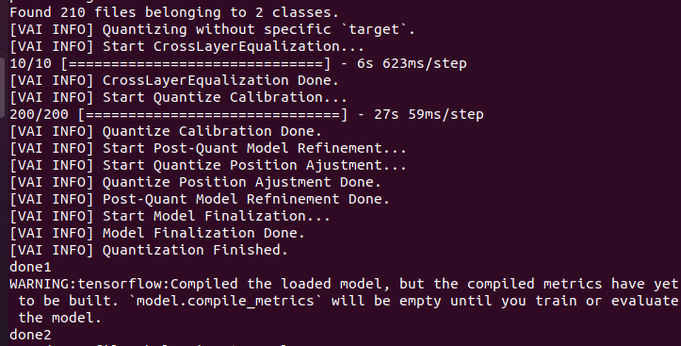
Get the trained float model
Prepare a calibration dataset (100-1000 images)
Use vitis-ai quantizer api
Quantization

Slide 11
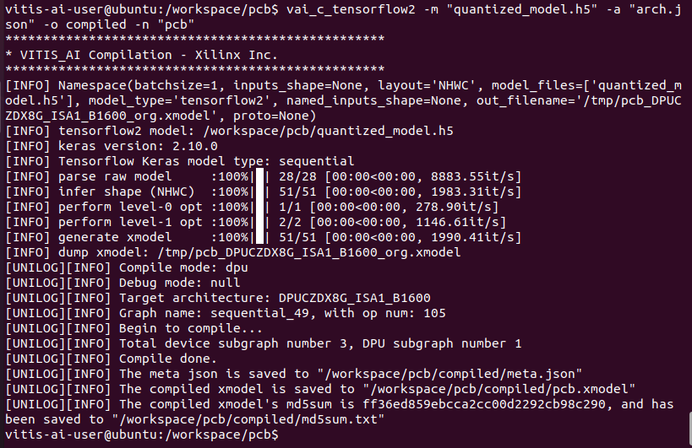
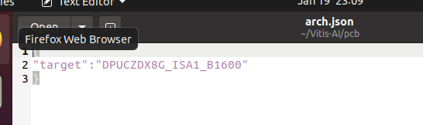
Get the quantized float model
Get the arch json file of the fpga
Use vai_c_tensorflow2 to compile
Compile

Slide 12
Done! Your own model.

