Slide 1
CBE255 Discussion 1
Open MATLAB and your Python IDE while waiting
If you have had installation problems we can try to debug before discussion starts (let me know)
I highly recommend downloading MATLAB instead of using the Citrix version

Slide 2
Agenda
Introduction
“Hello World!” example
Print statements
Quick data type review
String formatting
Homework-adjacent information and problems
Matrix operations
Allowed variable names
MATLAB Logic
MATLAB order of operations

Slide 3
About me
Turner Luke
Email: tluke@wisc.edu, include CBE255 in the subject line
Try to keep material questions to Piazza
Office hours: 6-7PM Thursday (Or later, let me know)
“TA office hours” in BBCollab
Discussion: Thursday 1:20 – 2:50 PM
Please remind me to record!
Never coded prior to CBE255
Independently learned Python, Julia and (just a little) C++

Slide 4
Discussion format
Synchronous
No attendance, optional
Hosted on BBCollaborate
4 Discussions
Wednesday: 3:30-5 PM - Becca
Thursday: 1:20-2:50 PM - Turner
Thursday: 3:30-5 PM - Bill
Friday: 1:20-2:50 PM – Suzy
About 50% material review & 50% time for questions
Discussion section is entirely for your benefit, please give me feedback on what is most effective
I will send out the discussion presentation prior to copy and paste code

Slide 5
Why CBE255?
How is CBE255 evolving?
Why do chemical engineers need to code?
You will need more powerful tools for data analysis
A workup in Python takes me minutes, while excel takes hours
Somebody has probably already done what you’re trying to do
Dr. Dahlke is adapting to a more modern computational approach
Industry employers will not have MATLAB
Nobody memorizes functions, packages, etc.
90% of coding is knowing how to google the right information
Projects are more effective than exams

Slide 6
Python vs. MATLAB Python > MATLAB >> True
Python
MATLAB
Open source
Huge community
Relatively easy
Packages
Weird native data structures
Many great and powerful IDEs
Slow
$860 Annually
Rarely used
Easier
No packages
Easy native data structures
Only one program
Also slow

Slide 7
Questions?
Content?
Course objectives?
Anything?
Moving forward: feel free to interrupt discussion at any time to ask a question
Let's code!

Slide 8
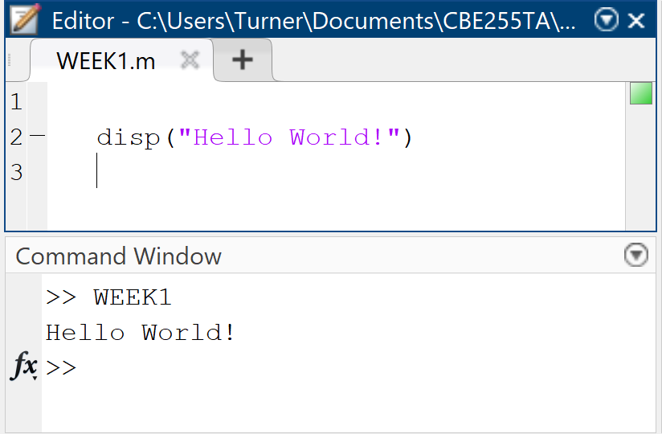
“Hello World!”
Goal: get MATLAB to “talk” to us through the Command Window using our code in the Editor
The display command:
disp(x)
Takes one argument (x) and displays it in the command window
x can be any data type, but what exactly are data types?

Slide 9
Variable assignment
Variables are assigned values using a single equals sign
a = 2
This line sets the variable named a to a value of 2
Remember: MATLAB outputs the result of every line executed, suppress this with a semicolon (Homework with a mess of outputs will be hard to grade)
a = 2;
Sets a to 2 without outputting result
Variables can be a combination of capital and lowercase letters, numbers and the underscore
Must start with a letter
Cannot conflict with MATLAB syntax (for, char, size, etc.)

Slide 10
Data Types
Numeric types
Numbers
Floats
Integers
Complex numbers
Infinity
Nan
Strings
Matrices
More (Not important now)
Functions
Tables
Booleans
Etc.

Slide 11
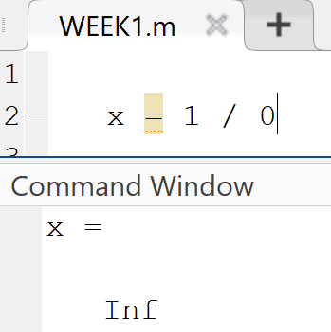
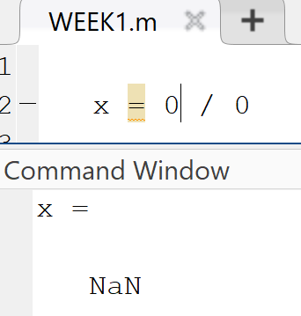
Numeric
Numbers
Floats and Integers – Don’t worry about it
For now: Just numbers
Complex numbers
x = 1 + 3i
Infinity
x = Inf
Not a number
x = NaN

Slide 12
Strings
Strings are just lines of text
Strings must be surrounded by single or double quotes
a = “ABCDE”;
a = ‘abcde’;

Slide 13
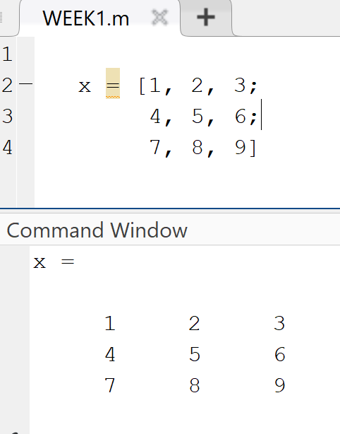
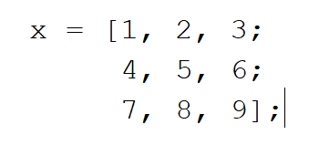

Matrices
Square brackets encase the creation of matrices
Spaces or commas separate horizontal elements
Semicolons separate elements vertically
Matrices have indexes, in the order (row, column)
What is the index of value seven in this Matrix?
FYI!
Code readability is important!
You can use many lines and spaces to make nicer code
These two are the exact same

Slide 14
Matrix Indexing and Slicing
A(i,j) – is the element of matrix A at the row i, column j
The colon (:) “slices” a matrix
By itself, the colon means “all”
Between two indices the colon means “between”
Matrix elements can be reassigned with the single equals sign
A(i, j) = z; Sets element i,j to the value of z. z must be a number here (Shape needs to work)
A(1, 1:2) = [a, b]

Slide 15
Back to printing
Formatting print statements
disp(x) doesn’t tell us much
We want to be able to customize the printed output
Format data to text output
fprintf(formatSpec,A1,…,An)
A1,…,An : The arguments to be formatted to the formatSpec string
formatSpec : A string containing “instructions” on what to print

Slide 16
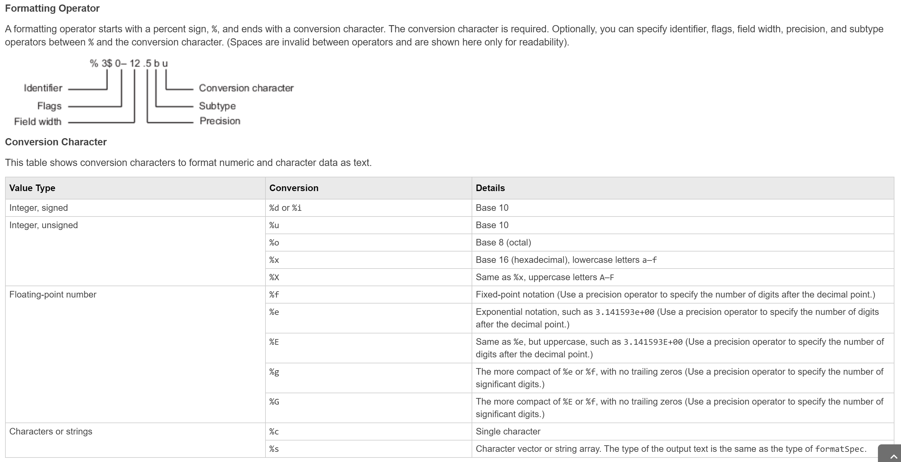
fprintf formatting (Don’t memorize!)
https://www.mathworks.com/help/matlab/ref/fprintf.html

Slide 17

Practical examples of fprintf
Print out two variables x and y
fprintf(“Variable x is : %f\nVariable y is : %f”, x, y)
“Hey MATLAB format the first argument here and make it a float (containing decimal).”
\n is the enter character, recall matlab doesn’t recognize enters as anything other than formatting

Slide 18
Try it yourself
Print a statement of your name, how many credits you’re taking (as an integer), and how many seconds old you are (in exponential notation with only 3 sigfigs)
Format nicely, as if you’re printing the results of a script for someone else to read
We haven’t touched on string, integer, exponential formatting or sigfigs. Finding coding information on google is 90% of the battle!
There are 3.154E7 seconds in a year (I don’t actually care how right your value is)
Spoilers on the next slide!

Slide 19
My results
name = "Turner Luke";
cred = 9;
age = 22 * 3.154E7;
fprintf("Hey class, my name is %s.\nThis semester I'm only taking %i credits!\nI'm about %.2E seconds old.", name, cred, age);
Output:
Hey class my name is Turner Luke.
This semester I'm only taking 9 credits!
I'm about 6.94E+08 seconds old.

Slide 20
“Hello world” in Python
Printing is much nicer in python
print(“Hello World!”)
print()takes one argument
Equivalent to disp(x) in MATLAB
Can format strings like fprintf
print(“A:%f\nB:%f\nC:%f”% (A,B,C))
print("A:{}\nB:{}\nC:{}".format(A, B, C))
Don’t worry about this syntax right now (This is a good topic if we have time after)
We’re going to come back to Python later

Slide 21
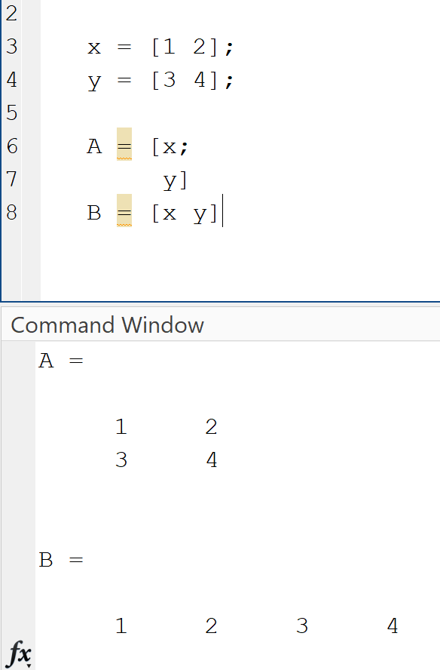
Matrix (Array) Operations in MATLAB
MATLAB stands for Matrix Laboratory
MATLAB always reverts to matrix operations instead of element-wise
Modifying matrices has a nice easy syntax
You can create a new matrix using variables, as long as the dimensions works out
Uses the same syntax
Space or comma separates elements horizontally
Semicolon separates elements vertically

Slide 22
Matrix Manipulation Example
Copy the following text:
A = [1 2 3];
B = [4; 8; 12];
C = [5; 9];
D = [6 7; 10 11];
E = [13 14 15 16];
Create this matrix using A,B,C,D,&E
1 2 3 4
5 6 7 8
9 10 11 12
13 14 15 16
First: Append matrices together with square brackets []
Second: Initialize a matrix of zeros and modify its elements with the starting matrices
X = zeros(n) returns an n-by-n matrix of zeros.

Slide 23
Answer
A = [1 2 3];
B = [4; 8; 12];
C = [5; 9];
D = [6 7; 10 11];
E = [13 14 15 16];
x = [[[A; [C D]] B]; E]
z = zeros(4);
z(1, 1:3) = A;
z(1:3, 4) = B;
z(2:3, 1) = C;
z(2:3, 2:3) = D;
z(4, :) = E

Slide 24
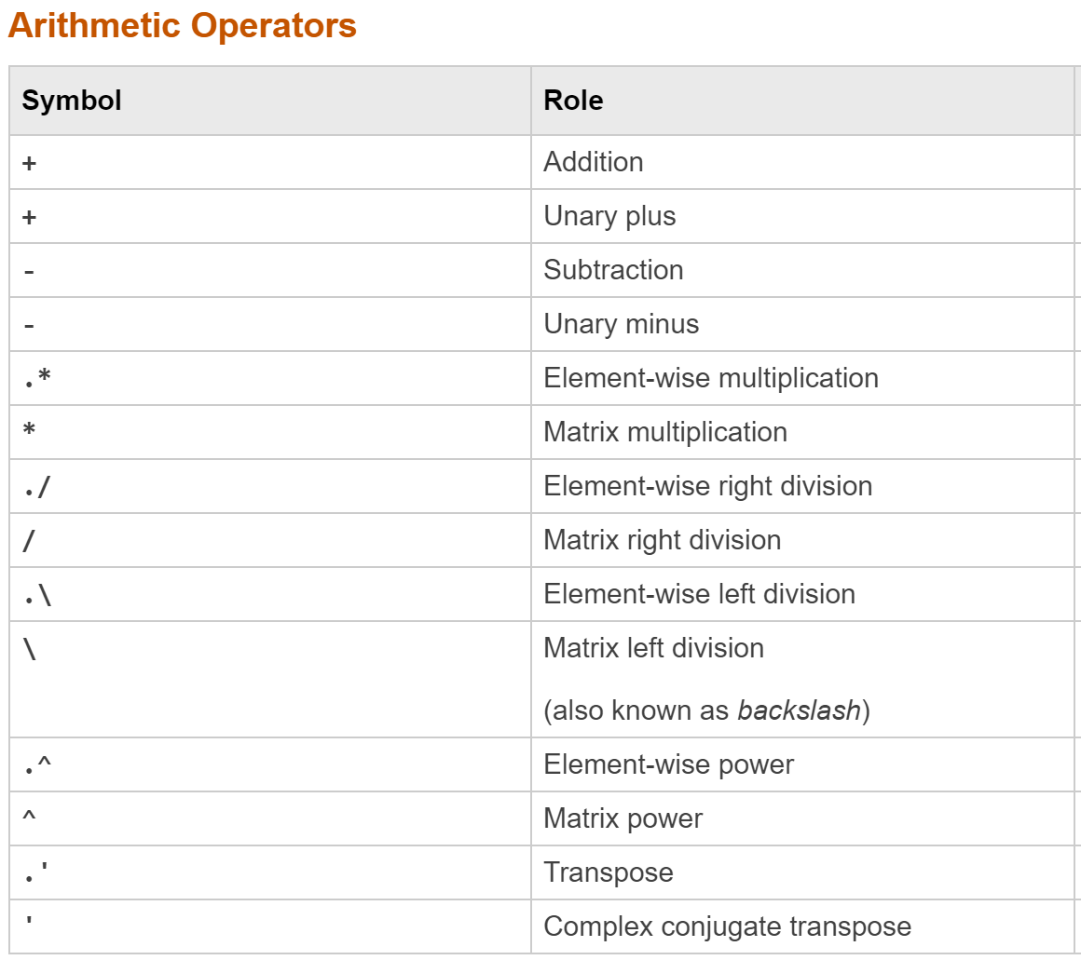
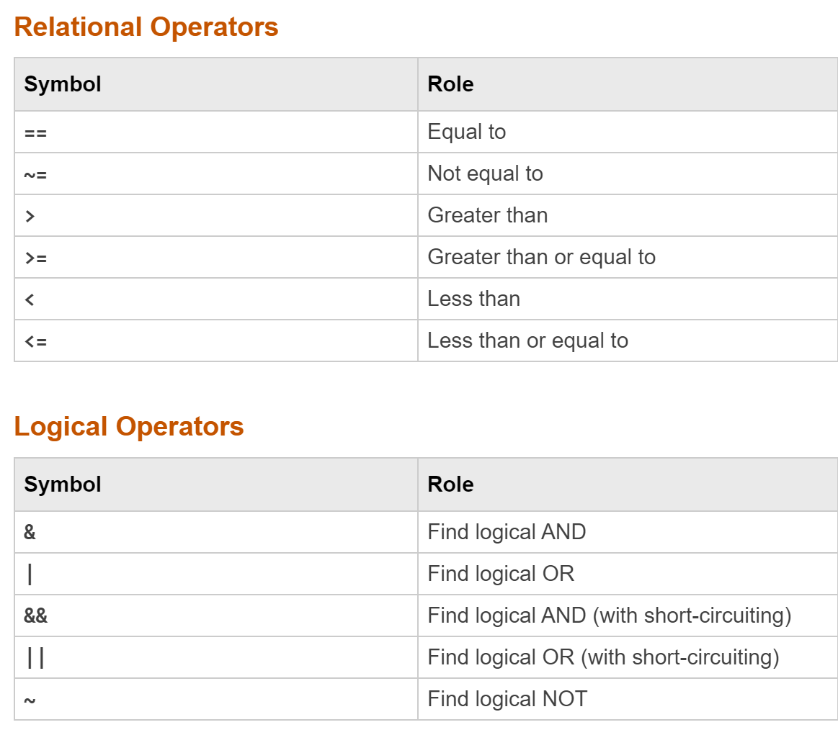
Back to Operations

Slide 25
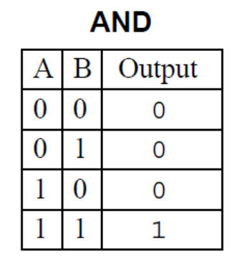
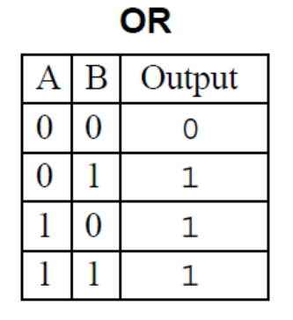
Boolean Logic
Operations using Boolean True or False
In MATLAB True is 1 and False is 0
All nonzero numbers are interpreted as True
AND (&)
x AND y
Returns true if both x and y are true
OR (|)
x OR y
Returns true if either x or y are true (Can be both)
NOT (~)
NOT x
Returns the opposite of x

Slide 26
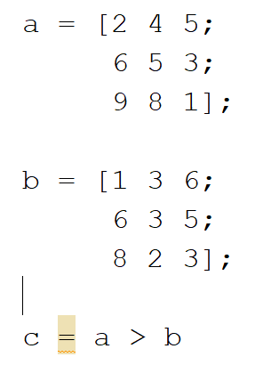
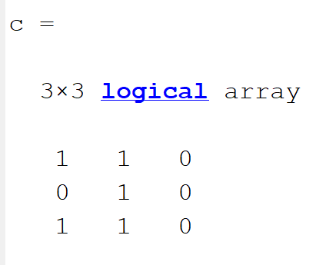
Relations
Operate on two arguments, and return a Boolean (Remember true and false are literally just 1 and 0 in MATLAB)
Equal to
==
Not equal to
~=
Greater than
>
Greater than or equal to
>=
Less than
<
Less than or equal to
<=
Logical and relational operation on matrices are always performed element-wise!

Slide 27
Order of Operations (MATLAB) https://www.mathworks.com/help/matlab/matlab_prog/operator-precedence.html
Parentheses ()
Transpose (.'), power (.^), complex conjugate transpose ('), matrix power (^)
Power with unary minus (.^-), unary plus (.^+), or logical negation (.^~) as well as matrix power with unary minus (^-), unary plus (^+), or logical negation (^~).
Unary plus (+), unary minus (-), logical negation (~)
Multiplication (.*), right division (./), left division (.\), matrix multiplication (*), matrix right division (/), matrix left division (\)
Addition (+), subtraction (-)
Colon operator (:)
Less than (<), less than or equal to (<=), greater than (>), greater than or equal to (>=), equal to (==), not equal to (~=)
Element-wise AND (&)
Element-wise OR (|)
Short-circuit AND (&&)
Short-circuit OR (||)
This entire list is shown for completeness, but for now don’t worry about operators that are crossed out. (We could discuss in any extra time if desired)

Slide 28
Logic, Comparison, and Order of Operation Examples
Predict the output of the following (if you see something new google it!)
Do it on paper before checking in MATLAB
If you get any wrong, try breaking them down into smaller components
a = [1 2 0];
b = [3 4 5];
sum(a>=1)
a>=1 & b<4
sum(b > 2 | a) + b
(a - 2 .* b & (b < 2) + 8) .* a
(a & ~b | a + 4 * 32 & ~a + true - (b | a)) * false

