Slide 1
CBE255 Discussion 11 4/15/21
Turner Luke
* If you are not registered for this discussion, let me know so I can send you the presentation

Slide 2
Reminders
Homework 9 due Tomorrow
Please submit a single PDF
Project 3 due April 23rd
Project 4 due May 4th
A little harder than project 3, and a bit removed from what we’ve done in this course- Start early!

Slide 3
Agenda
Questions?
Parameter estimation
Linear
Nonlinear

Slide 4

Linear Parameter Estimation
How can you fit a model into matrix operations on a dataset?
$$X Θ = Y$$
$$Θ= X\backslash Y$$
$x, y are sets of size (1,n)$
Find the form and shape of $X$, $Y$, and $Θ$
$$y = mx + b$$
$$Y_{\left[n,1\right]}=\left[y^{T}\right]$$
$$X_{\left[n,2\right]}=\left[x^{T},1\right]$$
$$Θ_{\left[2,1\right]}=\left[\begin{matrix}m \\ b\end{matrix}\right]$$

Slide 5

Manipulate the Following Models Into a Form That Be Fit with a Matrix Operation
$$y=ax^{2}+bx+c$$
$$y=\frac{a}{x}+b$$
$$y=y_{o}exp\left(\frac{x}{b}\right)$$
$$y=x^{a}$$
$$y=b ln\left(ax\right)$$
$$y=x^{a}exp\left(bx\right)$$

Slide 6







$y=ax^{2}+bx+c$
$y=\frac{a}{x}+b$
$y=y_{o}exp\left(\frac{x}{b}\right)$
$y=x^{a}$
$y=b ln\left(ax\right)$
$y=x^{a}exp\left(bx\right)$
$$Y_{\left[n,1\right]}=\left[{ln\left(y\right)}^{T}\right]$$
$$X_{\left[n,1\right]}=\left[{ln(x)}^{T}\right]$$
$$Θ_{\left[1,1\right]}=\left[a\right]$$
$$Y_{\left[n,1\right]}=\left[y^{T}\right]$$
$$X_{\left[n,3\right]}=\left[{x^{2}}^{T},x^{T},1\right]$$
$$Θ_{\left[3,1\right]}=\left[\begin{matrix}a \\ b \\ c\end{matrix}\right]$$
$$Y_{\left[n,1\right]}=\left[y^{T}\right]$$
$$X_{\left[n,2\right]}=\left[{\frac{1}{x}}^{T},1\right]$$
$$Θ_{\left[2,1\right]}=\left[\begin{matrix}a \\ b\end{matrix}\right]$$
$$Y_{\left[n,1\right]}=\left[y^{T}\right]$$
$$X_{\left[n,2\right]}=\left[{ln\left(x\right)}^{T}, 1\right]$$
$$Θ_{\left[2,1\right]}=\left[\begin{matrix}b \\ b ln\left(a\right)\end{matrix}\right]$$
$$Y_{\left[n,1\right]}=\left[{ln\left(y\right)}^{T}\right]$$
$$X_{\left[n,2\right]}=\left[x^{T},1\right]$$
$$Θ_{\left[2,1\right]}=\left[\begin{matrix}1/b \\ ln\left(y_{0}\right)\end{matrix}\right]$$
$$Y_{\left[n,1\right]}=\left[y^{T}\right]$$
$$X_{\left[n,2\right]}=\left[{ln\left(x\right)}^{T},x^{T}\right]$$
$$Θ_{\left[2,1\right]}=\left[\begin{matrix}a \\ b\end{matrix}\right]$$

Slide 7
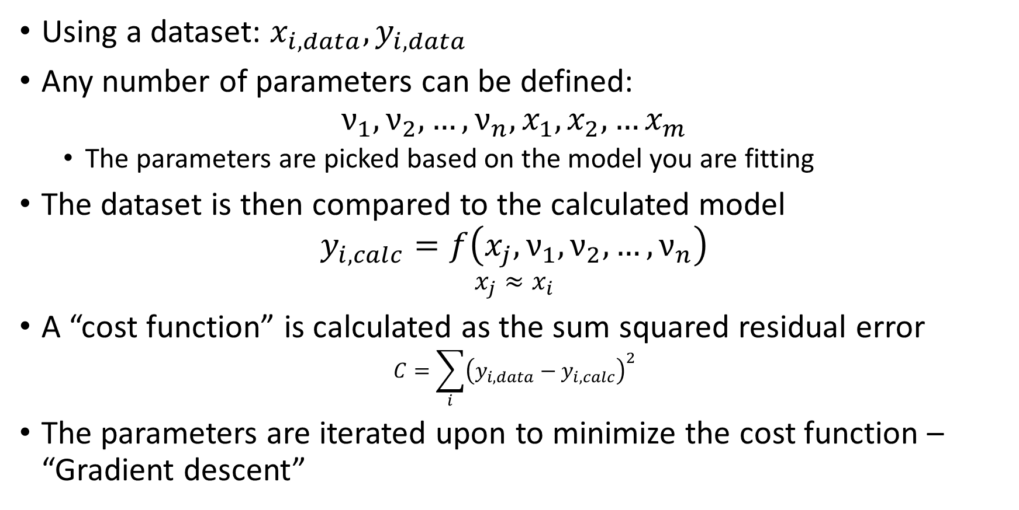
Nonlinear Parameter Estimation(Conceptual)
Using a dataset: $x_{i,data},y_{i,data}$
Any number of parameters can be defined:
$$ν_{1},ν_{2},…,ν_{n},x_{1},x_{2},…x_{m}$$
The parameters are picked based on the model you are fitting
The dataset is then compared to the calculated model
$$y_{i,calc}=f\left(x_{j},ν_{1},ν_{2},…,ν_{n}\right)$$
$$x_{j}≈x_{i}$$
A “cost function” is calculated as the sum squared residual error
$$C=\sum_{i}{{\left(y_{i,data}−y_{i,calc}\right)}^{2}}$$
The parameters are iterated upon to minimize the cost function – “Gradient descent”

Slide 8

Gradient Descent
$$ΔC≈\frac{∂C}{∂ν_{1}}Δν_{1}+…+\frac{∂C}{∂ν_{n}}Δν_{n}$$
$$∇C≡{\left(\frac{∂C}{∂ν_{1}},\frac{∂C}{∂ν_{2}},…,\frac{∂C}{∂ν_{n}}\right)}^{T}$$
$$Δν= − η∇C$$
$η$: Learning rate, small and positive
$$ΔC≈− η∇C⋅∇C=−η{\left|\left|∇C\right|\right|}^{2}$$
$$ν_{new}=ν−η∇C$$

Slide 9
Nonlinear Parameter Estimation (Process)
def residuals_of_model(inp): # Unpack the input # Recall fsolve, input is a single vector nus = inp[0 : n+1] xs = inp[n+1 : n+m+2] # Calculate the datapoints to be fitted ycalc = f(nus, xs) # Return a vector of residuals (not squared, the function performs this) return (y - ycalc) / sigma_y

Slide 10
Nonlinear Parameter Estimation Functions
MATLAB:
x = lsqnonlin(fun,x0)
Python:
scipy.optimize.least_squares(fun, x0)

Slide 11
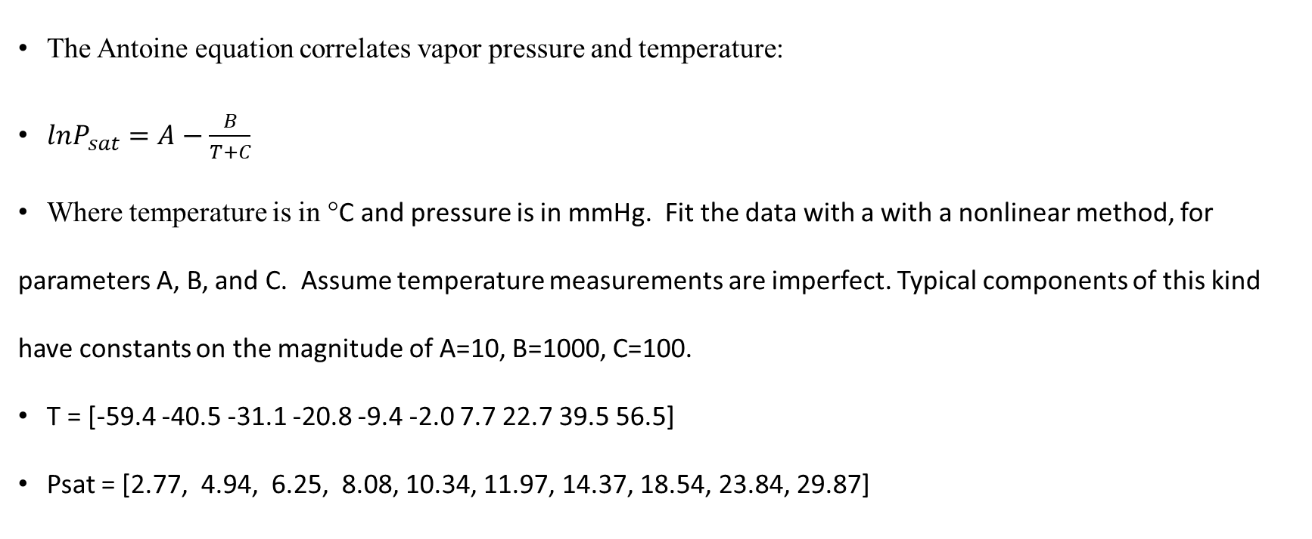
Antoine Equation Example
The Antoine equation correlates vapor pressure and temperature:
$lnP_{sat}=A−\frac{B}{T+C}$
Where temperature is in °C and pressure is in mmHg. Fit the data with a with a nonlinear method, for parameters A, B, and C. Assume temperature measurements are imperfect. Typical components of this kind have constants on the magnitude of A=10, B=1000, C=100.
T = [-59.4 -40.5 -31.1 -20.8 -9.4 -2.0 7.7 22.7 39.5 56.5]
Psat = [2.77, 4.94, 6.25, 8.08, 10.34, 11.97, 14.37, 18.54, 23.84, 29.87]
A = 7.122
B = 1.107e+03
C = 240.7

Slide 12
import numpy as np from scipy.optimize import least_squares T = np.array([-59.4, -40.5, -31.1, -20.8, -9.4, -2.0, 7.7, 22.7, 39.5, 56.5]) Psat = np.array([ 2.77, 4.94, 6.25, 8.08, 10.34, 11.97, 14.37, 18.54, 23.84, 29.87]) def antoine_resid(inp): A = inp[0] B = inp[1] C = inp[2] Tcalc = inp[3:] Pcalc = np.exp(A - B / (Tcalc + C)) return [*(Psat - Pcalc), *(T - Tcalc)] xg = [10, 1000, 100, *T] theta = least_squares(antoine_resid, xg) print(theta) A, B, C = theta['x'][:3] print("A = {:.4}\n" "B = {:.4}\n" "C = {:.4}\n".format(A, B, C))

Slide 13
global T Psat
T = [-59.4, -40.5, -31.1, -20.8, -9.4, -2.0, 7.7, 22.7, 39.5, 56.5];
Psat = [ 2.77, 4.94, 6.25, 8.08, 10.34, 11.97, 14.37, 18.54, 23.84, 29.87];
xg = [10, 1000, 200, T];
theta = lsqnonlin(@antoine_resid, xg);
A = theta(1);
B = theta(2);
C = theta(3);
disp(A)
disp(B)
disp(C)
function F = antoine_resid(inp)
global T Psat
A = inp(1);
B = inp(2);
C = inp(3);
Tcalc = inp(4 : end);
Pcalc = exp(A - B ./ (Tcalc + C));
F = [(Psat - Pcalc), (T - Tcalc)];
end

Slide 14
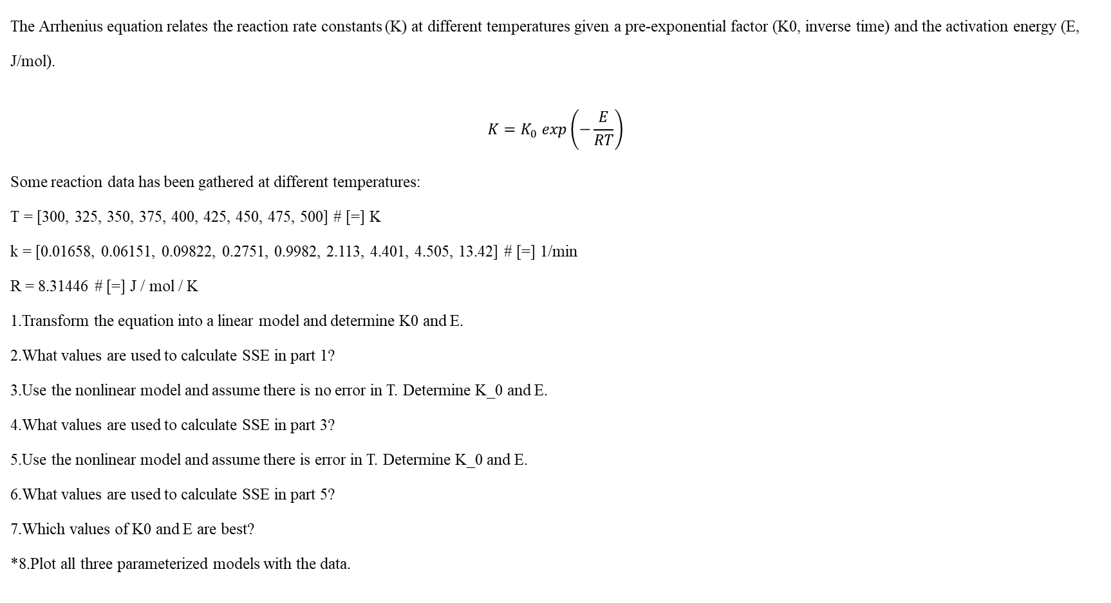
Example: The Arrhenius Equation
The Arrhenius equation relates the reaction rate constants (K) at different temperatures given a pre-exponential factor (K0, inverse time) and the activation energy (E, J/mol).
$$K=K_{0} exp\left(−\frac{E}{RT}\right)$$
Some reaction data has been gathered at different temperatures:
T = [300, 325, 350, 375, 400, 425, 450, 475, 500] # [=] K
k = [0.01658, 0.06151, 0.09822, 0.2751, 0.9982, 2.113, 4.401, 4.505, 13.42] # [=] 1/min
R = 8.31446 # [=] J / mol / K
1.Transform the equation into a linear model and determine K0 and E.
2.What values are used to calculate SSE in part 1?
3.Use the nonlinear model and assume there is no error in T. Determine K_0 and E. 4.What values are used to calculate SSE in part 3?
5.Use the nonlinear model and assume there is error in T. Determine K_0 and E.
6.What values are used to calculate SSE in part 5?
7.Which values of K0 and E are best?
*8.Plot all three parameterized models with the data.

Slide 15
global K R T
T = [300, 325, 350, 375, 400, 425, 450, 475, 500];
K = [0.01658, 0.06151, 0.09822, 0.2751, 0.9982, 2.113, 4.401, 4.505, 13.42];
R = 8.31446;
y = log(K');
x = [1./T', ones(length(T), 1)];
theta = x \ y;
E_lin = -theta(1) * R;
K0_lin = exp(theta(2));
x0 = [K0_lin, E_lin];
[theta, resnorm, res, flag] = lsqnonlin(@arrhenius_no_error, x0);
K0_nonlin_no_error = theta(1);
E_nonlin_no_error = theta(2);
x0 = [x0, T];
[theta, resnorm, res, flag] = lsqnonlin(@arrhenius_w_error, x0);
K0_nonlin_w_error = theta(1);
E_nonlin_w_error = theta(2);
T_plt = min(T) : .01 : max(T);
arr_model = @ (K0, E) K0 * exp(-E ./ R ./ T_plt);
hold on
plot(T, K, '.')
K_lin = arr_model(K0_lin, E_lin);
plot(T_plt, K_lin, 'b', 'LineWidth', 2)
K_nonlin_no_error = arr_model(K0_nonlin_no_error, E_nonlin_no_error);
plot(T_plt, K_nonlin_no_error)
K_nonlin_w_error = arr_model(K0_nonlin_w_error, E_nonlin_w_error);
plot(T_plt, K_nonlin_w_error, 'r--', 'LineWidth', 2)
legend(["Data", "Linearized Model", "Nonlinear No T Error", "Nonlinear w/ T Error"])
title("Arrhenius Data Fitting")
ylabel("K [min^{-1}]")
xlabel("Temperature [K]")
function F = arrhenius_no_error(inp)
global K R T
K0 = inp(1);
E = inp(2);
K_calc = K0 * exp(-E ./ R ./ T);
F = K - K_calc;
end
function F = arrhenius_w_error(inp)
global K R T
K0 = inp(1);
E = inp(2);
Ti = inp(3 : length(K) + 2);
K_calc = K0 * exp(-E ./ R ./ Ti);
F = [K - K_calc, T - Ti];
end

Slide 16
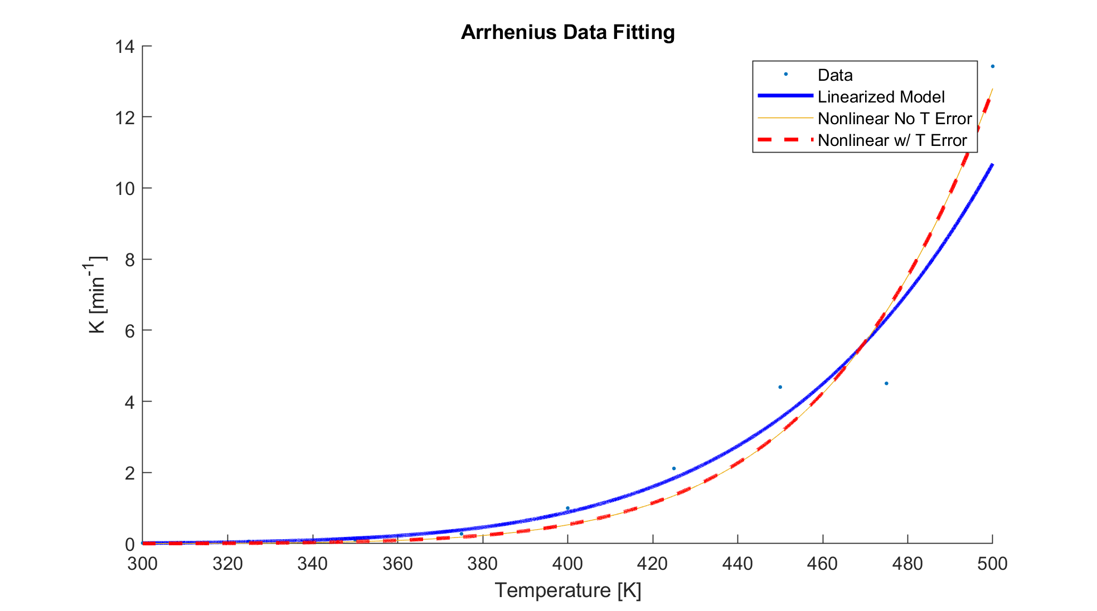

Slide 17
import numpy as np from scipy.optimize import least_squares import matplotlib.pyplot as plt T = np.array([300, 325, 350, 375, 400, 425, 450, 475, 500]) # [=] K K = np.array([0.01658, 0.06151, 0.09822, 0.2751, 0.9982, 2.113, 4.401, 4.505, 13.42]) # [=] 1/min R = 8.31446 # [=] J / mol / K y = np.log(K[np.newaxis].T) x = np.append(1/T[np.newaxis].T, np.ones([len(T), 1]), axis=1) theta = np.linalg.lstsq(x, y)[0] E_lin = -theta[0, 0] * R K0_lin = np.exp(theta[1, 0]) def arrhenius_resid(inp, *args): K0 = inp[0] E = inp[1] if args[0]: Ti = inp[2: len(K) + 2] else: Ti = T K_calc = K0 * np.exp(-E / R / Ti) return K - K_calc x0 = [K0_lin, E_lin] theta = least_squares(arrhenius_resid, x0, args=[False])['x'] K0_nonlin_no_error = theta[0] E_nonlin_no_error = theta[1] x0 = [*x0, *T] theta = least_squares(arrhenius_resid, x0, args=[True])['x'] K0_nonlin_w_error = theta[0] E_nonlin_w_error = theta[1] T_plt = np.linspace(min(T), max(T), num=200) def arr_model(K0, E): return K0 * np.exp(-E / R / T_plt) fig, ax = plt.subplots() ax.plot(T, K, '.') K_lin = arr_model(K0_lin, E_lin) ax.plot(T_plt, K_lin, 'b', linewidth=6) K_nonlin_no_error = arr_model(K0_nonlin_no_error, E_nonlin_no_error) ax.plot(T_plt, K_nonlin_no_error) K_nonlin_w_error = arr_model(K0_nonlin_w_error, E_nonlin_w_error) ax.plot(T_plt, K_nonlin_w_error, 'r', linewidth=2) ax.legend(["Data", "Linearized Model", "Nonlinear No T Error", "Nonlinear w/ T Error"]) ax.set_title("Arrhenius Data Fitting") ax.set_ylabel("K $[min^{-1}]$") ax.set_xlabel("Temperature [K]") plt.show()

Slide 18
