Slide 1
CBE255 Discussion 12 4/22/21
Turner Luke
* If you are not registered for this discussion, let me know so I can send you the presentation

Slide 2
Reminders
Homework 10 due Monday
Please submit a single PDF
Project 3 due Tomorrow
Project 4 due May 4th

Slide 3
Agenda
Questions?
Parameter estimation with ODEs
Topics I think are important, but we don’t get to cover in 255
Unit packages
Less heavyweight IDEs
Symbolic math
Object-oriented programing
Other promising scientific computing languages

Slide 4
How to fit parameters with ODE solvers?
init_guess = [*nu_g, *tdata] def residuals(inp): nu = inp[0:n] t = inp[n:] y0 = fn1(nu) args = fn2(nu) y = solve_ivp(dydt, t, y0, args) resid = [*(ydata - y) / std_y, *(tdata - t) / std_t] return resid def dydt(t, y, *args): return f(t, y)
init_guess = [*nu_g] def residuals(inp): nu = inp[0:n] y0 = fn1(nu) args = fn2(nu) y = solve_ivp(dydt, t, y0, args) resid = [*(ydata - y) / std_y,] return resid def dydt(t, y, *args): return f(t, y)

Slide 5

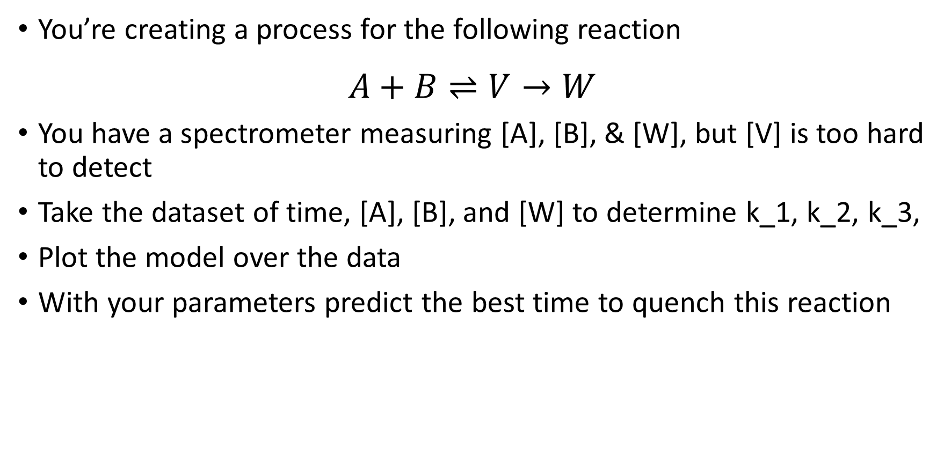


Chemical Kinetics Parameter Example
You’re creating a process for the following reaction
$$A+B⇌V→W$$
You have a spectrometer measuring [A], [B], & [W], but [V] is too hard to detect
Take the dataset of time, [A], [B], and [W] to determine k_1, k_2, k_3,
Plot the model over the data
With your parameters predict the best time to quench this reaction
$$k_{1}$$
$$k_{3}$$
$$k_{2}$$

Slide 6
More Info
All measurements are from the same spectrometer, so standard deviations are arbitrary
The computer measures time accurately, and doesn’t need to be iterated upon
You can optimize the starting concentrations of [A] & [B] for more accurate results
MATLAB doesn’t like optional arguments:
Recall dydt needs to be in the form f(t, y)
Define your main dydt = @(t, y, params)
Pass an anonymous function to the ode solver
X = ode15s(@(t, y) dydt(t, y, [a, b, c,…], y0,…)

Slide 7

Kinetics
$$\frac{d\left[A\right]}{dt}=\frac{d\left[B\right]}{dt}=−k_{1}[A] [B]$$
$$\frac{d\left[V\right]}{dt}=k_{1}[A] [B]−{(k_{2}+k}_{3})[V]$$
$$\frac{d\left[W\right]}{dt}=k_{3}[V]$$

Slide 8
import numpy as np import pandas as pd import matplotlib.pyplot as plt from scipy.optimize import least_squares from scipy.integrate import solve_ivp # Unpack data dat = pd.read_csv("ODEParamData.txt") t = dat['time [sec]'].to_numpy() A_data = dat['C_A [M]'].to_numpy() B_data = dat['C_B [M]'].to_numpy() W_data = dat['C_W [M]'].to_numpy() def dCdt(t, C, *args): k = args[0] A = C[0] B = C[1] V = C[2] W = C[3] dA = -k[0] * A * B dB = dA dW = k[2] * V dV = -dA - k[1] * V - dW return [dA, dB, dV, dW] def kinetics_residuals(inp): k = inp[0:3] CA0 = inp[3] CB0 = inp[4] C0 = [CA0, CB0, 0, 0] ODE_result = solve_ivp(dCdt, [t.min(), t.max()], C0, args=(k,), t_eval=t) C = ODE_result['y'] A = C[0, :] B = C[1, :] V = C[2, :] W = C[3, :]
# We can compare the residuals of A, B, and W - There is no V data resid = [*(A_data - A), *(B_data - B), *(W_data - W)] return resid # We need to find k1, k2, k3 xg = [*np.ones(3) * .5] # We can also modify initial values of A & B xg = [*xg, A_data[0], B_data[0]] lb = np.zeros(5) # None of the parameters can be negative ub = [*(np.inf * np.ones(3)), # We don't have a good guess as to how large K's will be (1.5 * A_data[0]), # The starting points shouldn't be 50% off of the data (1.5 * B_data[0])] theta = least_squares(kinetics_residuals, xg, bounds=(lb, ub)) k1, k2, k3, A0, B0 = theta['x'] print("K1\n{}\nK2\n{}\nK3\n{}".format(k1, k2, k3)) tplt = np.linspace(t.min(), t.max(), num=500) C0 = [A0, B0, 0, 0] k = k1, k2, k3 ODE_result = solve_ivp(dCdt, [t.min(), t.max()], C0, args=(k,), t_eval=tplt) Cplt = ODE_result['y'] V = Cplt[2, :] maxV = max(V) maxt = tplt[V == maxV] fig, ax = plt.subplots() ax.plot(t, A_data, '.') ax.plot(t, B_data, '.') ax.plot(t, W_data, '.') ax.plot(tplt, Cplt.T) ax.plot(maxt, maxV, 'rd', markersize=8) ax.legend(["A data", "B data", "W data", "A fitted", "B fitted", "V fitted", "W fitted", "Optimal Reaction"]) plt.show()

Slide 9
% Unpack data
dat = readmatrix("ODEParamData.txt");
global A_data B_data W_data t
t = dat(:, 1);
A_data = dat(:, 2);
B_data = dat(:, 3);
W_data = dat(:, 4);
% We need to find k1, k2, k3
xg = [ones(1,3) * .5];
% We can also modify initial values of A & B
xg = [xg, A_data(1), B_data(1)];
lb = zeros(1, 5); % None of the parameters can be negative
ub = [inf * ones(1, 3),... % We don't have a good guess as to how large K's will be
1.5 * A_data(1),... % The starting points shouldn't be 50% off of the data
1.5 * B_data(1)];
theta = lsqnonlin(@kinetics_residuals, xg, lb, ub)
k1 = theta(1);
k2 = theta(2);
k3 = theta(3);
k = [k1, k2, k3];
A0 = theta(4);
B0 = theta(5);
disp("Ks:")
disp(k)
tplt = linspace(min(t), max(t), 500);
C0 = [A0, B0, 0, 0];
[~, Cplt] = ode15s(@(t, y) dCdt(t, y, [k]), tplt, C0);
V = Cplt(:, 3);
maxV = max(V);
maxt = tplt(V == maxV);
hold on
plot(t, A_data, '.')
plot(t, B_data, '.')
plot(t, W_data, '.')
plot(tplt, Cplt')
plot(maxt, maxV, 'rd', 'markersize', 8)
legend("A data", "B data", "W data", "A fitted", "B fitted", "V fitted", "W fitted", "Optimal Reaction")
%
function Z = dCdt(t, C, args)
k = args(1:3);
A = C(1);
B = C(2);
V = C(3);
W = C(4);
dA = -k(1) * A * B;
dB = dA;
dW = k(2) * V;
dV = -dA - k(2) * V - dW;
Z = [dA, dB, dV, dW]';
end
function resid = kinetics_residuals(inp)
global A_data B_data W_data t
k = inp(1:3);
CA0 = inp(4);
CB0 = inp(5);
C0 = [CA0, CB0, 0, 0];
[~, C] = ode15s(@(t, y) dCdt(t, y, [k]), t, C0);
A = C(:, 1);
B = C(:, 2);
V = C(:, 3);
W = C(:, 4);
%We can compare the residuals of A, B, and W - There is no V data
resid = [(A_data - A),
(B_data - B),
(W_data - W)];
end

Slide 10
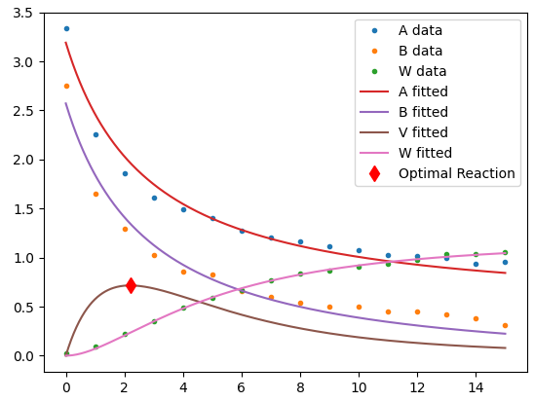
This fit isn’t very good!
K1
0.11947430161552963
K2
0.2381011192661575
K3
0.2034321830731515
The best time to quench the reaction is @ t=2.19438878.
[V] will be 0.7160746192431494.

Slide 11
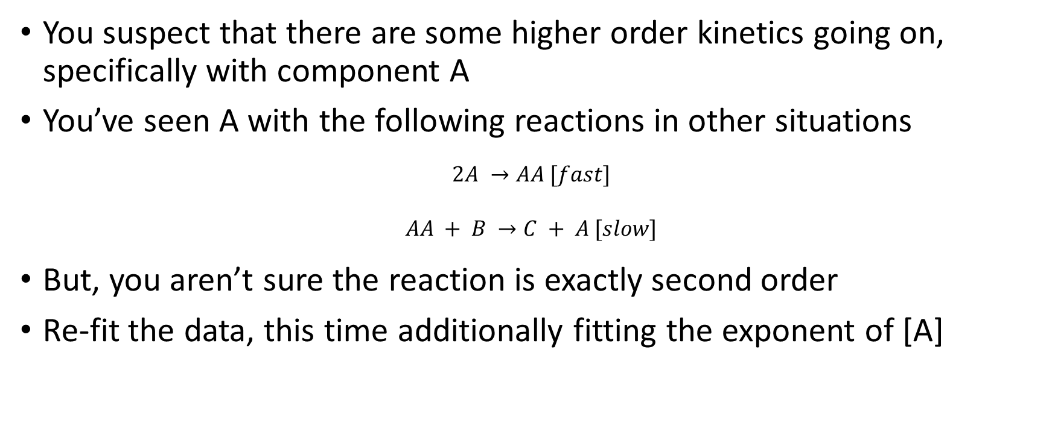
New Kinetic Model
You suspect that there are some higher order kinetics going on, specifically with component A
You’ve seen A with the following reactions in other situations
$$2A →AA [fast]$$
$$AA + B →C + A [slow]$$
But, you aren’t sure the reaction is exactly second order
Re-fit the data, this time additionally fitting the exponent of [A]

Slide 12

Kinetics
$$\frac{d\left[A\right]}{dt}=\frac{d\left[B\right]}{dt}=−k_{1}{\left[A\right]}^{n}\left[B\right]$$
$$\frac{d\left[V\right]}{dt}=k_{1}{\left[A\right]}^{n}[B]−{(k_{2}+k}_{3})\left[V\right]$$
$$\frac{d\left[W\right]}{dt}=k_{3}[V]$$

Slide 13
Hints
Set upper and lower bounds
Feasibility boundaries
Will the optimized starting concentrations be substantially different than the data?
Will the reaction exponents be large
Physical boundaries
Can K be negative?
Can exponents be negative?

Slide 14
import numpy as np import pandas as pd import matplotlib.pyplot as plt from scipy.optimize import least_squares from scipy.integrate import solve_ivp # Unpack data dat = pd.read_csv("ODEParamData.txt") t = dat['time [sec]'].to_numpy() A_data = dat['C_A [M]'].to_numpy() B_data = dat['C_B [M]'].to_numpy() W_data = dat['C_W [M]'].to_numpy() def dCdt(t, C, *args): n = args[0] k = args[1] A = C[0] B = C[1] V = C[2] W = C[3] dA = -k[0] * A ** n * B dB = dA dW = k[2] * V dV = -dA - k[1] * V - dW return [dA, dB, dV, dW] def kinetics_residuals(inp): k = inp[0:3] n = inp[3] CA0 = inp[4] CB0 = inp[5] C0 = [CA0, CB0, 0, 0] ODE_result = solve_ivp(dCdt, [t.min(), t.max()], C0, args=(n, k), t_eval=t) C = ODE_result['y'] A = C[0, :] B = C[1, :] V = C[2, :] W = C[3, :] # We can compare the residuals of A, B, and W - There is no V data resid = [*(A_data - A), *(B_data - B), *(W_data - W)] return resid # We need to find k1, k2, k3, n xg = [*np.ones(3) * .5, 1] # We can also modify initial values of A & B xg = [*xg, A_data[0], B_data[0]] lb = np.zeros(6) # None of the parameters can be negative ub = [*(np.inf * np.ones(3)), # We don't have a good guess as to how large K's will be 3, # Exponents are practically never greater than 2 (1.5 * A_data[0]), # The starting points shouldn't be 50% off of the data (1.5 * B_data[0])] theta = least_squares(kinetics_residuals, xg, bounds=(lb, ub)) k1, k2, k3, n, A0, B0 = theta['x'] print("K1\n{}\nK2\n{}\nK3\n{}".format(k1, k2, k3)) print("Exponents before rounding") print("n\n{}".format(n)) # Round n to the nearest .5 n = round(n / .5) * .5 print("Exponent after rounding") print("n\n{}".format(n)) tplt = np.linspace(t.min(), t.max(), num=500) C0 = [A0, B0, 0, 0] k = k1, k2, k3 ODE_result = solve_ivp(dCdt, [t.min(), t.max()], C0, args=(n, k), t_eval=tplt) Cplt = ODE_result['y'] V = Cplt[2, :] maxV = max(V) maxt = tplt[V == maxV] print("The best time to quench the reaction is @ t={}.\n" "[V] will be {}.".format(maxt[0], maxV)) fig, ax = plt.subplots() ax.plot(t, A_data, '.') ax.plot(t, B_data, '.') ax.plot(t, W_data, '.') ax.plot(tplt, Cplt.T) ax.plot(maxt, maxV, 'rd', markersize=8) ax.legend(["A data", "B data", "W data", "A fitted", "B fitted", "V fitted", "W fitted", "Optimal Reaction"]) plt.show()

Slide 15
% Unpack data
dat = readmatrix("ODEParamData.txt");
global A_data B_data W_data t
t = dat(:, 1);
A_data = dat(:, 2);
B_data = dat(:, 3);
W_data = dat(:, 4);
% We need to find k1, k2, k3, n
xg = [ones(1,3) * .5, 1];
% We can also modify initial values of A & B
xg = [xg, A_data(1), B_data(1)];
lb = zeros(1, 6); % None of the parameters can be negative
ub = [inf * ones(1, 3),... % We don't have a good guess as to how large K's will be
3,... % Exponents are practically never greater than 2
1.5 * A_data(1),... % The starting points shouldn't be 50% off of the data
1.5 * B_data(1)];
theta = lsqnonlin(@kinetics_residuals, xg, lb, ub)
k1 = theta(1);
k2 = theta(2);
k3 = theta(3);
k = [k1, k2, k3];
n = theta(4);
A0 = theta(5);
B0 = theta(6);
disp("Ks:")
disp(k)
disp("Exponent before rounding")
disp(n)
n = round(n / .5) * .5;
disp("Exponents after rounding")
disp(n)
tplt = linspace(min(t), max(t), 500);
C0 = [A0, B0, 0, 0];
[~, Cplt] = ode15s(@(t, y) dCdt(t, y, [n, k]), tplt, C0);
V = Cplt(:, 3);
maxV = max(V);
maxt = tplt(V == maxV);
hold on
plot(t, A_data, '.')
plot(t, B_data, '.')
plot(t, W_data, '.')
plot(tplt, Cplt')
plot(maxt, maxV, 'rd', 'markersize', 8)
legend("A data", "B data", "W data", "A fitted", "B fitted", "V fitted", "W fitted", "Optimal Reaction")
function Z = dCdt(t, C, args)
n = args(1);
k = args(2:4);
A = C(1);
B = C(2);
V = C(3);
W = C(4);
dA = -k(1) * A ^ n * B;
dB = dA;
dW = k(2) * V;
dV = -dA - k(2) * V - dW;
Z = [dA, dB, dV, dW]';
end
function resid = kinetics_residuals(inp)
global A_data B_data W_data t
k = inp(1:3);
n = inp(4);
CA0 = inp(5);
CB0 = inp(6);
C0 = [CA0, CB0, 0, 0];
[~, C] = ode15s(@(t, y) dCdt(t, y, [n, k]), t, C0);
A = C(:, 1);
B = C(:, 2);
V = C(:, 3);
W = C(:, 4);
%We can compare the residuals of A, B, and W - There is no V data
resid = [(A_data - A),
(B_data - B),
(W_data - W)];
end

Slide 16
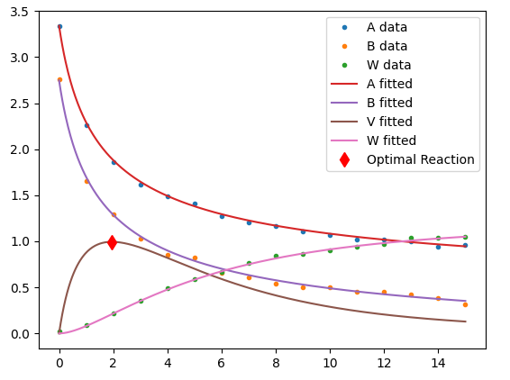
K1
0.06477022227484518
K2
0.1633878401465131
K3
0.1410649959113494
Exponents before rounding
n
2.046338262252474
Exponent after rounding
n
2.0
The best time to quench the reaction is @ t=1.9539078156312624.
[V] will be 0.9947984555330109.
Better!

