Slide 1
CBE255 Discussion 2 2/4/21
* If you are not registered for this discussion, let me know so I can send you the presentation

Slide 2
Reminders
HW1 is due tomorrow at 4 PM
Submit 1 PDF file with all the questions
Suppress unnecessary output

Slide 3
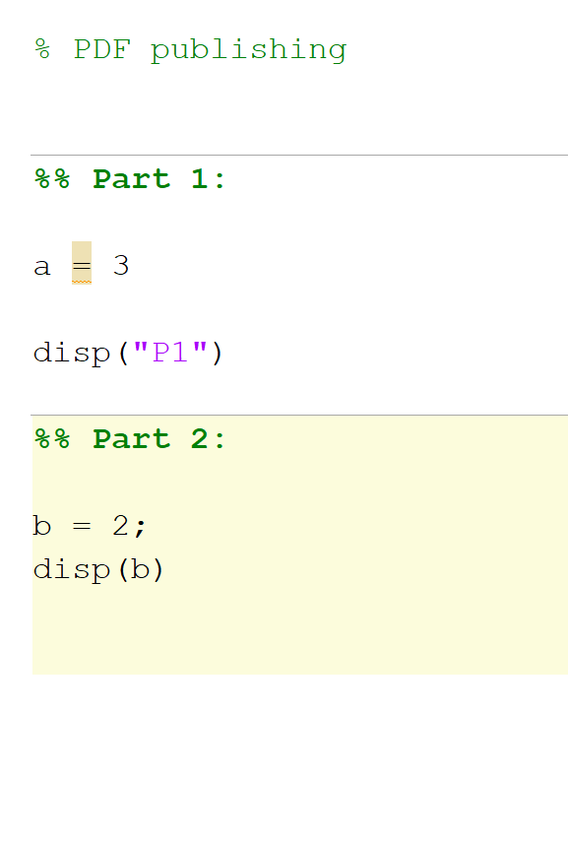
Publishing a Single PDF

Slide 4
Agenda
Questions?
Logic
Summary
Logic by hand examples
Comparisons
Summary
Examples
Operator Overview
Examples
Linear Algebra
ChE Examples
Project
Loops and Conditional Statements

Slide 5
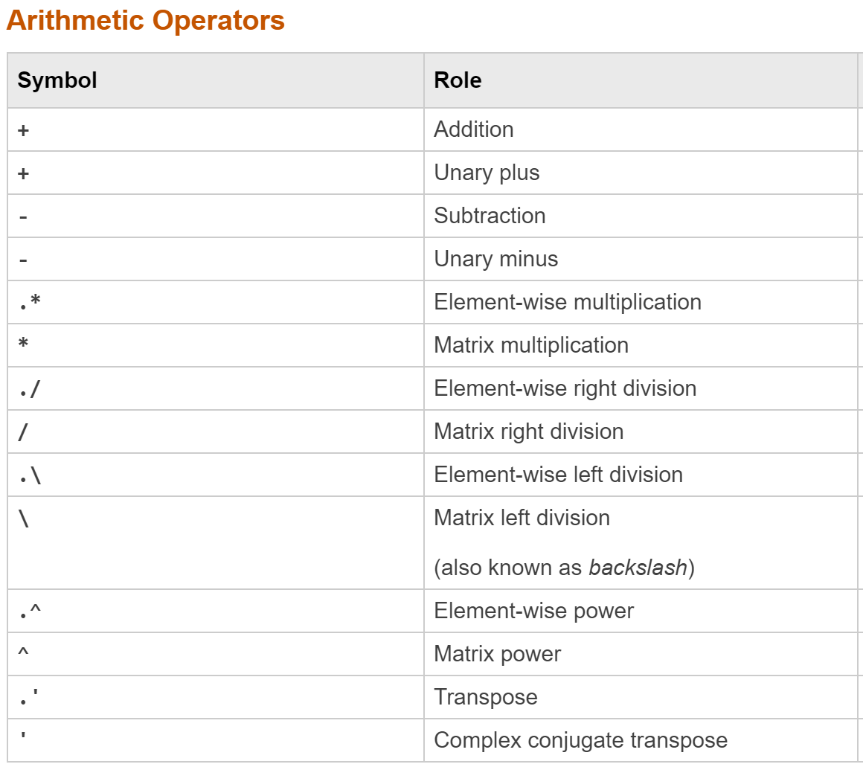
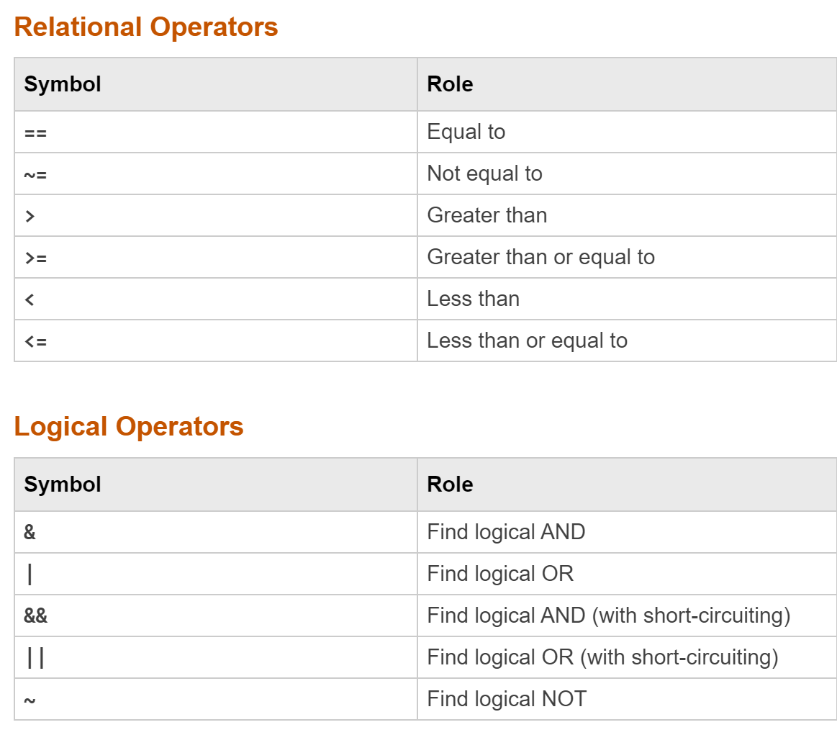
Today: Operation Summary

Slide 6
Order of Operations (MATLAB) https://www.mathworks.com/help/matlab/matlab_prog/operator-precedence.html *Note the website is incorrect here
Parentheses ()
Transpose (.'), power (.^), complex conjugate transpose ('), matrix power (^)
Power with unary minus (.^-), unary plus (.^+), or logical negation (.^~) as well as matrix power with unary minus (^-), unary plus (^+), or logical negation (^~).
Multiplication (.*), right division (./), left division (.\), matrix multiplication (*), matrix right division (/), matrix left division (\)
Unary plus (+), unary minus (-), logical negation (~)
Addition (+), subtraction (-)
Colon operator (:)
Less than (<), less than or equal to (<=), greater than (>), greater than or equal to (>=), equal to (==), not equal to (~=)
Element-wise AND (&)
Element-wise OR (|)
Short-circuit AND (&&)
Short-circuit OR (||)
This entire list is shown for completeness, but for now don’t worry about operators that are crossed out. (We could discuss in any extra time if desired)
Parentheses
Powers
Multiplication/Division
Addition/Subtraction
Comparisons
Logic

Slide 7
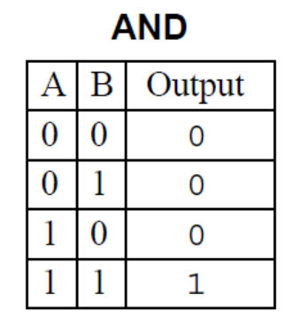
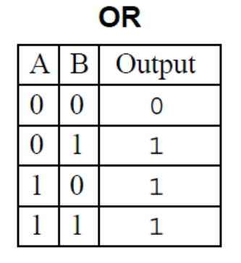
Boolean Logic
Operations using Boolean True or False (“Values”)
In MATLAB True is 1 and False is 0
All nonzero numbers are interpreted as True
Matrix logic operations are always element-wise
Foundational Operations:
AND (&)
x AND y
Returns true if both x and y are true
OR (|)
x OR y
Returns true if either x or y are true (Can be both)
NOT (~)
NOT x
Returns the opposite of x

Slide 8
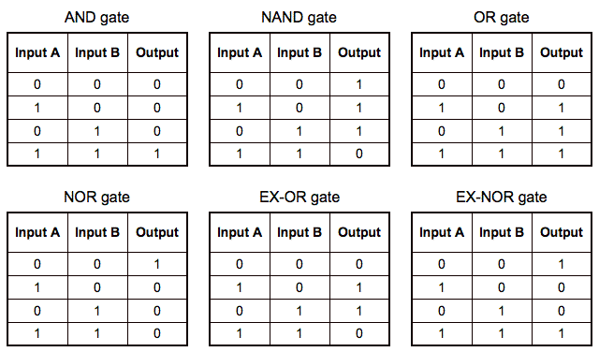
Other Operators
Built from the foundational operators (AND, OR, NOT)
ALL(a1, a2, …, an)
= a1 AND a2 AND a3 AND … AND an
ANY(a1, a2, …, an)
= a1 OR a2 OR a3 OR … OR an
a NAND b (not and)
NOT (a AND b)
a XOR b (exclusive or)
(a OR b) AND (NOT (a AND b))
a NOR b (not or)
NOT (a OR b) alternatively (NOT a) AND (NOT b)
a XNOR b (exclusive not or)
(NOT (a OR b)) OR (a AND b)
Don’t memorize these!
Takeaway:
All logical combinations of outputs from operations on A and B can be built up from AND OR NOT

Slide 9
Logic by Hand
1.) (True or False) and (True and False) or (False or False)
A = [1, 1, 0, 0];
B = [1, 0, 1, 0];
2.) A or B
3.) A and not B
4.) (A & B) | (A | B)
5.) (A | B) & (~ (A & B)) bonus: (what is this?)
6.) (A & ~B) & ~(A | B) | (B | ~B)

Slide 10
Logic by Hand Answers
1. False
2. [1, 1, 1, 0]
3. [0, 1, 0, 0]
4. [1, 1, 1, 0]
5. [0, 1, 1, 0] , XOR
6. [1, 1, 1, 1]

Slide 11
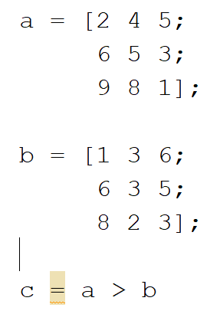
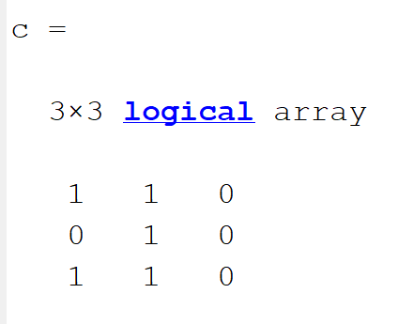
Relations
Operate on two arguments, and return a Boolean (Remember true and false are literally just 1 and 0 in MATLAB)
Equal to
==
Not equal to
~=
Greater than
>
Greater than or equal to
>=
Less than
<
Less than or equal to
<=
Logical and relational operation on matrices are always performed element-wise!

Slide 12
Logic, Comparison, and Order of Operation Examples
a = [1 2 0];
b = [3 4 5];
sum(a>=1)
a>=1 & b<4
sum(b > 2 | a) + b
(a - 2 .* b & (b < 2) + 8) .* a
(a & ~b | a + 4 * 32 & ~a & (3 * 5) + ~(a | b) + true - (b | a)) * false
Predict the output of the following (if you see something new google it!)
Do it on paper before checking in MATLAB
If you get any wrong, try breaking them down into smaller components

Slide 13
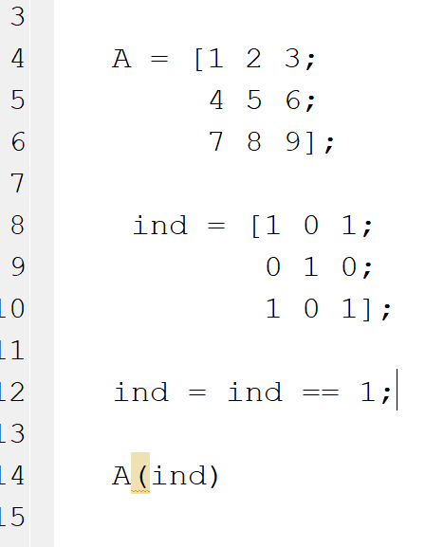
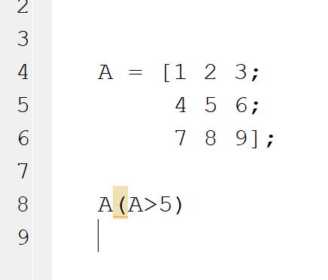
Logical and Comparison Indexing
You can index an array with an array of Booleans with the same size

Slide 14
Example
Take the A vector
A = [1 2 3;
4 5 6;
7 8 9];
Return all the values that are greater than 6 or less than or equal to 3
1) Do so without preserving the original structure
2) Do so with preserving the original structure (Equivalent to turning the false conditions to zero)

Slide 15
Results
A = [1 2 3;
4 5 6;
7 8 9];
A(A>6 | A<=3)
A .* (A>6 | A<=3)
ans =
1
7
2
8
3
9
ans =
1 2 3
0 0 0
7 8 9

Slide 16
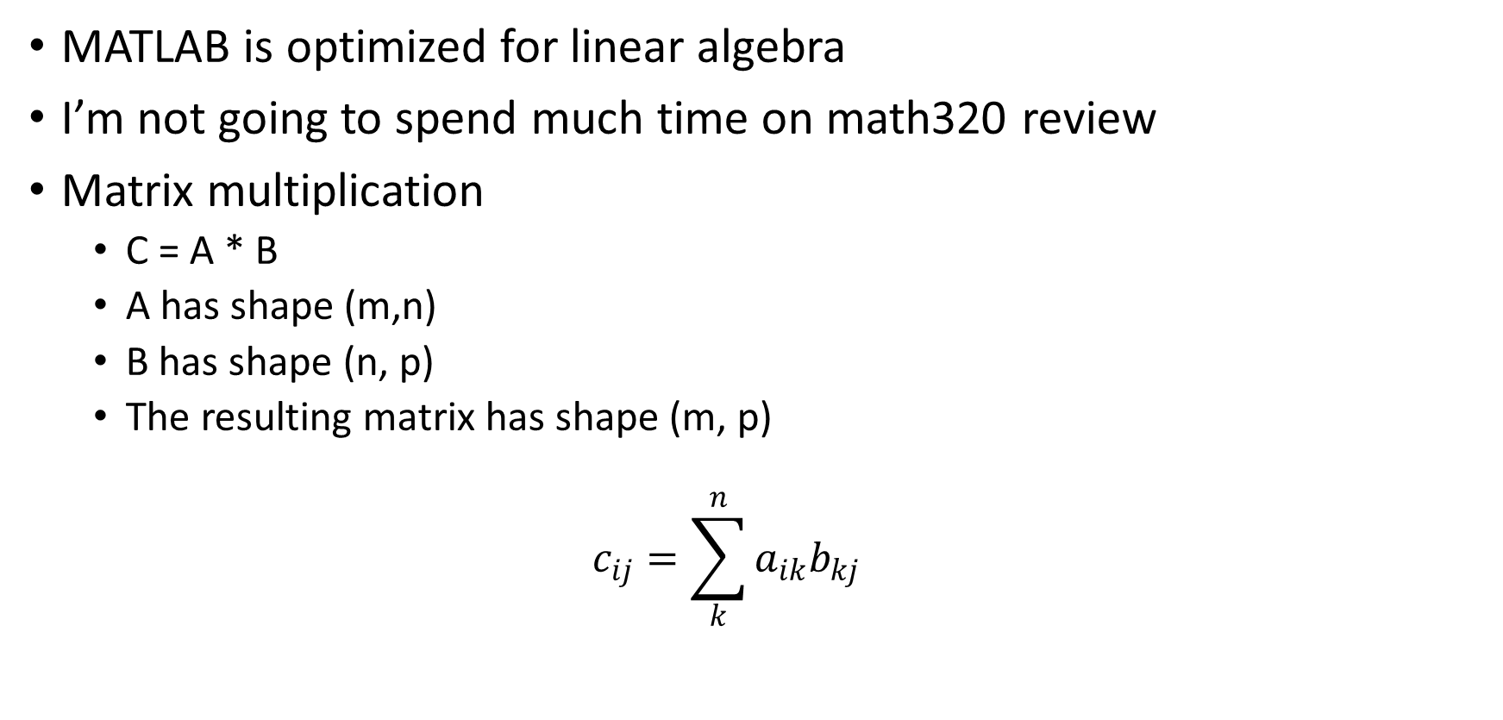
Matrix Operations
MATLAB is optimized for linear algebra
I’m not going to spend much time on math320 review
Matrix multiplication
C = A * B
A has shape (m,n)
B has shape (n, p)
The resulting matrix has shape (m, p)
$$c_{ij}=\sum_{k}^{n}{a_{ik}b_{kj}}$$

Slide 17
Solving Linear Systems of Equations
Ax = b
A(n, n)
x(n, 1)
B(n, 1)
x = A⁻¹b
Recall: Matrix division is not defined, however the MATLAB syntax:
A\b is equivalent to A⁻¹b

Slide 18

Linear System of Equations Example
x =
0.3767
-0.0516
0.1182
-0.4950
0.0826
Solve with matrix operations:
$x_{1}+2x_{2}+5x_{3}−6x_{4}+2x_{5}=4$
$4x_{1}+4x_{2}+6x_{3}−2x_{4}=3$
$11x_{1}+4x_{3}−6x_{4}+5x_{5}=8$
$x_{1}+4x_{2}+5x_{3}−1x_{4}+9x_{5}=2$
$5x_{1}+6x_{2} − 6x_{3}−6x_{4}+2x_{5}=4$

Slide 19
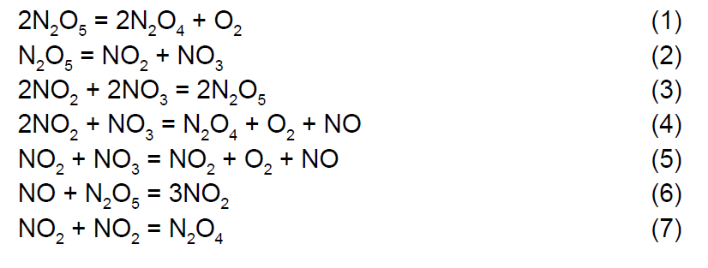
Matrix Operations for Chemical Engineering Example
νA = 0
How many independent reactions?
Math320 : How many independent equations in a system?

Slide 20
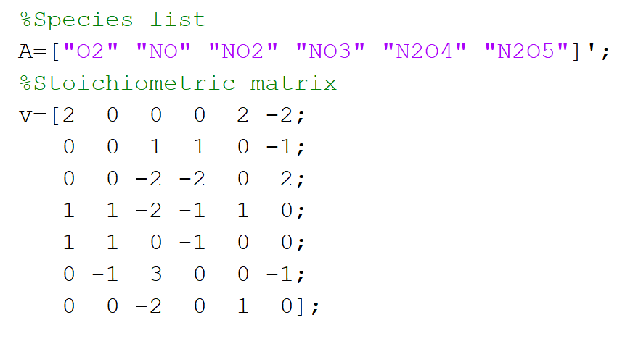
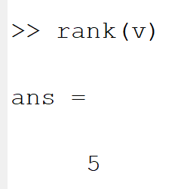

Slide 21
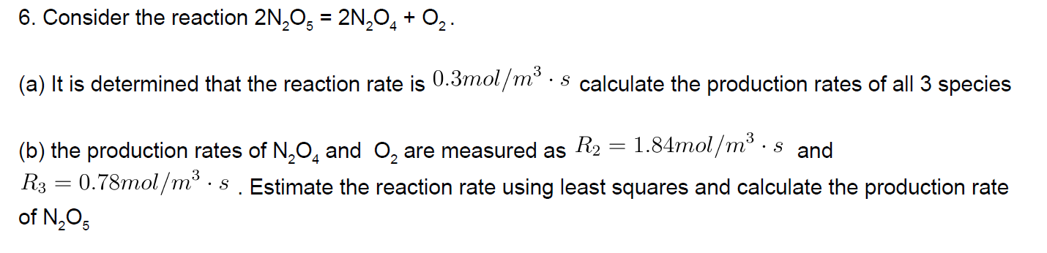


More ChE
$$Δn = ν∗ ξ$$
$$Δn \left[=\right] ξ \left[=\right] \frac{mol}{m^{3}s}$$
$ξ$ : Reaction Rate
Use this component order
A=["O2" "N2O4" "N2O5"];

Slide 22
v=[1 2 -2];
A=["O2" "N2O4" "N2O5"];
%a)
ext=0.3; %mol/(m^3*s)
dn = v * ext;
disp("A:\nProd Rates:")
disp(dn)
%b)
dn_observed = [0.78 1.84]';
vslice = v(1, 1:2);
ext_observed = vslice' \ dn_observed;
dn_approx = v * ext_observed;
dn_N2O4 = dn_approx(3);
disp("B:\nMeasured extent:")
disp(ext_observed)
disp("N2O4 Production rate:")
disp(dn_N2O4)
A: Prod Rates:
0.3000 0.6000 -0.6000
B: Measured extent:
0.8920
N2O4 Production rate:
-1.7840

Slide 23
Math Functions
log(x)
Natural log
log10(x)
Log base 10
exp(x)
e ^ x
sin(x)
cos(x)
tan(x)
sqrt(x)
Square root

Slide 24
A Bunch of Functions
X = randi([min,max],a₁,a₂,…a_{n})
Returns a matrix of random integers from min -> max of shape a₁ * a₂ * … * a_{n}
sz = size(A)
Returns a row vector whose elements are the lengths of the corresponding dimensions of A. For example, if A is a 3-by-4 matrix, then size(A) returns the vector [3 4].
I = eye(n)
I = eye(n,m)
Returns identity matrix of size n*n if only one argument, n * m if both

Slide 25
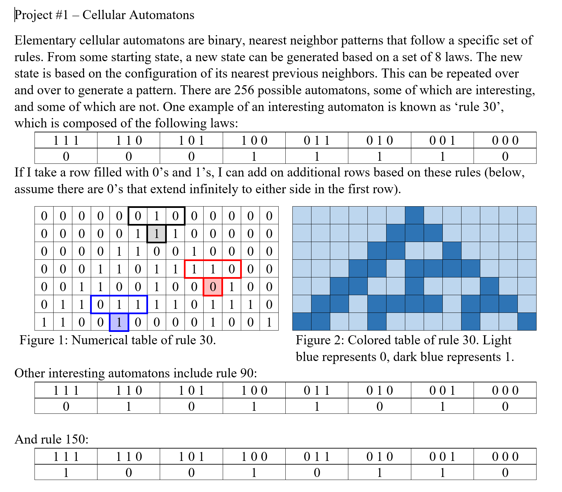
Project 1

Slide 26
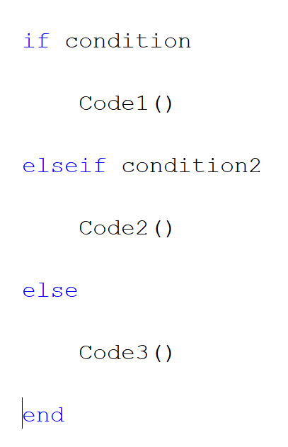
If Statements

Slide 27
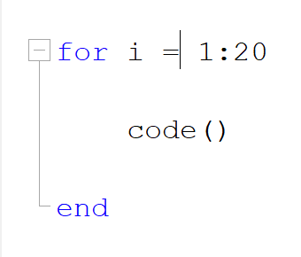
For Loop

Slide 28
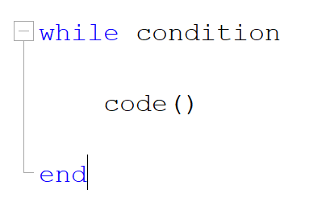
While Loop
The code must modify the condition!

Slide 29
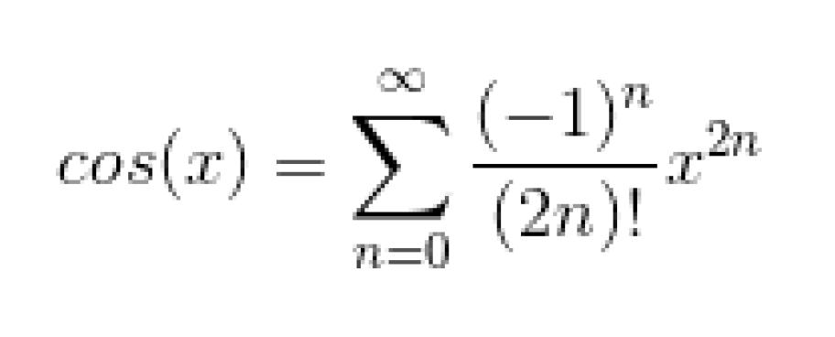
While Loop Example
Using a while loop calculate the cosine of pi/4 using the Taylor expansion below
Quit when the magnitude of the terms become less than 1E-5
What n did this occur at?

Slide 30
x = pi / 4;
% Alpha is the actual value
Alpha = cos(x);
%delta is the value of the current iteration
delta = 1; % Arbitrary value to start the loop
% n is the iteration number
n = 0;
% A is the iterative value
A = 0;
while abs(delta) >= 1E-5
delta = (-1) ^ n * x ^ (2 * n) / factorial(2 * n);
n=n+1;
A = A + delta;
end
disp(n)

