Slide 1
CBE255 Discussion 3 2/11/21
* If you are not registered for this discussion, let me know so I can send you the presentation

Slide 2
Reminders
HW2 is due tomorrow at 4 PM
Submit 1 PDF file with all the questions
Separate questions into sections (%%)
Suppress unnecessary output
SUBMIT A PDF OUTPUT FROM MATLAB (We need to see the code and output)

Slide 3
Agenda
Questions?
Project
Loops and Conditional Statements
Python!

Slide 4
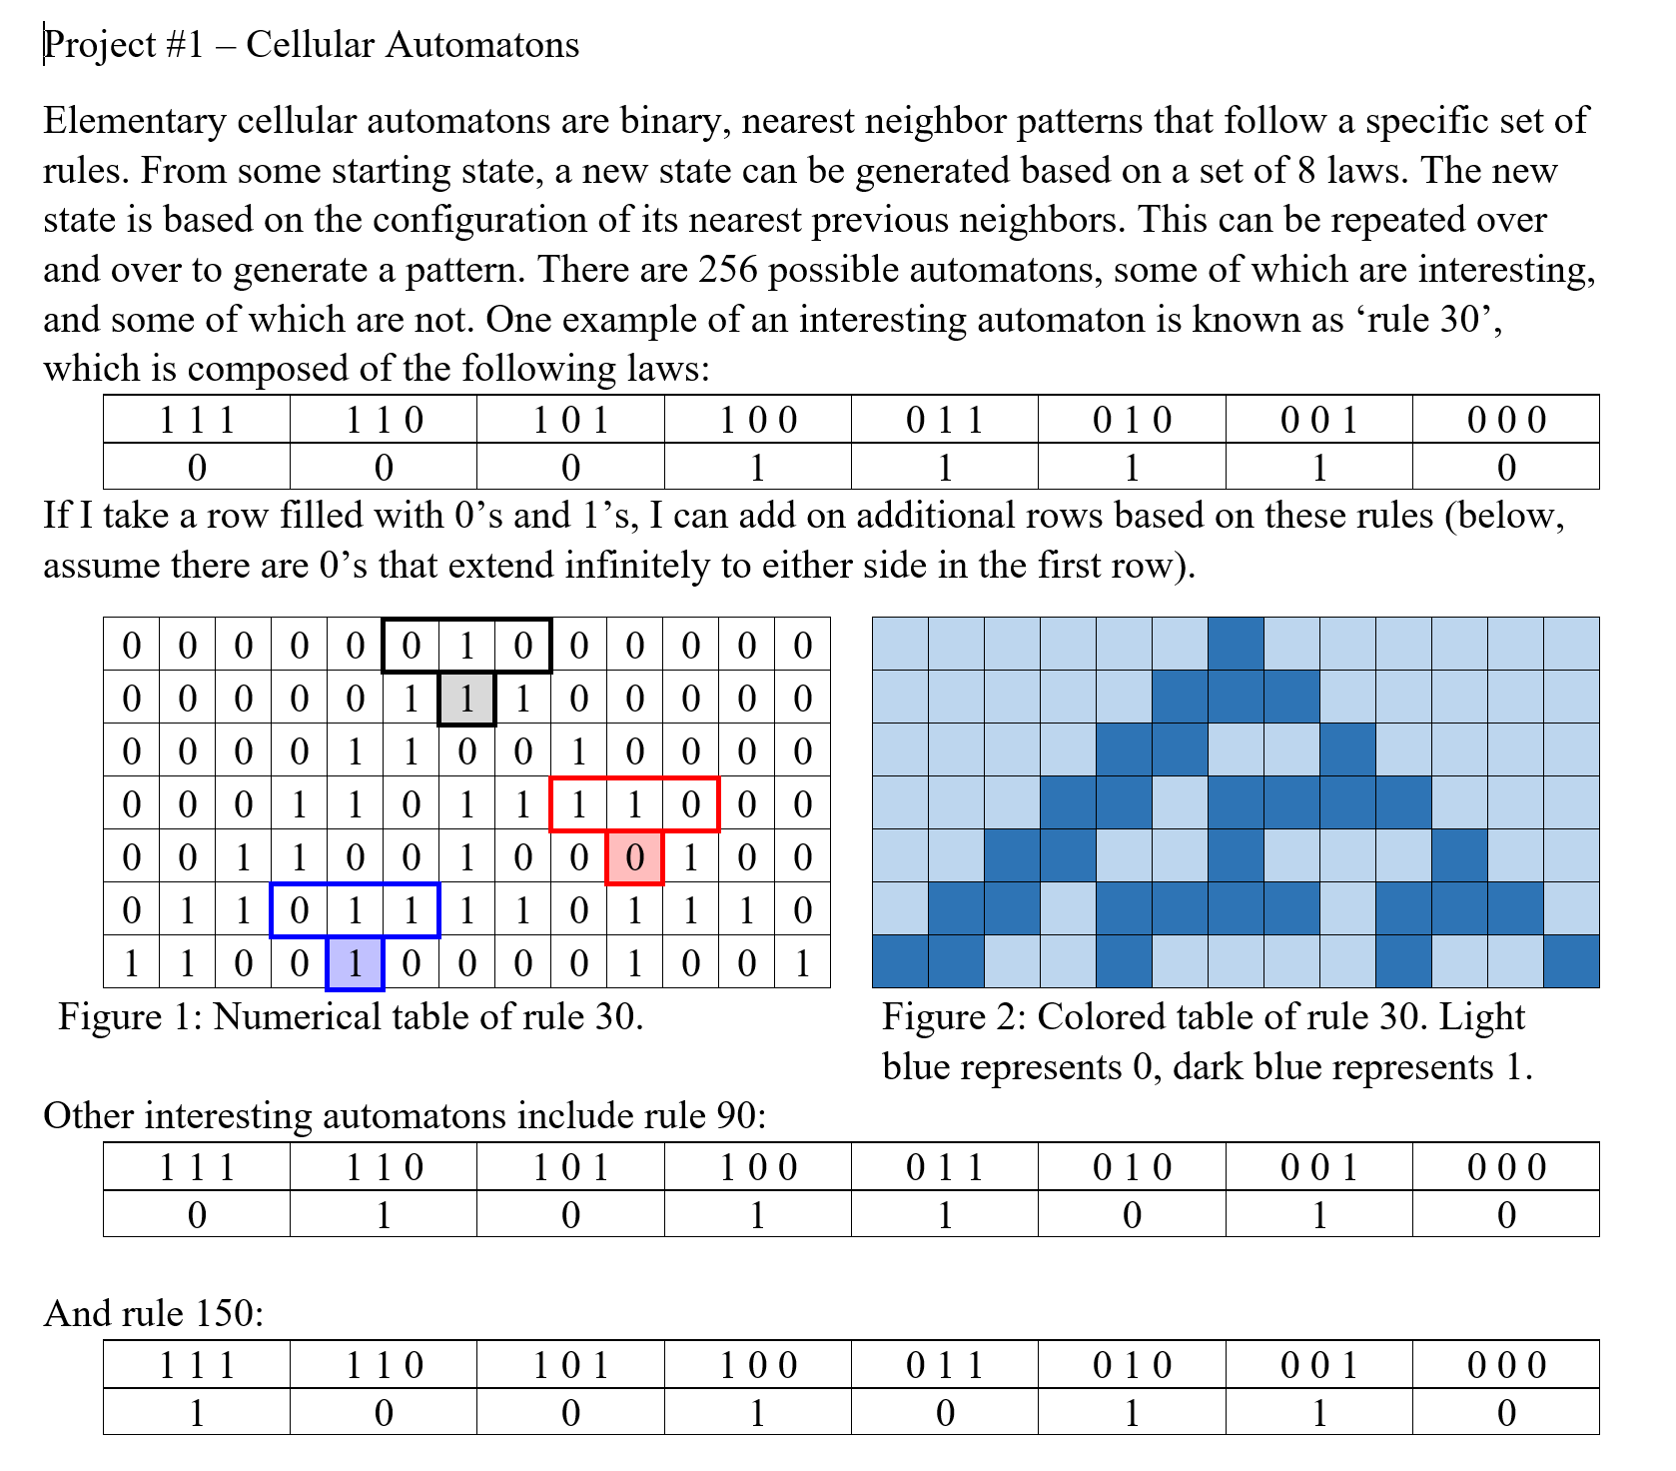
Project 1

Slide 5
Important Info For Project 1
Project 1 will be graded more harshly
You will need to use functions not from lecture
We aren’t supposed to give too much help directly
Instead: Ask a TA how to execute an idea you’re working on. We will give you insight into our processes for finding documentation
We are going to require “good” commenting/documentation
Your function should throw errors for improper inputs

Slide 6
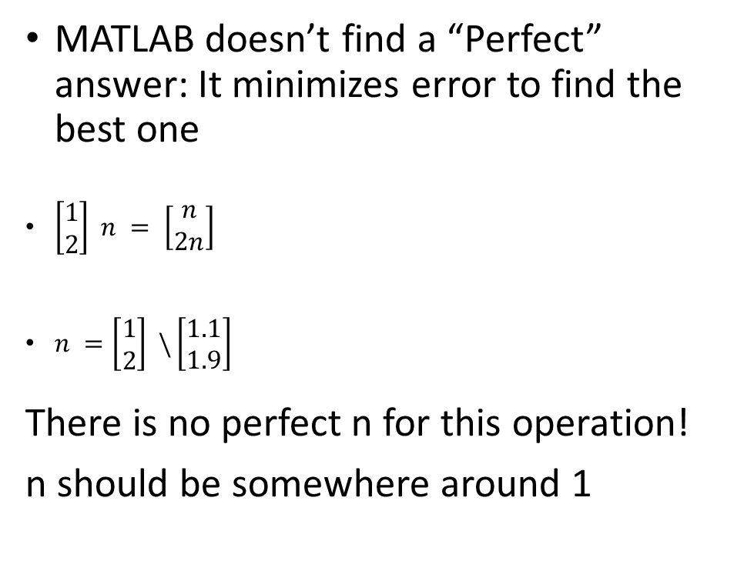
Solving Linear Systems of Equations With Matrix Functions
MATLAB doesn’t find a “Perfect” answer: It minimizes error to find the best one
$\left[\begin{matrix}1 \\ 2\end{matrix}\right] n = \left[\begin{matrix}n \\ 2n\end{matrix}\right]$
$n =\left[\begin{matrix}1 \\ 2\end{matrix}\right] \backslash \left[\begin{matrix}1.1 \\ 1.9\end{matrix}\right]$
There is no perfect n for this operation!
n should be somewhere around 1
n = [1; 2] \ [1.1; 1.9]
>> n = 0.9800

Slide 7
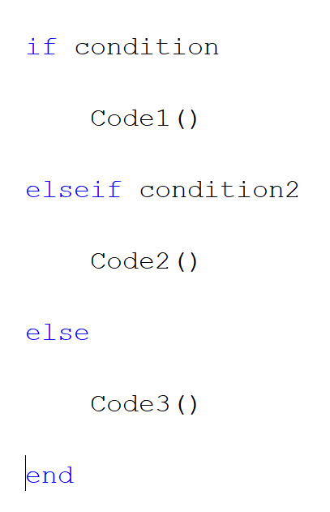
If Statements
Condition is treated as a Boolean
If condition is a matrix, there is an implied all(condition)
In MATLAB conditional statements must be ended with
“end”
In a single if conditional:
First condition is always an ‘if’
There can be any number of ‘elseif’ statements
There can only be on ‘else’ statement

Slide 8
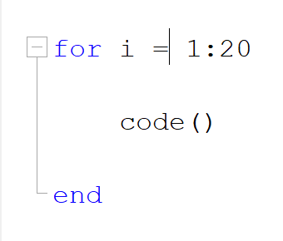
For Loop
The code block is ran through multiple times
Each iteration the ‘i’ variable switches to the next value in the iterable it is assigned to
For loops must be terminated with ‘end’

Slide 9
The Most Obnoxious For Loop & If Statement Exercise: “FizzBuzz”
“The "Fizz-Buzz test" is an interview question designed to help filter out the 99.5% of programming job candidates who can't seem to program their way out of a wet paper bag.”
Print the numbers from 1 to 100
But:
Instead of multiples of 15 print “FizzBuzz”
Instead of multiples of 3 print “Fizz”
Instead of multiples of 5 print “Buzz”

Slide 10
%%
for i = 1:100
if mod(i, 15) == 0
disp("FizzBuzz")
elseif mod(i, 5) == 0
disp("Buzz")
elseif mod(i, 3) == 0
disp("Fizz")
else
disp(i)
end
end

Slide 11
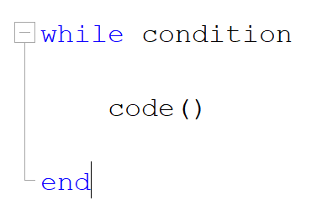
While Loop
Condition is checked
Code is executed
Condition is rechecked
If condition is still true: Code reran
If condition is now false: proceeds
The code must modify the condition!

Slide 12
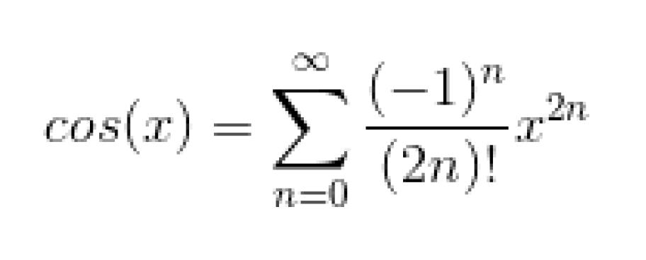
While Loop Example
Using a while loop calculate the cosine of pi/4 using the Taylor expansion below
Quit when the magnitude of the terms become less than 1E-5
What n did this occur at?

Slide 13
x = pi / 4;
% Alpha is the actual value
Alpha = cos(x);
%delta is the value of the current iteration
delta = 1; % Arbitrary value to start the loop
% n is the iteration number
n = 0;
% A is the iterative value
A = 0;
while abs(delta) >= 1E-5
delta = (-1) ^ n * x ^ (2 * n) / factorial(2 * n);
n=n+1;
A = A + delta;
end
disp(n)

Slide 14
Break and Continue
Break terminates the execution of a for or while loop. Statements in the loop after the break statement do not execute.
In nested loops, break exits only from the loop in which it occurs. Control passes to the statement that follows the end of that loop.
continue passes control to the next iteration of a for or while loop. It skips any remaining statements in the body of the loop for the current iteration. The program continues execution from the next iteration.
continue applies only to the body of the loop where it is called. In nested loops, continue skips remaining statements only in the body of the loop in which it occurs.

Slide 15
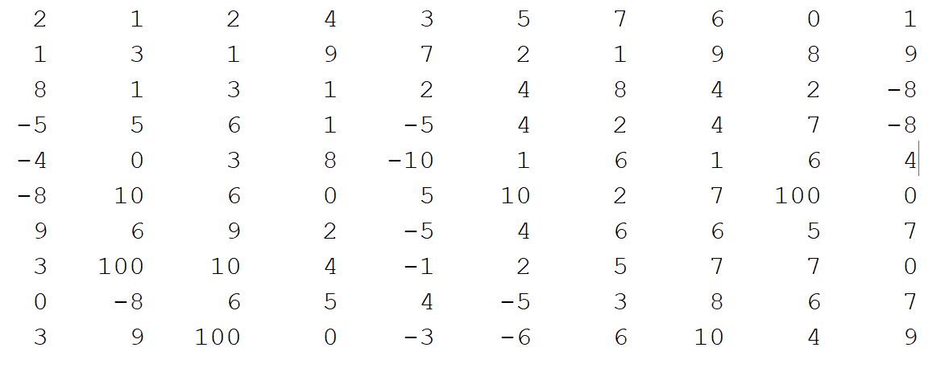
Break, Continue, For Loop Example
Loop through columns:
1. If a number is negative, make it positive
2. If a number is -5, skip the rest of the row
3. If a number is -8 leave it alone
4. If a number is -6, make it positive but also make the next number 100
Use this array to check if you got it right, but if you’re done early use a random array of integers
A = [2 1 -2 4 -3 5 7 6 0 1;
1 3 -1 -9 -7 -2 -1 9 8 -9;
8 1 -3 1 2 4 8 -4 2 -8;
-5 5 6 1 -5 4 -2 4 -7 -8;
-4 0 3 8 -10 -1 6 -1 -6 4;
-8 10 6 0 5 -10 -2 7 -2 0;
9 -6 9 -2 -5 -4 6 6 5 -7;
3 -8 10 4 -1 -2 5 -7 7 0;
0 -8 -6 5 4 -5 -3 8 6 -7;
3 -9 -8 0 -3 -6 -6 10 -4 -9];
Hints: This is supposed to be hard!
If you can’t get it all in one go, code one rule at a time
Write pseudocode if you’re struggling to write in MATLAB

Slide 16
sA = size(A); % Create a variable of A shape to avoid calling size(A) multiple times
for i = 1:sA(2) % Loop through columns
for j = 1:sA(1) % Loop through rows of each column
if A(j,i) == -5 % Breaking to the next column with a -5 is the first check!
break
elseif A(j,i) == -8 % Leaves -8 alone
continue
elseif A(j,i)<0 % Checks for negative values
if A(j,i) == -6
if j < sA(1) % What if -6 is on the bottom row?
A(j+1, i) = 100;
end
end
A(j,i) = abs(A(j,i)); % Flips sign of negatives
end
end
end
disp(A)

Slide 17
Programming Basics
Learning a New Language
Environment
Variables
Keywords
Data types
Boolean logic
Conditional statements
Loops
Functions
Syntax
Operations
Data types
Quirks

Slide 18
Python
Python is incredibly easy to learn from another language
Syntax
Attributes
Object methods
Operations
Convenient string operations
Data types
Strings, Integers, Floats, Complex, Booleans (You can figure these out!)
Lists
Tuples
Zip Objects, Dictionaries, Range, more. (Won’t cover today)
Quirks
0 based indexing
Modules, non-native data structures
List comprehension

Slide 19
Python Syntax
See “Python_Matlab_comparison.pdf” on Canvas!
Assignment is still a single equals sign
Don’t need to suppress output with a semicolon (;)
Indentation is REQUIRED in Python (if statements, for loops, while loops, etc)
Don’t use “end” keyword (return to previous indentation)
Comment with #
‘elseif’ is changed to “elif”
Use a colon after for/while loops and if statements
Functions are syntactically different (Later)

Slide 20
Modules
Python doesn’t have many native functions
For more you need modules
1
2
3
4
Imports entire “math” module, it’s functions and attributes are stored under math
Imports entire “numpy” module, it’s functions and attributes are stored under np (you can use any pseudonym you want but Python communities are strict about their naming conventions!)
Imports one function (fsolve) from the scipy module, it is NOT stored under scipy
Imports the entirety of the scipy.optimize module, functions and attributes are NOT stored under scipy.optimize
import math import numpy as np from scipy import fsolve from scipy.optimize import *

Slide 21
Module.attribute
pi = math.pi a = math.sin(pi) b = np.array([1, 2, 3])
The value pi is an attribute (float) belonging to the math module
The function sin is an attribute belonging to the math module
An array is a datatype belonging to the numpy module

Slide 22
Data Types
List
Square brackets []
Comma separates elements
There is only a single index (no second or greater dimension)
You can store ANYTHING in a list index (Even another list)
Tuple
Parentheses ()
Very similar to list
Immutable (Cannot be modified once made)

Slide 23
What about arrays/matrices?!
It is incredibly rare to need linear algebra
A list of lists is sort of like a native array
Arrays aren’t the best way to store data. Ask yourself: would you rather have a DataFrame (Think table) or define your own class?
If mathematical operations are needed: We will learn more about numpy

Slide 24
List of Lists
a = [1, 2, 3, 4, 5, 6]
a[1]
b = [[1, 2, 3], [1, 2], [1, 2, 3, 4], [1,2]]
b[2]
b[2][1]

Slide 25
A Bunch of Convenient Python Functionalities
A string is an iterable
The “in” keyword
A in B
Quick conditions
A = B if Condition else C
Code1() if Condition else Code2()
String attributes
String operations
Chained Comparisons
A <= B <= C <= D <= E
A <= B AND B <= C AND C <= D AND D <= E

Slide 26
For Loops and Understanding 0 Based Indexing
What is the output of the following
for i in range(4):
print(i)

Slide 27
For Loops and Understanding 0 Based Indexing
Python indexes go [inclusive : exclusive]
When you say range(4), it’s equivalent to range(0 -> 4)
The set of integers in [0, 4) are
0, 1, 2, 3
Python Supports negative indices
-1 – last
-2 – Second to last
etc

Slide 28
Predict Indexing Outputs
import numpy as np x = np.array([ [1, 2, 3], [4, 5, 6], [7, 8, 9] ]) A = x[3, 3] B = x[0, :] C = x[1:, 1:] D = x[1, 0:3] print(A) print(B) print(C) print(D)

Slide 29
import numpy as np x = np.array([ [1, 2, 3], [4, 5, 6], [7, 8, 9] ]) # A = x[3, 3] # IndexError: index 3 is out of bounds for axis 0 with size 3 B = x[0, :] C = x[1:, 1:] D = x[1, 0:3] #print(A) print(B) print(C) print(D)
[1 2 3]
[[5 6]
[8 9]]
[4 5 6]
Process finished with exit code 0

Slide 30
Python For Loop Example
Write a script to print the following pattern:
1
1 3
1 4 7
1 5 9 13
1 6 11 16 21
https://docs.python.org/3/library/functions.html#print

Slide 31
for i in range(5): for j in range(i+1): if i == j: end = '\n' else: end = ' ' print((i+1) * j + 1, end=end)
1
1 3
1 4 7
1 5 9 13
1 6 11 16 21

