Slide 1
CBE255 Discussion 4 2/18/21
Turner Luke
* If you are not registered for this discussion, let me know so I can send you the presentation

Slide 2
Reminders
HW 3 is due February 26 (not tomorrow)
Project 1 is due on March 5th (Get a head start!)

Slide 3
Agenda
Questions?
Python
Functions
Plotting
Time for project questions

Slide 4
Python Syntax
See “Python_Matlab_comparison.pdf” on Canvas!
Assignment is still a single equals sign
Don’t need to suppress output with a semicolon (;)
Indentation is REQUIRED in Python (if statements, for loops, while loops, etc)
Don’t use “end” keyword (return to previous indentation)
Comment with #
‘elseif’ is changed to “elif”
Use a colon after for/while loops and if statements
Functions are syntactically different (Later)

Slide 5
Modules
Python doesn’t have many native functions
For more you need modules
1
2
3
4
Imports entire “math” module, it’s functions and attributes are stored under “math”
Imports entire “numpy” module, it’s functions and attributes are stored under np (you can use any pseudonym you want but Python communities are strict about their naming conventions!)
Imports one function (fsolve) from the scipy module, it is NOT stored under scipy
Imports the entirety of the scipy.optimize module, functions and attributes are NOT stored under scipy.optimize
import math import numpy as np from scipy import fsolve from scipy.optimize import *

Slide 6
Module.attribute
pi = math.pi a = math.sin(pi) b = np.array([1, 2, 3])
The value pi is an attribute (float) belonging to the math module
The function sin is an attribute belonging to the math module
An array is a datatype belonging to the numpy module

Slide 7
Data Types
List
Square brackets []
Comma separates elements
There is only a single index (no second or greater dimension)
You can store ANYTHING in a list index (Even another list)
Tuple
Parentheses ()
Very similar to list
Immutable (Cannot be modified once made)
A lot more!

Slide 8
What about arrays/matrices?!
It is incredibly rare to need linear algebra
A list of lists is sort of like a native array
Arrays aren’t the best way to store data. Ask yourself: would you rather have a DataFrame (think: table) or define your own class?
If mathematical operations are needed -> numpy

Slide 9
List of Lists
a = [1, 2, 3, 4, 5, 6]
a[1]
b = [[1, 2, 3], [1, 2], [1, 2, 3, 4], [1,2]]
b[2]
b[2][1]

Slide 10
A Bunch of Convenient Python Functionalities
A string is an iterable
The “in” keyword
A in B
Quick conditions
A = B if Condition else C
Code1() if Condition else Code2()
String attributes
String operations
Chained Comparisons
A <= B <= C <= D <= E
A <= B AND B <= C AND C <= D AND D <= E

Slide 11
For Loops and Understanding 0 Based Indexing
What is the output of the following
for i in range(4):
print(i)

Slide 12
For Loops and Understanding 0 Based Indexing
Python indexes go [inclusive : exclusive]
When you say range(4), it’s equivalent to range(0, 4)
The set of integers in [0, 4) are
0, 1, 2, 3
Python Supports negative indices
-1 – last
-2 – Second to last
etc

Slide 13
Predict Indexing Outputs
import numpy as np x = np.array([ [1, 2, 3], [4, 5, 6], [7, 8, 9] ]) A = x[3, 3] B = x[0, :] C = x[1:, 1:] D = x[1, 0:3] print(A) print(B) print(C) print(D)

Slide 14
import numpy as np x = np.array([ [1, 2, 3], [4, 5, 6], [7, 8, 9] ]) # A = x[3, 3] # IndexError: index 3 is out of bounds for axis 0 with size 3 B = x[0, :] C = x[1:, 1:] D = x[1, 0:3] #print(A) print(B) print(C) print(D)
[1 2 3]
[[5 6]
[8 9]]
[4 5 6]

Slide 15
Python For Loop Example
Write a script to print the following pattern:
1
1 3
1 4 7
1 5 9 13
1 6 11 16 21
https://docs.python.org/3/library/functions.html#print

Slide 16
for i in range(5): for j in range(i+1): if i == j: end = '\n' else: end = ' ' print((i+1) * j + 1, end=end)
1
1 3
1 4 7
1 5 9 13
1 6 11 16 21

Slide 17
Functions
MATLAB
function [y1,...,yN] = myfun(x1,...,xM)
code() % Calc y1-yN
end
Functions MUST be defined at the end of a script
Anonymous Function
myfun = @(x1) code()
Python
def myfun(x1,…,xM):
code() # Calc y1-yN
return y1,…,yN
You can return different things based on conditions!
Functions MUST be defined before being used
Lambda Function
myfun = lambda x1 : code()

Slide 18
Python Functions Have Many More Functionalities!
Default Parameter Values
def function(a, b = val1, c = val2)
a is a positional argument and needs to accept an argument
b and c are positional but do not need an argument
Arbitrary Arguments
def function(a, b, c, *args)
The * allows for any number of arguments
Extra arguments are passed as a tuple called args
Keyword Arguments
def function(a, b, c, **kwargs)
Not going to cover

Slide 19
Python Function Example :Default Parameters
Predict the output of these functions
def fun(a, b, c=2, d=3): print(a + b*c + d**2)
fun(1, 2) fun(1, c=3) fun(2, 2, 3) fun(1, 1, 2, 1) fun(2, d=2, 3) fun(2, 3, d=2, c=1)

Slide 20
def fun(a, b, c=2, d=3): print(a + b*c + d**2) fun(1, 2) # 14 # fun(1, c=3) # TypeError: fun() missing 1 required positional argument: 'b' fun(2, 2, 3) # 17 fun(1, 1, 2, 1) # 4
#fun(2, d=2, 3) # SyntaxError: positional argument follows keyword argument fun(2, 3, d=2, c=1) # 9

Slide 21
Python Function Example : “Perfect Numbers”
In number theory, a perfect number is a positive integer that is equal to the sum of its proper positive divisors, that is, the sum of its positive divisors excluding the number itself (also known as its aliquot sum).
Write a function that tells the user if an integer passed is a “Perfect Number”
Perfect numbers: 6, 28, 496, 8128
Hints :
Remember Python indexes [inclusive, exclusive]
Modulo operator (%) returns the remainder
Indentation and colons (:)

Slide 22
def perfect_number(z): sum = 0 for i in range(1, z): if z % i == 0: sum += i if sum == z: return "This is a perfect number" else: return "This is not a perfect number" print(perfect_number(6))

Slide 23
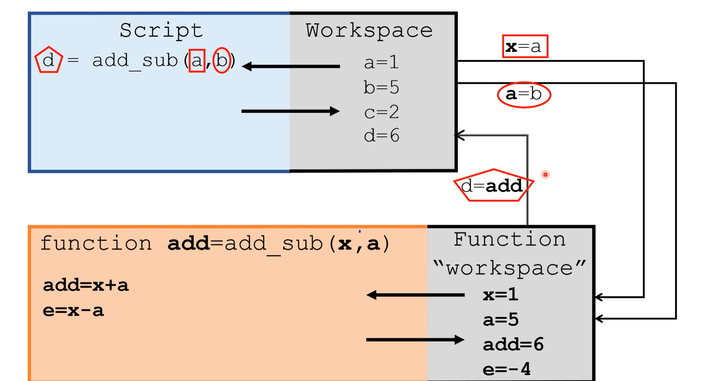
Variable Scope
From Dr. Dahlke’s tutorial 3_10_1

Slide 24
Variable Scope
In MATLAB, if you don’t need to pass something to a function but want to use it, you need to declare that variable global
a = 3;
y = add_a(3);
function y = add_a(x)
global a
y = a + x;
end
In Python if a variable is not defined in a function scope it will check the global scope and use it
Python communities consider using the “global” keyword to be a bad practice!
def add_a(x): return a + x a = 3 y = add_a(x)

Slide 25
Plotting in MATLAB vs Python
MATLAB
Python
All plotting functionalities are native to MATLAB
Plotting functionalities belong to “matplotlib.pyplot” module
By convention matplotlib.pyplot is imported as plt
Matplotlib is designed to be similar to MATLAB plotting
Need to show the plot after creation
plt.show()

Slide 26
A Bunch of MATLAB Plotting Functions
plot(X1,Y1,LineSpec1,...,Xn,Yn,LineSpecn)
fplot
subplot(m,n,l)
xlim([low,high])
ylim([low,high])
axis([xlow,xhigh,ylow,yhigh])
xlabel(‘xstring’)
ylabel(‘ystring’)
title(‘titlestring’)
legend(label1,label2,…,labelN)

Slide 27
Quick Python Plot
Plot y = x * sin(1/x)
0 < x <= pi/12
Increase the number of points in linspace to make the plot look better
Play with line formatting

Slide 28
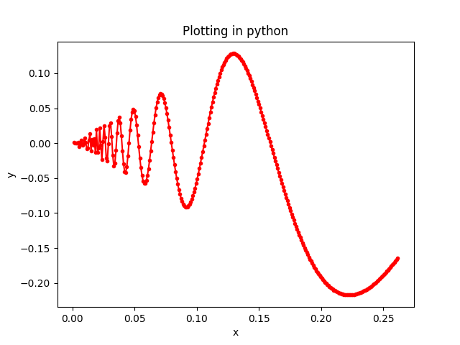
import numpy as np import matplotlib.pyplot as plt x = np.linspace(.001, np.pi / 12, num=300) y = x * np.sin(1/x) plt.plot(x, y, 'r-o', markersize=3) plt.xlabel("x") plt.ylabel("y") plt.title("Plotting in python") plt.show()

Slide 29
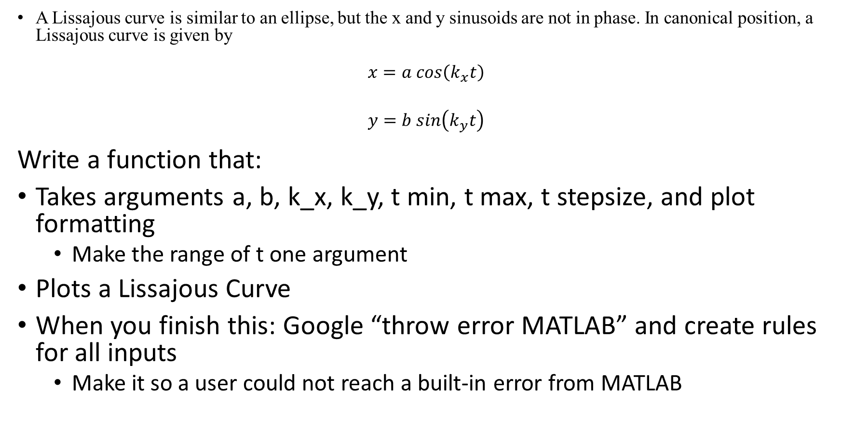
MATLAB Plotting Example : Lissajous Curve
A Lissajous curve is similar to an ellipse, but the x and y sinusoids are not in phase. In canonical position, a Lissajous curve is given by
$$x=a cos\left(k_{x}t\right)$$
$$y=b sin\left(k_{y}t\right)$$
Write a function that:
Takes arguments a, b, k_x, k_y, t min, t max, t stepsize, and plot formatting
Make the range of t one argument
Plots a Lissajous Curve
When you finish this: Google “throw error MATLAB” and create rules for all inputs
Make it so a user could not reach a built-in error from MATLAB

Slide 30
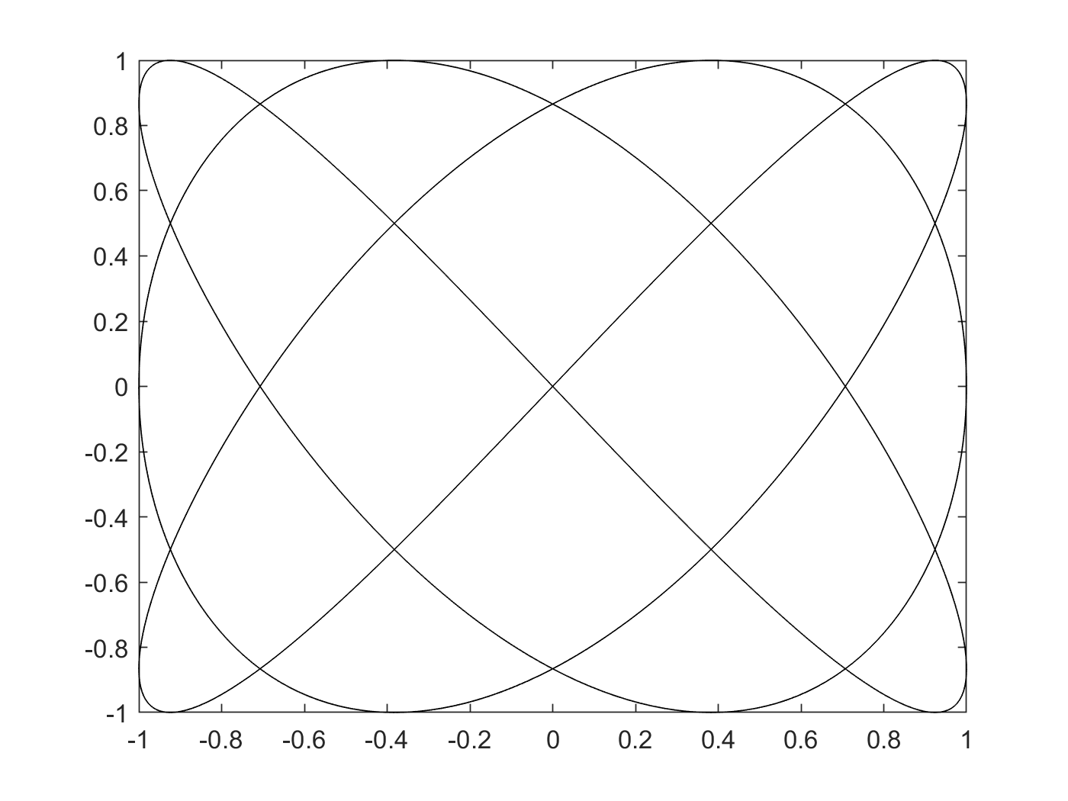
Lissajous(1, 1, 3, 4, [0,10], .01, 'k-')
function [] = Lissajous(a, b, k_x, k_y, t_range, step, lf)
% Lissajous Creates a Lissajous plot provided required values
% Check for errors
if ~(class(a) == 'double')
error("Type Error: a must be a scalar.")
end
if size(t_range) ~= [1,2]
error("Size Error: t_range must be size [1,2]")
end
if ~strcmp(class(ls), 'char') && ~strcmp(class(ls), 'string')
error('Type Error: ls must be a string')
end
% Create the plotting vector of t
t = t_range(1) : step : t_range(2);
% Calculate x and y
x = a * cos(k_x * t);
y = b * sin(k_y * t);
% Plot the results
plot(x, y, lf)
end

