Slide 1
CBE255 Discussion 5 2/25/21
Turner Luke
* If you are not registered for this discussion, let me know so I can send you the presentation

Slide 2
Reminders
HW 3 is due tomorrow (Feb 26)
Project 1 is due on March 5th

Slide 3
Agenda
Questions?
String Formatting
Function Clarifications
Function Examples
Data Importing
Data Importing Example (MATLAB & Python)
Data Exporting

Slide 4
Project 1 Errors
Last time we used error() to throw a custom error string
In your project we don’t want you to terminate your program early if unnecessary
Instead use the disp() function with some conditions to inform the user when their inputs don’t work but you still want to proceed
Error messages:
You should anticipate the user inputting the wrong things. If the user inputs something silly, like rule -42, you should display an error message that states that the rule number is incorrect for excellence. For minimally acceptable, you can have a generic error message that can be displayed if any of the inputs are wrong ("You have an input that is not allowed")

Slide 5
String Formatting
We want a better way to report values than the disp() or print() functions
MATLAB
Format data to text output
fprintf(“formatSpec”,A1,…,An)
A1,…,An : The arguments to be formatted to the “formatSpec” string
formatSpec : A string containing “instructions” on what to print
Python
Option 1 : The modulus operator on strings (%)
“formatSpec” % (A1, A2,…, An)
Option 2 : the .format() string method
“formatSpec”.format(A1,A2,…An)

Slide 6
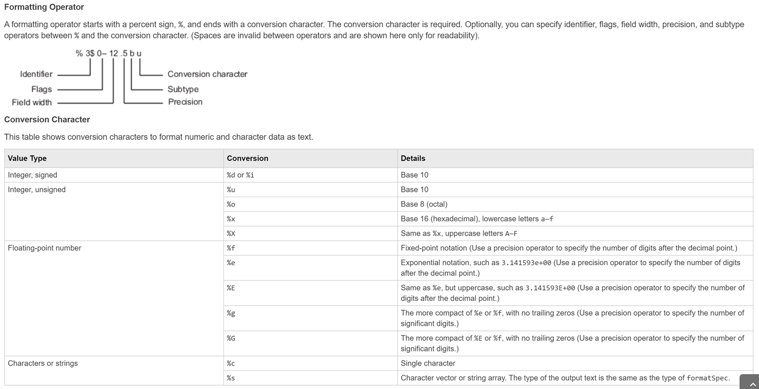
% - formatting
https://www.mathworks.com/help/matlab/ref/fprintf.html
MATLAB fprintf and the python modulo(%) operation are the same

Slide 7
% - formatting continued
MATLAB
fprintf(“formatSpec”,A1,…,An)
Returns and prints the formatted string (You don’t have to assign a variable to the formatted string if you only want to print)
sprintf(“formatSpec”,A1,…,An)
Only returns the formatted string
Python
“formatSpec” % (A1,…,An)
% is an operator (like +,-,*,&,!=,==,**, etc)
There is no logical use for the remainder of division of a string, so % formats a string when it’s first argument is a string and the second is a list/tuple with the same number of elements as %’s in the formatSpec string

Slide 8
% formatting
fprintf(“The pressure was observed to be %f MPA”, P)
print(“The pressure was observed to be %f” % (P) )
Precision Specification
fprintf(“The pressure was observed to be %.3f MPA, P)

Slide 9
Python .format() string method
{} is the formatting identifier instead of %
In order
Repeated
Using variable names
my_string = "a is {}\nb is {}\nc is {}".format(a, b, c)
my_string = "a is {0}\nb is {1}\na is still {0}".format(a, b)
my_string = f"a is {a}\nb is {b}\nc is {c}\n"

Slide 10
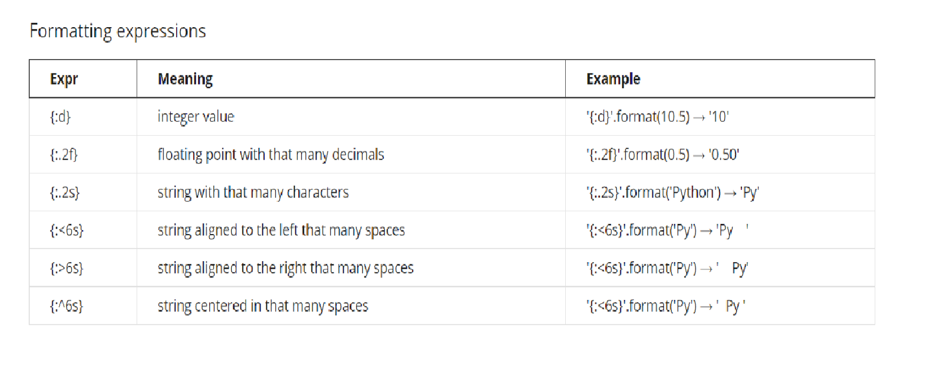
Python .format() string method continued
This is not everything!
https://kapeli.com/cheat_sheets/Python_Format_Strings.docset/Contents/Resources/Documents/index

Slide 11
String Formatting Example
In your language of choice print:
Pi with 5 sig figs
The speed of light in exponential form with 4 sig figs
Your age as an integer
Your age as a binary number
A string of the most recent book you read

Slide 12
from numpy import pi C = 299792458 age = 22 book = "Crime and Punishment" print("pi is approximately : {:.5g}\n" "The speed of light is {:.3E}\n" "I am {:g} years old, which is {:b} in binary.\n" "The most recent book I read was {}.".format(pi, C, age, age, book))
pi is approximately : 3.1416
The speed of light is 2.998E+08
I am 22 years old, which is 10110 in binary.
The most recent book I read was Crime and Punishment.
C = 299792458;
age = 22;
book = "Crime and Punishment";
fprintf("pi is approximately %.4f\nThe speed of light is %.4E\nI am %i years old, which is %s in binary.\nThe most recent book I read was %s.\n", pi, C, age, dec2bin(age), book);
pi is approximately 3.1416
The speed of light is 2.9979E+08
I am 22 years old, which is 10110 in binary.
The most recent book I read was Crime and Punishment.

Slide 13
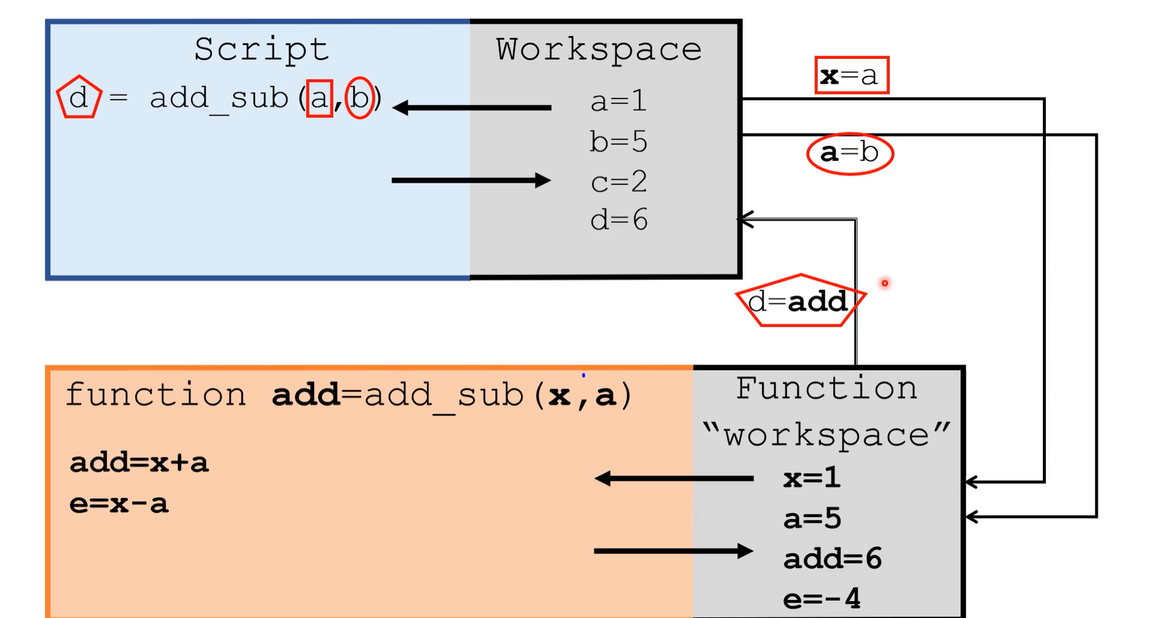
Variable Scope
From Dr. Dahlke’s tutorial 3_10_1

Slide 14
A simple function
def exponent(number, power): result = number ** power return result c = exponent(2, 3)

Slide 15
Scope Question
What is the output of this script?
def func(a, b): return a ** b a = 2 b = 3 c = func(b, a) print(c)

Slide 16
Script Workspace
Function Workspace
def func(a, b): result = a**b return result
a = 2 b = 3 c = func(b, a)
print(c)
Assign the first argument passed to the variable “a”
Assign the second argument passed to the variable “b”
a = 3
b = 2
Calculate “result”
Result = 9
Return result

Slide 17
Functions are for Repeating Code!
Write a function that :
Creates a multiplication table from the inputs - column , row , and remove_evens
Colums is the integer number of columns
Row is the integer number of rows
Remove_evens is a Boolean instructing if you should remove even values from your table
Call this function multiple times with different variable names
Call this function with random inputs

Slide 18
import numpy as np import random def multiplication_table_creator(col, row, remove_evens=False): rows = np.array([np.arange(1, row+1)]).T cols = np.arange(1, col+1) tab = rows * cols if remove_evens: tab[tab%2==0] = 0 return tab a = 3 b = 5 rem = True table1 = multiplication_table_creator(a, b, rem) Q = 34 P = 12 table2 = multiplication_table_creator(Q, P) Z = random.randint(0, 12) Y = random.randint(7, 9) table3 = multiplication_table_creator(Z, Y, True)

Slide 19
Reading Data from Excel and Text/CSV files
MATLAB
A = readmatrix(filename)
Python
“pandas” module
A = pandas.read_excel(‘name’)
https://pandas.pydata.org/pandas-docs/stable/reference/api/pandas.read_excel.html

Slide 20
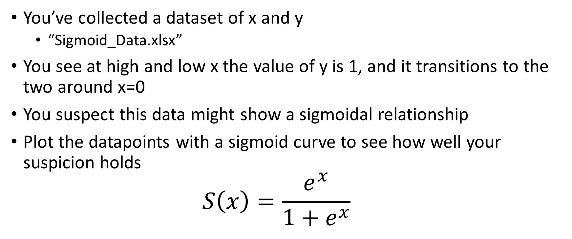
Reading Data Example
You’ve collected a dataset of x and y
“Sigmoid_Data.xlsx”
You see at high and low x the value of y is 1, and it transitions to the two around x=0
You suspect this data might show a sigmoidal relationship
Plot the datapoints with a sigmoid curve to see how well your suspicion holds
$$S\left(x\right)=\frac{e^{x}}{1+e^{x}}$$

Slide 21
MATLAB
A = readmatrix(“sigmoid_data.xlsx");
xdata = A(:,2);
ydata = A(:,3);
xplt = min(xdata): .01 : max(xdata);
yplt = exp(xplt) ./ (1 + exp(xplt));
plot(xdata, ydata, 'r.', xplt, yplt, 'b')

Slide 22
Python
import numpy as np import matplotlib.pyplot as plt import pandas as pd dat = pd.read_excel("sigmoid_data.xlsx") ydat = dat['y'] xdat = dat['x'] xplt = np.linspace(xdat.min(), xdat.max(), num=100) yplt = np.exp(xplt) / (1 + np.exp(xplt)) plt.plot(xdat, ydat, 'r.', xplt, yplt, 'b-') plt.show()

Slide 23
Writing Data to Excel, Text, CSV, etc.
MATLAB
writematrix(A, filename)
Python
df.to_excel(“Filename.xlsx”)
“df” is a pandas dataframe
.to_excel is a method belonging to the dataframe datastructure

Slide 24
Writing Data Example
Create a fake dataset (like I did for the sigmoid function)
Calculate a perfect function and introduce noise with random deviation
Write the result to an excel file

Slide 25
How I Created the Fake Sigmoid Dataset:
import numpy as np import pandas as pd import matplotlib.pyplot as plt x = np.linspace(-20, 20, num=100) y = np.exp(x) / (np.exp(x) + 1) y += np.random.uniform(-.1, .1, y.shape) plt.plot(x, y) plt.show() df = pd.DataFrame({'x': x, 'y': y}) df.to_excel("Sigmoid_Data.xlsx")

