Slide 1
CBE255 Discussion 6 3/4/21
Turner Luke
* If you are not registered for this discussion, let me know so I can send you the presentation

Slide 2
Reminders
Project 1 and Homework 4 due tomorrow

Slide 3
Agenda
Questions?
Interpolation
Python

Slide 4
1-D Interpolation
Your x dataset MUST be monotonic
MATLAB
yq = interp1(x, y, xq, ‘method’)
Python
np.interp(xq, x, y)
scipy.interpolate.interp1d(x, y, ‘method’)
Returns a function y(xq)

Slide 5
2-D Interpolation
X and Y must be monotonic
MATLAB
zq = interp2(x, y, z, xq, yq)
X is a vector of size (n,)
Y is a vector of size (m,)
Z is an array of the size (m, n) with indices (y, x)
Python
scipy.interpolate.interp2d(x, y, z, kind)
Returns a function z(x, y)

Slide 6

Interpolation Methods
‘linear’
$$\frac{y−y_{0}}{x−x_{0}}=\frac{y_{1}−y_{0}}{x_{1}−x_{0}}$$
$$y=y_{0}+\frac{y_{1}−y_{0}}{x_{1}−x_{0}}(x−x_{0})$$
‘nearest’
‘cubic’
‘makima’
‘spline’

Slide 7
Example : Understanding Interpolation Methods
Using the following dataset:
Prepare a nice-looking graph with as many interpolation methods displayed on it.

Slide 8
import numpy as np from scipy.interpolate import interp1d import matplotlib.pyplot as plt x = [1, 3, 4, 5, 6, 8, 9] y = [1, 5, 3, 3, 5, 7, 8] xplt = np.linspace(min(x), max(x), num=200) types = ['linear', 'zero', 'quadratic', 'cubic', 'previous', 'next', 'nearest'] y_types = [] for type_i in types: y_types.append(interp1d(x, y, type_i)(xplt)) styles = [':', '-', '-', '-', ':', ':', ':'] plt.plot(x, y, 'r.', markersize=20) for y_i, style in zip(y_types, styles): plt.plot(xplt, y_i, style) types.insert(0, "Data") plt.legend(types) plt.show()

Slide 9
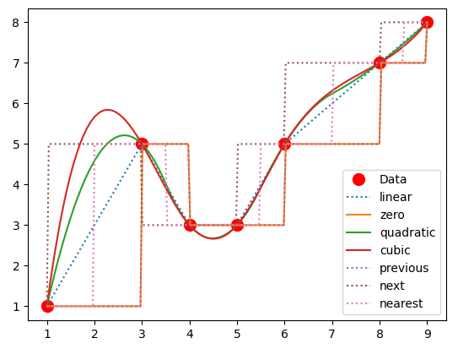

Slide 10
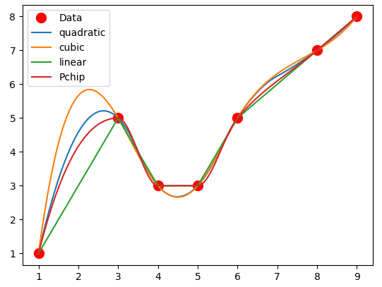
Should Data Interpolations Be Monotonic?
import numpy as np from scipy.interpolate import interp1d, PchipInterpolator import matplotlib.pyplot as plt x = [1, 3, 4, 5, 6, 8, 9] y = [1, 5, 3, 3, 5, 7, 8] xplt = np.linspace(min(x), max(x), num=200) types = ['quadratic', 'cubic', 'linear'] y_types = [] for type_i in types: y_types.append(interp1d(x, y, type_i)(xplt)) y_types.append(PchipInterpolator(x, y)(xplt)) plt.plot(x, y, 'r.', markersize=20) for y_i in y_types: plt.plot(xplt, y_i, '-') types.insert(0, "Data") types.append("Pchip") plt.legend(types) plt.show()

Slide 11
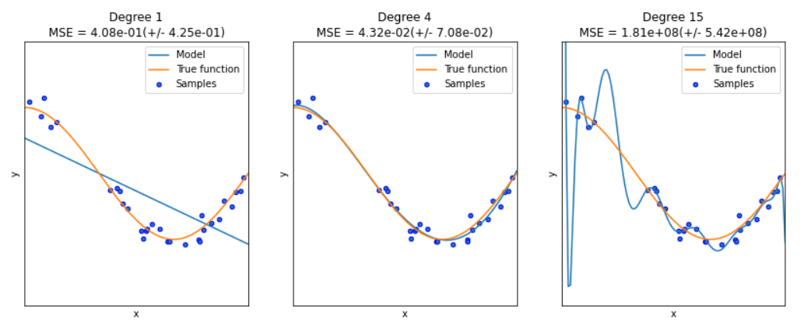
Use Your Best Judgement When Choosing a Model!

Slide 12
Interpolation Problem
You are running an endothermic batch reaction
The heat is supplied to this reaction by condensing pressurized steam
The reaction proceeds at a rate proportional to the temperature
Pressurized steam costs money
You can’t buy pressurized steam on a gradient
You have to buy the next highest pressure of steam and let it depressurize through a valve
The cost of pressurized steam has been calculated per run (no need to worry about condensation etc)
Your time is valuable
The reactor could be making $50/hour for the company elsewhere
Use linear interpolations where appropriate
The product degrades above 200°C
Answer:
The ideal pressure to run this reaction is 79.929 MPa
It will cost $187.56 per run

Slide 13
Data
Pressure vs Boiling Temperature
P_PTdata = [1, 5, 10, 50, 100, 300, 500, 700, 1000] # kPa
T_PTdata = [6.97, 32.87, 45.81, 81.32, 99.61, 133.52, 151.83, 164.95, 179.88] # degC
Temperature vs Time of Reaction
T_Ttdata = [5, 50, 70, 90, 100, 150, 175, 200] # degC
t_Ttdata = [1000, 202.3, 183.2, 150.5, 129.8, 102.4, 85.6, 59.2] # minutes
Pressure of Steam vs Cost (of entire run)
P_Pcdata = [20, 50, 100, 500, 1000] # kPa
c_Pcdata = [10, 80, 170, 800, 1800] # $/run

Slide 14

Method
Guess P
“Guess” P
The temperature can be interpolated from P
The time can be interpolated from T
The cost can be calculated from t and interpolated from P
Therefore, after guessing a pressure the cost is fully specified
Performing this calculation a multitude of times across the pressure range can allow you to find the minimum price
This is called “brute forcing”
Answer :
The ideal pressure to run this reaction is 79.929 MPa
It will cost $187.56 per run
T(P)
t(T)
C(t,P) -> C(P)

Slide 15
Python
import numpy as np from scipy.interpolate import interp1d P_PTdata = [1, 5, 10, 50, 100, 300, 500, 700, 1000] # kPa T_PTdata = [6.97, 32.87, 45.81, 81.32, 99.61, 133.52, 151.83, 164.95, 179.88] # degC T_Ttdata = [5, 50, 70, 90, 100, 150, 175, 200] # degC t_Ttdata = [1000, 202.3, 183.2, 150.5, 129.8, 102.4, 85.6, 59.2] # minutes P_Pcdata = [20, 50, 100, 500, 1000] # kPa c_Pcdata = [10, 80, 170, 800, 1800] # $/run T_of_P = interp1d(P_PTdata, T_PTdata, 'linear', fill_value='extrapolate') t_of_T = interp1d(t_Ttdata, T_Ttdata, 'linear', fill_value='extrapolate') c_of_P = interp1d(c_Pcdata, P_Pcdata, 'next', fill_value='extrapolate') P_vec = np.linspace(min(P_PTdata), max(P_PTdata), num=10000) T_vec = T_of_P(P_vec) t_vec = t_of_T(T_vec) cost_of_steam = c_of_P(P_vec) cost_of_time = t_vec * 50 / 60 # 60 minutes/hr total_cost = cost_of_time + cost_of_steam min_cost = min(total_cost) best_run = total_cost == min_cost best_pressure = P_vec[best_run][0] print("The ideal pressure to run this reaction is {:.5} MPa\n" "It will cost ${:.5} per run".format(best_pressure, min_cost))
The ideal pressure to run this reaction is 79.929 MPa
It will cost $187.56 per run

Slide 16
MATLAB
P_PTdata = [1, 5, 10, 50, 100, 300, 500, 700, 1000]; % kPa
T_PTdata = [6.97, 32.87, 45.81, 81.32, 99.61, 133.52, 151.83, 164.95, 179.88]; % degC
T_Ttdata = [5, 50, 70, 90, 100, 150, 175, 200]; % degC
t_Ttdata = [1000, 202.3, 183.2, 150.5, 129.8, 102.4, 85.6, 59.2]; % minutes
P_Pcdata = [20, 50, 100, 500, 1000]; % kPa
c_Pcdata = [10, 80, 170, 800, 1800]; % $/run
T_of_P = @(P) interp1(P_PTdata, T_PTdata, P,'linear');
t_of_T = @(T) interp1(t_Ttdata, T_Ttdata, T, 'linear');
c_of_P = @(P) interp1(c_Pcdata, P_Pcdata, P, 'next');
P_vec = linspace(min(P_PTdata), max(P_PTdata), 10000);
T_vec = T_of_P(P_vec);
t_vec = t_of_T(T_vec);
cost_of_steam = c_of_P(P_vec);
cost_of_time = t_vec * 50 / 60; % 60 minutes/hr
total_cost = cost_of_time + cost_of_steam;
min_cost = min(total_cost);
best_run = total_cost == min_cost;
best_pressure = P_vec(best_run);
fprintf("The ideal pressure to run this reaction is %.3f MPa\nIt will cost $%.2f per run",best_pressure, min_cost)
The ideal pressure to run this reaction is 79.929 MPa
It will cost $187.56 per run>>

Slide 17
Convenient Python Objects: Dictionary
A = myDictionary["Second"] print(A)
myDictionary = { "First": 1, "Second": 2, "Last": 3 }
Dictionaries are indexed with their keys
>> 2
Dictionaries are created with {}, consisting of “Key”: value,

Slide 18
String Operations in Python
This will be important for project 2!
myStr = "CBE255 is the best class ever!"
Strings are indexable
print(myStr[:6])
>>CBE255
There are tons of string methods
https://www.w3schools.com/python/python_ref_string.asp
If you want to know if a string consists of just numbers
isnumeric()
If you want to change the first letter of each word to be capitalized
title()

Slide 19
String Operation Example
Take the following string:
“Hey ClasS, i really HOPe evERybOdy geTs 100% on thEIr Project!”
Return:
Just the numbers in the string
The entire string with proper capitalization
The string with no spaces

Slide 20
start = "Hey ClasS, i really HOPe evERybOdy geTs 100% on thEIr Project!" # Return just numbers: num = ''.join([i for i in start if i.isnumeric()]) print(num) # Fix capitalization # 1) Make all lower cap = start.lower() # 2) Fix first letter cap = cap.capitalize() # 3) Fix all "I"s i_ind = cap.rindex(" i ") cap = cap[:i_ind] + cap[i_ind:i_ind + len(" i ")].upper() + cap[i_ind+len(" i "):] print(cap) # Remove all Spaces spa = cap.replace(" ", "") print(spa)

