Slide 1
CBE255 Discussion 7 3/11/21
Turner Luke
* If you are not registered for this discussion, let me know so I can send you the presentation

Slide 2
Reminders
Homework 5 due tomorrow

Slide 3
Agenda
Questions?
Linear systems of equations
HW question 2
Introduction to solving nonlinear systems of equations
Miscellaneous Python

Slide 4

Matrix Multiplication
Quick Math320 Review
C = A * B
A has shape (m, n)
B has shape (n, p)
The resulting matrix has shape (m, p)
$$c_{ij}=\sum_{k}^{n}{a_{ik}b_{kj}}$$

Slide 5
Linear System of Equations
Ax = b
Shape of A: (n, n)
Shape of x: (n, 1)
Shape of b: (n, 1)
x = A⁻¹b
Recall: Matrix division is not defined, however the MATLAB syntax:
A\b is equivalent to A⁻¹b

Slide 6
More Math320 Review: Independent Equations
Ax = b
Shape of A: (n, n)
Shape of x: (n, 1)
Shape of b: (n, 1)
Underspecified
Perfectly Specified
Over Specified
Consistent
Inconsistent

Slide 7
More Math320 Review: Independent Equations
Ax = b
Shape of A: (n, n)
Shape of x: (n, 1)
Shape of b: (n, 1)
Underspecified
Rank([A b]) < size(A)(2)
Perfectly Specified
Rank([A b]) == size(A)(2)
Over Specified
Rank([A b]) > size(A)(2)
Consistent
Rank(A) == rank([A b])
Inconsistent
Rank(A) != rank([A b])

Slide 8
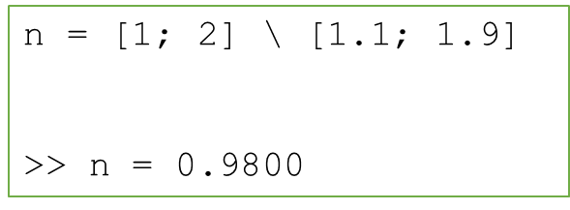
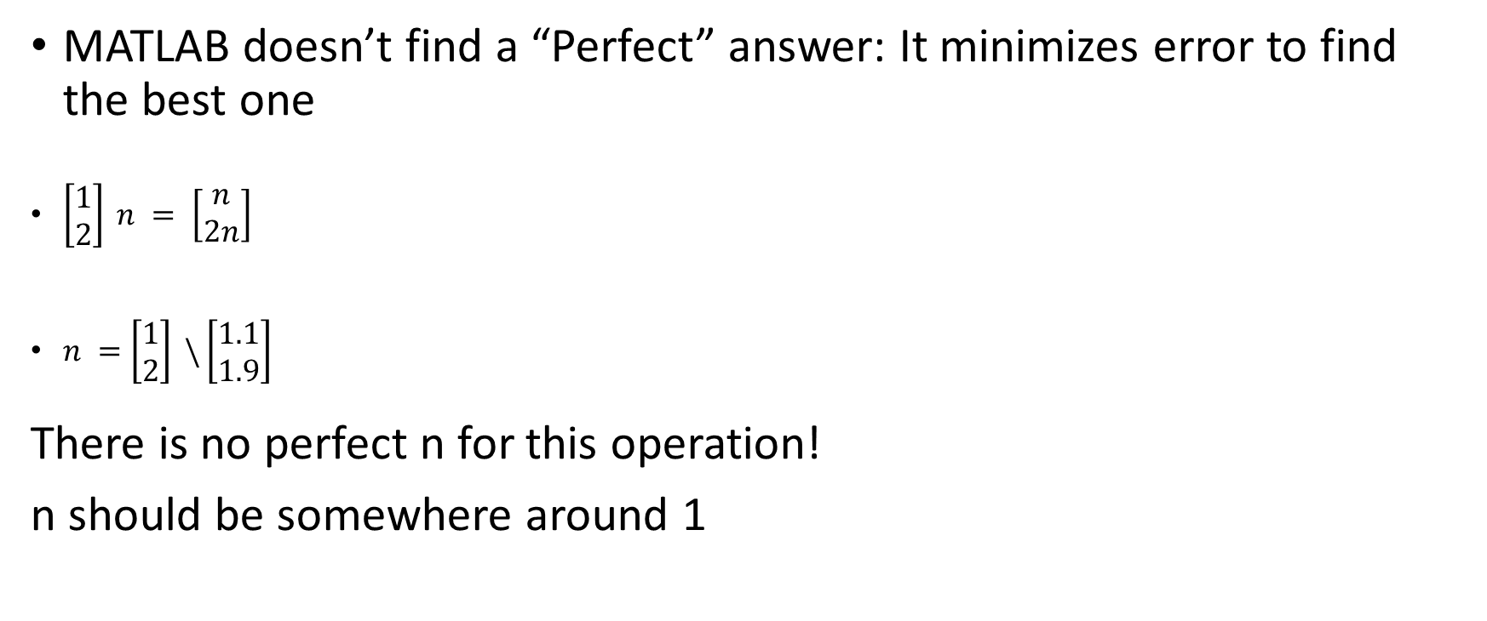
Exact vs Approx Answer
MATLAB doesn’t find a “Perfect” answer: It minimizes error to find the best one
$\left[\begin{matrix}1 \\ 2\end{matrix}\right] n = \left[\begin{matrix}n \\ 2n\end{matrix}\right]$
$n =\left[\begin{matrix}1 \\ 2\end{matrix}\right] \backslash \left[\begin{matrix}1.1 \\ 1.9\end{matrix}\right]$
There is no perfect n for this operation!
n should be somewhere around 1

Slide 9
Homework 5 Question 2
A solution containing 10.6 mol% glucose, 7.7 mol% fructose, and 81.7 mol% water is fed to a reactor at 158 mol/min. Glucose and fructose are isomers. In the reactor, some percentage of the glucose is converted to fructose. Calculate the reactor output flows of glucose, fructose, and water for 10, 15, 20, …, 60% of glucose converted to fructose. These results should be stored in a matrix, along with the % glucose converted. The table can display on two lines in the published .m file.
Do not solve for any value by hand – you should do this all in Matlab. You may set up the equations on paper and transfer them to Matlab.
Sugars in
Reactor
Sugars out
x_g = .106
x_f = .077
x_w = .817
m_g = ?
m_f = ?
m_w = ?

Slide 10
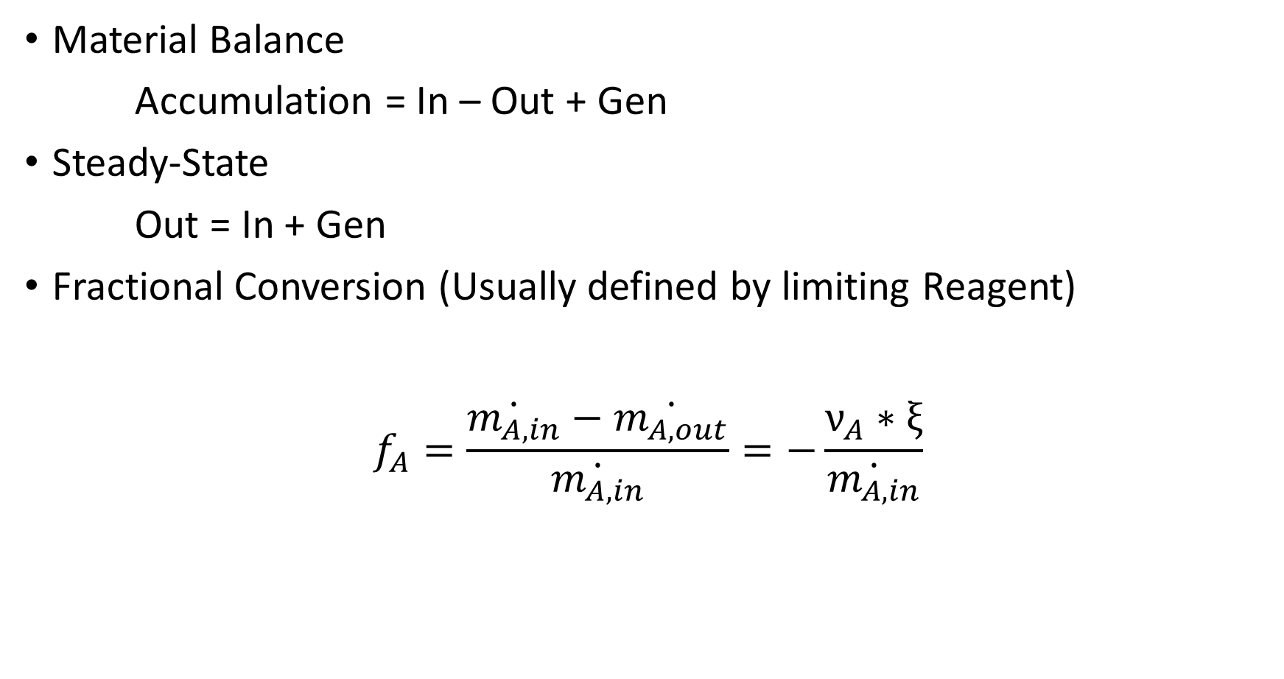
Material Balance
Accumulation = In – Out + Gen
Steady-State
Out = In + Gen
Fractional Conversion (Usually defined by limiting Reagent)
$$f_{A}=\frac{\dot{m_{A,in}}−\dot{m_{A,out}}}{\dot{m_{A,in}}}=−\frac{ν_{A}∗ξ}{\dot{m_{A,in}}}$$

Slide 11
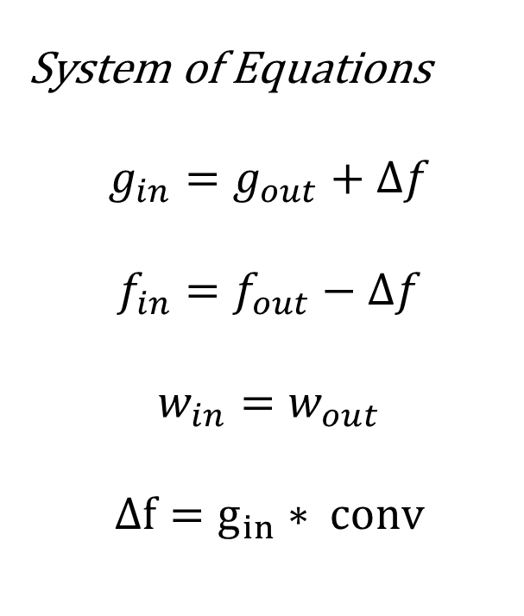
Matrix Multiplication Answer
System of Equations
$$g_{in}=g_{out}+Δf$$
$$f_{in}=f_{out}−Δf$$
$$w_{in}=w_{out}$$
$$Δf=g_{in}∗ conv$$

Slide 12
Solving Nonlinear Functions
Imagine f(x) a one valued function
We have no idea what f is (linear, polynomial, logarithmic, exponential)
We can only evaluate f(x)
f(x)
y
x

Slide 13
How can you solve f(x) = a for any a?
f(x)
x

Slide 14

Newton’s Method
Iterating upon x to achieve f(x) = 0
$$x_{n+1}=x_{n}−\frac{f\left(x_{n}\right)}{f^{′}\left(x_{n}\right)}$$
$$f^{′}\left(x_{n}\right)=\frac{Δy}{Δx}=\frac{f\left(x_{n}+Δx\right)−f\left(x_{n}\right)}{Δx}$$

Slide 15
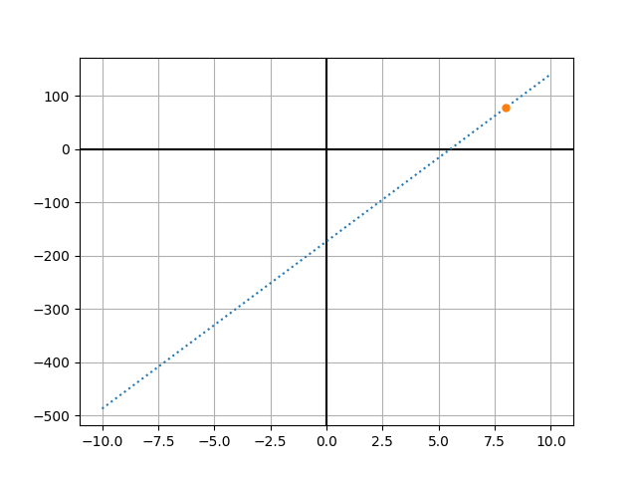
Guess x = 8, calculate slope

Slide 16
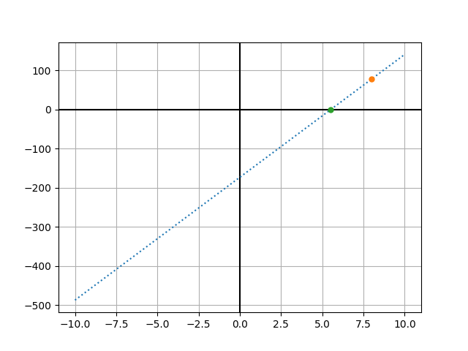
Change Guess to Next Point

Slide 17
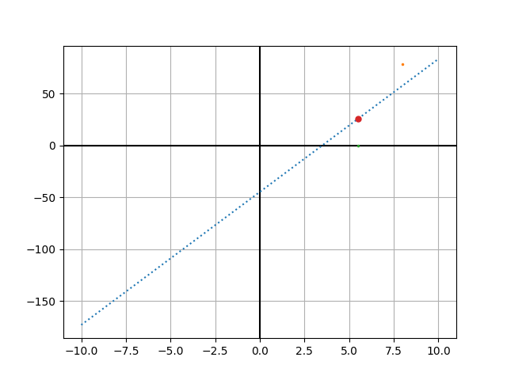
Evaluate at Next Point

Slide 18
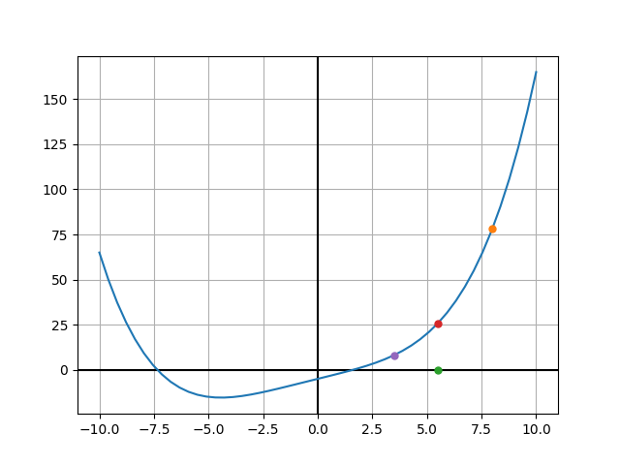
Continue…

Slide 19
Python – List comprehension
You can’t perform mathematical operations on the elements in a list.
Multiplication by an integer repeats the list
Lists have to be iterated through to do numerical operations on their elements
l = ['a', 'b', 'c'] x = l * 3 print(x)
['a', 'b', 'c', 'a', 'b', 'c', 'a', 'b', 'c']

Slide 20
Squaring the Elements in a List
A = [1, 2, 3, 4] B = [] for i in A: B.append(i**2)
B = [i**2 for i in A]

Slide 21
With Conditions
A = range(11) B = [i**2 if i%2==0 else 0 for i in A] print(B)
[0, 0, 4, 0, 16, 0, 36, 0, 64, 0, 100]

Slide 22
Nesting List Comprehensions
A = range(10) B = range(10) C = [[Ai * Bi for Ai in A] for Bi in B] for i in C: print(i)

