Slide 1
HW 5 Q 2 Answers
Turner Luke Disc 303

Slide 2
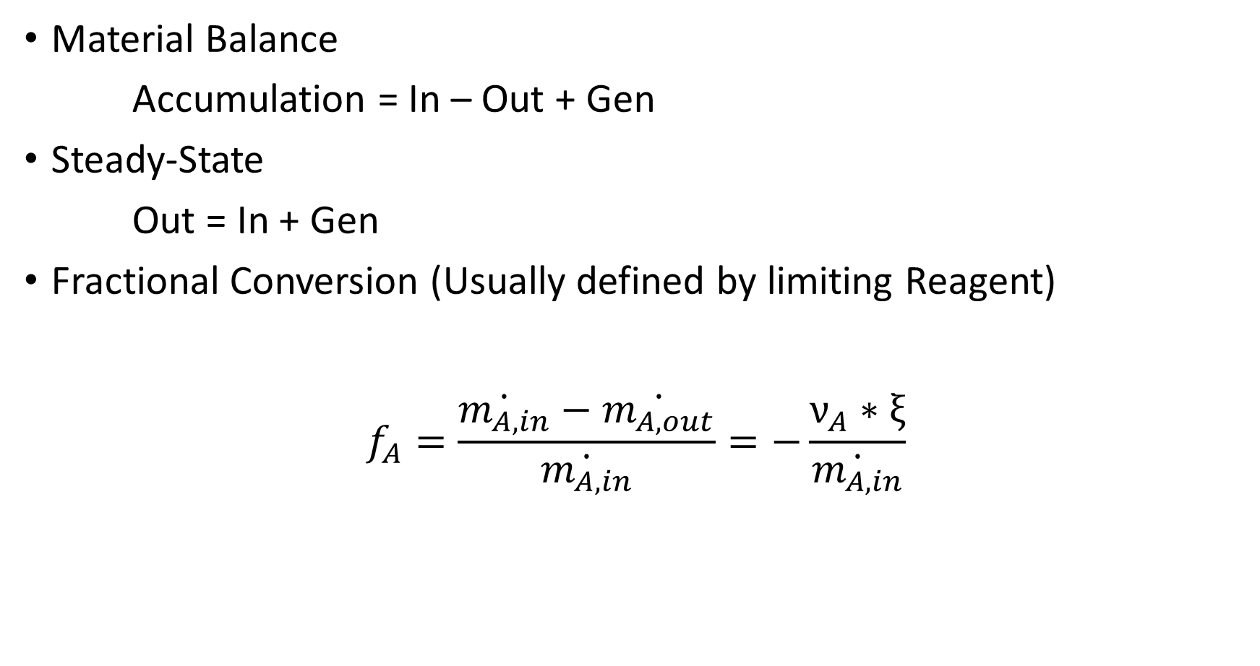
Material Balance
Accumulation = In – Out + Gen
Steady-State
Out = In + Gen
Fractional Conversion (Usually defined by limiting Reagent)
$$f_{A}=\frac{\dot{m_{A,in}}−\dot{m_{A,out}}}{\dot{m_{A,in}}}=−\frac{ν_{A}∗ξ}{\dot{m_{A,in}}}$$

Slide 3
Vector Operation Answer
m_total_in = 158; %mol/min
x_in = [.106, .077, .817]; % glu, fru, water
m_in = m_total_in * x_in;
nu = [-1, 1, 0];
result = [];
for f = .1 : .05 : .6
ext = - f * m_in(1) / nu(1);
m_out = m_in + nu * ext;
result = [result [f; m_out']];
end
disp(result)

Slide 4
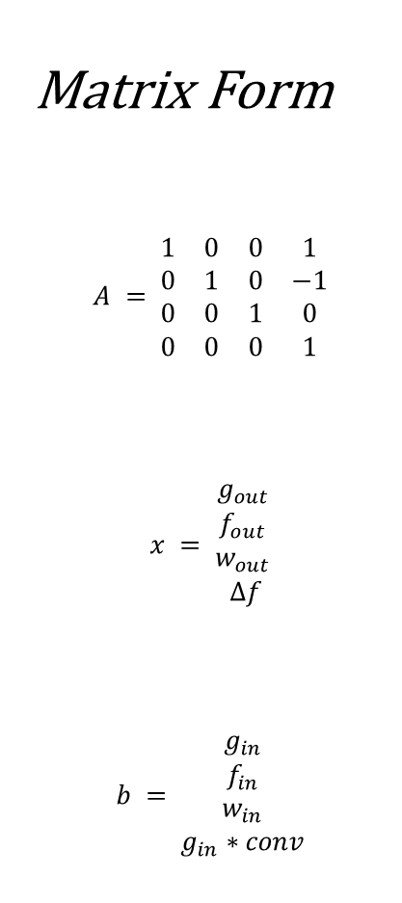
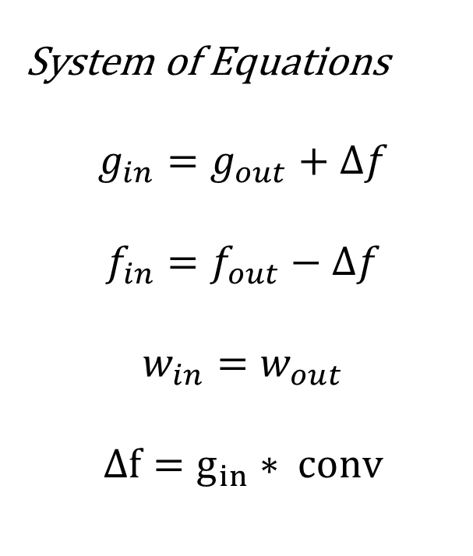
Matrix Multiplication Answer
Matrix Form
$$A = \begin{matrix}1 & 0 & 0 & 1 \\ 0 & 1 & 0 & −1 \\ 0 & 0 & 1 & 0 \\ 0 & 0 & 0 & 1\end{matrix}$$
$$x = \begin{matrix}g_{out} \\ f_{out} \\ w_{out} \\ Δf\end{matrix}$$
$$b = \begin{matrix}g_{in} \\ f_{in} \\ w_{in} \\ g_{in}∗conv\end{matrix}$$
System of Equations
$$g_{in}=g_{out}+Δf$$
$$f_{in}=f_{out}−Δf$$
$$w_{in}=w_{out}$$
$$Δf=g_{in}∗ conv$$

Slide 5
Matrix Multiplication Answer
m_total_in = 158; %mol/min
x_in = [.106, .077, .817]; % glu, fru, water
m_in = m_total_in * x_in;
A = [1 0 0 1;
0 1 0 -1;
0 0 1 0;
0 0 0 1];
result = [];
for f = .1 : .05 : .6
b = [m_in'; m_in(1) * f];
x = A\b;
result = [result [f; x(1:3)]];
end
disp(result)

