Slide 1
CBE255 Discussion 8 3/18/21
Turner Luke
* If you are not registered for this discussion, let me know so I can send you the presentation

Slide 2
Reminders
Homework 6 due tomorrow
Project 2 March 31st

Slide 3
Agenda
Questions?
Nonlinear systems of equations
fzero
fsolve
roots
Project 2
Writing documentation in Pycharm
Debugging in Pycharm

Slide 4
fzero
MATLAB
x = fzero(fun, x0, options)
Fun is a function to solve for x such that fun(x) = 0
x0 is the initial guess.
fzero solves for point where the sign of f(x) changes
Can’t find the root of something like x^2

Slide 5
Can you do fzero in Python?
Kinda
This doesn’t use the same sign changing method as fzero
Can detect answers for things such as x^2
from scipy.optimize import fsolve def f(x): return x**2 - 4 xg = 3 output = fsolve(f, xg) print(output)

Slide 6
Polynomial roots
MATLAB
Python
r = roots(p)
np.roots(p)
If the length of p is n+1 then the polynomial is described by:
p[0] * x**n + p[1] * x**(n-1) + ... + p[n-1]*x + p[n] = 0
roots uses algebraic expressions as opposed to iteration
The correctness of your answer is only limited by machine precision as opposed to machine precision and iteration tolerance

Slide 7
Solve the following polynomials
2x**2 + 4x = 3
4x**3 + 3x + 2 = 2x**2
5x**3 + 2 = 0
0x**4 + 0x**3 + x**2 + 5x = 4
[-2.58113883, 0.58113883]
[ 0.46659244+0.96774639j, 0.46659244-0.96774639j -0.43318488+0.j ]
[-0.7368063 +0.j, 0.36840315+0.63809297j, 0.36840315-0.63809297j]
[-5.70156212, 0.70156212]

Slide 8
import numpy as np r1 = np.roots([2, 4, -3]) r2 = np.roots([4, -2, 3, 2]) r3 = np.roots([5, 0, 0, 2]) r4 = np.roots([1, 5, -4]) print(r1) print(r2) print(r3) print(r4)

Slide 9
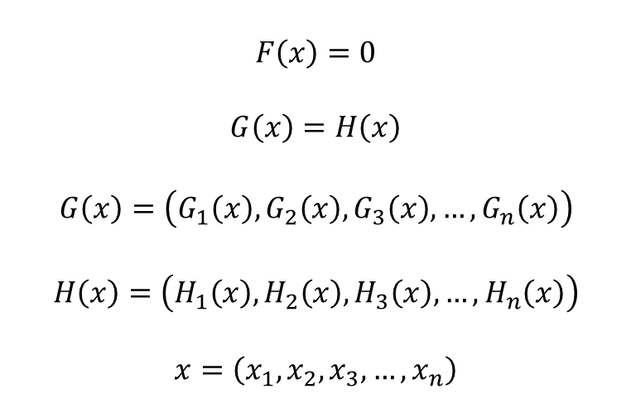
Nonlinear Systems of Equations: fsolve
$$F\left(x\right)=0$$
$$G\left(x\right)=H\left(x\right)$$
$$G\left(x\right)=\left(G_{1}\left(x\right),G_{2}\left(x\right),G_{3}\left(x\right),…,G_{n}\left(x\right)\right)$$
$$H\left(x\right)=\left(H_{1}\left(x\right),H_{2}\left(x\right),H_{3}\left(x\right),…,H_{n}\left(x\right)\right)$$
$$x=\left(x_{1},x_{2},x_{3},…,x_{n}\right)$$
MATLAB
[x, fval, exitflag, output] = fsolve(fun, x0, options)
Python
scipy.optimize.fsolve(func, x0,…)

Slide 10
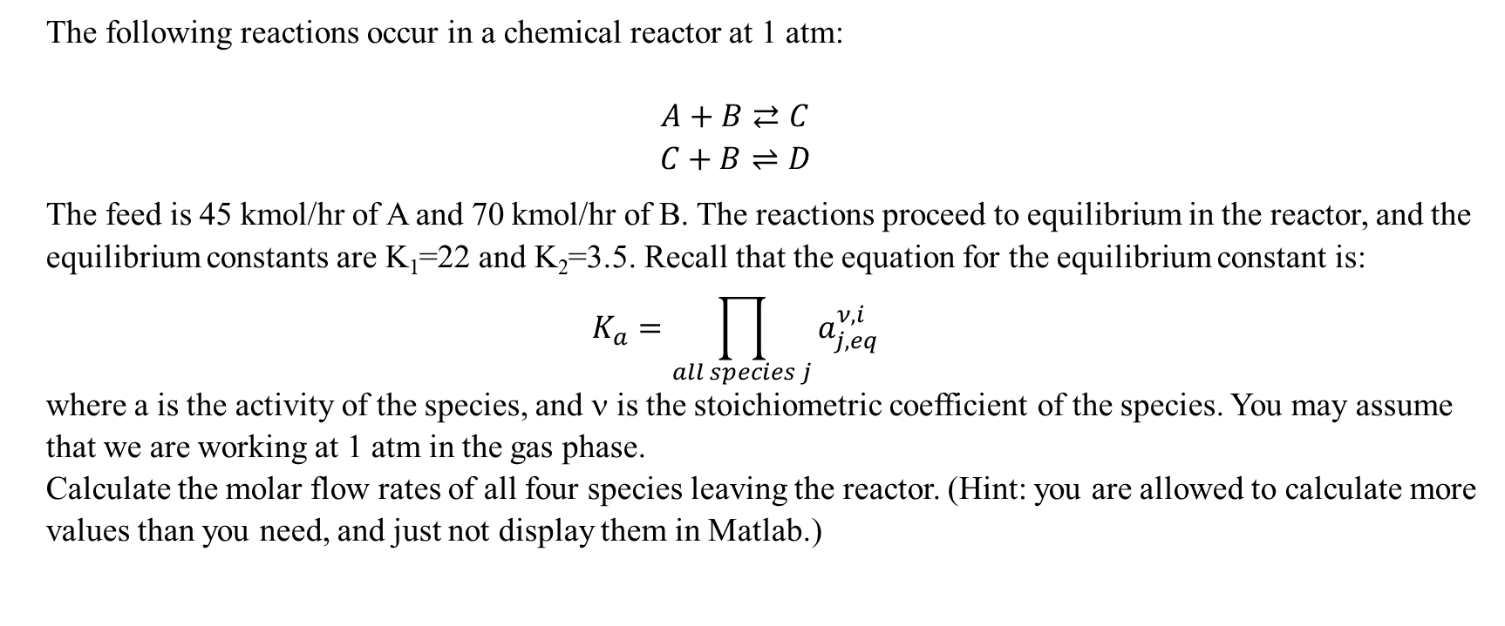
Nonlinear System of Equations Example
The following reactions occur in a chemical reactor at 1 atm:
$$A+B⇄C$$
$$C+B⇌D$$
The feed is 45 kmol/hr of A and 70 kmol/hr of B. The reactions proceed to equilibrium in the reactor, and the equilibrium constants are K₁=22 and K₂=3.5. Recall that the equation for the equilibrium constant is:
$$K_{a}=\prod_{all species j}{a_{j,eq}^{ν,i}}$$
where a is the activity of the species, and ν is the stoichiometric coefficient of the species. You may assume that we are working at 1 atm in the gas phase.
Calculate the molar flow rates of all four species leaving the reactor. (Hint: you are allowed to calculate more values than you need, and just not display them in Matlab.)

Slide 11
global n_in K P P0 nu
nu = [-1, -1, 1, 0;
0, -1, -1, 1];
P = 1;
P0 = 1;
K = [22, 3.5];
n_in = [45, 70, 0, 0];
xg = [16, 8];
ext = fsolve(@solve_extents, xg);
change1 = ext(1) * nu(1,:);
change2 = ext(2) * nu(2,:);
change = change1 + change2;
n_out = n_in + change;
disp(n_out)
function resid = solve_extents(inp)
global n_in K P P0 nu
ext1 = inp(1);
ext2 = inp(2);
change1 = ext1 * nu(1,:);
change2 = ext2 * nu(2,:);
change = change1 + change2;
n_out = n_in + change;
y = n_out / sum(n_out);
K_calc1 = prod(y.^nu(1,:)) * P/P0 ^ sum(nu(1,:));
K_calc2 = prod(y.^nu(2,:)) * P/P0 ^ sum(nu(2,:));
resid = K - [K_calc1, K_calc2]
end
Easy to read answer

Slide 12
import numpy as np from scipy.optimize import fsolve P = 1 # [=] atm P0 = 1 # [=] atm nu = np.array([ [-1, -1, 1, 0], [0, -1, -1, 1] ]) K = np.array([22, 3.5]) n_in = np.array([45, 70, 0, 0]) # [=] kmol/hr def intermediate_calcs(inp): exts = inp # ext is now a vector size (2,) exts = exts[np.newaxis].T # exts is now a vector of size (2,1) delta_moles = nu * exts n_out = n_in + np.sum(delta_moles, axis=0) y = n_out / sum(n_out) K_calc = np.prod(y ** nu, axis=1) * (P/P0)**np.sum(nu, axis=1) return n_out, K_calc def solve_extent(inp): _, K_calc = intermediate_calcs(inp) return K - K_calc xg = np.array([2, 1]) * 8 # fsolve initial guess fsolve_output = fsolve(solve_extent, xg, full_output=True) if fsolve_output[2] == 1: ext = fsolve_output[0] else: raise ValueError("Fsolve did not converge.") n_out, _ = intermediate_calcs(ext) print("The molar flow rates leaving the reactor are as follows:") for comp, n in zip("ABCD", n_out): print("{}: {:.5} kmol/hr".format(comp, n))
The molar flow rates leaving the reactor are as follows:
A: 4.7948 kmol/hr
B: 12.452 kmol/hr
C: 22.862 kmol/hr
D: 17.343 kmol/hr

Slide 13
Writing Documentation In PyCharm
A triple quote creates a block comment in python
When initiated directly after defining a function it is the docstring
Most IDEs will fill the string into a good notation.
Show PyCharm function docstring here*

Slide 14
Debugging in PyCharm
PyCharm's debugger is one of its best functionalities!
A debugger allows you to see the lines of code ran, in any scope, leading up to an error
Demonstrate the debugger with the equilibrium script here*

