Slide 1
CBE255 Discussion 10 4/8/21
Turner Luke
* If you are not registered for this discussion, let me know so I can send you the presentation

Slide 2
Reminders
Homework 8 due Tomorrow
Please submit a single PDF
I can’t stay late after OH tonight
I don’t anticipate it will be busy, but coming early will guarantee I get to your question
Or use the extra time after discussion

Slide 3
Agenda
Questions?
Integration
Combining Integration and Interpolation
HW8Q3 Help

Slide 4
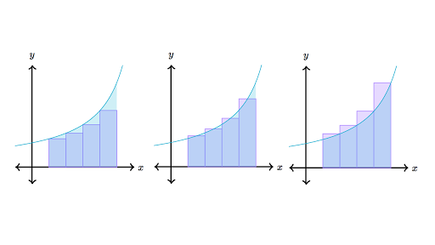

Recall Elementary Calculus
$$\int_{a}^{b}{f\left(x\right)dx}=\lim_{n→∞}{\sum{f\left(x\right)\frac{b−a}{n}}}$$
Recall Riemann Sum

Slide 5
Pre-Coded Integral Solvers
MATLAB
1 Dimensional
q = integral(fun,xmin,xmax)
2 Dimensional
q = integral2(fun,xmin,xmax,ymin,ymax)
Python
1 Dimensional
scipy.integrate.quad(func, a, b)
2 Dimensional
scipy.integrate.dblquad(func, a, b)

Slide 6

Code a Function Calculating the Error Function
$$erf\left(x\right)=\frac{2}{\sqrt{π}}\int_{0}^{x}{e^{−t^{2}}}$$
Validate your results with a native error function

Slide 7
import numpy as np from scipy.integrate import quad from scipy.special import erf def error_function(x): return 2 / np.sqrt(np.pi) * quad(lambda t: np.exp(-t**2), 0, x)[0] print(error_function(5)) print(erf(5))
disp(error_function(5))
disp(erf(5))
function F = error_function(x)
f = @(t) exp(-t.^2);
F = 2 / sqrt(pi) * integral(f,0,x);
end

Slide 8
Interpolation with Data
1: Create a function with the data f(x)
Select interpolation method that best matches the physical concepts behind the data
f = @(x) interp1(xdata, ydata, x, ‘method’)
f = scipy.interpolate.interp1d(xdata, ydata, kind=“method”)
2: Pass the interpolation function in an integral method

Slide 9
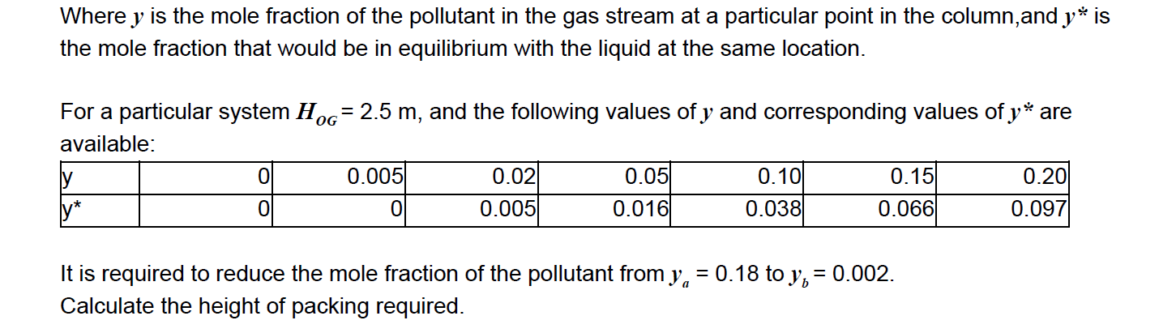

CBE 426 Example
The height of a packed column is equal to the height of a transfer unit by the number of transfer units
$z_{T}=H_{TU}N_{TU}$
Depending on the basis of your packed column: (Overall, Gas)
$$N_{OG}=\int_{y_{b}}^{y_{a}}{\frac{dy}{\left(1−y\right)\left(y−y^{∗}\right)}}$$

Slide 10
import numpy as np from scipy.interpolate import interp1d from scipy.integrate import quad y = np.array([0, 0.005, 0.02, 0.05, 0.10, 0.15, 0.20]) ys = np.array([0, 0, 0.005, 0.016, 0.038, 0.066, 0.097]) ys_of_y = interp1d(y, ys) def f(y): return 1 / (1 - y) / (y - ys_of_y(y)) N = quad(f, 0.002, 0.18)[0] H = 2.5 Z = H * N print("The required height of packing is {:.2f} m.".format(Z))

Slide 11
y_data = [0, 0.005, 0.02, 0.05, 0.10, 0.15, 0.20];
ys_data = [0, 0, 0.005, 0.016, 0.038, 0.066, 0.097];
ys_of_y = @(y) interp1(y_data, ys_data, y, 'spline');
f = @(y) 1 ./ (1 - y) ./ (y - ys_of_y(y));
N = integral(f, 0.002, 0.18);
H = 2.5;
Z = H * N;
fprintf("The required height of packing is %.2f m.", Z)

Slide 12
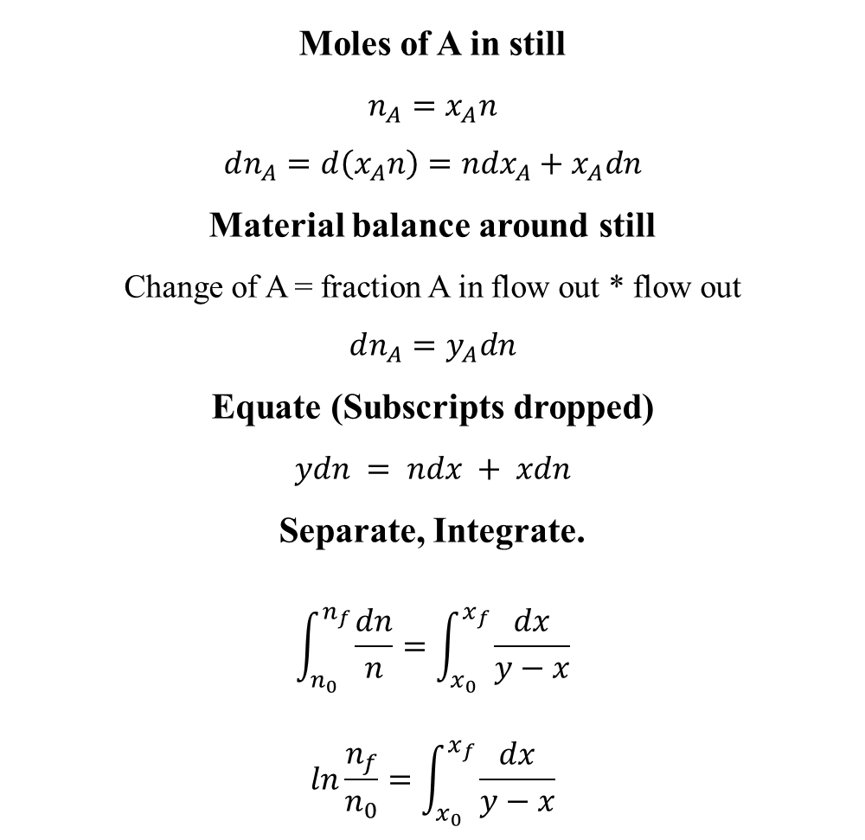
Rayleigh Equation (CBE426)
Moles of A in still
$$n_{A}=x_{A}n$$
$$dn_{A}=d\left(x_{A}n\right)=ndx_{A}+x_{A}dn$$
Material balance around still
Change of A = fraction A in flow out * flow out
$$dn_{A}=y_{A}dn$$
Equate (Subscripts dropped)
$$ydn = ndx + xdn$$
Separate, Integrate.
$$\int_{n_{0}}^{n_{f}}{\frac{dn}{n}}=\int_{x_{0}}^{x_{f}}{\frac{dx}{y−x}}$$
$$ln\frac{n_{f}}{n_{0}}=\int_{x_{0}}^{x_{f}}{\frac{dx}{y−x}}$$
Q
Condenser
Receiver
X_D
Batch Still
x
Q

Slide 13
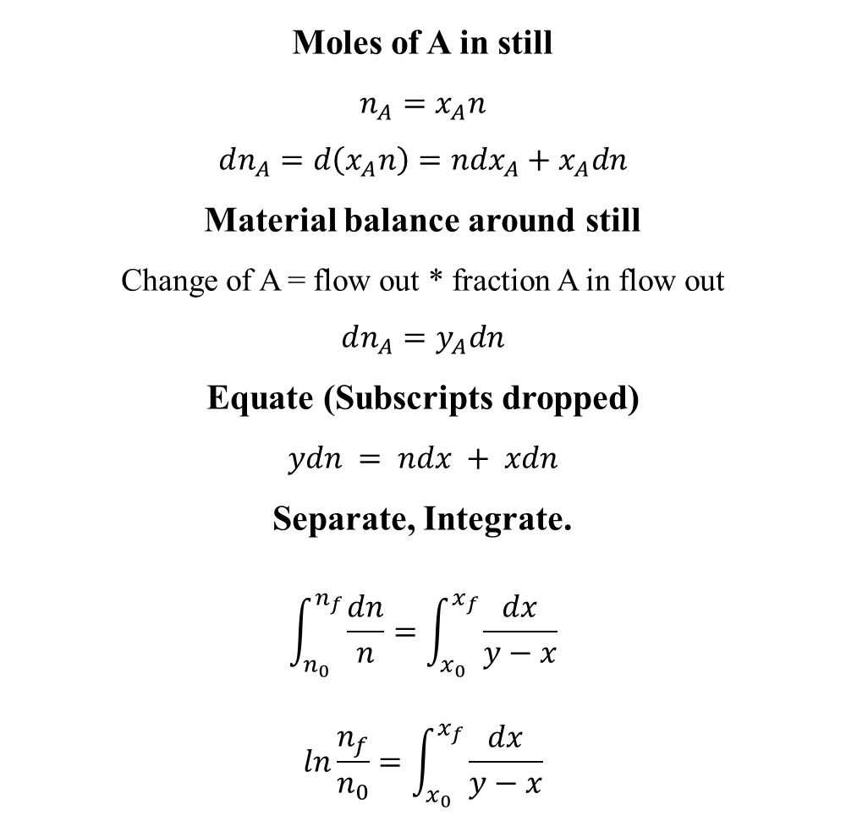
Moles of A in still
$$n_{A}=x_{A}n$$
$$dn_{A}=d\left(x_{A}n\right)=ndx_{A}+x_{A}dn$$
Material balance around still
Change of A = flow out * fraction A in flow out
$$dn_{A}=y_{A}dn$$
Equate (Subscripts dropped)
$$ydn = ndx + xdn$$
Separate, Integrate.
$$\int_{n_{0}}^{n_{f}}{\frac{dn}{n}}=\int_{x_{0}}^{x_{f}}{\frac{dx}{y−x}}$$
$$ln\frac{n_{f}}{n_{0}}=\int_{x_{0}}^{x_{f}}{\frac{dx}{y−x}}$$

Slide 14
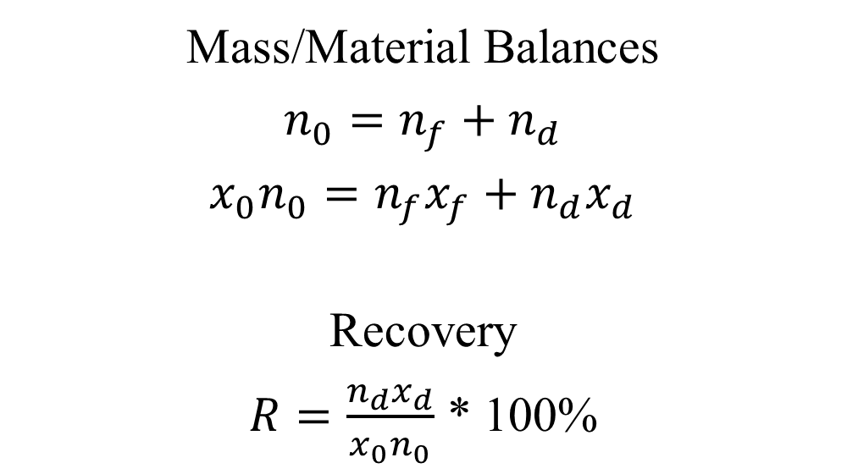
Mass/Material Balances
$$n_{0}=n_{f}+n_{d}$$
$$x_{0}n_{0}=n_{f}x_{f}+n_{d}x_{d}$$
Recovery
$R=\frac{n_{d}x_{d}}{x_{0}n_{0}}$ * 100%

Slide 15
Project 3 “Above and Beyond”: LaTeX
LaTeX is a software system for document preparation.
Like much of the things we do in this class, LaTeX is more powerful than typical methods, but less user friendly
https://www.overleaf.com/learn/latex/Learn_LaTeX_in_30_minutes

Slide 16

$$ln\frac{n_{f}}{n_{0}}=\int_{x_{0}}^{x_{f}}{\frac{dx}{y−x}}$$
$$ln\backslash frac\{n_f\}\{n_0\}=\backslash int_\{x_0\}^\{x_f\}\backslash frac\{dx\}\{y−x\}$$
$${\left(C_{10}H_{8}O_{4}\right)}_{n}→C_{6}H_{6}+4CO+H_{2}$$
$$(C_\{10\}H_8O_4)_n \backslash rightarrow C_6H_6 + 4CO + H_2$$
$$d_{2}=d_{1}{\left[{\left(\frac{D_{c2}}{D_{c1}}\right)}^{3}\frac{Q_{1}}{Q_{2}}\frac{Δρ_{1}}{Δρ_{2}}\frac{μ_{2}}{μ_{1}}\right]}^{1/2}$$
$$d_2 = d_1 [ (\backslash frac\{D_\{c2\}\}\{D_\{c1\}\})^3 \backslash frac\{Q_1\}\{Q_2\} \backslash frac\{\backslash Delta \backslash rho_1\}\{\backslash Delta \backslash rho_2\} \backslash frac\{\backslash mu_2\}\{\backslash mu_1\}]^\{1/2\}$$

