Slide 1

Employee Turnover
Turner Sale

Slide 2
Outline
Purpose
01
Data and Models
02
Conclusions

Slide 3
Purpose
Why do we care about predicting turnover risk?

Slide 4
Purpose
Today we see that employee turnover increases onboarding costs like IT resources, training time, manager interaction, and qualifications
We would like to retain good employees as long as possible
Turnover may have impacts on production or customer projects
If we can hold good employees, then onboarding costs sink
If we can predict high risk employees, we can act proactively to retain them, rather than passively await their decision
If we identify issue areas, we can create corrective action

Slide 5
Data
What do we store and how do we interpret it?

Slide 6
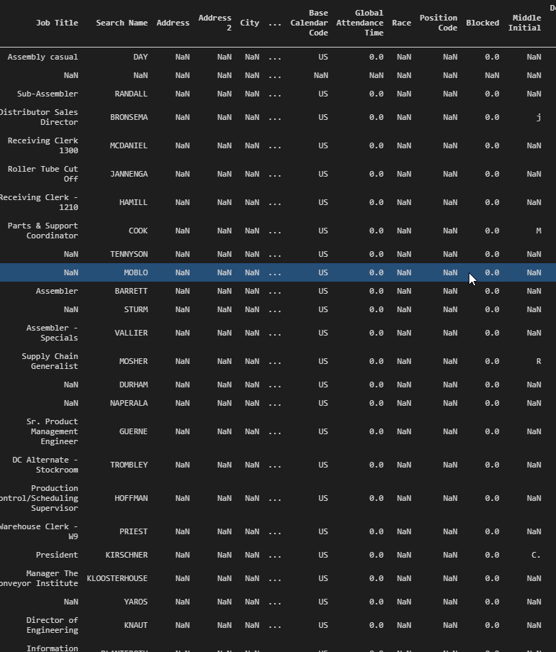
Employees
Contains information such as position, name, start date, inactive reason, and department
Does not contain salary data
Provides a base for current and inactive employees

Slide 7
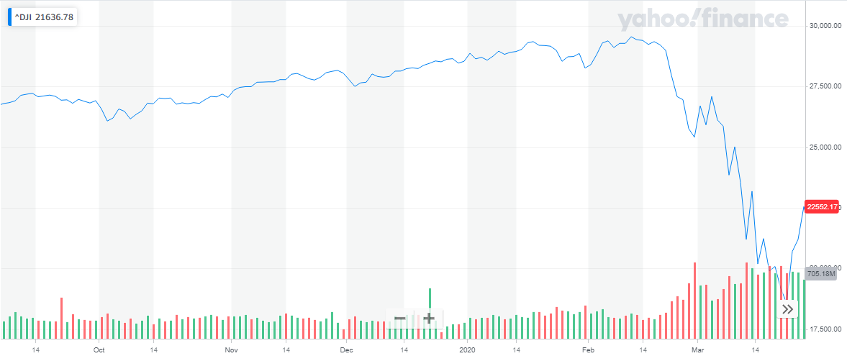
Dow Jones Industrial Average and Consumer Price Index
Provides macroeconomic data
Insight as to market conditions upon inactive date or current time period
Has some issues with modelling as we will see

Slide 8
Production Data
Shipments
Production Orders
Invoice amount by period
Days past due or early
Provided since start of Navision
Provides view of on-time shipment
Run time by period
Days past due or early
Provided since start of Navision
Provides view of on-time assembly
Both data sets are prepared, but not used for modeling
Additional analysis will be required

Slide 9
Important Models
Which ones are the best performers?

Slide 10
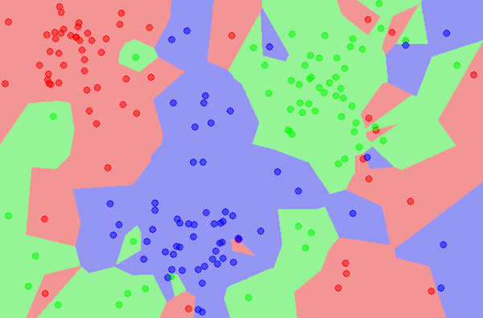
K-Nearest Neighbors
Designed to find clusters of data points
Uses a “hyper-plane”
A way to imagine a set of features that are not possible to visualize in 3D space
Provides “distance” between points in each dimension
Very good accuracy
Does not require a large amount of data prep

Slide 11
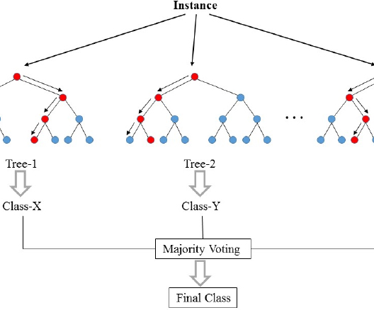
Random Forest
Multiple decision trees run with slight differences
The best performing trees are kept and influence the final result
Highest accuracy on our data
Easy to interpret

Slide 12
Which model should we pick?
Random Forest is the best performer in key categories:
Accuracy
AUC –ROC (how well and quickly the model reduces false positives)
Computation time
Readability
K-Nearest Neighbors is a close second
Just slightly below Random Forest in key categories
Harder to interpret

Slide 13
What does the model tell us?
Length of employment is the largest contributing factor
SHOP employees have a higher turnover
Building code has an impact
Manager can Have a large impact

Slide 14
What can we do?
Identify employees that are near retirement or are temporary and recognize they are higher risk
Prepare retirement plans early for an easy transition
Prepare hiring plans for seasonal employees and temporary workers to reduce onboarding costs
Interact with managers that have high turnover
Determine if the issue is the leadership or the group
Example, assembly has a high turnover, is this because of the managerial staff or the nature of the work?

Slide 15
What next?
More data
More analysis
Incorporate salary data
Compare across the US national average
Address
Does distance from place of work make a difference?
Satisfaction
How do our employees feel about the company?
Market conditions
Find an appropriate way to incorporate without biasing the classifier
Does turnover impact production metrics?
Does turnover show a significant impact on budget variance?
Can we predict WHEN an employee may leave?
Can we find creative ways to retain employees at high risk?
What impact does the market have on turnover?

Slide 16


Thank you!

