Slide 1
Predicting Production Hours
Turner Sale

Slide 2
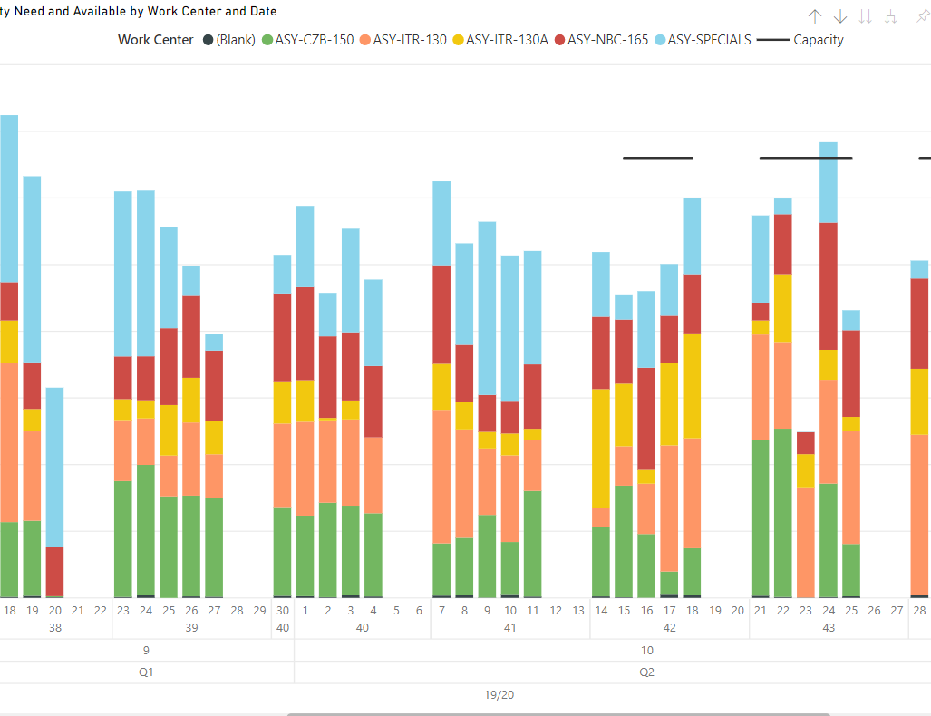
Introduction and Purpose
Company A competes in the conveyance and intralogistics market
Production for North America is centered in Michigan
All internal productions are routed through product specific work centers
Tooling for planned and simulated production orders are being worked on, but only predict known demand
The purpose of this analysis is to predict the future production times

Slide 3
Data
Ending Date | Work Center No_ | Count of Prod_ Orders | Total Run Time
07/01/16 | 301 | 8 | 14
07/01/16 | ABENCHASSY | 95 | 149.97
07/01/16 | BBENCHASSY | 37 | 42.59
07/01/16 | CBENCHASSY | 12 | 15.6
07/05/16 | ABENCHASSY | 112 | 127.47
07/05/16 | BBENCHASSY | 37 | 63.6
07/05/16 | CBENCHASSY | 11 | 23.2
07/06/16 | 301 | 11 | 13.33
07/06/16 | 305 | 1 | 1.15
07/06/16 | ABENCHASSY | 100 | 108.76
07/06/16 | BBENCHASSY | 32 | 37.74
07/06/16 | CBENCHASSY | 8 | 15.05
07/07/16 | ABENCHASSY | 62 | 154.76
07/07/16 | BBENCHASSY | 36 | 52.4
07/07/16 | CBENCHASSY | 2 | 6.55
07/08/16 | 301 | 2 | 3.54
07/08/16 | ABENCHASSY | 86 | 100.94
07/08/16 | BBENCHASSY | 21 | 36.51
07/08/16 | CBENCHASSY | 34 | 80.26
07/08/16 | LINEASSY | 1 | 1
07/11/16 | 301 | 1 | 2
Data is drawn from production orders on a daily grain (grouped by date and work center)
Data was too inconsistent (missing dates like weekends) so it was grouped on a monthly grain
Aggregated data ignored work center, as some have been removed during the analysis period

Slide 4
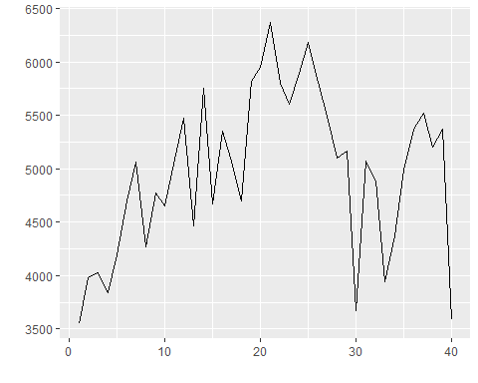
Preliminary Analysis
Data was plotted along a time axis by month after aggregation
The 40th month was removed (analysis was done in the middle of the month, so the total is inaccurate)
Data shows a positive trend for the first ~25 months, with a downward trend in months 26-35

Slide 5
Why the downturn?
Most players in the market experienced the same
Movement to new facility
Required large investment of time and planned reduction in run times
Recovery as e-commerce regains some of its lost ground
Large players in the industry

Slide 6
Looking Forwards
Data Transformations
Executive Summary
Box-Cox transformations unnecessary as variance is uniformly spread
Monthly grain for a reduction in error
Weekly analysis removed for the time being (week fluctuations are greater than the monthly grain)
Data is stationary, so no need for differencing
Run times did not see any transformations
Months provided better, more consistent, data
Data need not be differenced to account for seasonality
Data is non-seasonal

Slide 7
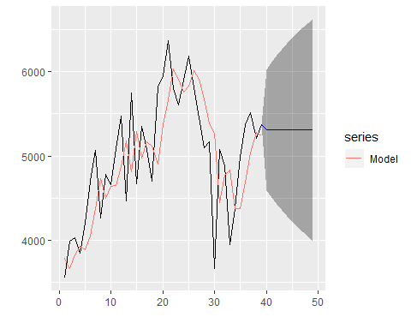
Model 1 – Exponential Smoothing
Shorthand name: SES1
Model predicts a near flatline
Prediction interval (values that indicate how confident the prediction is) is quite large
Model does a decent job of fitting existing data, but is not a great predictor

Slide 8
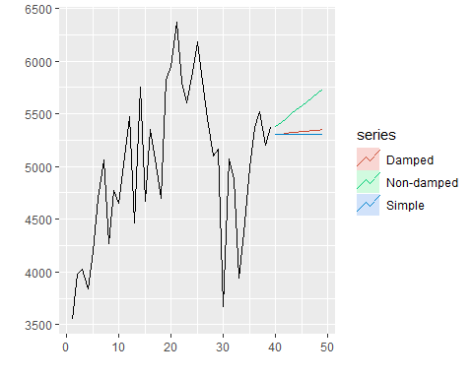
Models 2 and 3 – Holt’s Method
Holt’s methods are designed to better handle trend data
Two methods were tested
Non-Damped: prediction holds the trend indefinitely
Damped: predictions level out over time
Damped methods tend to be more popular and in our case is more accurate
SES1 performed better in performance metrics

Slide 9
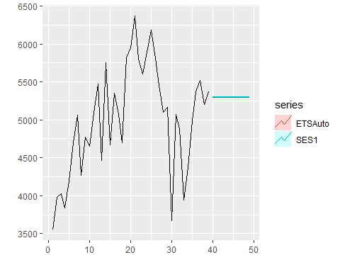
Models 3,4, and 5 – ETS()
3 methods were used:
Automatic inside R – ETSAuto
Additive error – ETSANN
Multiplicative error – ETSMNN
ETSAuto happened to fall upon the same model as ETSMNN
ETSAuto performed best, thus was compared to the previous best (SES1)
Predictions are not very different, but SES1 performs better

Slide 10
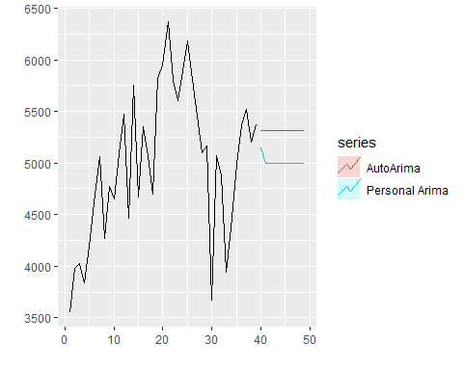
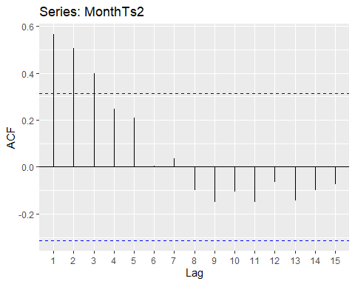
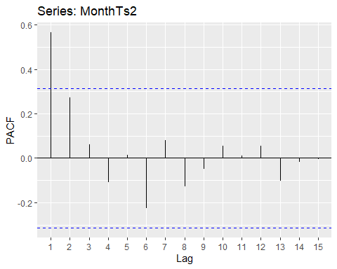
Models 6 and 7 - ARIMA
Predictions
Arima Models
Automatic: AutoA
Personally selected based on ACF and PACF: PersonalA

Slide 11
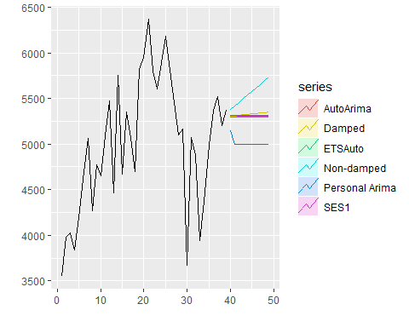
Model Comparison
Best performer was the Automatic Arima model
SES1 was the best performer of the simple models
Several models predict similar results, with two outlier models
Given market trends, the Non-Damped Holt’s is possible, but based on history the Automatic Arima model is the best

Slide 12
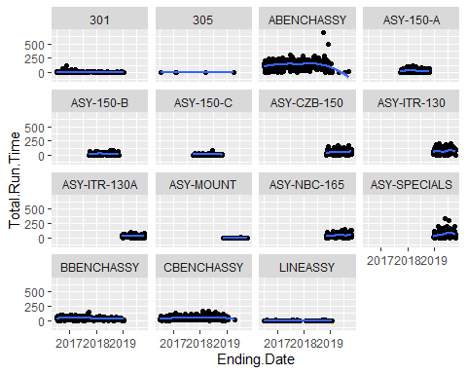
Future Ideas/Changes
Split data by work center
Difficult until the existing centers are longer-lived and transitions have been worked out
Use more complex models
Deep learning using Neural Networks
Use a weekly grain
May introduce more variance on a small time frame, but includes more data points and potential cycles

