Slide 1
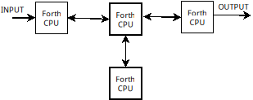
Independent Forth CPUs
Passing data between neighbors, but no direct communication with nodes farther away

Slide 2

56 fully interconnected nodes?
I don’t think the AI understood me correctly

Slide 3
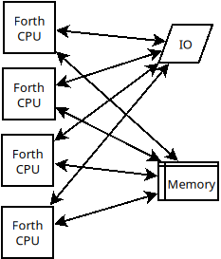
TP-Forth
Every running instance has access to everything, but care must be taken so they don’t mess things up for one another

Slide 4
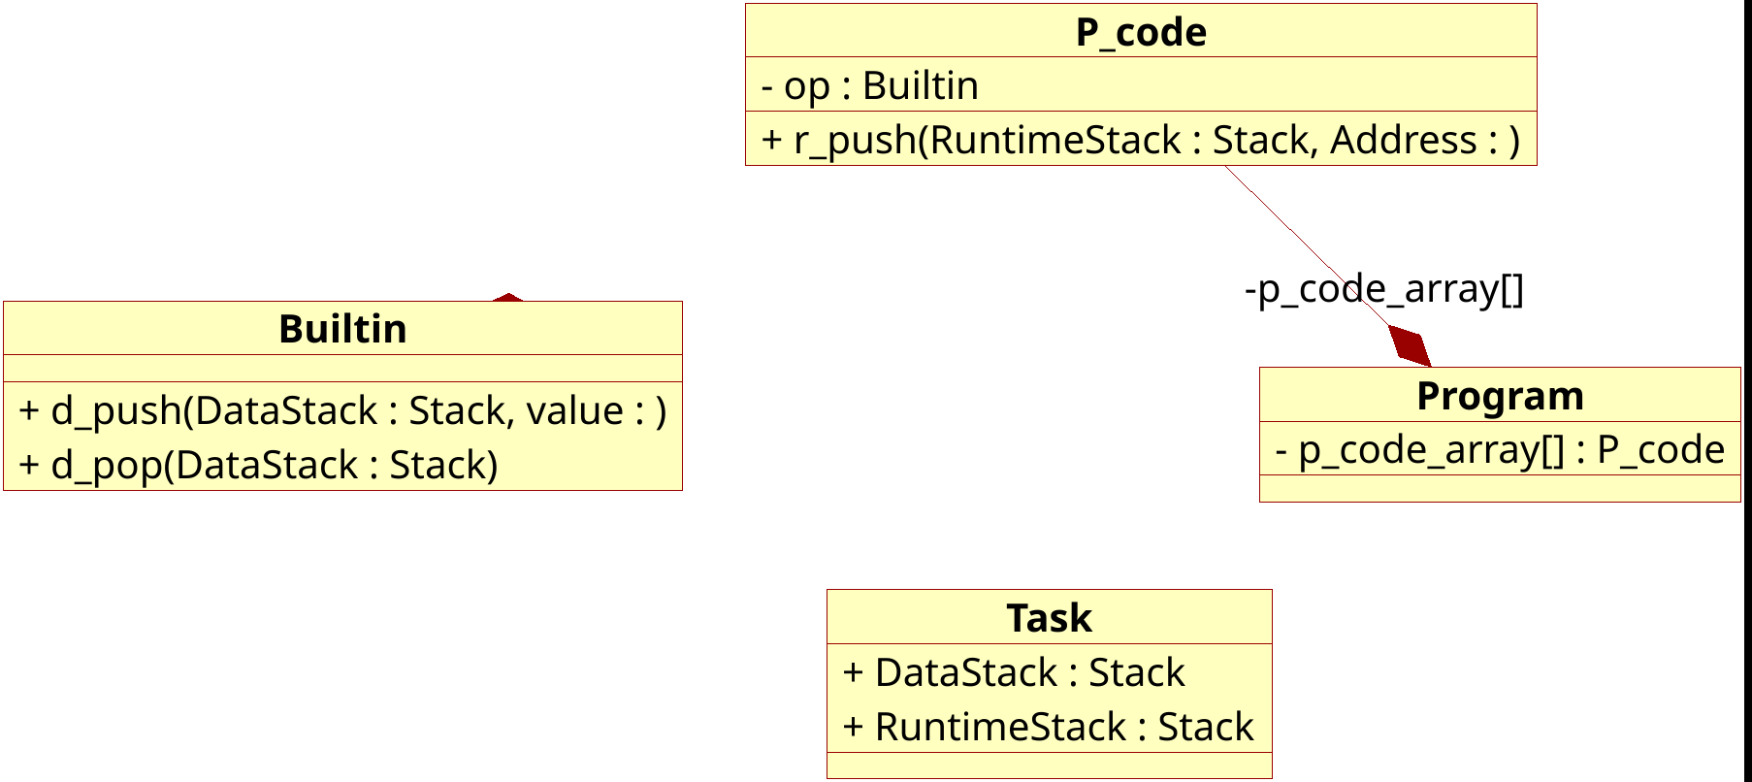
OO but not OO

Slide 5
The Alien approach
Built-ins
How would a space alien approach this?
P-CODES
Forth source

Slide 6
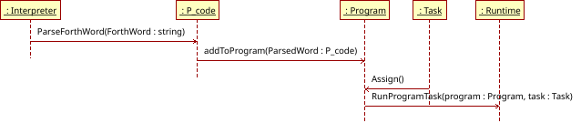
From source to running process
That arrow is going the wrong way!

Slide 7
Limitations
Can’t pass parameters on the stack (each task has its own stack)
Must communicate through Queues to avoid race conditions

Slide 8
OFF TO THE RACES
Try some code
Repo: https://github.com/turnimator/tpforth

