Slide 1
Requirements
If your robot about to crash or drive off an edge, it must stop immediately
For this you need IR sensors all around the the body, and ideally, underneath as well.
In order to keep the robot from veering left or right, you need to know how far each wheel has traveled
For this you need at least two disc encoders with optical sensors
As your project progresses, you’ll want to add more features.
For less than 8$, you can get a box with 37 sensors, most of which could be useful, or at least fun to add.
Buzzers, Movement detectors (are the wheels spinning?), relays, color detectors (for line following and more), tilt switches, temperature sensors, sound detectors, shock detectors, humidity detectors (we don’t want to get wet!)
Combining multiple input types, you can make inferences about the state of the robot and its environment.
The more capabilities you add, the more awesome your robot becomes
However ...

Slide 2
Limitations
… the ESP32 has 36 IO pins
This may seem like a lot at first, but as you add sensors, distance measuring, GPS, … you’ll find the number of free pins dwindeling faster than the money in an average pensioner’s bank account
In order to connect all your devices to the ESP32, you will have to make some kind of mainboard anyway, so why not solve two problems at once?

Slide 3
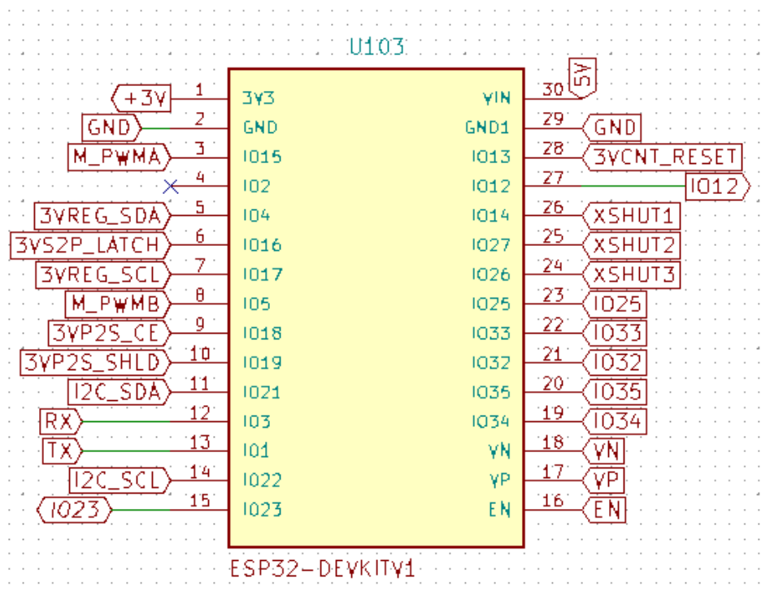
ESP32 Superexpander
The ESP32 Superexpander gives you
3 headers for VL53L0X laser distance meters
4 I²C headers
2 headers for wheel motion IR sensors
1 header for L298 or compatible motor driver
12 on-off outputs for relays, switches, …
8 on-off inputs for sensors
12 breakouts for GPIO pins

Slide 4
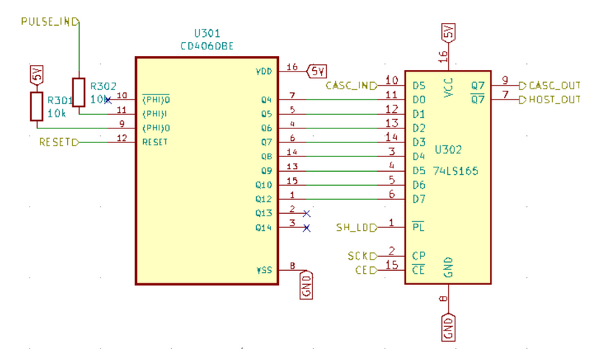
Counters
For some input, we need to know immediately if it goes active, e.g. an imminent crash or other catastrophe. An Interrupt Service Routine must set a variable and disable the motor before returning.
For other inputs, like wheel motion, it’s enough to know how far we’ve traveled on each iteration. However, wheel motion arrives in tiny millimeter increments, and when driving at full speed, they arrive too fast for us to poll them. We need one interrupt handler for the left wheel and one for the right, updating two variables that we can read on each iteration.
With all the other stuff that will be going on, reading a compass, reading lasers, communicating telemetry over UDP, avoiding obstacles, calculating trajectories, …. having two ISRs just for keeping track of wheel motion seems like an awful waste of resources.
Why not offload the millimeter counting to a special purpose circuit like the 4060 and the read the count from a register on each iteration?

Slide 5
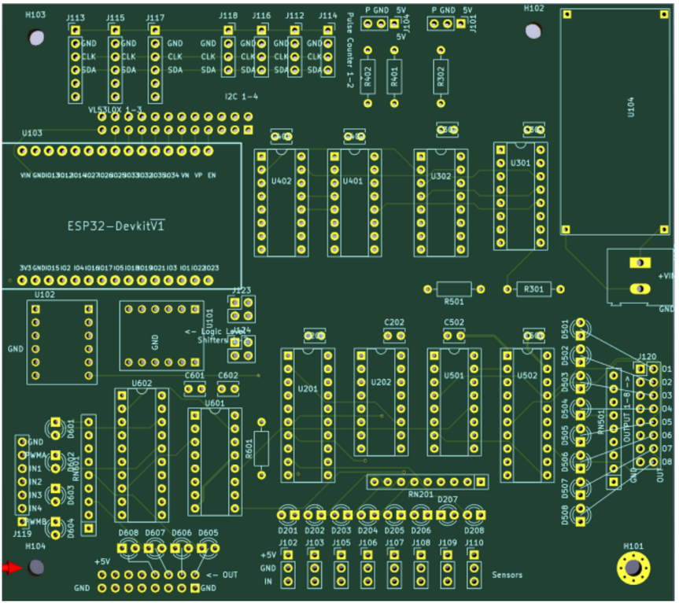
Design
Putting it all together in KiCad, you might get something like this

Slide 6
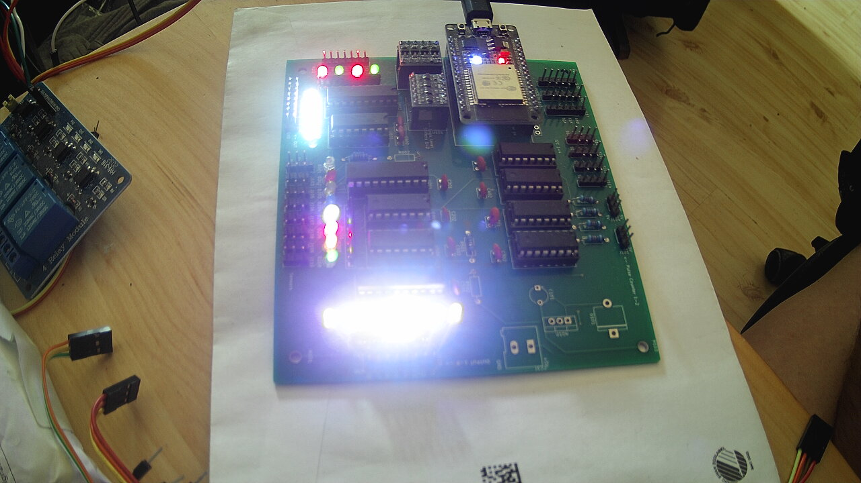
BLINKENLIGHTS!!!
… and, if you’re not careful when selecting resistor values for the LEDs, when you hook it up and turn on the power, it will look like this (which is what I wanted anyway because I’m crazy):

Slide 7
The Fun Stuff

