Slide 1


Data Warehousing Laboratory Project following the CRISP-DM through the example of soccer statistics
Students: Onur Yavuz, Eugenio Donaque, Artur Baliet, Hannes Daniel

Slide 2
Structure
Introduction
CRISP-DM
Concept of the problem
Data Preparation
Solution approach
Implementation steps
Conclusion
References

Slide 3
Introduction
Football is the most popular sport on this planet and games from previous seasons
are compared to follow the development
Our task was to enable useful information out of the huge amount of data
We solved this task through following the CRISP-DM process.

Slide 4

CRISP-DM
Figure 1: Crisp-DM model
https://statistik-dresden.de/archives/1128

Slide 5
Business Understanding Phase
Our topic: Soccer statistics about the Bundesliga in Germany
Our goal: Understand the Performance development of a team

Slide 6
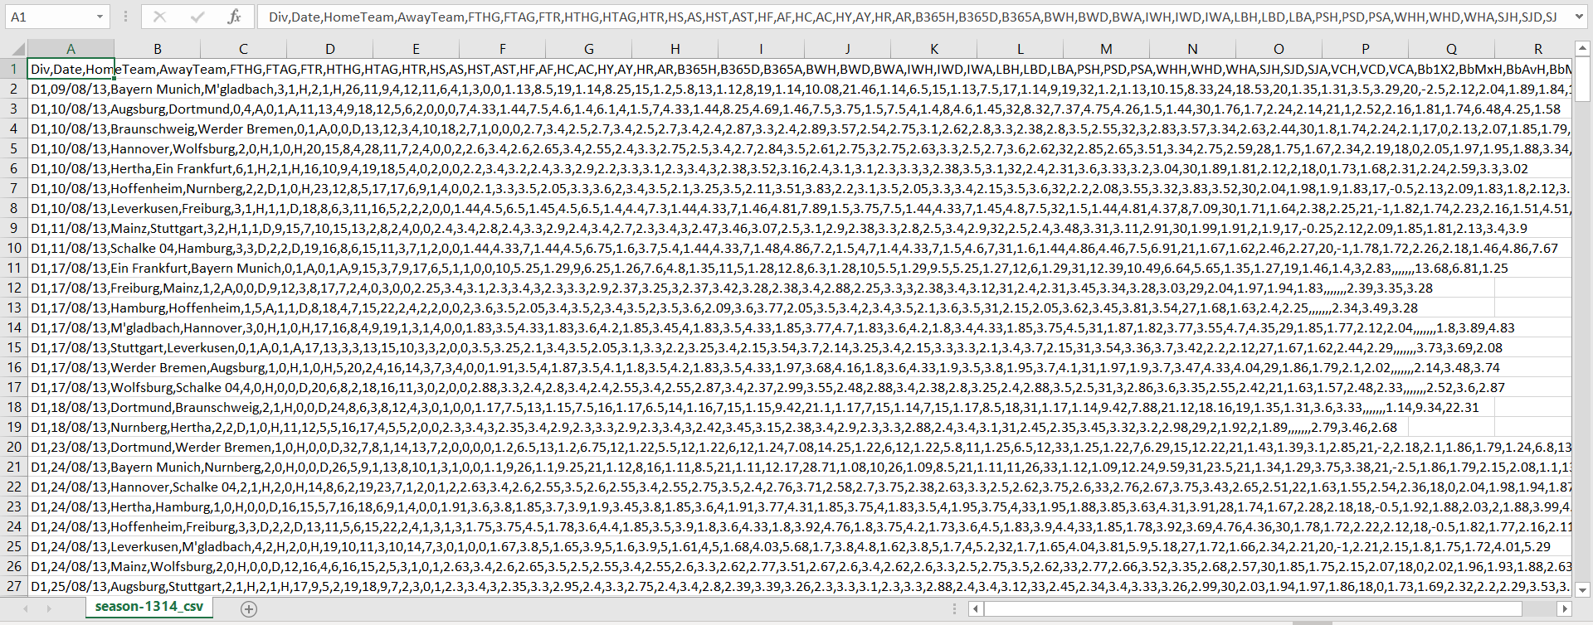
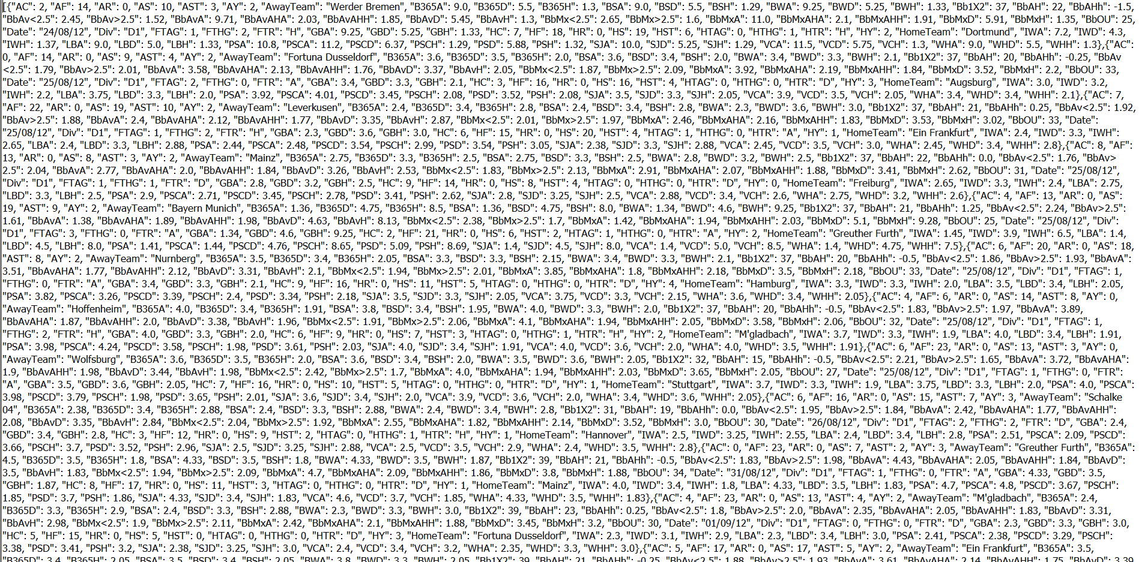
Data Understanding Phase
Source
Open Data: http://www.football-data.co.uk/
Contains data for last 10 seasons of German Bundesliga including current season
Contains various statistical data
Each season in a separate file
← row data →

Slide 7
Necessary tools:
Latex → perform analytic report
Microsoft Excel → convert to CSV-files
PhpMyAdmin → build new database
MySQL Workbench → design and build DWH/ DM
Notes:
XAMPP and we use for local...
In php we built the db
Latex is an.... We used it for our scientific paper...
Excel was a nice tool for converting the data and in some steps it was useful within micros....
MySQL was our environment we used it to deal with the db as well as in phpmy....

Slide 8
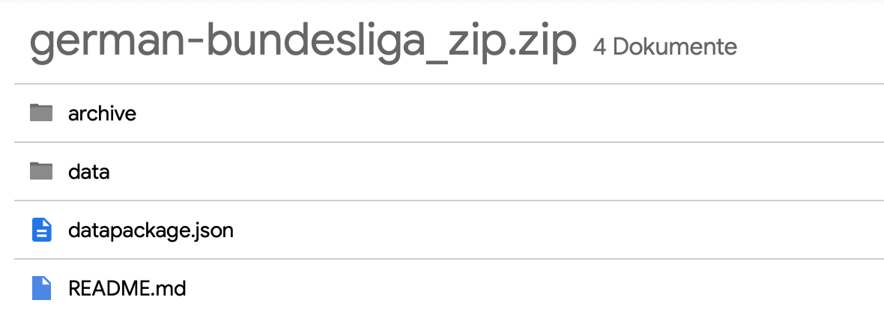
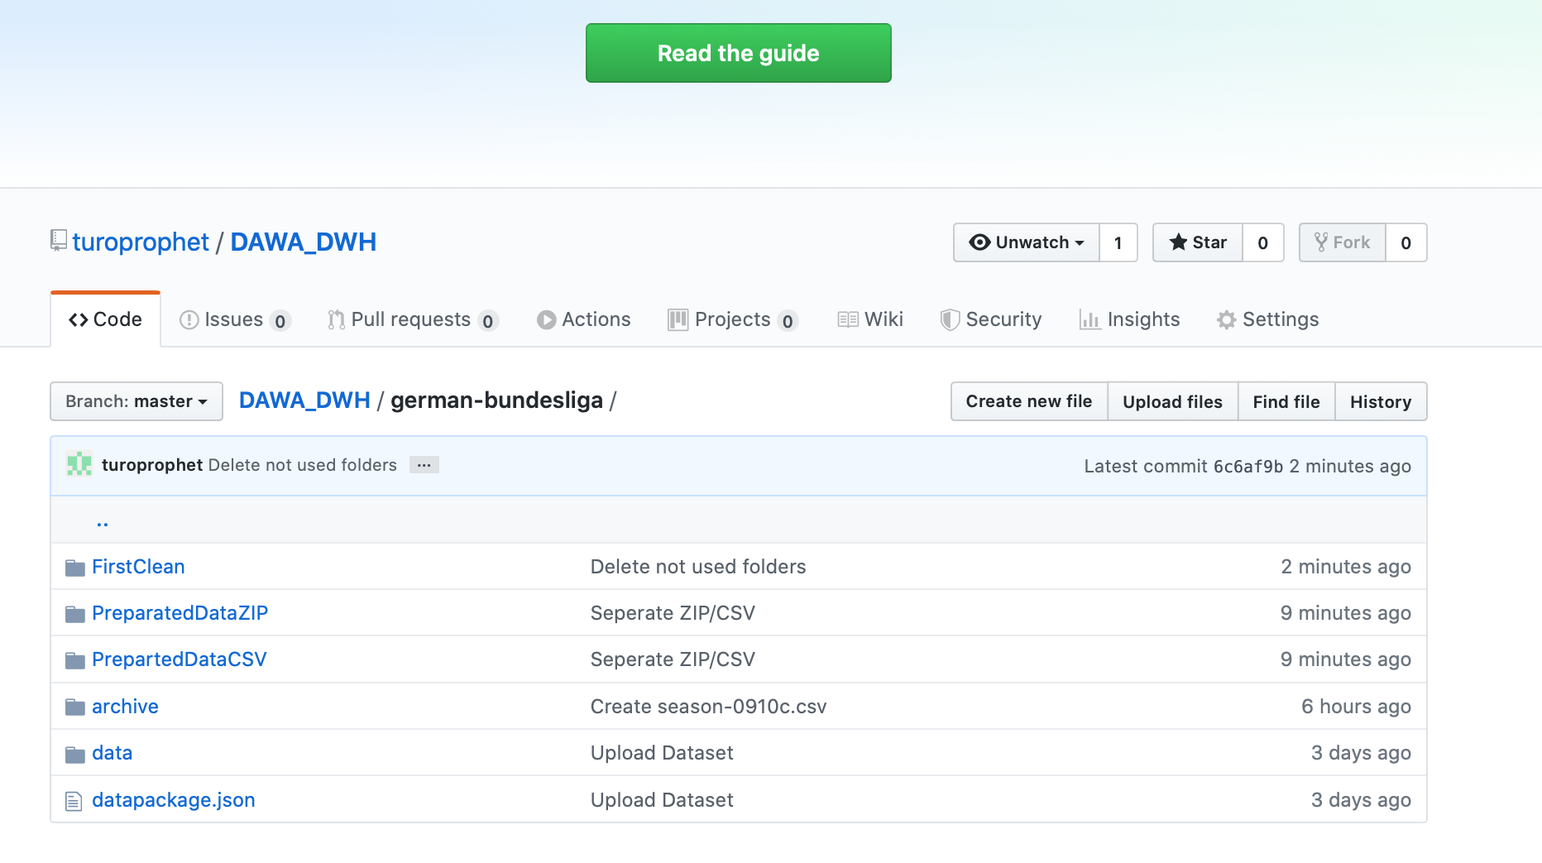
GitHub
Source code management
Repository
Work efficently in our team

Slide 9
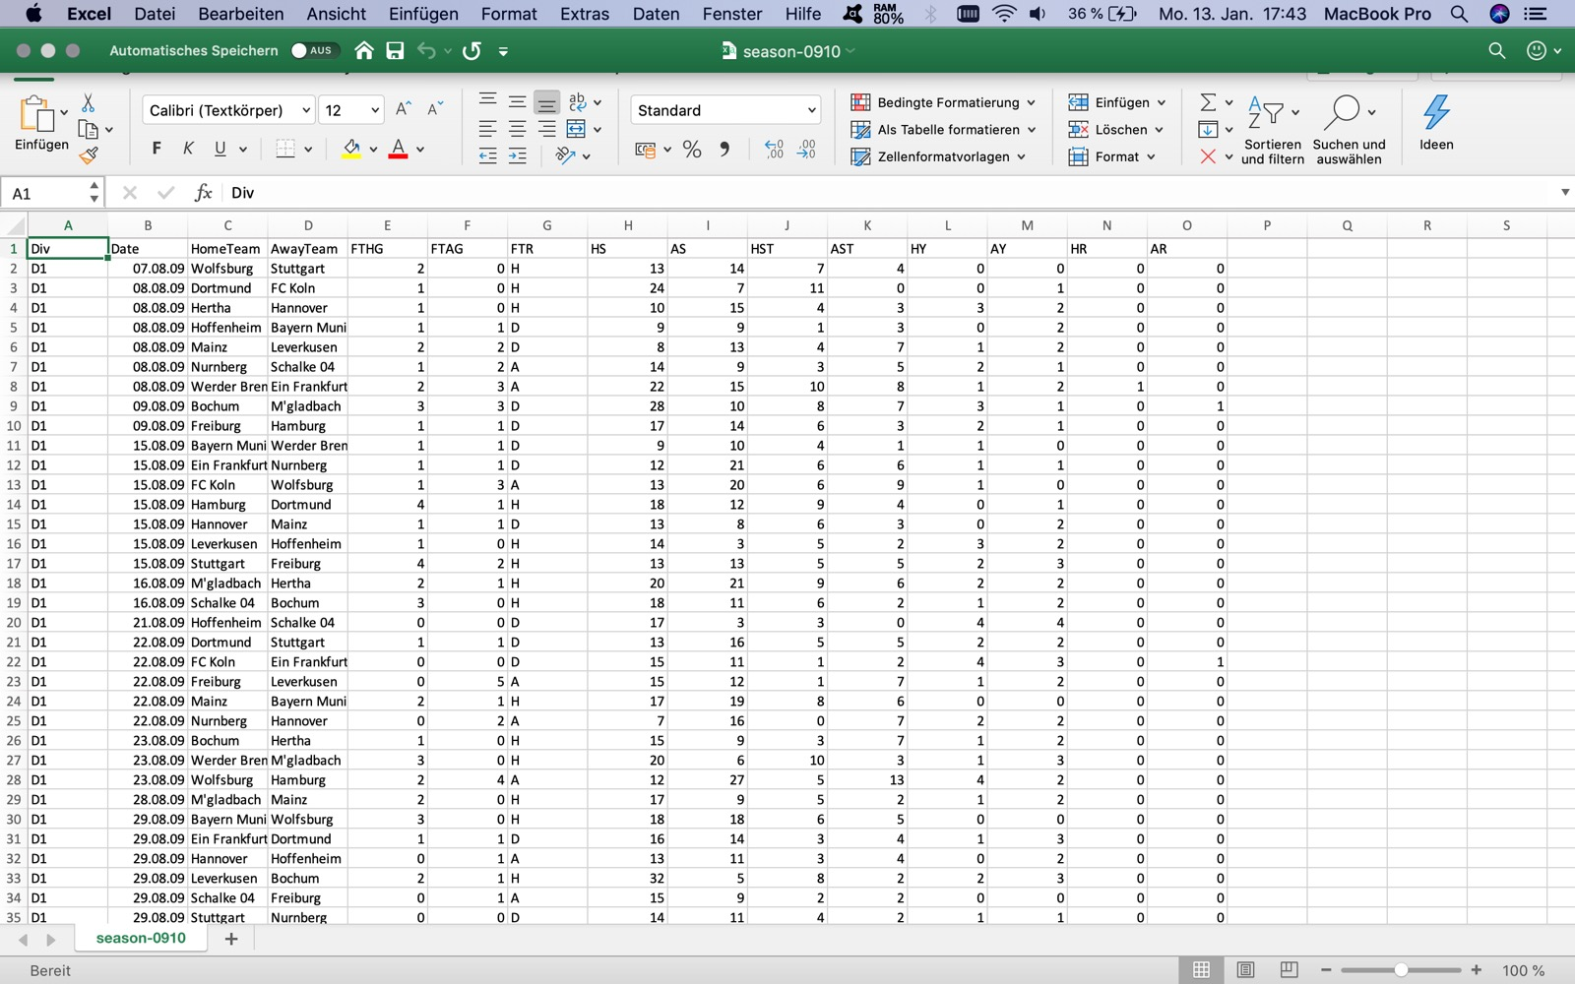
Data Preparation Phase
Data Preparation
Cleansing
Compress CSV in ZIP
Upload all Seasons (csv.zip)
Notes:
At the beginning of the Preparation Phase we had to knew which parameters are needed because there a lot of parameters we didnt need. We decided to take the Divison, Date, HomeTeam, AwayTeam, Full Time Away Goals which means: The Sum of the Goals of the AwayTeam and also for
HomeTeam Full Time Home Goals, Full Time Result (H=Home Win, D=Draw, A=Away Win)....
I did this first cleaning step in Excel and first seperated all the parameter in diffrent columns.... After that I deleted the not needed columns....for each season
Next step was to put this data via phpmyadmin into the db, compress the csv file into zip that the client was able to read it and also to separted it.....

Slide 10
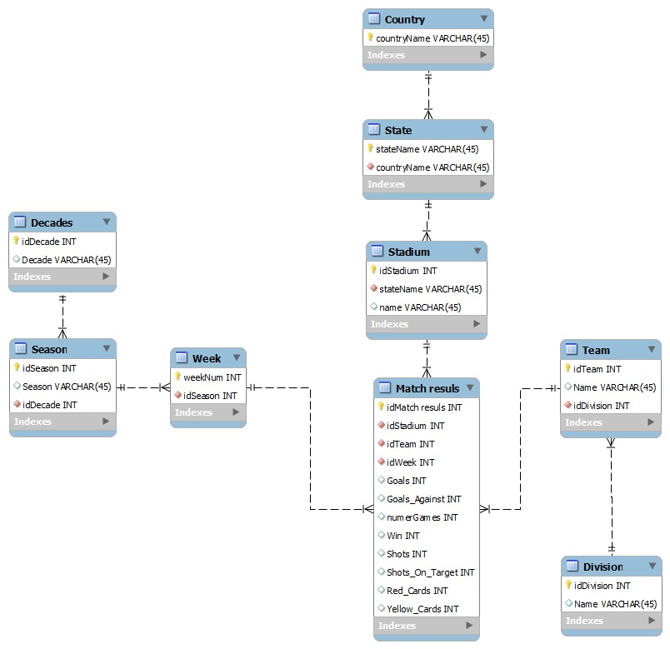
Star Schema
Figure 2: Star Schema

Slide 11
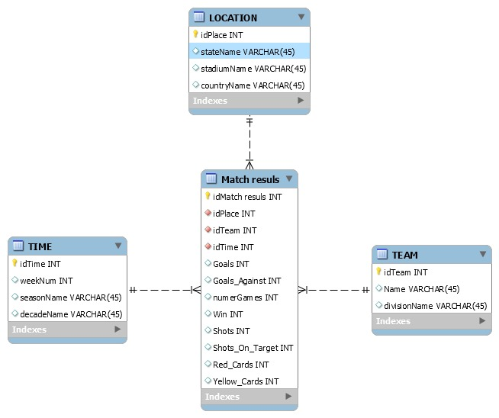
Data Mart
Figure 3: Data Mart

Slide 12


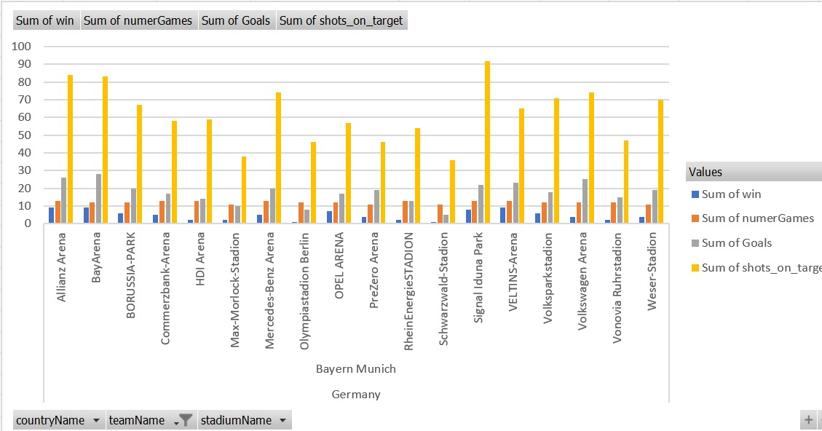

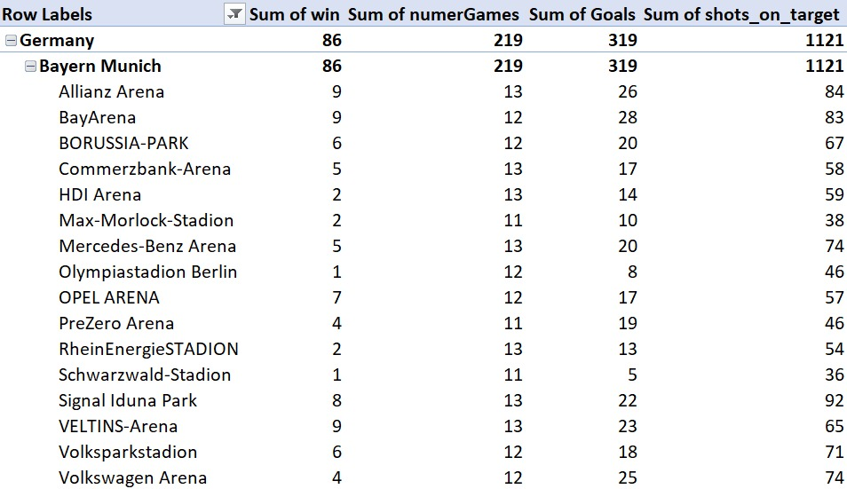
Bayern Munich
Performance of BM depending on the stadium

Slide 13
Conclusion
Raw data is used to create a Data Warehouse
Check the data quality and reduced to the relevance data
Easy and compact information about the football statics
Good a new experience for the group
Notes:
In the Projekt we have learn to do the raw data to used to create a Data Warehouse and check the data quality and reduced to the relevance of data we needed.
Our Goal was easy and compact information about the football statics to present and with this information to the see the development of the Team
For our Team was this a good and new experience to see the problems to create a Data Mart, Snowflakes or clean and push the data intro a database

Slide 14
Thank you...

