Slide 1
360 Visual Design
Final Project
Mural Work of a Building resides
in METU Campus

Slide 2
Introduction
I have choosen “Presidency Building“.
The reason is that to take its photo is easy and its walls are appropriate to paint.
Another point is that I have worked on the only one lock of the whole building because it would be difficult to apply the same theme to whole building because the other parts of the building has different structure, such as balcony and and large windows, small wall areas

Slide 3
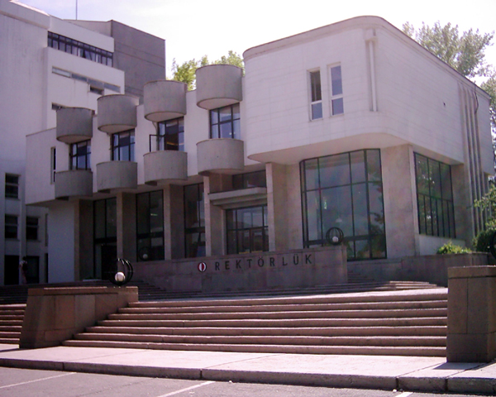
Profile View Original
This is the original profile view of the building.
Walls are flat and white originally and it seems more formal.

Slide 4
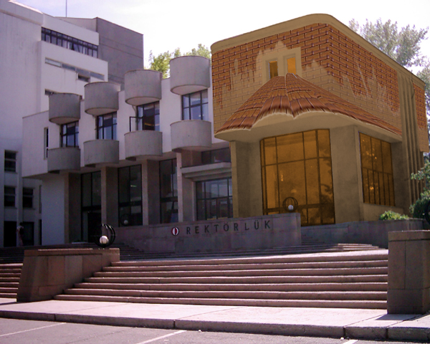
Profile View New
I have filled the walls with a brick pattern and changed the wall color to more warm color (tones of brown). This makes the building more informal. Also I have tried to draw a small roof to wall which resemble to building in hot, holiday places and it also contributes to informality.

Slide 5
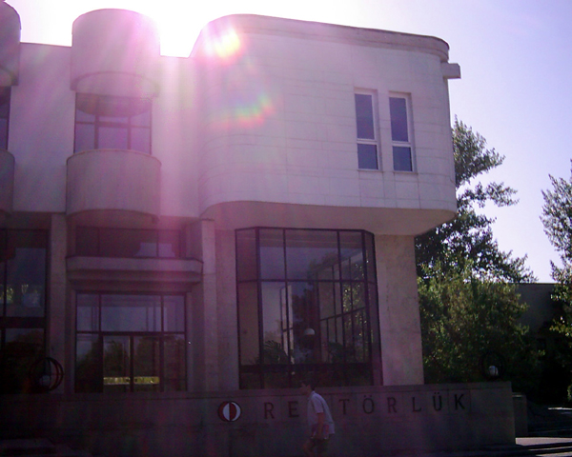
Front View Original
This is the original front view.

Slide 6
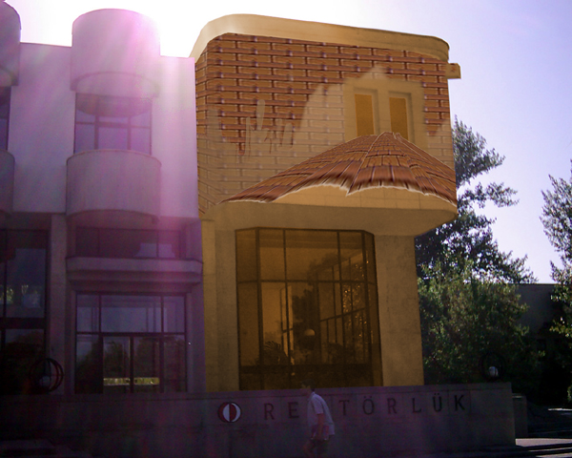
Front View New
In new look, it has the same characteristics with “profile view”. Walls are brick textured, main color is brown and it has a roof. Also, at the bottom, there is a thick light brown line.

Slide 7
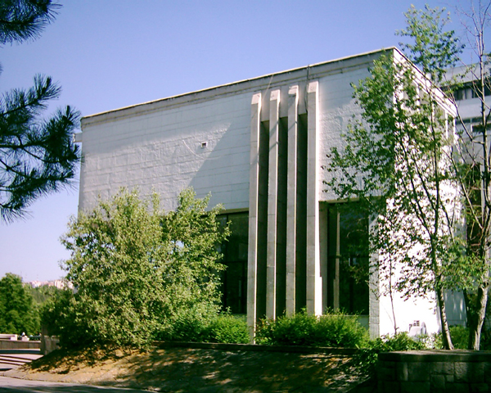
Side View Original
This is the original side view of the building. It has large walls and four block of walls after each other in the middle. And two windows at the bottom.

Slide 8
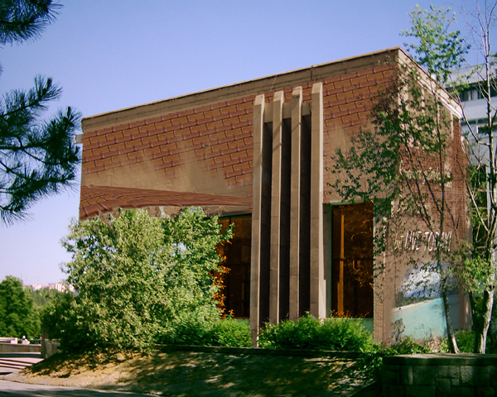
Side View New
In new look, this side has mostly brick textured walls and rest of the walls are brown. Also, it has the some part of the roof figure which can be seem better at “profile view”. Finally, the thick brown line still exist at the top.

Slide 9
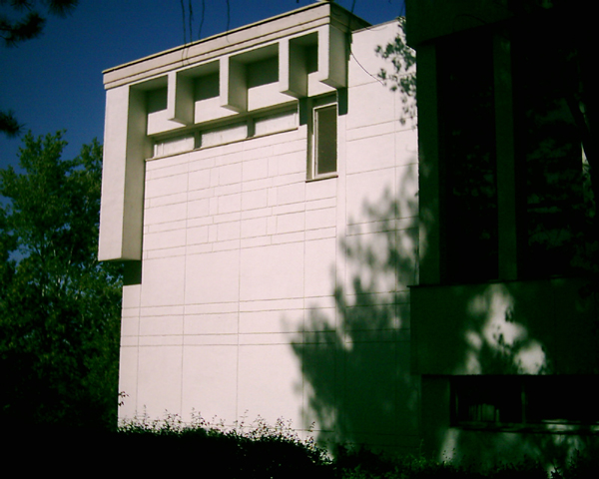
Back View Original
This is the back an the last side of the building. It has still white and flat walls and it has a window.

Slide 10
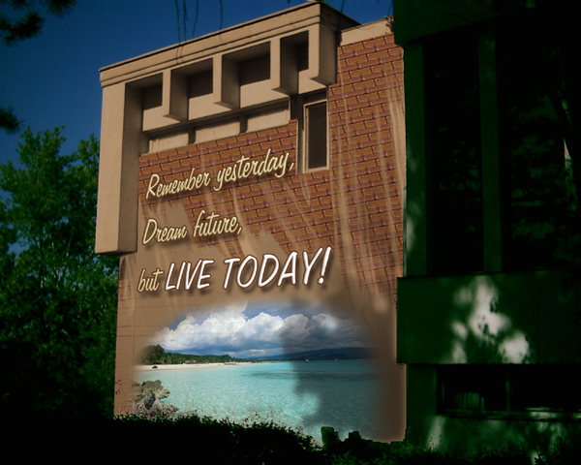
Side View New
In new look, its wall is brick textured and rest of the building id brown. Also, the thick line still exists at tho top. Furthermore, as in all views, window and its border is obvious and light brown. Also, again as in all views, over the brick texture, there is a brown paint layer which blurs while going to high.

Slide 11
Final Notes
I have tried to decrese the formality of the building by using warm colors and smooth shapes such as roof.
I have aimed to make 2 contrast:
  Flat walls vs. Brick walls
  Flat wall vs. Roof which creates a third dimention to that wall

Slide 12
Final Notes
Remember yesterday,
Dream future
but LIVE TODAY!
☺ ☺ ☺

