Slide 1
Alameda

Slide 2
Vision
Alameda is a prediction engine that foresees future resource usage of cluster from the cloud layer down to the instance level.
We use machine learning technology to provide intelligence that enables dynamic scaling and scheduling of your instances - effectively making us the “brain” of cluster resource orchestration.
By providing full foresight of resource availability, demand, health, impact and SLA, we enable cloud strategies that involve changing provisioned resources in real time.

Slide 3
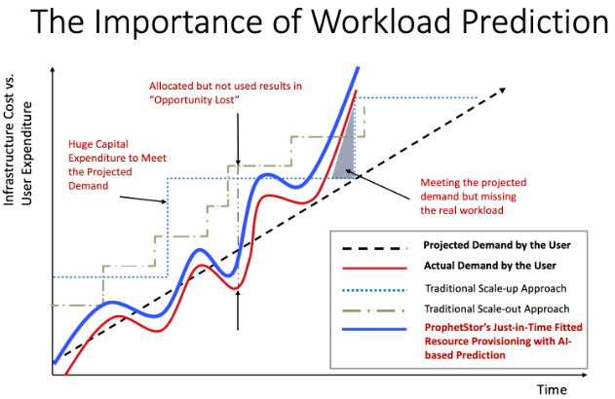

Slide 4
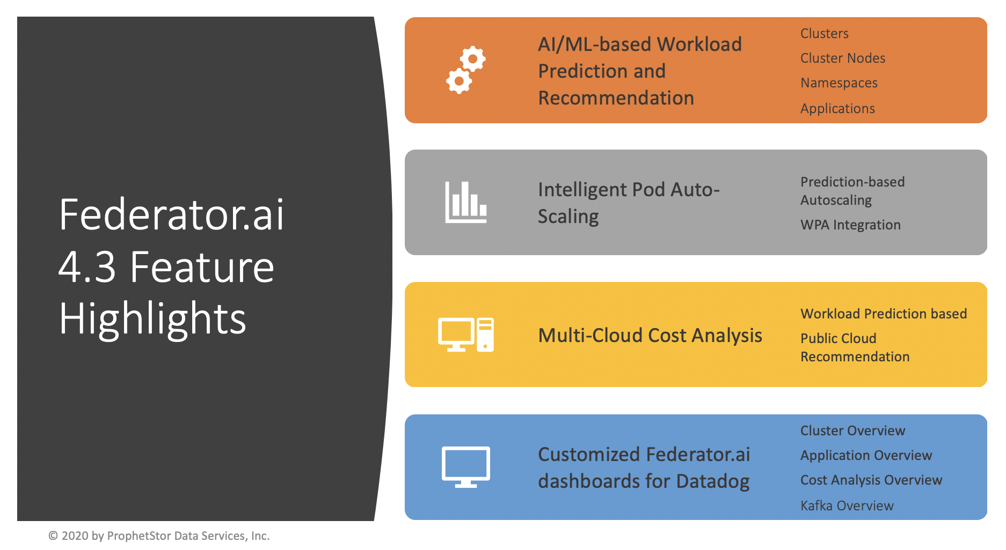

Slide 5
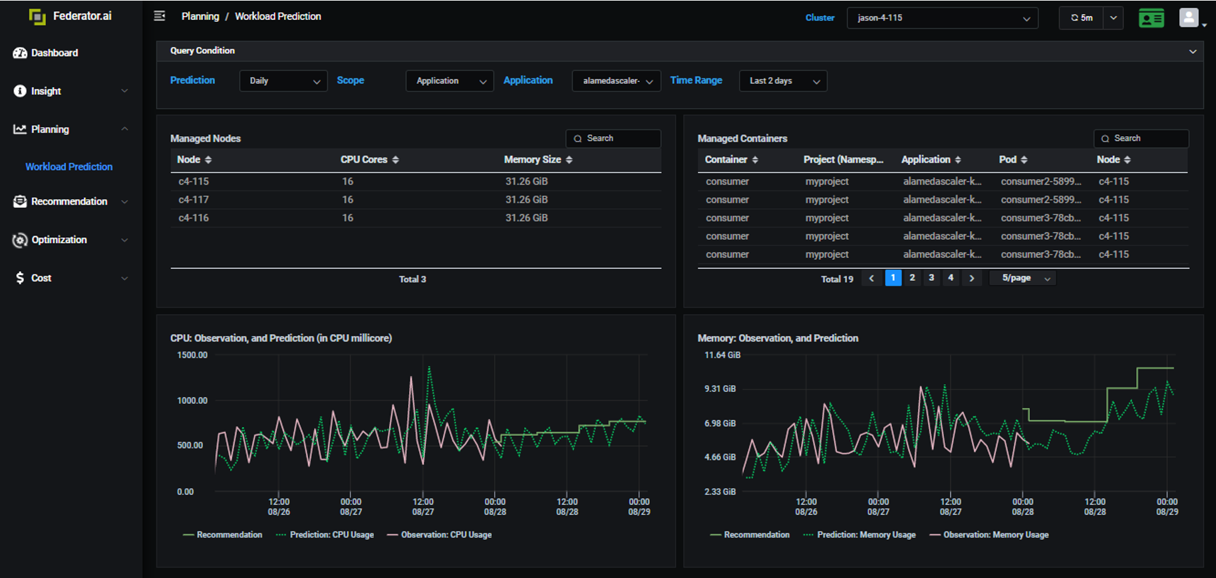

Slide 6
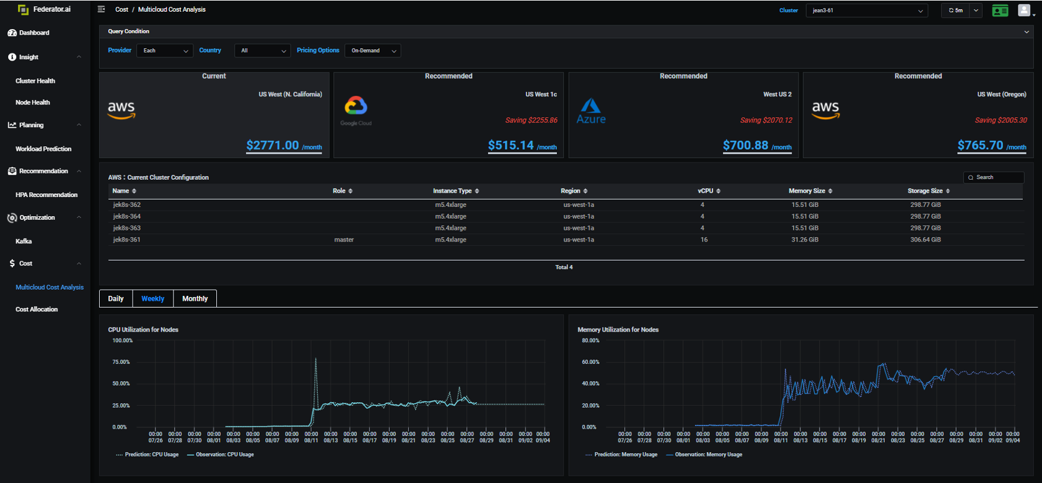

Slide 7
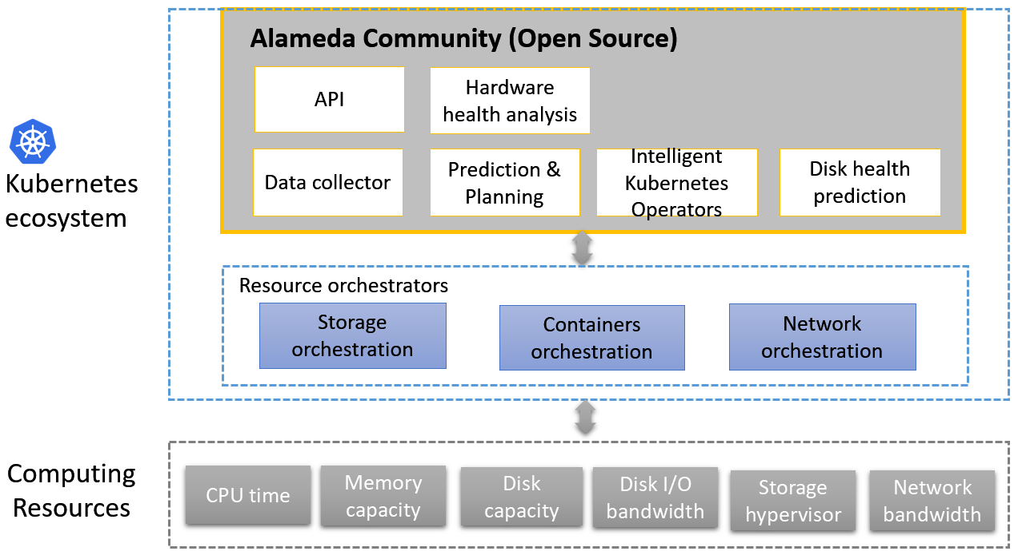

Slide 8
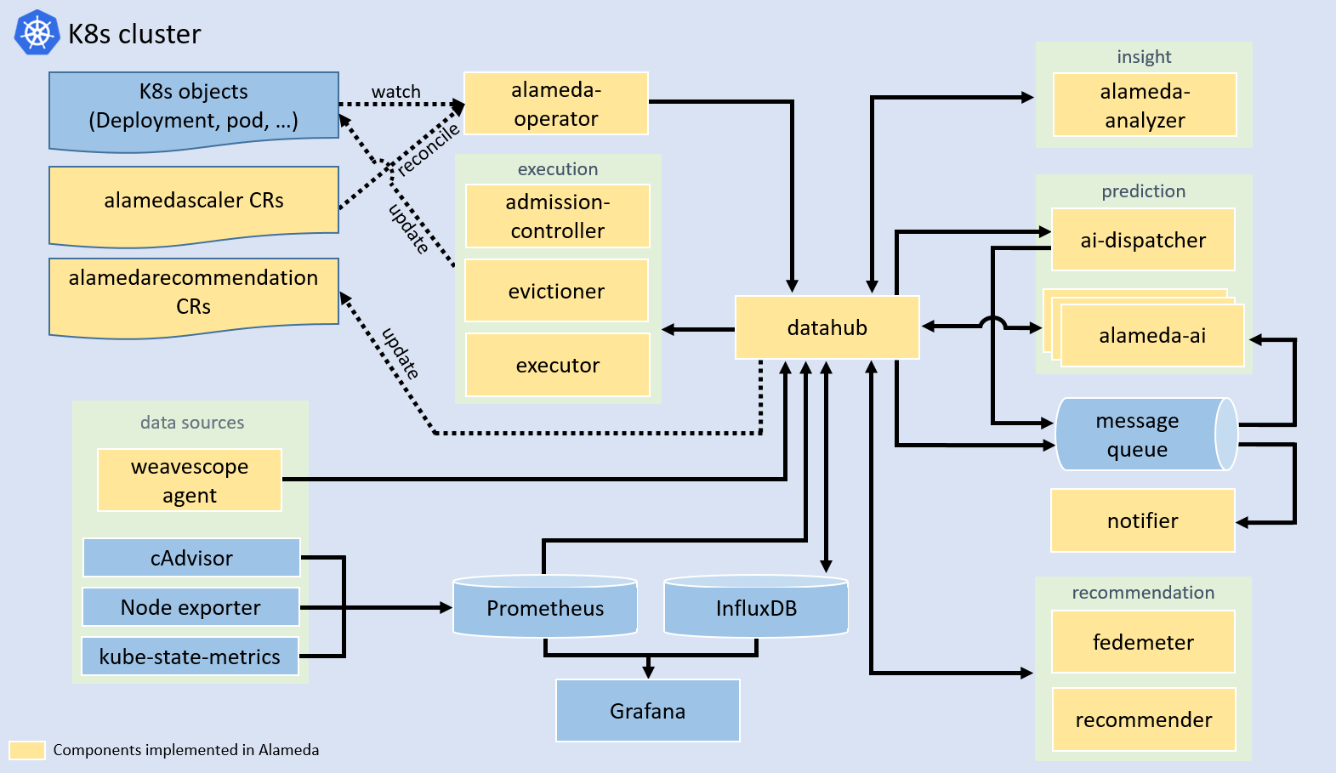

Slide 9
Datahub
0. once cycle of sending job with granularity_{j} is coming, start job sending process
1. get last prediction point of target to get model ID if target not found in model map. However, if target is found in model map, use newMId as model ID to query predict series in later step.
Prediction (granularity_{j}) | (mid₁, pid_{k}, pval_{n})
1
2. use model id from step 1 to get prediction series
now
2
time
3. query metric of target with same time range of prediction series from step 2
(mid₁, pid₁, pval₁)
(mid₁, pid₂, pval₃)
(mid₁, pid_{k}, pval_{n})
(mid₁, pid_{k+1}, pval_{n+2})
3
(mid₁, pid₁, pval₂)
…….…
(mid₁, pid_{k}, pval_{n+1})
…….…
5. If evaluation calculated from step 4 greater than threshold we defined or there are no fresh predict found, check model map
5.1 if no record found in model map, then send model job to queue and add new record in model map
5.2 if record found in model, do not send model job again
AI dispatcher
4
time | t₁ | t₂ | t₃ | … | t_{n}
metrics | mval₁ | mval₂ | mval₃ | … | mval_{n}
Prediction (granularity_{j}) | (mid₁, pid₁, pval₁) | (mid₁, pid₁, pval₂) | (mid₁, pid₂, pval₃) | … | (mid₁, pid_{k}, pval_{n})
5
Queue
6
6. Send predict job of the target directly without any calculation
4. Use metrics and predictions series from step 2 and 3 to calculate evaluation (MAPE or RMSE)
mid: model id
pid: predict id
mval: metric value
pval: predict value
9
model map
8
9. Update newMId in model map when receive model complete job from queue
{
POD: {
30s: {
“ns1/name1”: {
timestamp: xx,
newMId: yy
}
}
}
}
8. Once model job is done, send complete job to notify AI dispatcher and a new predict job to use new model to predict
7
7. AI agent consume model and predict jobs from queue
AI Agent

Slide 10
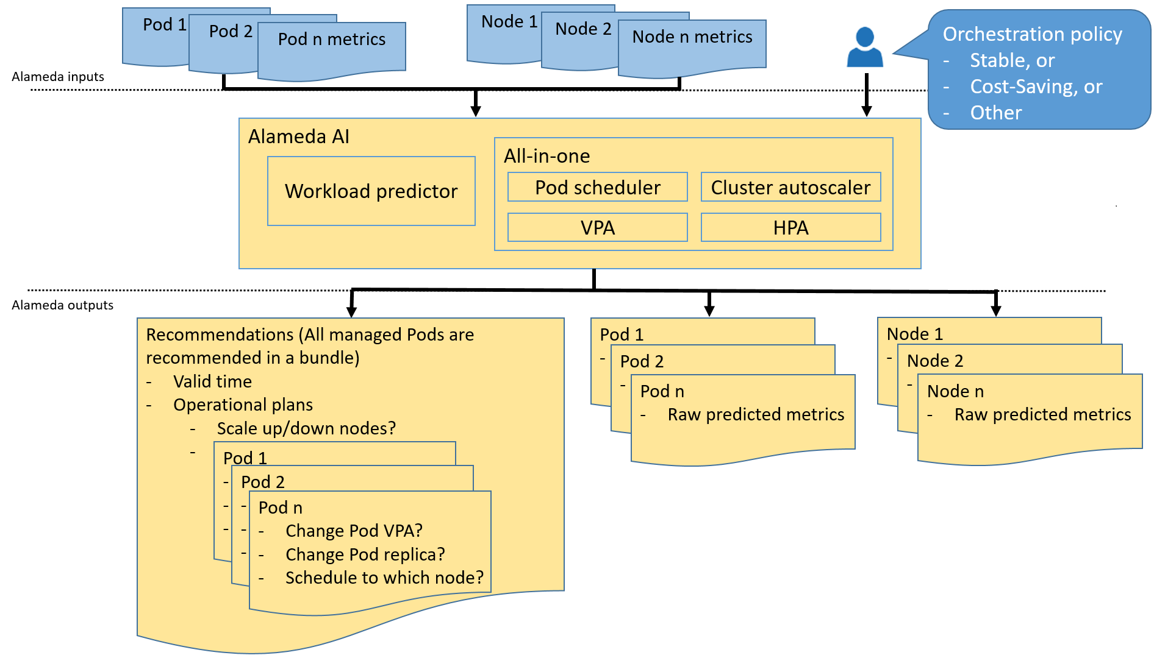

Slide 11
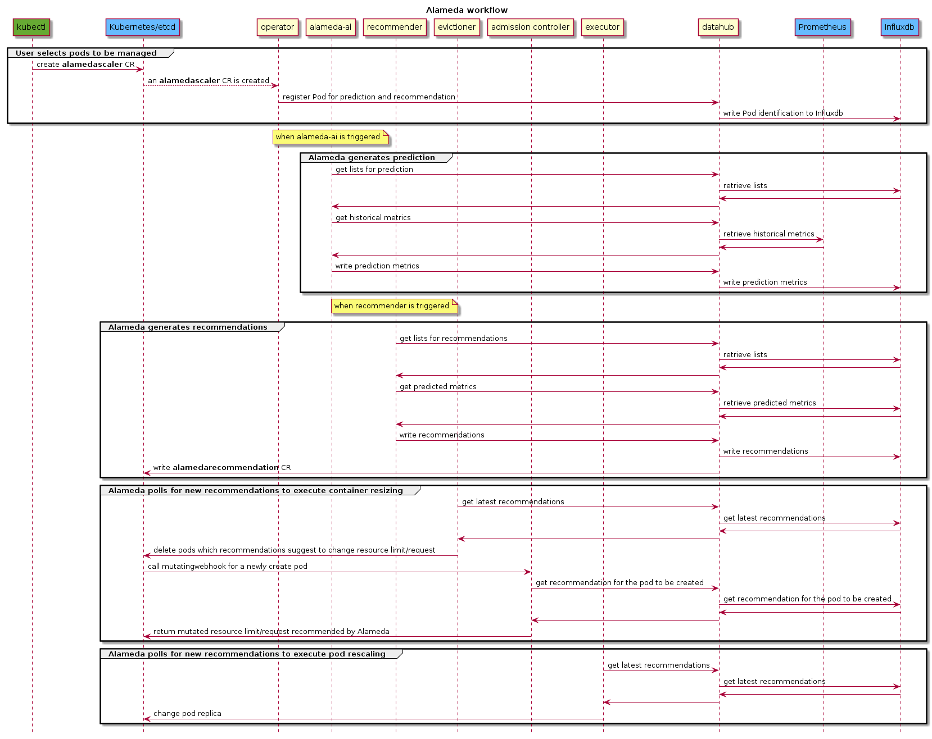

Slide 12
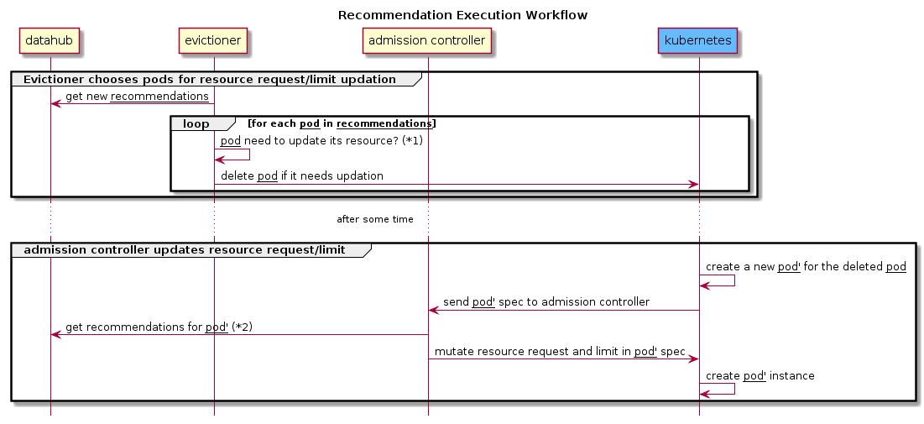

Slide 13
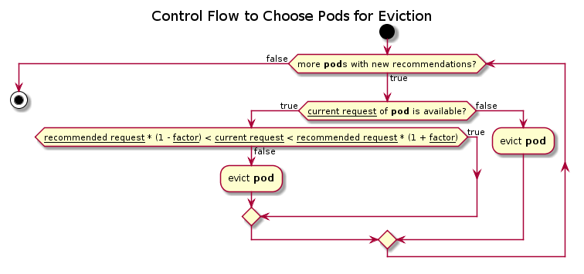

Slide 14
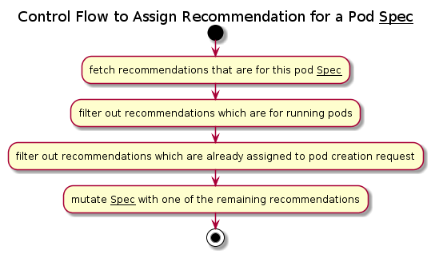

Slide 15
分类 | 模型 | 参考
时序 | ARIMA, LSTM, Prophet | https://www.kaggle.com/cdabakoglu/time-series-forecasting-arima-lstm-prophet
* 性能比较 https://www.hindawi.com/journals/complexity/2020/6622927/

Slide 16
Ai-core datastore
File dao
Influx dao
Metric dao

Slide 17
Ai-core queue
Connection
Consumer

Slide 18
Ai-dispatcher
Datahub
Queue
Service
Granularities: [30s,1m,3m,1h,6h,24h]
Predictunits: [pod, gpu, namespace,application, cluster, controller, node]
Measurement
MAPE, RMSE

Slide 19
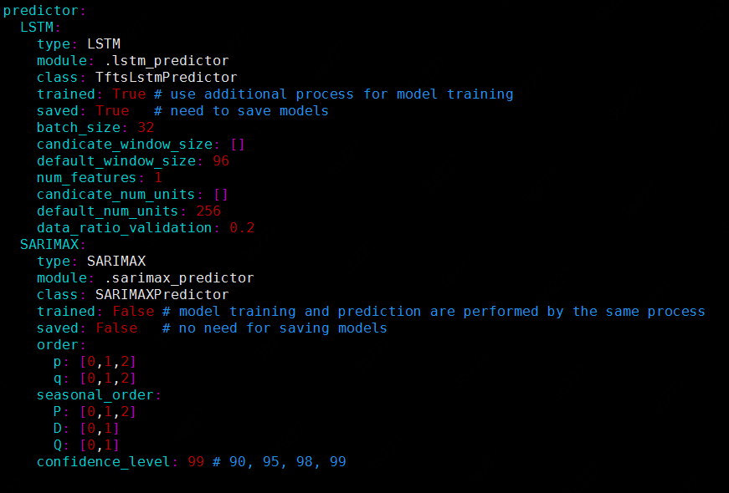
Ai-core workload prediction
Abnormal prediction processor
Data processor
Sarimax/LSTM predictor
Autocorrelation
Preprocessor
Workload predictor
Workload prediction

Slide 20
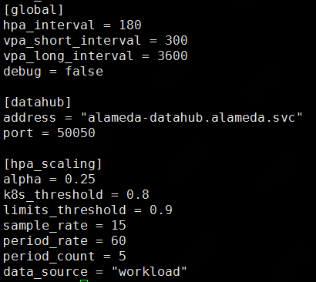
Federatorai-recommender
Fedemeter
Scheduler
Recommender
Processor
HPA
Probe (datahub)

Slide 21
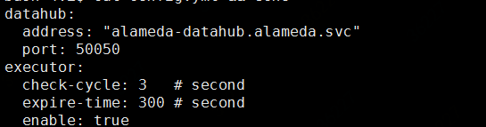
Federatorai-execution
Datahub
Executor
Probe alameda executor (datahub)

Slide 22
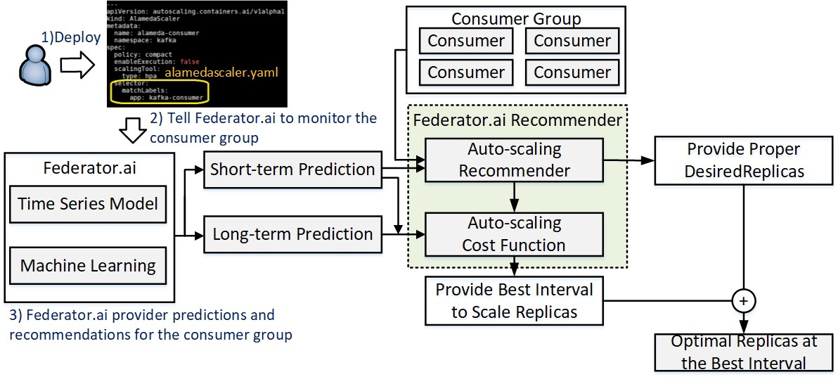
https://prophetstor.medium.com/federator-ai-drastically-improves-cost-and-performance-of-kafka-running-on-kubernetes-92cea48f8887

Slide 23
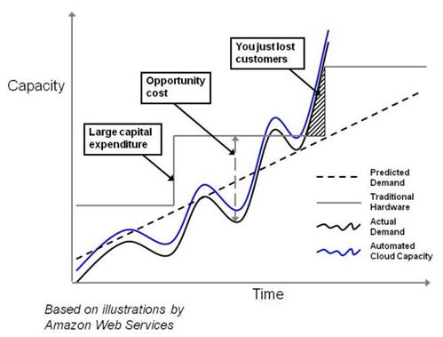
容量 vs. 利用率曲线

