Slide 1


Slide 2
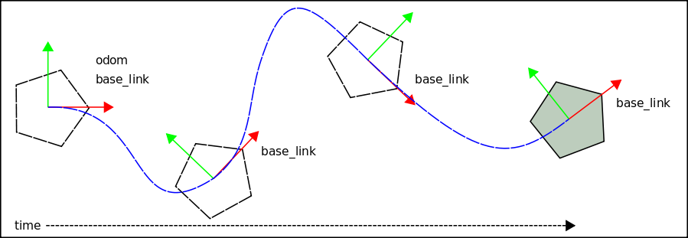
Odometry is the use of data from moving sensors to estimate
change in position over time. Odometry is used by some robots,
whether legged or wheeled, to estimate (not determine) their
position relative to a starting location.
http://en.wikipedia.org/wiki/Odometry

Slide 3
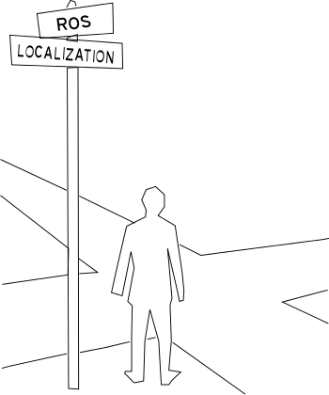
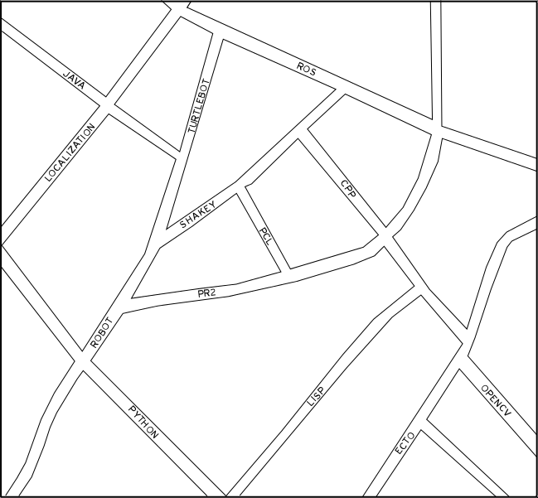
Localization is the process of determining where you with respect
to a known map. When you are navigating in a city you use street
Signs to localize yourself in a map.

Slide 4
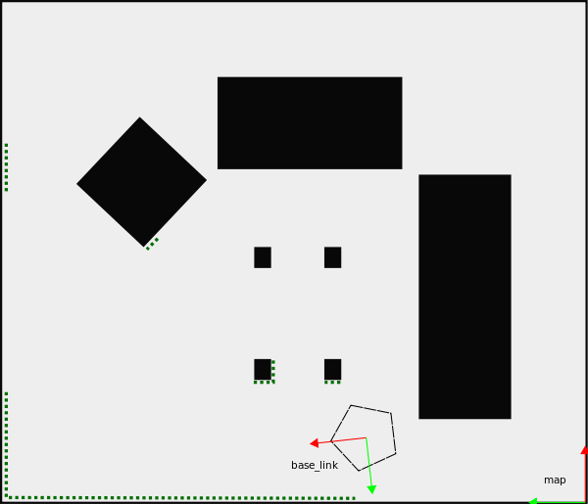
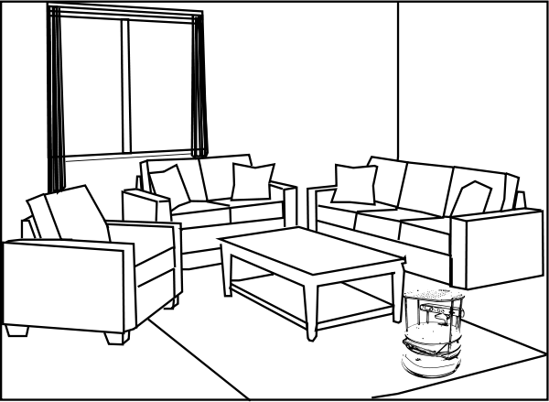
In your home a robot localizes itself using odometry and laser
scan data. The right image shows a map of the image on the
left with robot localized with laser data overlayed on the map
Image. The grey areas of the map show the unobstructed areas
of the map while the black show the obstructed areas.

Slide 5
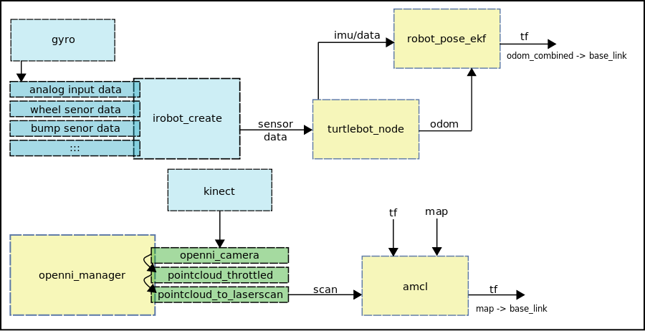
The openni_manager uses the kinect pointcloud data to create
laser scan data for use with amcl. The amcl node uses the scan
Data and odom_combined to compute the transform from the
map to base_link.

Slide 6
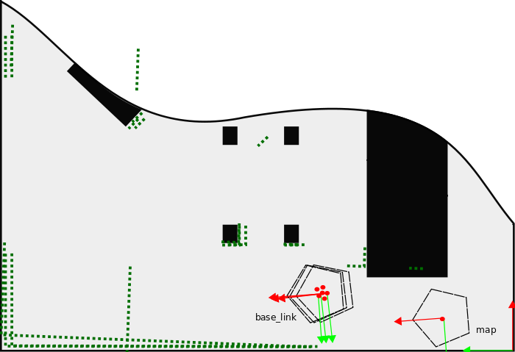
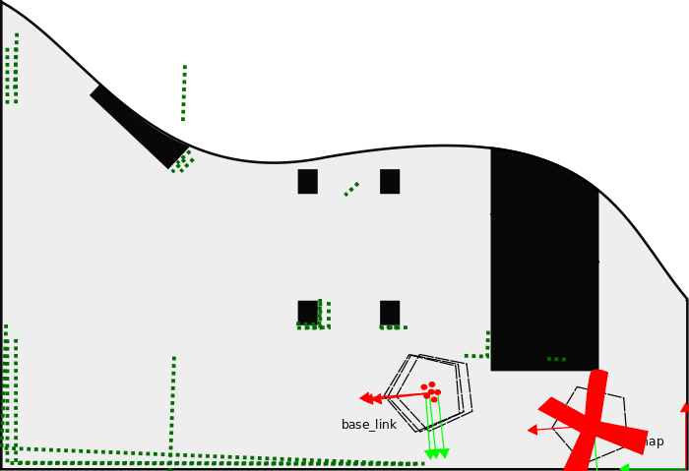
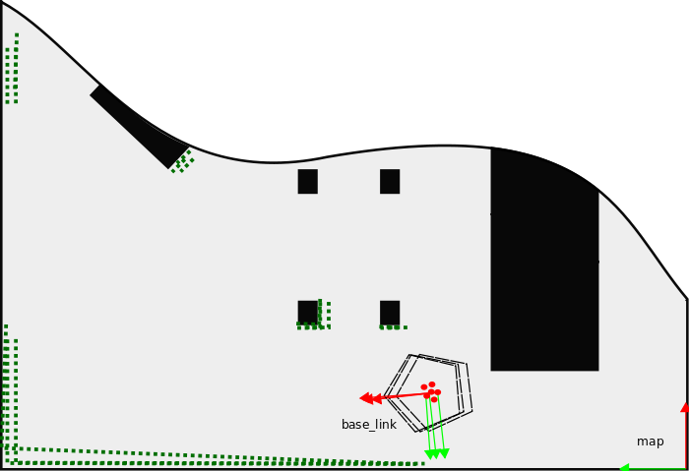
amcl (adaptive Monte Carlo localization) works by figuring out
where the robot would need to be on the map in order for its laser
scans to make sense. Each possible location is represented by a
“particle” and particles with laser scans that do not match well
are removed resulting in a group of particles representing the
location of the robot in the map.

Slide 7
The amcl node uses the particle positions to compute and
publish the transform from map to base_link.

