Slide 1


Slide 2
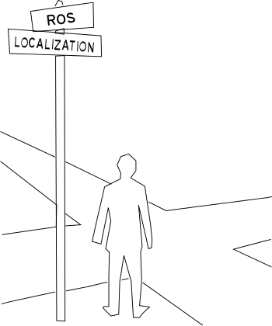
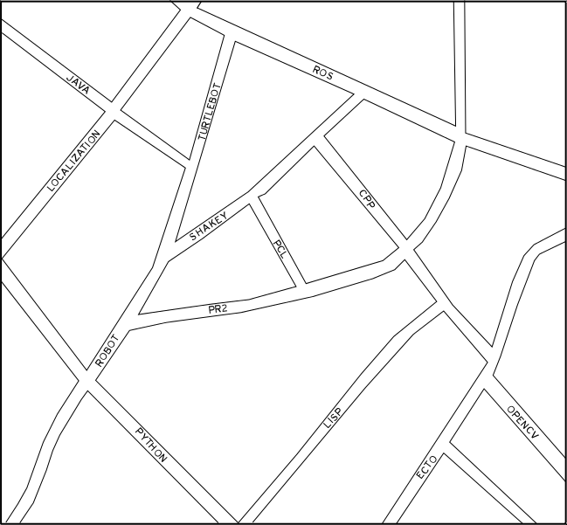
Localization is the process of determining where you are with
respect to a known map. When you are navigating in a city you
use street signs to localize yourself in a map.

Slide 3
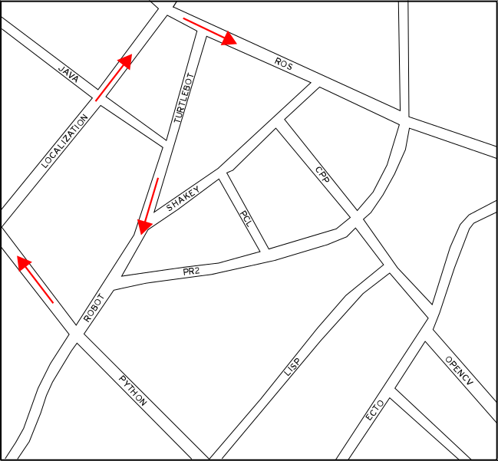
Mapping is the process of constructing a map of an unknown environment. If you wanted to draw a map of a city you would start at a corner and walk the streets while keeping track of distance and signs to construct the map.

Slide 4
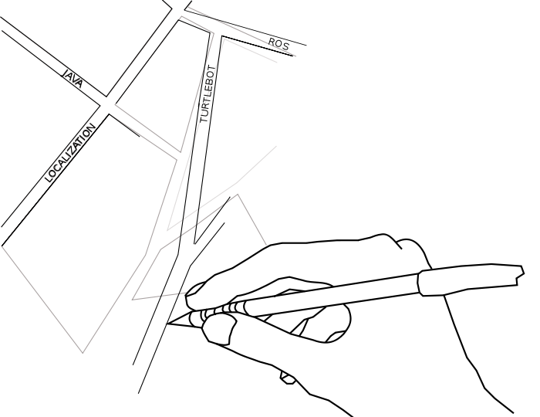
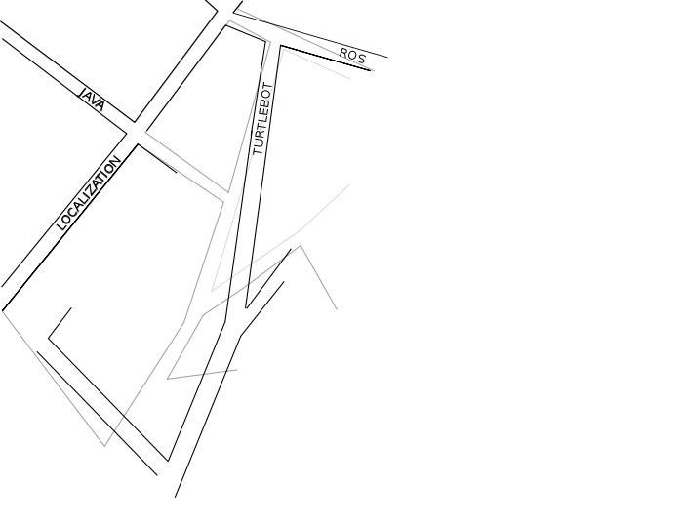
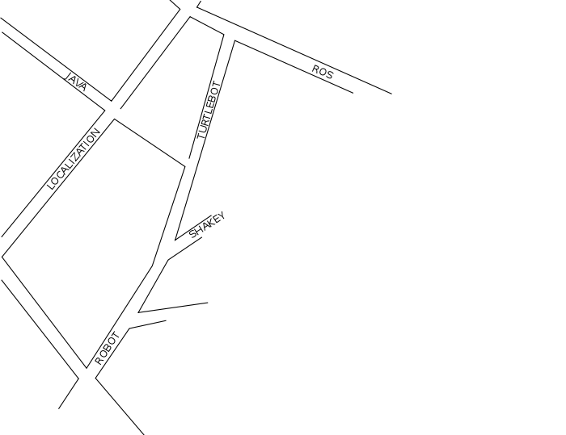
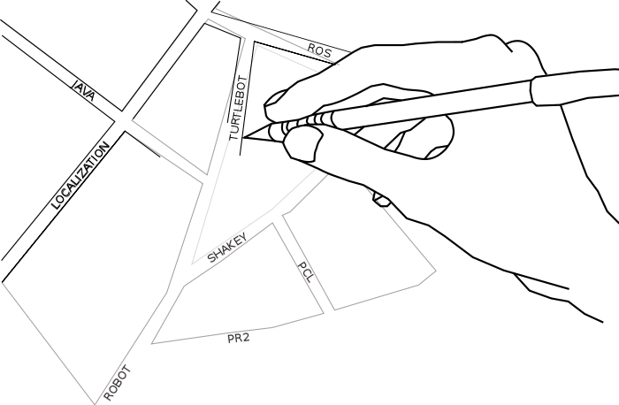
Loop Closure
As you draw a map small errors may accumulate to larger errors.
When you return to an intersection you have been to before the
map can be updated to correct the errors this process is called
loop closure.

