Slide 1


Slide 2
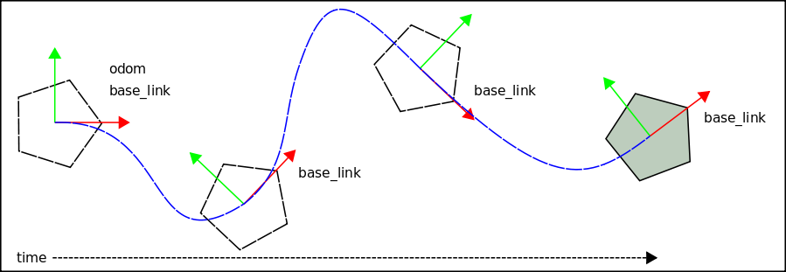
Odometry is the use of data from moving sensors to estimate
change in position over time. Odometry is used by some robots,
whether legged or wheeled, to estimate (not determine) their
position relative to a starting location.
http://en.wikipedia.org/wiki/Odometry

Slide 3
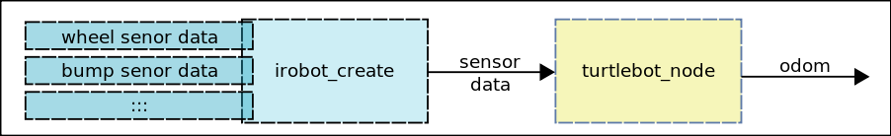
The turtlebot_node takes the sensor data from the irobot create
base and computes the odometry as the TurtleBot moves.

Slide 4
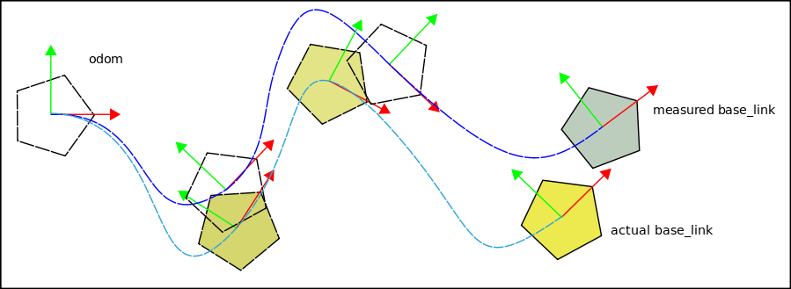
Odometry is used by some robots, whether they be legged or
wheeled, to estimate (not determine) their position relative to a
starting location. Above shows the accumulation of error over
time.

Slide 5
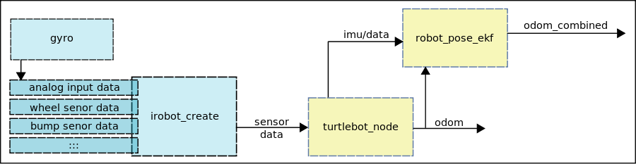
To improve the TurtleBot odometry we have added a gyro to
the irobot create. The robot_pose_ekf node use the gyro and
odom data to compute and publish the more accurate
odom_combined.

Slide 6
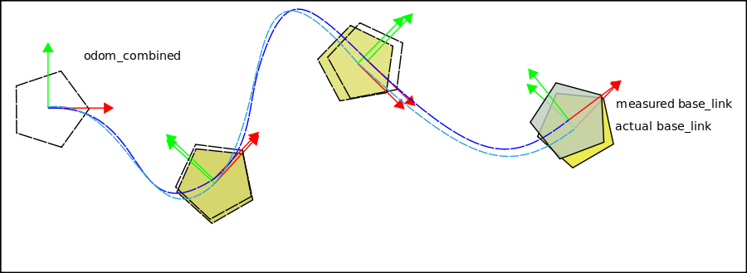
robot_pose_ekf (ekf: extended kalman filter) uses measurements
observed over time, containing noise (random variations) and
other inaccuracies, and produce values that tend to be closer
to the true values of the measurements than their associated
calculated values.
http://en.wikipedia.org/wiki/Kalman_filter

Slide 7
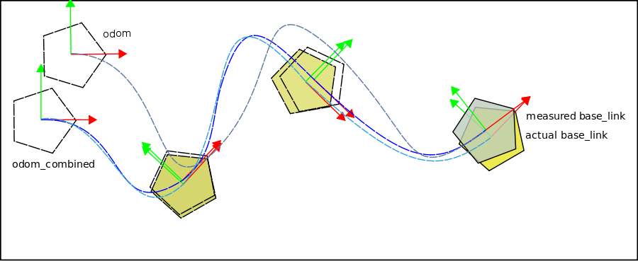
turtlebot_node publishes odom which is the transformation from
odom to base_link
robot_pose_ekf publishes odom_combined which is the
transformation from odom_combined to base_link

