Slide 1
Chapter 8 – Object-Based Programming
Outline
8.2 Implementing Multiple Classes
8.3 Class Scope
8.4 Controlling Access to Members
8.5 Initializing Class Objects: Constructors
8.6 Using Overloaded Constructors
8.7 Properties
8.8 Composition: Objects as Instance Variables of Other Classes
8.9 Using the this Reference
8.10 Garbage Collection
8.11 static Class Members
8.12 const and readonly Members
8.13 Indexers
8.14 Data Abstraction and Information Hiding
8.15 Software Reusability
8.16 Namespaces and Assemblies
8.17 Class View and Object Browser

Slide 2
8.2 Implementing Multiple Classes within same project
Use Project < Add Class to add a new class to your project
  In the Add New Item dialog box, enter the new class name in the Name text box and click Open button.
  Note file name (ending with .cs) appears in Solution Explorer

Slide 3
1 // Fig. 8.1: Time1.cs
2 // Class Time1 maintains time in 24-hour format.
3
4 using System;
5
6 // Time1 class definition
7 public class Time1 : Object
8 {
9 private int hour; // 0-23
10 private int minute; // 0-59
11 private int second; // 0-59
12
13 // Time1 constructor initializes instance variables to
14 // zero to set default time to midnight
15 public Time1()
16 {
17 SetTime( 0, 0, 0 );
18 }
19
20 // Set new time value in 24-hour format. Perform validity
21 // checks on the data. Set invalid values to zero.
22 public void SetTime(
23 int hourValue, int minuteValue, int secondValue )
24 {
25 hour = ( hourValue >= 0 && hourValue < 24 ) ?
26 hourValue : 0;
27 minute = ( minuteValue >= 0 && minuteValue < 60 ) ?
28 minuteValue : 0;
29 second = ( secondValue >= 0 && secondValue < 60 ) ?
30 secondValue : 0;
31 }
32
Default constructor
Private instance variables
Method SetTime

Slide 4
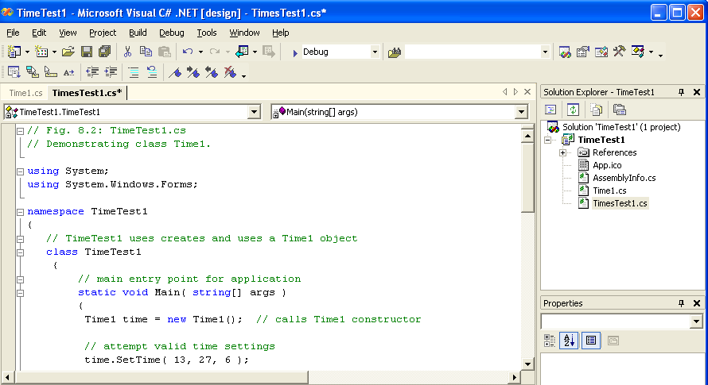
Call method SetTime to set the time with valid arguments
Call default constructor; Operator new used to instantiate class

Slide 5
8.3 Class Scope
All members are accessible within the class’s methods and can be referenced by name
Member Access Modifiers
  public : member is accessible wherever an instance of the object exists
  private : members is accessible only inside the class definition (default)
Outside a class, public members may be referenced using the dot operator (referenceName.memberName )
Method-scope variables
  Only accessible within the methods in which they are defined
  Hide instance variables
    Instance variables may be accessed by using the keyword this and the dot operator (such as this.hour).

Slide 6
8.5 Initializing Class Objects: Constructors
Instances of classes are initialized by constructors
Even if the constructor does not explicitly do so, all data members are initialized
  Primitive numeric types are set to 0
  Boolean types are set to false
  Reference types are set to null
If a class has no constructor, a default constructor is provided
  It has no code and takes no parameters

Slide 7
1 // Fig. 8.4: Time2.cs
2 // Class Time2 provides overloaded constructors.
4 using System;
5
6 // Time2 class definition
7 public class Time2
8 {
9 private int hour; // 0-23
10 private int minute; // 0-59
11 private int second; // 0-59
12
13 // Time2 constructor initializes instance variables to
14 // zero to set default time to midnight
15 public Time2()
16 {
17 SetTime( 0, 0, 0 );
18 }
19
20 // Time2 constructor: hour supplied, minute and second
21 // defaulted to 0
22 public Time2( int hour )
23 {
24 SetTime( hour, 0, 0 );
25 }
26
27 // Time2 constructor: hour and minute supplied, second
28 // defaulted to 0
29 public Time2( int hour, int minute )
30 {
31 SetTime( hour, minute, 0 );
32 }
33
Default constructor
Constructor which takes the hour as the input
Constructor which takes the hour and minute as input

Slide 8
1 // Fig. 8.5: TimeTest2.cs
2 // Using overloaded constructors.
3
4 using System;
5 using System.Windows.Forms;
6
7 // TimeTest2 demonstrates constructors of class Time2
8 class TimeTest2
9 {
10 // main entry point for application
11 static void Main( string[] args )
12 {
13 Time2 time1, time2, time3, time4, time5, time6;
14
15 time1 = new Time2(); // 00:00:00
16 time2 = new Time2( 2 ); // 02:00:00
17 time3 = new Time2( 21, 34 ); // 21:34:00
18 time4 = new Time2( 12, 25, 42 ); // 12:25:42
19 time5 = new Time2( 27, 74, 99 ); // 00:00:00
20 time6 = new Time2( time4 ); // 12:25:42
Test the constructors

Slide 9
8.7 Properties
Public properties allow clients to:
  Get (obtain the values of) private data
    But controls formatting and display
  Set (assign values to) private data
    But scrutinizes attempts to modify value
56 // property Hour
57 public int Hour
58 {
59 get
60 {
61 return hour;
62 }
63
64 set
65 {
66 hour = ( ( value >= 0 && value < 24 ) ? value : 0 );
67 }
Note capitalization

Slide 10
101 // convert time to universal-time (24 hour) format string
102 public string ToUniversalString()
103 {
104 return String.Format(
105 "{0:D2}:{1:D2}:{2:D2}", Hour, Minute, Second );
106 }
107
108 // convert time to standard-time (12 hour) format string
109 public string ToStandardString()
110 {
111 return String.Format( "{0}:{1:D2}:{2:D2} {3}",
112 ( ( Hour == 12 || Hour == 0 ) ? 12 : Hour % 12 ),
113 Minute, Second, ( Hour < 12 ? "AM" : "PM" ) );
114 }
115
116 } // end class Time3

Slide 11
2 // Windows Application to demonstrate Time3 properties Hour, Minute and Second.
11 // TimeTest3 class definition
12 public class TimeTest3 : System.Windows.Forms.Form
13 {
private Time3 time;
36 public TimeTest3()
37 {
38 // Required for Windows Form Designer support
39 InitializeComponent();
40
41 time = new Time3();
42 UpdateDisplay();
43 }
44
45 // Visual Studio .NET generated code
46
47 // main entry point for application
48 [STAThread]
49 static void Main()
50 {
51 Application.Run( new TimeTest3() );
52 }
53
54 // update display labels
55 public void UpdateDisplay()
56 {
57 displayLabel1.Text = "Hour: " + time.Hour + "; Minute: " + time.Minute +
59 "; Second: " + time.Second;
60 displayLabel2.Text = "Standard time: " + time.ToStandardString() +
61 "\nUniversal time: " + time.ToUniversalString();
63 }

Slide 12
65 // set Hour property when hourButton pressed
66 private void hourButton_Click(
67 object sender, System.EventArgs e )
68 {
69 time.Hour = Int32.Parse( hourTextBox.Text );
70 hourTextBox.Text = "";
71 UpdateDisplay();
72 }
73
91
92 // add one to Second when addButton pressed
93 private void addButton_Click(
94 object sender, System.EventArgs e )
95 {
96 time.Second = ( time.Second + 1 ) % 60;
97
98 if ( time.Second == 0 )
99 {
100 time.Minute = ( time.Minute + 1 ) % 60;
101
102 if ( time.Minute == 0 )
103 time.Hour = ( time.Hour + 1 ) % 24;
104 }
105
106 UpdateDisplay();
107 }
Add 1 second to Time3 object
Set Hour property of Time3 object

Slide 13
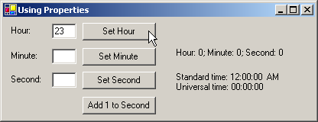
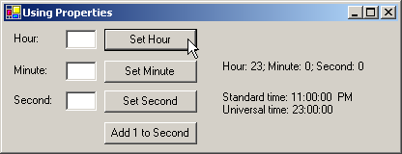

Slide 14
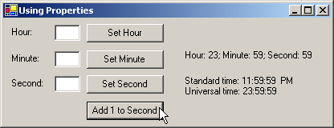


Slide 15
8.8 Composition: Object References as Instance Variables of Other Classes
Software Reuse – referencing existing object is easier and faster then rewriting the objects’ code for new classes
Use user-defined types as instance variables

Slide 16
Date.cs
1 // Fig. 8.8: Date.cs
2 // Date class definition encapsulates month, day and year.
3
4 using System;
5
6 // Date class definition
7 public class Date
8 {
9 private int month; // 1-12
10 private int day; // 1-31 based on month
11 private int year; // any year
12
13 // constructor confirms proper value for month;
14 // call method CheckDay to confirm proper
15 // value for day
16 public Date( int theMonth, int theDay, int theYear )
17 {
18 // validate month
19 if ( theMonth > 0 && theMonth <= 12 )
20 month = theMonth;
21
22 else
23 {
24 month = 1;
25 Console.WriteLine(
26 "Month {0} invalid. Set to month 1.", theMonth );
27 }
28
29 year = theYear; // could validate year
30 day = CheckDay( theDay ); // validate day
31 }
32

Slide 17
1 // Fig. 8.9: Employee.cs
2 // Employee class definition encapsulates employee's first name,
3 // last name, birth date and hire date.
4
5 using System;
6
7 // Employee class definition
8 public class Employee
9 {
10 private string firstName;
11 private string lastName;
12 private Date birthDate;
13 private Date hireDate;
14
15 // constructor initializes name, birth date and hire date
16 public Employee( string first, string last,
17 int birthMonth, int birthDay, int birthYear,
18 int hireMonth, int hireDay, int hireYear )
19 {
20 firstName = first;
21 lastName = last;
22
23 // create new Date for Employee birth day
24 birthDate = new Date( birthMonth, birthDay, birthYear );
25 hireDate = new Date( hireMonth, hireDay, hireYear );
26 }
Two Date objects are members of the Employee class
Constructor that initializes the employee’s name, birth date and hire date

Slide 18
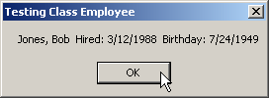
1 // Fig. 8.10: CompositionTest.cs
2 // Demonstrate an object with member object reference.
3
4 using System;
5 using System.Windows.Forms;
6
7 // Composition class definition
8 class CompositionTest
9 {
10 // main entry point for application
11 static void Main( string[] args )
12 {
13 Employee e =
14 new Employee( "Bob", "Jones", 7, 24, 1949, 3, 12, 1988 );
15
16 MessageBox.Show( e.ToEmployeeString(),
17 "Testing Class Employee" );
18
19 } // end method Main
20
21 } // end class CompositionTest

Slide 19
8.9 Using the this reference
Every object can reference itself by using the keyword this
Often used to distinguish between a method’s variables and the instance variables of an object

Slide 20
Time4.cs
1 // Fig. 8.11: Time4.cs
2 // Class Time2 provides overloaded constructors.
3
4 using System;
5
6 // Time4 class definition
7 public class Time4
8 {
9 private int hour; // 0-23
10 private int minute; // 0-59
11 private int second; // 0-59
12
13 // constructor
14 public Time4( int hour, int minute, int second )
15 {
16 this.hour = hour;
17 this.minute = minute;
18 this.second = second;
19 }
20
21 // create string using this and implicit references
22 public string BuildString()
23 {
24 return "this.ToStandardString(): " +
25 this.ToStandardString() +
26 "\nToStandardString(): " + ToStandardString();
27 }
28
The this reference is used to set the class member variables to the constructor arguments
The this reference is used to refer to an instance method

Slide 21
8.10 Garbage Collection
Operator new allocates memory
When objects are no longer referenced, the CLR performs garbage collection
Garbage collection helps avoid memory leaks (running out of memory because unused memory has not been reclaimed)
Allocation and deallocation of other resources (database connections, file access, etc.) must be explicitly handled by programmers

Slide 22
8.10 Garbage Collection
Use finalizers in conjunction with the garbage collector to release resources and memory
Before garbage collector reclaims an object’s memory, it calls the object’s finalizer
Each class has only one finalizer (also called destructor)
Name of a destructor is the ~ character, followed by the class name
Destructors do not receive any arguments

Slide 23
8.11 static Class Members
Every object of a class has its own copy of all instance variables
Sometimes it is useful if all instances of a class share the same copy of a variable
Declare these variables using keyword static
Scope may be defined for static variables (public, private, etc.)

Slide 24
1 // Fig. 8.13: Employee.cs
2 // Employee class contains static data and a static method.
3
4 using System;
5
6 // Employee class definition
7 public class Employee
8 {
9 private string firstName;
10 private string lastName;
11 private static int count; // Employee objects in memory
12
13 // constructor increments static Employee count
14 public Employee( string fName, string lName )
15 {
16 firstName = fName;
17 lastName = lName;
18
19 ++count;
20
21 Console.WriteLine( "Employee object constructor: " +
22 firstName + " " + lastName + "; count = " + Count );
23 }
24
25 // destructor decrements static Employee count
26 ~Employee()
27 {
28 --count;
29
30 Console.WriteLine( "Employee object destructor: " +
31 firstName + " " + lastName + "; count = " + Count );
32 }
33
Employee destructor
Update number of Employees
Decrease static member count, to signify that there is one less employee

Slide 25
Employee.cs
52 // static Count property
53 public static int Count
54 {
55 get
56 {
57 return count;
58 }
59 }

Slide 26
StaticTest.cs
1 // Fig. 8.14: StaticTest.cs
2 // Demonstrating static class members.
3
4 using System;
5
6 // StaticTest class definition
7 class StaticTest
8 {
9 // main entry point for application
10 static void Main( string[] args )
11 {
12 Console.WriteLine( "Employees before instantiation: " +
13 Employee.Count + "\n" );
14
15 // create two Employees
16 Employee employee1 = new Employee( "Susan", "Baker" );
17 Employee employee2 = new Employee( "Bob", "Jones" );
18
19 Console.WriteLine( "\nEmployees after instantiation: " +
20 "Employee.Count = " + Employee.Count + "\n" );
21
22 // display the Employees
23 Console.WriteLine( "Employee 1: " + employee1.FirstName + " " + employee1.LastName +
25 "\nEmployee 2: " + employee2.FirstName + " " + employee2.LastName + "\n" );
27
28 // mark employee1 and employee1 objects for garbage collection
30 employee1 = null;
31 employee2 = null;
32
33 // force garbage collection
34 System.GC.Collect();
Create 2 Employee objects
Set Employee objects to null
Force garbage collection

Slide 27
Employees before instantiation: 0
Employee object constructor: Susan Baker; count = 1
Employee object constructor: Bob Jones; count = 2
Employees after instantiation: Employee.Count = 2
Employee 1: Susan Baker
Employee 2: Bob Jones
Employee object destructor: Bob Jones; count = 1
Employee object destructor: Susan Baker; count = 0
Employees after garbage collection: 2

Slide 28
8.12 const and readonly Members
Declare constant members (members whose value will never change) using the keyword const
const members are implicitly static (they are shared by all instances of the class)
const members must be initialized when they are declared
Use keyword readonly to declare members who will be initialized in the constructor but not change after that

Slide 29
UsingConstAndReadOnly.cs
Readonly variable radius; must be initialized in constructor
1 // Fig. 8.15: UsingConstAndReadOnly.cs3
4 using System;
5 using System.Windows.Forms;
6
7 // Constants class definition
8 public class Constants
9 {
10 // PI is constant variable
11 public const double PI = 3.14159;
12
13 // radius is a constant variable that is uninitialized
15 public readonly int radius;
16
17 public Constants( int radiusValue )
18 {
19 radius = radiusValue;
20 }
21
22 } // end class Constants
23
24 // UsingConstAndReadOnly class definition
25 public class UsingConstAndReadOnly
26 {
27 // method Main creates Constants object and displays it's values
29 static void Main( string[] args )
30 {
31 Random random = new Random();
32
33 Constants constantValues =
34 new Constants( random.Next( 1, 20 ) );
Constant variable PI
Initialize readonly member radius

Slide 30
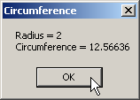
36 MessageBox.Show( "Radius = " + constantValues.radius + "\nCircumference = " +
38 2 * Constants.PI * constantValues.radius, "Circumference" );
40
41 } // end method Main
42
43 } // end class UsingConstAndReadOnly

Slide 31
8.13 Indexers
Sometimes a classes encapsulates data which is like a list of elements
Indexers are special properties that allow array-style access to the data in the class
Indexers can be defined to accept both integer and non-integer subscripts
Defined using the keyword this
When using indexers, programmers use the bracket ([]) notation, as with arrays, for get and set accessors

Slide 32
Indexer declaration; indexer receives an integer to specify which dimension is wanted
1 // Fig. 8.10: IndexerTest.cs
2 // Indexers provide access to an object's members via a
3 // subscript operator.
11
12 // Box class definition represents a box with length,
13 // width and height dimensions
14 public class Box
15 {
16 private string[] names = { "length", "width", "height" };
17 private double[] dimensions = new double[ 3 ];
18
19 // constructor
20 public Box( double length, double width, double height )
21 {
22 dimensions[ 0 ] = length;
23 dimensions[ 1 ] = width;
24 dimensions[ 2 ] = height;
25 }
26
27 // access dimensions by index number
28 public double this[ int index ]
29 {
30 get
31 {
32 return ( index < 0 || index > dimensions.Length ) ?
33 -1 : dimensions[ index ];
34 }
The get index accessor
If the index requested is out of bounds, return –1; otherwise, return the appropriate element

Slide 33
IndexerTest.cs
36 set
37 {
38 if ( index >= 0 && index < dimensions.Length )
39 dimensions[ index ] = value;
40 }
41
42 } // end numeric indexer
43
44 // access dimensions by their names
45 public double this[ string name ]
46 {
47 get
48 {
49 // locate element to get
50 int i = 0;
51
52 while ( i < names.Length &&
53 name.ToLower() != names[ i ] )
54 i++;
56 return ( i == names.Length ) ? -1 : dimensions[ i ];
57 }
58
59 set
60 {
61 // locate element to set
62 int i = 0;
63
64 while ( i < names.Length &&
65 name.ToLower() != names[ i ] )
66 i++;
67
68 if ( i != names.Length )
69 dimensions[ i ] = value;
70 }
72 } // end indexer
74 } // end class Box
Indexer that takes the name of the dimension as an argument
The set accessor for the index
Validate that the user wishes to set a valid index in the array and then set it

Slide 34
IndexerTest.cs
75
76 // Class IndexerTest
77 public class IndexerTest : System.Windows.Forms.Form
78 {
95
96 private Box box;
97
98 // constructor
99 public IndexerTest()
100 {
101 // required for Windows Form Designer support
InitializeComponent();
103
104 // create block
105 box = new Box( 0.0, 0.0, 0.0 );
106 }

Slide 35
IndexerTest.cs
Use the get accessor of the indexer
Use the set accessor of the indexer
107
108 // Visual Studio .NET generated code
116
117 // display value at specified index number
118 private void ShowValueAtIndex( string prefix, int index )
119 {
120 resultTextBox.Text =
121 prefix + "box[ " + index + " ] = " + box[ index ];
122 }
123
124 // display value with specified name
125 private void ShowValueAtIndex( string prefix, string name )
126 {
127 resultTextBox.Text =
128 prefix + "box[ " + name + " ] = " + box[ name ];
129 }
130
131 // clear indexTextBox and valueTextBox
132 private void ClearTextBoxes()
133 {
134 indexTextBox.Text = "";
135 valueTextBox.Text = "";
136 }
137

Slide 36
IndexerTest.cs
138 // get value at specified index
139 private void intGetButton_Click(object sender, System.EventArgs e )
141 {
142 ShowValueAtIndex(
143 "get: ", Int32.Parse( indexTextBox.Text ) );
144 ClearTextBoxes();
145 }
146
147 // set value at specified index
148 private void intSetButton_Click(object sender, System.EventArgs e )
150 {
151 int index = Int32.Parse( indexTextBox.Text );
152 box[ index ] = Double.Parse( valueTextBox.Text );
153
154 ShowValueAtIndex( "set: ", index );
155 ClearTextBoxes();
156 }
157
158 // get value with specified name
159 private void nameGetButton_Click(object sender, System.EventArgs e )
161 {
162 ShowValueAtIndex( "get: ", indexTextBox.Text );
163 ClearTextBoxes();
164 }
Use integer indexer to set value
Use integer indexer to get value
Use string indexer to get value

Slide 37
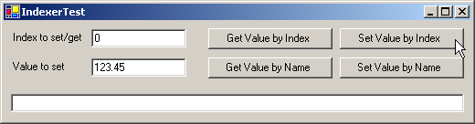
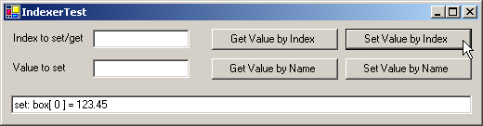
166 // set value with specified name
167 private void nameSetButton_Click(
168 object sender, System.EventArgs e )
169 {
170 box[ indexTextBox.Text ] =
171 Double.Parse( valueTextBox.Text );
172
173 ShowValueAtIndex( "set: ", indexTextBox.Text );
174 ClearTextBoxes();
175 }
176
177 } // end class IndexerTest
Use string indexer to set value
Before setting value by index number
After setting value by index number

Slide 38
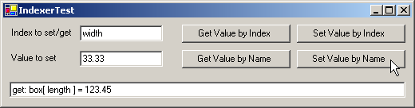
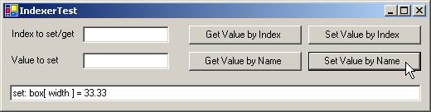
IndexerTest.cs
Program Output
Before setting value by dimension name
After setting value by dimension name

Slide 39
8.15 Software Reusability
The Framework Class Library (FCL) contains thousands of predefined classes
The FCL classes should be used whenever possible
  No bugs
  Optimized
  Well-documented
Reusing code facilitates Rapid Application Development (RAD)

Slide 40
8.16 Namespaces and Assemblies
Programmers should make software components reusable
Two classes may have same name → collision
Namespaces provide logical grouping of classes
Classes in different namespaces may have the same name
No two classes in the same namespace may have the same name
Dynamic Link Libraries (.dll files) allow classes to be packaged for reuse

Slide 41
TimeLibrary.cs
1 // Fig. 8.17: TimeLibrary.cs
2 // Placing class Time3 in an assembly for reuse.
3
4 using System;
5
6 namespace TimeLibrary
7 {
8 // Time3 class definition
9 public class Time3
10 {
11 private int hour; // 0-23
12 private int minute; // 0-59
13 private int second; // 0-59
14
15 // Time3 constructor initializes instance variables to
16 // zero to set default time to midnight
17 public Time3()
18 {
19 SetTime( 0, 0, 0 );
20 }
21
22 // Time3 constructor: hour supplied, minute and second
23 // defaulted to 0
24 public Time3( int hour )
25 {
26 SetTime( hour, 0, 0 );
}
.
:
118 } // end class Time3
119 }
Define the TimeLibrary namespace
Only public classes can be reused from class libraries. Non-public classes can be used only by other classes in the same assembly.

Slide 42
Packaging a Class into Dynamic Link Library
Programs load dll’s at execution time
A dll represents an assembly
When a project uses a class library, the project must contain a reference to the assembly that defines the class library.
DEMO

Slide 43
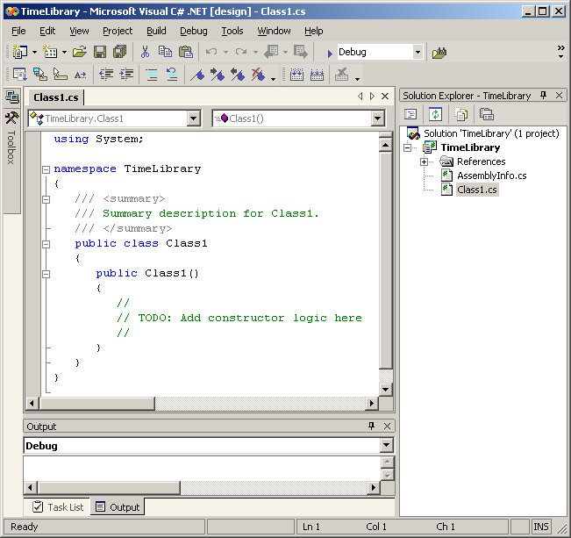
8.16 Namespaces and Assemblies
No main method

Slide 44
1 // Fig. 8.19: AssemblyTest.cs
2 // Using class Time3 from assembly TimeLibrary.
3
4 using System;
5 using TimeLibrary;
6
7 // AssemblyTest class definition
8 class AssemblyTest
9 {
10 // main entry point for application
11 static void Main( string[] args )
12 {
13 Time3 time = new Time3( 13, 27, 6 );
14
15 Console.WriteLine(
16 "Standard time: {0}\nUniversal time: {1}\n",
17 time.ToStandardString(), time.ToUniversalString() );
18 }
19 }
Use Time3 as usual
Reference the TimeLibrary namespace
Standard time: 1:27:06 PM
Universal time: 13:27:06

Slide 45
8.17 Class View and Object Browser
Class View and Object Browser are features of Visual Studio that facilitate the design of object-oriented applications
Class View
  Displays variables and methods for all classes in a project
  Displays as treeview hierarchical structure
  + at nodes allows nodes to be expanded
  - at nodes allows nodes to be collapsed
  Can be seen by selecting View < Class View

Slide 46
8.17 Class View and Object Browser
Object Browser
  Lists all classes in a library
  Helps developers learn about the functionality of a specific class
  To view the Object Browser select any .NET FCL method and select Go To Definition

Slide 47
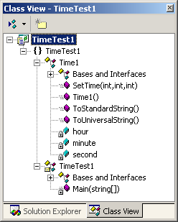
8.17 Class View and Object Browser
Fig. 8.20 Class View of class Time1 (Fig. 8.1) and class TimeTest (Fig. 8.2).

Slide 48
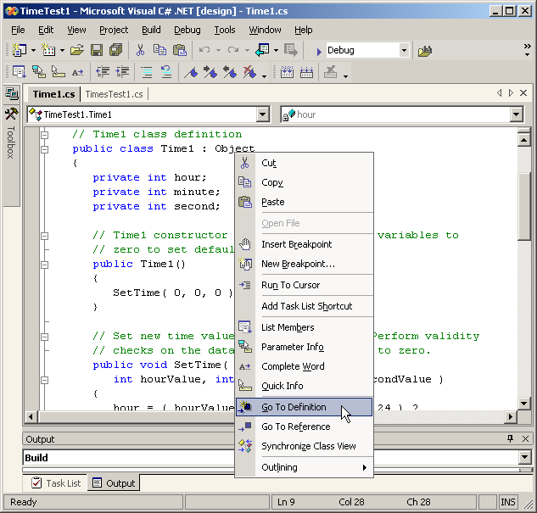
8.17 Class View and Object Browser
Fig. 8.21 Object Browser when user selects Object from Time1.cs. (part 1)

Slide 49
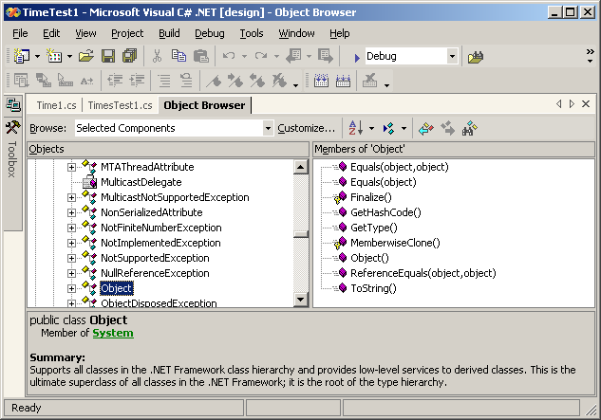
8.17 Class View and Object Browser
Fig. 8.21 Object Browser when user selects Object from Time1.cs. (part 1)

