Slide 1
Adaptation of Vision Foundation Models for Knee Osteoarthritis Classification
Jonah Belback

Slide 2
Purpose
Knee osteoarthritis is a very common degenerative joint disease
Pain, swelling, stiffness
Affects roughly 23% of adults over 40 worldwide
365 million people
Medical Professionals are busy!!!
Too many patients, not enough doctors
Diagnostics done with imaging (radiographs) can be aided easily by AI tools
Save medical professional’s time
Notes:
So Knee osteoarthritis is a very common degenerative joint disease, caused by the cartilage in your knee joints breaking down and causing the bones to rub together. Causeing pain, swelling, and stiffness.
It affects roughly 23% of adults over 40 worldwide, impacting 365 million people.
It is diagnosed by a medical professional evaluating a radiograph of the knee. And Medical professionals are very busy and the evaluation of radiographs are a prime target to use with automated AI tools to decrease the amount of time it takes a medical professional to make their diagnosis. And that’s the purpose of this study is to evaluate how we can do that.

Slide 3
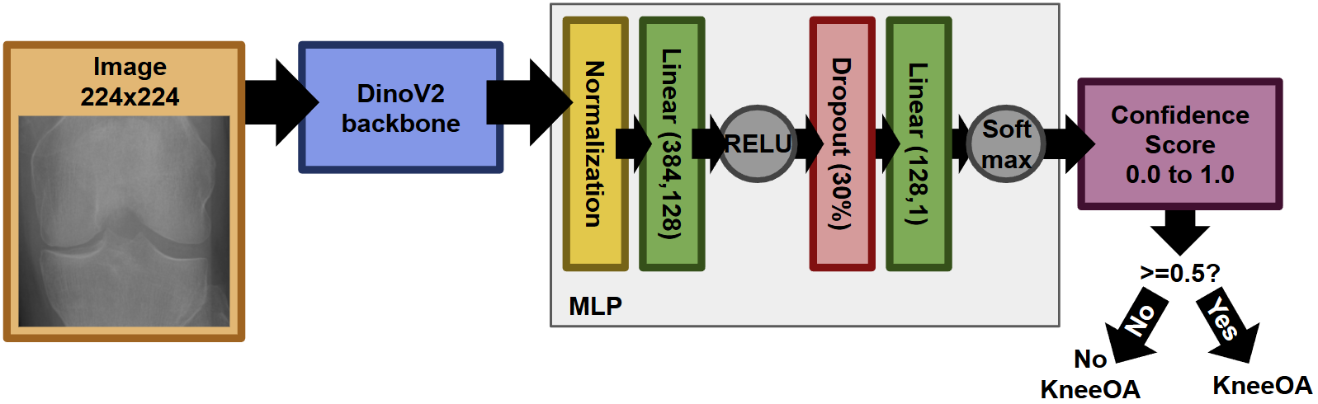
Architecture
Notes:
So this is my overall model structure where DinoV2[1], or rather ViT, is used as a backbone to extract features from out input images. These features are then given to an MLP as a classification head for a binary label decided by a threshold of 0.5 on the confidence percentage that the input image shows Knee Osteoarthritis.

Slide 4
Experimental Setup
Ran on CUDA on personal PC
Cross Entropy Loss Function
Optimized with Adam
For both frozen, and finetuning: found best learning rate
15 epochs, from 1e-1 to 1e-7 by steps of 0.1
Used 70% training, 15% validation, 15% evaluation
Found 1e-6 was best for frozen, 1e-5 best for finetuning
Full table on paper, not super important to showcase
Notes:
All the experiments were run on CUDA on my personal Pc for convience reasons.
It utilized the Cross Entropy Loss function and was optimized with Adam.
Metrics used for evaluation was AUC, accuracy, marco-f1, and for both classes: precision, recall, and f1-score. There was also a generated Confusion Matrix, Loss curve, and ROC-AUC curve.
And fore the learning rate, we separately found for frozen and finetuning the best rate through a stepped approach.

Slide 5
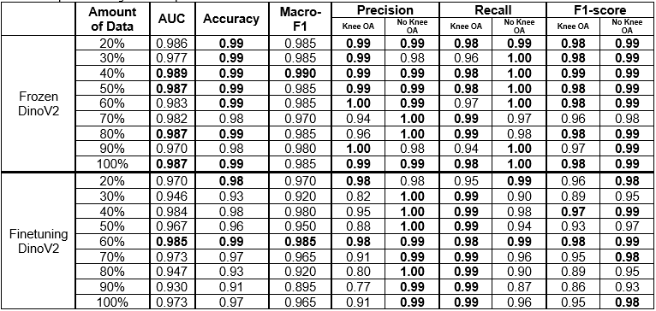
Results – Changes on amount of training data
Notes:
So these are our results:
As the amount of data increases, so does the performance. This is because as the model gets more and more data, it is introduced to new cases it hasn’t seen before and becomes more generalizable to said data. With smaller amounts of data there is also the possibility of overfitting to a bias present in your small sample that will affect your performance to unseen data.

Slide 6
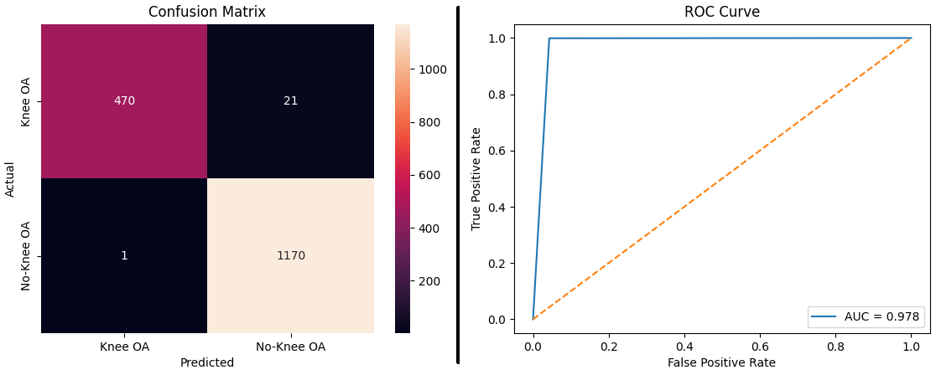
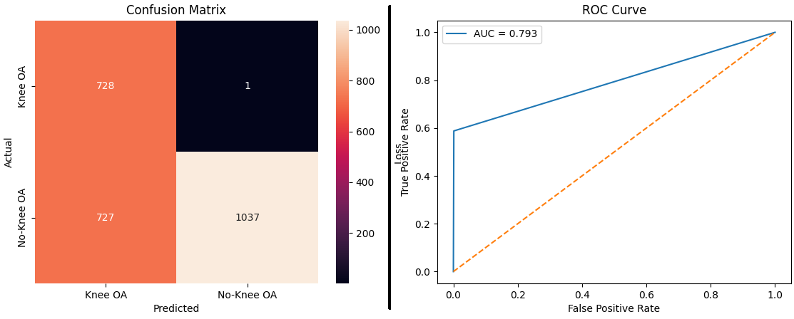
Results – Frozen DinoV2 vs Finetuning
 | AUC | Accuracy | Macro-F1 | Precision |  | Recall |  | F1-score
 |  |  |  | Knee OA | No Knee OA | Knee OA | No Knee OA | Knee OA | No Knee OA
Best Frozen | 0.989 | 0.99 | 0.990 | 0.99 | 0.99 | 0.98 | 1.00 | 0.99 | 0.99
Best Finetuned | 0.985 | 0.99 | 0.985 | 0.98 | 0.99 | 0.98 | 0.99 | 0.98 | 0.99
Best Frozen Model
Best Finetuning Model
Notes:
And then comparing specifically frozen vs finetuning DinoV2: here are our best models for each for an easier comparison.
Models with a frozen DinoV2 backbone were better compared to models that did finetuning. Although the performance can be considered comparable in many metrics, especially when there isn’t much to improve with such high scores, frozen always lead to a higher AUC. This can also be seen in their ROC graphs, where the curve for frozen is almost a right angle, while the finetuning is not as lucky. Also in the confusion matrixes where frozen has an almost perfect alignment, while finetuning has a very poor false positive rate.

Slide 7
Discussion
Evaluated likelihood of knee osteoarthritis in radiographs using DinoV2
Captured changes in frozen vs finetuning backbone
Captured how model performance increases with amount of data
Obtained a model with a very high level of performance
Notes:
In this study we developed a model to evaluate the likelihood of knee osteoarthritis in radiographs using the DinoV2 model. Our results shows that as the amount of data increases, so does the performance and generalizability of our model. We were also able to evaluate the effects of finetuning or freezing the DinoV2 model and were able to achieve an extremely high level of performance.

Slide 8
References
[1] Oquab, M., Darcet, T., Moutakanni, T., Vo, H., Szafraniec, M., Khalidov, V., Fernandez, P., Haziza, D., Massa, F., El-Nouby, A., Assran, M., Ballas, N., Galuba, W., Howes, R., Huang, P.-Y., Li, S.-W., Misra, I., Rabbat, M., Sharma, V., & Synnaeve, G. (2023, April 14). DINOv2: Learning Robust Visual Features without Supervision. ArXiv.org. https://doi.org/10.48550/arXiv.2304.07193
Notes:
And that’s the end of my presentation!

