Slide 1




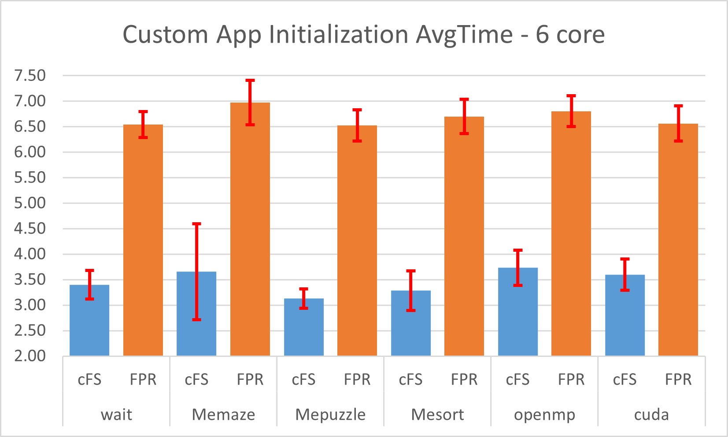
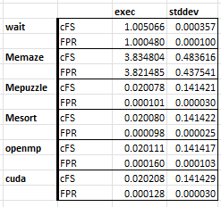
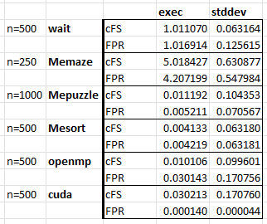
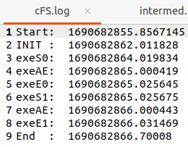

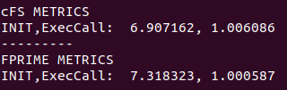
SHREC
SURG
ParPro: Flight Software Frameworks: cFS vs FPRIME
Jonah Belback
2023
EXPO
I. Goals, Motivations, and Challenges
III. Progress and Achievements
Goals
Research and compare the long Golden Standard to a popular new alternative
Motivations
Wanted to do something with Telemetry
Custom app in existing Architecture
Challenges
FPRIME’s inexperience
Cross language interaction, very specific problems
Context
Some metrics weren’t fair to compare from diff UI
Results
FPRIME has faster execution (10-100x), but slows over exec’s
FPRIME has a slower start up (cFS is 1.85x faster initializing)
FPRIME’s poor general overviews and website
FPRIME’s more abstracted app design and construction
Differences in how both Frameworks Thread and message Apps
II. Approach and Methods
VM: Virtual Machine
Automated Testing with Dynamic Algorithm Injection
Researched both Framework’s goals and approach
Used Ubuntu VM, automated testing with Python and shell scripts, custom app in both programs and algorithms for comparison in C with dynamic injection
Design of logs and what metrics could be made
Limitations of what could be fairly compared
IV: Conclusions and Future Research
Achieved Understanding of Frameworks
How they are constructed, connected (porting, threading)
Interaction with custom apps
I’d like to thank all SURG mentors
Next Steps/Lessons Learned
Higher level custom apps, integration
Done in separate device rather then VM (ie. rasp pi)
Notes:
Redo charts with para

Slide 2
Goals of a Framework
Previous system of reusing and refashioning software of last-launch to port to new hardware was schedule and resource intensive
Framework with standardized common bases that shouldn’t be reworked every time (telemetry, os abstraction, porting, unit testing, etc)
Allows for more work on the mission specific applications
OS abstraction to ease integration of newer hardware
Reuse of other mission work
App store of previous created custom apps for future missions to borrow
Run and test apps on a developer’s desktop, deploy without any changes
All this to allow focus on mission specific development

Slide 3
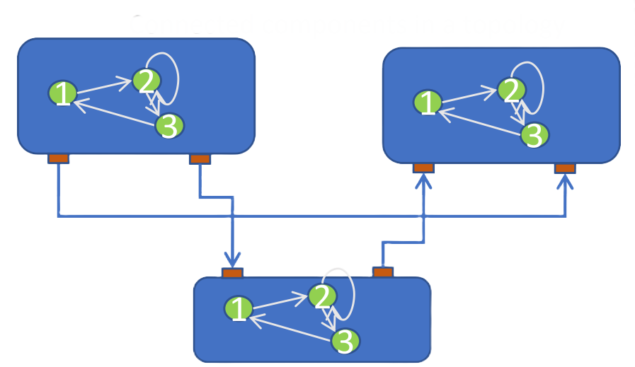
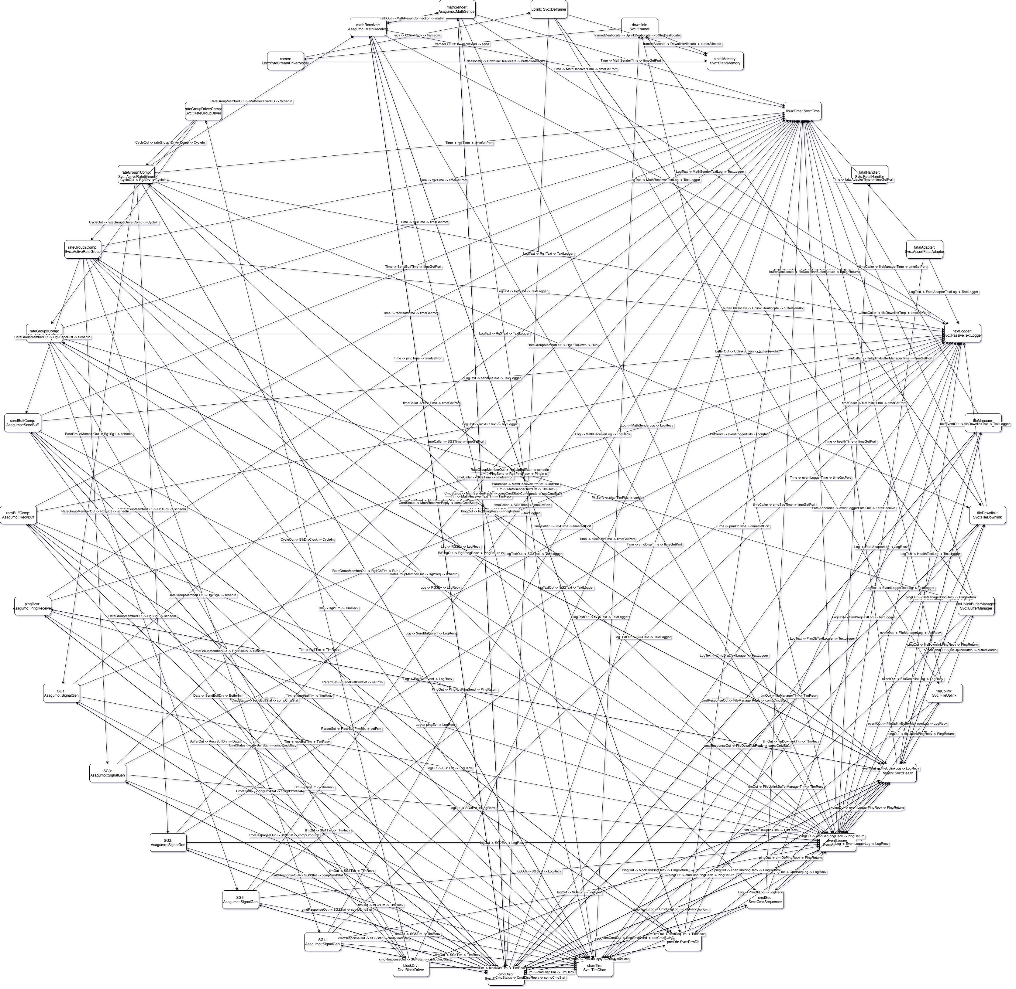
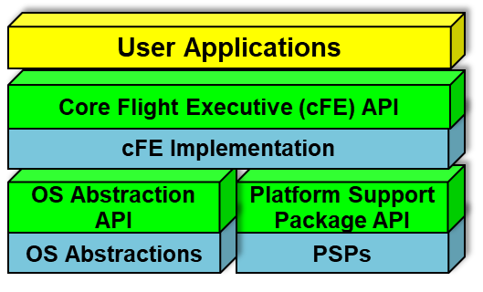
cFS vs FPRIME (design)
Layered software, component-based design (components in layers)
Independently handled
Code is handwritten
Each component must have its own thread; can be scheduled at fixed times
Publish-Subscribe porting Event driven; a ‘publisher’ sends out a message, those ‘subscribed’ receive it
Component-based Architecture
Projects with everything separated into components, all ported together
Has an OS Abstraction layer
Code generation (devs write models)
Components can have multiple threads or share them with other components
Point-to-point porting no other networking between connections
Notes:
A lot of my problems with fprime was that it is new, but it has more promise than cfs. FPRIMEs future is everything, cFS’s future is what it already has

Slide 4
cFS vs FPRIME (user experience)
cFS
Information was easy to find
Right on its nasa.gov page
Github came with prebuilt sample_app
Also tutorials making from scratch from nasa engineers
Build instructions were basic and easy to follow
Where to code in app template was immediate
Very easy to automate
Benefits greatly from its constant use in NASA and other Space Agencies
FPRIME
Information on not all together
Multiple “puzzle piece” presentations
Website was a maze, some parts wrong
Links to links, going back gave old pages with missing or crucial info
Some info was wrong
Build instructions were unintuitive
Didn't know where to code until experience with cFS
Some issues with Selenium 4 meant I never finished full automation
Most problems came from its infancy
Notes:
A lot of my problems with fprime was that it is new, but it has more promise than cfs. FPRIMEs future is everything, cFS’s future is what it already has

Slide 5
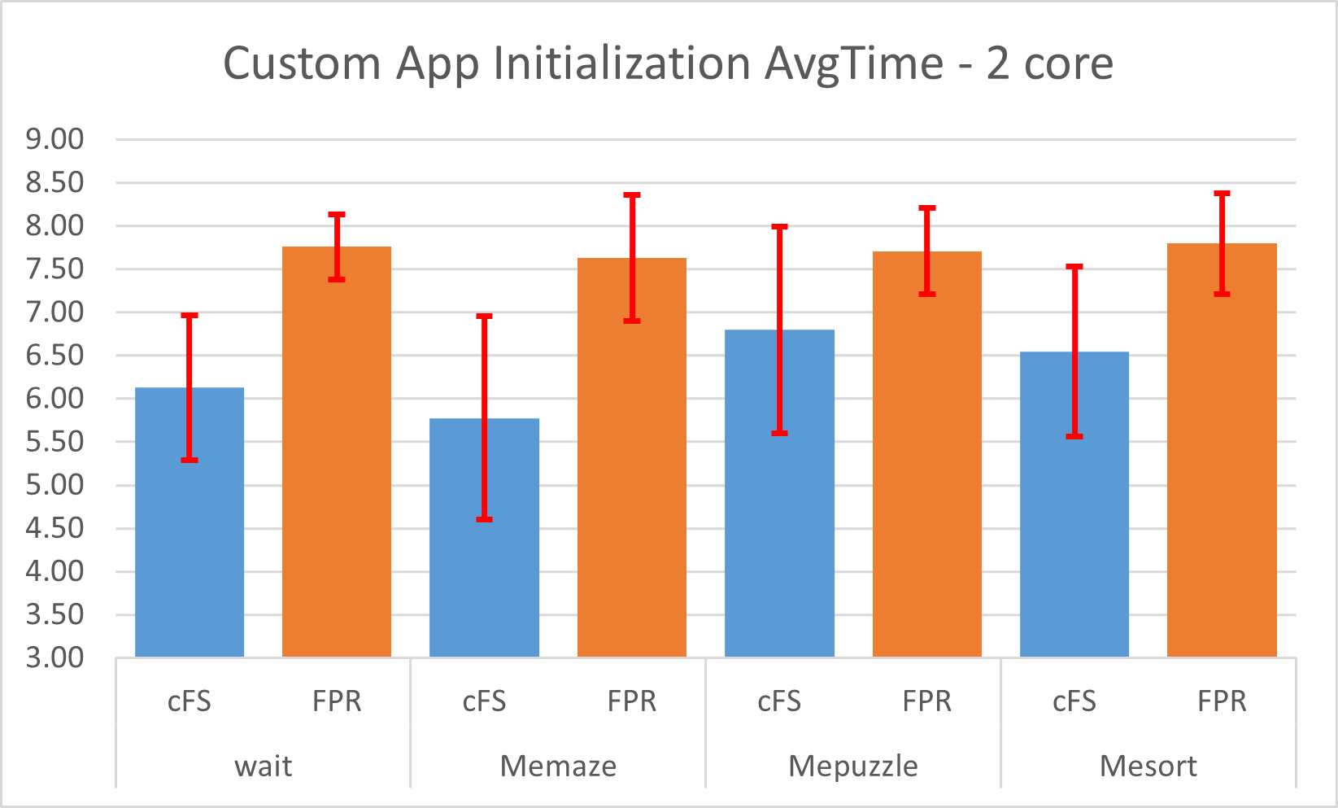
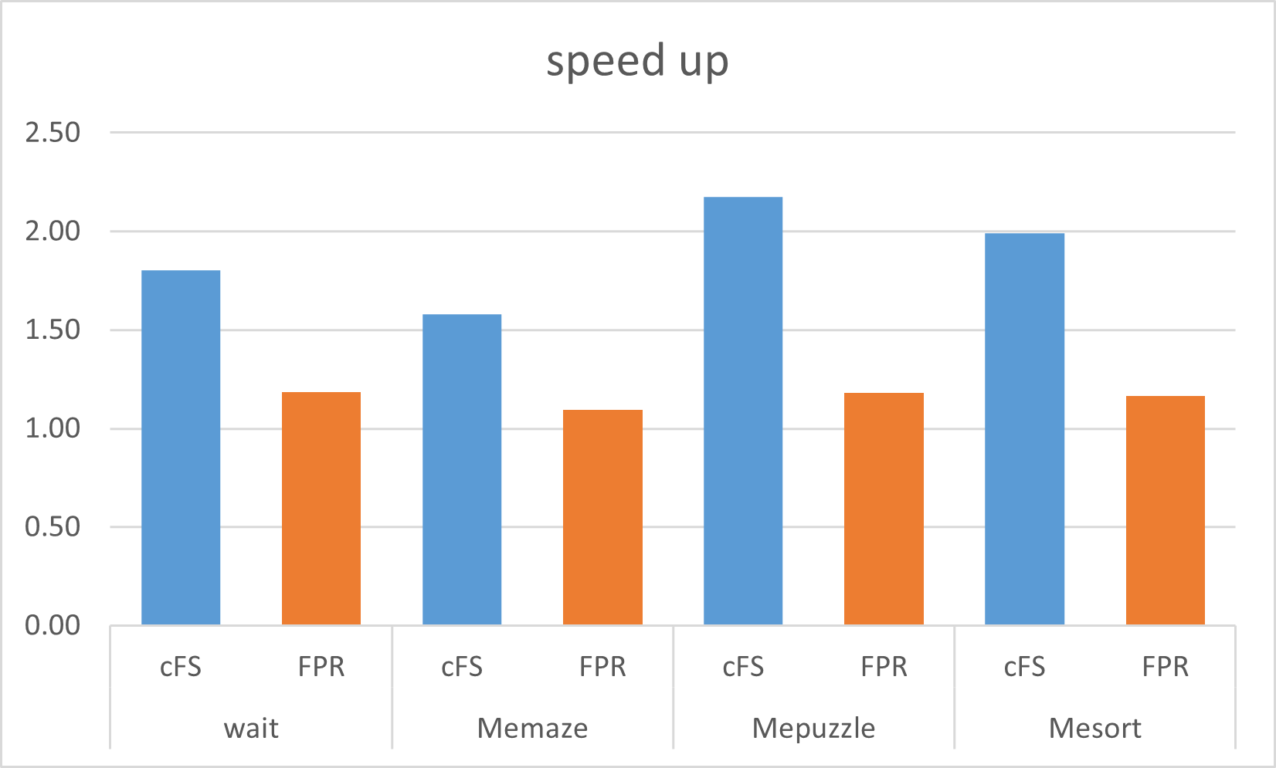
Initialization Metrics (n=50)
Notes:
ADD

Slide 6
Varying metrics (n=50)
Different types of executions gave different conclusions
Little execution: wait (1sec)
Can see the exact amount of time it takes to come in and out of the App
Lesser tests: MEpuzzle, MEsort
Extremely similar tests (both sorting related)
FPRIME clearly much faster
this becomes more confusing
Major execution: MEmaze
FPRIME has less overall, but not too conclusive just from this example
Parallelism
Not so different from serial in lesser executions
Execution: FPRIME > cFS??

Slide 7
Larger size n=500
Every similar executions
Nothing should be interfering
In VM so no background operations
cFS has to wait on priority but the thread is theirs when given
FPRIME doesn’t execute till in App’s main
Conclusions
FPRIME starts having more flare ups of “lag” the more it executes the same command
If it wasn’t for this, FPRIME would have better execution across the board
Both are similar in regular execution
Serial, openMP
Decaying
FPRIME parallels very well with Cuda
Dedicated thread that splits to works off CPU
FPRIME cuts away from App faster
Decaying

Slide 8

Thank you! Questions?
Notes:
lol

Slide 9
References
General cFS information, official website [1]“Core Flight System,” cfs.gsfc.nasa.gov. https://cfs.gsfc.nasa.gov/
General FPRIME information #1 [2] J. Levison and Supervisor, “F Prime Open Source Flight Software NASA LEARN Forum Overview,” 2022. Available: https://www.nasa.gov/sites/default/files/atoms/files/canham_and_levison-f_prime_overview-learn_forum-2022.pdf
General FPRIME information #2 [3]“Mars Science Laboratory F`Software Framework A Small Scale Component Framework for Space,” 2018. Accessed: Jul. 30, 2023. [Online]. Available: https://nasa.github.io/fprime/Architecture/FPrimeArchitectureShort.pdf
FPRIME information and tutorial, official website [4]“F´ A Flight Software and Embedded Systems Framework,” F´. https://nasa.github.io/fprime/
cFS tutorial and help [5] D. Ferreira, “Space Nerds: Celebrate the Launch of Artemis 1 by Building & Running NASA’s cFS 7 (core Flight System) on Your Own Laptop,” Space Nerds. https://davefer.blogspot.com/2022/08/space-nerds-celebrate-launch-of-artemis.html
FPRIME webbed component image [6] IonRod, Available: https://github.com/nasa/fprime/discussions/868
‌

Slide 10
Thank you! Questions?
Notes:
The following slides are additional

Slide 11
SHREC
SURG
ParPro: Flight Software Frameworks: cFS vs FPRIME
Jonah Belback
2023
EXPO
I. Goals, Motivations, and Challenges
III. Progress and Achievements
Goals
Research and compare the long Golden Standard to a popular new alternative
Motivations
Wanted to do something with Telemetry
Custom app in existing Architecture
Challenges
FPRIME’s inexperience
Cross language interaction, very specific problems
Context
Some metrics weren’t fair to compare from diff UI
Results
FPRIME has faster execution (10-100x), but slows over exec’s
FPRIME has a slower start up (cFS is 1.85x faster initializing)
FPRIME’s poor general overviews and website
FPRIME’s more abstracted app design and construction
Differences in how both Frameworks Thread and message Apps
II. Approach and Methods
VM: Virtual Machine
Automated Testing with Dynamic Algorithm Injection
Researched both Framework’s goals and approach
Used Ubuntu VM, automated testing with Python and shell scripts, custom app in both programs and algorithms for comparison in C with dynamic injection
Design of logs and what metrics could be made
Limitations of what could be fairly compared
IV: Conclusions and Future Research
Achieved Understanding of Frameworks
How they are constructed, connected (porting, threading)
Interaction with custom apps
I’d like to thank all SURG mentors
Next Steps/Lessons Learned
Higher level custom apps, integration
Done in separate device rather then VM (ie. rasp pi)
Notes:
Redo charts with para

Slide 12
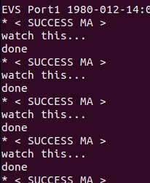
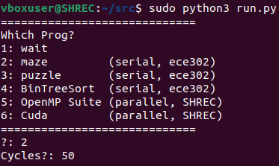
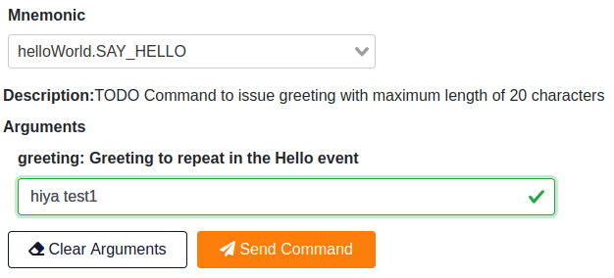


Automated Testing
cFS and FPRIME have to be rebuilt with shell commands
Overall Python (easier)
cFS and FPRIME apps are in c
cFS is in C: .c, .h
FPRIME is in C++: .cpp, .fpp, .hpp
Intermediate statically located .txt files (easier and quicker)
Let’s me do runs with inputted type of Algorithm I want, and # of cycles without changing files at all
Custom apps are built on this dynamic injection using ‘system’ command
Log files
With how differently FPRIME and cFS ran apps, was unfair to compare some metrics
cFS’s execution
FPRIME execution

Slide 13

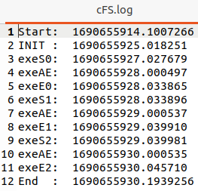
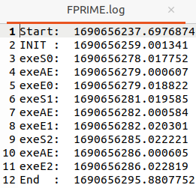
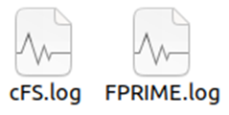

Automated Testing
FPRIME execution
cFS and FPRIME have to be rebuilt with shell commands
Overall Python (easier)
cFS and FPRIME apps are in c
cFS is in C: .c, .h
FPRIME is in C++: .cpp, .fpp, .hpp
Intermediate statically located .txt files (easier and quicker)
Let’s me do runs with inputted type of Algorithm I want, and # of cycles without changing files at all
Custom apps are built on this dynamic injection using ‘system’ command
Log files
With how differently FPRIME and cFS ran apps, was unfair to compare some metrics
- Loc of Algo
- #cycles
cFS’s execution
Best I can do
S#: before algo call in app
E#: after
AE: end of algo
Failed metrics, not fair to compare

Slide 14
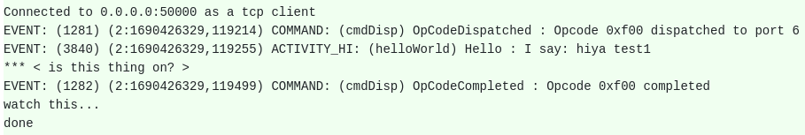
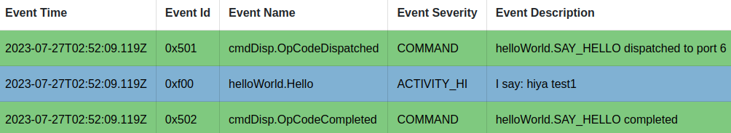
Automated Testing (metrics)
With how differently FPRIME and cFS ran apps, unfair to compare some metrics
cFS immediately executes if scheduled
FPRIME requires user input (30ms click?)
Discovered metrics*
*Specific metric:
In/out of App
Determined metrics
Failed metrics, not fair to compare
FPRIME printouts/confirmation
cFS’s execution
FPRIME execution

Slide 15

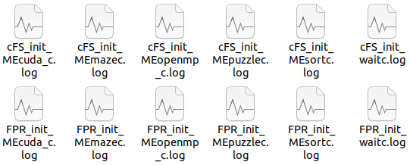
Automated Testing (logs)
Additional logs;
Constant appending
Metric calculations
INIT: Py call; init of app
INIT - START
ExecAvg: App’s Algo call; End of Algo before return
AE - S#n
ExecCall: App’s Algo execution and return
E#n - S#n
ThreadCall: App priority wait
E#n - S#(n+1)
Separated run.py for init collection
cmd line Algo select
# of cycles locked to 0
Start: before shell script call in Python
INIT: when custom app is initialized
S#: before algo call in
E#: after call in app
AE: end of algo
End: after shell script call is done in Py

Slide 16
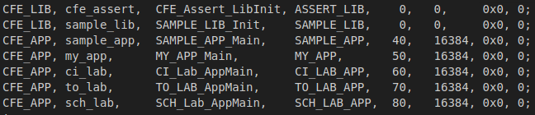
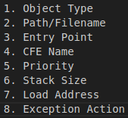
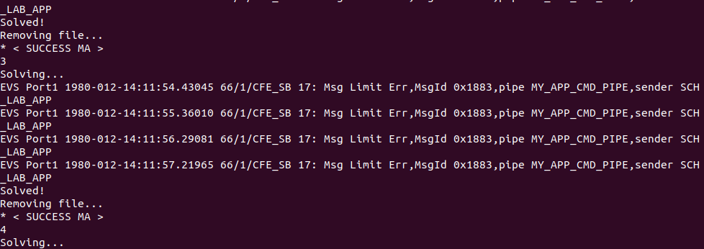
cFS Overview
Layer software , component-based design (components in layers)
Each layer hides its implementation/technology from other layers with APIs
A layer’s internals can change without effecting other layers internals or components
Layered software, component-based design (components in layers)
Independently handled
Code isn’t generated, connection and threading done by developer
Each component must have its own thread; can be scheduled at fixed times
Publish-Subscribe porting
Event driven; a ‘publisher’ sends out a message, those ‘subscribed’ receive it
Notes:
ADDITIONAL

Slide 17
cFS Overview
OS Abstraction Layer (OSAL)
Lower layer
Software library that isolates and abstracts upper layers from Real-time OS
Implementation provided for non-real time OS like Linux
FPRIME also has this as a layer
TLDR: allows easy dev/deploy across OS’s
Platform Support Package (PSP)
Lower layer
Provides APIs and software to abstract and adapt processor hardware computing system
Memory, I/O ports, non-volatile memory
implementation for various processors
TLDR: allows easy dev/deploy across hardware
Core Flight Executive (cFE)
Middle layer
Runtime environment; static/dynamic linking
Defines standardized API with apps for custom app development
Services: time, event (alerts), execution, messaging, table services, plug and play capability
Tool suite
TLDR: where custom apps are created and ran
Application
Contains set of re-usable libraries and apps
Described as an “Appstore” for common Flight-Software components
Allows more time on mission specific development
Notes:
ADDITIONAL

Slide 18
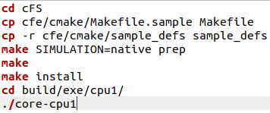

cFS Execution
Notes:
ADDITIONAL

Slide 19
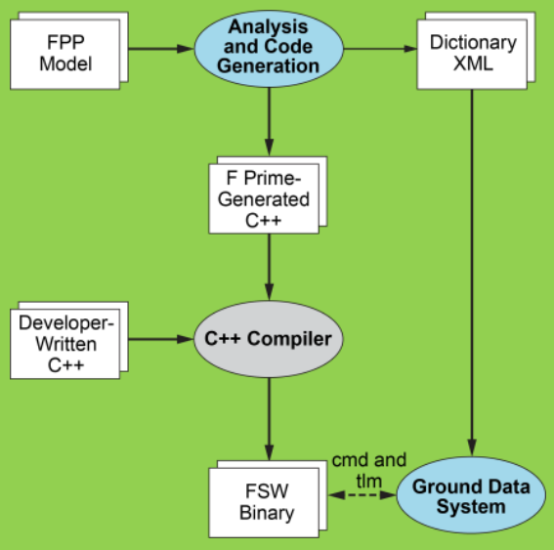
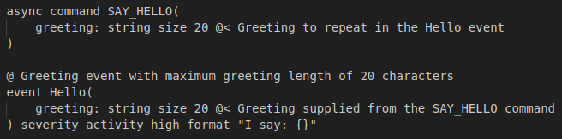

FPRIME Overview
Component based Framework
Code generation: Devs write up models, generated code handles lesser necessities
Point-to-point links: no other networking between connections
Modules are more reusable than cFS, doesn’t need global IDs of messages (Publish-Subscribe)
Three port attributes:
Synchronous: no thread, handler exec’s on calling thread
Guarded: Synch but guarded calls share mutex
Asynchronous: invocation places message on component queue, dequeued on comp. thread
Handled generation
Generation of code
Notes:
ADDITIONAL

Slide 20

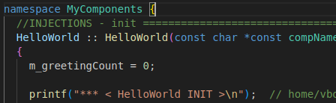
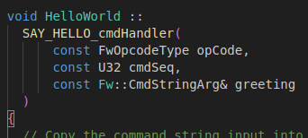


FPRIME Execution
[app’s init]
[app’s exec]
Notes:
ADDITIONAL

