Slide 1
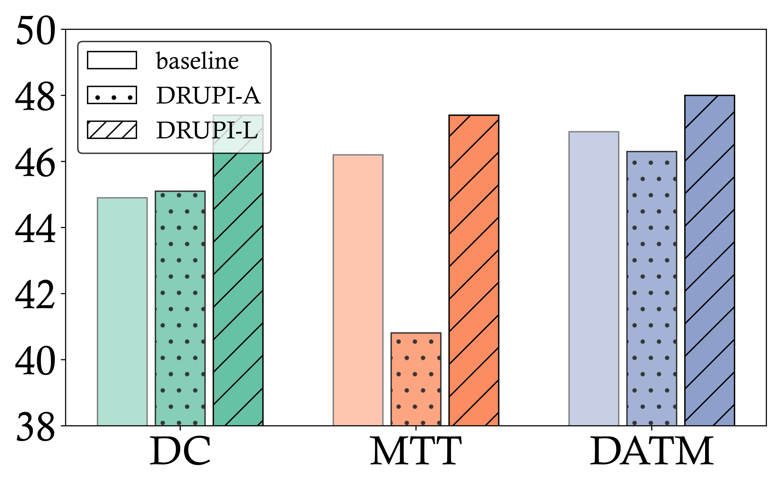

Slide 2
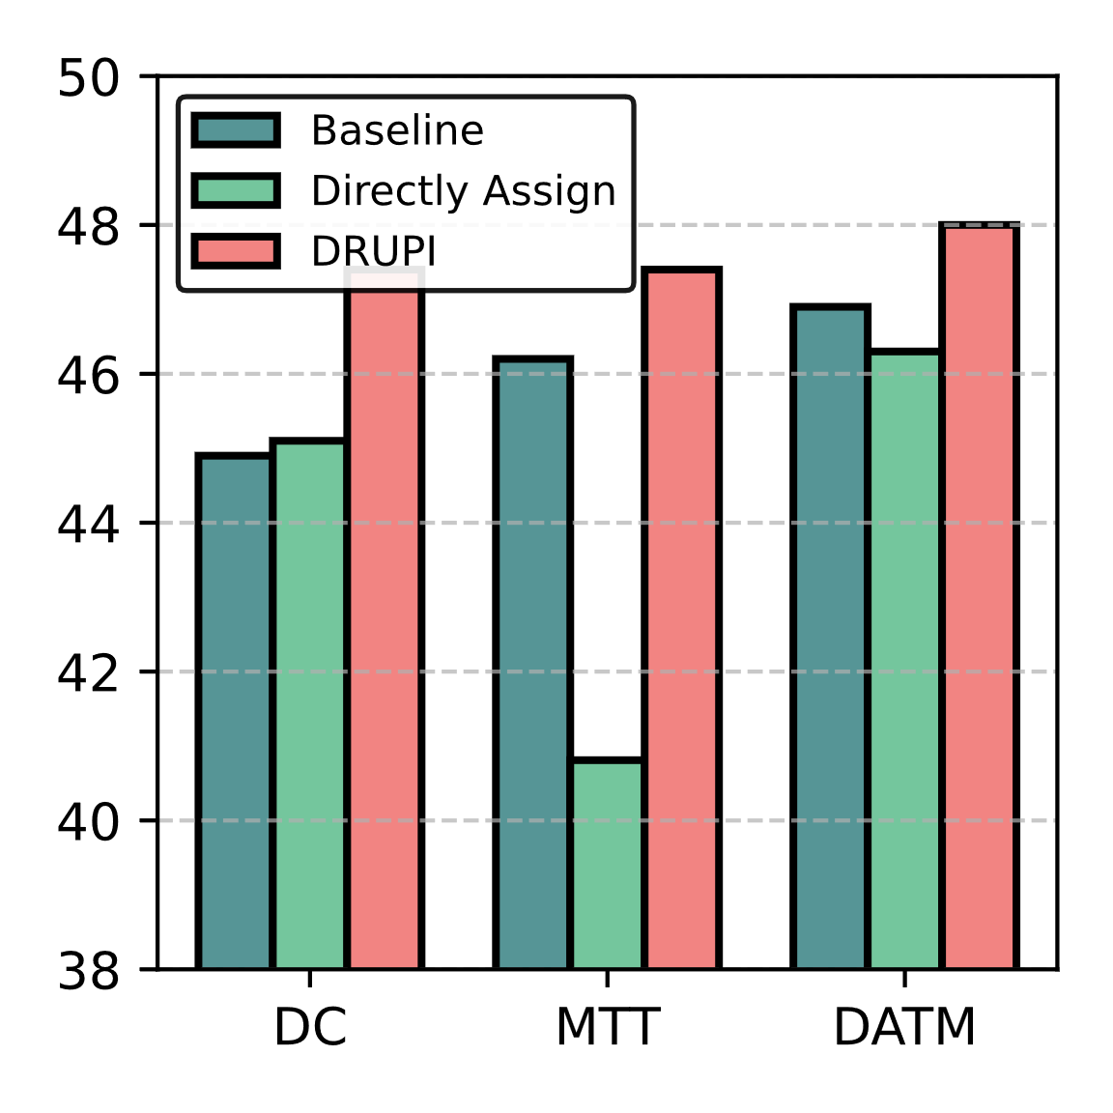
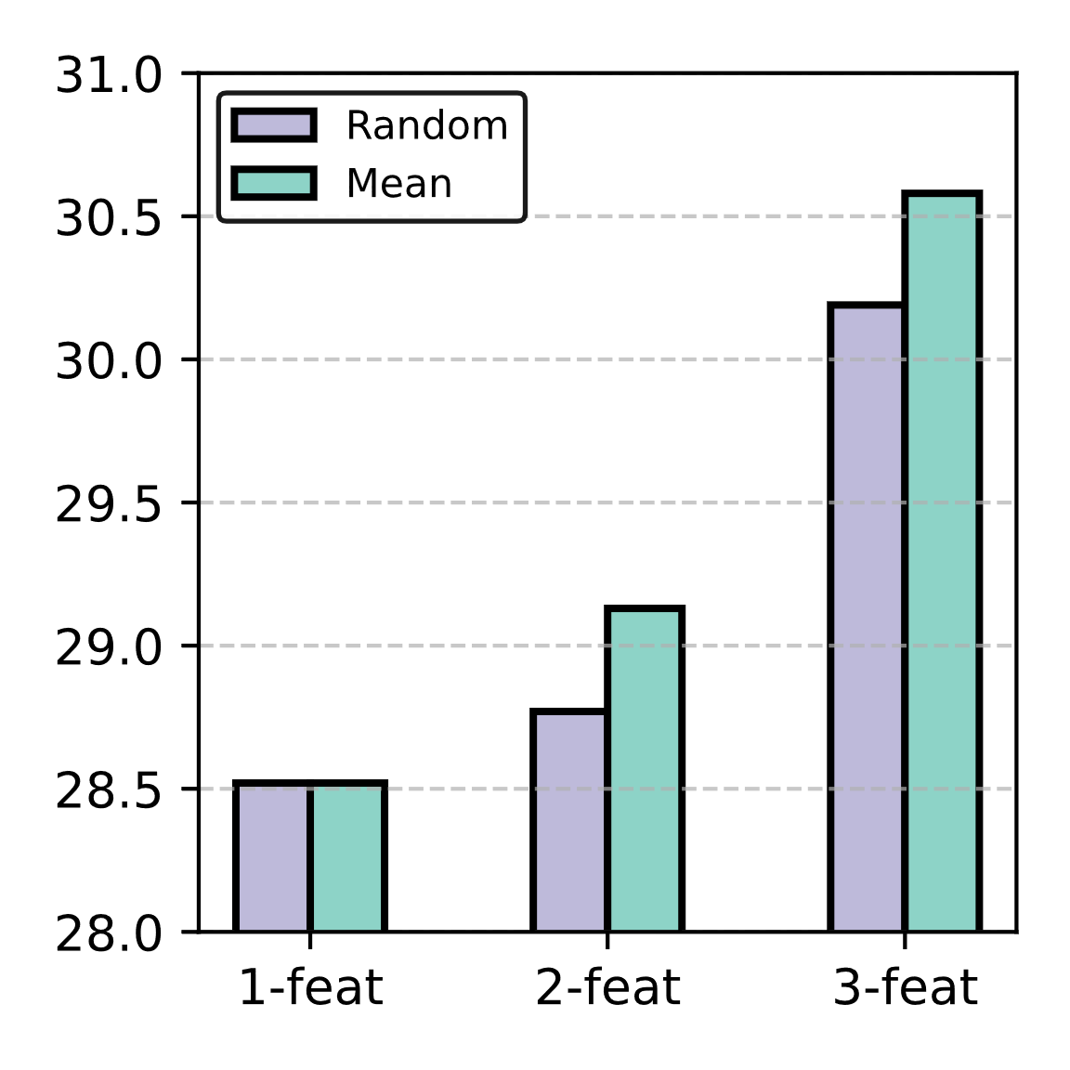
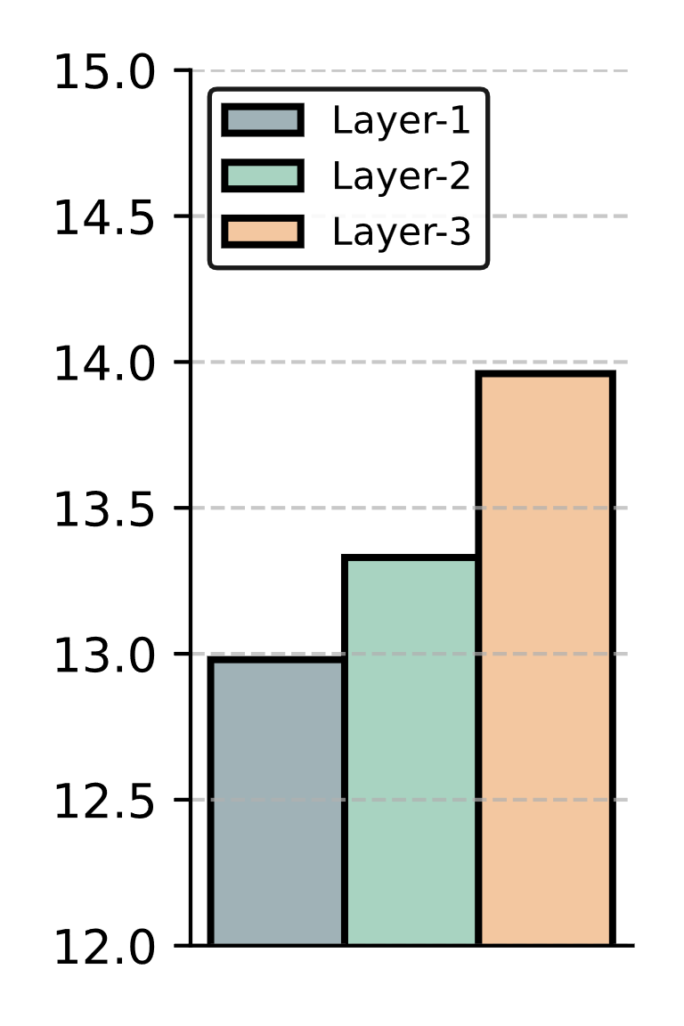
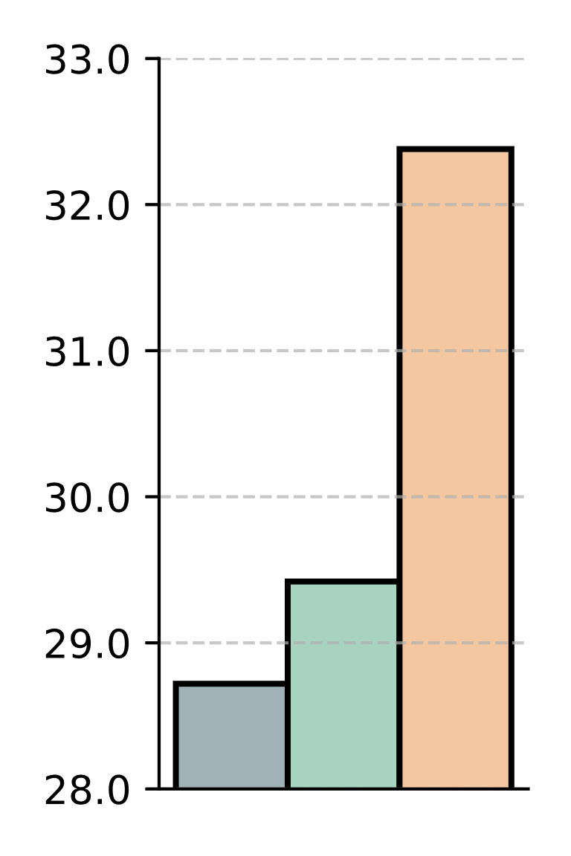
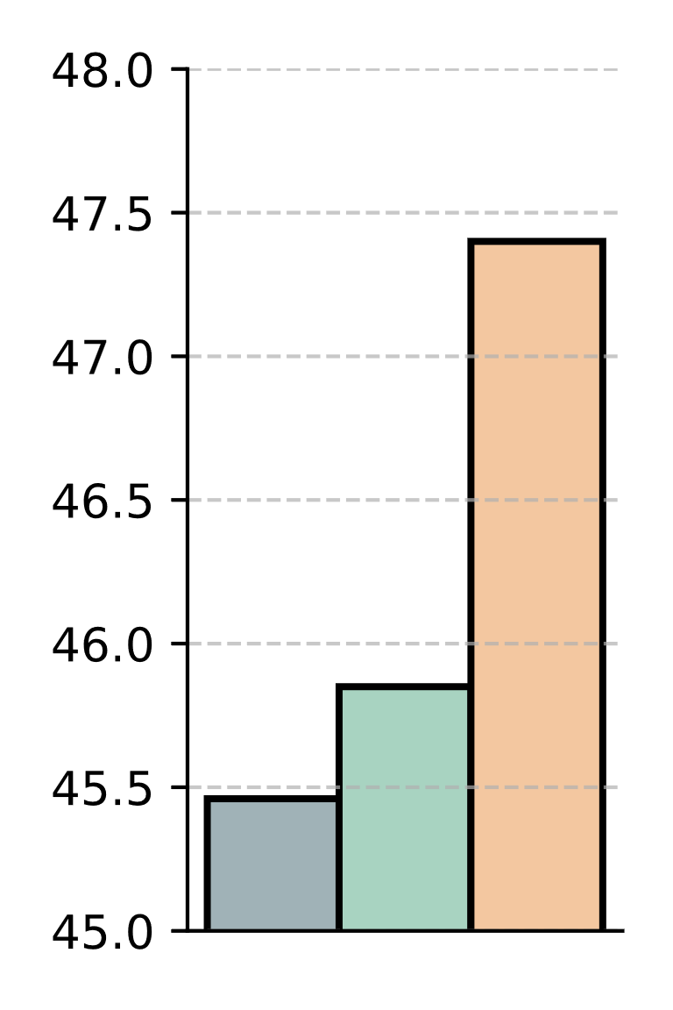
Evaluation Acc (%)
CIFAR-100 IPC=1
CIFAR-10 IPC=10
CIFAR-10 IPC=1
(a) Different Methods to Synthesize Privileged Information
(b) Impact of Feature Label Versatility
(c) Effect of the Supervision Layer Choice

