Slide 1
What I was looking for in a cms
Easy to get started
Flexible
Python/Django based
Dynamic

Slide 2
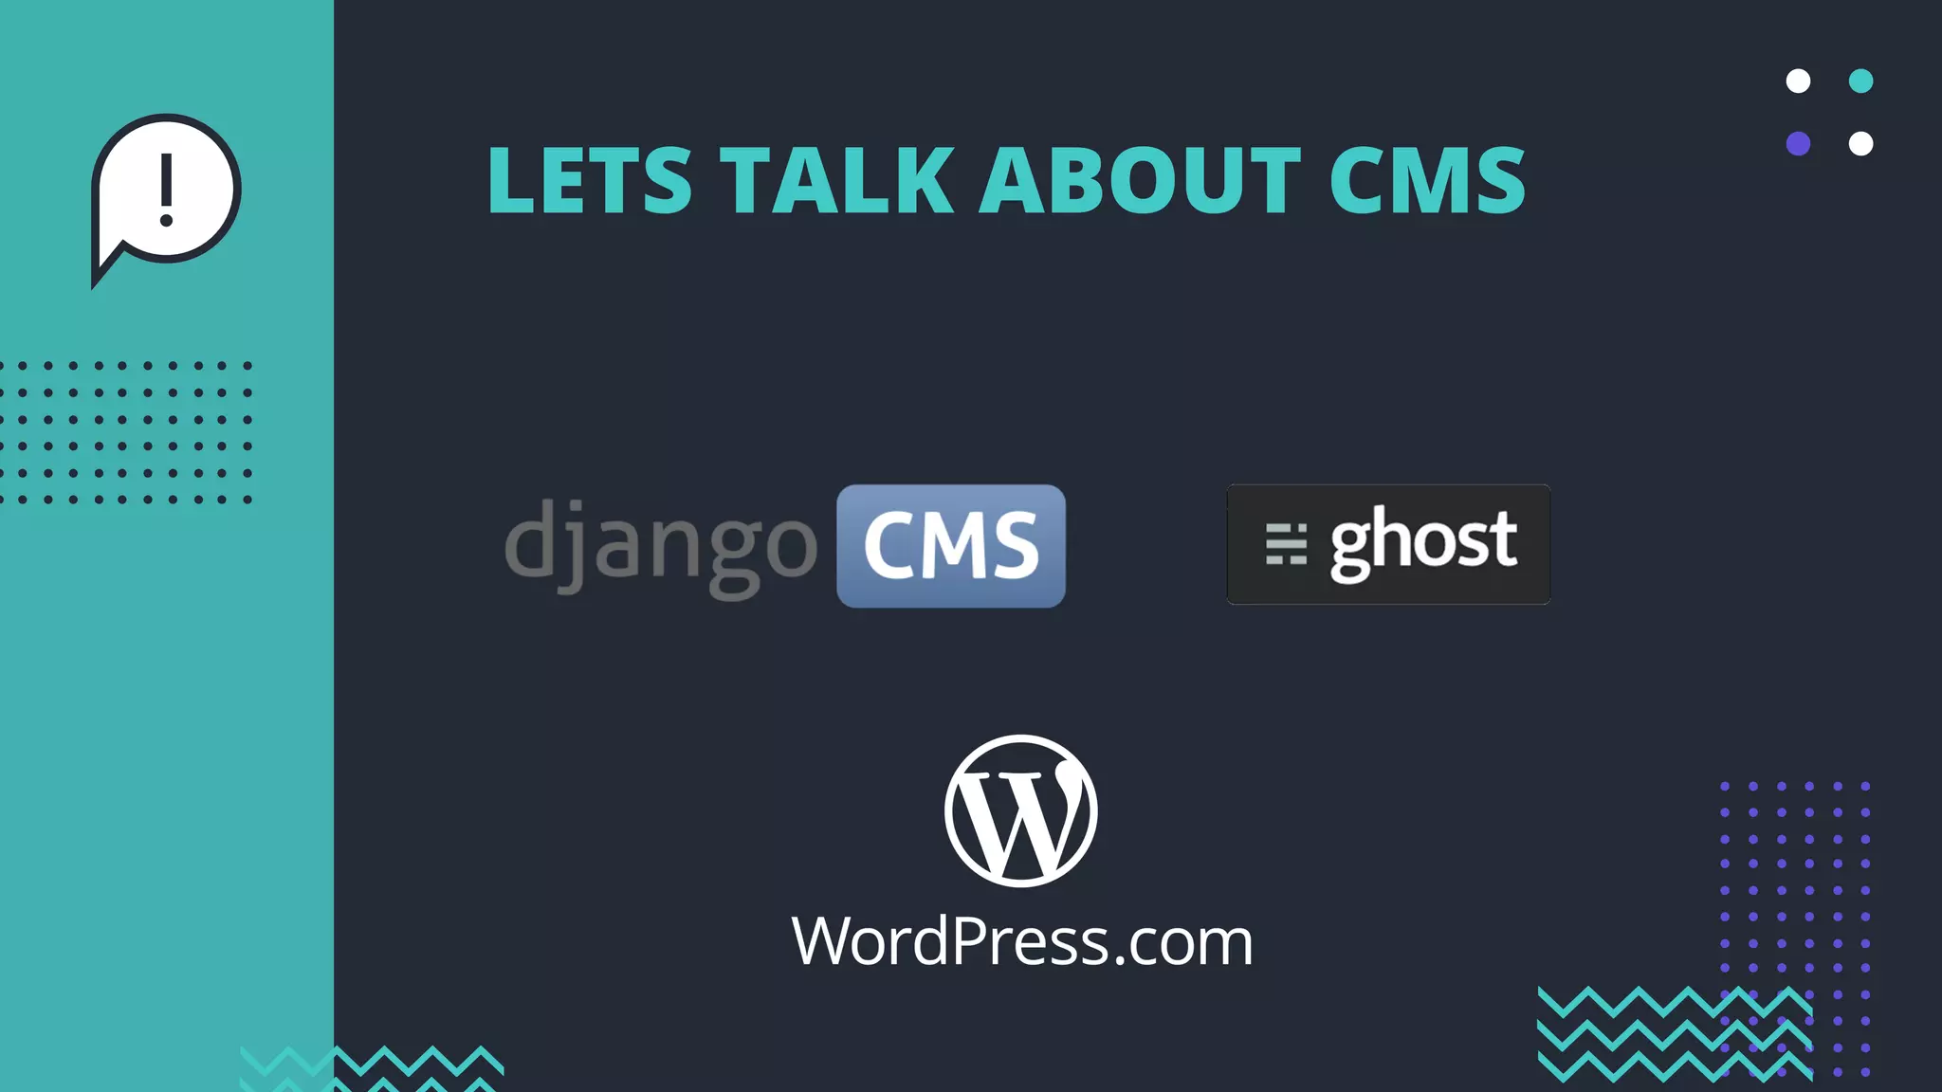

Slide 3

Prepared by Turyan Azizov

Slide 4
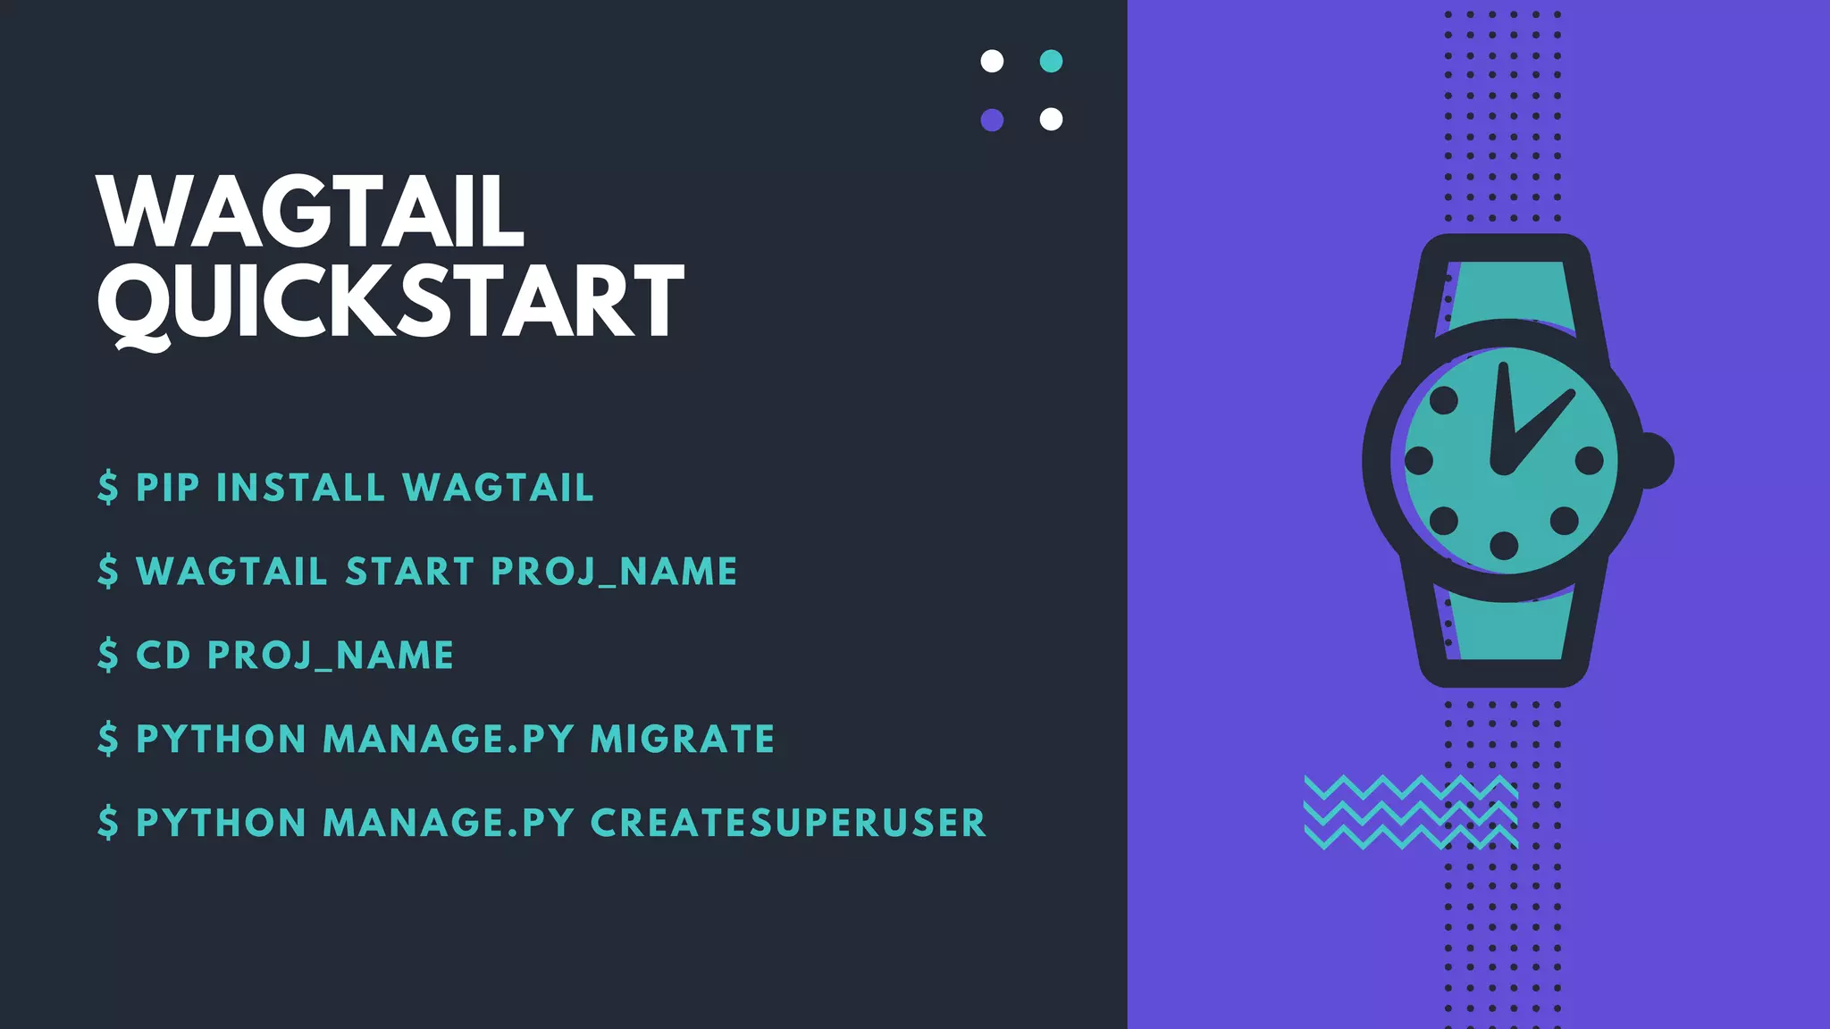

Slide 5
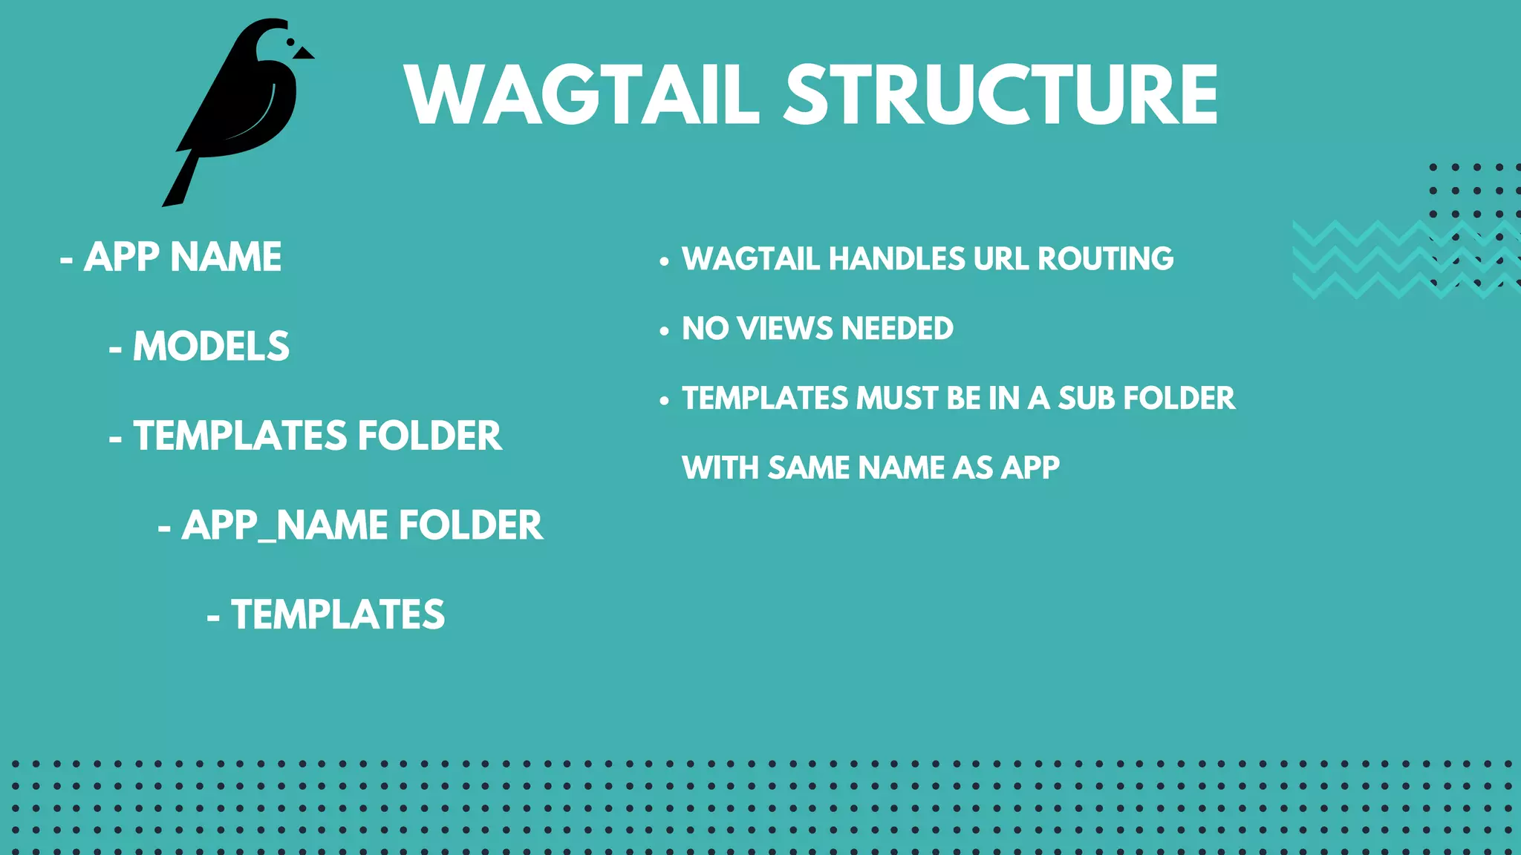

Slide 6
Advantages of wagtail
Snippets
Image handling
Modern UI
Streamfield
Clear documentation
Easy integration existing project

Slide 7
Resources
https://wagtail.org/
https://github.com/springload/awesome-wagtail
https://madewithwagtail.org/

Slide 8
Thanks for your attention

