Slide 1
COSENTIAL DATA QUALITY
August 20, 2026
Presented by:
Tushar
Data Science Intern

Slide 2
The Blind Spot Nobody Was Watching

Slide 3
Why This Mattered
The problem, before we started
Lack of Observability - Data issues sat quietly in the dark
SMEs lacked visibility into their data
Entries drifted from the approved list
Issues surfaced only after issues observed – instead of being reactive, this is a proactive approach

Slide 4
TITLE
Automated checks on a regular, repeating pipeline schedule
Bronze – checks whether data is refreshing properly
Gold – business rules
Reviews completeness, accuracy, and consistency
Routes findings toward the right owner

Slide 5
The Scale
23
211
17
Tables Monitored
Automated Checks
Source Feeds Watched
Every corner of the pipeline, covered.
Running continuously, watching for drift.
Catching outages within hours.

Slide 6
Then We Found Something
Real Findings
Many entries didn't match approved lists
Market names often didn't match standards
Office names also frequently mismatched
Delivery methods didn't follow the standard
Most records were missing an address
Some opportunities had no location at all
Duplicate approval records found on records
Some listed contacts hadn't logged in years

Slide 7
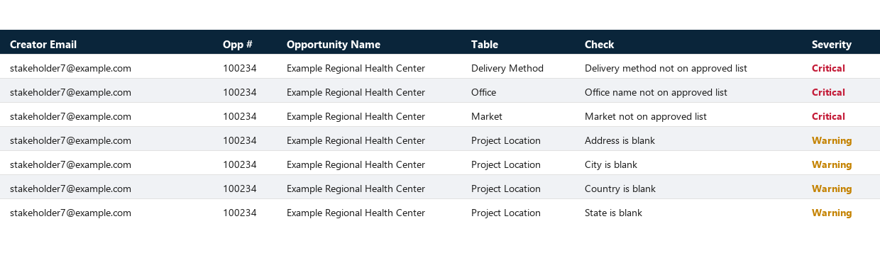
A Real Example
One flagged opportunity, one owner
One real opportunity, flagged across different checks at once all pointing back to the same record and the same owner. This is what the system surfaces automatically, every week, without anyone having to go looking for it.

Slide 8
Why Ownership Gets Tricky
Closing the loop isn't always simple
Some record owners left the company
One contact was last active in 2014
Stale contacts complicate fixing issues
Most flagged records still find an owner
Nearly all issues route successfully today
A small share still need manual follow-up
We're closing that gap over time

Slide 9
Where This Goes Next

Slide 10
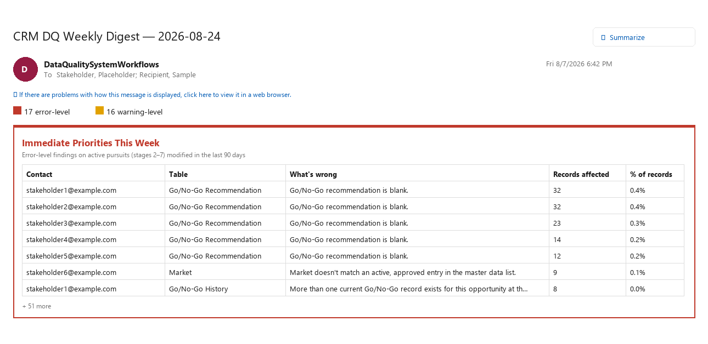
The Weekly Digest
Every week, a plain-language email lands in the right inboxes: how many records are flagged, the highest-priority issues on active deals, and for each recipient a short, personal list of exactly what to fix.

Slide 11
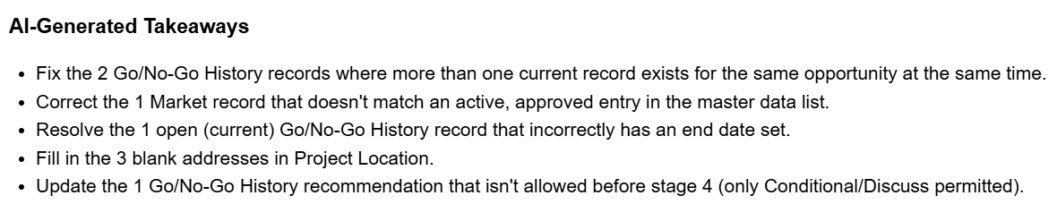
Personalized, Not Generic
Every recipient gets their own version
Each recipient gets their own summary
Plain-language explanation of what's wrong
Clear list of what to fix
Delivered automatically, every single week
Turns data into direct action

Slide 12
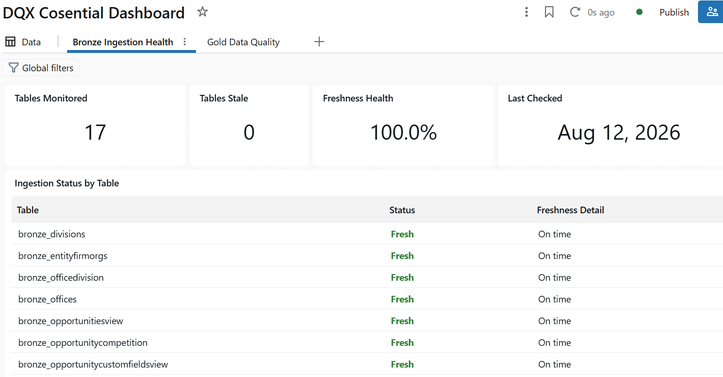
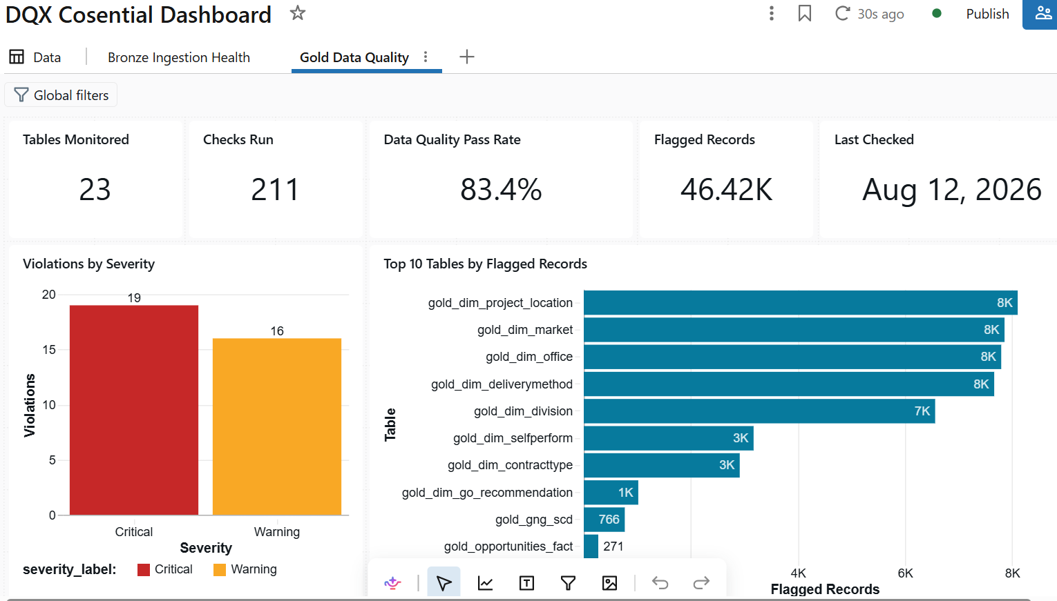
The Dashboard
For anyone who wants to look deeper
Beyond the weekly email, a live dashboard shows overall data health at a glance: which tables are freshest, which checks are struggling, and who's carrying the most flagged records. It updates continuously, so anyone can check in anytime.

Slide 13
There's More Than Dashboard and Digest
A glimpse of what's possible
Dashboard and digest are just chapter one
Same data already supports deeper reporting
Power BI could layer on today
No new pipeline work required
Self-serve drill-down for any team
More products can build on this foundation

Slide 14
Who Gets What
Right message, right person, every time
Think of it like a company memo
Stakeholders see everything, every week
Owners get their own personal list

Slide 15
Where's the Next Blind Spot?
A framework waiting for its next pipeline
This found real problems in one pipeline
Every pipeline has its own blind spots
The same approach can apply elsewhere
SAP, WinEst, and others are candidates
We're already testing this on FileMaker
Curiosity is the first step forward

Slide 16
Built to Be Reused
A head start for every next pipeline
Rules live outside the code itself
Business reviewers can propose changes too
The DQX AI-profiler suggests new rules
Example: FileMaker only needed new rules
One framework, reused again and again

Slide 17
What's Next
The roadmap from here
Finish rolling out the weekly digest
Extend the same pattern to FileMaker
Build out the Power BI layer
Continue closing the ownership gap
Bring more pipelines into the fold
Keep leadership updated on progress
Grow this into a shared standard

Slide 18
THANK YOU
Questions and Discussion

