Slide 1
Neural Machine Translation
(DPPL PROJECT)
BY- TUSHITA SINGH(BT16CSE006)

Slide 2
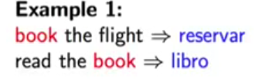
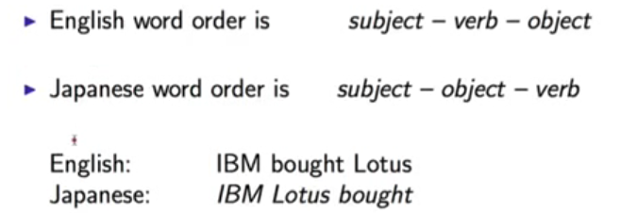
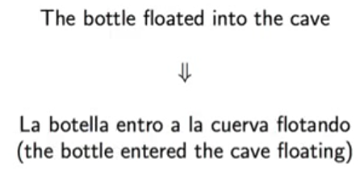
THE CHALLENGES :
1)Lexical Ambiguity:
(eng-Spanish)
2)Differing Word Orders:
(eng-Japanese)
3)Syntactic Structure is not preserved Across translations:
4)Syntactic Ambiguity Causes Problems
5)Pronoun Resolution

Slide 3
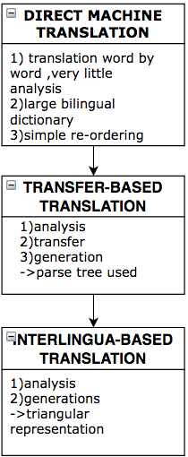
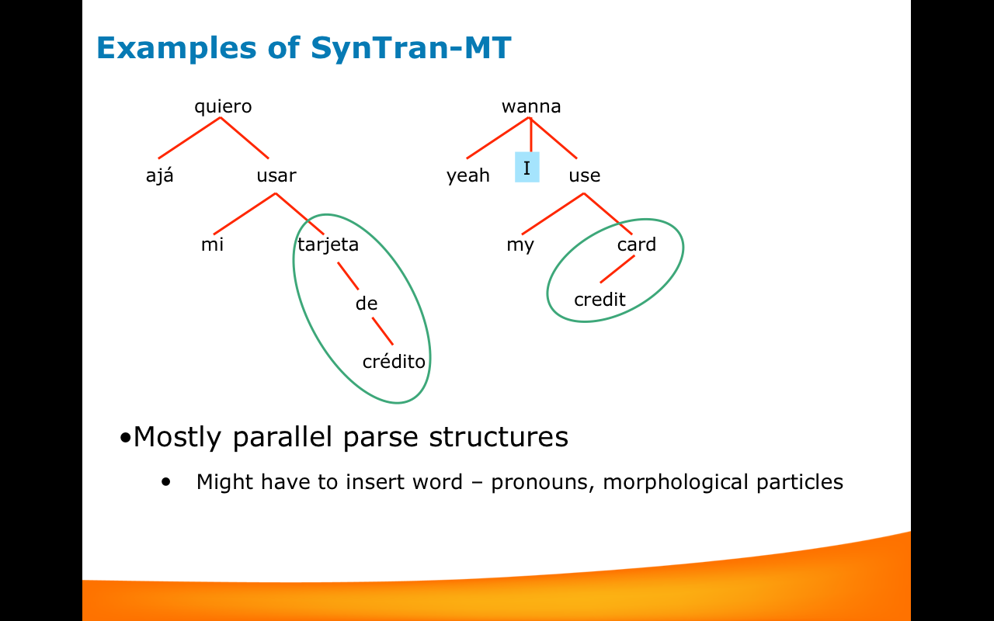
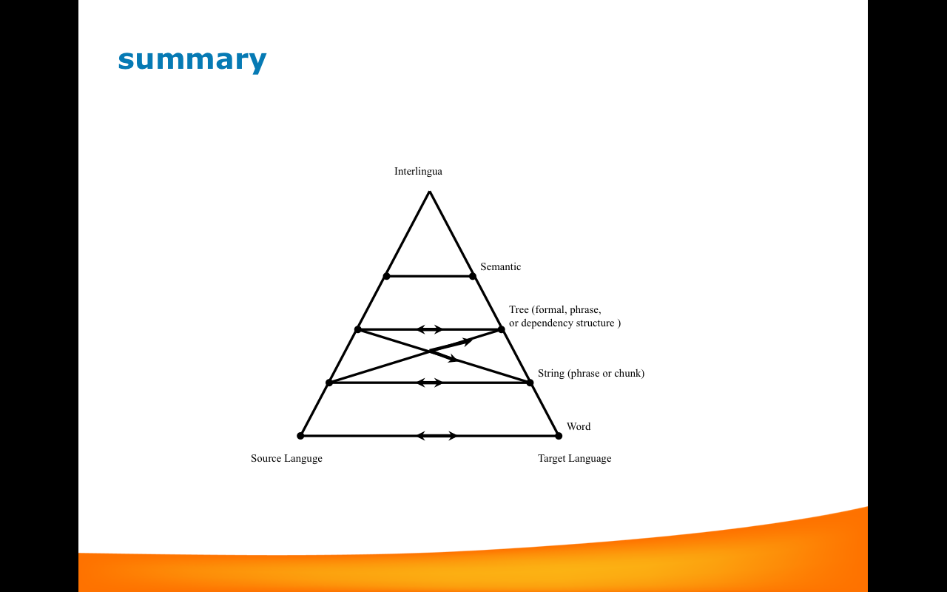
RESEARCH METHODOLOGY

Slide 4
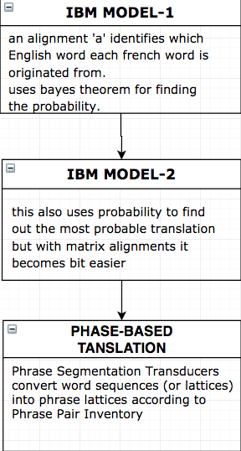
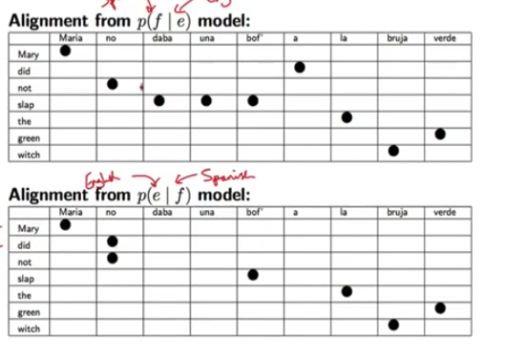
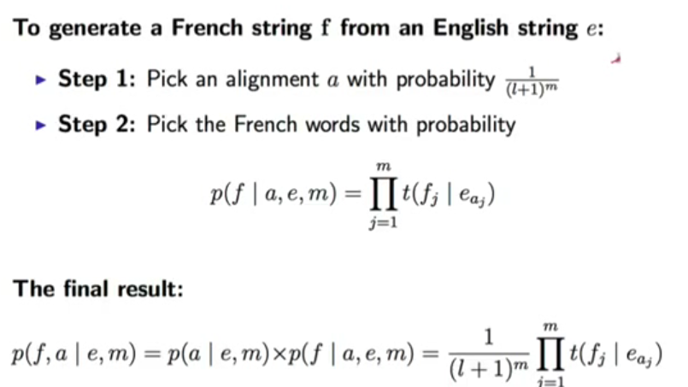

Slide 5
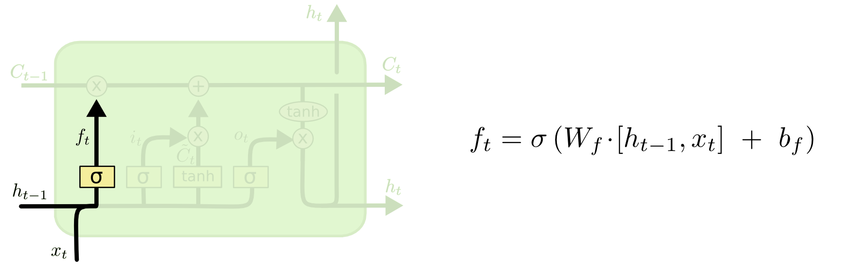
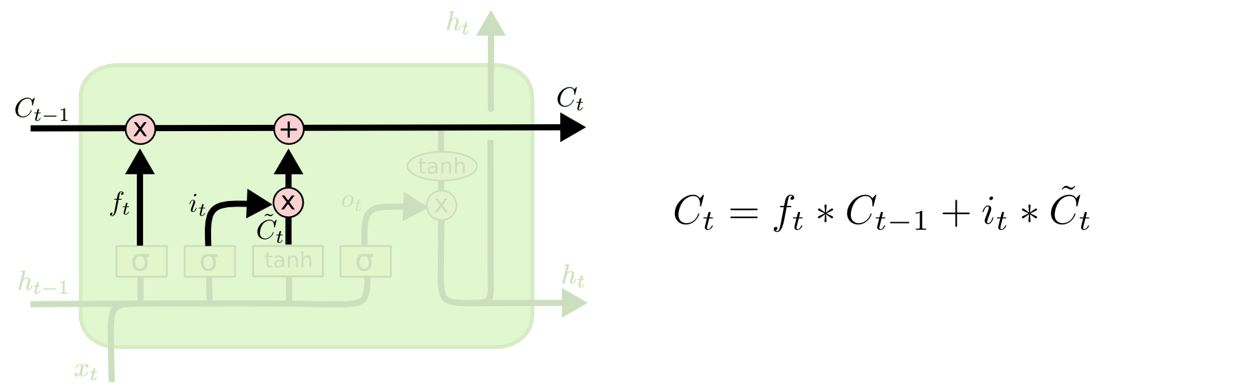
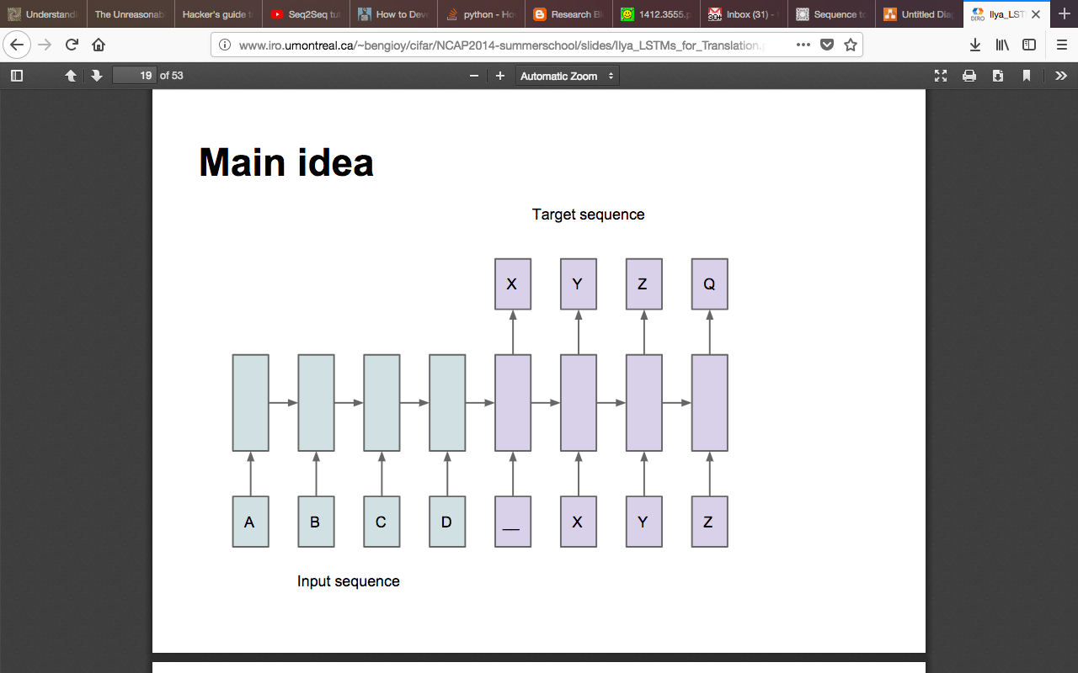

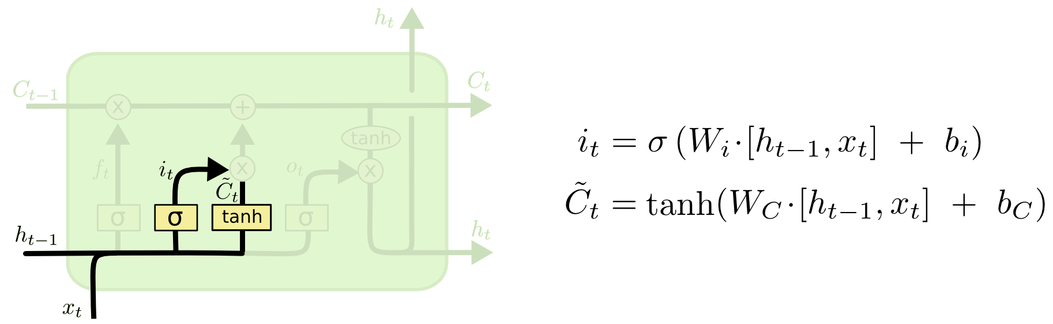
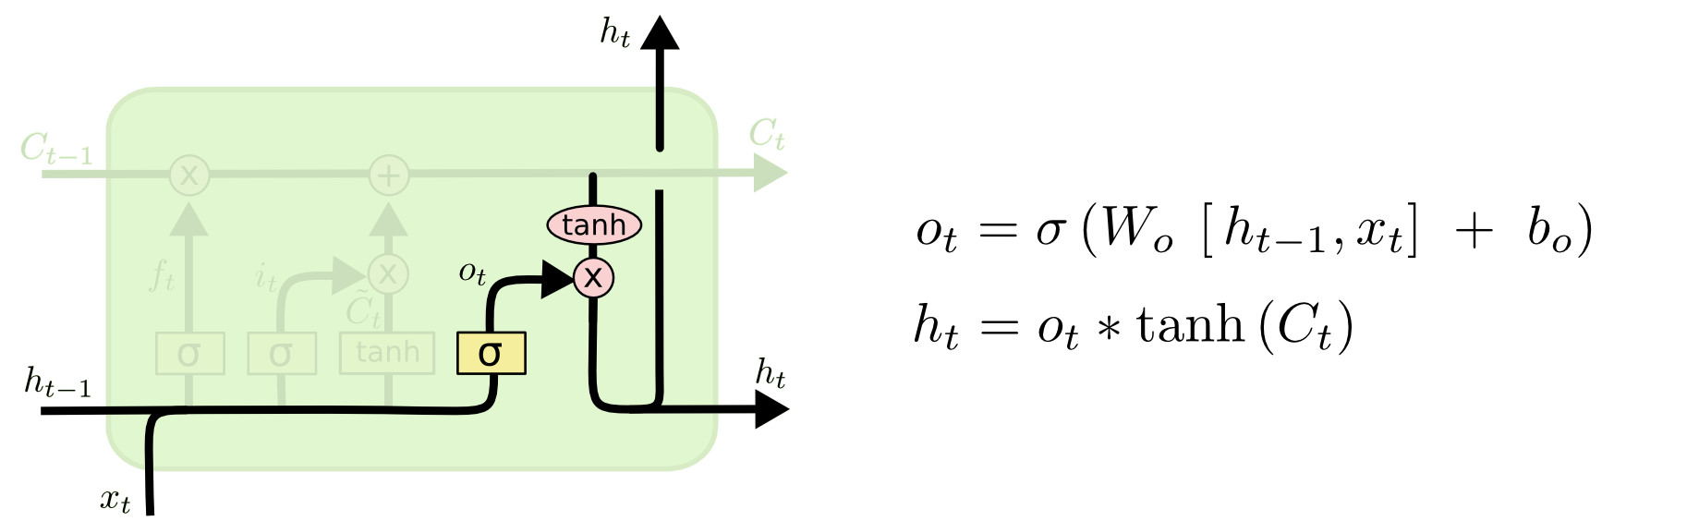

LSTM: long short term memory networks

Slide 6
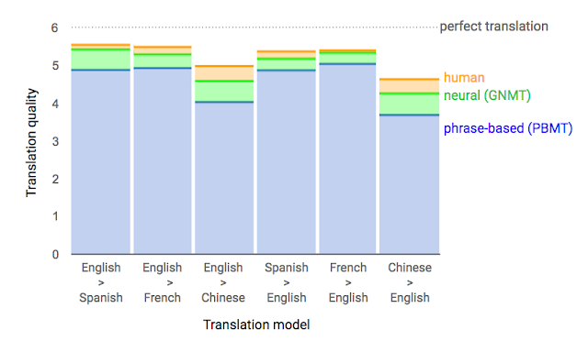
RESULTS AND ANLYSIS
Discovered that the LSTM did well on long sentences.
One of the attractive features of this model is its ability to turn a sequence of words into a vector of fixed dimensionality.
Many techniques to improve NMT, including work on handling rare words by mimicking an external alignment model , using attention to align input words and output words and breaking words into smaller units to cope with rare words.

Slide 7
RELATED WORK
combine an NNLM with a topic model of the input sentence, which improves rescoring performance.
A similar approach, but they incorporated their NNLM into the decoder of an MT system and used the decoder’s alignment information to provide the NNLM with the most useful words in the input sentence.
Similarly to this work, Cho etal used an LSTM-like RNN architecture to map sentences into vectors and back, although their primary focus was on integrating their neural network into an SMT system.
Bahdanau et al also attempted direct translations with a neural network that used an attention mechanism to overcome the poor performance on long sentences experienced
Likewise, Pouget-Abadie et al attempted to address the memory problem of Cho etal by translating pieces of the source sentence in way that produces smooth translations, which is similar to a phrase-based approach.

Slide 8
CONCLUSION
large deep LSTM with a limited vocabulary can outperform a standard SMT-based system whose vocabulary is unlimited on a large-scale MT task.
We conclude that it is important to find a problem encoding that has the greatest number of short term dependencies, as they make the learning problem much simpler.
LSTM trained on the reversed dataset had little difficulty translating long sentences.
the LSTM unit controls the amount of the new memory content being added to the memory cell independently from the forget gate.

Slide 9
References
Sutskever, I., Vinyals, O., & Le, Q. V. (2014). Sequence to sequence learning with neural networks. In Advances in neural information processing systems (pp. 3104-3112).
Chung, J., Gulcehre, C., Cho, K., & Bengio, Y. (2014). Empirical evaluation of gated recurrent neural networks on sequence modeling. arXiv preprint arXiv:1412.3555.
Olah, C. (2015). Understanding lstm networks, 2015. URL https://colah. github. io/posts/2015-08-Understanding-LSTMs.
Wu, Y., Schuster, M., Chen, Z., Le, Q. V., Norouzi, M., Macherey, W., ... & Klingner, J. (2016). Google's neural machine translation system: Bridging the gap between human and machine translation. arXiv preprint arXiv:1609.08144.
Hutchins, W. J., & Somers, H. L. (1992). An introduction to machine translation (Vol. 362). London: Academic Press.

