Slide 1

CSIS 3860 Term Project Road Accident Analysis
Made By:
Arshdeep Singh Chandhok - 300381056
Tushar Shandilya - 300378305

Slide 2
Table of Contents
1
2
3
4
5
Introduction
Tableau Implementation
Visualizations
Conclusion
Refrences

Slide 3

Introduction
This project aims to analyze road accident data to improve road safety by providing stakeholders with valuable insights. With over 308,000 entries in the dataset, including factors like accident severity, location, and vehicle details, our focus areas include total casualties, monthly trends, and location-based patterns. By identifying high-risk areas and informing targeted preventive measures, we aim to enhance emergency response planning, infrastructure, and community engagement, ultimately promoting shared responsibility for road safety.

Slide 4

Implementation
In Tableau, we're working with a dataset of 308,000 entries across 21 columns, encompassing both categorical and numeric data. Analyzing this mix requires meticulous attention to ensure accuracy, especially given the presence of numerous null values. Prior to analysis, thorough data preprocessing and cleaning are essential. Tableau's robust features facilitate the creation of interactive visualizations, enabling quick exploration of large datasets. Visualizations, ranging from bar charts to maps, offer intuitive insights, enhancing comprehension compared to static reports. Our goal is to tailor these visualizations to address key analysis questions, empowering stakeholders with actionable insights.

Slide 5
Visualizations
The Visualizations Used are –
Stacked Bar Charts
Breakdown by Light Conditions
Horizontal Bar Charts (Severity vs Casualties)
Maps
Line Charts (Month-over-Month Difference)
Pie Chart (Urban vs Rural)
Speed Limit vs Casualties
Packed Bubbles (Vehicles vs Casualties)

Slide 6
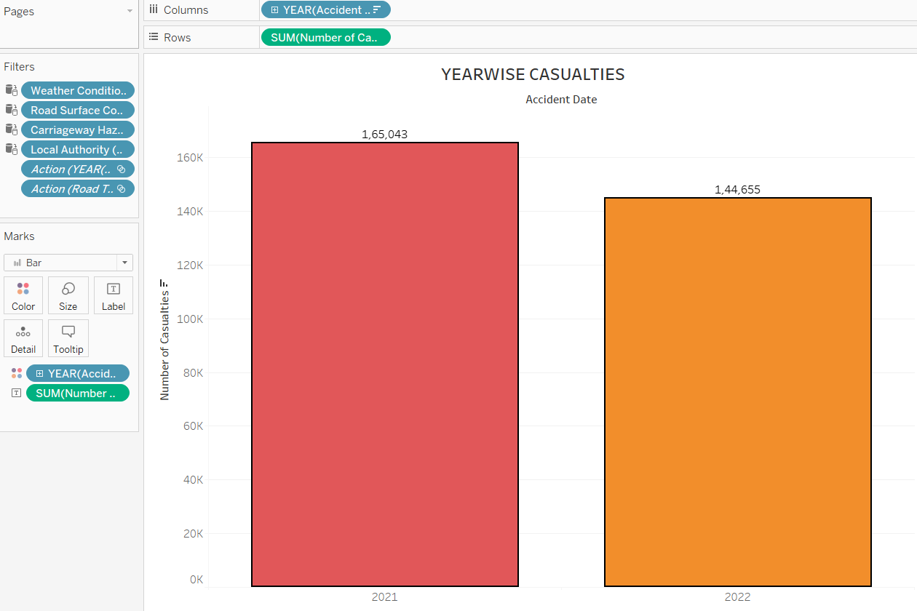
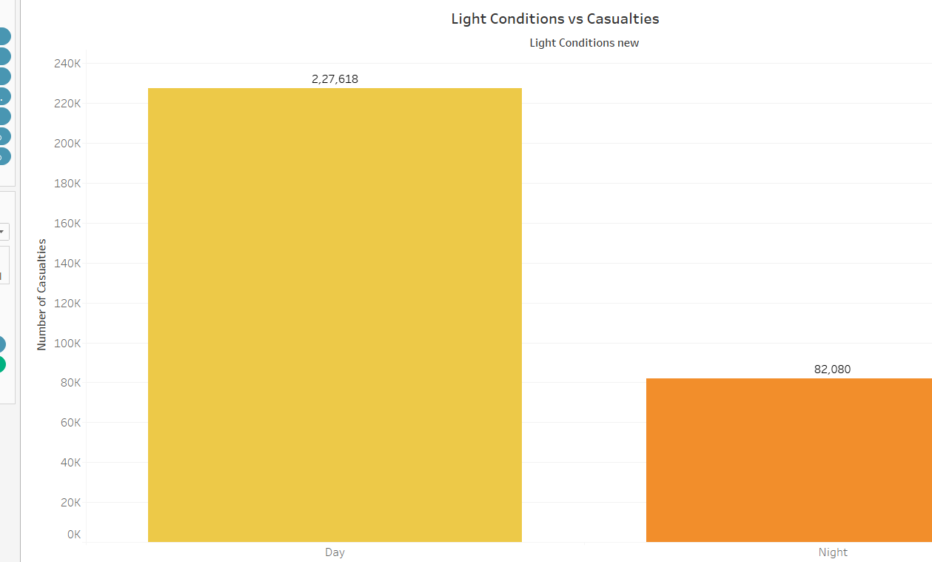
Stacked Bar Chart
Yearwise Casualties
Casualties by Day/ Night

Slide 7
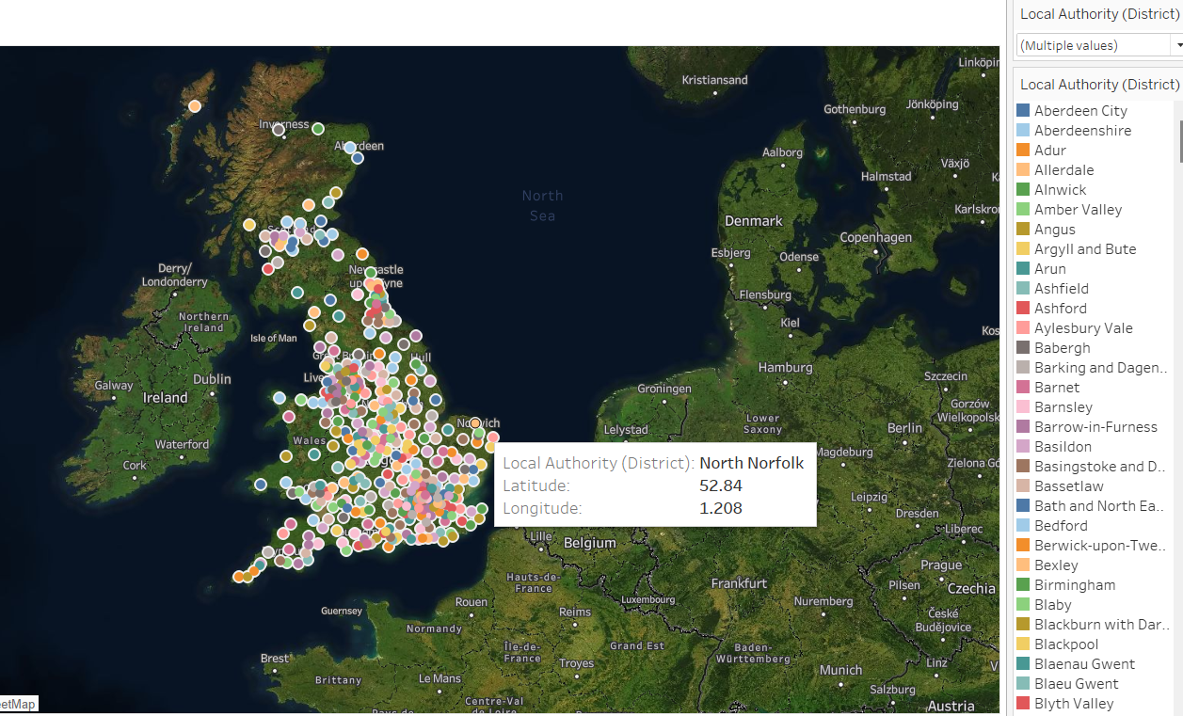
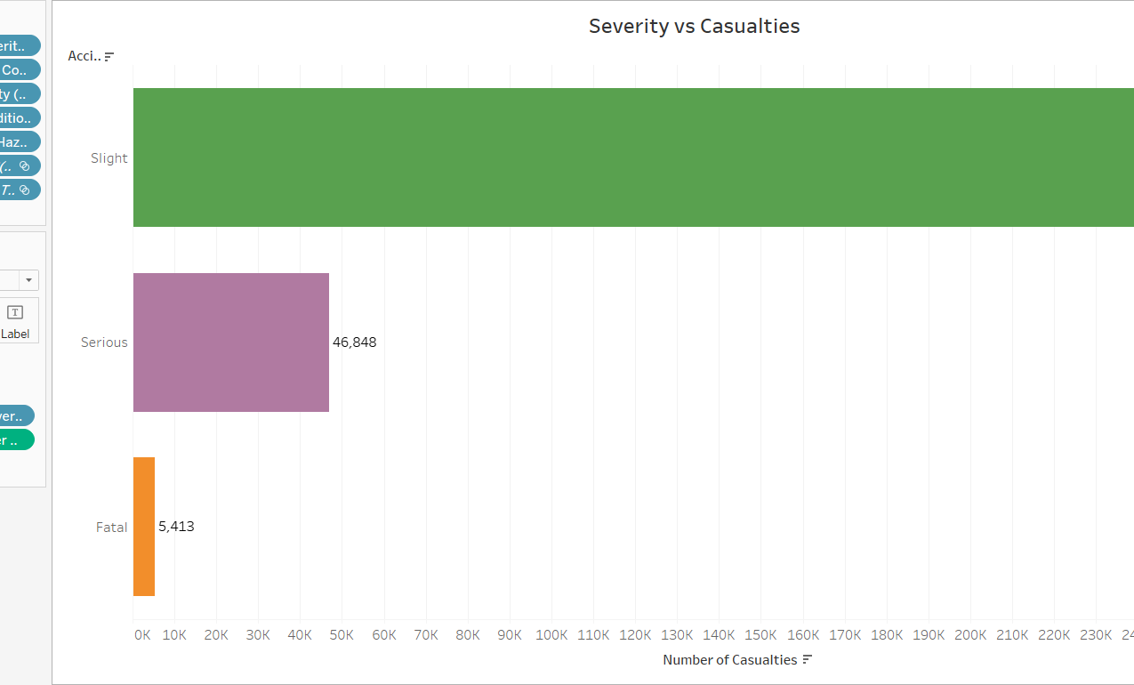
Map & Horizontal Bar Chart
Map
Severity vs Casualties

Slide 8
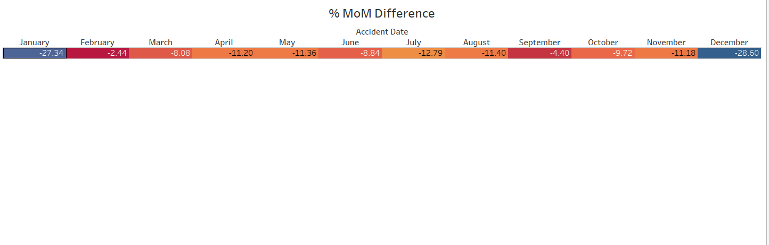
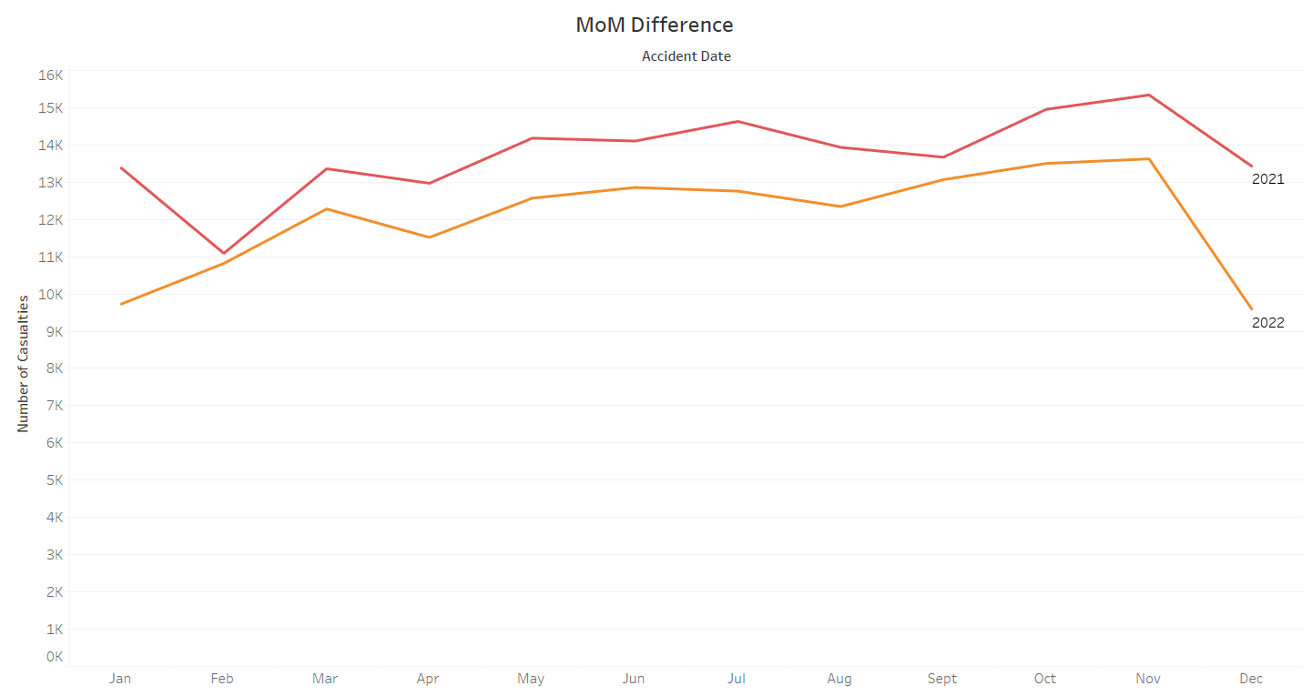
Trend Lines
MoM Difference
MoM Difference By Months

Slide 9
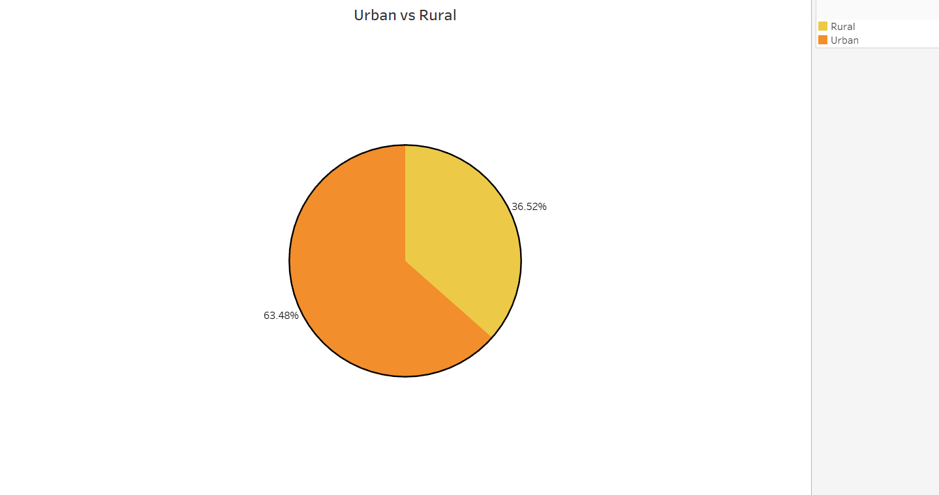
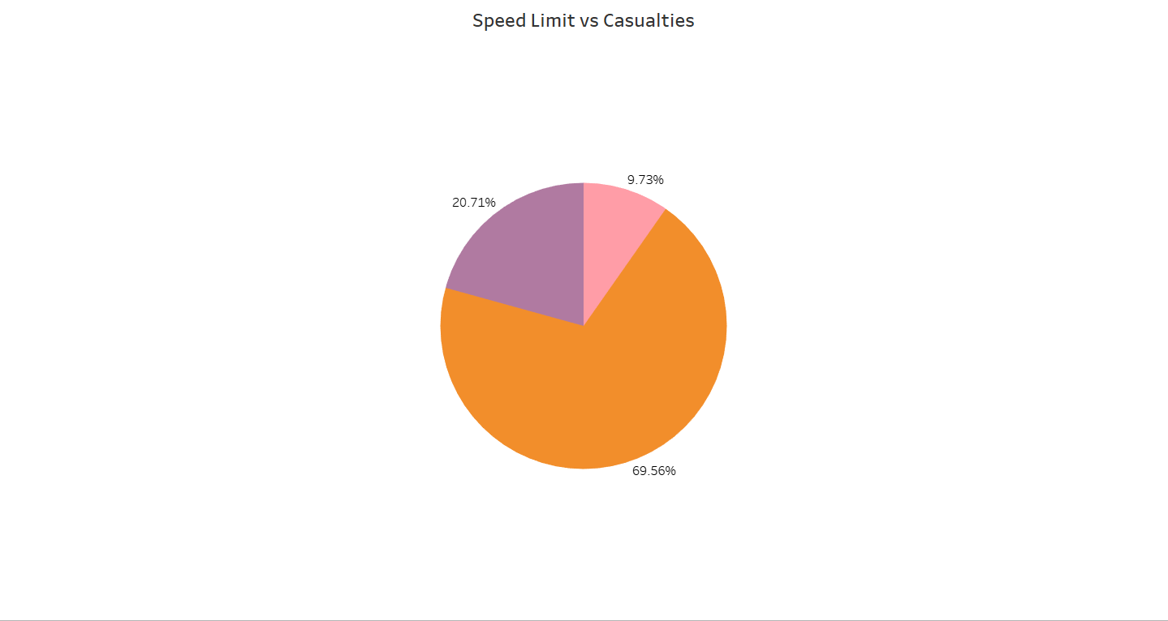
Pie Chart
Urban Vs Rural
Speed Limit VS Casualties

Slide 10
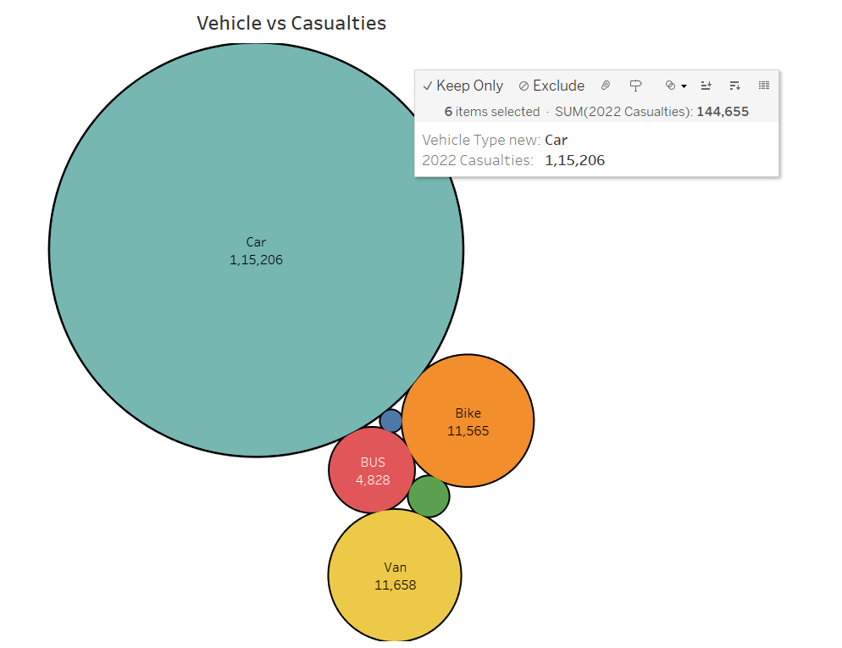
Packed Bubbles
Vehicle vs Casualties

Slide 11

Conclusion
This study uses Tableau to visualize road accident data, exploring casualties, severity, vehicle types, monthly trends, and urban-rural disparities. It advocates tailored interventions based on the unequal distribution of injuries. The study promotes data-driven approaches to enhance road safety, saving lives, and improving public health.

Slide 12

References
https://youtu.be/8C0MKaIR-EE?si=S24DmohO0-DbkK1q
https://stackoverflow.com/questions/49675825/tableau-desktop-add-calculated-field
https://stackoverflow.com/questions/69015518/line-graphs-in-tableau
https://community.tableau.com/s/question/0D54T00000C6Ri6SAF/tableau-table-graph

Slide 13
Thank you

