Slide 1


Slide 2


Slide 3
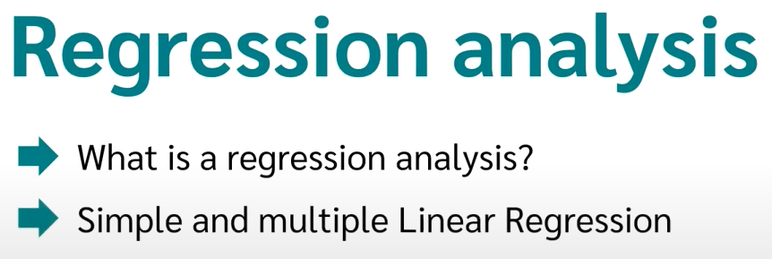

Slide 4
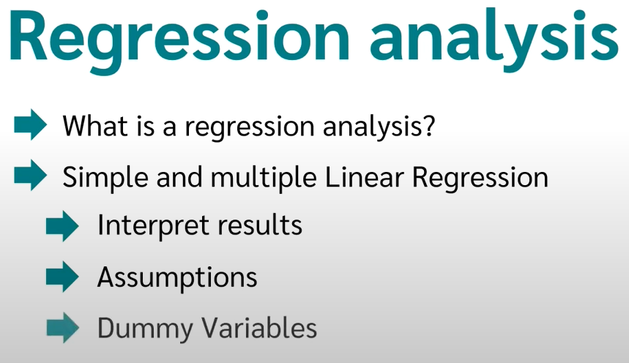

Slide 5
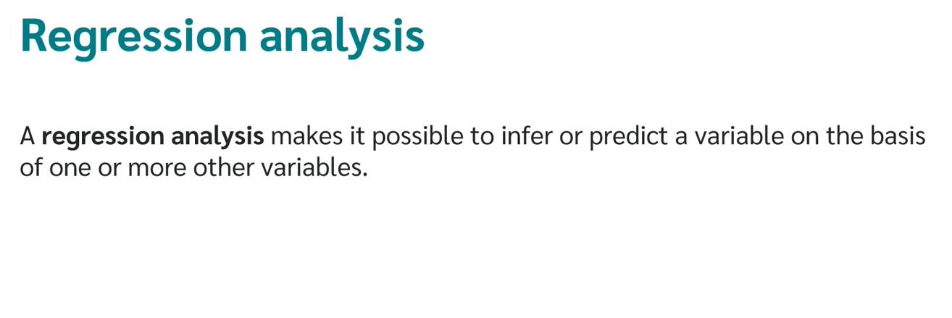

Slide 6
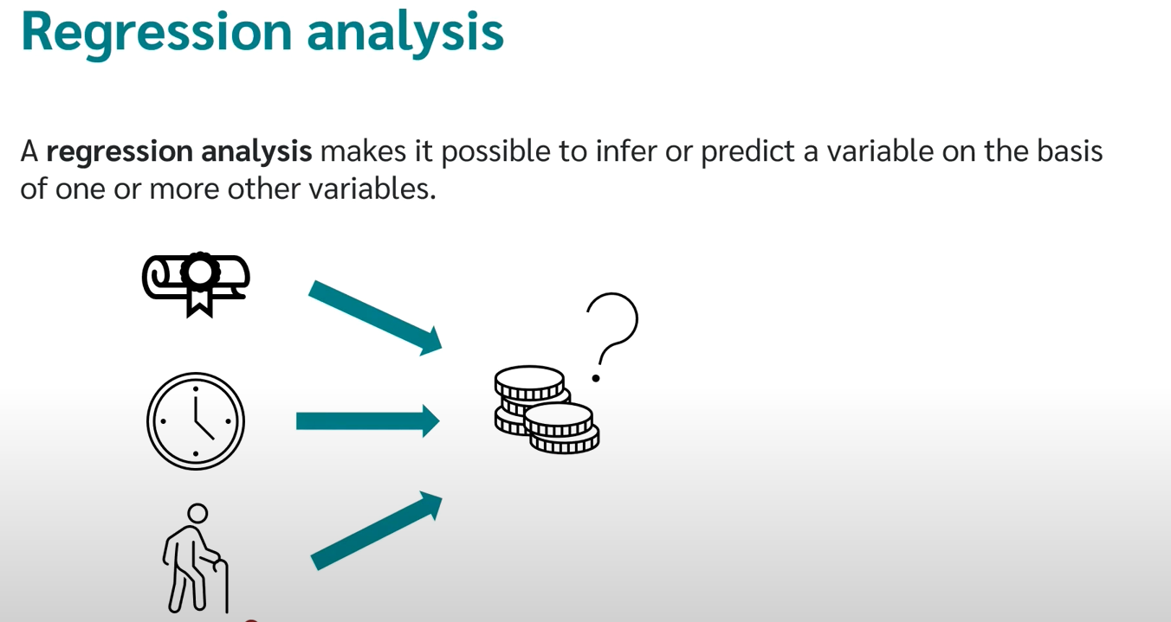

Slide 7
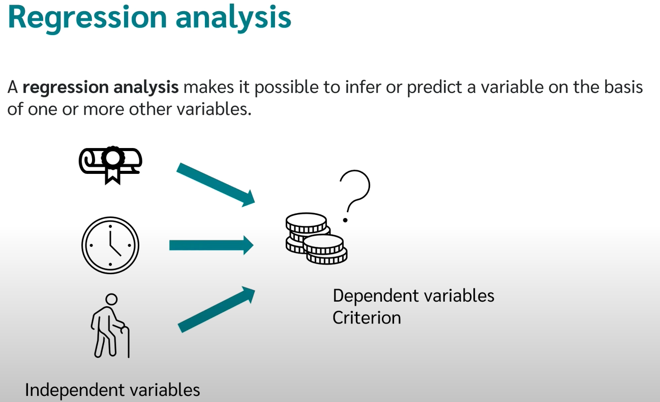

Slide 8
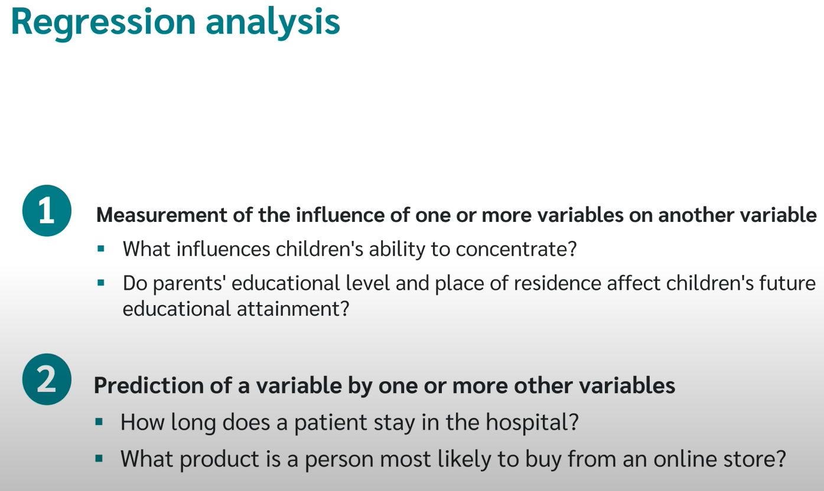

Slide 9
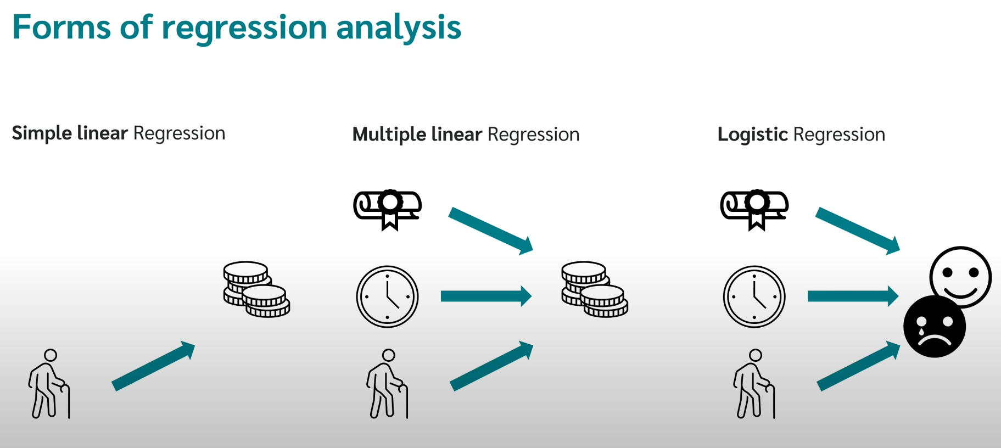

Slide 10
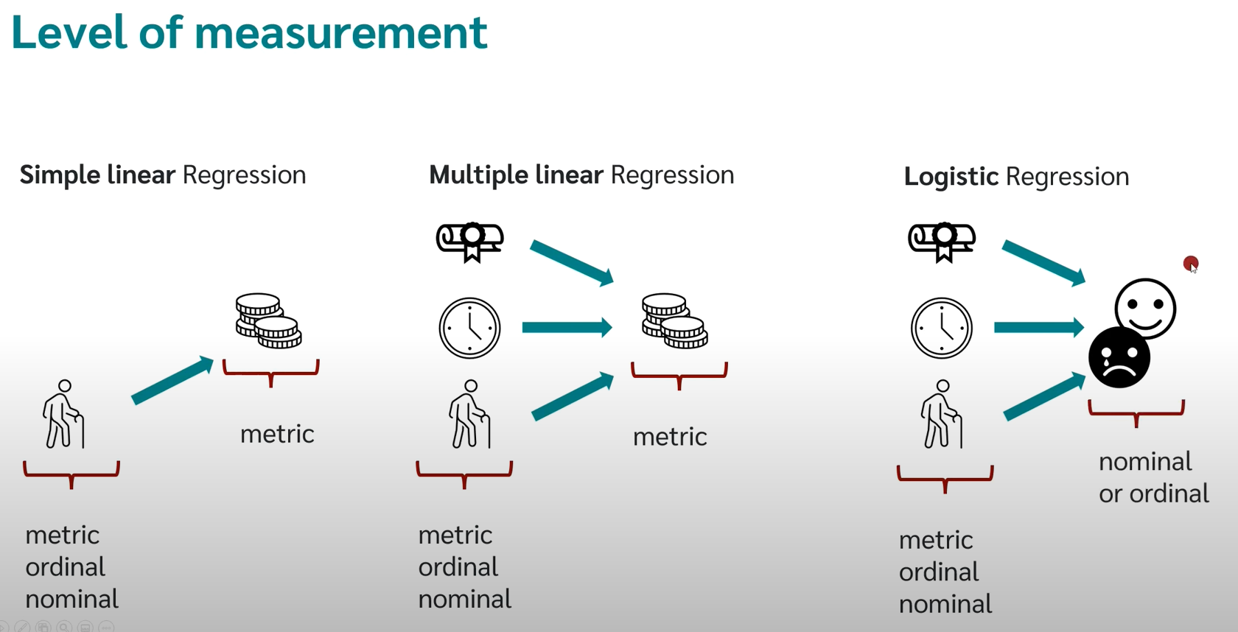

Slide 11
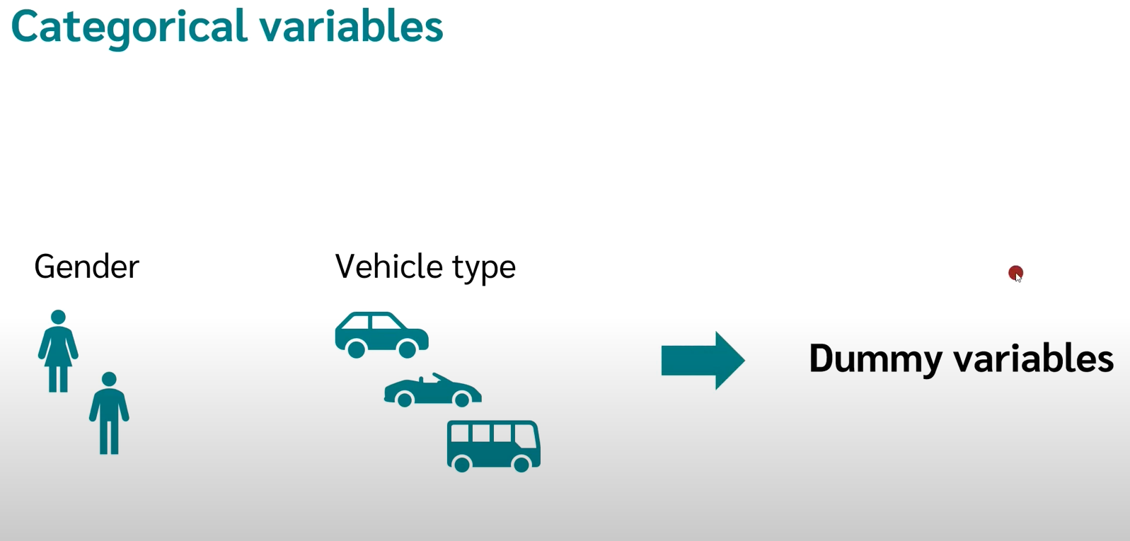

Slide 12
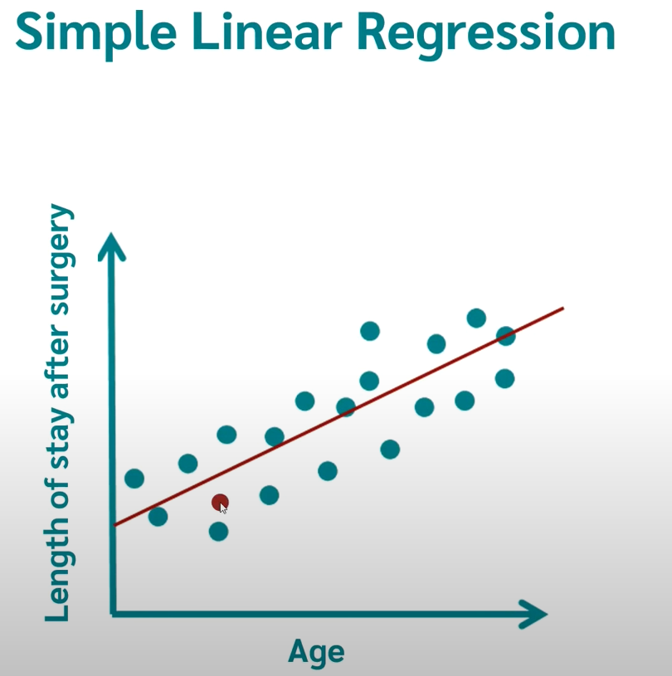

Slide 13
y = A* x + B
A = sum((x(i) - mean(x)) * (y(i) - mean(y))) / sum( (x(i) - mean(x))^2 )
B = mean(y) - B1 * mean(x)

