Slide 1

Malicious and Benign Websites
Classify by application and network features
Implemented By:
Md Maminur Islam

Slide 2

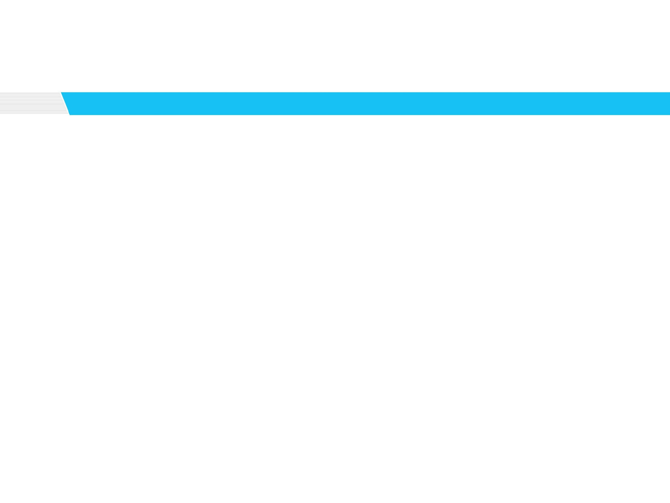
Objective
Websites have become intruder’s main target.
Costly to manually analyze each URL one by one and add to blacklist.
Goal:
Detect malicious web pages using ML based classifiers

Slide 3
Dataset & Pre-processing
Dataset:
Collected from Kaggle.
1780 data points.
Features:
Total 20 features.
Both network and application features.
URL_LENGTH, SERVER, CONTENT_LENGTH, REMOTE_IPS, DNS_QUERY_TIMES etc.

Slide 4

Challenges
Too many categorical features
High cardinality.
Existing approaches produce more than 1000 features.
Solution:
Replace high cardinality feature values by numeric values(Moeyersoms & Martens, 2015).
Supervised Ratio: $SR_{i}=\frac{P_{i}}{N_{i}+P_{i}}$
Weight of Evidence: $WOE_{i}=ln⁡(\frac{\frac{P_{i}}{TP}}{\frac{N_{i}}{TN}})$

Slide 5
Pre-processing & Classification
Pre-processing:
Fill missing values.
Replace categorical values.
Classification:
Compared performance among Neural Net, Decision Tree, SVM, Random Forest and K-Nearest Neighbors.

Slide 6
Observations
Neural is fast and ≈90% accurate
SVM shows better performance(≈92%) than NN but very slow.
KNN and NN shows almost similar performance.
Decision Tree and Random Forest show best performance.

Slide 7


Slide 8
Future Work
Experiment with other datasets available in the internet.

Slide 9

Questions?

Slide 10
Thanks!!!

