Slide 1
TUBERCULOSIS DETECTION FROM CHEST X-RAYS USING IMAGE SEGMENTATION AND CLASSIFICATION.
Md Tushar Ahmed
ID: 201-15-3549
Project ID: SP23D779
Israt Jahan
Lecturer (Senior Scale)
Department of CSE
Daffodil International University
Tuesday 23 January 2024

Slide 2
Presentation Outline
Introduction
Motivation
Objective
Literature Review
Methodology
Experimental Results and Analysis
Future work & Conclusions

Slide 3

Introduction
In my research based project, used data collection from Kaggle.
Applied 5 algorithms – DenseNet121, VGG16, ResNet50, InceptionV3, ConvNet.
VGG16 gives highest accuracy
The nature of data is CXR images and used in metadata
Utilized Grad-CAM for visualizing key regions of interest in chest X-ray images and validating the significance of identified features.
Applied segmentation techniques for precise X-ray image analysis by U-net model

Slide 4

Motivation
The rising incidence of Tuberculosis and the concomitant difficulties in prompt and precise diagnosis are the fundamental driving forces behind this study.
Enormous amount of data
Enhancing diagnostic precision by integrating image segmentation to isolate key regions of interest in chest X-rays, aiding in targeted tuberculosis identification.
In fact, Improve patient outcomes by increasing the effectiveness of diagnostics.

Slide 5

Objectives
Create an accurate chest X-ray segmentation model for tuberculosis patterns.
Employ advanced algorithms, including CNNs, for precise tuberculosis detection through segmented regions.
Healthcare Integration
Continuous monitoring and Real world Implementation
Visualization
Streamline the segmentation and classification processes to enhance computational efficiency for feasible real-time application.
Validate real-word impact

Slide 6
Related Work
Reference | Used Algorithms | Accuracy
Suci Aulia, Sugondo Hadiyoso | CNN based VGG16 | 99.7
Eman Showkatian.. Nahid Sadighi | ConvNet Exception ResNet50 VGG16 | 91% 90% 87% 87%
TAWSIFUR..E.H Chowdhury | ResNet18, ResNet50, ResNet101, ChexNet, InceptionV3, Vgg19, DenseNet201, SqueezeNet, and MobileNet | 96.47%, 96.62%, 96.47%, 96.47%, 96.51%, 98.6%, 98.57%, 98.56%, 98.56%
Saad I. Nafisah1 • Ghulam Muhammad | EfficientNetB3 | 91.1

Slide 7
Methodology
Chest X-Ray
Training
Testing
Pre-Processing
segmentation
Classification
Deep CNN models (DenseNet121, ResNet50, VGG16, InceptionV3, ConvNet)
Comparison of Performance of Different CNN models for accuracy

Slide 8
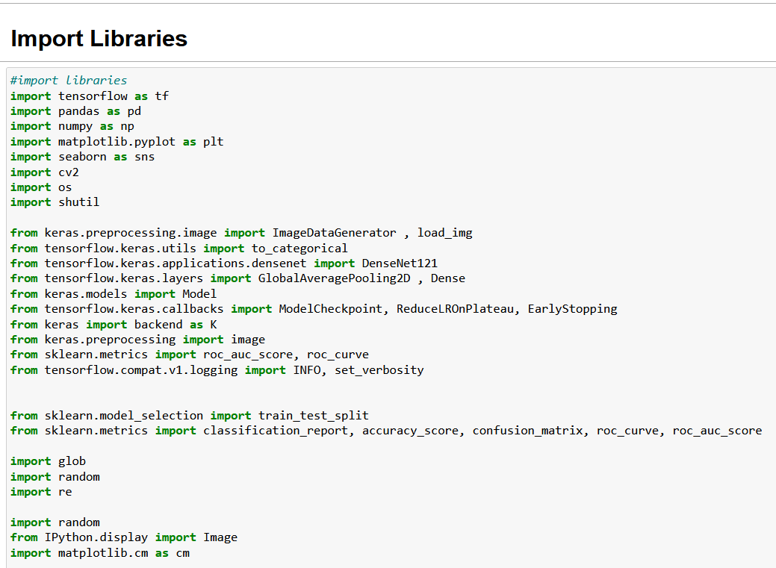
Import Libraries

Slide 9
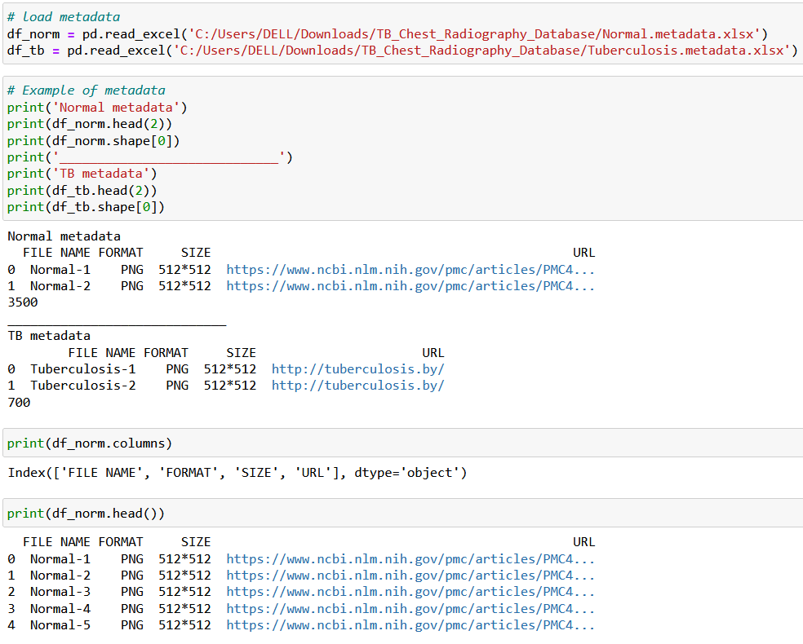
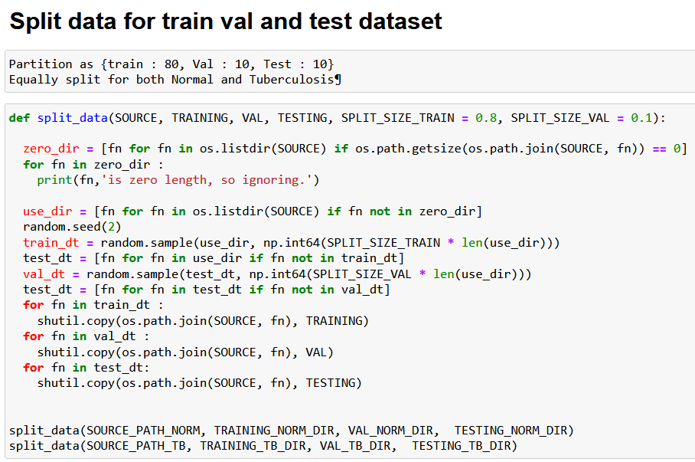
Data Load

Slide 10
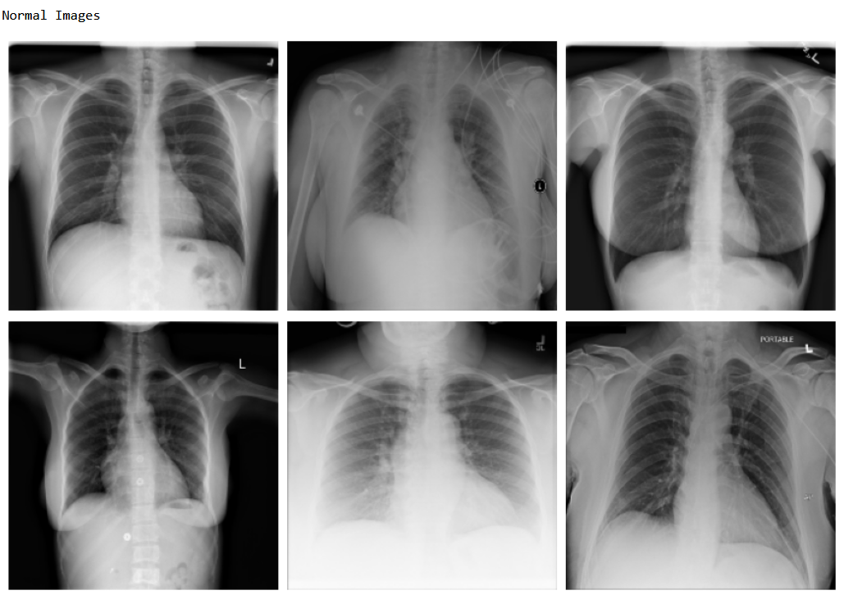
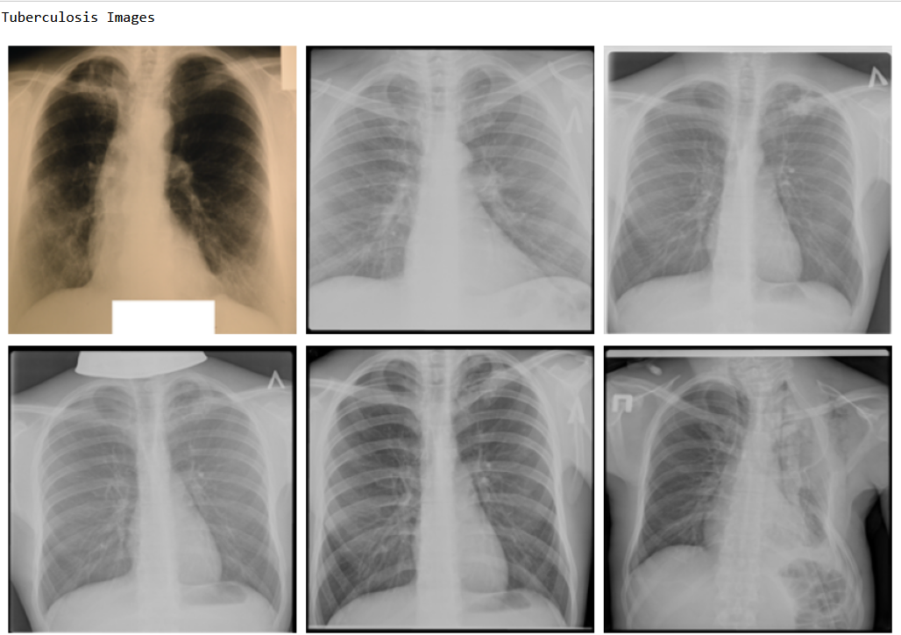
Output-Chest X-rays

Slide 11
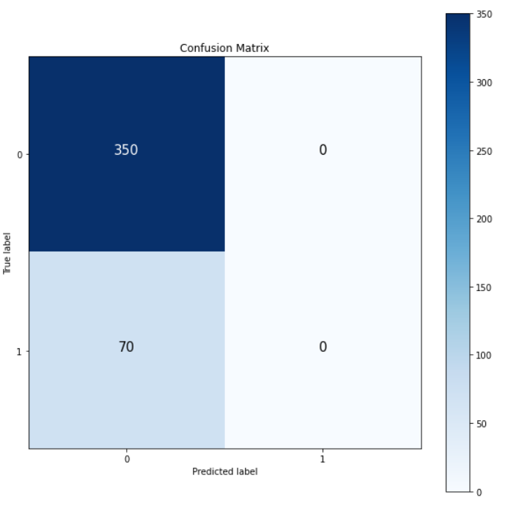
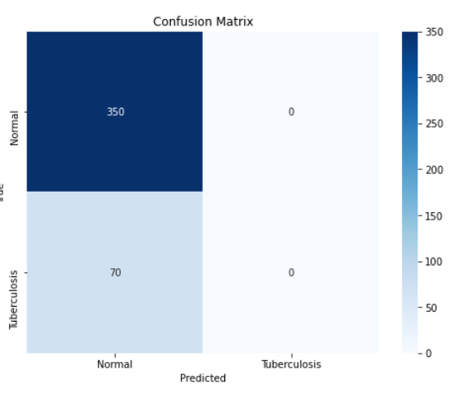
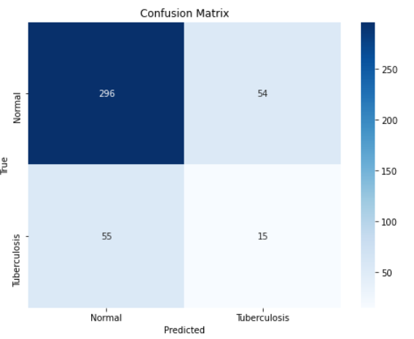
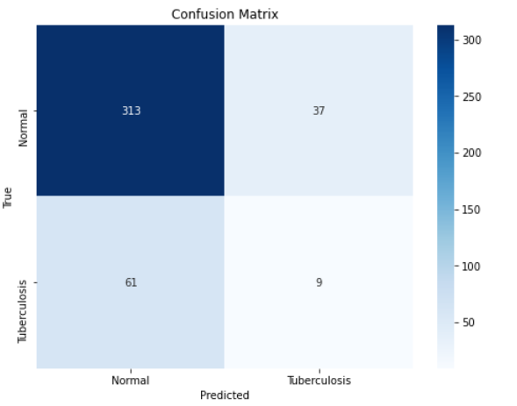
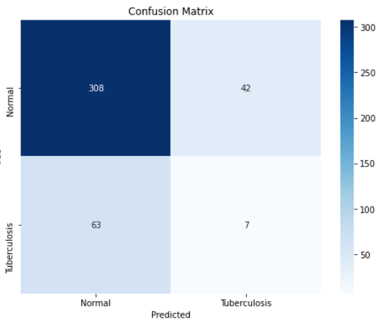
Confusion Matrix of 5 applied algorithms

Slide 12
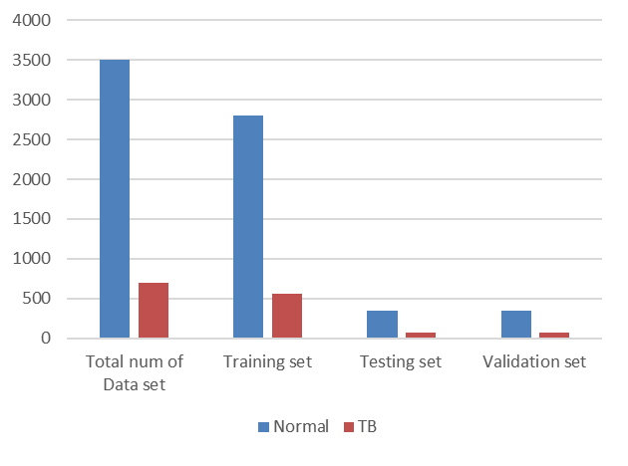
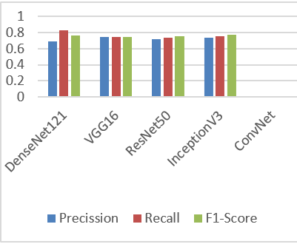
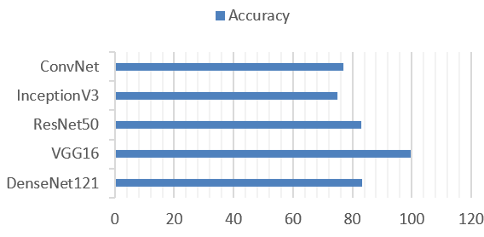
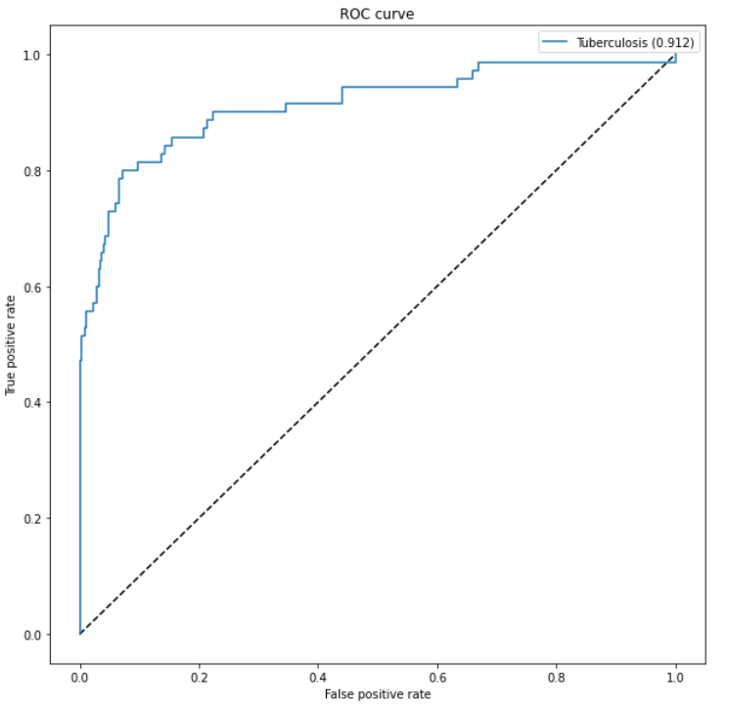
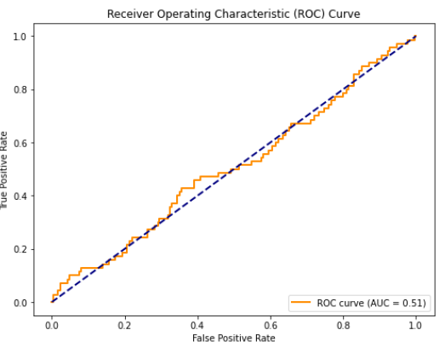
Data Analysis

Slide 13
Data Pre-Processing
1. We normalize the mean and standard deviation of each data
2. We shuffle the input after each epoch.
3. We set the image size to be 320px by 320px
4. We apply some augmentations (Rotation, Zoom, Width shift and Height shift) based on position deviation which could possibly be slightly changed when radiographers x-ray patients
5. The generator converts single channel X-ray images (gray-scale) to a three-channel format by repeating the values in the image across all channels. (The pre-trained model requires three-channel inputs)

Slide 14
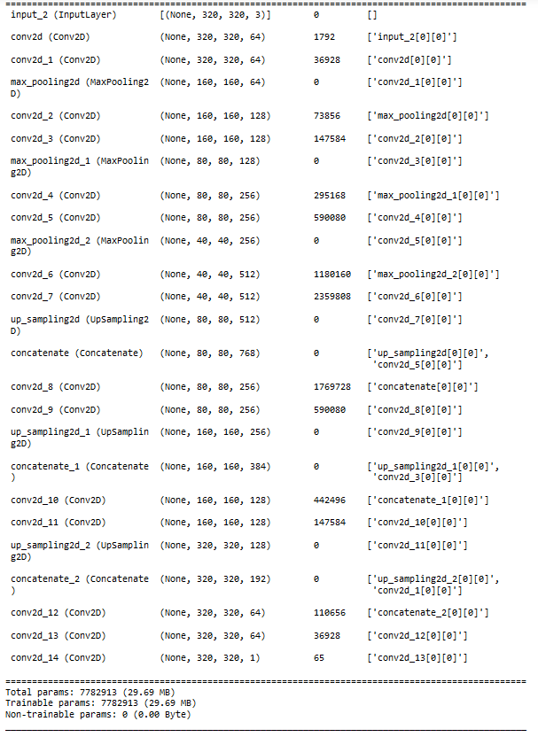
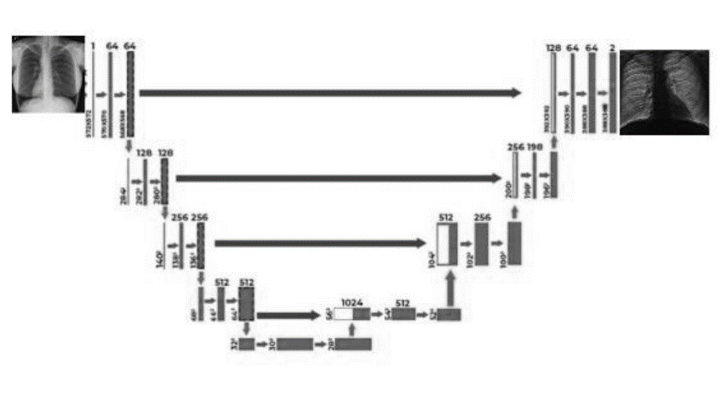
Segmentation: U-net

Slide 15
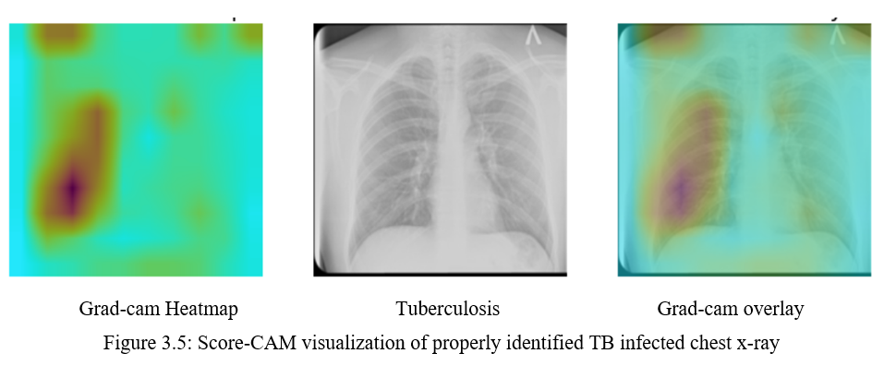
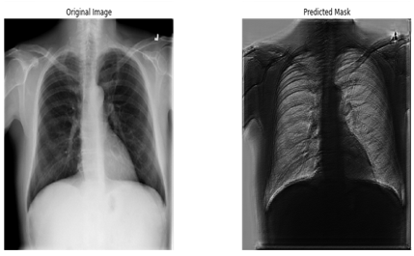
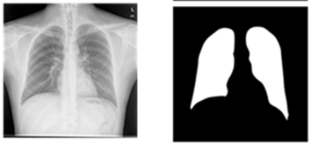
1
U-Net

Slide 16
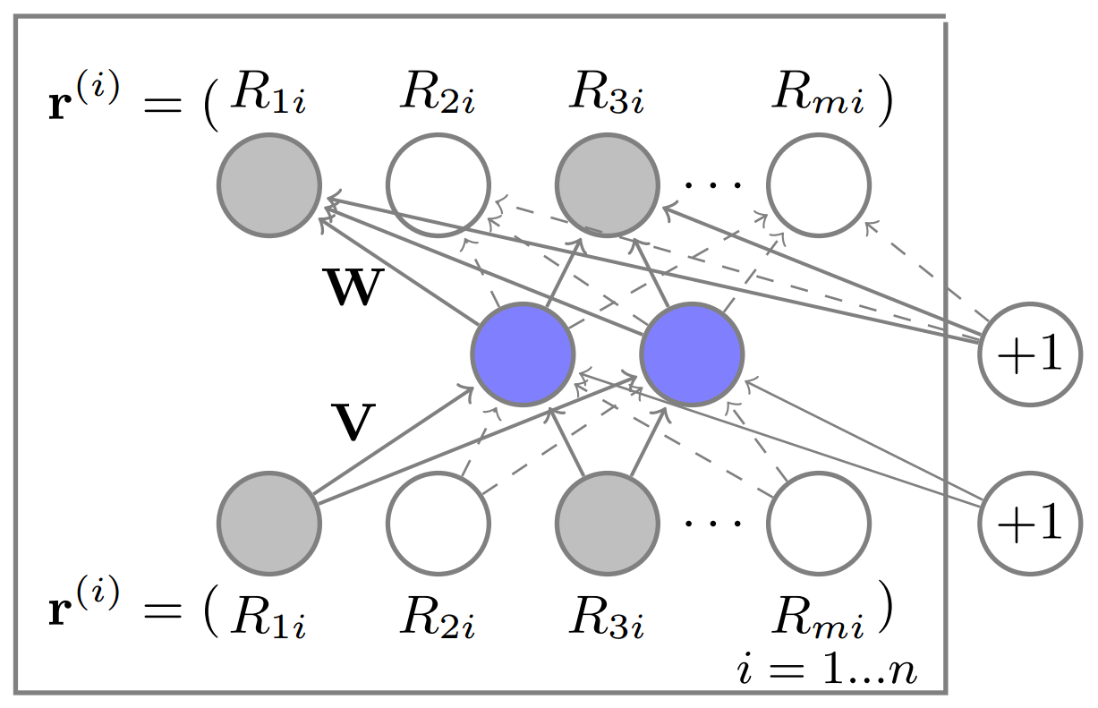
Model Selection
DenseNet121
ResNet50
VGG16
InceptionV3
ConvNet

Slide 17
Experimental Result and Analysis
I applied total five algorithms and they provided different accuracy which helps me for classification. The accuracy table is given bellow:
Models | Precision | Recall | F1 Score | Accuracy
DenseNet121 | 0.83 | 1.0 | 0.91 | 0.83
VGG16 | 0.84 | 0.85 | 0.84 | 0.99
ResNet50 | 0.83 | 1.0 | 0.91 | 0.83
InceptionV3 | 0.83 | 0.88 | 0.85 | 0.75
ConvNet | 0.84 | 0.89 | 0.86 | 0.77

Slide 18

Advantages
Find out best accuracy using the applied algorithms
Highly effective Pattern Recognition and adaptability to Diverse data
Feature Extraction or Feature Classification Without manual Intervention
Continuous improvement with more data.
Low cost and flexible
Potential for real time diagnosis

Slide 19
Future Work
I want to provide a thorough, integrated evaluation of the state of my knowledge about lung segmentation and disease classification in chest X-rays with this study.
I would want to attempt producing heatmaps using the u-net network. Compared to other networks, I hope that these heatmaps will gather more pertinent data.
Enhanced Segmentation technique.
Real time implementation and Collaboration with healthcare professionals
Continuous model monitoring and Updating

Slide 20
Conclusion
As a result of our study, we found that the dataset has an impact on a supervised learning model's diagnostic performance. This is due to the distribution of illness severity in various groups as well as the differing technical specifications of CXR images.
Early diagnosis of this infection is crucial in order to give the right treatment. The different models have different accuracy, such as densenet121, VGG16, ResNet50, InceptionV3, and ConvNet, which have respectively 83.33%, 99.00%, 83.33%, 75.00%, and 76.67%.

Slide 21

1
Any Questions ?

