Slide 1
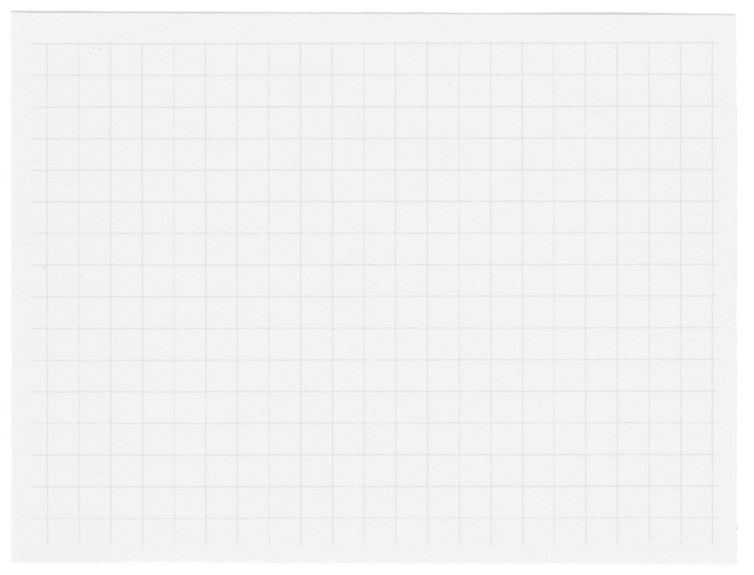

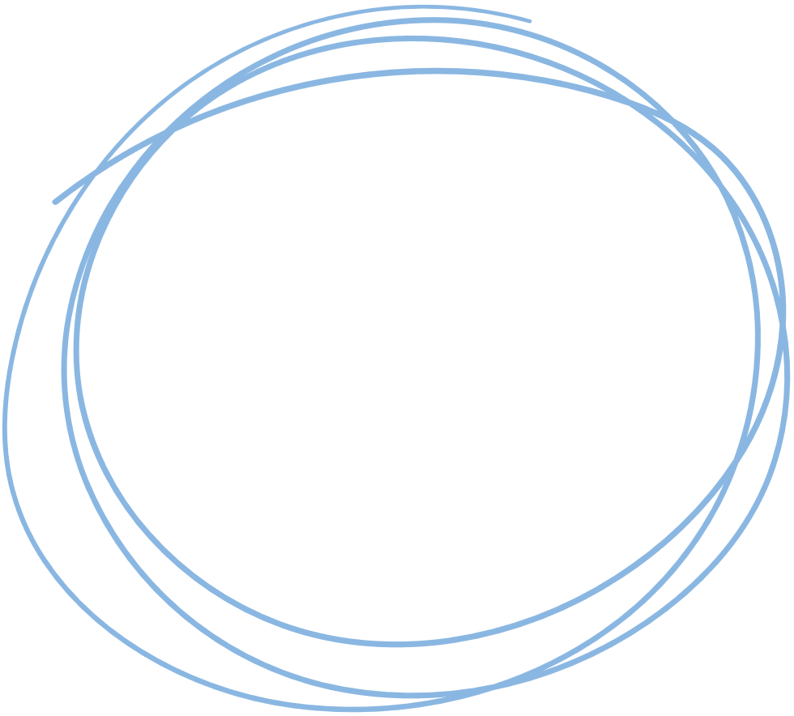













National Institute of Technology Tiruchirappalli
Department of Computer Applications
THE SECOND HAND STORE
Presented By Tushar Nanda
Master of Computer Applications(MCA)
205122102
under the guidance of
Dr. B. Balaji
Assistant Professor
Department of Computer Applications
NITT

Slide 2
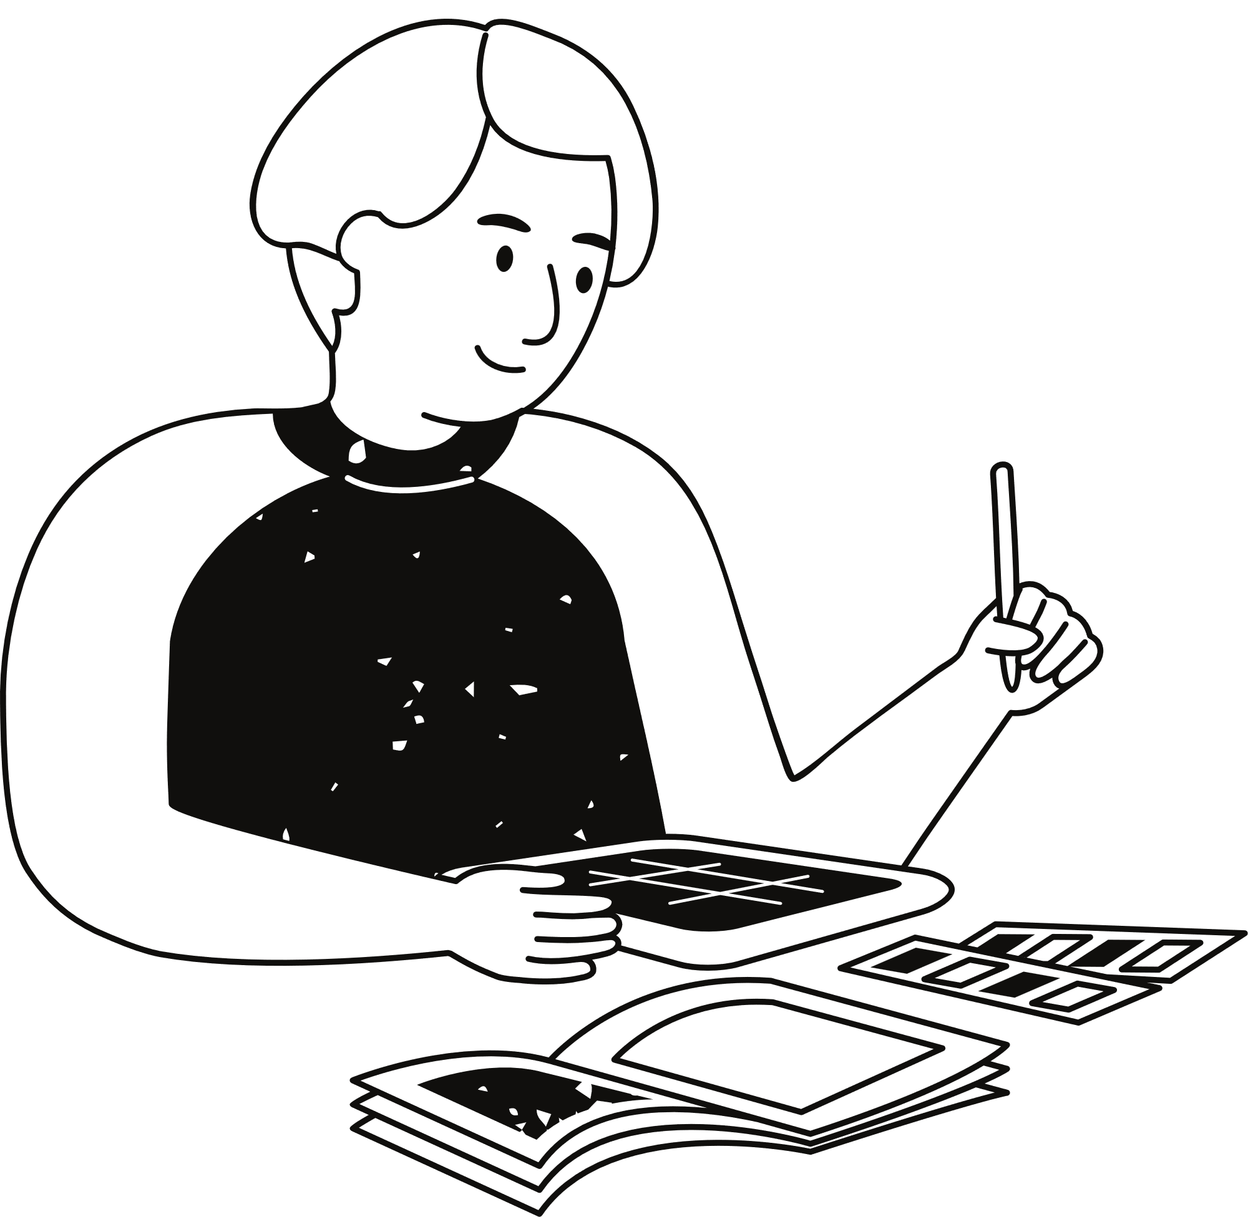
Problem Statement
Our platform aims to connect graduating students selling items they no longer need with newcomers seeking affordable essentials. Additionally, we facilitate inter-branch exchanges, allowing students from different fields to connect and trade goods within the campus community.”
our platform aims to bridge these gaps. Here are the key aspects:
1.Graduating Students Selling to Newcomers
2.Inter-Branch Exchange:

Slide 3

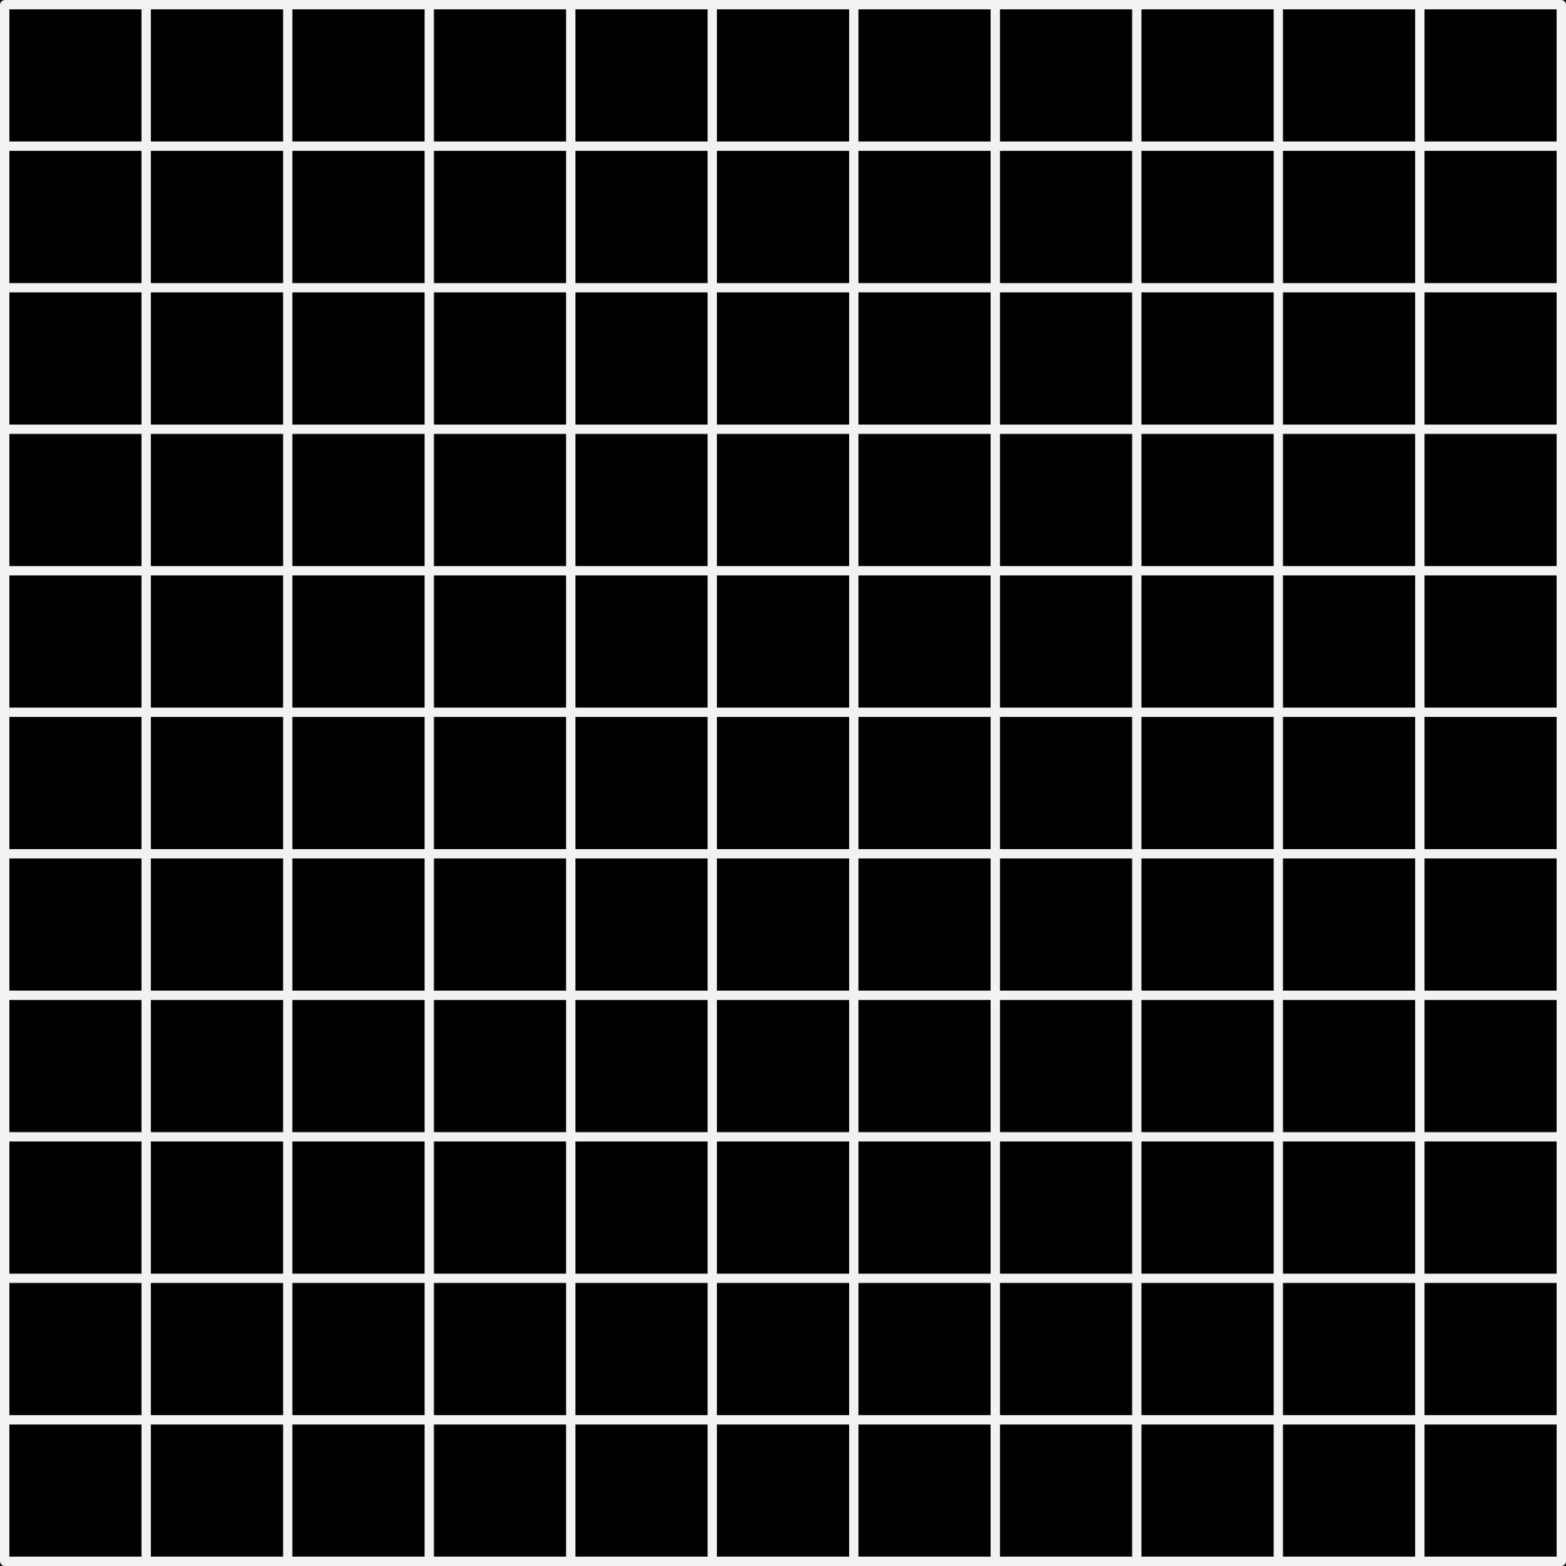






TECHNOLOGIES USED
TOOLS USED

Slide 4
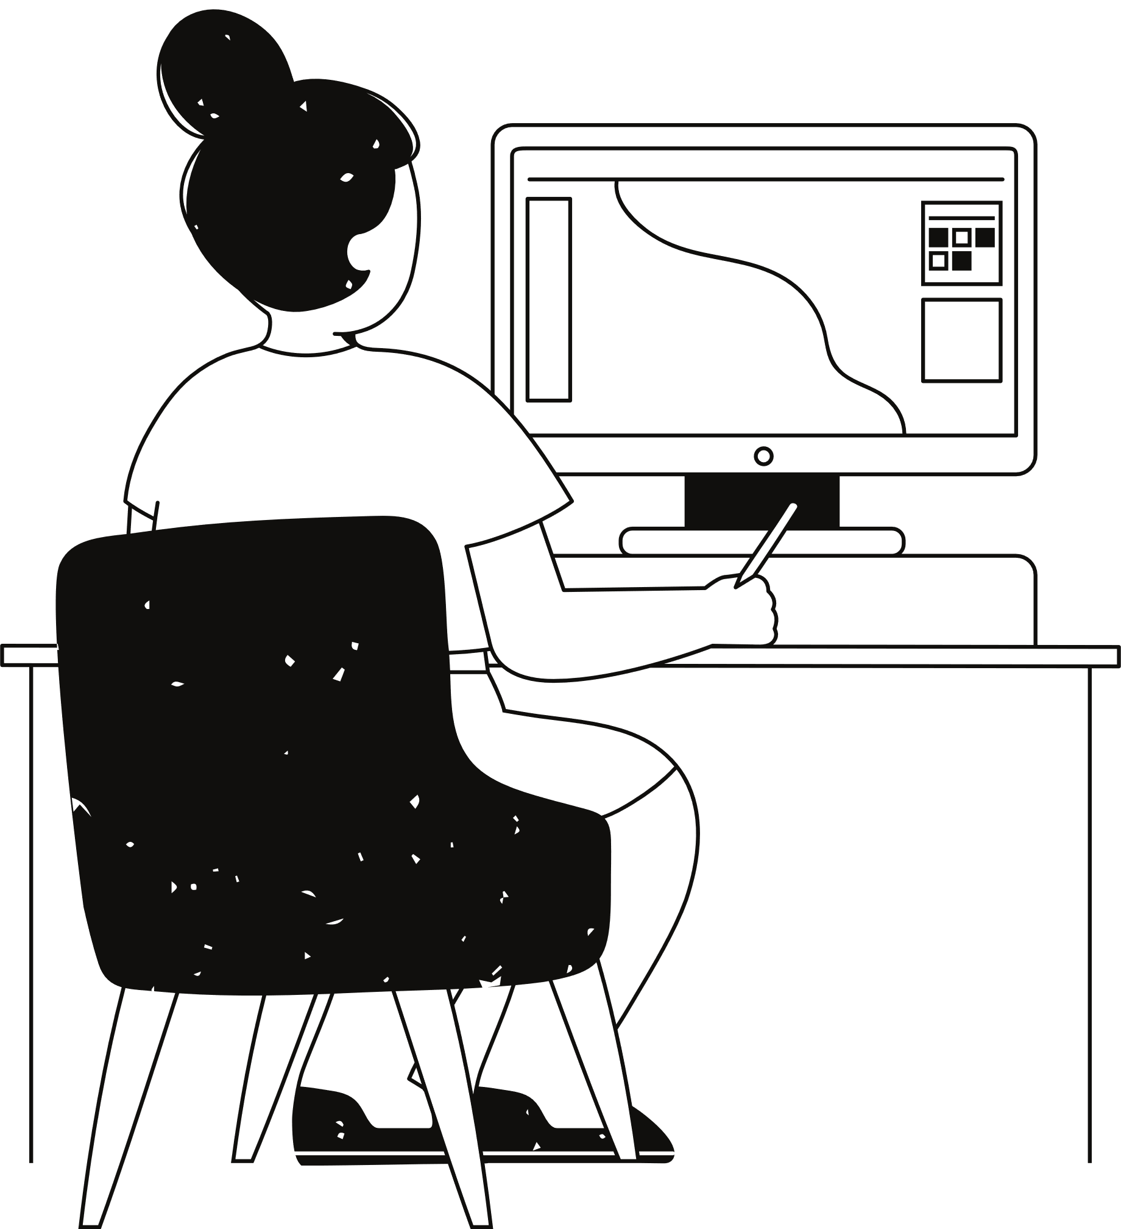
Work done so Far
1. Create React App Setup:
Set up your React project using Create React App
.
2. Authentication API (Login and Signup):
Implemented authentication endpoints using JWT tokens.

Slide 5


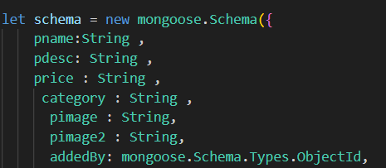
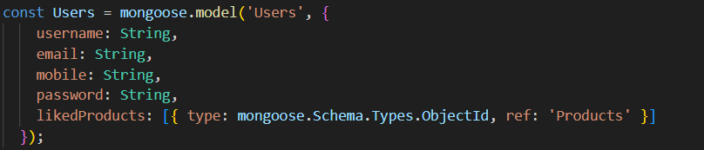


Database Connection:
Connected app to a MongoDB database using Mongoose.
Stored user data (non-relational) such as users and products.

Slide 6


CONTINUE...
3.Product Section:
Created a section for adding products.
Used npm multer to handle image uploads.
4.Search Functionality:
Added a search box that works with product data.
5.Product Interactions:
Implemented features like liking and disliking products. Added a toggle button for user preferences.
Enabled users to add products to their favorites.

Slide 7
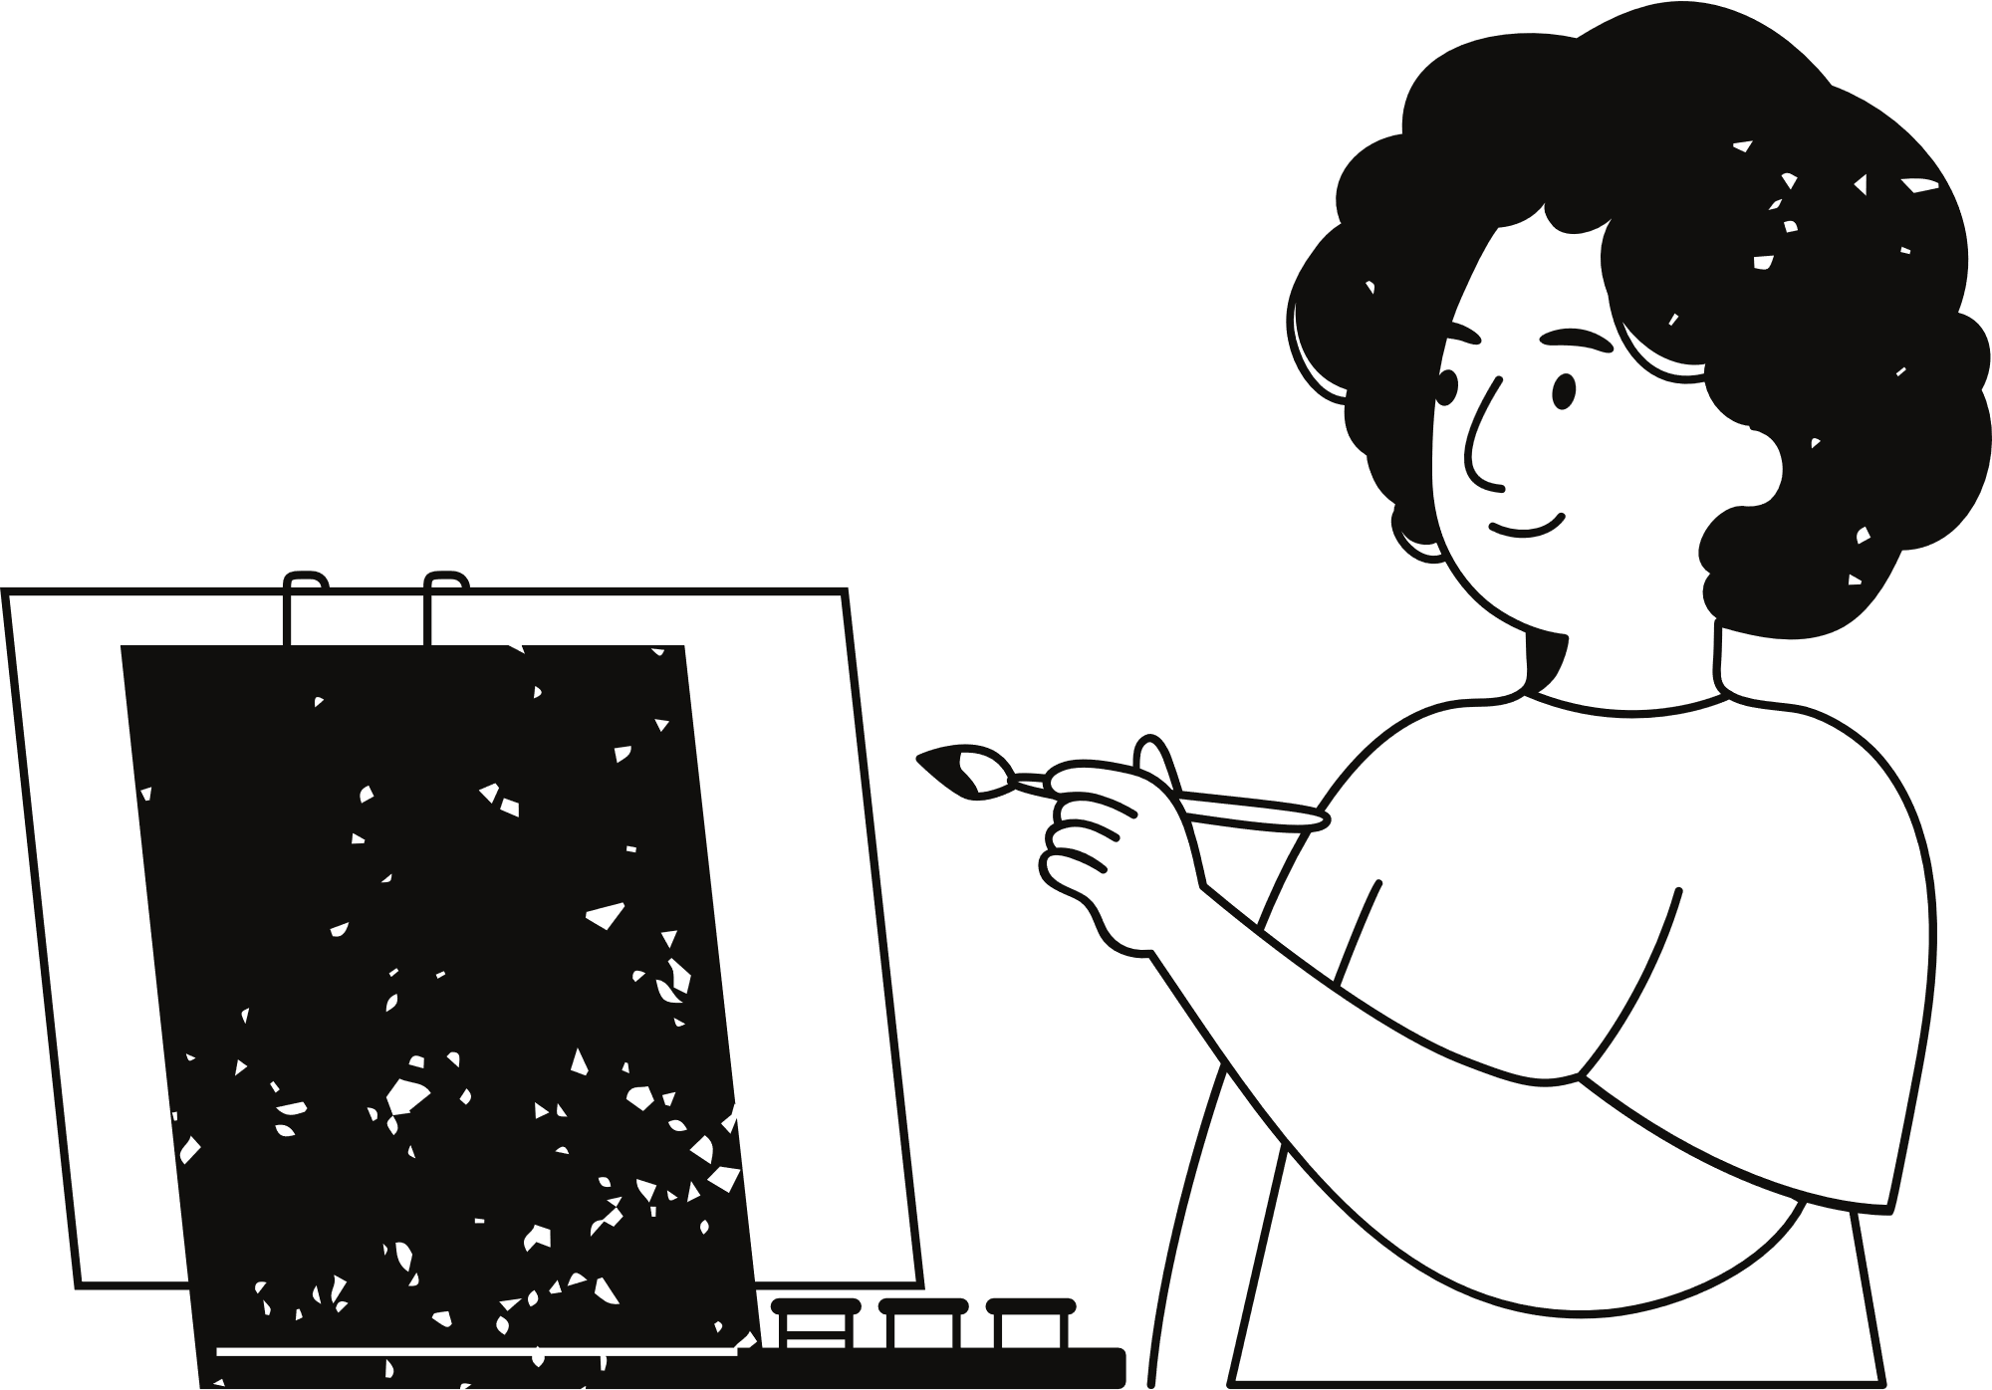
6. My Profile Section:
Created a section for user profiles.
7. Code Organization:
Separated backend code into two files for better organization.

Slide 8




THANK YOU

