Slide 1
CS321: Friday Tutorial
Tushar Semwal

Slide 2
MQ Telemetry Transport (MQTT)

Slide 3
MQTT: Basics
A lightweight messaging protocol
Publish/Subscribe
For M2M telemetry with low-bandwidth and -footprint
Created by IBM in 1999 for Oil pipeline telemetry via satellite. NOW OPEN SOURCE

Slide 4
By the way
Telemetering means??
Tele + Metering
Tele = Far or Remote
Metering = Measurement
Remote Measurements and sending data to the base server

Slide 5
Terms
Client: A “device” that publishes a message or subscribes to a topic
Publish: A client sends a message
Subscribe: The broker sends the message about the topic to which a client is subscribed to.
Topic: A namespace (casually, address string) to/from which clients publish and subscribe
Broker: A “server” which accepts messages and delivers messages from/to clients

Slide 6
Model
Subscriber-1
Publisher-1
/topic-B
/topic-A
Broker
/topic-A
Subscriber-2
/topic-B
/topic-B
Publisher-2
Subscriber-3

Slide 7
Why not HTTP?
Lot of header. Too big. MQTT smallest packet size is just 2 bytes
Request/Response
Usually synchronous. MQTT is asynchronous.

Slide 8
Usage
Facebook Messenger (mobile app) uses MQTT to minimize latency and battery usage (https://ibm.co/2vNa8Uk)
St Jude Medical, who use MQTT to remotely monitor patient implants (https://ibm.co/2JfCNWK)
Consert, use MQTT as a part of their real-time home energy monitoring and management solution

Slide 9
Broker
Open source implementations are available:
Mosquitto (https://mosquitto.org/)
Mirco Broker (https://github.com/micro/go-micro)

Slide 10
CS321: Use Case
Temperature sensor
/group1/temp1
CSE Office
Accelero
/group7/acc1
Group 3

Slide 11
Resouces
https://www.baldengineer.com/mqtt-tutorial.html
https://github.com/256dpi/arduino-mqtt

Slide 12
Embedded Programming
What is so different?

Slide 13
Difference
PC/Mobile
Embedded System
General purpose
Over 1MB of memory
High performance CPU
No energy constraints
Goal: overall performance
Specific digital control
Memory in Kbs
Low-end MCU
Energy constraint
Goal: Attain required performance at the lowest cost

Slide 14
Why Memory is limited?
MPU chip
Embedded System
Few variables are enough for digital control
Less area
Low cost
Less energy
Address <= 16 bit
CPU
CPU
Cache
RAM
ROM
Main Memory
Disk
Mother Board

Slide 15
Power Consumption
int main(void)
{
Initialize();
while(1)
{
do_some_useful_work();
hibernate(2ms);
}
}

Slide 16
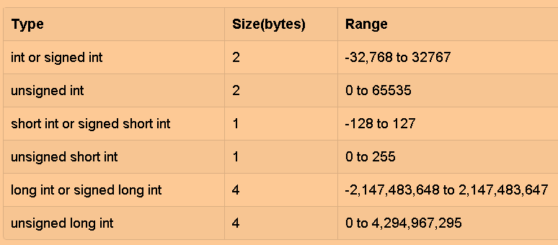
Choosing the Right Data Type
Memory: Smaller variables
Storage: Smaller constants and program

Slide 17
<stdint.h>
uint8_t
uint16_t
uint32_t
int8_t
int16_t
int32_t

Slide 18
Floating point
Be very careful
Usually NO FPU
Software managed
Avoid usage if possible

Slide 19
Check memory usage with Arduino
handson

Slide 20
Takeaways
Use portable fixed size types
Use smallest type possible
Use floats only if necessary

Slide 21
Defining Qualifiers is IMPORTANT!!
Qualifiers determine where the variable is stored and other stuffs:
Memory: Stored in RAM
Storage: Stored in ROM
Hardware: letting hardware directly access some variables for e.g. registers
Compiler optimization control

Slide 22
Quiz
int a;
int b;
void experiment(){
a=8; b=a*7;
If(a==8)
printf(“a equals 8”)
else
printf(“a NOT equals 8”)}
What is the ouput?
a equals 8
a NOT equals 8
Can’t say – I am a loser =D
Is it possible to execute the ELSE part?
YES
NO

Slide 23
Quiz – why?
int a;
int b;
void experiment(){
a=8; b=a*7;
If(a==8)
printf(“a equals 8”)
else
printf(“a NOT equals 8”)}
Multiprocessors with shared memory
Multithreading
Hardware attached variables Or memory mapped I/O
Interrupts

Slide 24
Volatile Qualifier – Quick fix
volatile int a;
int b;
void experiment(){
a=8; b=a*7;
If(a==8)
printf(“a equals 8”)
else
printf(“a NOT equals 8”)}

Slide 25
Takeaways
The volatile qualifier informs the compiler that variable may change because of hardware or other means
Use to explicitly avoid optimization

Slide 26
Constants – const qualifier
const int ledPin = 13;
#define ledPin 13
const stored in ROM
#define also stored in ROM but copied wherever used in program
#define simply replaces text
GOOD: easy to change the value of a constant
BAD: code bloating and no type or syntax checking – runtime errors!!
const send to ROM once – memory addressing
GOOD: Large constants will be stored once, better for double, long
BAD: practically NONE

Slide 27
Function Alternatives
Memory: Traditional functions are put in stack
Storage: Look Up Tables (LUT) and Inline functions are stored in ROM
Processing power: LUT are easy on CPU

Slide 28
Look Up Tables
Constant Arrays containing a collection of return values
e.g. const float log_LUT[256] = {-1.0E-30, 0.0000, 0.693147, ….}
Multiplication tables we learned
Some scientific calculators have LUTs
uint8_t x;
float y;
y = log(x);
y = log_LUT[x]
e.g. IMU Euler angle calculations

Slide 29
Macro Functions
#define square_macro(x) x*x
Advantages
No need to send or return values – a bit fast
Readability
Disadvantages
Code bloating

Slide 30
Inline Functions
While regular functions may take time to execute AND Macros can be troublesome
Inline provides best of both
Identical to regular functions
Just write inline while writing function definition
Advantages over Macro
Parameters are inspected
Debugging is easier

Slide 31
Forced vs Suggested Inlining
int square_AI(unsigned char x)__attribute__((always_inline));
//Always Inline
int square_AI(unsigned char x){
return x*x;}
//suggested Inline
int inline square_SI(unsigned char x){
return x*x;}

Slide 32
Takeaways
Macros are okay for simple functions
If you need inlining, you may force it on compiler
Otherwise leave inlining to compiler

Slide 33
Thank You!
Questions?

