Slide 1
Exception Handling in Java
The Exception Handling in Java is one of the powerful mechanism to handle the runtime errors so that the normal flow of the application can be maintained.
In Java, an exception is an event that disrupts the normal flow of the program.
It is an object which is thrown at runtime.
Exception Handling is a mechanism to handle runtime errors such as ClassNotFoundException, IOException, SQLException, RemoteException, etc.
An exception normally disrupts the normal flow of the application; that is why we need to handle exceptions.
What is the difference between exception and error in Java?
Errors typically happen while an application is running. For instance, Out of Memory Error occurs in case the JVM runs out of memory. On the other hand, exceptions are mainly caused by the application. For instance, Null Pointer Exception happens when an app tries to get through a null object.

Slide 2
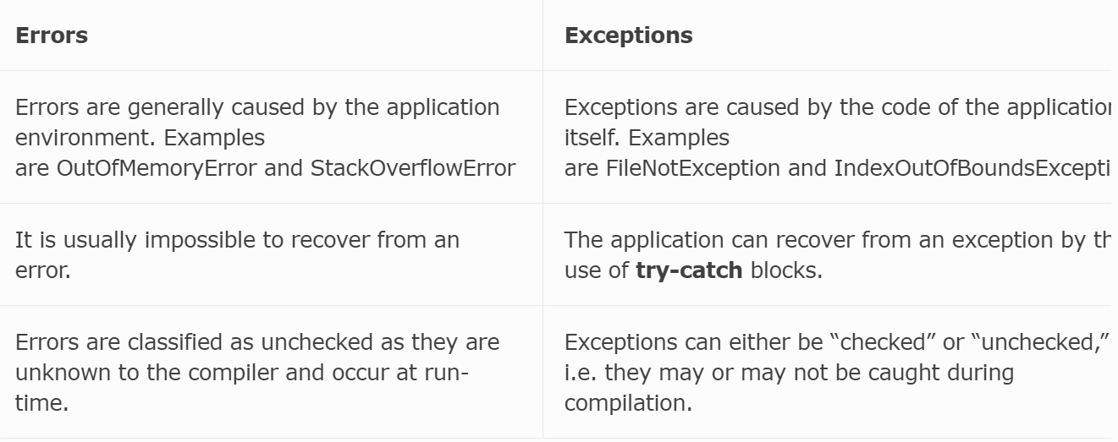
Why do we need exception handling in Java?
If there is no try and catch block while an exception occurs, the program will terminate. Exception handling ensures the smooth running of a program without program termination.
Exception occur because of program.
Error due to lack of system resources.
Exception is recoverable.
Error is not recoverable.

Slide 3
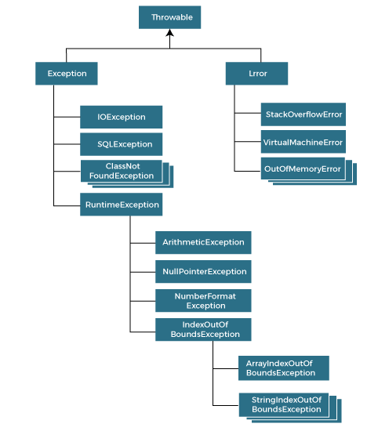
Hierarchy of Java Exception classes
The java.lang.Throwable class is the root class of Java Exception hierarchy inherited by two subclasses: Exception and Error.

Slide 4
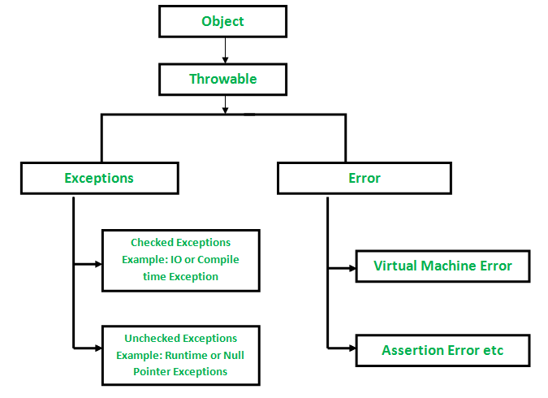
Types of Java Exceptions
There are mainly two types of exceptions: checked and unchecked.
An error is considered as the unchecked exception. However, according to Oracle, there are three types of exceptions namely:
Checked Exception
Unchecked Exception
Error

Slide 5
Difference between Checked and Unchecked Exceptions
1) Checked Exception
The classes that directly inherit the Throwable class except RuntimeException and Error are known as checked exceptions.
For example, IOException, SQLException, etc. Checked exceptions are checked at compile-time.
2) Unchecked Exception
The classes that inherit the RuntimeException are known as unchecked exceptions.
For example, ArithmeticException, NullPointerException, ArrayIndexOutOfBoundsException, etc. Unchecked exceptions are not checked at compile-time, but they are checked at runtime.
3) Error
Error is irrecoverable.
Some example of errors are OutOfMemoryError, VirtualMachineError, AssertionError etc.

Slide 6
Java Exception Keywords
Keyword | Description
try | The "try" keyword is used to specify a block where we should place an exception code. It means we can't use try block alone. The try block must be followed by either catch or finally.
catch | The "catch" block is used to handle the exception. It must be preceded by try block which means we can't use catch block alone. It can be followed by finally block later.
finally | The "finally" block is used to execute the necessary code of the program. It is executed whether an exception is handled or not.
throw | The "throw" keyword is used to throw an exception.
throws | The "throws" keyword is used to declare exceptions. It specifies that there may occur an exception in the method. It doesn't throw an exception. It is always used with method signature.

Slide 7
Common Scenarios of Java Exceptions
int a=50/0;//ArithmeticException
String s=null;
System.out.println(s.length());//NullPointerException
String s="abc";
int i=Integer.parseInt(s);//NumberFormatException
int a[]=new int[5];
a[10]=50; //ArrayIndexOutOfBoundsException

Slide 8
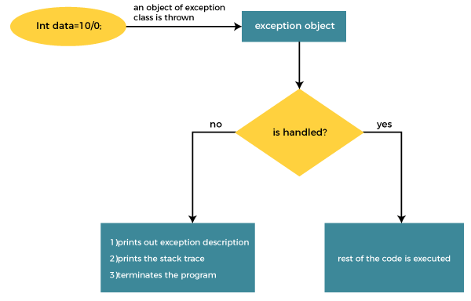
The JVM firstly checks whether the exception is handled or not.
If exception is not handled, JVM provides a default exception handler that performs the following tasks:
Prints out exception description.
Prints the stack trace (Hierarchy of methods where the exception occurred).
Causes the program to terminate.

Slide 9
public class TryCatchExample2 {
public static void main(String[] args) {
try {
int data=50/0; //may throw exception
}
//handling the exception
catch(ArithmeticException e) {
System.out.println(e);
// displaying the custom message
System.out.println("Can't divided by zero");
}
System.out.println("rest of the code");
}
}
java.lang.ArithmeticException: / by zero
Can't divided by zero
rest of the code

Slide 10
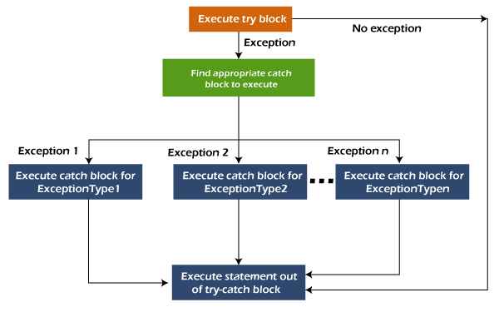
Java Multi-catch block
A try block can be followed by one or more catch blocks.
Each catch block must contain a different exception handler.
So, if you have to perform different tasks at the occurrence of different exceptions, use java multi-catch block.

Slide 11
public class MultipleCatchBlock1 {
public static void main(String[] args) {
try{
int a[]=new int[5];
a[5]=30/0;
}
catch(ArithmeticException e) {
System.out.println("Arithmetic Exception occurs");
}
catch(ArrayIndexOutOfBoundsException e) {
System.out.println("ArrayIndexOutOfBounds Exception occurs");
}
catch(Exception e) {
System.out.println("Parent Exception occurs");
}
System.out.println("rest of the code");
}
}

Slide 12
Java Nested try block
In Java, using a try block inside another try block is permitted.
It is called as nested try block.
Every statement that we enter a statement in try block, context of that exception is pushed onto the stack.
For example, the inner try block can be used to handle ArrayIndexOutOfBoundsException while the outer try block can handle the ArithemeticException (division by zero).
Sometimes a situation may arise where a part of a block may cause one error and the entire block itself may cause another error. In such cases, exception handlers have to be nested.

Slide 13
public class NestedTryBlock{
public static void main(String args[]){
try{ //outer try block
try{ //inner try block 1
System.out.println("going to divide by 0");
int b =39/0;
} //catch block of inner try block 1
catch(ArithmeticException e) {
System.out.println(e);
}
try{ //inner try block 2
int a[]=new int[5]; //assigning the value out of array bounds
a[5]=4;
} //catch block of inner try block 2
catch(ArrayIndexOutOfBoundsException e) {
System.out.println(e);
}
System.out.println("other statement");
} //catch block of outer try block
catch(Exception e) {
System.out.println("handled the exception (outer catch)");
}
System.out.println("normal flow..");
}
}

Slide 14
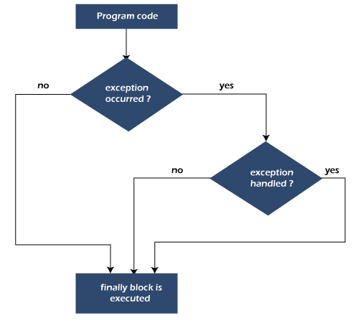
Java finally block
Java finally block is a block used to execute important code such as closing the connection, etc.
Java finally block is always executed whether an exception is handled or not.
Therefore, it contains all the necessary statements that need to be printed regardless of the exception occurs or not.
Why use Java finally block?
finally block in Java can be used to put "cleanup" code such as closing a file, closing connection, etc.
The important statements to be printed can be placed in the finally block.

Slide 15
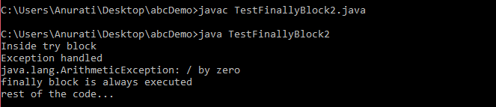
public class TestFinallyBlock2{
public static void main(String args[]){
try {
System.out.println("Inside try block");
//below code throws divide by zero exception
int data=25/0;
System.out.println(data);
}
//handles the Arithmetic Exception / Divide by zero exception
catch(ArithmeticException e){
System.out.println("Exception handled");
System.out.println(e);
}
//executes regardless of exception occured or not
finally {
System.out.println("finally block is always executed");
}
System.out.println("rest of the code...");
}
}

Slide 16
Rule: For each try block there can be zero or more catch blocks, but only one finally block.
Note: The finally block will not be executed if the program exits (either by calling System.exit() or by causing a fatal error that causes the process to abort).

Slide 17
Java throw keyword
The Java throw keyword is used to throw an exception explicitly.
We specify the exception object which is to be thrown.
The Exception has some message with it that provides the error description.
These exceptions may be related to user inputs, server, etc.
We can throw either checked or unchecked exceptions in Java by throw keyword.
It is mainly used to throw a custom exception.
We can also define our own set of conditions and throw an exception explicitly using throw keyword.
For example, we can throw ArithmeticException if we divide a number by another number.
Here, we just need to set the condition and throw exception using throw keyword.

Slide 18
throw new exception_class("error message");
Where the Instance must be of type Throwable or subclass of Throwable.

Slide 19
Example 1: Throwing Unchecked Exception
In this example, we have created a method named validate() that accepts an integer as a parameter.
If the age is less than 18, we are throwing the ArithmeticException otherwise print a message welcome to vote.
public class TestThrow1 {
//function to check if person is eligible to vote or not
public static void validate(int age) {
if(age<18) {
//throw Arithmetic exception if not eligible to vote
throw new ArithmeticException("Person is not eligible to vote");
}
else {
System.out.println("Person is eligible to vote!!");
}
}
//main method
public static void main(String args[]){
//calling the function
validate(13);
System.out.println("rest of the code...");
}
}
Exception in thread "main" java.lang.ArithmeticException: Person is not eligible to vote
at amitgoyal/dd.TestThrow1.validate(TestThrow1.java:8)
at amitgoyal/dd.TestThrow1.main(TestThrow1.java:17)

Slide 20
Note: If we throw unchecked exception from a method, it is must to handle the exception or declare in throws clause.

Slide 21
Example 2: Throwing Checked Exception
Note: Every subclass of Error and RuntimeException is an unchecked exception in Java.
A checked exception is everything else under the Throwable class.

Slide 22
import java.io.*;
public class TestThrow2 {
//function to check if person is eligible to vote or not
public static void method() throws FileNotFoundException {
FileReader file = new FileReader("C:\\Users\\Anurati\\Desktop\\abc.txt");
BufferedReader fileInput = new BufferedReader(file);
throw new FileNotFoundException();
}
//main method
public static void main(String args[]){
try {
method();
}
catch (FileNotFoundException e) {
e.printStackTrace();
}
System.out.println("rest of the code...");
}
}

Slide 23
java.io.FileNotFoundException: C:\Users\Anurati\Desktop\abc.txt (The system cannot find the path specified)
at java.base/java.io.FileInputStream.open0(Native Method)
at java.base/java.io.FileInputStream.open(FileInputStream.java:216)
at java.base/java.io.FileInputStream.<init>(FileInputStream.java:157)
rest of the code...
at java.base/java.io.FileInputStream.<init>(FileInputStream.java:111)
at java.base/java.io.FileReader.<init>(FileReader.java:60)
at amitgoyal/dd.TestThrow2.method(TestThrow2.java:7)
at amitgoyal/dd.TestThrow2.main(TestThrow2.java:15)

Slide 24
Example 3: Throwing User-defined Exception
exception is everything else under the Throwable class.
/ class represents user-defined exception
class UserDefinedException extends Exception {
public UserDefinedException(String str) {
// Calling constructor of parent Exception
super(str);
}
}
// Class that uses above MyException
public class TestThrow3 {
public static void main(String args[]) {
try {
// throw an object of user defined exception
throw new UserDefinedException("This is user-defined exception");
}
catch (UserDefinedException ude) {
System.out.println("Caught the exception");
// Print the message from MyException object
System.out.println(ude.getMessage());
}
}
}
Caught the exception
This is user-defined exception

Slide 25
Java Exception Propagation
An exception is first thrown from the top of the stack and if it is not caught, it drops down the call stack to the previous method.
If not caught there, the exception again drops down to the previous method, and so on until they are caught or until they reach the very bottom of the call stack.
This is called exception propagation.
Note: By default, Unchecked Exceptions are forwarded in calling chain (propagated).

Slide 26
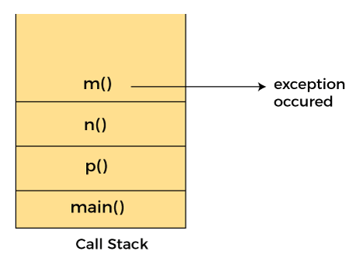
class TestExceptionPropagation1{
void m(){
int data=50/0;
}
void n(){
m();
}
void p(){
try{
n();
}catch(Exception e){System.out.println("exception handled");}
}
public static void main(String args[]){
TestExceptionPropagation1 obj=new TestExceptionPropagation1();
obj.p();
System.out.println("normal flow...");
}
}
In the above example exception occurs in the m() method where it is not handled, so it is propagated to the previous n() method where it is not handled, again it is propagated to the p() method where exception is handled.
exception handled
normal flow...

Slide 27
Java throws keyword
The Java throws keyword is used to declare an exception.
It gives an information to the programmer that there may occur an exception.
So, it is better for the programmer to provide the exception handling code so that the normal flow of the program can be maintained.
Exception Handling is mainly used to handle the checked exceptions.
If there occurs any unchecked exception such as NullPointerException, it is programmers' fault that he is not checking the code before it being used.
return_type method_name() throws exception_class_name{
//method code
}

Slide 28
Which exception should be declared?
Ans: Checked exception only, because:
unchecked exception: under our control so we can correct our code.
error: beyond our control. For example, we are unable to do anything if there occurs VirtualMachineError or StackOverflowError.
Advantage of Java throws keyword
Now Checked Exception can be propagated (forwarded in call stack).
It provides information to the caller of the method about the exception

Slide 29
Java throws clause which describes that checked exceptions can be propagated by throws keyword.
import java.io.IOException;
class Testthrows1{
void m()throws IOException{
throw new IOException("device error");//checked exception
}
void n()throws IOException{
m();
}
void p(){
try{
n();
}catch(Exception e){
System.out.println("exception handled");}
}
public static void main(String args[]){
Testthrows1 obj=new Testthrows1();
obj.p();
System.out.println("normal flow...");
}
}
Rule: If we are calling a method that declares an exception, we must either caught or declare the exception.

Slide 30
There are two cases:
Case 1: We have caught the exception i.e. we have handled the exception using try/catch block.
Case 2: We have declared the exception i.e. specified throws keyword with the method.
In case we declare the exception, if exception does not occur, the code will be executed fine.
In case we declare the exception and the exception occurs, it will be thrown at runtime because throws does not handle the exception.

Slide 31
Case 1: Handle Exception Using try-catch block
In case we handle the exception, the code will be executed fine whether exception occurs during the program or not.
import java.io.*;
class M{
void method()throws IOException{
throw new IOException("device error");
}
}
public class Testthrows2{
public static void main(String args[]){
try{
M m=new M();
m.method();
}catch(Exception e){System.out.println("exception handled");}
System.out.println("normal flow...");
}
}

Slide 32
A) If exception does not occur
import java.io.*;
class M{
void method()throws IOException{
System.out.println("device operation performed");
}
}
class Testthrows3{
public static void main(String args[])throws IOException{//declare exception
M m=new M();
m.method();
System.out.println("normal flow...");
}
}

Slide 33
B) If exception occurs
import java.io.*;
class M{
void method()throws IOException{
throw new IOException("device error");
}
}
class Testthrows4{
public static void main(String args[])throws IOException{//declare exception
M m=new M();
m.method();
System.out.println("normal flow...");
}
}

Slide 34
S. no. | Basis of Differences | throw | throws
1. | Definition | Java throw keyword is used throw an exception explicitly in the code, inside the function or the block of code. | Java throws keyword is used in the method signature to declare an exception which might be thrown by the function while the execution of the code.
2. | Type of exception | Using throw keyword, we can only propagate unchecked exception i.e., the checked exception cannot be propagated using throw only. | Using throws keyword, we can declare both checked and unchecked exceptions. However, the throws keyword can be used to propagate checked exceptions only.
3. | Syntax | The throw keyword is followed by an instance of Exception to be thrown. | The throws keyword is followed by class names of Exceptions to be thrown.
4. | Declaration | throw is used within the method. | throws is used with the method signature.
5. | Internal implementation | We are allowed to throw only one exception at a time i.e. we cannot throw multiple exceptions. | We can declare multiple exceptions using throws keyword that can be thrown by the method. For example, main() throws IOException, SQLException.

