Slide 1
Java Threads

Slide 2
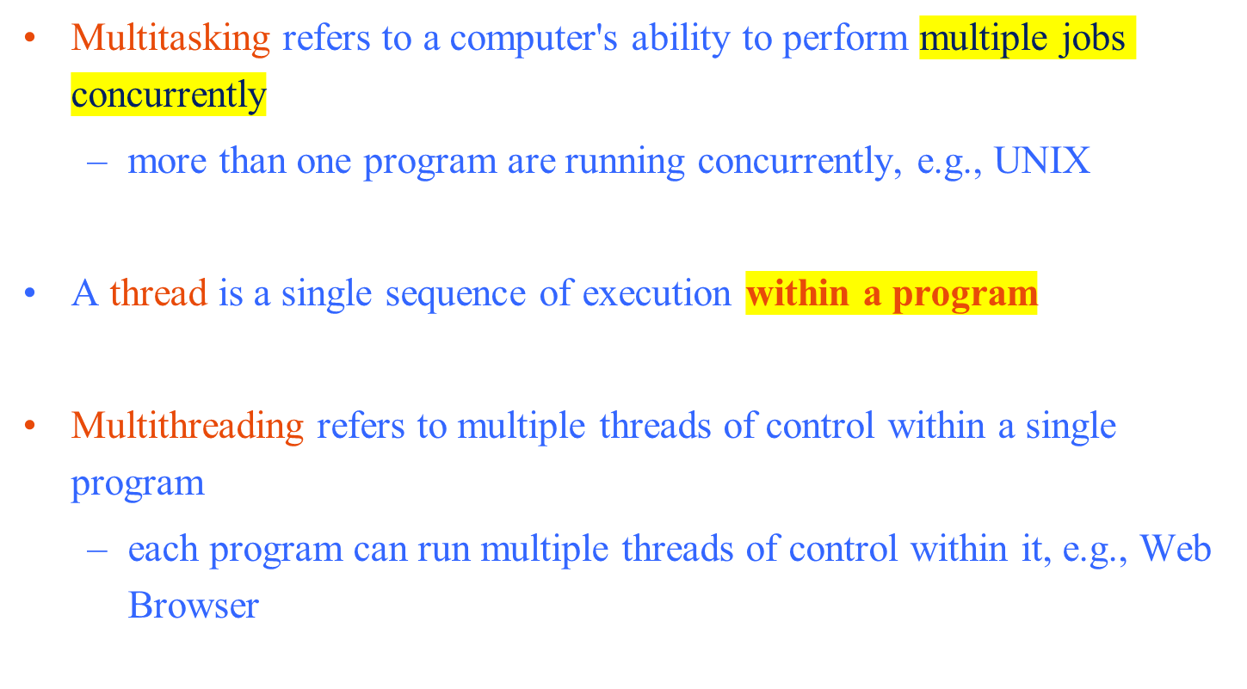
Multitasking and Multithreading

Slide 3
Concurrency vs. Parallelism
CPU
CPU1
CPU2

Slide 4
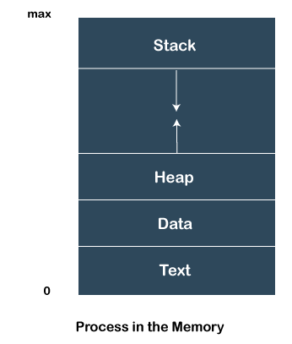
A process is an instance of a program that is being executed.
When we run a program, it does not execute directly.
It takes some time to follow all the steps required to execute the program, and following these execution steps is known as a process.
A process can create other processes to perform multiple tasks at a time; the created processes are known as clone or child process, and the main process is known as the parent process.
Each process contains its own memory space and does not share it with the other processes.
It is known as the active entity.

Slide 5
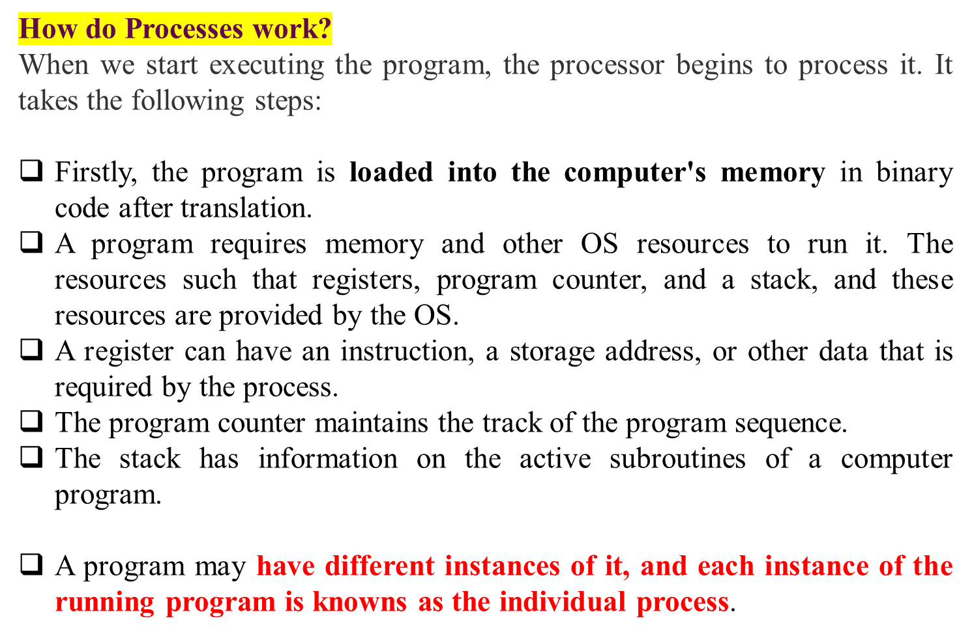

Slide 6
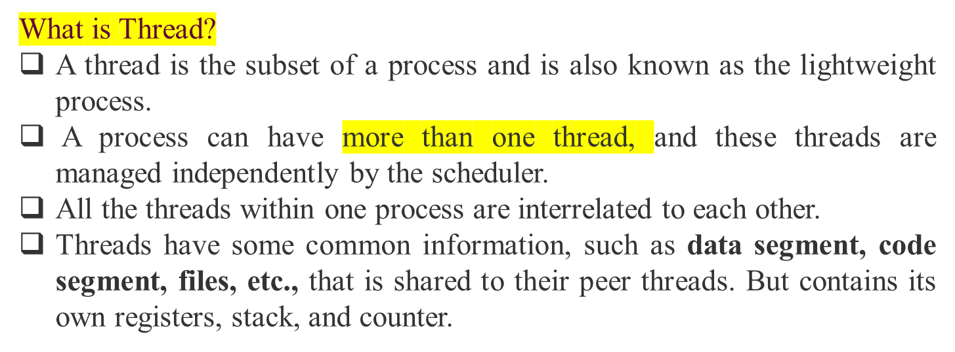
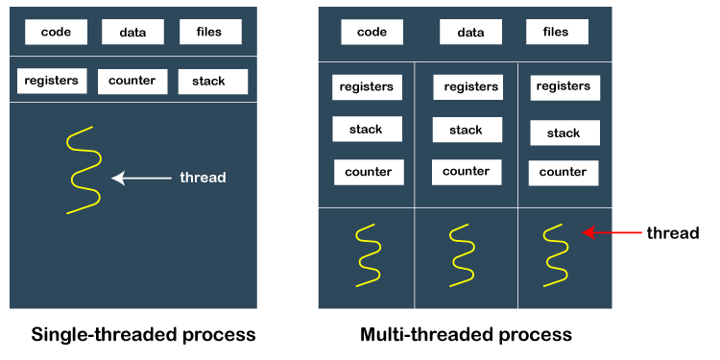

Slide 7
Threads and Processes
CPU
Process 1
Process 2
Process 3
Process 4
main
run
GC

Slide 8
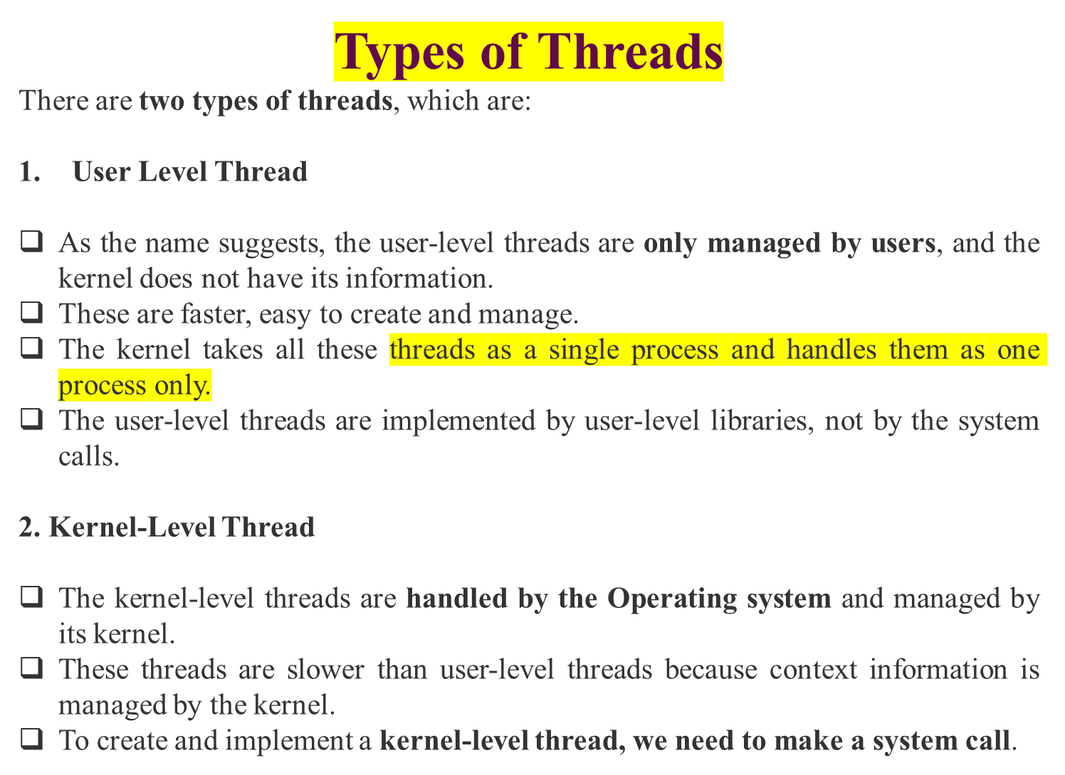

Slide 9
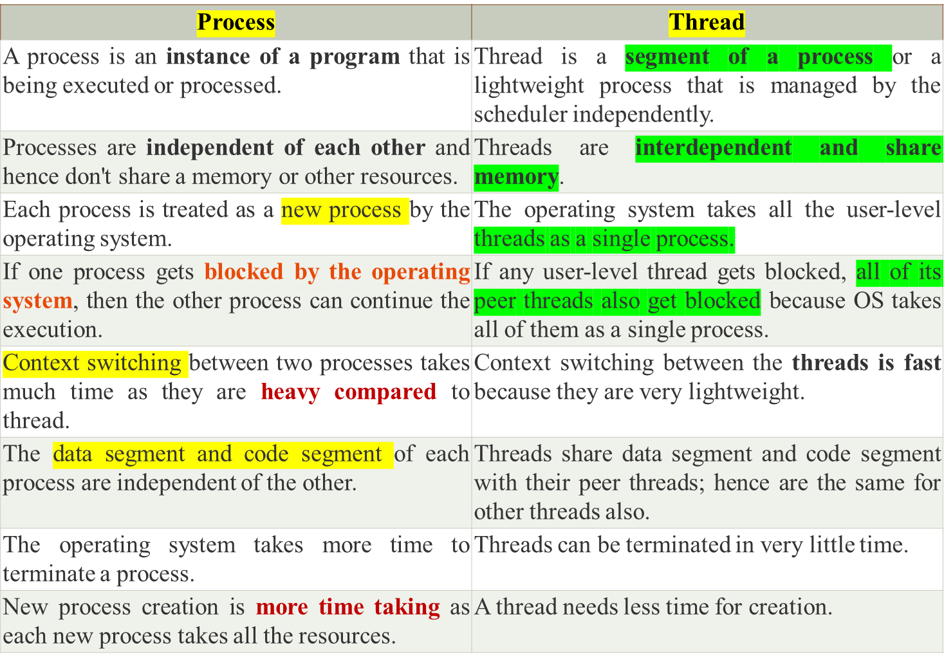
Difference Table Between Process and Thread

Slide 10
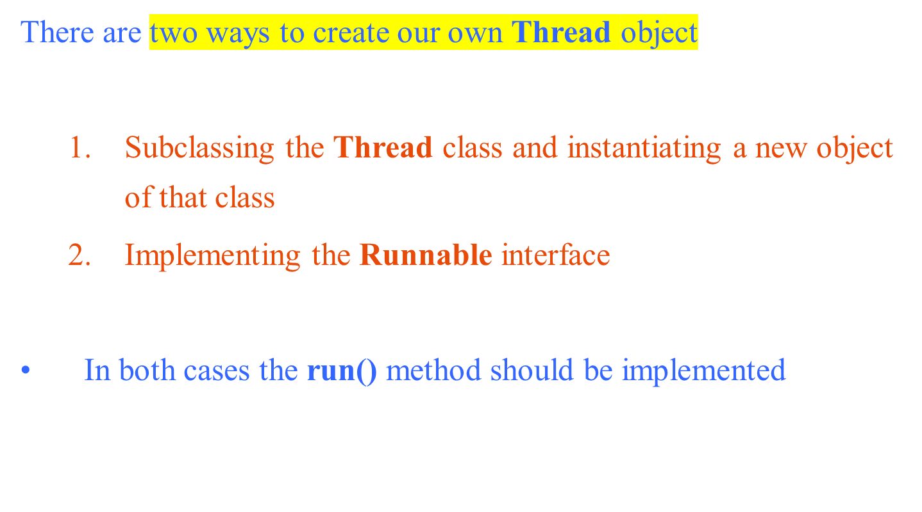
Creating Threads

Slide 11
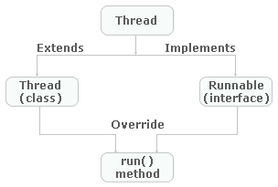
Thread Creation Continued…

Slide 12
Extending Thread
public class ThreadExample extends Thread {
public void run () {
for (int i = 1; i <= 100; i++) {
System.out.println(“Thread: ” + i);
}
}
}
Thread class:
Thread class provide constructors and methods to create and perform operations on a thread.
Thread class extends Object class and implements Runnable interface.
Commonly used Constructors of Thread class:
    Thread()
    Thread(String name)
    Thread(Runnable r)
    Thread(Runnable r,String name)

Slide 13
class Multi extends Thread{
  public void run(){
  System.out.println("thread is running...");
}
public static void main(String args[]){
  Multi t1=new Multi();
  t1.start();
}
}
public class MyThread{
// Main method
public static void main(String argvs[]) {
  // creating an object of the Thread class using the constructor Thread(String name)
  Thread t= new Thread("My first thread");
  // the start() method moves the thread to the active state
  t.start();
  // getting the thread name by invoking the getName() method
  String str = t.getName();
  System.out.println(str);
}
}

Slide 14
2) Java Thread Example by implementing Runnable interface
class Multi3 implements Runnable{
  public void run(){
    System.out.println("thread is running...");
}
public static void main(String args[]){
  Multi3 m1=new Multi3();
  Thread t1 =new Thread(m1); // Using the constructor Thread(Runnable r)
  t1.start();
}
}

Slide 15
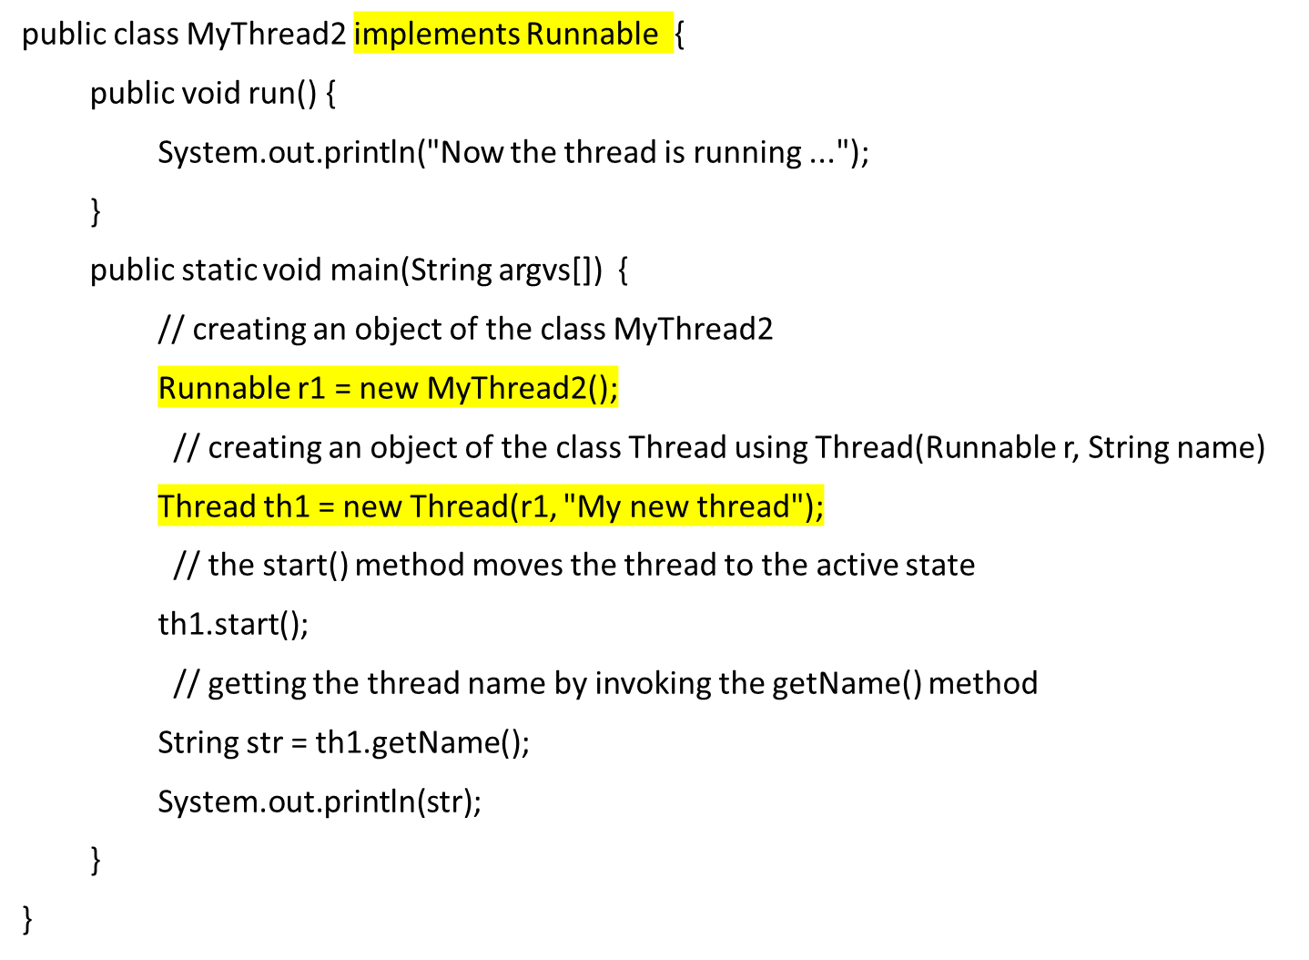
My new thread
Now the thread is running ...

Slide 16
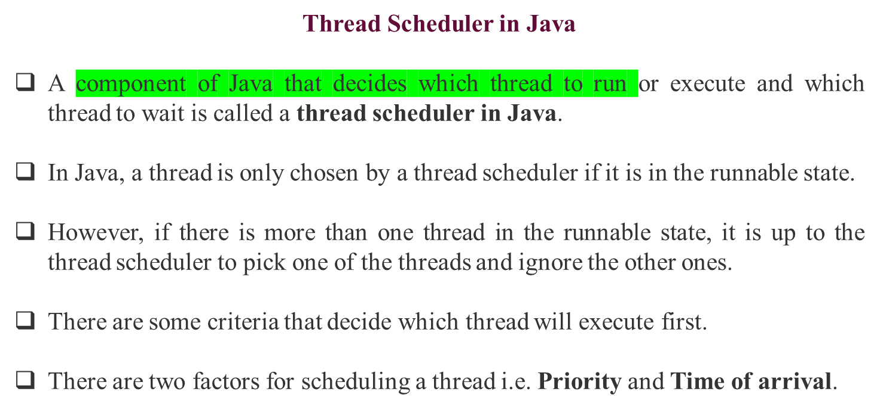

Slide 17
Priority:
Priority of each thread lies between 1 to 10.
If a thread has a higher priority, it means that thread has got a better chance of getting picked up by the thread scheduler.
Time of Arrival:
Suppose two threads of the same priority enter the runnable state, then priority cannot be the factor to pick a thread from these two threads.
In such a case, arrival time of thread is considered by the thread scheduler.
A thread that arrived first gets the preference over the other threads.

Slide 18
Thread Scheduler Algorithms
On the basis of the above-mentioned factors, the scheduling algorithm is followed by a Java thread scheduler.
First Come First Serve Scheduling
Time-slicing scheduling:
Preemptive-Priority Scheduling:

Slide 19
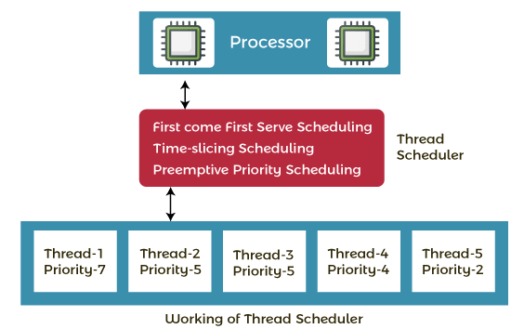
Working of the Java Thread Scheduler
Suppose, there are five threads that have different arrival times and different priorities. Now, it is the responsibility of the thread scheduler to decide which thread will get the CPU first.

Slide 20
Starting the Threads
public class ThreadsStartExample {
public static void main (String argv[]) {
new ThreadExample ().start ();
new Thread(new RunnableExample ()).start ();
}
}
RESULT

Slide 21
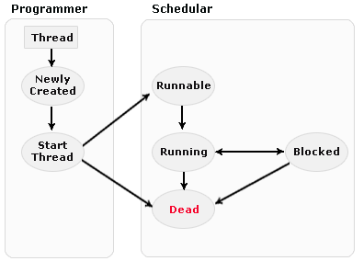
Life Cycle of Thread

Slide 22
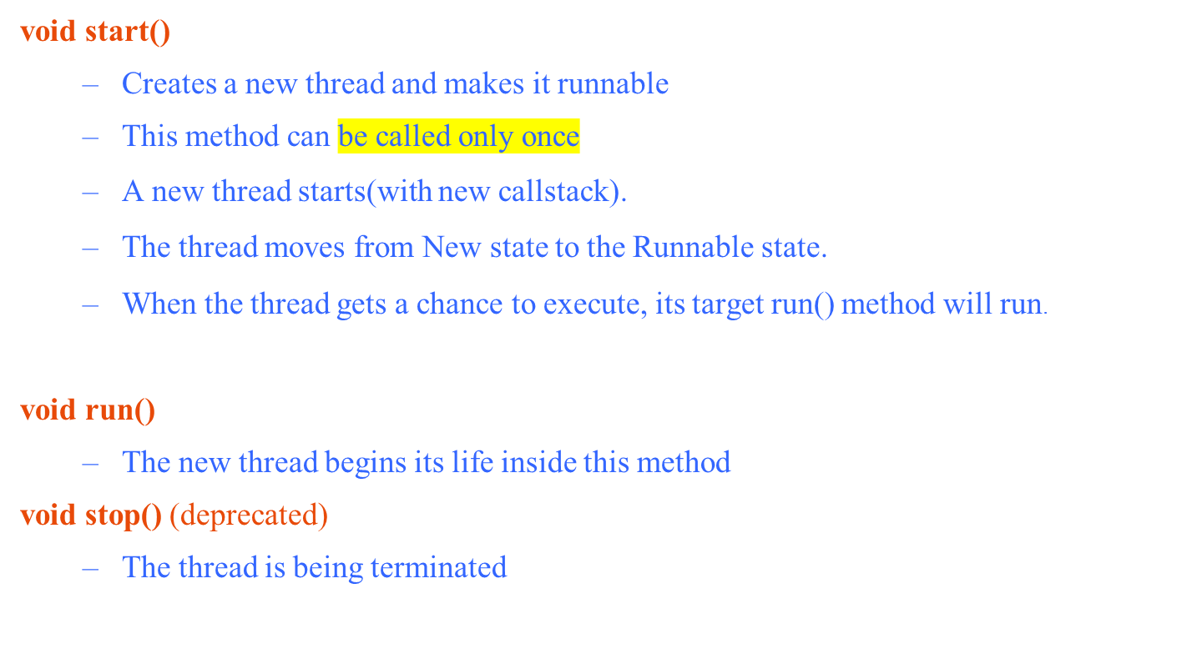
Thread Methods

Slide 23
Thread Methods
yield()
  Causes the currently executing thread object to temporarily pause and allow other threads to execute
  Allow only threads of the same priority to run
sleep(int m)/sleep(int m,int n)
  The thread sleeps for m milliseconds, plus n nanoseconds

Slide 24
Scheduling Threads
start()
Ready queue
Newly created
threads
Currently executed
thread
I/O operation completes
What happens when
a program with a
ServerSocket calls
accept()?
Waiting for I/O operation to be completed
Waiting to be notified
Sleeping
Waiting to enter a synchronized section

Slide 25
Thread State Diagram
Alive
Running
new ThreadExample();
while (…) { … }
New Thread
Runnable
Dead Thread
thread.start();
run() method returns
Blocked
Object.wait()
Thread.sleep()
blocking IO call
waiting on a monitor

Slide 26
Synchronization in Java is the capability to control the access of multiple threads to any shared resource.
Java Synchronization is better option where we want to allow only one thread to access the shared resources.
The synchronization is mainly used to
To prevent thread interference.
To prevent consistency problem.
There are two types of synchronization
    Process Synchronization
    Thread Synchronization

Slide 27
Thread Synchronization
There are two types of thread synchronization mutual exclusive and inter-thread communication.
Mutual Exclusive
  Synchronized method.
  Synchronized block.
  Static synchronization.
Cooperation (Inter-thread communication in java)

Slide 28
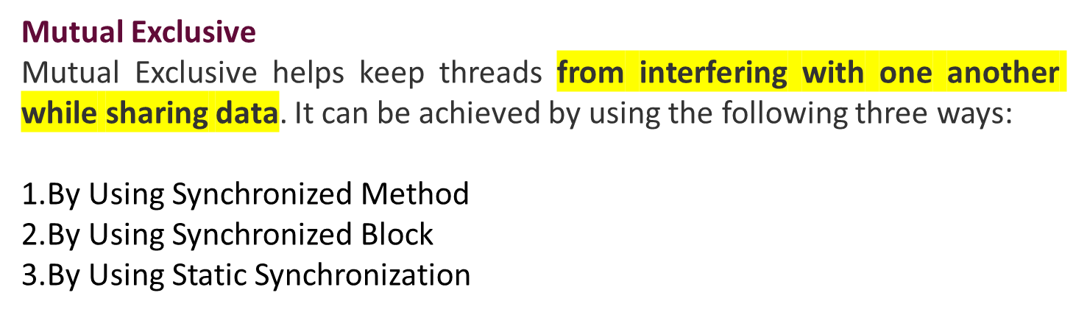

Slide 29
Concept of Lock in Java
Synchronization is built around an internal entity known as the lock or monitor.
Every object has a lock associated with it.
By convention, a thread that needs consistent access to an object's fields has to acquire the object's lock before accessing them, and then release the lock when it's done with them.
From Java 5 the package java.util.concurrent.locks contains several lock implementations.
Understanding the problem without Synchronization
In this example, there is no synchronization, so output is inconsistent.

Slide 30
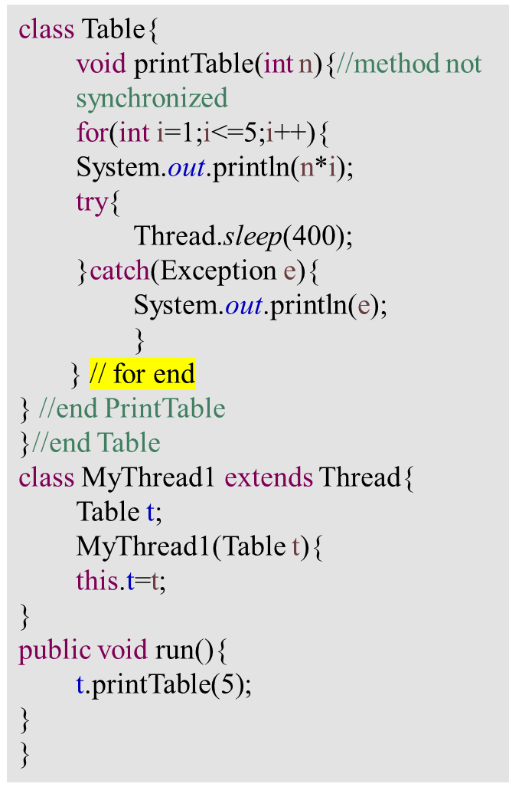
class MyThreadd2 extends Thread{
  Table t;
  MyThreadd2(Table t){
  this.t=t;
} // end constructor
public void run(){
  t.printTable(100);
}
} // end of MyThread2
class TestSynchronization1{
  public static void main(String args[]){
    Table obj = new Table();//only one object
    MyThread1 t1=new MyThread1(obj);
    MyThreadd2 t2=new MyThreadd2(obj);
    t1.start();
    t2.start();
  }
}
5
100
10
200
15
300
20
400
25
500

Slide 31
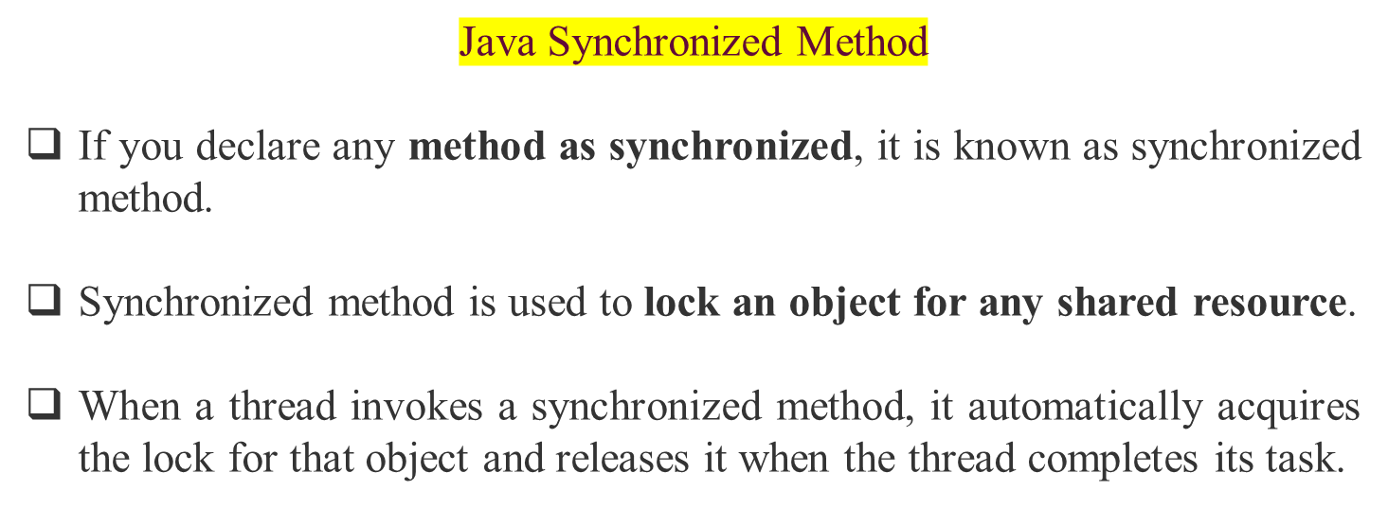

Slide 32
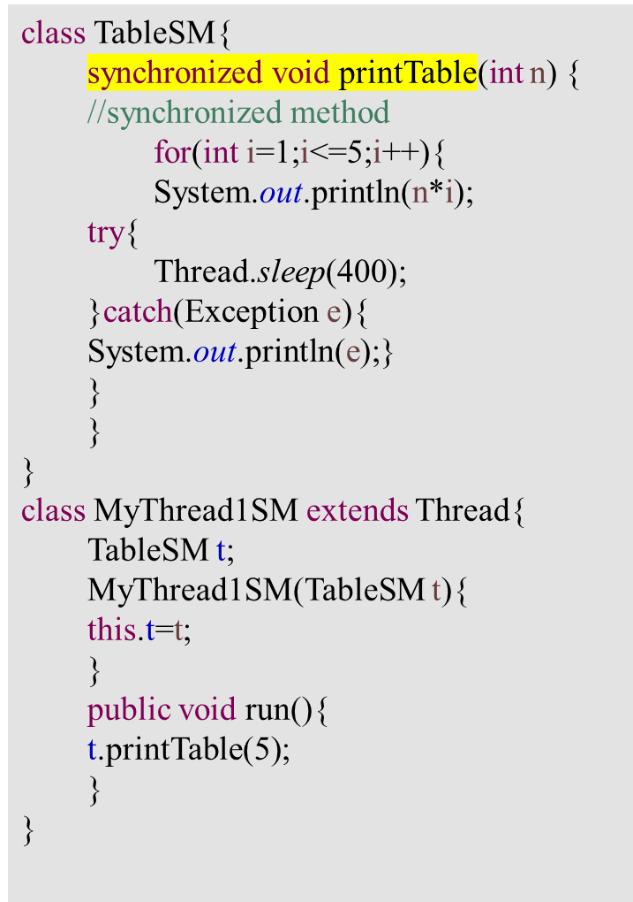
class MyThread2SM extends Thread{
  TableSM t;
  MyThread2SM(TableSM t){
  this.t=t;
}
public void run(){
t.printTable(100);
}
}
public class TestSynchronization2{
  public static void main(String args[]){
  TableSM obj = new TableSM();
  //only one object
  MyThread1SM t1=new MyThread1SM(obj);
  MyThread2SM t2=new MyThread2SM(obj);
  t1.start();
  t2.start();
  }
}
5 10 15 20 25 100 200 300 400 500

Slide 33
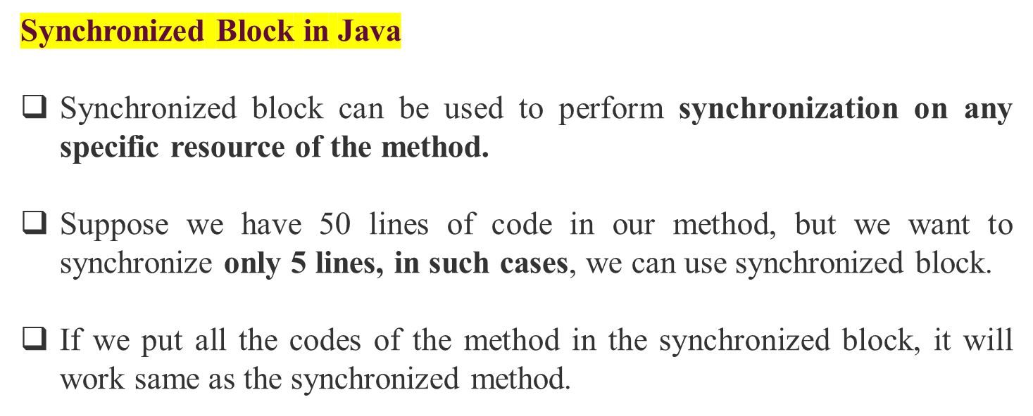
synchronized (object reference expression) {
//code block
}

Slide 34
class TableSB{
void printTable(int n){
  synchronized(this){
  //synchronized block
  for(int i=1;i<=5;i++){
  System.out.println(n*i);
  try{
  Thread.sleep(400);
  }catch(Exception e){
  System.out.println(e);}
  }
}
}//end of the method
}
class MyThread1SB extends Thread{
  TableSB t;
  MyThread1SB(TableSB t){
  this.t=t;
  }
  public void run(){
  t.printTable(5);
}
}
class MyThread2SB extends Thread{
  TableSB t;
  MyThread2SB(TableSB t){
  this.t=t;
  }
  public void run(){
  t.printTable(100);
  }
}
public class TestSynchronizedBlock1{
public static void main(String args[]){
TableSB obj = new TableSB();//only one object
MyThread1SB t1=new MyThread1SB(obj);
MyThread2SB t2=new MyThread2SB(obj);
t1.start();
t2.start();
}
}

Slide 35

Static Synchronization

Slide 36
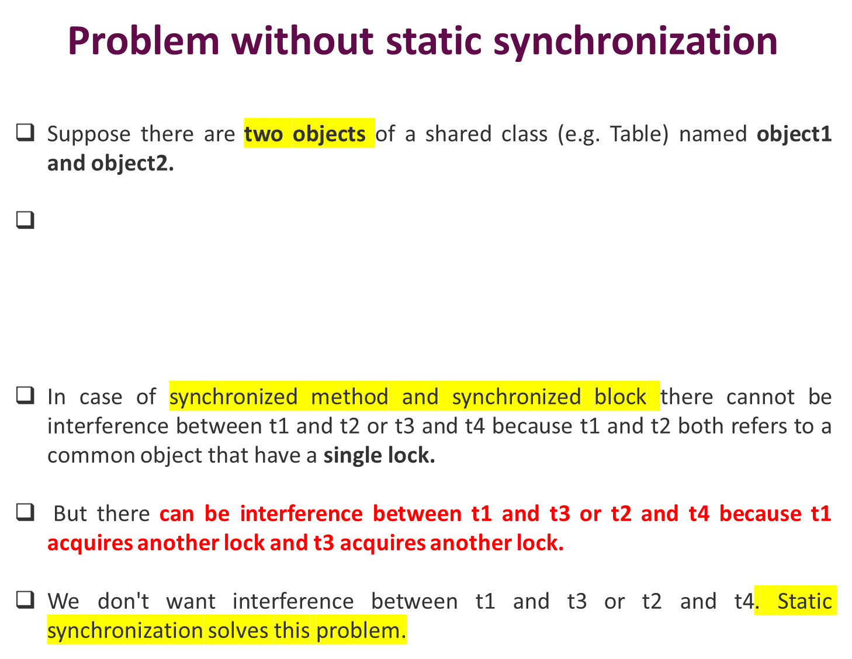
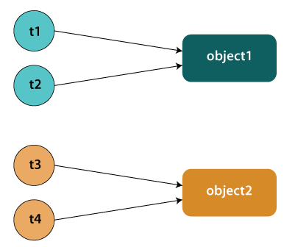

Slide 37
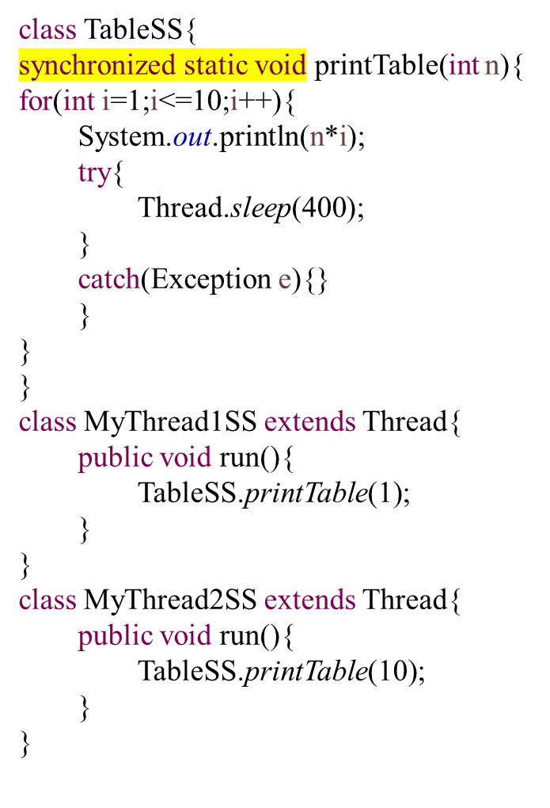
class MyThread3SS extends Thread{
public void run(){
TableSS.printTable(100);
}
}
class MyThread4SS extends Thread{
  public void run(){
  TableSS.printTable(1000);
  }
}
public class TestSynchronization4{
public static void main(String t[]){
MyThread1SS t1=new MyThread1SS();
  MyThread2SS t2=new MyThread2SS();
  MyThread3SS t3=new MyThread3SS();
  MyThread4SS t4=new MyThread4SS();
  t1.start();
  t2.start();
  t3.start();
  t4.start();
}
}

Slide 38
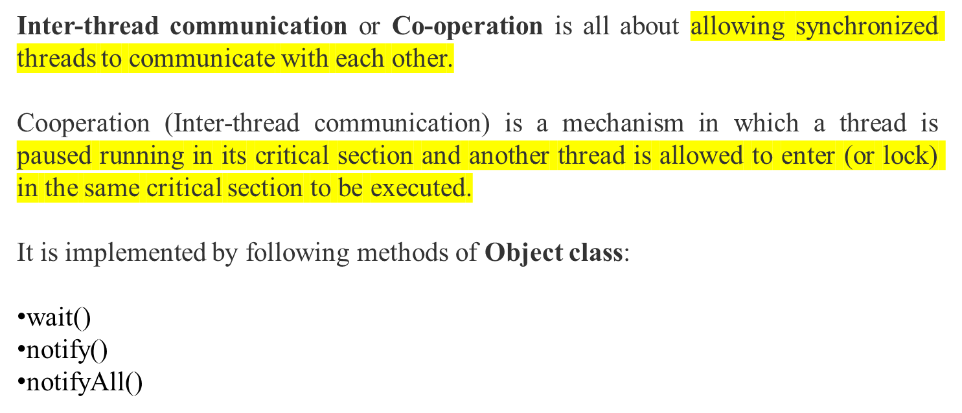
Inter-thread Communication in Java

Slide 39
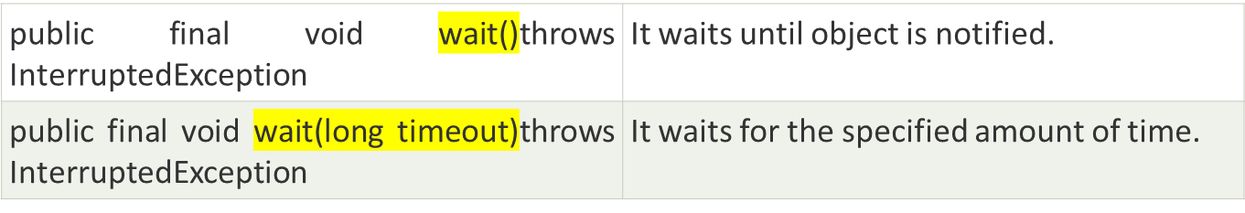
wait() method
The wait() method causes current thread to release the lock and wait until either another thread invokes the notify() method or the notifyAll() method for this object, or a specified amount of time has elapsed.

Slide 40
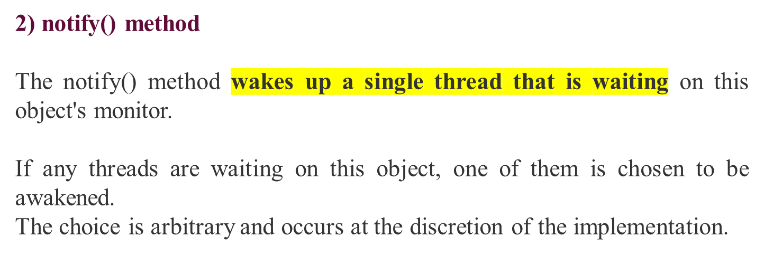
3) notifyAll() method
Wakes up all threads that are waiting on this object's monitor.

Slide 41
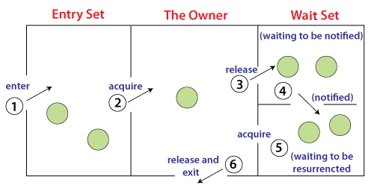
Understanding the process of inter-thread communication
Threads enter to acquire lock.
Lock is acquired by on thread.
Now thread goes to waiting state if you call wait() method on the object. Otherwise, it releases the lock and exits.
If you call notify() or notifyAll() method, thread moves to the notified state (runnable state).
Now thread is available to acquire lock.
After completion of the task, thread releases the lock and exits the monitor state of the object.

Slide 42
Why wait(), notify() and notifyAll() methods are defined in Object class not Thread class?
It is because they are related to lock and object has a lock.
wait() | sleep()
The wait() method releases the lock. | The sleep() method doesn't release the lock.
It is a method of Object class | It is a method of Thread class
It is the non-static method | It is the static method
It should be notified by notify() or notifyAll() methods | After the specified amount of time, sleep is completed.

Slide 43
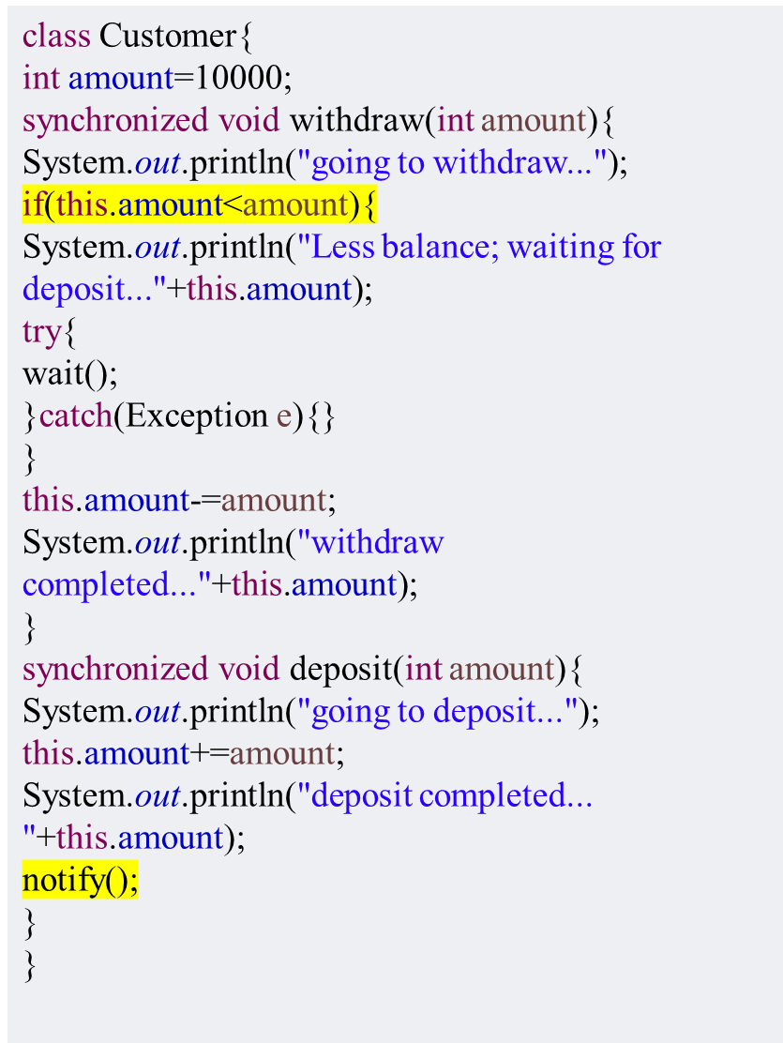
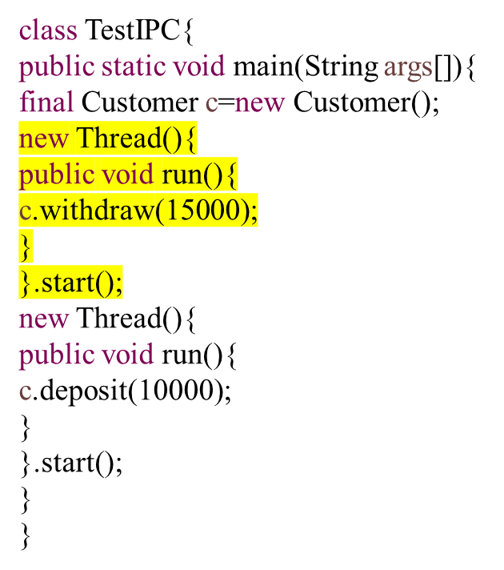

Slide 44
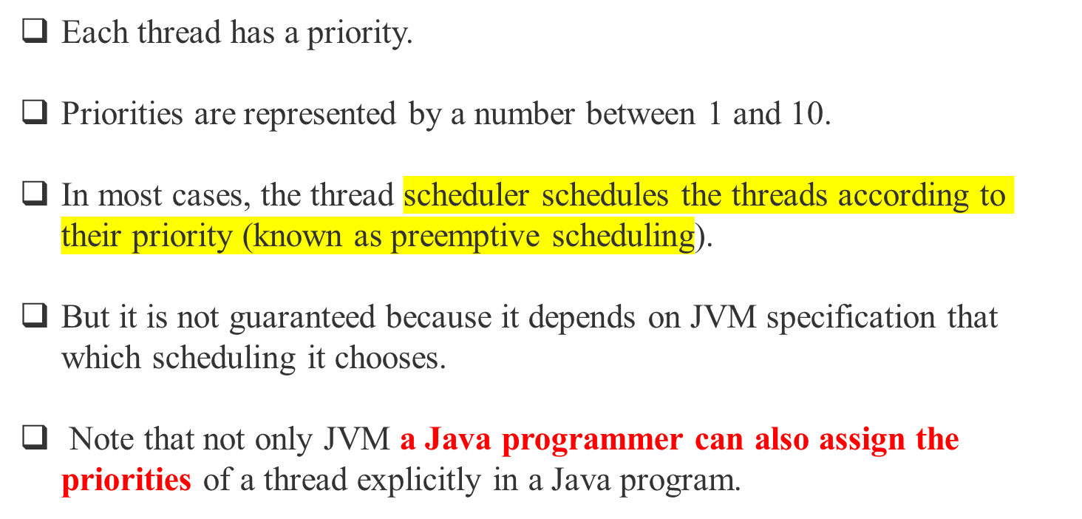
Priority of a Thread (Thread Priority)

Slide 45
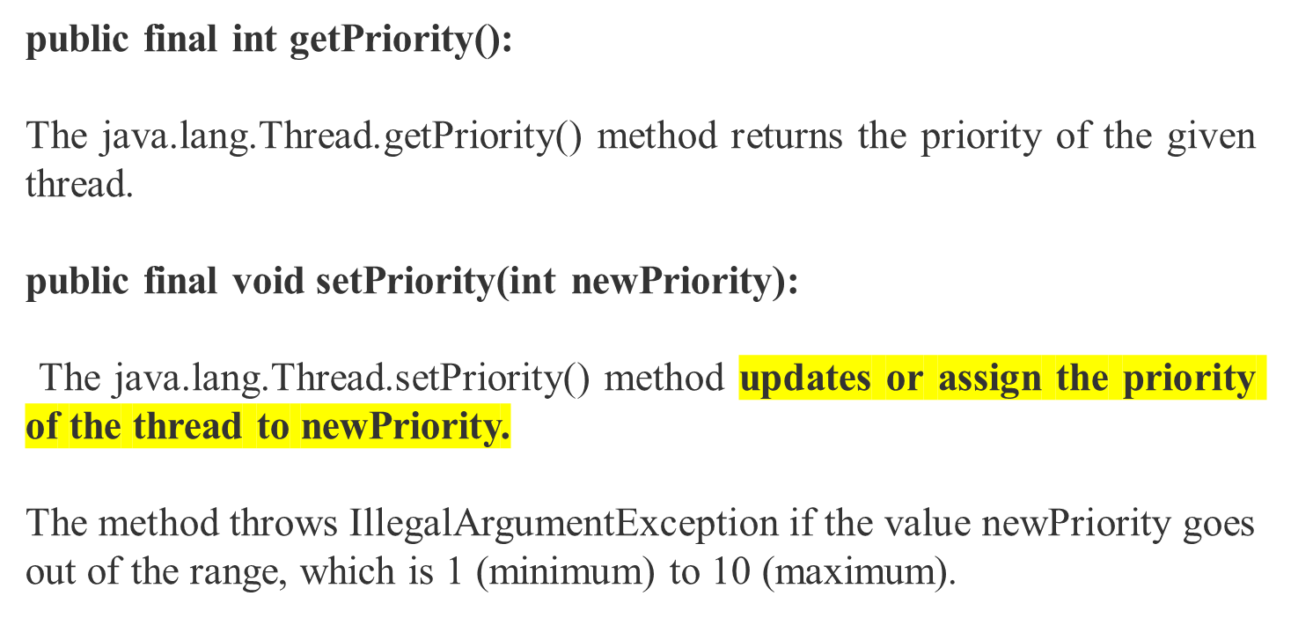
Setter & Getter Method of Thread Priority

Slide 46
3 constants defined in Thread class:
public static int MIN_PRIORITY
public static int NORM_PRIORITY
public static int MAX_PRIORITY
Default priority of a thread is 5 (NORM_PRIORITY). The value of MIN_PRIORITY is 1 and the value of MAX_PRIORITY is 10.

Slide 47
import java.lang.*;
public class TreadPriorityExample1 extends Thread{
//Method 1 Whenever the start() method is called by a thread the run() method is invoked
public void run(){ //the print statement
System.out.println("Inside the run() method");
}
public static void main(String argvs[]){
//Creating threads with the help of ThreadPriorityExample class
  TreadPriorityExample1 th1 = new TreadPriorityExample1();
  TreadPriorityExample1 th2 = new TreadPriorityExample1();
  TreadPriorityExample1 th3 = new TreadPriorityExample1();
//We did not mention the priority of the thread. Therefore, the priorities of the thread is 5, the default value 1st Thread

Slide 48
System.out.println("Priority of the thread th1 is : " + th1.getPriority()); //2nd Thread
System.out.println("Priority of the thread th2 is : " + th2.getPriority()); //3rd Thread
System.out.println("Priority of the thread th2 is : " + th2.getPriority());
//Setting priorities of above threads by passing integer arguments
th1.setPriority(6);
th2.setPriority(3);
th3.setPriority(9);
System.out.println("Priority of the thread th1 is : " + th1.getPriority());
System.out.println("Priority of the thread th2 is : " + th2.getPriority());
System.out.println("Priority of the thread th3 is : " + th3.getPriority());
//Main thread
System.out.println("Currently Executing The Thread : " + Thread.currentThread().getName());
System.out.println("Priority of the main thread is : " + Thread.currentThread().getPriority());
//Priority of the main thread is 10 now
Thread.currentThread().setPriority(10);
System.out.println("Priority of the main thread is : " + Thread.currentThread().getPriority());
}
}

Slide 49
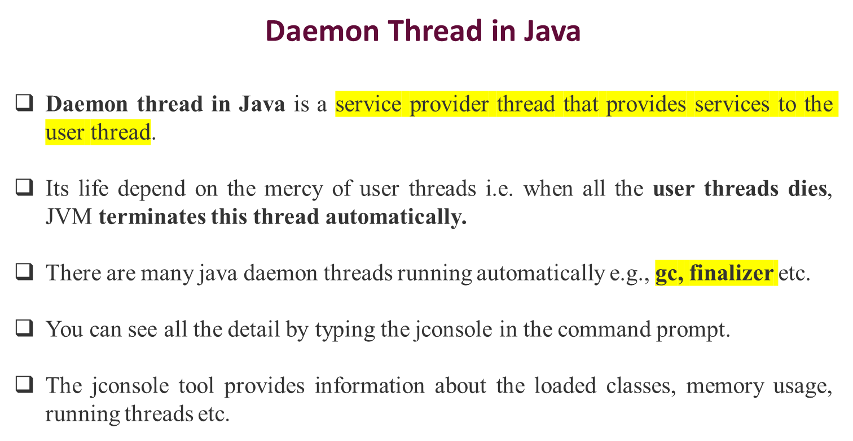

Slide 50
Points to remember for Daemon Thread in Java
It provides services to user threads for background supporting tasks.
It has no role in life than to serve user threads.
Its life depends on user threads.
It is a low priority thread.

Slide 51
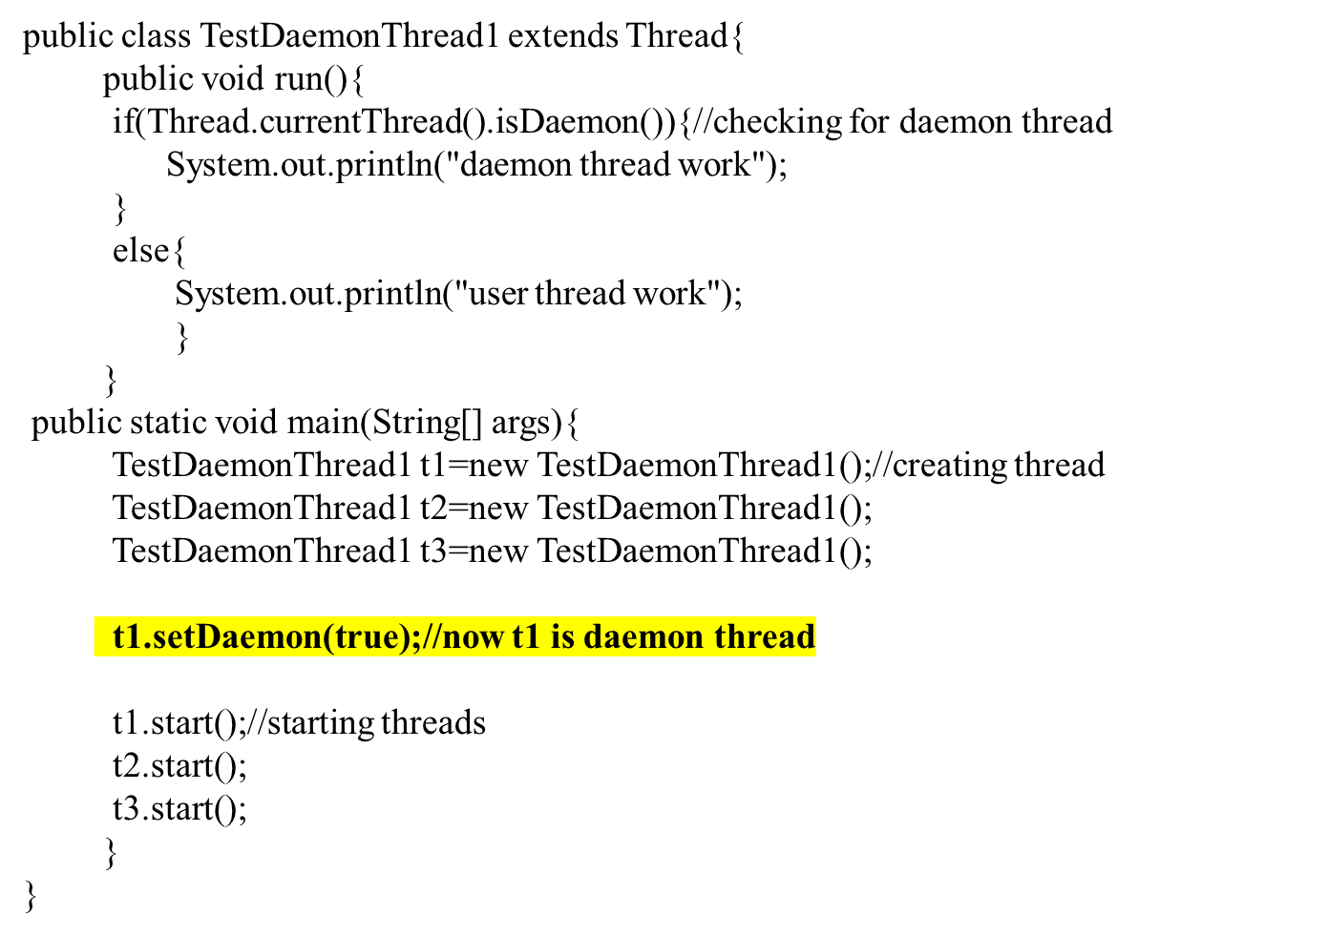
daemon thread work
user thread work
user thread work

Slide 52
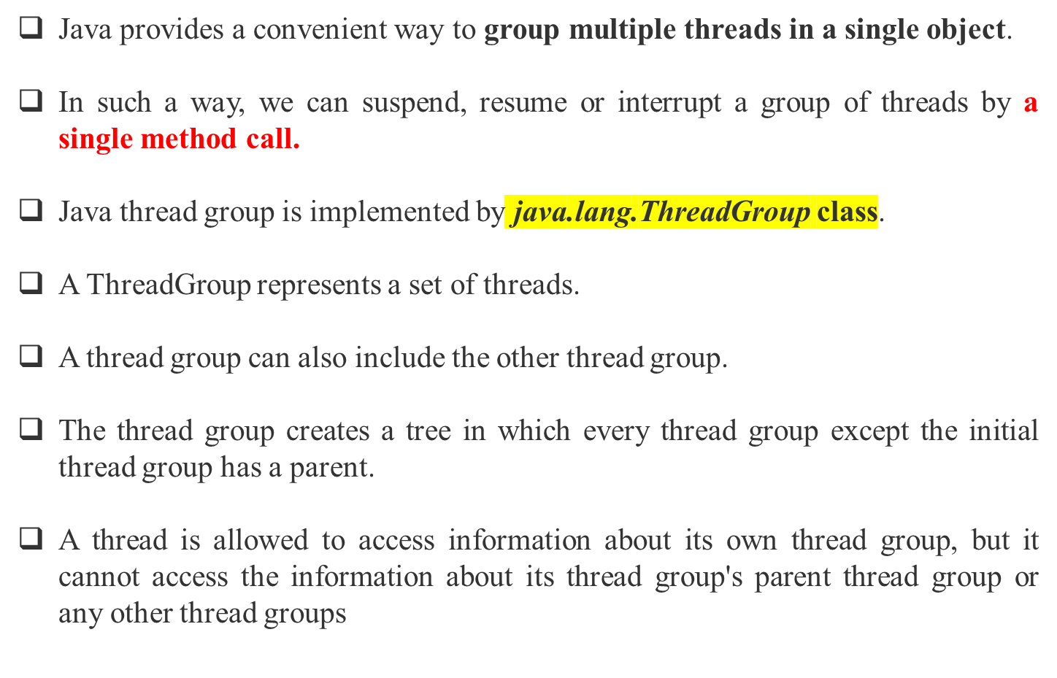

Slide 53
Constructors of ThreadGroup class
There are only two constructors of ThreadGroup class.
No. | Constructor | Description
1) | ThreadGroup(String name) | creates a thread group with given name.
2) | ThreadGroup(ThreadGroup parent, String name) | creates a thread group with a given parent group and name.
ThreadGroup tg1 = new ThreadGroup("Group A");
Thread t1 = new Thread(tg1,new MyRunnable(),"one");
Thread t2 = new Thread(tg1,new MyRunnable(),"two");
Thread t3 = new Thread(tg1,new MyRunnable(),"three");

Slide 54
package Collections;
public class ThreadGroupDemo implements Runnable{
public void run() {
System.out.println(Thread.currentThread().getName());
}
public static void main(String[] args) {
  ThreadGroupDemo ruble = new ThreadGroupDemo();
  ThreadGroup tg1 = new ThreadGroup("Parent ThreadGroup");
  Thread t1 = new Thread(tg1, ruble,"one");
  t1.start();
  Thread t2 = new Thread(tg1, ruble,"two");
  t2.start();
  Thread t3 = new Thread(tg1, ruble,"three");
  t3.start();
  System.out.println("Thread Group Name: "+tg1.getName());
  tg1.list();
}
}
one
two
three
Thread Group Name: Parent ThreadGroup
java.lang.ThreadGroup[name=Parent ThreadGroup,maxpri=10]

Slide 55
package Collections;
import java.lang.*;
class ThreadNew extends Thread {
//constructor of the class
  ThreadNew(String tName, ThreadGroup tgrp){
    super(tgrp, tName);
    start();
  }
//overriding the run method
public void run(){
  for (int j = 0; j < 1000; j++){
  try {
  Thread.sleep(5);
}
catch (InterruptedException e) {
System.out.println("The exception has been encountered " + e);
}
}
}
}

Slide 56
public class ActiveCountExample {
//main method
public static void main(String argvs[]){
//creating the thread group
ThreadGroup tg = new ThreadGroup("The parent group of threads");
ThreadNew th1 = new ThreadNew("first", tg);
System.out.println("Starting the first");
ThreadNew th2 = new ThreadNew("second", tg);
System.out.println("Starting the second");
//checking the number of active thread by invoking the activeCount() method
System.out.println("The total number of active threads are: " + tg.activeCount());
}
}
Starting the first
Starting the second
The total number of active threads are: 2

