Slide 1
Java is a programming language and a platform.
Java is a high level, robust, object-oriented and secure programming language.
Java was developed by Sun Microsystems (which is now the subsidiary of Oracle) in the year 1995.
James Gosling is known as the father of Java.
Before Java, its name was Oak.
Since Oak was already a registered company, so James Gosling and his team changed the name from Oak to Java.

Slide 2
Types of Java Applications
There are mainly 4 types of applications that can be created using Java programming:
Standalone Application
Standalone applications are also known as desktop applications or window-based applications.
These are traditional software that we need to install on every machine.
Examples of standalone application are Media player, antivirus, etc.
AWT and Swing are used in Java for creating standalone applications.
2) Web Application
An application that runs on the server side and creates a dynamic page is called a web application.
Servlet, JSP, Struts, Spring, Hibernate, JavaServer Faces (JSF), etc. technologies are used for creating web applications in Java.

Slide 3
3) Enterprise Application
An application that is distributed in nature, such as banking applications, etc. is called an enterprise application.
It has advantages like high-level security, load balancing, and clustering.
In Java, EJB is used for creating enterprise applications.
4) Mobile Application
An application which is created for mobile devices is called a mobile application.
Android studio, Kotlin etc. are used for creating mobile applications.

Slide 4
Java Platforms / Editions
There are 4 platforms or editions of Java:
1) Java SE (Java Standard Edition)
It is a Java programming platform.
It includes Java programming APIs such as java.lang, java.io, java.net, java.util, java.sql, java.math etc.
It includes core topics like OOPs, String, Regex, Exception, Inner classes, Multithreading, I/O Stream, Networking, AWT, Swing, Reflection, Collection, etc.
2) Java EE (Java Enterprise Edition)
It is an enterprise platform that is mainly used to develop web and enterprise applications.
It is built on top of the Java SE platform. It includes topics like Servlet, JSP, Web Services, EJB, Java™ Persistence API(JPA), etc.
3) Java ME (Java Micro Edition)
It is a micro platform that is dedicated to mobile applications.
4) JavaFX
It is used to develop rich internet applications.
It uses a lightweight user interface API.

Slide 5
JDK vs JRE vs JVM
JVM
JVM (Java Virtual Machine) is an abstract machine. It is called a virtual machine because it doesn't physically exist. It is a specification that provides a runtime environment in which Java bytecode can be executed. It can also run those programs which are written in other languages and compiled to Java bytecode.
The JVM performs the following main tasks:
Loads code
Verifies code
Executes code
Provides runtime environment.

Slide 6
JRE
JRE is an acronym for Java Runtime Environment. It is also written as Java RTE. The Java Runtime Environment is a set of software tools which are used for developing Java applications. It is used to provide the runtime environment. It is the implementation of JVM. It physically exists. It contains a set of libraries + other files that JVM uses at runtime.
JDK
JDK is an acronym for Java Development Kit. The Java Development Kit (JDK) is a software development environment which is used to develop Java applications and applets. It physically exists. It contains JRE + development tools.
JDK is an implementation of any one of the below given Java Platforms released by Oracle Corporation:
Standard Edition Java Platform
Enterprise Edition Java Platform
Micro Edition Java Platform
The JDK contains a private Java Virtual Machine (JVM) and a few other resources such as an interpreter/loader (java), a compiler (javac), an archiver (jar), a documentation generator (Javadoc), etc. to complete the development of a Java Application.

Slide 7
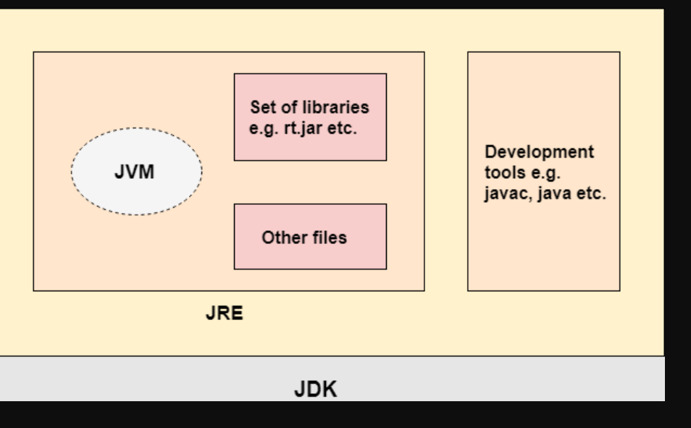

Slide 8
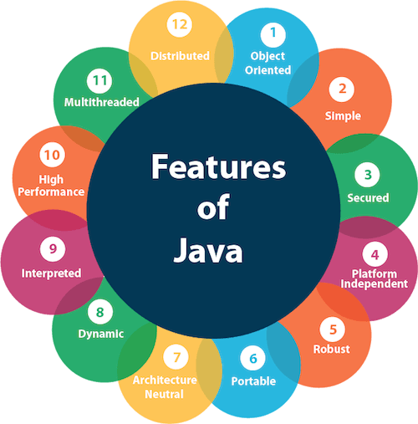
Features of Java
Simple
Object-Oriented
Portable
Platform independent
Secured
Robust
Architecture neutral
Interpreted
High Performance
Multithreaded
Distributed
Dynamic

Slide 9
Simple
Java is very easy to learn, and its syntax is simple, clean and easy to understand.
According to Sun Microsystem, Java language is a simple programming language because:
Java syntax is based on C++ (so easier for programmers to learn it after C++).
Java has removed many complicated and rarely-used features, for example, explicit pointers, operator overloading, etc.
There is no need to remove unreferenced objects because there is an Automatic Garbage Collection in Java.

Slide 10
Object-oriented
Java is an object-oriented programming language.
Everything in Java is an object.
Object-oriented means we organize our software as a combination of different types of objects that incorporate both data and behavior.
Object-oriented programming (OOPs) is a methodology that simplifies software development and maintenance by providing some rules.
Basic concepts of OOPs are:
Object
Class
Inheritance
Polymorphism
Abstraction
Encapsulation

Slide 11
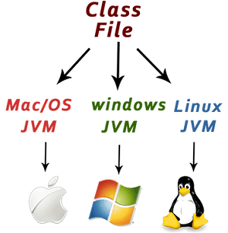
Platform Independent
Java is platform independent because it is different from other languages like C, C++, etc. which are compiled into platform specific machines while Java is a write once, run anywhere language.
A platform is the hardware or software environment in which a program runs.
Java is platform-independent because it is compiled to a byte code that
can be run on any device that has a Java Virtual Machine (JVM).

Slide 12
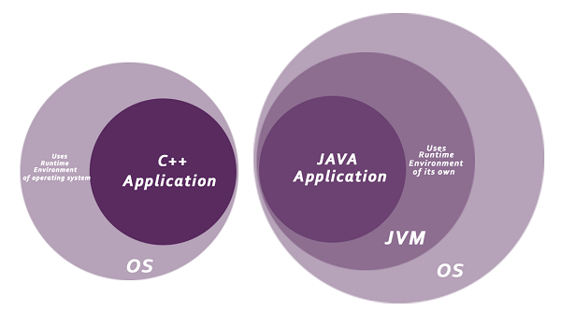
Secured
Java is best known for its security.
With Java, we can develop virus-free systems.
Java is secured because:
No explicit pointer
Java Programs run inside a virtual machine sandbox
Classloader: Classloader in Java is a part of the Java Runtime Environment (JRE) which is used to load Java classes into the Java Virtual Machine dynamically.
It adds security by separating the package for the classes of the local file system from those that are imported from network sources.
Bytecode Verifier: It checks the code fragments for illegal code that can violate access rights to objects.
Security Manager: It determines what resources a class can access such as reading and writing to the local disk.

Slide 13
Robust
The English mining of Robust is strong. Java is robust because:
It uses strong memory management.
There is a lack of pointers that avoids security problems.
Java provides automatic garbage collection which runs on the Java Virtual Machine to get rid of objects which are not being used by a Java application anymore.
There are exception handling and the type checking mechanism in Java.
All these points make Java robust.

Slide 14
Architecture-neutral
Java is architecture neutral because there are no implementation dependent features, for example, the size of primitive types is fixed.
In C programming, int data type occupies 2 bytes of memory for 32-bit architecture and 4 bytes of memory for 64-bit architecture.
However, it occupies 4 bytes of memory for both 32 and 64-bit architectures in Java.

Slide 15
Portable
Java is portable because it facilitates you to carry the Java bytecode to any platform.
It doesn't require any implementation.
High-performance
Java is faster than other traditional interpreted programming languages because Java bytecode is "close" to native code.
It is still a little bit slower than a compiled language (e.g., C++).
Java is an interpreted language that is why it is slower than compiled languages, e.g., C, C++, etc.

Slide 16
Distributed
Java is distributed because it facilitates users to create distributed applications in Java.
RMI and EJB are used for creating distributed applications.
This feature of Java makes us able to access files by calling the methods from any machine on the internet.
Multi-threaded
A thread is like a separate program, executing concurrently.
We can write Java programs that deal with many tasks at once by defining multiple threads.
The main advantage of multi-threading is that it doesn't occupy memory for each thread.
It shares a common memory area.
Threads are important for multi-media, Web applications, etc.
Dynamic
Java is a dynamic language.
It supports the dynamic loading of classes.
It means classes are loaded on demand.
It also supports functions from its native languages, i.e., C and C++.

Slide 17
Java Variables
A variable is a container which holds the value while the Java program is executed.
A variable is assigned with a data type.
Variable is a name of memory location.
There are three types of variables in java: local, instance and static.

Slide 18
Local Variable
A variable declared inside the body of the method is called local variable.
You can use this variable only within that method and the other methods in the class aren't even aware that the variable exists.
A local variable cannot be defined with "static" keyword.
2) Instance Variable
A variable declared inside the class but outside the body of the method, is called an instance variable.
It is not declared as static.
It is called an instance variable because its value is instance-specific and is not shared among instances.
3) Static variable
A variable that is declared as static is called a static variable. It cannot be local.
You can create a single copy of the static variable and share it among all the instances of the class.
Memory allocation for static variables happens only once when the class is loaded in the memory.

Slide 19
public class A
{
static int m=100;//static variable
void method() {
int n=90;//local variable
}
public static void main(String args[])
int data=50;//instance variable
}
}//end of class

Slide 20
10 10.0
public class Simple{
public static void main(String[] args){
int a=10;
float f=a;
System.out.println(a);
System.out.println(f);
}
}
Java Variable Example: Widening
public class Simple{
public static void main(String[] args){
float f=10.5f;
//int a=f;//Compile time error
int a=(int)f;
System.out.println(f);
System.out.println(a);
}
}
Java Variable Example: Narrowing (Typecasting)

Slide 21
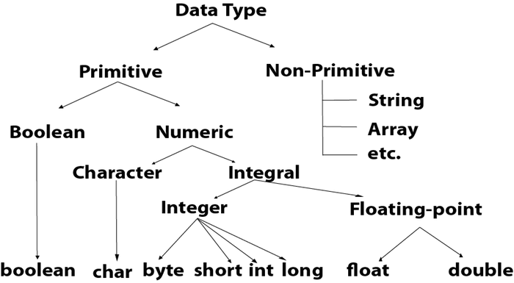
Data types specify the different sizes and values that can be stored in the variable.
There are two types of data types in Java:
Primitive data types: The primitive data types include boolean, char, byte, short, int, long, float and double.
Non-primitive data types: The non-primitive data types include Classes, Interfaces, and Arrays.

Slide 22
Object
An entity that has state and behavior is known as an object e.g., chair, bike, marker, pen, table, car, etc.
It can be physical or logical (tangible and intangible). The example of an intangible object is the banking system.
An object has three characteristics:
State: represents the data (value) of an object.
Behavior: represents the behavior (functionality) of an object such as deposit, withdraw, etc.
Identity: An object identity is typically implemented via a unique ID.
The value of the ID is not visible to the external user.
However, it is used internally by the JVM to identify each object uniquely.

Slide 23
An object is an instance of a class.
A class is a template or blueprint from which objects are created.
So, an object is the instance(result) of a class.
Object Definitions:
An object is a real-world entity.
An object is a runtime entity.
The object is an entity which has state and behavior.
The object is an instance of a class.
Class
A class is a group of objects which have common properties.
It is a template or blueprint from which objects are created.
It is a logical entity. It can't be physical.
class is group of objects which have similar properties but differentiate with behavior.
A class in Java can contain:
Fields, Methods, Constructors, Blocks, Nested class and interface

Slide 24
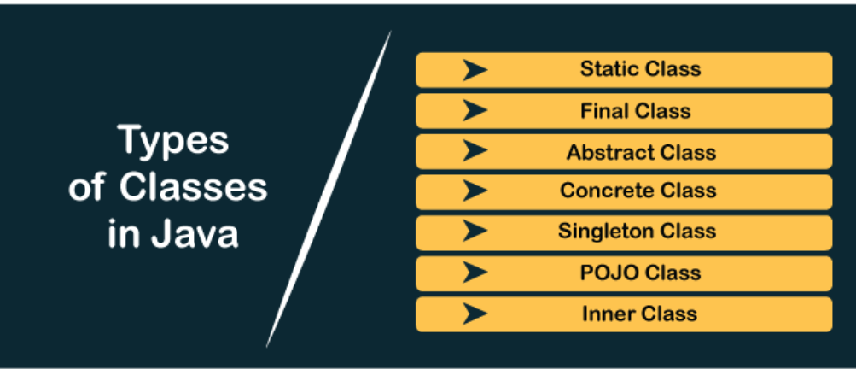

Slide 25
public class Student{
public static void main(String args[]) {
TestStudent t=new TestStudent();
System.out.println(t.id);
System.out.println(t.str);
}
}
class TestStudent{
int id;
String str;
}
O/P
O
NULL

Slide 26
initialize object
There are 3 ways to initialize object in Java.
By reference variable
By method
By constructor

Slide 27
1) Object and Class Example: Initialization through reference
Initializing an object means storing data into the object.
public class TestStudent2 {
public static void main(String args[]){
Student1 s1=new Student1();
s1.id=101;
s1.name="Sonoo";
System.out.println(s1.id+" "+s1.name);//printing members with a white space
}
}
class Student1{
int id;
String name;
}

Slide 28
2) Object and Class Example: Initialization through method
In this example, we are creating the two objects of Student class and initializing the value to these objects by invoking the insertRecord method..
public class TestStudent4 {
public static void main(String args[]){
Student2 s1=new Student2();
Student2 s2=new Student2();
s1.insertRecord(111,"Karan");
s2.insertRecord(222,"Aryan");
s1.displayInformation();
s2.displayInformation();
}
}
class Student2{
int rollno;
String name;
void insertRecord(int r, String n){
rollno=r;
name=n;
}
void displayInformation(){
System.out.println(rollno+" "+name);
}
}

Slide 29
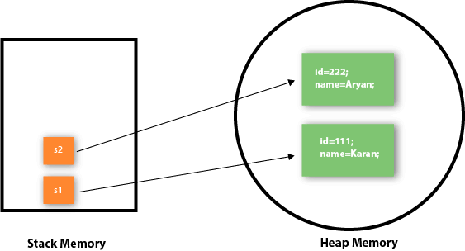
object gets the memory in heap memory area.
The reference variable refers to the object allocated in the heap memory area.
Here, s1 and s2 both are reference variables that refer to the objects allocated in memory.

Slide 30
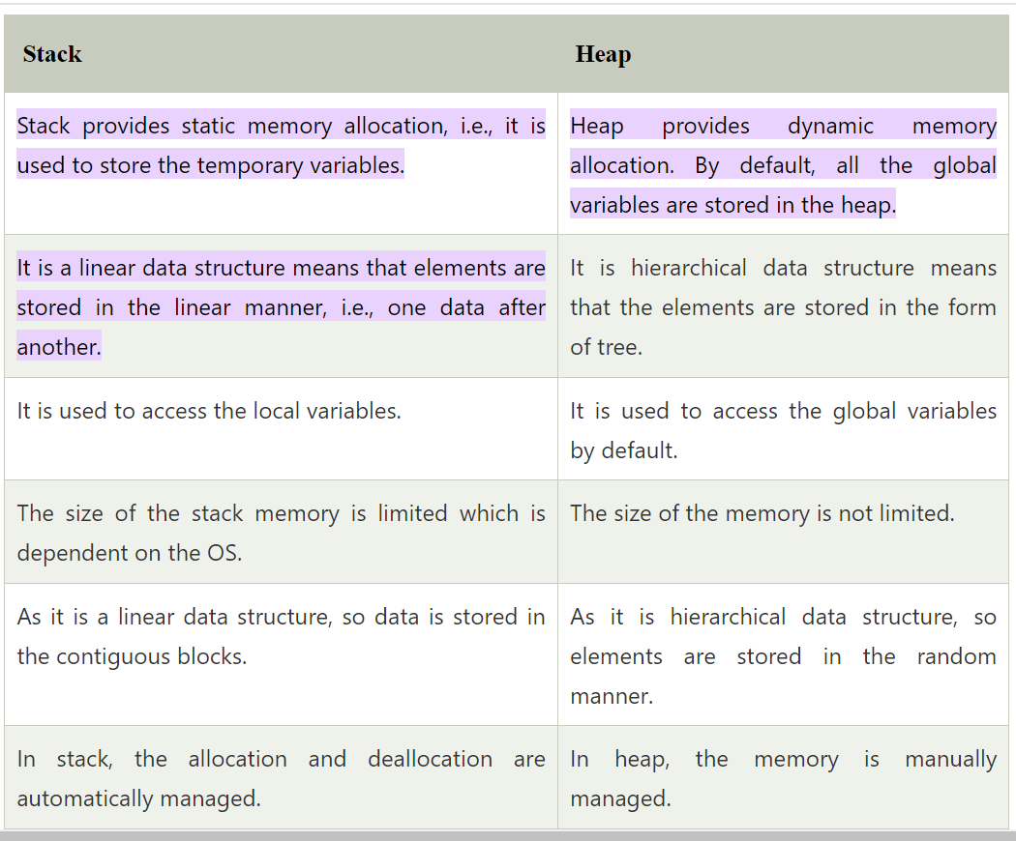
Heap V/S Stack

Slide 31
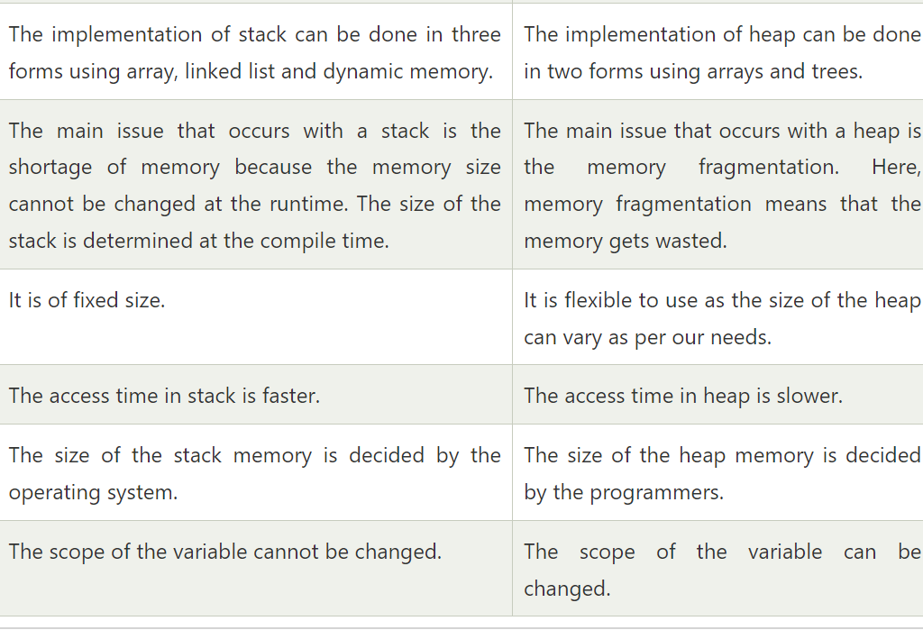

Slide 32
public class Rectangle1 {
public static void main(String args[]){
Rectangle r1=new Rectangle();
Rectangle r2=new Rectangle();
r1.insert(11,5);
r2.insert(3,15);
r1.calculateArea();
r2.calculateArea();
}
}
class Rectangle{
int length;
int width;
void insert(int l, int w){
length=l;
width=w;
}
void calculateArea(){
System.out.println(length*width);}
}

Slide 33
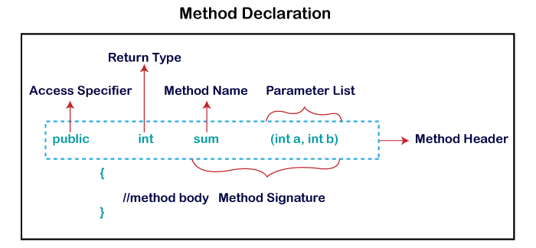
What is a method in Java?
A method is a block of code or collection of statements, or a set of code grouped together to perform a certain task or operation.
It is used to achieve the reusability of code.
While defining a method, remember that the method name must be a verb and start with a lowercase letter.
If the method name has more than two words, the first name must be a verb followed by adjective or noun.
In the multi-word method name, the first letter of each word must be in uppercase except the first word.

Slide 34
Types of Method -There are two types of methods in Java:
Predefined Method
User-defined Method
In Java, predefined methods are the method that is already defined in the Java class libraries is known as predefined methods.
It is also known as the standard library method or built-in method.
Each and every predefined method is defined inside a class.
Such as print() method is defined in the java.io.PrintStream class.
It prints the statement that we write inside the method.
For example, print("Java"), it prints Java on the console.

Slide 35
User-defined Method
The method written by the user or programmer is known as a user-defined method.
These methods are modified according to the requirement.

Slide 36
import java.util.Scanner;
public class EvenOdd {
public static void main (String args[]) {
Scanner scan=new Scanner(System.in);
System.out.print("Enter the number: ");
int num=scan.nextInt();
findEvenOdd(num);
}
public static void findEvenOdd(int num) {
if(num%2==0)
System.out.println(num+" is even");
else
System.out.println(num+" is odd");
}
}

Slide 37
Static Method
A method that has static keyword is known as static method.
In other words, a method that belongs to a class rather than an instance of a class is known as a static method.
We can also create a static method by using the keyword static before the method name.
The main advantage of a static method is that we can call it without creating an object.
It can access static data members and also change the value of it.
It is used to create an instance method.
It is invoked by using the class name.
The best example of a static method is the main() method.

Slide 38
public class Display {
public static void main(String[] args){
show();
}
Static void show(){
System.out.println("It is an example of static method.");
}
}

Slide 39
public class InstanceMethodExample {
public static void main(String [] args) {
InstanceMethodExample obj = new InstanceMethodExample();
System.out.println("The sum is: "+obj.add(12, 13));
}
int s;
//user-defined method because we have not used static keyword
public int add(int a, int b) {
s = a+b;
//returning the sum
return s;
}
}

Slide 40
Abstract Method
The method that does not has method body is known as abstract method.
In other words, without an implementation is known as abstract method.
It always declares in the abstract class.
It means the class itself must be abstract if it has abstract method.
To create an abstract method, we use the keyword abstract.

Slide 41
abstract class Demo {
//abstract method declaration
abstract void display();
}
public class MyClass extends Demo {
//method impelmentation
void display() {
System.out.println("Abstract method?");
}
public static void main(String args[]) {
//creating object of abstract class
Demo obj = new MyClass();
//invoking abstract method
obj.display();
}
}

Slide 42
Constructors in Java
A constructor is a block of codes similar to the method.
It is called when an instance of the class is created.
At the time of calling constructor, memory for the object is allocated in the memory.
It is a special type of method which is used to initialize the object.
Every time an object is created using the new() keyword, at least one constructor is called.
It calls a default constructor if there is no constructor available in the class.
In such case, Java compiler provides a default constructor by default
There are two types of constructors in Java: no-arg constructor, and parameterized constructor.
It is because java compiler creates a default constructor if your class doesn't have any.

Slide 43
Rules for creating Java constructor
There are two rules defined for the constructor.
Constructor name must be the same as its class name
A Constructor must have no explicit return type
A Java constructor cannot be abstract, static, final, and synchronized
There are two types of constructors in Java:
Default constructor (no-arg constructor)
Parameterized constructor

Slide 44
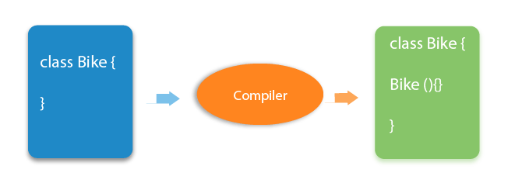
Java Default Constructor
A constructor is called "Default Constructor" when it doesn't have any parameter.
//Java Program to create and call a default constructor
class Bike1{
//creating a default constructor
Bike1(){
System.out.println("Bike is created");
}
//main method
public static void main(String args[]){
//calling a default constructor
Bike1 b=new Bike1();
}
}
If there is no constructor in a class, compiler automatically creates a default constructor.

Slide 45
Java Parameterized Constructor
A constructor which has a specific number of parameters is called a parameterized constructor.
The parameterized constructor is used to provide different values to distinct objects. However, you can provide the same values also.
class Student4{
int id;
String name;
//creating a parameterized constructor
Student4(int i,String n){
id = i;
name = n;
}
void display(){System.out.println(id+" "+name);}
public static void main(String args[]){
//creating objects and passing values
Student4 s1 = new Student4(111,"Karan");
Student4 s2 = new Student4(222,"Aryan");
s1.display();
s2.display();
}
}

Slide 46
Constructor overloading in Java is a technique of having more than one constructor with different parameter lists.
They are arranged in a way that each constructor performs a different task.
They are differentiated by the compiler by the number of parameters in the list and their types.
class Student5{
int id; String name; int age;
Student5(int i,String n){
id = i;
name = n;
}
Student5(int i,String n,int a){
id = i;
name = n;
age=a;
}
void display(){System.out.println(id+" "+name+" "+age);}
public static void main(String args[]){
Student5 s1 = new Student5(111,"Karan");
Student5 s2 = new Student5(222,"Aryan",25);
s1.display();
s2.display();
}
}

Slide 47
Java Copy Constructor
There is no copy constructor in Java. However, we can copy the values from one object to another like copy constructor in C++.
Does constructor return any value?
Yes, it is the current class instance (You cannot use return type, yet it returns a value).

Slide 48
The static keyword in Java is used for memory management mainly.
The static can be:
Variable (also known as a class variable)
Method (also known as a class method)
Block
Nested class
1. The static variable gets memory only once in the class area at the time of class loading.
class Student{
int rollno;
String name;
String college="ITS";
}
Suppose there are 500 students in college, now all instance data members will get memory each time when the object is created.
All students have its unique rollno and name, so instance data member is good in such case.
Here, "college" refers to the common property of all objects.
If we make it static, this field will get the memory only once.

Slide 49
class Student{
int rollno;//instance variable
String name;
static String college =“KIET";//static variable
Student(int r, String n){
rollno = r;
name = n;
}
void display (){System.out.println(rollno+" "+name+" "+college);}
}
public class TestStaticVariable1{
public static void main(String args[]){
Student s1 = new Student(111,"Karan");
Student s2 = new Student(222,"Aryan");
s1.display();
s2.display();
}
}

Slide 50
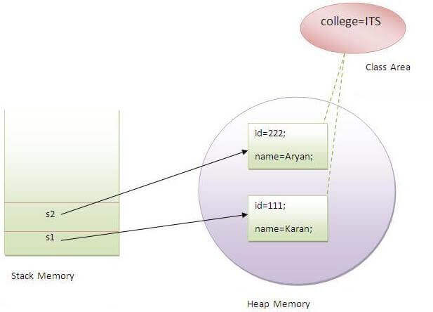

Slide 51
public class c {
static int count=0;//will get memory only once and retain its value
c(){
count++;//incrementing the value of static variable
System.out.println("Count="+count);
}
public static void main(String args[]){
//creating objects
c c1=new c();
c c2=new c();
c c3=new c();
}
}
Count=1
Count=2
Count=3
static variable will get the memory only once, if any object changes the value of the static variable, it will retain its value.

Slide 52
2) Java static method
If you apply static keyword with any method, it is known as static method.
A static method belongs to the class rather than the object of a class.
A static method can be invoked without the need for creating an instance of a class.
A static method can access static data member and can change the value of it.

Slide 53
class Student6{
int rollno; String name; static String college = "ITS";
//static method to change the value of static variable
static void change(){
college = "KIET";
}
Student6(int r, String n){
rollno = r;
name = n;
}
void display(){System.out.println(rollno+" "+name+" "+college);}
}
//Test class to create and display the values of object
public class TestStaticMethod{
public static void main(String args[]){
Student6.change();//calling change method
Student6 s1 = new Student6(111,"Karan");
Student6 s2 = new Student6(222,"Aryan");
Student6 s3 = new Student6(333,"Sonoo");
s1.display();
s2.display();
s3.display();
}
}
Output:
111 Karan KIET
222 Aryan KIET
333 Sonoo KIET

Slide 54
Restrictions for the static method
There are two main restrictions for the static method. They are:
The static method can not use non static data member or call non-static method directly.
this and super cannot be used in static context.
class A{
int a=40;//non static
public static void main(String args[]){
System.out.println(a);
}
}
Output:
Compile Time Error

Slide 55
3) Java static block
Is used to initialize the static data member.
It is executed before the main method at the time of class loading
class A2{
static{
System.out.println("static block is invoked");
}
public static void main(String args[]){
System.out.println("Hello main");
}
}
Output:
static block is invoked
Hello main

Slide 56
The access modifiers in Java specifies the accessibility or scope of a field, method, constructor, or class.
We can change the access level of fields, constructors, methods, and class by applying the access modifier on it.
here are four types of Java access modifiers:
Private: The access level of a private modifier is only within the class.
It cannot be accessed from outside the class.
Default: The access level of a default modifier is only within the package.
It cannot be accessed from outside the package.
If you do not specify any access level, it will be the default.
Protected: The access level of a protected modifier is within the package and outside the package through child class.
If you do not make the child class, it cannot be accessed from outside the package.
Public: The access level of a public modifier is everywhere.
It can be accessed from within the class, outside the class, within the package and outside the package.

Slide 57
Access Modifier | within class | within package | outside package by subclass only | outside package
Private | Y | N | N | N
Default | Y | Y | N | N
Protected | Y | Y | Y | N
Public | Y | Y | Y | Y

Slide 58
Private:
class A{
private int data=40;
private void msg(){
System.out.println("Hello java");
}
}
public class Simple{
public static void main(String args[]){
A obj=new A();
System.out.println(obj.data);//Compile Time Error
obj.msg();//Compile Time Error
}
}
class A{
private A(){}//private constructor
void msg(){
System.out.println("Hello java");
}
}
public class Simple{
public static void main(String args[]){
A obj=new A();//Compile Time Error
}
}

Slide 59
2) Default
if you don't use any modifier, it is treated as default by default. The default modifier is accessible only within package. It cannot be accessed from outside the package. It provides more accessibility than private. But, it is more restrictive than protected, and public.
//save by B.java
package mypack;
import pack.*;
class B{
public static void main(String args[]){
A obj = new A();//Compile Time Error
obj.msg();//Compile Time Error
}
}
//save by A.java
package pack;
class A{
void msg(){
System.out.println("Hello");
}
}

Slide 60
3) Protected
The protected access modifier is accessible within package and outside the package but through inheritance only.
The protected access modifier can be applied on the data member, method and constructor.
It can't be applied on the class.
It provides more accessibility than the default modifer.
/save by A.java
package pack;
public class A{
protected void msg(){
System.out.println("Hello");
}
}
/save by B.java
package mypack;
import pack.*;
class B extends A{
public static void main(String args[]){
B obj = new B();
obj.msg();
}
}

Slide 61
4) Public
The public access modifier is accessible everywhere.
It has the widest scope among all other modifiers.
//save by A.java
package pack;
public class A{
public void msg(){
System.out.println("Hello");
}
}
/save by B.java
package mypack;
import pack.*;
class B{
public static void main(String args[]){
A obj = new A();
obj.msg();
}
}

Slide 62
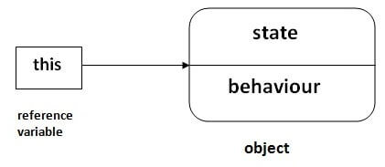
In Java, this is a reference variable that refers to the current object.

Slide 63
In the above example, parameters (formal arguments) and instance variables are same.
class Student12{
int rollno;
String name;
float fee;
Student12(int rollno,String name,float fee){
this.rollno=rollno;
this.name=name;
this.fee=fee;
}
void display(){
System.out.println(rollno+" "+name+" "+fee);
}
}
class TestThis2{
public static void main(String args[]){
Student12 s1=new Student12(111,"ankit",5000f);
Student12 s2=new Student12(112,"sumit",6000f);
s1.display();
s2.display();
}
}
If local variables(formal arguments) and instance variables are different, there is no need to use this keyword

Slide 64
What Is Inheritance?
Object-oriented programming allows classes to inherit commonly used state and behavior from other classes.
It enables classes to include properties of other classes.
The class that inherits the properties is called a child class or subclass, and the class from which the properties are inherited is called a parent class or superclass.
class Super1 {
.....
.....
}
class Sub extends Super1 {
.....
.....
}

Slide 65
Inheritance in Java: Why do we need it?
Code Reusability:
The code written in the Superclass is common to all subclasses. Child classes can directly use the parent class code.
Method Overriding:
Method Overriding is achievable only through Inheritance. It is one of the ways by which java achieves Run Time Polymorphism.
Abstraction:
The concept of abstract where we do not have to provide all details is achieved through inheritance. Abstraction only shows the functionality to the user.

Slide 66
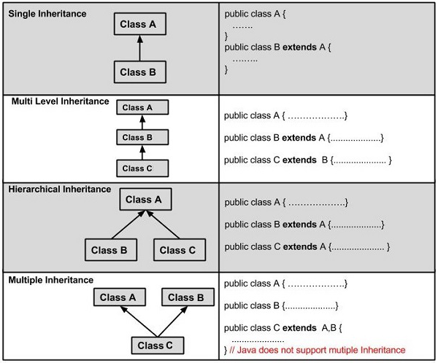

Slide 67
class Calculation {
int z;
public void addition(int x, int y) {
z = x + y;
System.out.println("The sum of the given numbers:"+z);
}
public void Subtraction(int x, int y) {
z = x - y;
System.out.println("The difference between the given numbers:"+z);
}
} public class My_Calculation extends Calculation {
public void multiplication(int x, int y) {
z = x * y;
System.out.println("The product of the given numbers:"+z);
}
public static void main(String args[]) {
int a = 20, b = 10;
My_Calculation demo = new My_Calculation();
demo.addition(a, b);
demo.Subtraction(a, b);
demo.multiplication(a, b);
}
}
The sum of the given numbers:30
The difference between the given numbers:10
The product of the given numbers:200

Slide 68
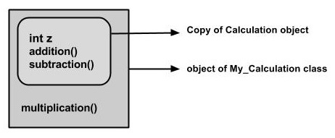
In the given program, when an object to My_Calculation class is created, a copy of the contents of the superclass is made within it.
That is why, using the object of the subclass you can access the members of a superclass.
The Superclass reference variable can hold the subclass object, but using that variable you can access only the members of the superclass, so to access the members of both classes it is recommended to always create reference variable to the subclass.
Calculation demo = new My_Calculation();
demo.addition(a, b);
demo.Subtraction(a, b);

Slide 69
A subclass inherits all the members (fields, methods, and nested classes) from its superclass.
Constructors are not members, so they are not inherited by subclasses, but the constructor of the superclass can be invoked from the subclass.
The super keyword is similar to this keyword.
Following are the scenarios where the super keyword is used.
It is used to differentiate the members of superclass from the members of subclass, if they have same names.
It is used to invoke the superclass constructor from subclass.
super.variable
super.method();

Slide 70
class Super_class {
int num = 20;
public void display() {// display method of superclass
System.out.println("This is the display method of superclass");
}
}//end of super class
public class Sub_class extends Super_class {
int num = 10;
public void display() {// display method of sub class
System.out.println("This is the display method of subclass");
}
public void my_method() {
Sub_class sub = new Sub_class(); // Instantiating subclass
sub.display(); // Invoking the display() method of sub class
super.display(); class// Invoking the display() method of superclass
// printing the value of variable num of subclass
System.out.println("value of the variable named num in sub class:"+ sub.num);
// printing the value of variable num of superclass
System.out.println("value of the variable named num in super class:"+ super.num);
}
public static void main(String args[]) {
Sub_class obj = new Sub_class();
obj.my_method();
}}

Slide 71
If a class is inheriting the properties of another class, the subclass automatically acquires the default constructor of the superclass.
But if you want to call a parameterized constructor of the superclass, you need to use the super keyword as shown below.
super(values);

Slide 72
class Superclass {
int age;
Superclass(int age) {
this.age = age;
}
public void getAge() {
System.out.println("The value of age in super class is: " +age);
}
}
public class Subclass extends Superclass {
Subclass(int age) {
super(age);
}
public static void main(String args[]) {
Subclass s = new Subclass(24);
s.getAge();
}
}

Slide 73
Method Overloading in Java
If a class has multiple methods having same name but different in parameters, it is known as Method Overloading.
There are two ways to overload the method in java
By changing number of arguments
By changing the data type
class Adder{
static int add(int a,int b){
return a+b;
}
static int add(int a,int b,int c){
return a+b+c;
}
}
class TestOverloading1{
public static void main(String[] args){
System.out.println(Adder.add(11,11));
System.out.println(Adder.add(11,11,11));
}
}
class Adder{
static int add(int a, int b){return a+b;}
static double add(double a, double b){return a+b;}
}
class TestOverloading2{
public static void main(String[] args){
System.out.println(Adder.add(11,11));
System.out.println(Adder.add(12.3,12.6));
}
}

Slide 74
Can we overload java main() method?
Yes, by method overloading.
You can have any number of main methods in a class by method overloading.
But JVM calls main() method which receives string array as arguments only.
Let's see the simple example:
class TestOverloading4{
public static void main(String[] args){
System.out.println("main with String[]");
}
public static void main(String args){
System.out.println("main with String");
}
public static void main(){
System.out.println("main without args");
}
}
Overloading is also a feature of OOP languages like Java that is related to compile-time (or static) polymorphism.

Slide 75
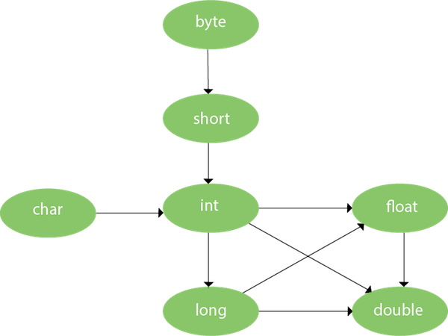
Method Overloading and Type Promotion
One type is promoted to another implicitly if no matching datatype is found.
Let's understand the concept by the figure given below:
class OverloadingCalculation1{
void sum(int a,long b){
System.out.println(a+b);
}
void sum(int a,int b,int c){
System.out.println(a+b+c);
}
public static void main(String args[]){
OverloadingCalculation1 obj=new OverloadingCalculation1();
obj.sum(20,20);//now second int literal will be promoted to long
obj.sum(20,20,20);
}
}

Slide 76
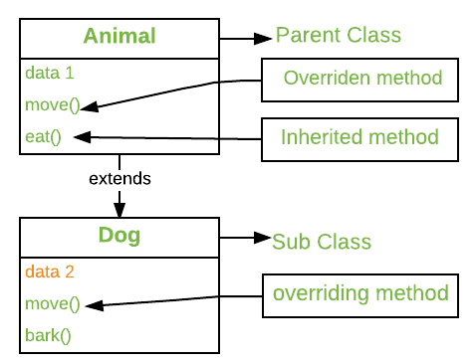
Method Overriding in Java
If subclass (child class) has the same method as declared in the parent class, it is known as method overriding in Java.
In other words, If a subclass provides the specific implementation of the method that has been declared by one of its parent class, it is known as method overriding.
class Vehicle{
//defining a method
void run(){
System.out.println("Vehicle is running");}
}
//Creating a child class
class Bike2 extends Vehicle{
//defining the same method as in the parent class
void run(){
System.out.println("Bike is running safely");
}
public static void main(String args[]){
Bike2 obj = new Bike2();//creating object
obj.run();//calling method
}
}

Slide 77
Static vs Dynamic Binding in Java
Connecting a method call to the method body is known as binding.
There are two types of binding
Static Binding (also known as Early Binding).
Dynamic Binding (also known as Late Binding).
The binding which can be resolved at compile time by the compiler is known as static or early binding.
The binding of all the static, private, and final methods is done at compile-time.
In Dynamic binding compiler doesn’t decide the method to be called. Overriding is a perfect example of dynamic binding. In overriding both parent and child classes have the same method.
private, final and static members (methods and variables) use static binding while for virtual methods (In Java methods are virtual by default) binding is done during run time based upon the run time object.
The static binding uses Type information for binding while Dynamic binding uses Objects to resolve to bind.
Overloaded methods are resolved (deciding which method to be called when there are multiple methods with the same name) using static binding while overridden methods use dynamic binding, i.e, at run time.

Slide 78
Static vs Dynamic Binding in Java
class Dog{
private void eat(){System.out.println("dog is eating...");}
public static void main(String args[]){
Dog d1=new Dog();
d1.eat();
}
}
class Animal{
void eat(){System.out.println("animal is eating...");}
}
class Dog extends Animal{
void eat(){System.out.println("dog is eating...");}
public static void main(String args[]){
Animal a=new Dog();
a.eat();
}
}

Slide 79
Method Hiding in Java
Static methods are bonded during compile time using types of reference variables not object.
We know that static methods are accessed by using the class name rather than an object.
Note that the static method can be overloaded, but cannot be overridden in Java.

Slide 80
class Demo {
public static void method1() {
System.out.println(“static Method-1 of the Demo class is executed."); }
public void method2() {
System.out.println(“Non- static Method-2 of the Demo class is executed."); }
}
//child class
public class Sample extends Demo {
public static void method1() {
System.out.println(“Static Method-1 of the Sample class is executed."); }
public void method2() {
System.out.println(“Non-static Method-2 of the Sample class is executed."); }
public static void main(String args[]) {
Demo d1 = new Demo();
//d2 is reference variable of class Demo that points to object of class Sample
Demo d2 = new Sample();
//method calling with reference (method hiding)
d1.method1();
d2.method1();
//method calling with object (method overriding)
d1.method2();
d2.method2();
}
}
Static Method-1 of the Demo class is executed.
Static Method-1 of the Demo class is executed.
Non-static Method-2 of the Demo class is executed.
Non static Method-2 of the Sample class is executed.

Slide 81
Wrapper classes in Java
The wrapper class in Java provides the mechanism to convert primitive into object and object into primitive.
Since J2SE 5.0, autoboxing and unboxing feature convert primitives into objects and objects into primitives automatically.
The automatic conversion of primitive into an object is known as autoboxing and vice-versa unboxing.

Slide 82
Use of Wrapper classes in Java
Java is an object-oriented programming language, so we need to deal with objects many times like in Collections, Serialization, Synchronization, etc. Let us see the different scenarios, where we need to use the wrapper classes.
Change the value in Method: Java supports only call by value. So, if we pass a primitive value, it will not change the original value. But, if we convert the primitive value in an object, it will change the original value.
Serialization: We need to convert the objects into streams to perform the serialization. If we have a primitive value, we can convert it in objects through the wrapper classes.
Synchronization: Java synchronization works with objects in Multithreading.
java.util package: The java.util package provides the utility classes to deal with objects.
Collection Framework: Java collection framework works with objects only. All classes of the collection framework (ArrayList, LinkedList, Vector, HashSet, LinkedHashSet, TreeSet, PriorityQueue, ArrayDeque, etc.) deal with objects only.

Slide 83
The eight classes of the java.lang package are known as wrapper classes in Java. The list of eight wrapper classes are given below:
Primitive Type | Wrapper class
boolean | Boolean
char | Character
byte | Byte
short | Short
int | Integer
long | Long
float | Float
double | Double

Slide 84
Autoboxing
The automatic conversion of primitive data type into its corresponding wrapper class is known as autoboxing,
for example, byte to Byte, char to Character, int to Integer, long to Long, float to Float, boolean to Boolean, double to Double, and short to Short.
Since Java 5, we do not need to use the valueOf() method of wrapper classes to convert the primitive into objects.
//Java program to convert primitive into objects
//Autoboxing example of int to Integer
public class WrapperExample1{
public static void main(String args[]){
//Converting int into Integer
int a=20;
Integer i=Integer.valueOf(a);//converting int into Integer explicitly
Integer j=a;//autoboxing, now compiler will write Integer.valueOf(a) internally
System.out.println(a+" "+i+" "+j);
}
}

Slide 85
Unboxing
The automatic conversion of wrapper type into its corresponding primitive type is known as unboxing.
It is the reverse process of autoboxing.
Since Java 5, we do not need to use the intValue() method of wrapper classes to convert the wrapper type into primitives.
//Java program to convert object into primitives
//Unboxing example of Integer to int
public class WrapperExample2{
public static void main(String args[]){
//Converting Integer to int
Integer a=new Integer(3);
int i=a.intValue();//converting Integer to int explicitly
int j=a;//unboxing, now compiler will write a.intValue() internally
System.out.println(a+" "+i+" "+j);
}
}

Slide 86
//Java Program to convert all primitives into its corresponding
//wrapper objects and vice-versa
public class WrapperExample3{
public static void main(String args[]){
byte b=10;
short s=20;
int i=30;
long l=40;
float f=50.0F;
double d=60.0D;
char c='a';
boolean b2=true;
//Autoboxing: Converting primitives into objects
Byte byteobj=b;
Short shortobj=s;
Integer intobj=i;
Long longobj=l;
Float floatobj=f;
Double doubleobj=d;
Character charobj=c;
Boolean boolobj=b2;
//Printing objects
System.out.println("---Printing object values---");
System.out.println("Byte object: "+byteobj);
System.out.println("Short object: "+shortobj);
System.out.println("Integer object: "+intobj);
System.out.println("Long object: "+longobj);
System.out.println("Float object: "+floatobj);
System.out.println("Double object: "+doubleobj);
System.out.println("Character object: "+charobj);
System.out.println("Boolean object: "+boolobj);
//Unboxing: Converting Objects to Primitives
byte bytevalue=byteobj;
short shortvalue=shortobj;
int intvalue=intobj;
long longvalue=longobj;
float floatvalue=floatobj;
double doublevalue=doubleobj;
char charvalue=charobj;
boolean boolvalue=boolobj;

Slide 87
//Printing primitives
System.out.println("---Printing primitive values---");
System.out.println("byte value: "+bytevalue);
System.out.println("short value: "+shortvalue);
System.out.println("int value: "+intvalue);
System.out.println("long value: "+longvalue);
System.out.println("float value: "+floatvalue);
System.out.println("double value: "+doublevalue);
System.out.println("char value: "+charvalue);
System.out.println("boolean value: "+boolvalue);
}}

Slide 89
Polymorphism in Java
Polymorphism in Java is a concept by which we can perform a single action in different ways. Polymorphism is derived from 2 Greek words: poly and morphs. The word "poly" means many and "morphs" means forms. So polymorphism means many forms.
There are two types of polymorphism in Java: compile-time polymorphism and runtime polymorphism. We can perform polymorphism in java by method overloading and method overriding.
If you overload a static method in Java, it is the example of compile time polymorphism. Here, we will focus on runtime polymorphism in java.
Runtime Polymorphism in Java
Runtime polymorphism or Dynamic Method Dispatch is a process in which a call to an overridden method is resolved at runtime rather than compile-time.
In this process, an overridden method is called through the reference variable of a superclass. The determination of the method to be called is based on the object being referred to by the reference variable.
Let's first understand the Upcasting before Runtime Polymorphism.
Upcasting
If the reference variable of Parent class refers to the object of Child class, it is known as Upcasting

Slide 90
Example of Java Runtime Polymorphism
class Bike{
void run(){System.out.println("running");}
}
class Splendor extends Bike{
void run(){System.out.println("running safely with 60km");}
public static void main(String args[]){
Bike b = new Splendor();//upcasting
b.run();
}
}
Compile-Time Polymorphism in Java
Method Overloading
In Java, compile-time polymorphism is mostly achieved by method overloading. Programmers can use it to create numerous methods with the same name but different parameters that are all included within the same class

