Slide 1
UNIT-V KCS-601 Software engineering PART-I
Software Engineering

Slide 2
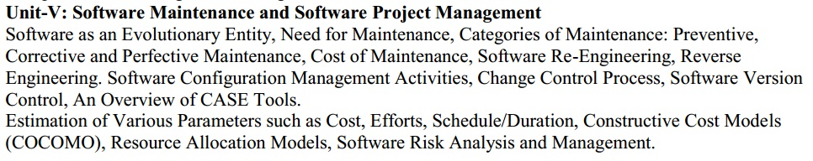
Syllabus

Slide 3
SOFTWARE AS AN EVOLUTION ENTITY
Lehman and Belady have studied the characteristics of the evolution of several software products [1980].
They have expressed their observations in the form of laws.
Their important laws are given below.
Lehman’s First Law: A software product must change continually or become progressively less useful.
Lehman’s second Law: The structure of a program tends to degrade as more and more maintenance is carried out on it.
Lehman’s third Law: Over a program’s lifetime, its rate of development is approximately constant.

Slide 4
Software Maintenance
Software Maintenance is a very broad activity that includes Error corrections, Enhancements of Capabilities, Deletion of Obsolete Capabilities, and Optimization.
Software Maintenance is Any modifications to a software product after it has been delivered to the customer.
Software Maintenance is an important activity for many organizations.
Maintenance is inevitable (expected) for almost any kind of product.
Most Products need maintenance Due to wear and tear caused by use. But Software Products do not need maintenance on this count.

Slide 5
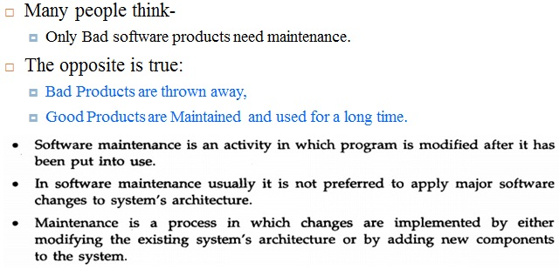
Software Maintenance

Slide 6
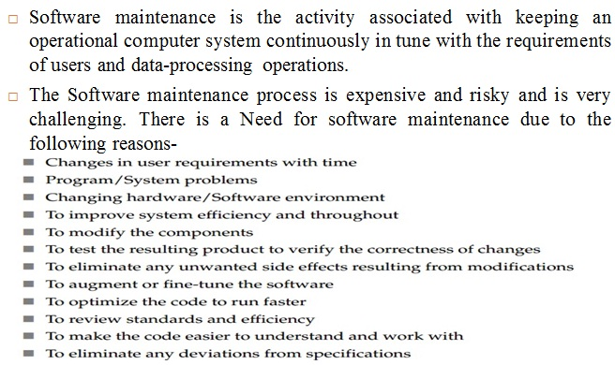
Need of Software Maintenance

Slide 7
Need of Software Maintenance
Software maintenance is becoming an important activity of a large number of software organizations.
When the Hardware platform is changed, and a software product performs some low-level functions, maintenance is necessary.
Also, whenever the support environment of a software product changes, the software product requires rework to cope up with the newer interface.
For instance, a software product may need to be maintained when the operating system changes.
Thus, Every software product continues to evolve after its development through maintenance efforts.
Therefore it can be stated that software maintenance is needed to correct errors, enhance features, port the software to new platforms, etc.

Slide 8
Types (Categories) of Software Maintenance
Maintenance may be classified into the four categories as follows:
Corrective- Reactive modifications to correct discovered problems.
Adaptive- Modifications to keep it usable in a changed or changing environment.
Perfective- Improve Performance or Maintainability.
Preventive- Modifications to Detect and Correct latent (hidden) faults.

Slide 9
Corrective
Corrective maintenance of a software product:
to correct bugs observed while the system is in use.
to enhance performance of the product.
Corrective maintenance means repairing processing or performance failures or making changes because of previously uncorrected problems.

Slide 10
Adaptive
A software Product needs maintenance when customers:
Need the Product to run on new platforms, or, on new operating systems,
Need the Product to interface with new hardware or software.
Adaptive maintenance is done to adapt to external environment changes.

Slide 11
Perfective
Perfective Maintenance-
To support new features required by users.
To change some functionality of the system due to customer demands.
Perfective Maintenance Means enhancing the performance or modifying the programs to respond to the user’s additional or changing Needs.

Slide 12
Preventive Maintenance.
Preventive Maintenance is the Process by which we Prevent our system from being obsolete.
Preventive Maintenance involves the concept of Re-engineering and reverse engineering in which an old System with an old technology is re-engineered using new technology.
This Maintenance Prevents the system from dying out.

Slide 13
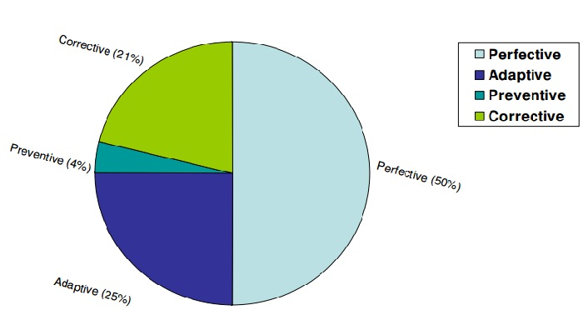
Maintenance Effort Distribution

Slide 14
Problems Associated with Software Maintenance
Software maintenance work typically is much more expensive than what it should be and takes more time than required.
In software organizations, maintenance work is mostly carried out using ad hoc techniques.
Software maintenance has a very poor image in industry.
Therefore, an organization often cannot employ bright engineers to carry out maintenance work.
Even though maintenance suffers from a poor image, the work involved is often more challenging than development work.
During maintenance it is necessary to thoroughly understand someone else’s work and then carry out the required modifications and extensions.

Slide 15
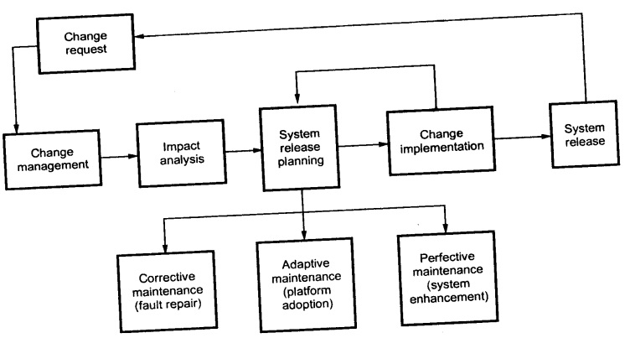
Software Maintenance Process

Slide 16
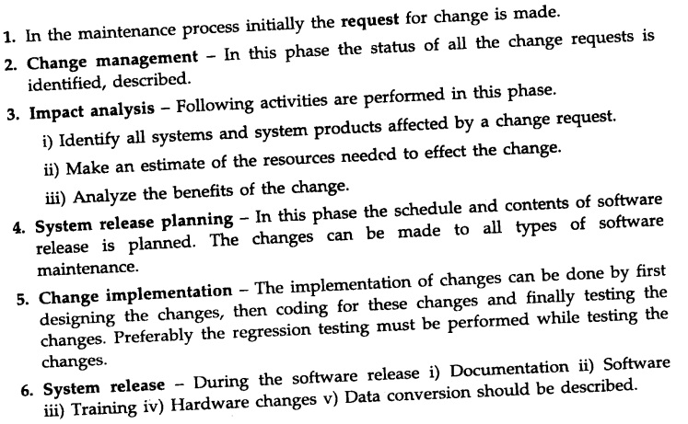
Software Maintenance Process

Slide 17
Cost of Maintenance
In the 1970s, most of a software system’s budget was spent on development.
The ratio of development money to maintenance money was reversed in the 1980s, and various estimates place maintenance at 40 to 60% of the full life-cycle cost of a system (i.e., from development through maintenance to eventual retirement or replacement).
However, this cost may vary widely from one application domain to another.
It is advisable to invest more effort in early phases of the software life-cycle to reduce maintenance costs.

Slide 18
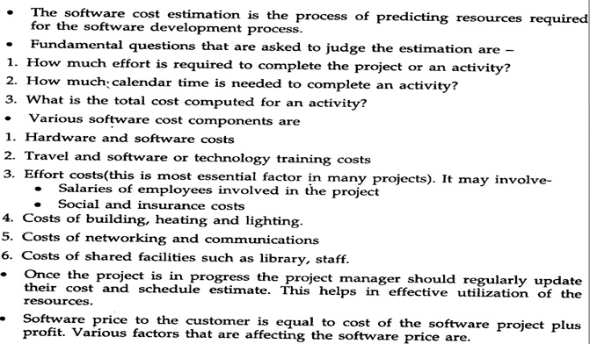
Cost of Maintenance

Slide 19
Modeling Maintenance Effort
As With software development, we want to estimate the effort required to maintain a software system.
There are two model which estimate the maintenance effort-
Belady and Lehman Model.
Boehm Model.

Slide 20
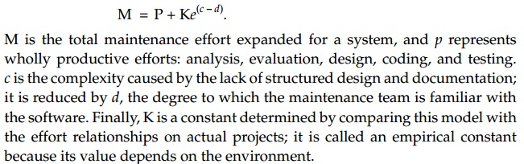
Modeling Maintenance Effort
Belady and Lehman Model- This Model indicates that effort and costs can increase exponentially if a poor software development approach is used, and the person or group that used the approach is no longer available to perform maintenance.
Belady and Lehman capture these effects in an equation:

Slide 21
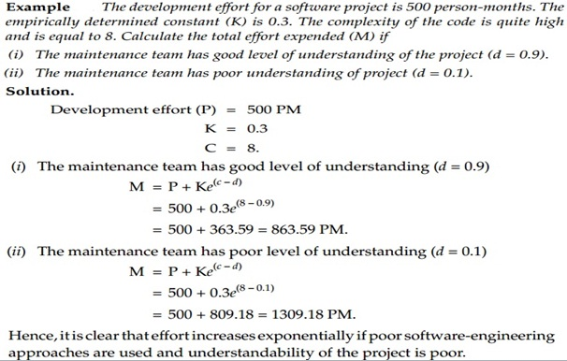
Modeling Maintenance Effort

Slide 22
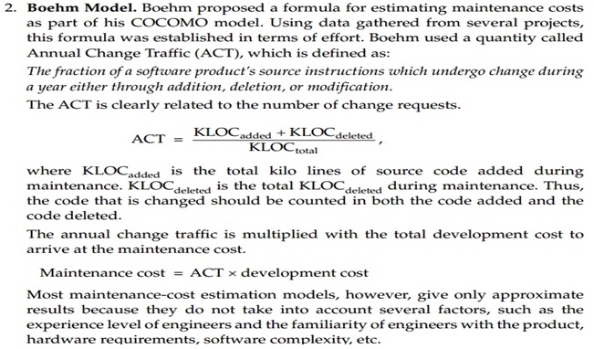
Modeling Maintenance Effort

Slide 23
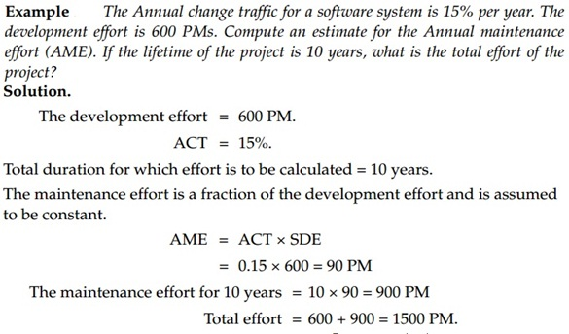
Modeling Maintenance Effort

Slide 24
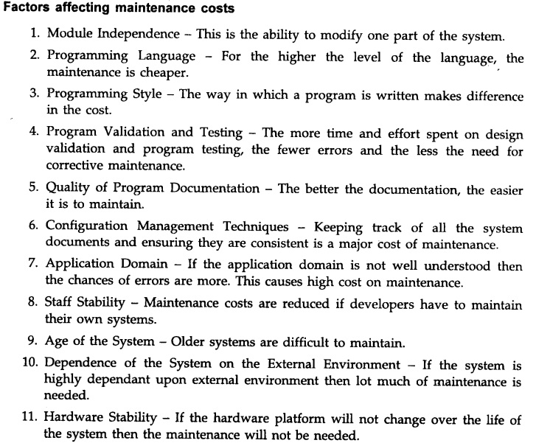
Factors Affecting Maintenance Cost

Slide 25
Software Reverse Engineering
The Term Reverse engineering has its origins in the Hardware world.
A company disassembles a competitive hardware product in an effort to under-stand its competitor's design and manufacturing "secrets.“
These secrets could be easily understood if the competitor's design and manufacturing specifications were obtained.

Slide 26
Reverse Engineering
But these documents are proprietary and unavailable to the company doing the reverse engineering.
In essence, successful reverse engineering derives one or more design and manufacturing specifications for a product by examining actual specimens of the product.
Reverse engineering for software is Quite similar.
In most cases, however, the program to be reverse engineered is not a competitor's. Rather, it is the company's own work (often done many years earlier).

Slide 27
Reverse Engineering
The "secrets" to be understood are unclear because no specification was ever developed.
Therefore, reverse engineering for software is the process of analyzing a program in an effort to create a representation of the program at a higher level of abstraction than source code.
Reverse engineering is a process of design recovery.
Reverse engineering tools extract data, architectural, and procedural design information from an existing program.

Slide 28
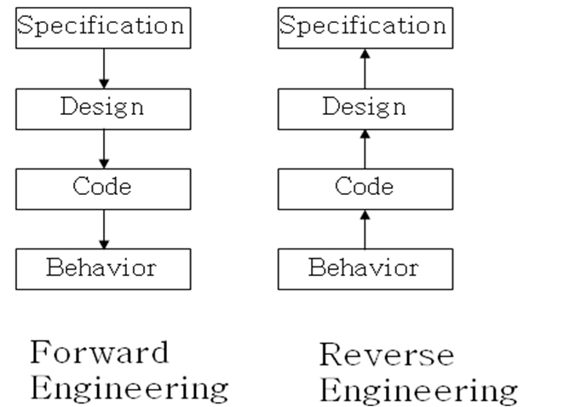
Process model for Reverse Engineering

Slide 29
Reverse Engineering
Analyzing software with a view to Understanding its design and specification.
May be part of a re-engineering process but may also be used to re-specify a system for re-implementation.
Reverse engineering is the process of deriving the system design and specification from its source code.
Reverse engineering often precedes re-engineering but is sometimes worthwhile in its own right.
The design and specification of a system may be reverse engineered so that they can be an input to the requirements specification process for the system’s replacement.
The design and specification may be reverse engineered to support program maintenance.

Slide 30
Reverse Engineering
The objective of re-engineering is to improve the system structure to make it easier to understand and maintain.
The re-engineering process involves source code translation, reverse engineering, program structure improvement, program modularization and data re-engineering.

Slide 31
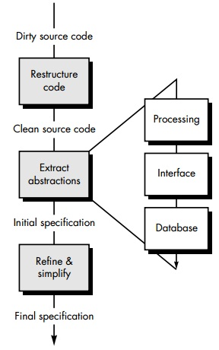
Reverse Engineering Process

Slide 32
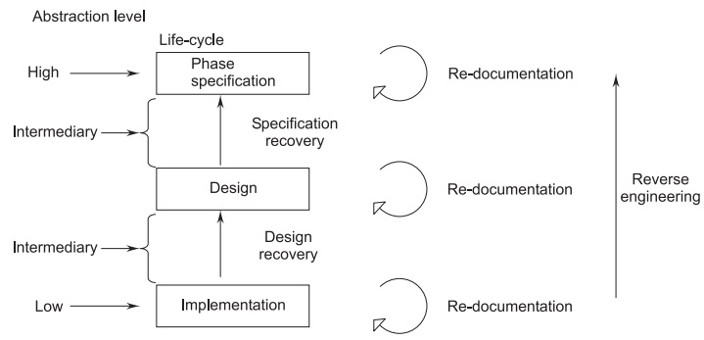
Level of Abstraction in Reverse Engineering

Slide 33
Software Re-Engineering
Software Re-engineering is concerned with taking existing legacy systems and re-implementing them to make them more maintainable.
Re-organizing and modifying existing software systems to make them more maintainable.
Re-Structuring or Re-Writing Part or all of a Legacy System(Old System) Without Changing its Functionality.
Applicable where some but not all sub-systems of a larger system require frequent maintenance.
Re-engineering involves adding effort to make them easier to maintain. The system may be Re-Structured and Re-Documented.

Slide 34
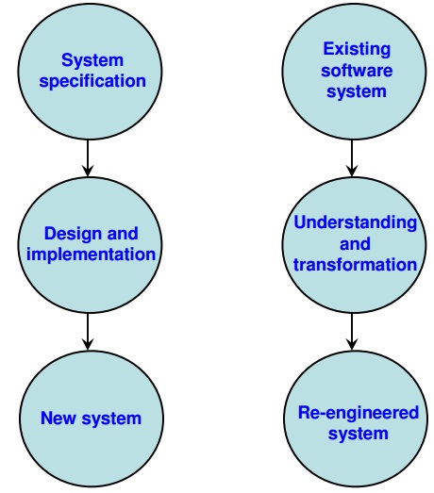
Software Re-Engineering (Comparison of new software development with re-engineering)

Slide 35
Software Re-Engineering (Comparison of new software development with re-engineering)
Change Requirements
Requirements Specification
New Requirements Specification
Design
Design
Code
Code

Slide 36
The following suggestions may be useful for the modification of the legacy code:
Study Code well before attempting changes.
Concentrate on overall control flow and not coding.
Heavily Comment internal code.
Create Cross References.
Build Symbol tables.
Use own variables, constants and declarations to localize the effect.
Keep Detailed Maintenance Document.
Use modern design techniques.

Slide 37
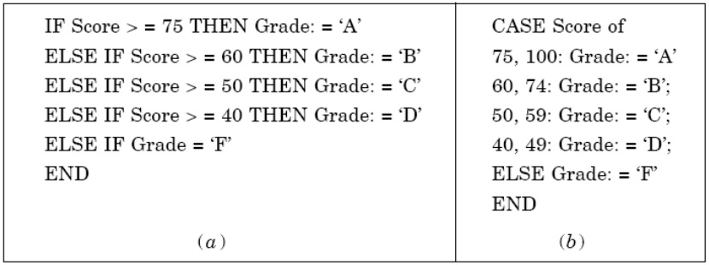
Restructuring a Program

Slide 38
Re-Engineering
Re-engineering is a rebuilding activity, and we can better understand the re-engineering of information systems if we consider an analogous activity: the rebuilding of a house.
Consider the following situation-
You have purchased a house in another state.
You’ve never actually seen the property, but you acquired it at an amazingly low price, with the warning that it might have to be completely rebuilt.
How would you proceed?

Slide 39
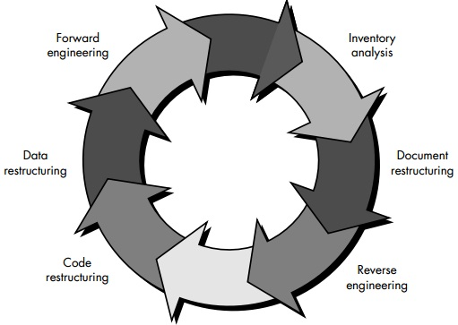
A Software Re-engineering Process Model

Slide 40
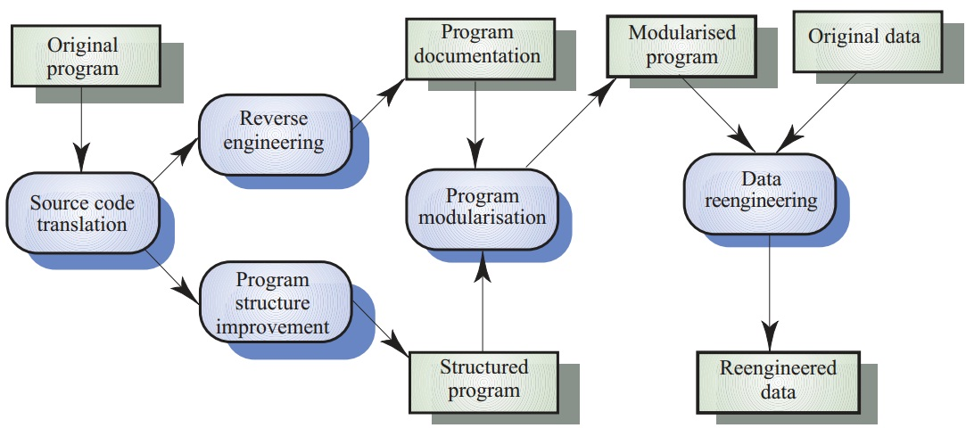
Re-engineering Process

Slide 41
Re-Engineering Advantages
Reduced Risk-
There is a high risk in new software development.
There may be development problems, staffing problems and specification problems.
Reduced Cost-
The cost of re-engineering is often significantly less than the costs of developing new software.

Slide 42
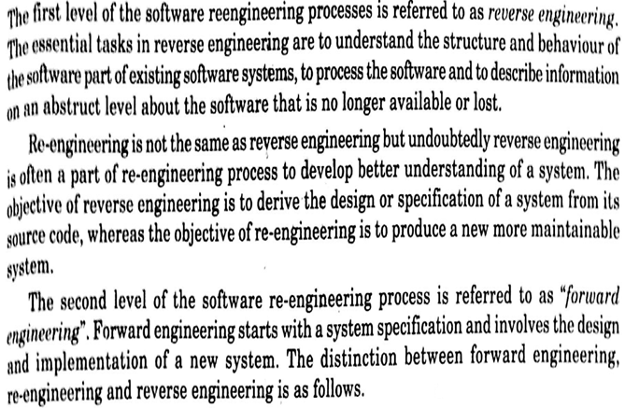
DIFFERENCE BETWEEN REVERSE, FORWARD & RE-ENGINEERING

Slide 43
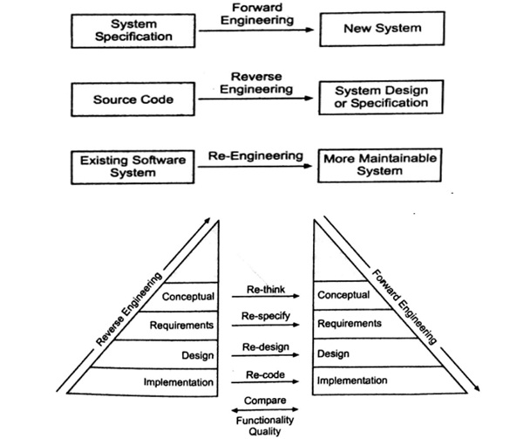
DIFFERENCE BETWEEN REVERSE, FORWARD & RE-ENGINEERING

Slide 44
DIFFERENCE BETWEEN REVERSE, FORWARD & RE-ENGINEERING
Reverse Engineering-
Performs Transformation from a Lower abstraction Level to Higher One.
Forward Engineering-
Performs Transformation a Higher Abstraction Level to Lower Abstraction Level
Re-Engineering-
It transform an existing software system into a new but more maintainable software system.
Re-Structuring-
Performs Transformation within the same abstraction Level

Slide 45
Software Configuration Management
The Process of controlling the software development and maintenance is called configuration management.
The Configuration Management is different in development and maintenance phases of life cycle due to different environments.
Configuration Management Activities divided into four broad categories-
The identification of the components and changes.
(Identify Changes)
The control of the way by which the changes are made.
(Control Changes)
Auditing the changes.
Status accounting recording and documenting all the activities that have take place.

Slide 46
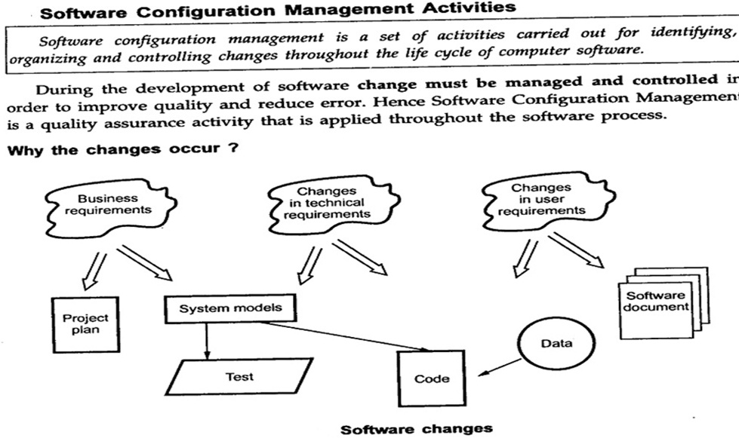
Software Configuration Management

Slide 47
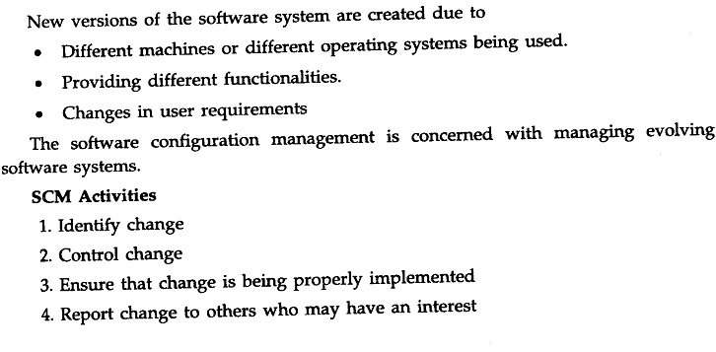
Software Configuration Management

Slide 48
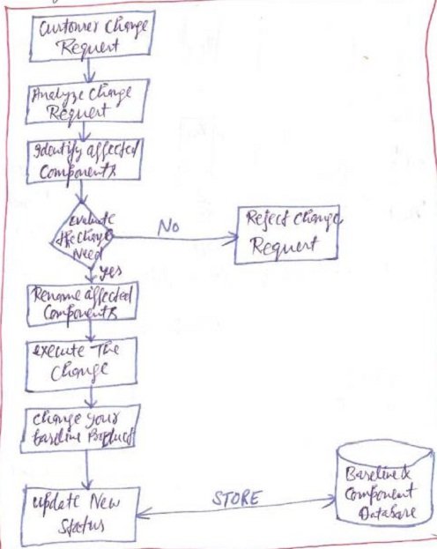
Change Control Process

Slide 49
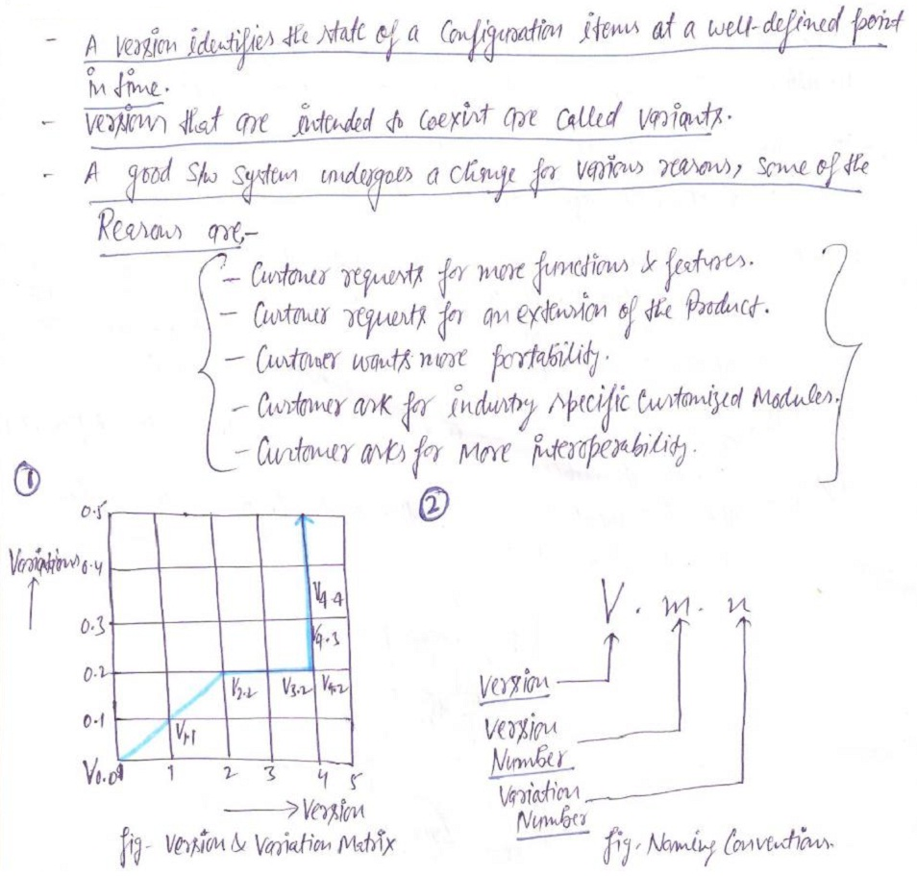
Software Version Control

Slide 50
An Overview of CASE Tools
CASE stands for Computer-Aided Software Engineering.
CASE is a tool that helps a software engineer maintain and develop software.
CASE is an automated support tool for software engineers in any software-engineering process.
Software engineering mainly includes the following Processes-
Translation of user needs into software requirements.
Transaction of software requirements into design specifications.
Implementation of design into code.
Testing of the code.
Documentation.
CASE technology provides software-process support by automating some process activities and by providing information about the software being developed.

Slide 51
An Overview of CASE Tools
CASE tools provides the software engineer with the ability to automate manual activities and to improve engineering task.
It can assist to perform various activities such as analysis, design, coding and testing.
With the help of CASE tools development process reduces the amount of effort.

Slide 52
An Overview of CASE Tools
CASE tools are programs that automate or support one or more phases in a SW development life cycle
Purpose:
increase the speed of SW development activities
increase the SW productivity
improve the quality of the SW developed

Slide 53
An Overview of CASE Tools
CASE tools may exist as a single tools or a collection of multiple tools.
Tool must communicate with various element such as hardware, database, people, network, OS and so on.
In blocks, Environment architecture, composed of the hardware platform and system support (including networking software, database management), lays the ground work for CASE.

Slide 54
An Overview of CASE Tools
Fig:Building Block of CASE Tools

Slide 55
CHARACTERISTICS OF CASE TOOLS
All CASE tools have the following Characteristics-
A graphic interface to draw diagrams, charts, models (uppercase, middle case, lowercase).
An information repository, a data dictionary for efficient information-management selection, usage, application, and storage.
Common user interface for integration of multiple tools used in various Phases.
Automatic code generators.
Automatic testing tools.

Slide 56
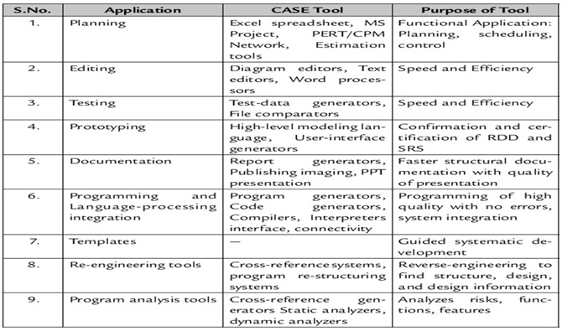
List of CASE Tools

Slide 57
Objectives or Advantages of CASE Tools
The Major Benefits of using CASE tools are-
Improved productivity.
Better documentation.
Improved accuracy.
Improved quality.
Reduced maintenance.
Reduced cost of software.
Produce high-quality and consistent documents.
Impact on the style of a working of company.
Increase speed of processing.
Easy to program software.
Improved coordination among staff members who are working on a large software project.
An increase in project control through better planning, monitoring, and communication.

Slide 58
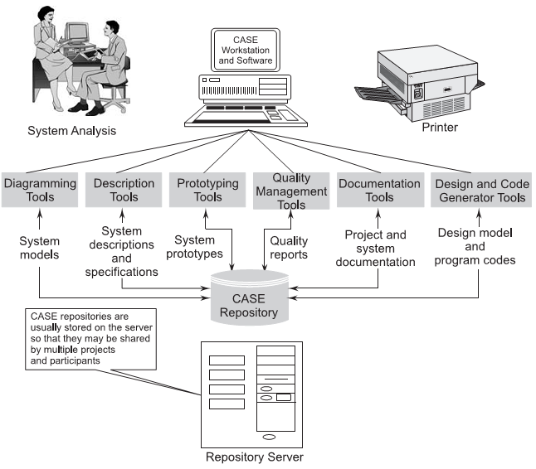
CASE REPOSITORY (A CASE repository is a system-developer database. Synonyms include dictionary and encyclopedia. It is a place where developers can store system models, detailed descriptions and specifications, and other products of system development.)

Slide 59
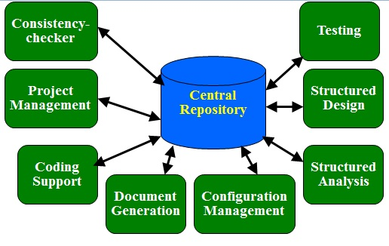
Schematic representation of architecture of CASE Environment

