Slide 1
UNIT-V KCS-601 Software engineering PART-II
Software Engineering

Slide 2
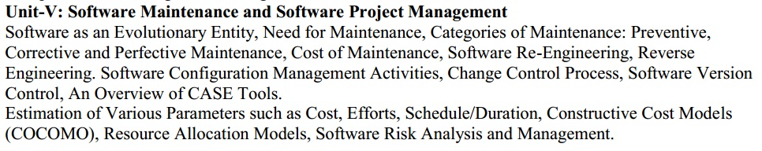
Syllabus

Slide 3
SOFTWARE-PROJECT ESTIMATION
Software-Project estimation is the process of estimating various resources required for the completion of a project.
Effective software-project estimation is an important activity in any software-development project.
Underestimating software projects and understaffing it often leads to low-quality deliverables, and the project misses the target deadline leading to customer dissatisfaction and loss of credibility to the company.

Slide 4
SOFTWARE-PROJECT ESTIMATION
On the other hand, overstaffing a project without proper control will increase the cost of the project and reduce the competitiveness of the company.
Software-Project estimation mainly encompasses the following steps-
Estimating the Size of the Project.
Estimating Efforts Based on Person-months or Person-hours.
Estimating Schedule in Calendar Days/Month/Year Based on Total Person-months Required and Manpower Allocated to the Project.
Estimating Total Cost of the Project Depending on the Above and Other Resources.

Slide 5
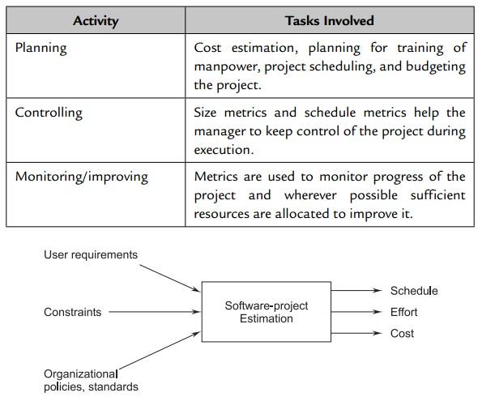
SOFTWARE-PROJECT ESTIMATION

Slide 6
SOFTWARE-PROJECT ESTIMATION
Estimating Size-Estimating the size of the software to be developed is the very first step to make an effective estimation of the project.
Estimating Effort-Once the size of software is estimated, the next step is to estimate the effort based on the size.
Estimating Schedule-The next step in the estimation process is estimating the project schedule from the effort estimated. The schedule for a project will generally depend on human resources involved in a process.
Estimating Cost- Cost estimation is the next step for projects. The cost of a project is derived not only from the estimates of effort and size but from other parameters, such as hardware, travel expenses, telecommunication costs, training costs, etc.

Slide 7
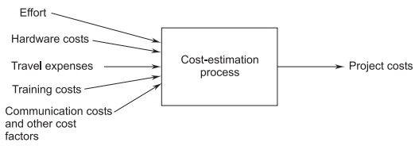
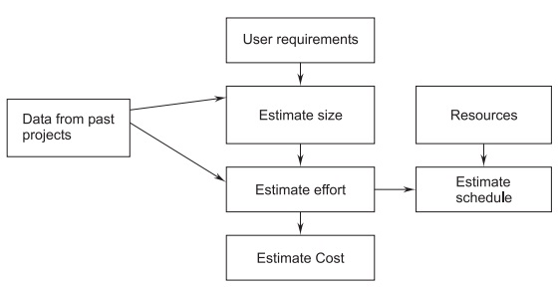
SOFTWARE-PROJECT ESTIMATION

Slide 8
CONSTRUCTIVE COST MODEL (COCOMO)
COCOMO stands for Constructive Cost Model.
It was introduced by Barry Boehm in 1981.
It is perhaps the best known and most thoroughly documented of all software-cost estimation models.
It provides the following Three levels of models-
Basic COCOMO: A single-value model that computes software-development costs as a function of an estimate of LOC.
Intermediate COCOMO: This model computes development costs and effort as a function of program size (LOC) and a set of cost drivers.
Complete COCOMO: This model computes development effort and costs which incorporates all characteristics of intermediate levels with assessment of cost implications in each step of development (analysis, design, testing, etc.).

Slide 9
CONSTRUCTIVE COST MODEL (COCOMO)
This model may be applied to three classes of software projects as given below:
Organic-
Small-size project.
A simple software project where the development team has good knowledge of the application.
Semi-Detached-
An intermediate-size project, and the project is based on rigid and semi-rigid requirements.
Embedded-
The project is developed under hardware, software, and operational constraints.
Examples are embedded software and flight-control software..

Slide 10
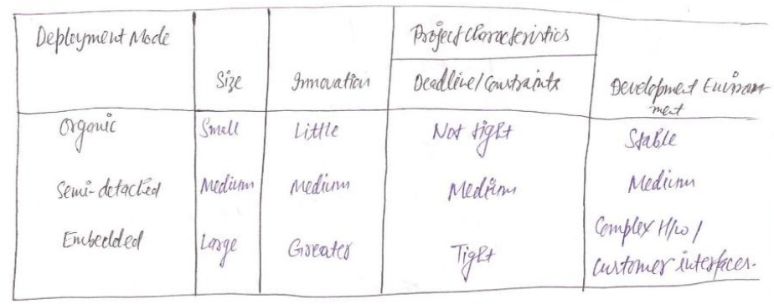
CONSTRUCTIVE COST MODEL (COCOMO)

Slide 11
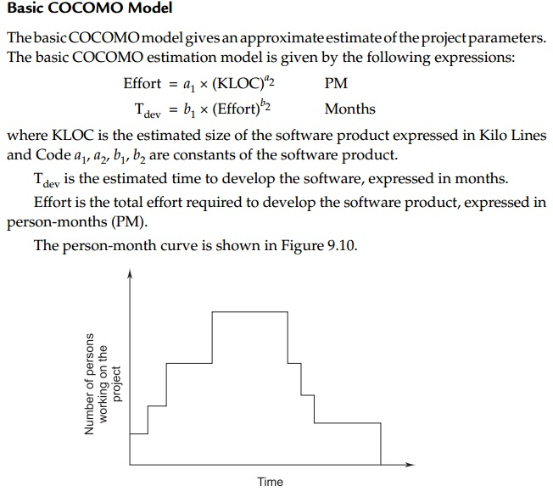
Basic COCOMO Model

Slide 12
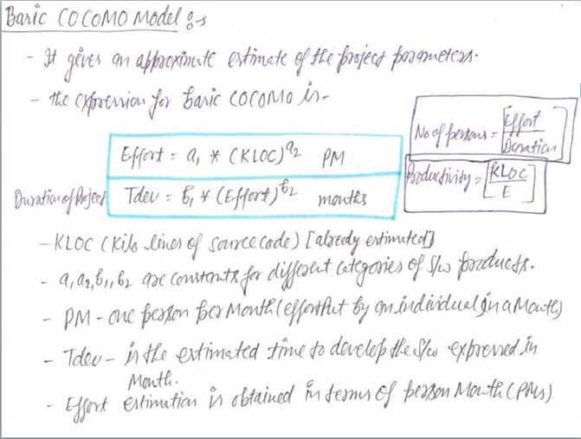
Basic COCOMO Model

Slide 13
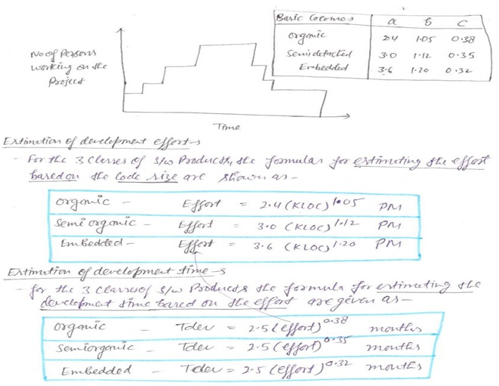

Slide 14
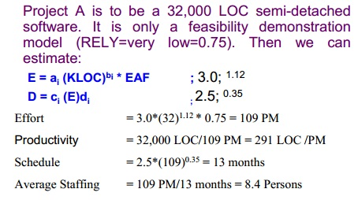
Example-1

Slide 15
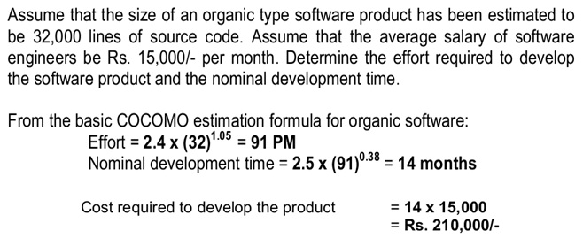
Example-2

Slide 16
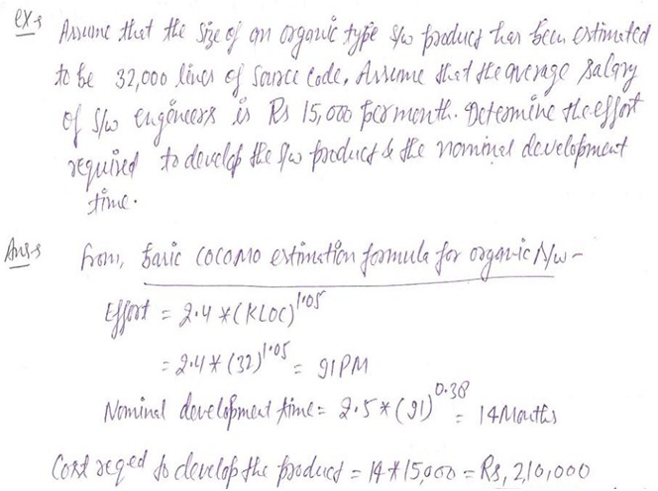

Slide 17
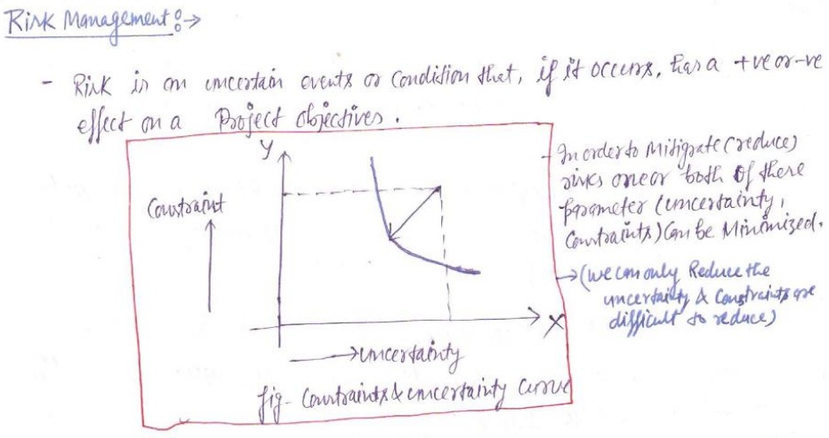
Software Risk Analysis & Management

Slide 18
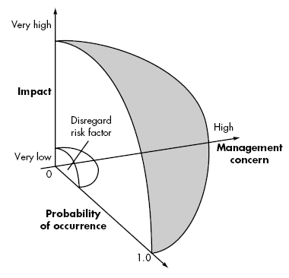
Software Risk Analysis & Management

Slide 19
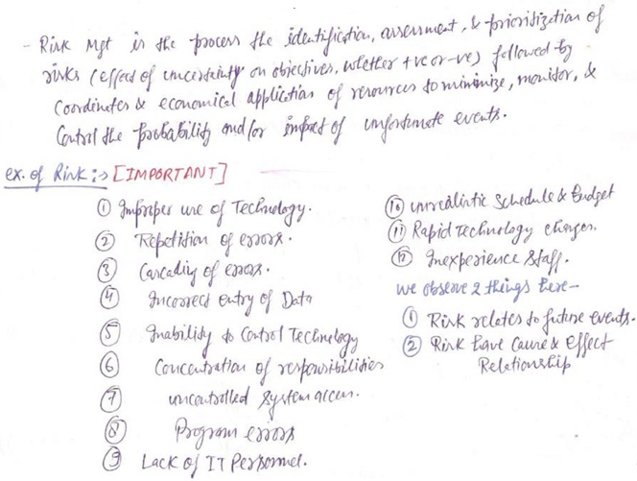
Software Risk Analysis & Management

Slide 20
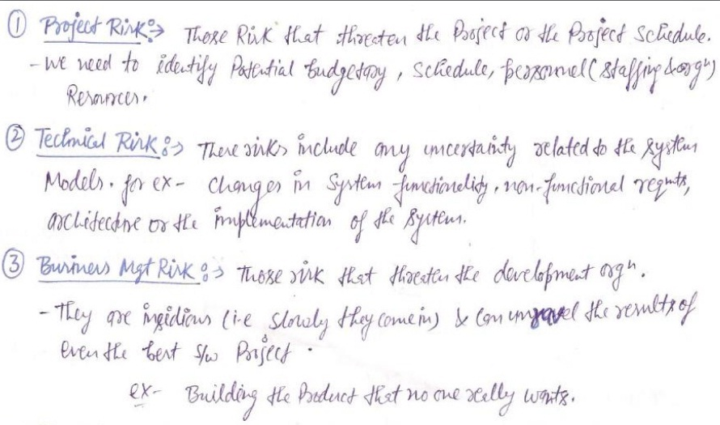
Type Of Risk

Slide 21
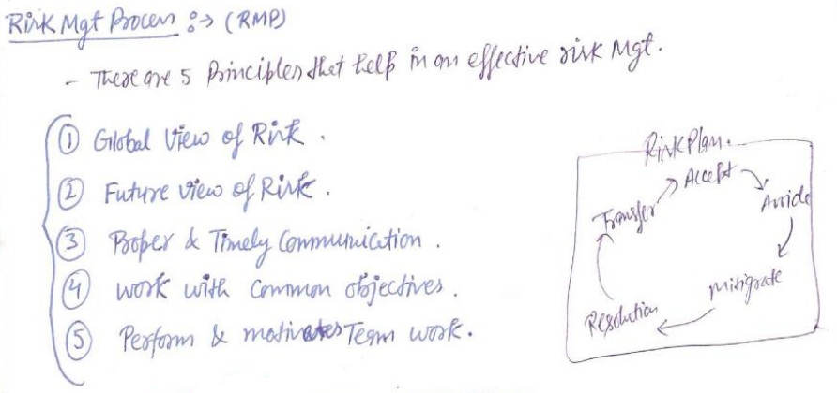
Risk Management Process And Plan

Slide 22
Bohem Project Risk Model

Slide 23
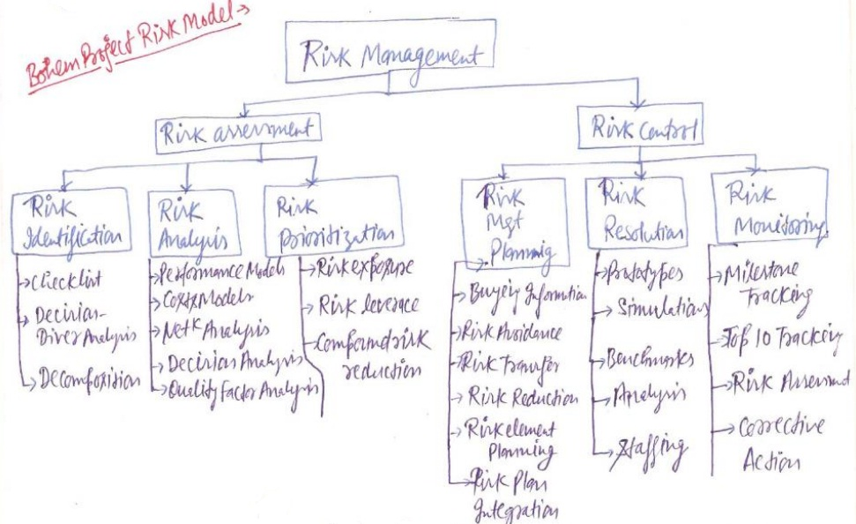
Bohem Project Risk Model

Slide 24
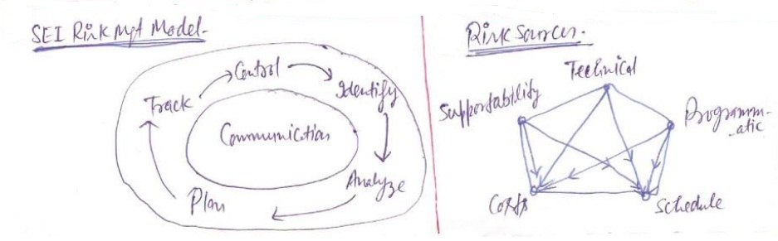
SEI Risk Management Model And Risk Sources

Slide 25
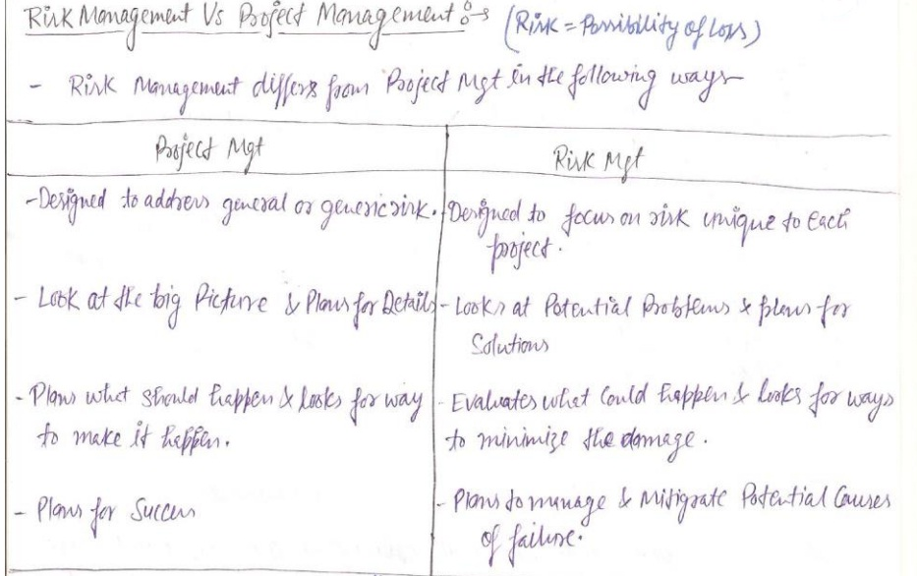
Risk Vs. Project Management

Slide 26
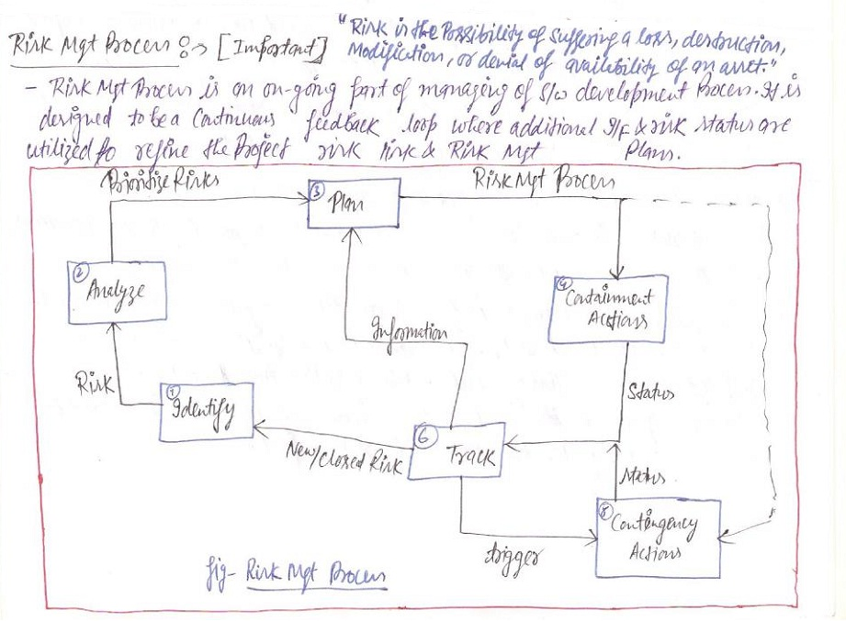
Risk Management Process

Slide 27
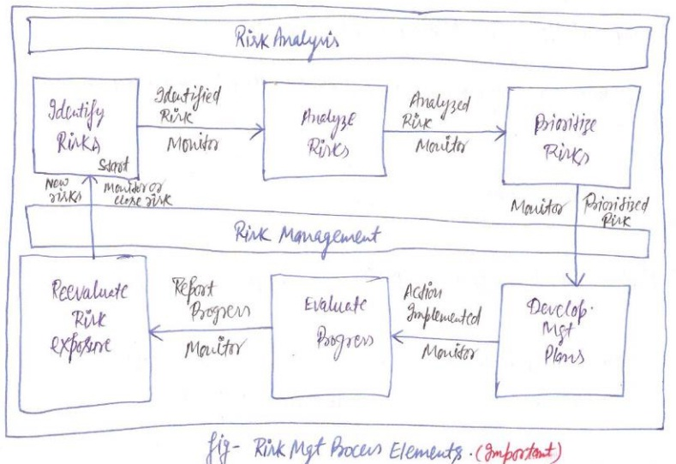
Risk Management Process Element

Slide 28
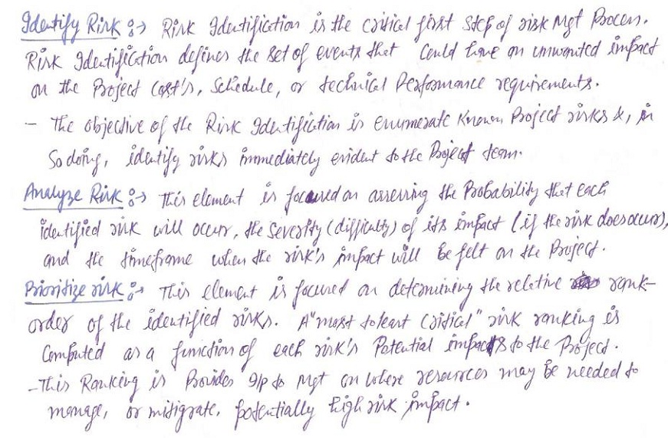
Risk Management Process Element

Slide 29
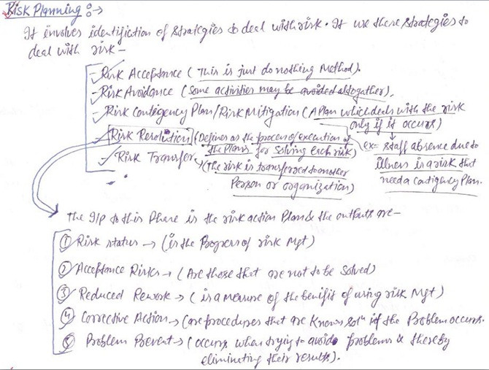
Risk Management Process Element

Slide 30
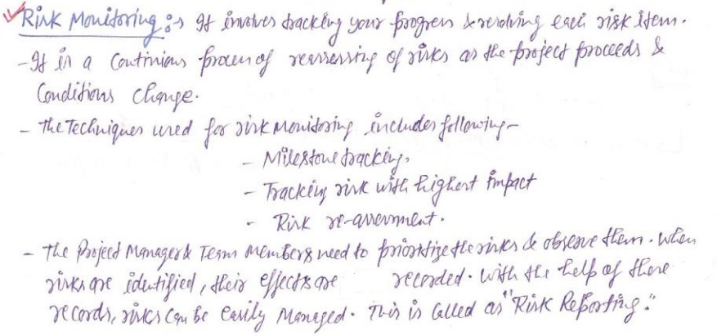
Risk Management Process Element

Slide 31
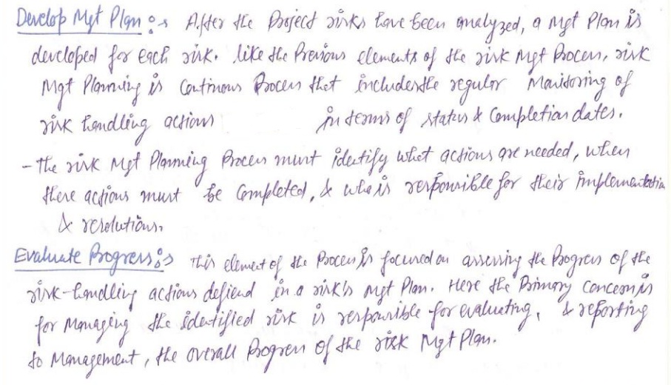
Risk Management Process Element

Slide 32
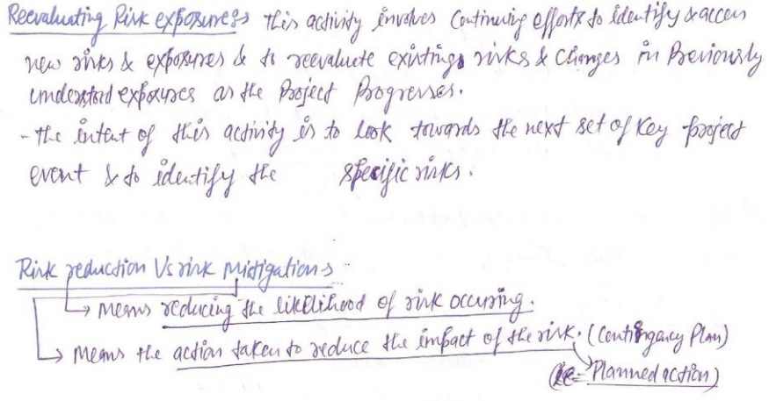
Risk Management Process Element

Slide 33
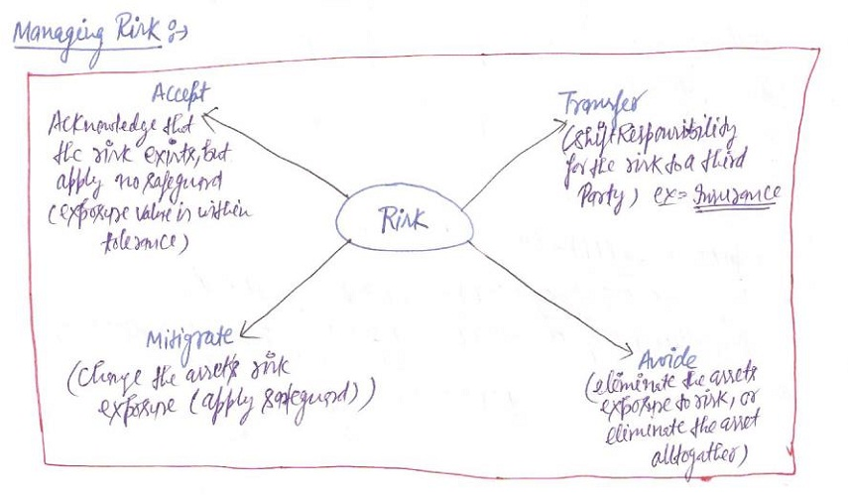
Managing Risk

Slide 34
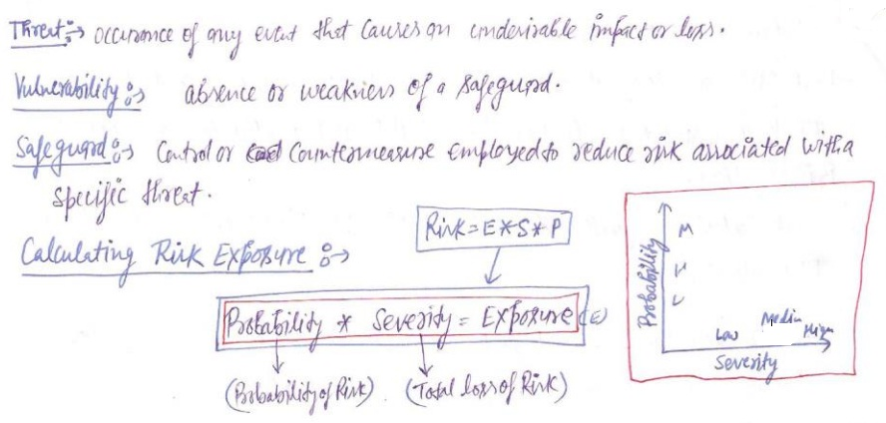
Numerical

Slide 35
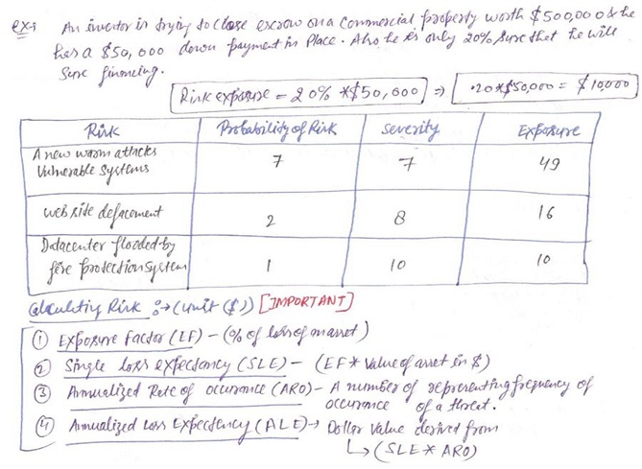

Slide 36
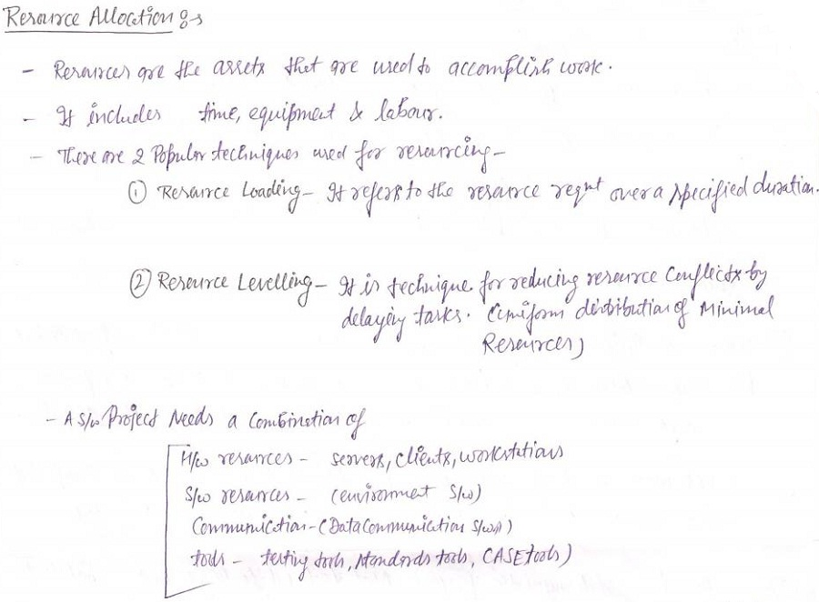
Resource Allocation

Slide 37
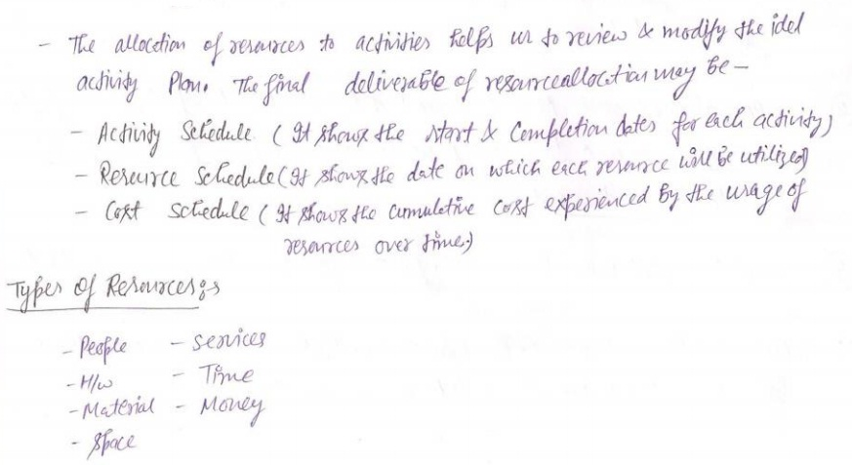
Resource Allocation

