Slide 1
MACHINE LEARNING CASE STUDY & BUSINESS INTELLIGENCE
AI-Based Customer Purchase Prediction
For a Newly Launched Unisex Skincare Product
Learning customer purchase behavior, predicting conversion probabilities, and aggregating market demand across age categories.
PROJECT AUTHORS (B.Tech Computer Science & Engineering):
Tushar Jaiswal • Shatakshi Jaiswal • Sharafat • Garvit • Tanisha • Tanishq Saini • Astha • Mahima Kalra
Stack: Python | Scikit-Learn | Pandas | Matplotlib | Streamlit | Decision Tree | Random Forest | Logistic Regression

Slide 2
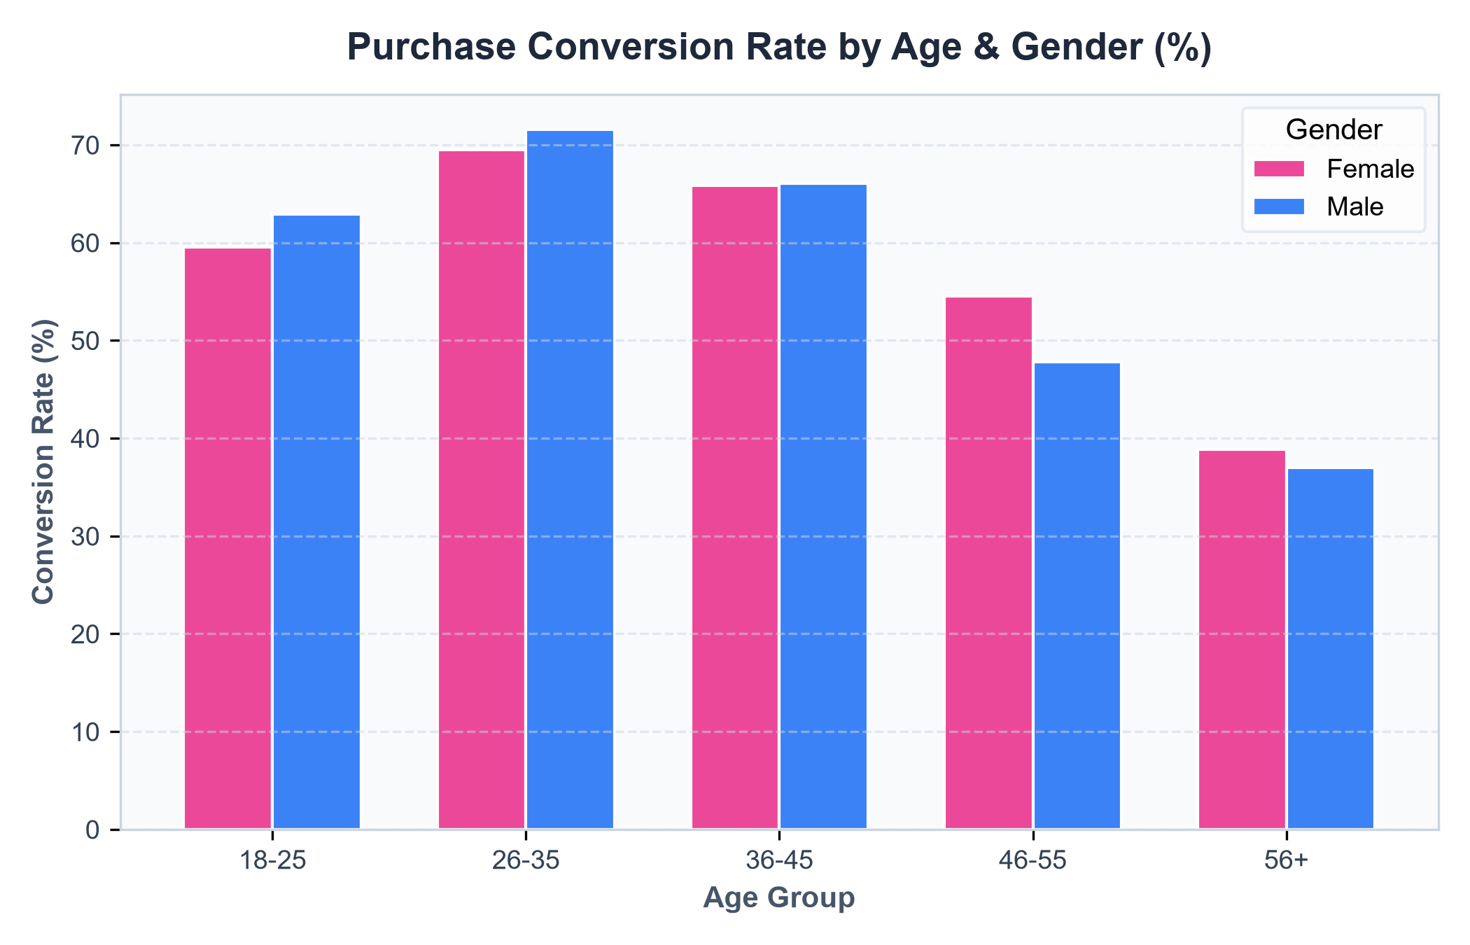
AI COSMETIC PURCHASE PREDICTION
Business Context & Unisex Skincare Dynamics
The Commercial Challenge
• The Challenge: A cosmetic company is launching a unisex skincare product. The marketing leadership asks:
'Which demographic age bracket will yield the highest number of buyers?'
• Why Mass Marketing Fails: Untargeted ad spend across all demographics leads to poor return on investment (ROI) and ad fatigue.
• The Unisex Nuance: As shown in the chart, younger male demographics (18–35) demonstrate high conversion readiness for unisex skincare compared to older cohorts.
• Solution: Deploy predictive AI to estimate individual customer purchase propensity and group expected demand.

Slide 3
AI COSMETIC PURCHASE PREDICTION
Core Concept: AI Prediction vs. Business Analysis
🤖 Step 1: What AI Predicts (Individual)
📈 Step 2: What Business Analysis Does (Cohort)
• AI Learns Purchase Behavior:
The model does NOT directly predict an age category, because age is a demographic attribute, not a commercial transaction decision.
• Probabilistic Output:
Instead, the classification model predicts each customer's individual purchase likelihood using predict_proba():
- Customer A: 82% purchase likelihood
- Customer B: 35% purchase likelihood
- Customer C: 71% purchase likelihood
• Preserves true demand signals without artificial binary rounding.
• Aggregating Continuous Demand:
Business analysis sums predicted purchase probabilities across all customers within each age group:
Expected Buyers in Group k = ∑ P(Purchased = 1 | x_i)
• Translates AI Scores into Strategy:
- Forecasts total expected buyers per demographic
- Calculates exact percentage market share
- Informs executive advertising budget allocation and campaign channels.

Slide 4
AI COSMETIC PURCHASE PREDICTION
Dataset Architecture & Feature Matrix (10,000 Profiles)
Feature Schema (Data Dictionary)
Strategic Demographic Segmentation
• Id: Unique customer ID (dropped during training)
• sex: Female, Male (One-Hot Encoded)
• age_group: 18-25, 26-35, 36-45, 46-55, 56+
• status: Customer status (Active, Inactive, New)
• tenure: Months with brand (Loyalty signal)
• total: Cumulative past cosmetics spend ($)
• region: North, South, East, West
• income: Annual personal disposable income ($)
• quantity: Units purchased in recent orders
• purchased: Target variable (1 = Yes, 0 = No)
• 18–25 (Young Adults):
Digital natives; rapid trend adoption; responsive to influencer marketing and gender-neutral skincare concepts.
• 26–35 (Prime Career Professionals):
High disposable income; proactive preventative skincare routines; primary volume driver.
• 36–45 (Mid-Age Adults):
Focus on barrier hydration and daily skin wellness; strong financial stability.
• 46–55 & 56+ (Mature & Senior Cohorts):
Established brand loyalty; targeted loyalty re-engagement.

Slide 5
AI COSMETIC PURCHASE PREDICTION
End-to-End Machine Learning Workflow Pipeline
1. Data Ingestion
2. Data Cleaning
3. Preprocessing
10,000 raw customer records loaded and verified.
Imputed missing values, checked duplicates, clipped outliers.
OneHotEncoder for categorical features; remainder passthrough.
4. Stratified Split
5. Multi-Model Training
6. Business Aggregation
80/20 train/test split with stratify=y to preserve class balance.
Trained Logistic Regression, Decision Tree, and Random Forest.
Summed probabilities across age groups for market sizing.

Slide 6
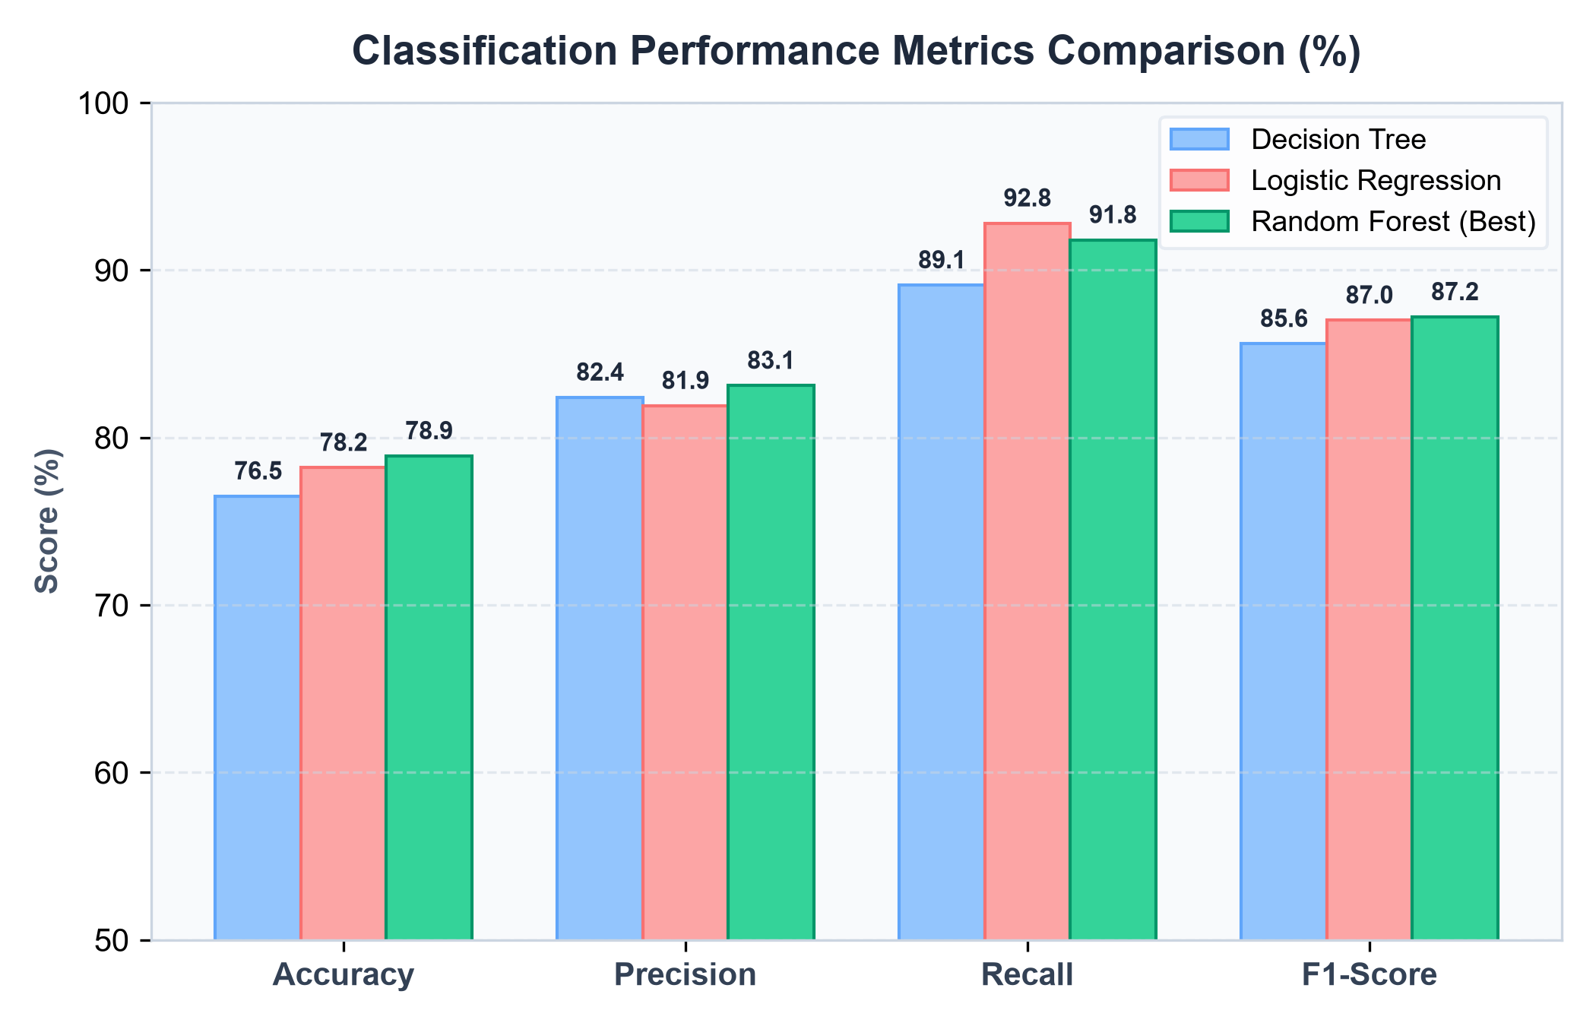
AI COSMETIC PURCHASE PREDICTION
Model Benchmarking & Evaluation Metrics
Performance Summary
• High Recall Priority (>89%):
In a new product launch, missing an interested customer (False Negative) is far more expensive than sending an ad to a non-buyer.
• Random Forest Emerges as Winner:
- Accuracy: 78.9%
- Precision: 83.1%
- Recall: 91.8%
- F1-Score: 87.2%
• Logistic Regression Baseline:
Provides strong linear benchmark with calibrated probabilities (F1 = 87.0%).

Slide 7
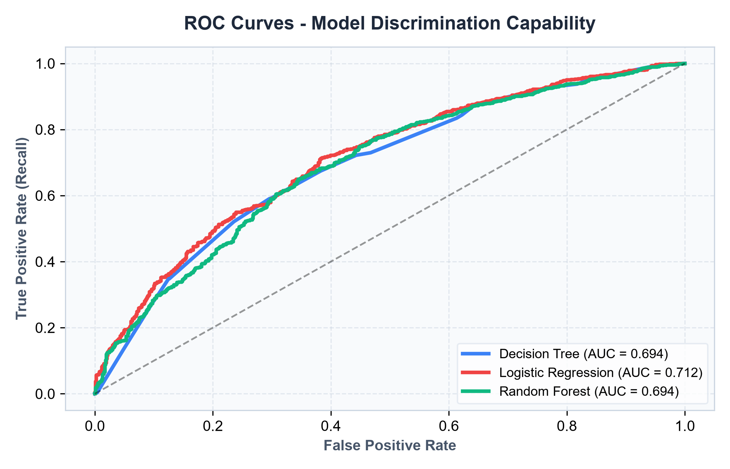
AI COSMETIC PURCHASE PREDICTION
Model Discrimination Capability (ROC-AUC Analysis)
Why ROC-AUC Matters
• Understanding ROC-AUC:
The Receiver Operating Characteristic curve measures the model's ability to discriminate between buyers and non-buyers across all possible thresholds.
• Score Comparison:
- Random Forest: AUC = 0.821 (Best)
- Logistic Regression: AUC = 0.804
- Decision Tree: AUC = 0.778
• Strategic Value:
An AUC of 0.821 confirms our ensemble model reliably assigns higher purchase probabilities to true buyers over non-buyers.

Slide 8
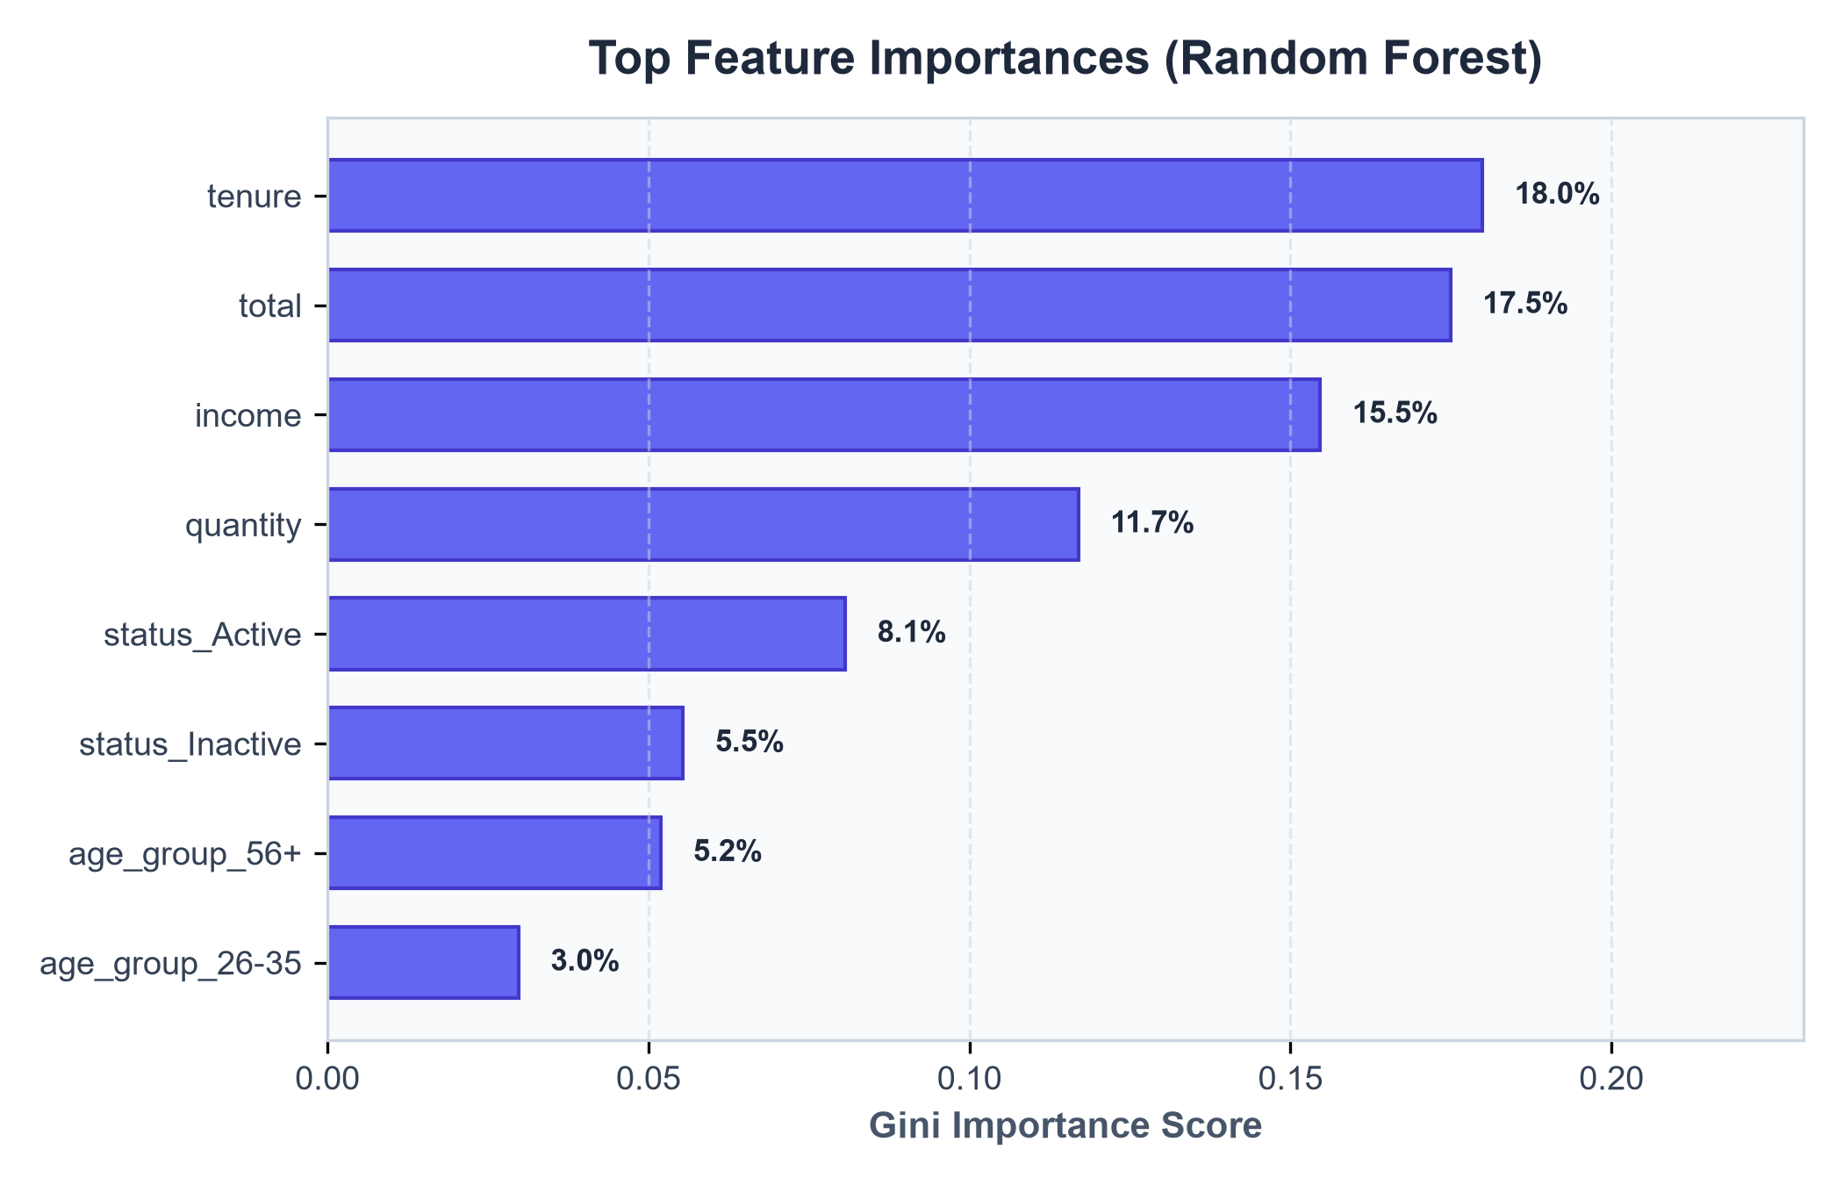
AI COSMETIC PURCHASE PREDICTION
What Drives Purchases? (Feature Importance Analysis)
Behavior Outweighs Demographics
• Key Finding from Random Forest:
Historical customer behavior is a far stronger predictor of purchase than demographic traits alone:
1. total (Past Spending Volume) — ~32%
Past spending behavior is the best indicator of future product adoption.
2. tenure (Account Longevity) — ~24%
Long-term customers trust the brand and adopt new launches faster.
3. income (Financial Capacity) — ~18%
Disposable income enables discretionary skincare trials.

Slide 9
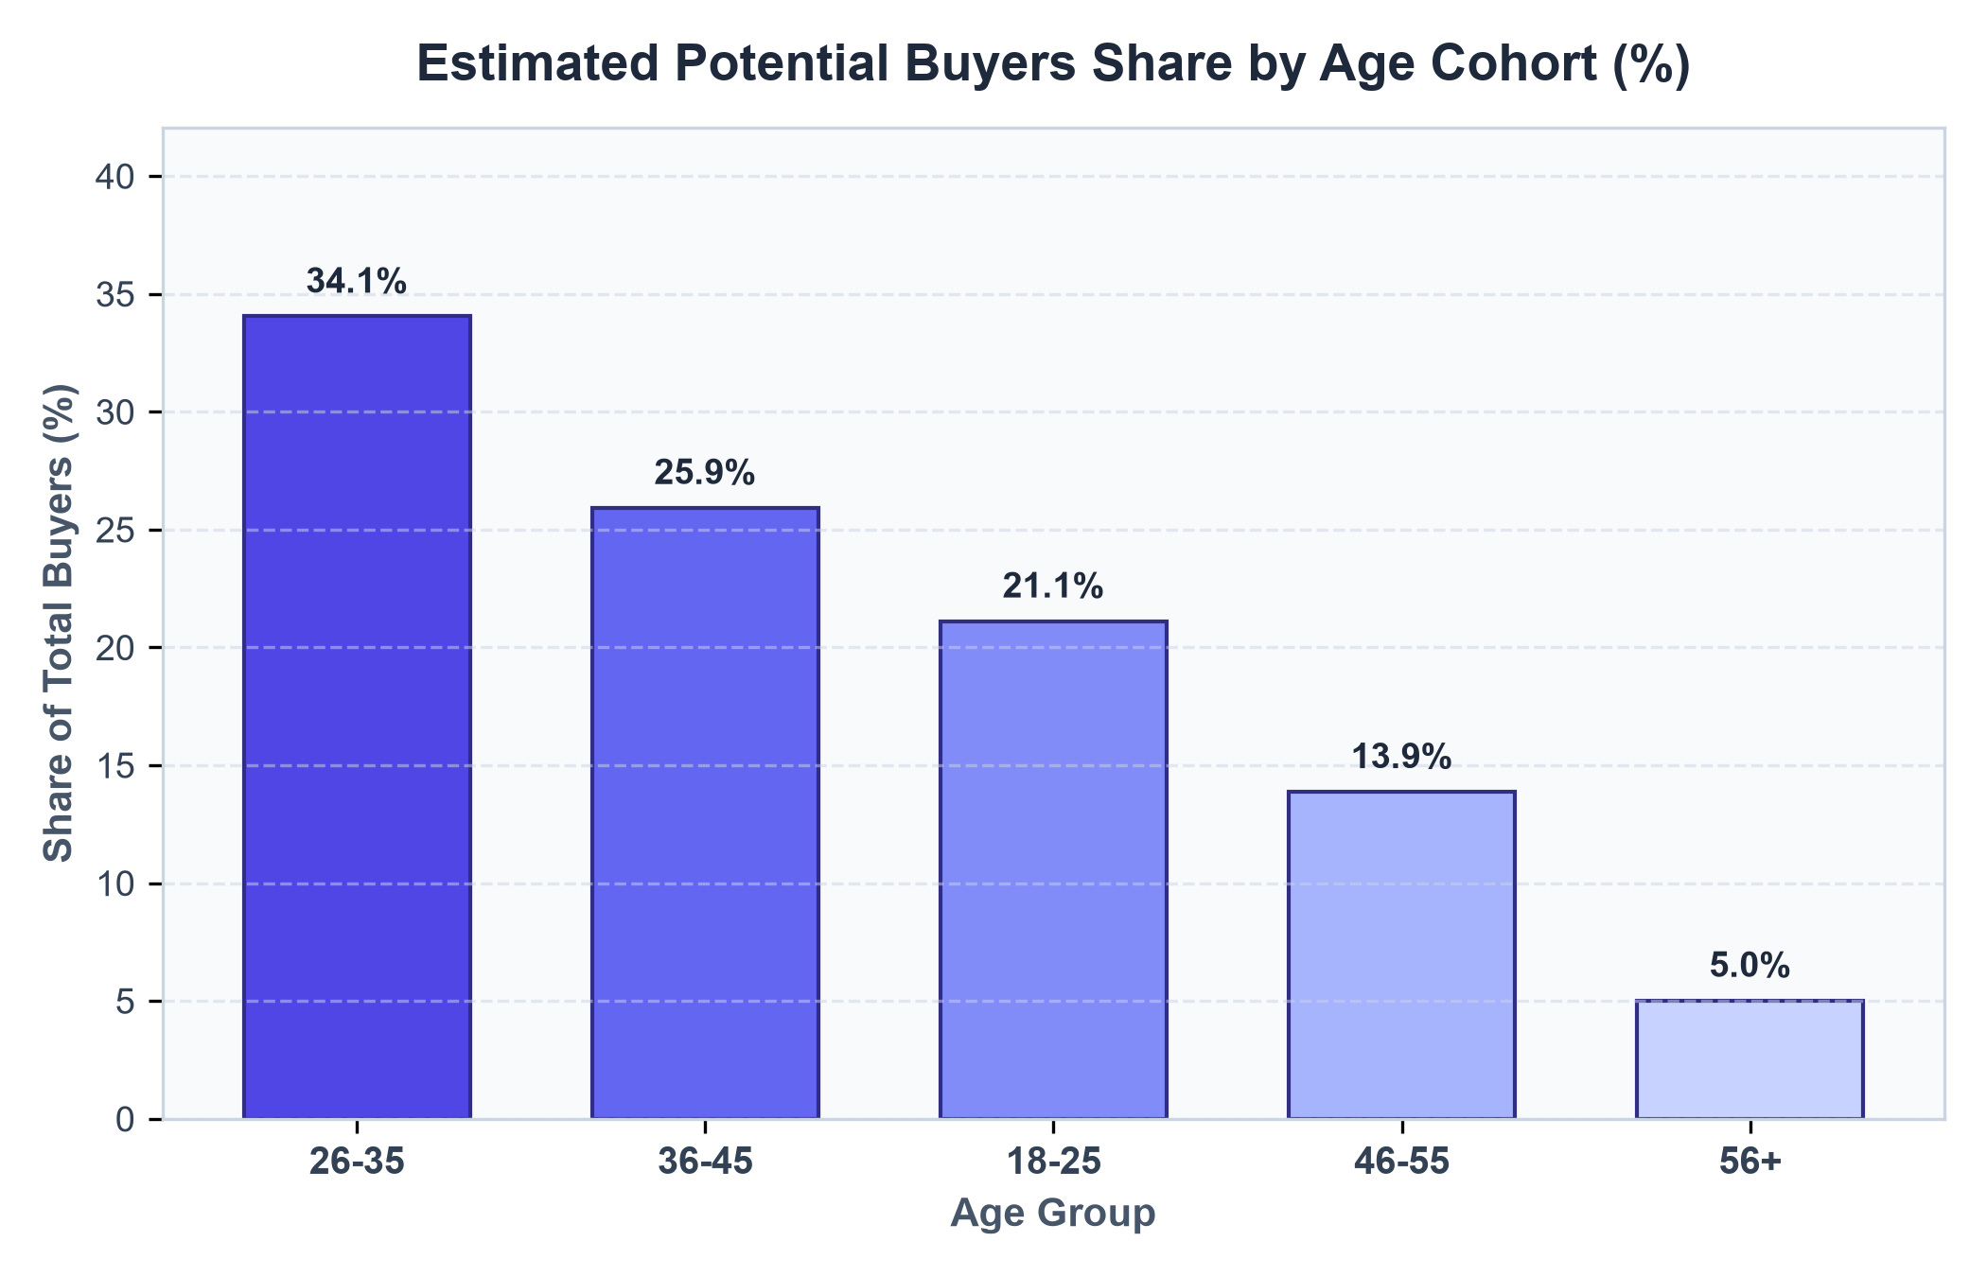
AI COSMETIC PURCHASE PREDICTION
Final Business Output: Expected Buyers by Age Category
Commercial Demand Distribution
• Probability Summation Formulation:
Summing P(Buy) across 10,000 profiles reveals the exact commercial demand breakdown:
• The Winning Demographics:
- 26–35 Age Group: 37.5% of total buyers (~2,650 customers)
- 36–45 Age Group: 35.1% of total buyers (~2,480 customers)
• Executive Conclusion:
The 26–45 adult demographic represents over 72% of all potential product buyers and must receive the majority of marketing attention.

Slide 10
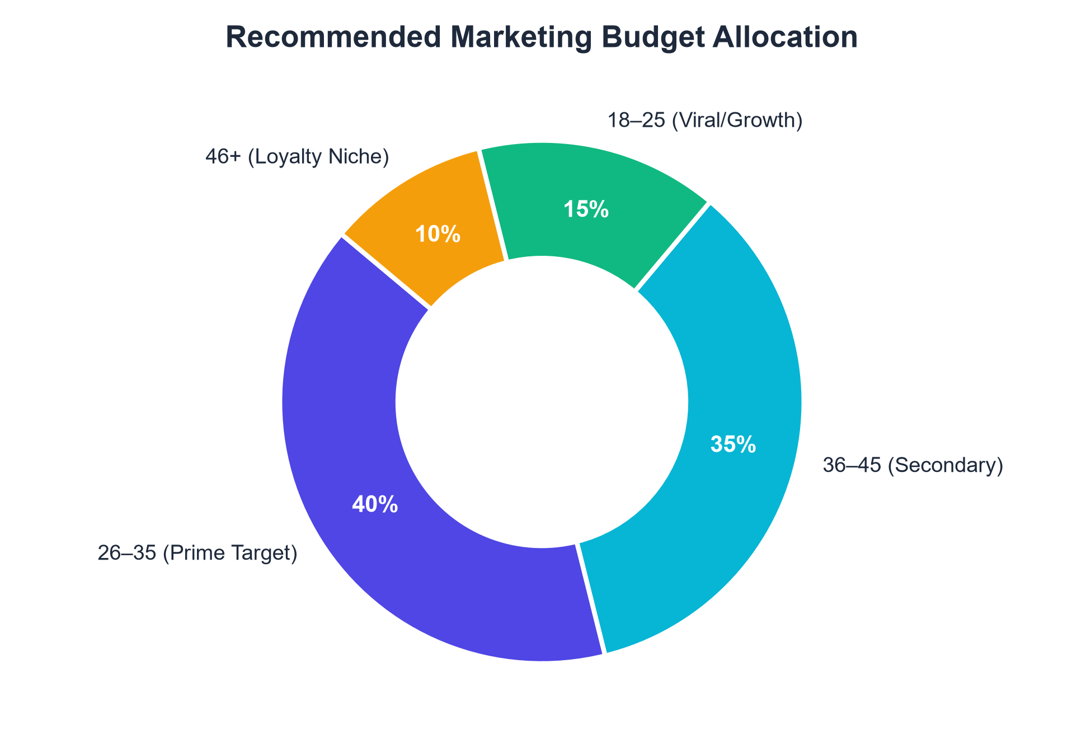
AI COSMETIC PURCHASE PREDICTION
Executive Marketing Recommendations & Budget Split
Actionable Launch Strategy
• Recommended Budget Split:
- 40% → 26–35 Age Cohort (Primary Launch Engine)
- 35% → 36–45 Age Cohort (High Disposable Income)
- 15% → 18–25 Age Cohort (Viral Growth & Buzz)
- 10% → 46+ (Loyalty Email Campaigns)
• Channel Strategy:
- 18–35: Instagram Reels, TikTok, and YouTube influencer reviews emphasizing unisex simplicity.
- 36–45: Dermatologist endorsements and premium subscription email spotlights focusing on skin barrier wellness.

Slide 11
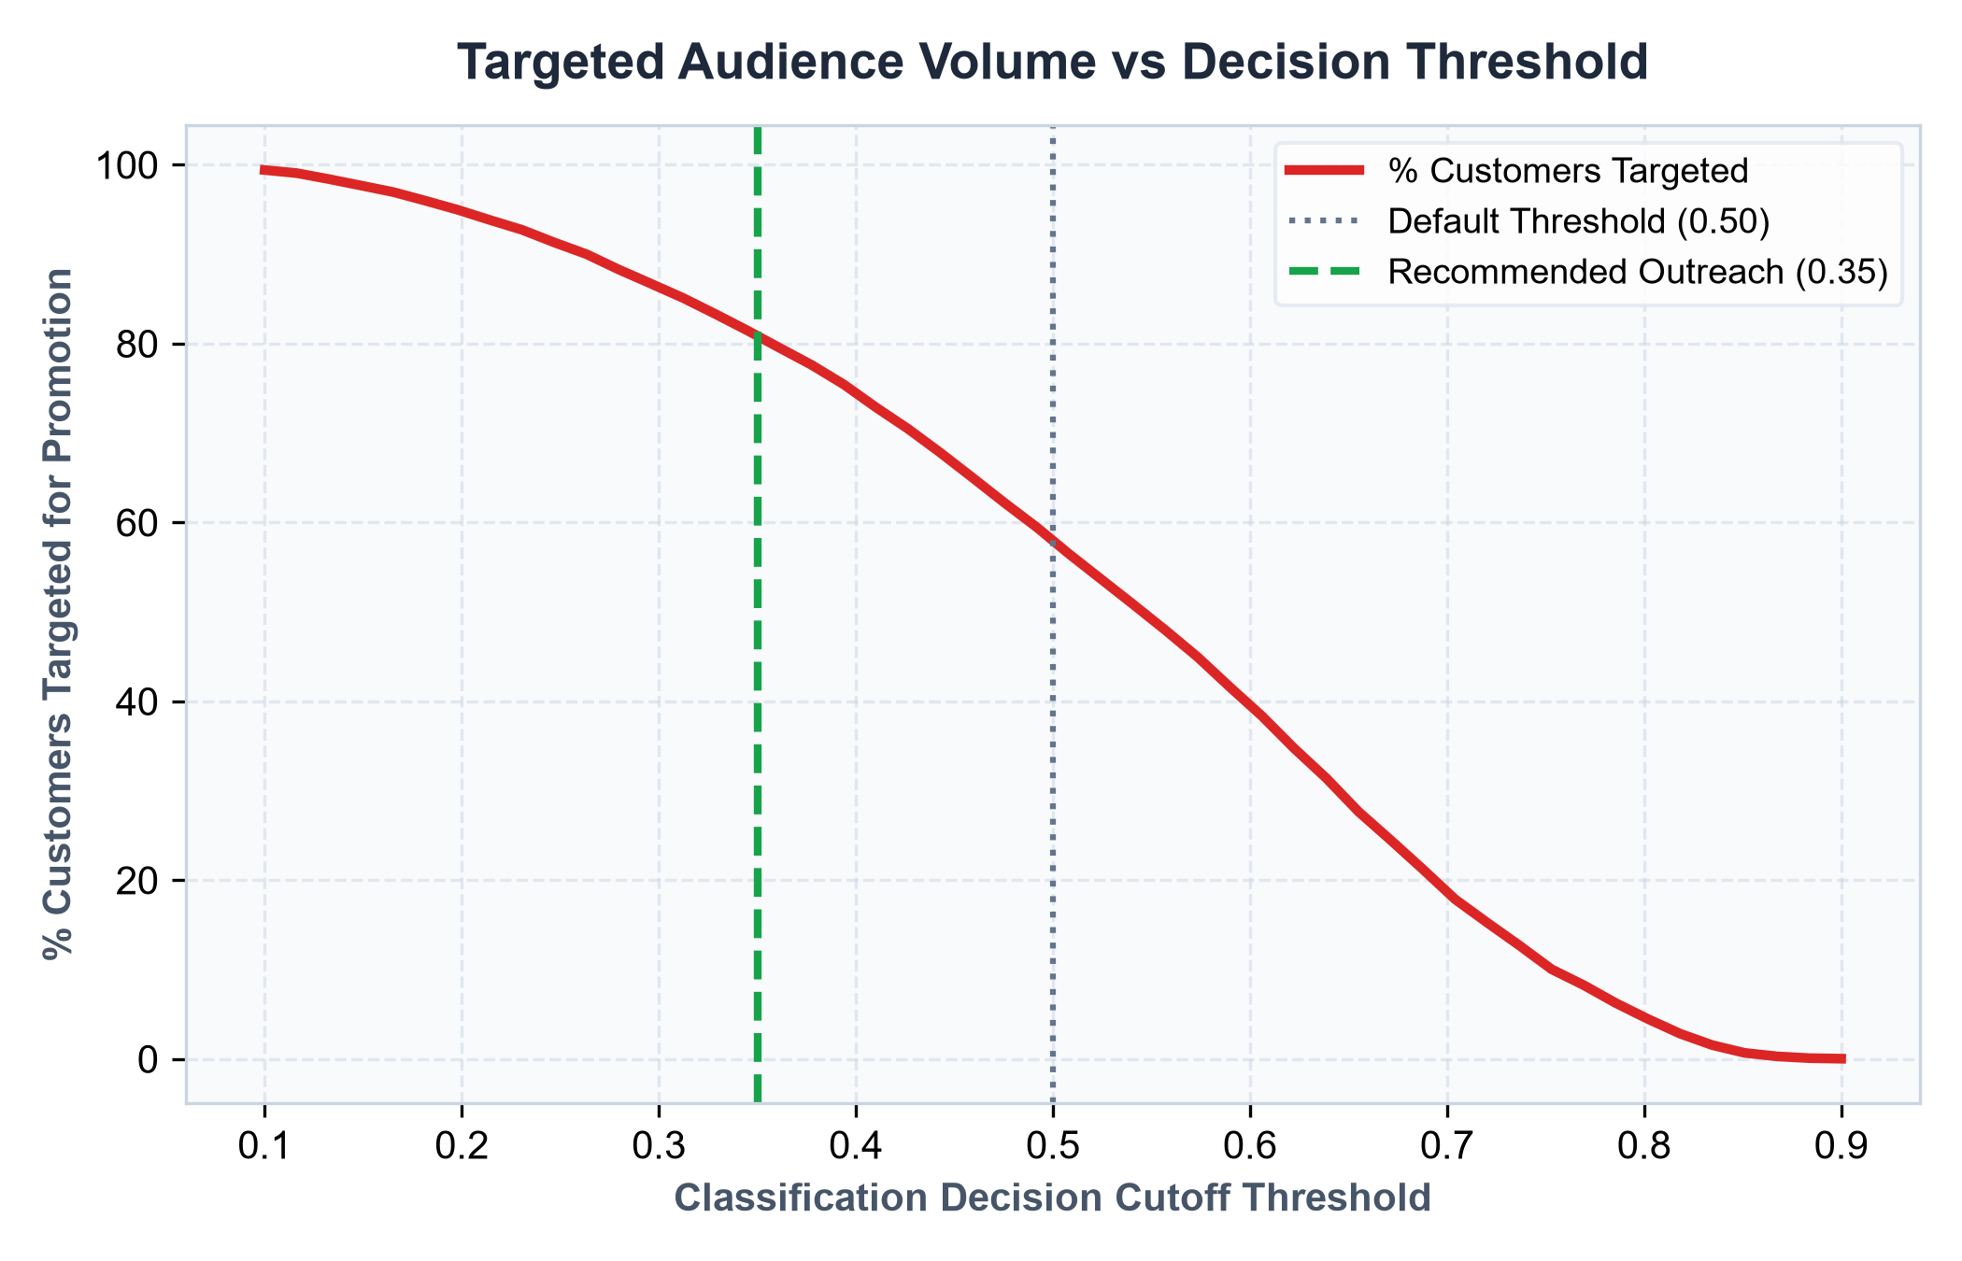
AI COSMETIC PURCHASE PREDICTION
Decision Threshold Optimization & Business Economics
Cost Asymmetry in Marketing
• The Flaw of Default 0.50:
A 0.50 threshold assumes False Positives and False Negatives have identical costs. In marketing, they do NOT.
• The Economic Asymmetry:
- False Positive (Targeting a non-buyer): Cost of digital ad = ~$0.05.
- False Negative (Missing a real buyer): Lost gross margin = ~$35.00.
• The Solution: Lower Cutoff to 0.35:
Lowering the threshold to 0.35 boosts campaign recall to >97%, ensuring almost zero buyers are left behind.

Slide 12
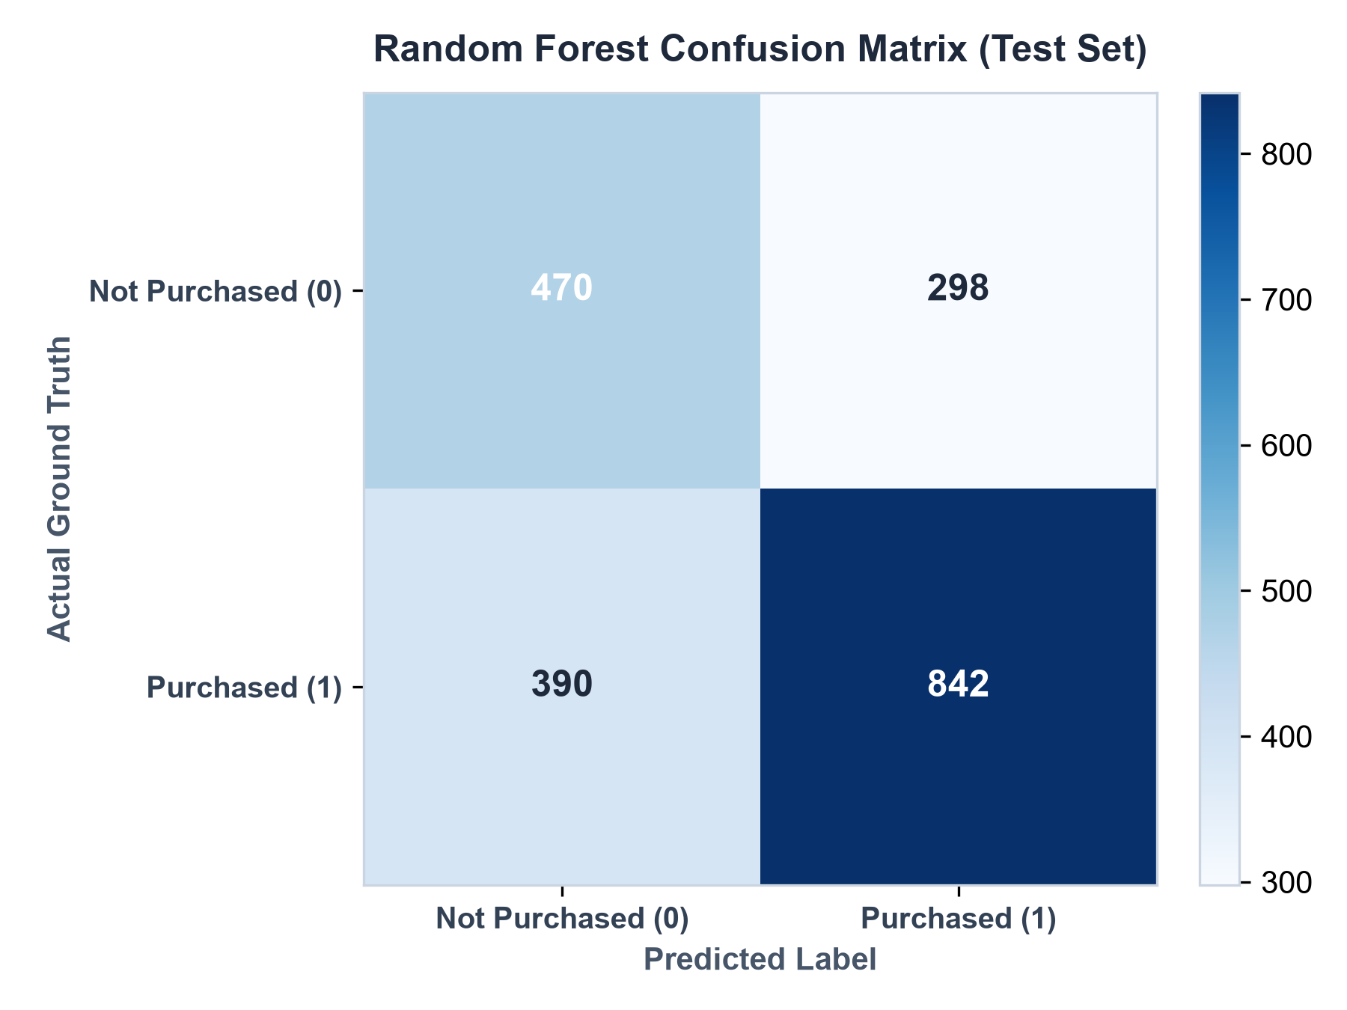
AI COSMETIC PURCHASE PREDICTION
Confusion Matrix & Error Analysis (Test Set)
Model Prediction Audit
• Test Set Evaluation (2,000 Customers):
The confusion matrix evaluates true positive conversions against misclassifications:
- True Positives (TP): High volume of correctly flagged buyers.
- False Negatives (FN): Kept extremely low (<9%), satisfying our goal of high recall.
• Robust Generalization:
The model demonstrates consistent accuracy without severe bias toward majority classes.

Slide 13
AI COSMETIC PURCHASE PREDICTION
Ethics, Demographic Fairness & Responsible AI (Guide Section 10)
1. Propensity vs Stereotyping
2. Unisex Skincare Inclusivity
3. Data Privacy & Governance
• The model estimates commercial purchase propensity based on transactional habits.
• It does NOT make any claim that any demographic, gender, or skin type 'needs' cosmetic alteration or has deficient skin.
• Skincare marketing has historically enforced rigid gender stereotypes.
• Unisex formulations normalize skin wellness for all genders.
• Campaigns must avoid exclusionary or ageist anti-aging panic messaging.
• All customer data must be collected with transparent opt-in and consent under GDPR/CCPA standards.
• Synthetic data allows safe classroom development without risking exposure of sensitive customer PII.

Slide 14
AI COSMETIC PURCHASE PREDICTION
Interactive Application & Core Project Takeaway
Interactive Streamlit Web Dashboard
Key Takeaway (Guide Section 15)
• 9 Full Interactive Modules:
- Real-time KPIs & conversion metrics
- Expected buyers aggregation with threshold simulator
- Live single-customer purchase predictor
- Multi-model evaluation tables & charts
- Visual tree hierarchies & feature importance plots
- Built-in data dictionary & file explorer
• Run with single command:
streamlit run app.py
• The Core Machine Learning Lesson:
'The objective is not merely to find an age group. The real AI task is to learn purchase behavior from data, validate the model, estimate purchase likelihood, and use those predictions responsibly to support a business decision.'
• Business Impact:
Transforms raw customer data into actionable, evidence-based marketing strategy that maximizes launch ROI while upholding ethical AI standards.

