Slide 1
HHS System Capacity & Care Load Analytics
Business Analysis & Operational Sustainability Dashboard
Prepared Using:
• Microsoft Excel
• MySQL Workbench
• Power BI
• SQL Analytics
• KPI Engineering
Project Focus:
Monitoring healthcare system burden, operational sustainability, and backlog pressure within the UAC healthcare support system.

Slide 2
Business Problem Statement
The healthcare support system lacked centralized visibility into:
• Healthcare system load
• Operational strain periods
• Sustainability gaps
• Intake vs discharge imbalance
• Capacity pressure accumulation
This project transformed operational healthcare records into a structured analytical reporting framework for executive decision-making.

Slide 3
Project Objectives
Primary Objectives
• Monitor healthcare operational burden
• Identify high-pressure periods
• Analyze sustainability trends
• Compare CBP vs HHS operational load
• Build executive-level interactive dashboard
Expected Outcomes
• Improved operational visibility
• Better resource planning support
• Healthcare strain identification
• Sustainability monitoring

Slide 4
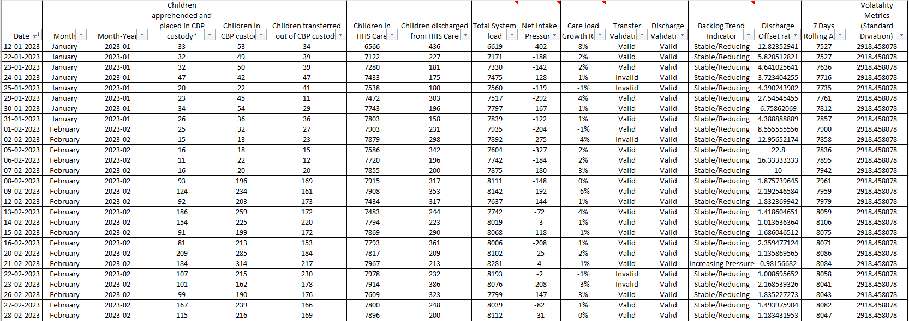
Excel Data Cleaning & KPI Engineering
Data Preparation Activities
• Date standardization
• Data validation
• KPI column creation
• Rolling average calculation
• Backlog trend classification
• Data quality correction
Result:
A clean analytical dataset prepared for SQL and Power BI analysis.

Slide 5
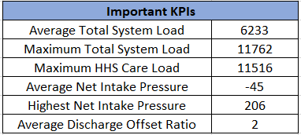
Key KPI Engineering
Critical KPIs Created
• Average Total System Load
• Maximum Total System Load
• Peak HHS Care Load
• Average Net Intake Pressure
• Highest Net Intake Pressure
• Average Discharge Offset Ratio
Business Importance:
These KPIs quantified healthcare burden and operational sustainability.

Slide 6
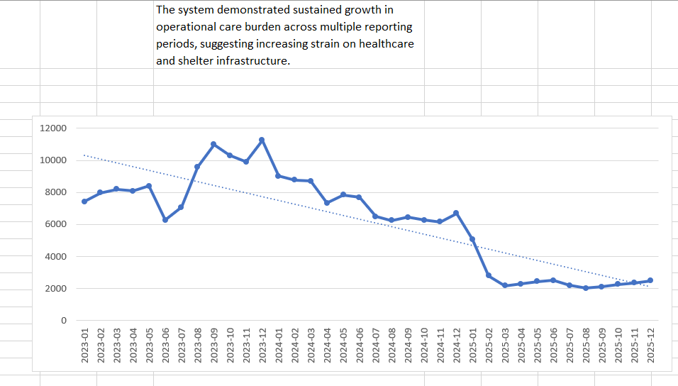
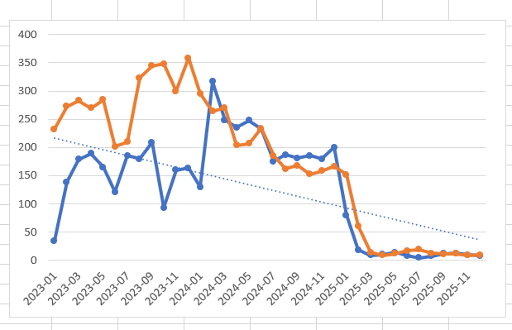
Trend Analysis & Exploratory Data Analysis
Key Observations
• Late 2023 showed severe operational strain
• HHS system load remained consistently high
• 2025 demonstrated significant stabilization
• Intake vs discharge imbalance highlighted backlog accumulation risk
• System burden reduced substantially during 2025

Slide 7
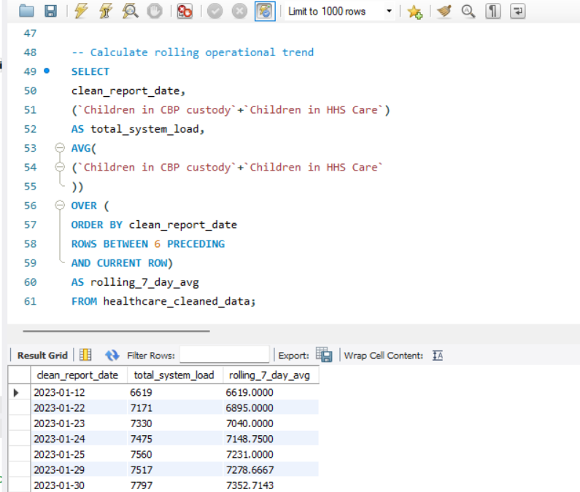
SQL Analytical Reporting
Advanced SQL Concepts Used
• Aggregate Functions
• Window Functions
• Rolling Average Analytics
• RANK() and DENSE_RANK()
• CASE Statements
• Sustainability Analysis
• Operational Pressure Segmentation
SQL analytics helped identify operational strain periods and sustainability trends.

Slide 8
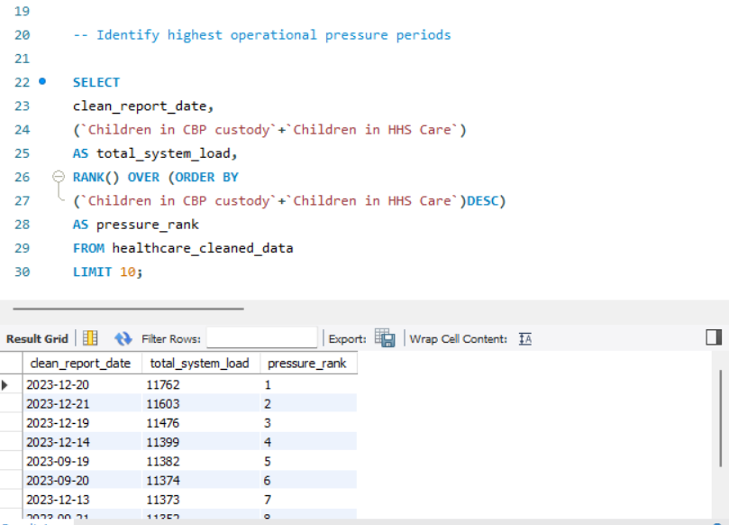
Operational Pressure Ranking Analysis
Business Insights
• Highest operational pressure occurred during September and December 2023
• Peak total system load exceeded 11,700
• Consecutive high-pressure periods indicated prolonged healthcare strain
• Sustained burden impacted operational stability and capacity management
Analytical Value:
RANK() window function identified critical operational stress periods.

Slide 9
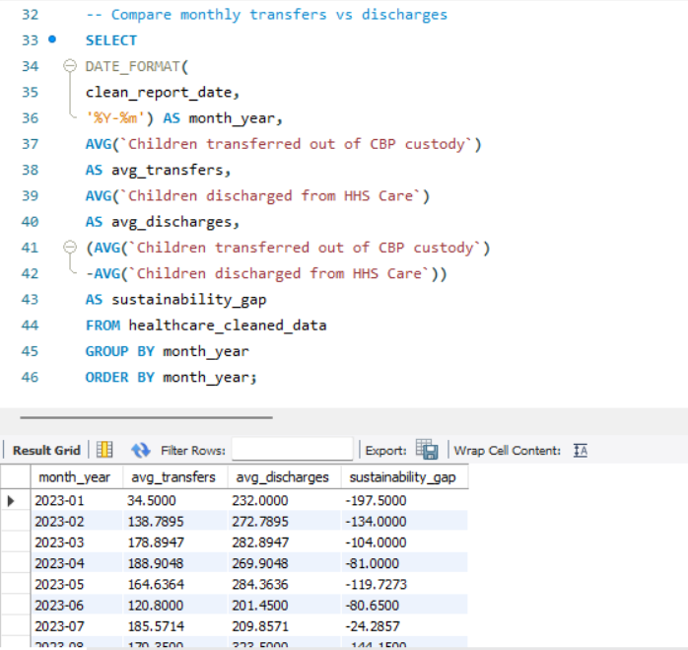
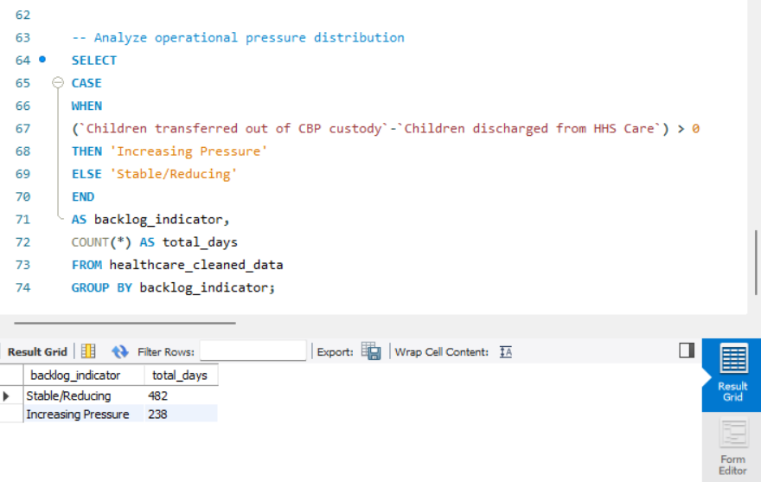
Sustainability & Backlog Analysis
Key Findings
• Multiple periods showed negative sustainability gaps
• Transfers frequently exceeded discharge throughput
• Operational backlog accumulation was successfully identified
• Stable/reducing pressure represented majority operational periods
Business Impact:
These findings highlighted healthcare sustainability risks.

Slide 10
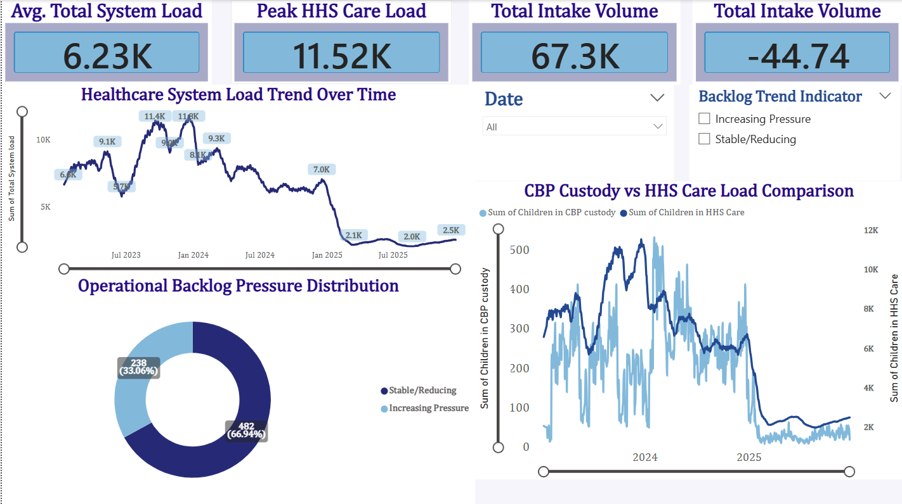
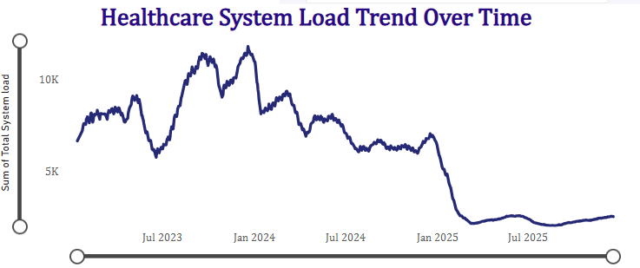
Power BI Dashboard Development
Dashboard Components
• Executive KPI Cards
• Healthcare System Trend Analysis
• CBP vs HHS Comparison
• Operational Backlog Distribution
• Interactive Slicers and Filters
Business Value:
Interactive analytical visibility for healthcare operations and executive monitoring.

Slide 11
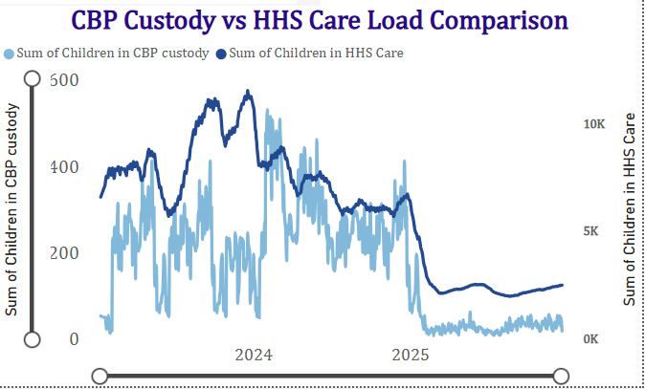
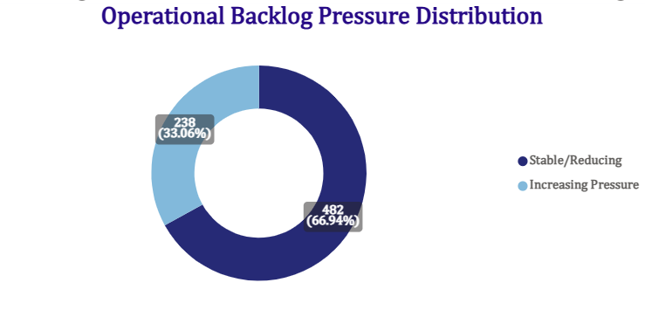
Final Dashboard Overview

Slide 12
Key Business Findings
• Peak HHS healthcare burden exceeded 11,500 children
• Late 2023 represented the highest operational pressure period
• HHS care load consistently dominated operational burden
• Rolling averages revealed sustained healthcare strain
• 2025 demonstrated significant operational stabilization
• Sustainability gaps highlighted backlog accumulation risks
• Interactive analytics improved operational visibility
Strategic Outcome:
The analytical framework successfully converted raw healthcare data into actionable operational insights.

Slide 13
Business Recommendations
Strategic Recommendations
• Improve discharge throughput coordination
• Strengthen operational monitoring mechanisms
• Expand healthcare surge-capacity planning
• Enhance sustainability KPI monitoring
• Implement predictive operational analytics
• Improve healthcare resource allocation visibility
Future Scope
• Real-time dashboard integration
• Predictive pressure forecasting
• AI-driven operational trend detection

Slide 14
Conclusion
The project successfully transformed raw operational healthcare records into a complete analytical reporting system using Excel, SQL, and Power BI.
Key Achievements:
• Operational burden monitoring
• Sustainability analysis
• Trend identification
• Executive dashboard development
• SQL analytical reporting
• Business insight generation
This project demonstrates complete end-to-end Business Analytics workflow implementation.

